Slide 1
State Personnel Development Grant
Ohio Department of Education
Notes:
2001-2006:Ohio’s Integrated Systems Model OISM is a comprehensive school improvement model which establishes a framework within which schools develop integrated, tiered academic services for students. All school improvement decisions are guided by building level action plans developed by representative building teams using a sustainable cycle of data-based planning that is based on a problem solving framework. OISM is a tiered model of prevention and intervention aimed at closing the achievement gap.
2007-2012:Expands the implementation of a unified school improvement framework for school districts.
Implements a statewide leadership development model to close achievement gaps. The SPDG will continue the work begun by Ohio’s State Improvement Grants, significantly expanded the leadership development component of this effort with the development of OLAC, Decision Framework, OIP 4 stages and 5 step process.
Current SPDG: Strong focus on full and deep implementation of OIP to close achievement gaps through evidence based leadership practices, parent teacher partnerships, equitable educational practices and policies and systems coaching from external/internal coaching partnerships.

Slide 2
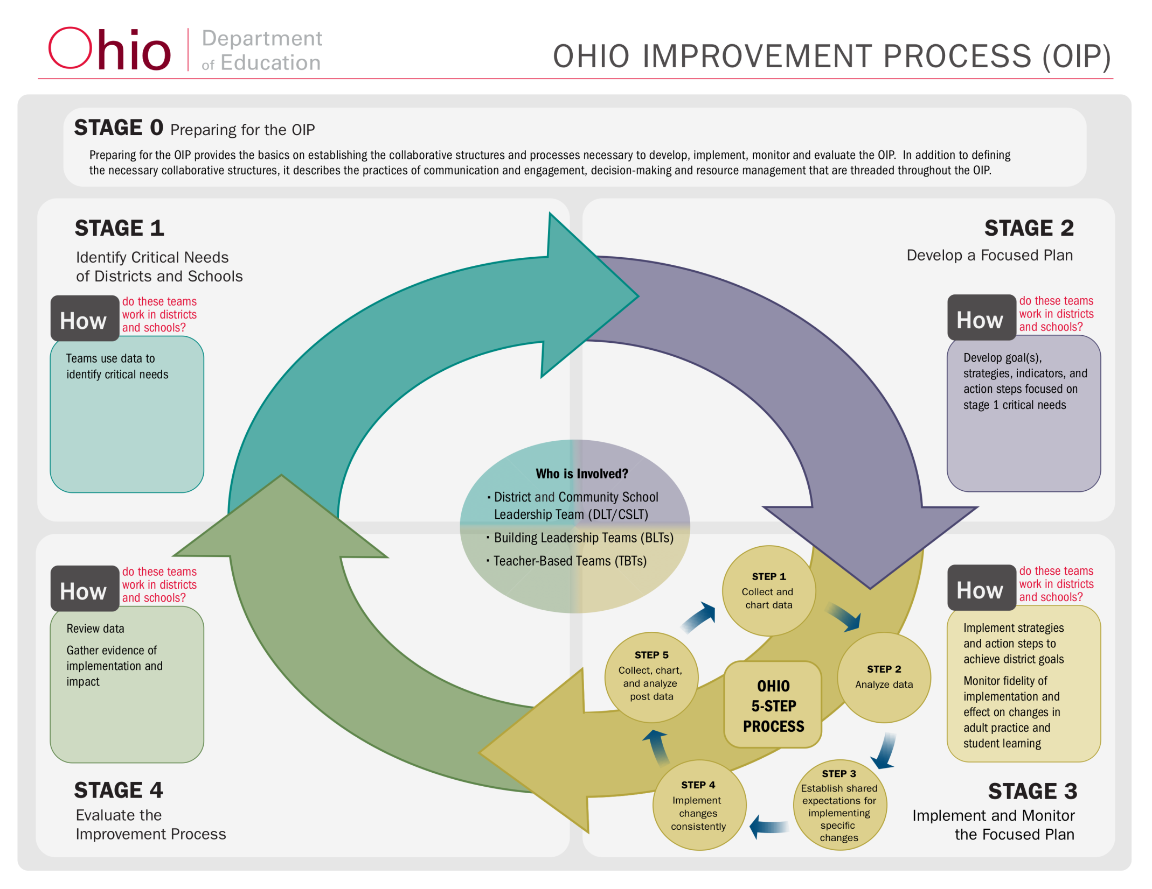
Focus on OIP Stage 3: Coaching and Monitoring Implementation of Evidence Based Practices

Slide 3
Collaborative Partners
National Experts
Higher Education
Regional
Local
Notes:
National Experts - Brian McNulty, Elise Frattura, Mary Murray, and Joellen Killion working collaboratively to develop and deliver PD and support at all levels.
Higher Education - Focused development and delivery of Parent Teacher Partnership trainings.
Regional -16 State Support Teams, each providing external coaching to cohort districts in their region.
Local (3 cohorts of 16 districts each) - Embedding new content knowledge into improvement work at all levels and providing internal coaching to district, building, and teacher based teams.

Slide 4
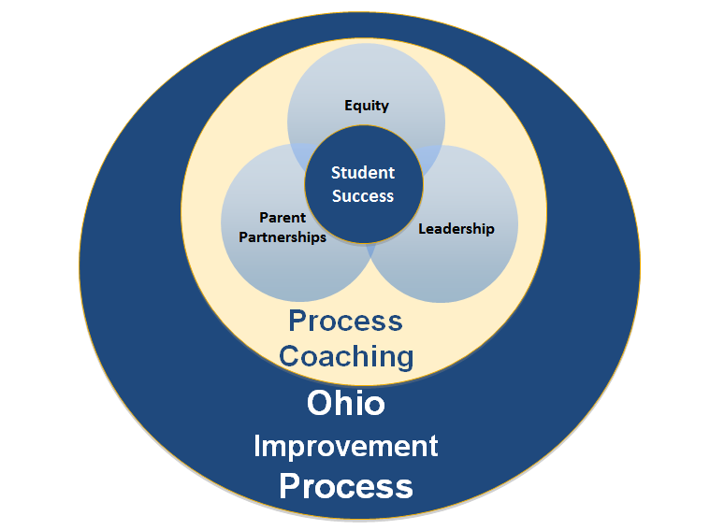
Ohio SPDG Model: Integration of Evidence Based Practices Within the Ohio Improvement Process Resulting in Student Success
Notes:
Grant provides professional development and support for evidenced based content and competent coaching to support implementation of evidence based content.

Slide 5
Effective Leadership Practices
Developing effective leaders –Brian McNulty and Ohio Leadership Advisory Council (OLAC)
Who?
OLAC modules provide specific content on leadership.
Flyer on Leadership Component of Ohio SPDG (app.box.com/s/jmvyyuvtb10po5aerhogaahhjhbb6uea)
Notes:
Superintendents, Central Office Personnel, Principals, and Teacher Leaders invited to participate in all components of SPDG professional development. Regional coaches support effective leadership practices in DLTs and BLTs.

Slide 6
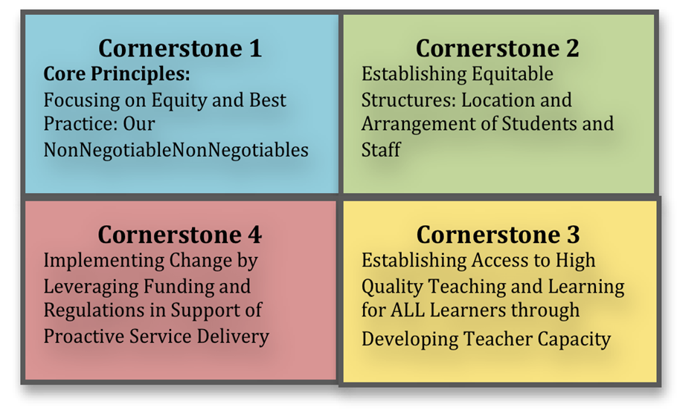
Equity in Teaching and Learning for All Students
Notes:
Four “cornerstones” of Integrated Comprehensive Systems (ICS)™-Frattura and Clapper
Participating districts and
coaches receive PD on
utilizing the cornerstones to
identify and interrupt current
policies and practices that
marginalize students and
perpetuate low achievement. Process coaching supports
implementation of new learning by DLT, BLTs, and TBTs.

Slide 7
Parent Teacher Partnerships
Parents and teachers teams learn how they can improve their partnership practices to support learning for all students. – Murray
Train the trainer format
Notes:
Parents and teachers work with regional coaches to strengthen partnerships that support student success. District and Building Leadership Teams learn how they can improve their partnership practices to support learning for all students. - Murray
In a train the trainer format, partners receive training in the six key areas of the School, Family and Community Partnerships Framework from Johns Hopkins University, and relational qualities drawn from the work of Ann and Rud Turnbull of the University of Kansas, which they utilize in training additional parents and teachers in their district.
Flyer of Parent Teacher Component of Ohio SPDG (app.box.com/s/3rt7mfcpg87th12z9a49bpnzeyvgcl5g)

Slide 8
Process Coaching
Notes:
Series of interactions - builds capacity of individuals, teams, and systems to achieve full and effective implementation of the Ohio Improvement Process and increased learning for every student.
Regional and District Coaches receive training and practice for effective process coaching, as well as evidence based leadership, equity, and parent teacher partnership practices.
Districts receive training in utilizing process coaching practices to facilitate deeper implementation of the 5 step process in DLT, BLTs and TBTs.
Flyer for Process Coaching Component of Ohio SPDG (https://app.box.com/s/ok18em228vypt0i0hm7c7o7mvbhuth4j)

Slide 9
Questions for Audience
What are some successes or challenges:
  in building a systemic approach to implementing concurrent multiple initiatives?
What feedback or comments do you have for us as we move forward with our work?

Slide 10
education.ohio.gov
Ohio Department of Education
Office for Exceptional Children
Sue.zake@education.ohio.gov
Johannah.ward@education.ohio.gov
Earl.Focht@education.ohio.gov
614-752-1378

