Slide 1
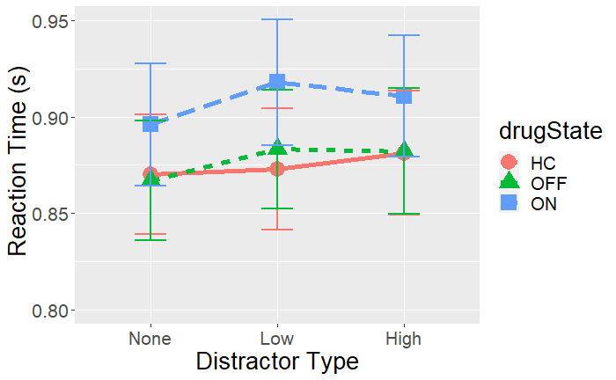
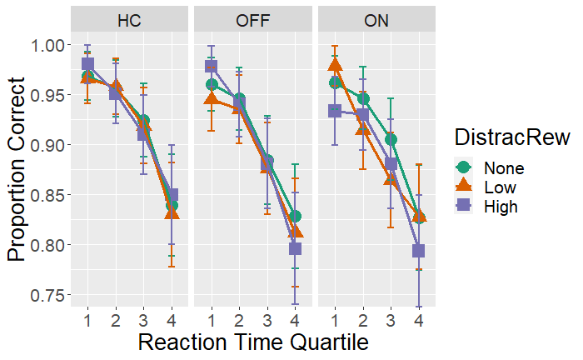
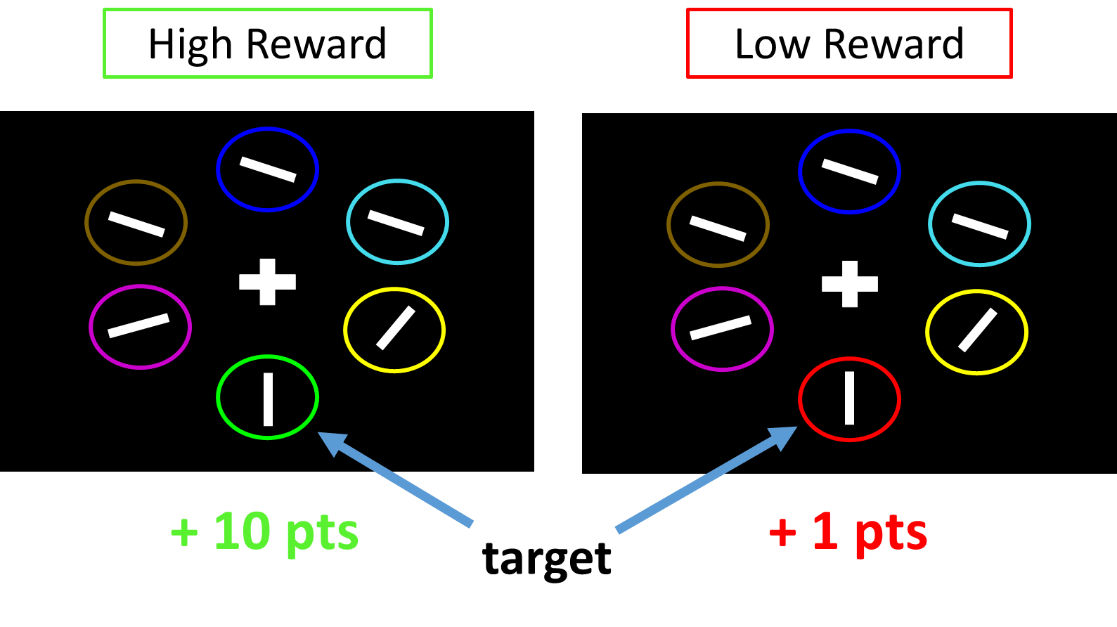
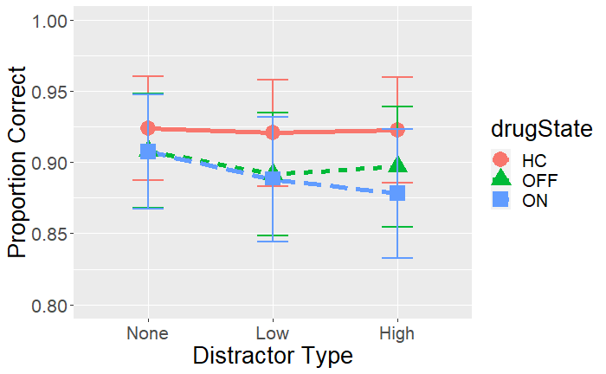
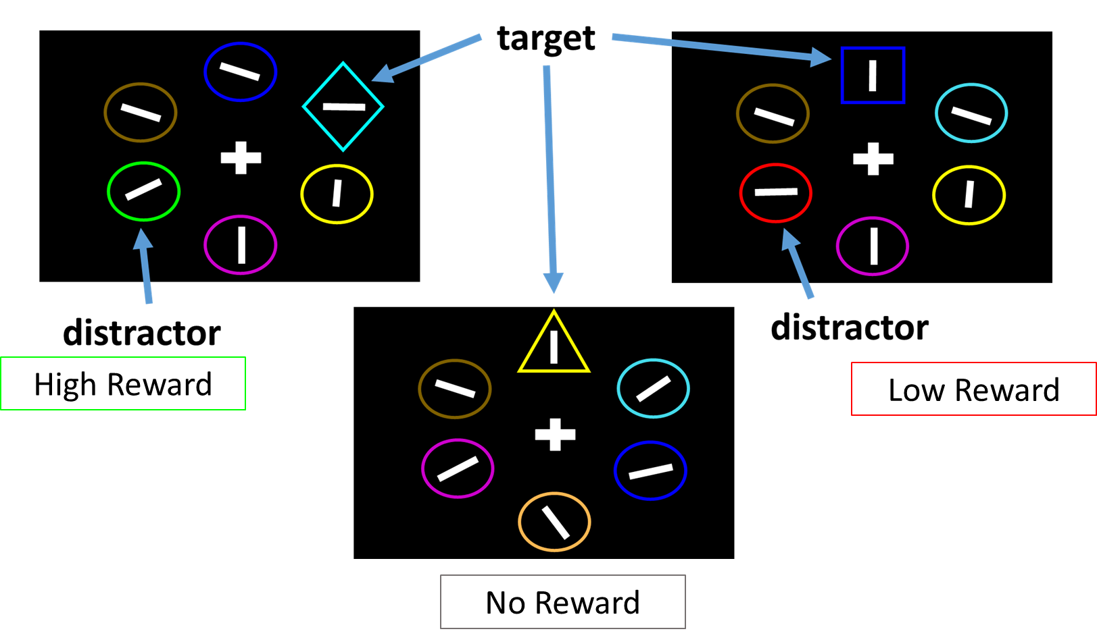
Influence of reward on attention selectivity in Parkinson’s disease
Matthew Pilgrim, Andy Ou, Madeleine Sharp
Department of Neurology and Neurosurgery, McGill University
Background
Results
Results
Executive function deficits are common in Parkinson’s disease, even early in the course of disease¹. Among these, attention impairments are common².
Dopamine-dependent reward processing is also disrupted in Parkinson’s disease³ but if and how this directly contributes to early executive dysfunction is unknown.
The allocation of attention, i.e. selective attention, is known to be guided by environmental reward signals ⁴.
Effect of reward and dopamine on attention: Reaction Time
Speed accuracy tradeoff
Distractor
Type
Are Parkinson’s patients impaired at using reward information to guide the allocation of attention?
Does dopamine replacement alter the selective allocation of attention?
Methods
Task: A two-phase selective attention task. Patients (n=24) were twice: ON and OFF their dopamine medication, and compared to older controls (n=28).
Phase 1: Reward Learning (240 trials)
Report the orientation of a white bar in either a red or green target
Trials are differentially rewarded for correct answers depending on the target color (1 vs. 10 points)
Participants learn to associate each color with either a low or high reward
Phase 2: Attention Test (240 trials)
Report the orientation of a white bar inside a target.
Target = “The Unique Shape”
On 2/3 trials either a Low or High reward distractor (i.e. a shape that is either red or green) is present. On 1/3 trials, no distractor is present.
Slowing of responses occurs when previously rewarded colors are present, and depends on reward level
In Control subjects, there was no effect of reward on the speed accuracy trade-off
In Patients, regardless of medication state, reward did not influence the speed accuracy trade-off
Healthy controls were sensitive to reward level: they were slowed by high (p=0.049) but not by low (p=0.58) reward distractors
Parkinson’s patients were not sensitive to reward level: responses were similarly slowed for both high (p=0.016) and low (p<0.001) reward distractors
Patients were not more ‘distractible’, overall, than controls
Though dopamine medication caused overall response slowing, dopamine did not modulate the effect of reward on attention, nor did it modulate overall distractibility
Summary and Discussion
In older controls, reward influences the allocation of attention: higher value but not lower value distractors slow performance.
In contrast, Parkinson’s patients do not allocate their attention according to reward level: both the high and low value distractors caused similar slowing. Importantly, patients show the same overall attention capacity as controls.
Surprisingly, dopamine medications did not modulate the influence of reward on attention.
These results suggest that attention impairments in Parkinson’s patients may be due to an inability to triage information for processing based on its reward association, rather than due to an overall reduction in attention capacity.
Effect of reward and dopamine on attention: Accuracy
References:
Kalia, L. V., & Lang, A. E. (2015). Parkinson’s disease. The Lancet, 386(9996), 896–912. https://doi.org/10.1016/S0140-6736(14)61393-3
Fallon, S. J., Bor, D., Hampshire, A., Barker, R. A., & Owen, A. M. (2017). Spatial structure normalises working memory performance in Parkinson’s disease. Cortex, 96, 73–82. https://doi.org/10.1016/j.cortex.2017.08.023
Frank, M. J., Seeberger, L. C., & O’Reilly, R. C. (2004). By Carrot or by Stick: Cognitive Reinforcement Learning in Parkinsonism. Science, 306(5703), 1940–1943. https://doi.org/10.1126/science.1102941
Anderson, B. A., Laurent, P. A., & Yantis, S. (2011). Value-driven attentional capture. Proceedings of the National Academy of Sciences, 108(25), 10367–10371. https://doi.org/10.1073/pnas.1104047108
Reward did not influence accuracy in either patients (p = 0.130) or controls (p = 0.162)
Dopamine medications did not modulate the effect of reward on accuracy
Funding: Canadian Institutes of Health Research (MP), Parkinson Society Canada (MS)

