Slide 1
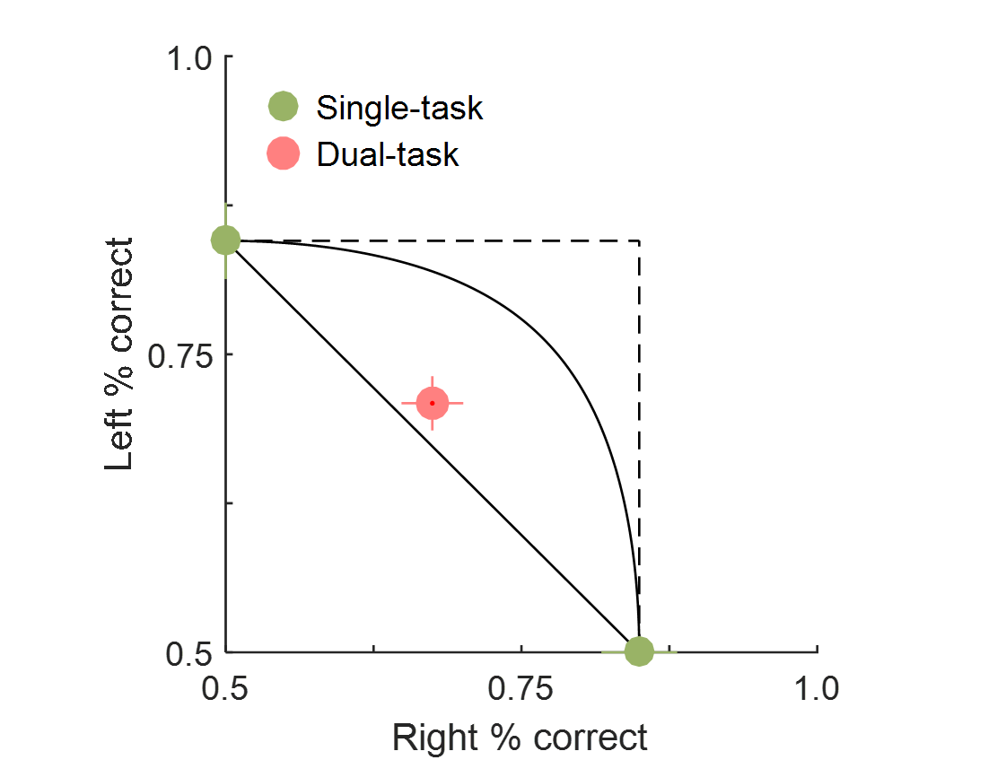
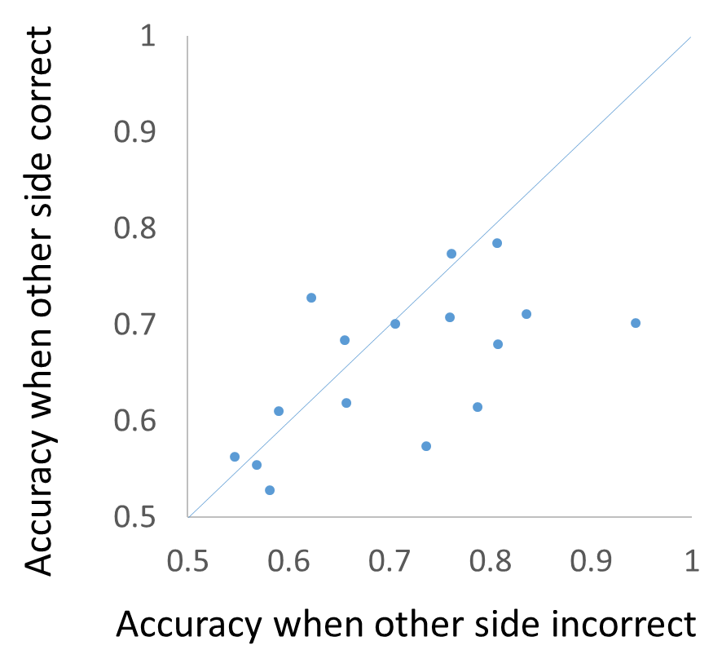
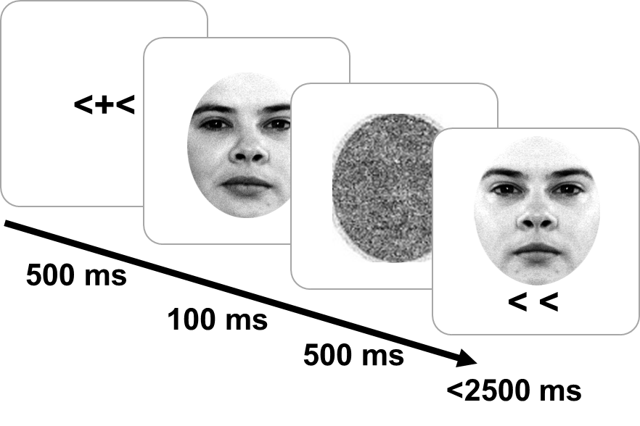
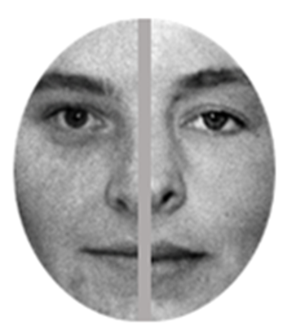
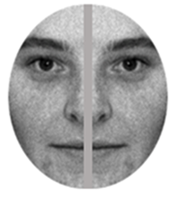
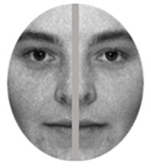
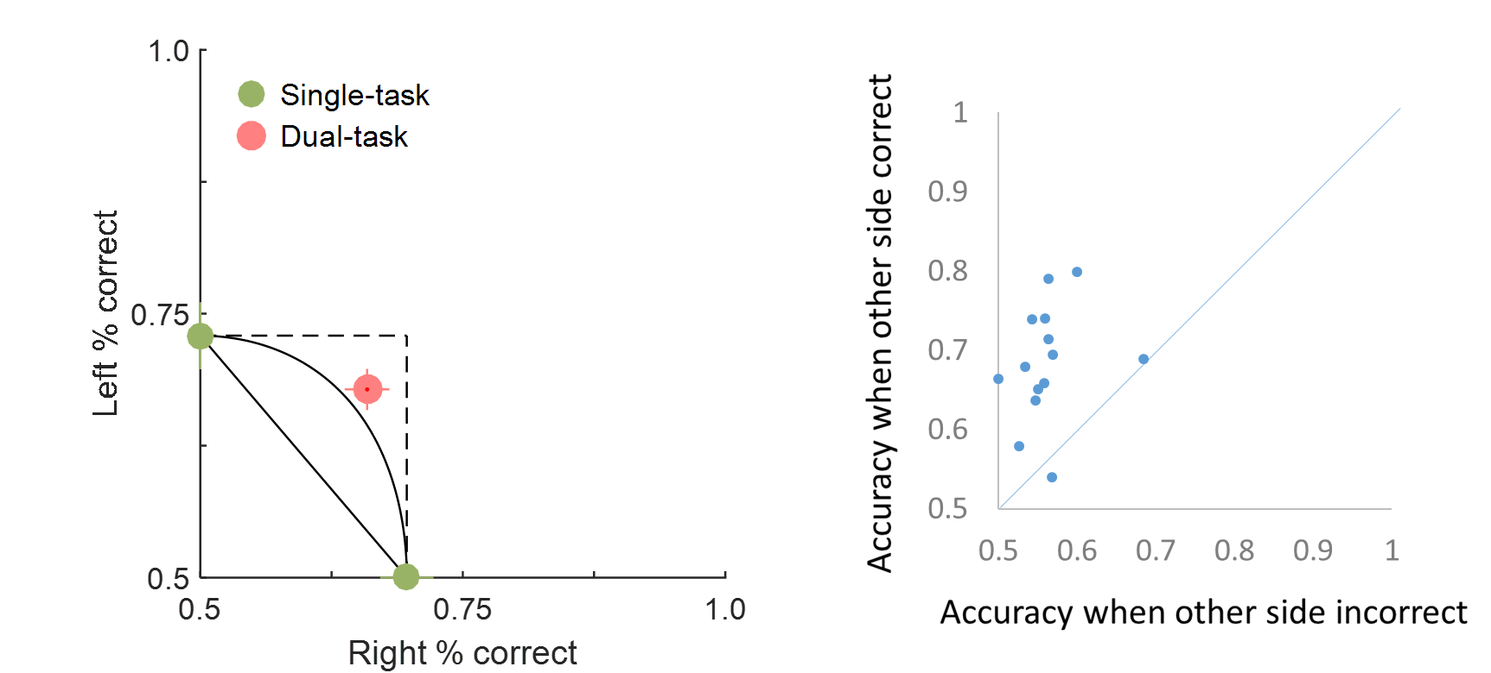
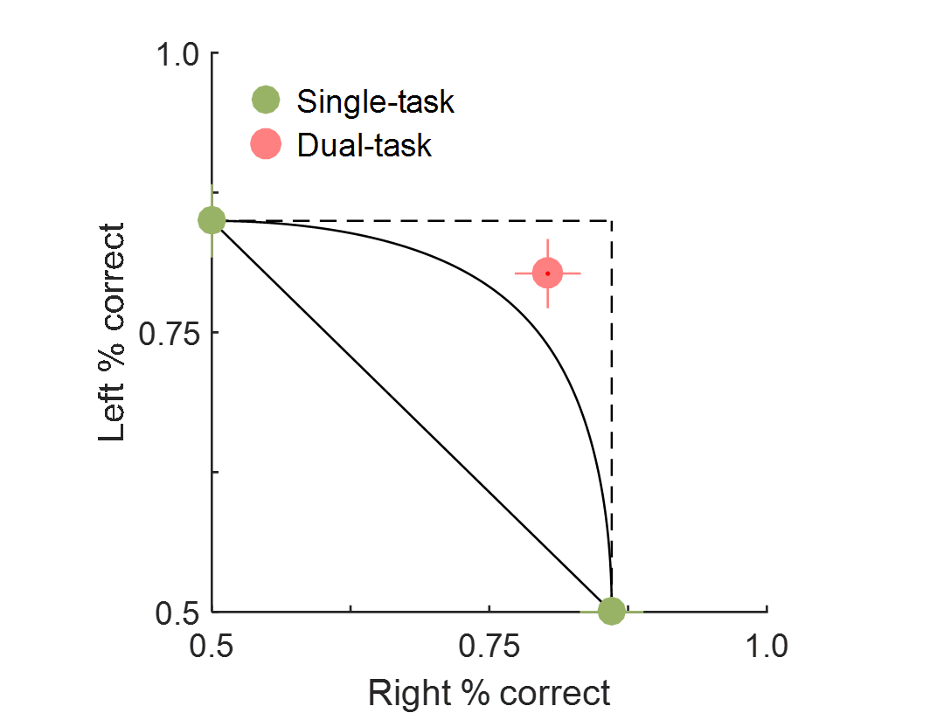
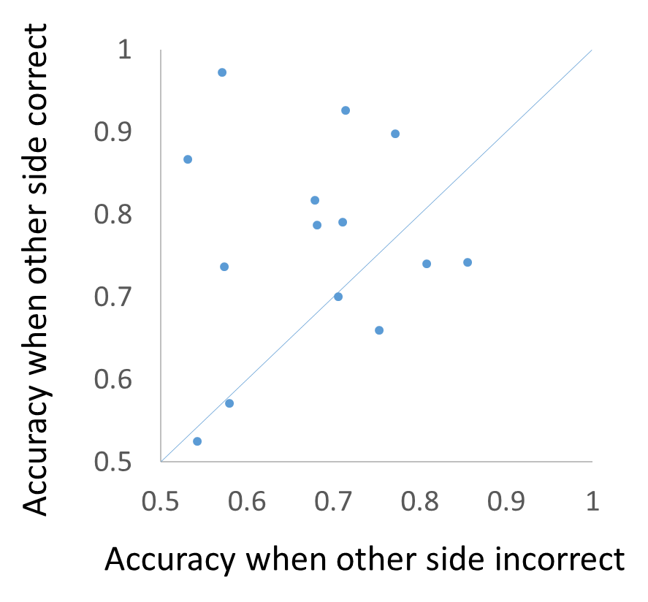
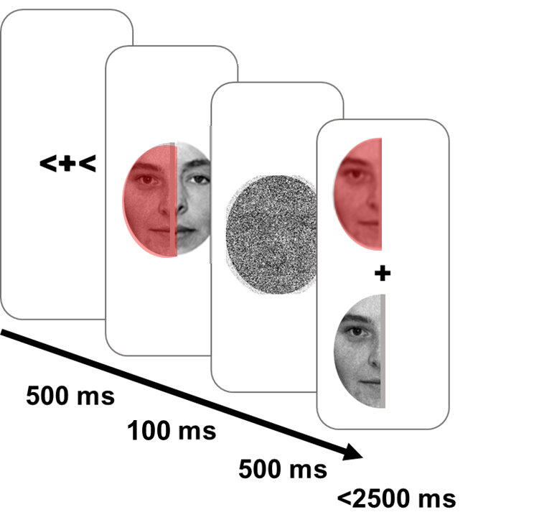
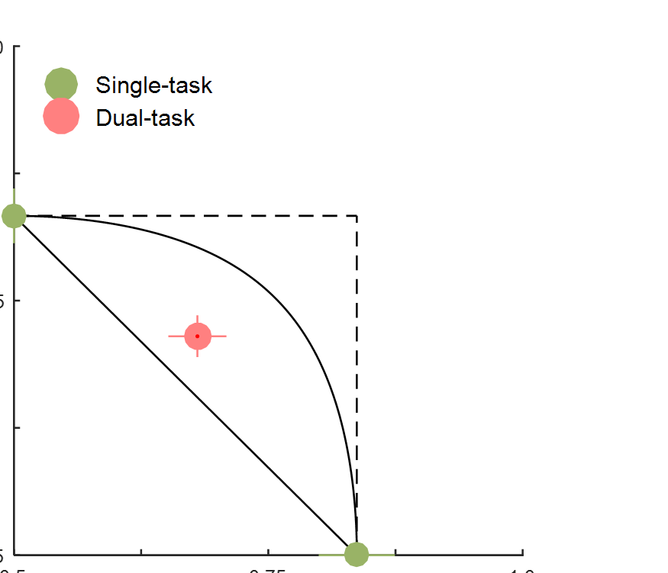
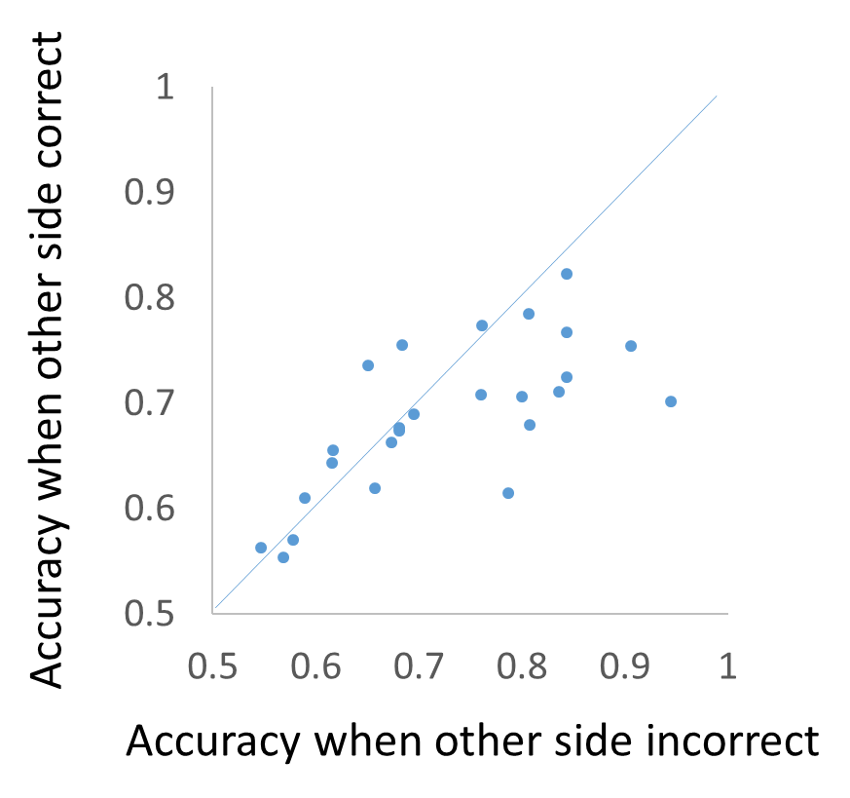
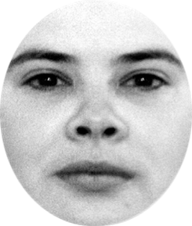
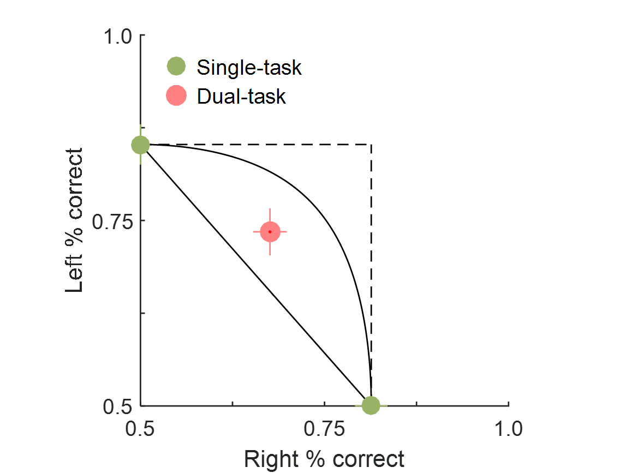
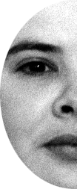
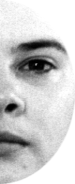
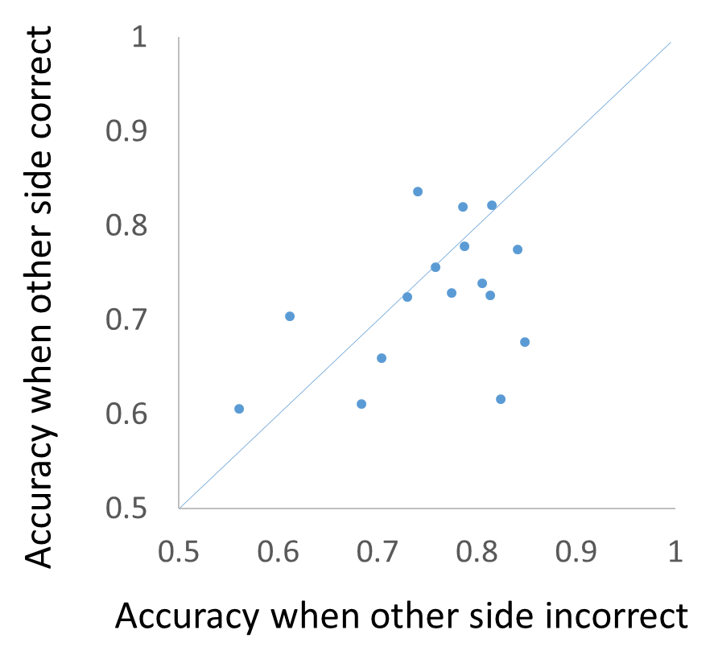
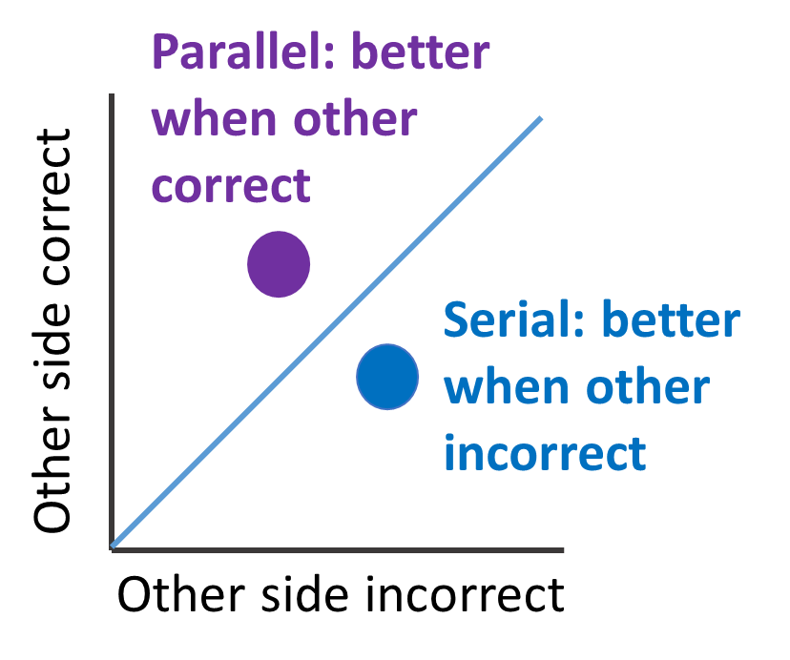
Serial processing of multiple identities in single (chimeric) faces
Matthew Harrison (mt.harrison@gmail.com) and Lars Strother
University of Nevada, Reno
Background
Experiment 1 (cont.)
Experiment 3
Face recognition is associated with holistic/integrative visual processing in the right hemisphere [1], and a corresponding LVF bias [2, 3].
Half face identity
Model fit: Serial
Accuracy other side incorrect >
accuracy other side correct
t(15) = 2.29, p = .04
Dual task: LVF bias
LVF > RVF, t(15) = 2.59, p = .02
Single task: No bias
LVF > RVF, t(15) = .002, p = .99
We predicted that selection would generalize to normal faces, and LVF bias would occur for dual task, but not single task conditions.
LVF bias may reflect selection of LVF half for representation, or greater weighting of LVF half during integration.
Same/Diff?
Normal faces
Model fit: Parallel
Accuracy other side correct >
accuracy other side incorrect
t(15) = 6.15, p < .001
Dual task: LVF bias
LVF > RVF, t(15) = 3.46, p = .004
Single task: LVF bias
LVF > RVF, t(15) = 2.52, p = .03
L
R
L
L+R
L+R
Chimeric face identities are processed serially: if you perceive one identity you do not perceive the other.
LVF bias occurs in dual task only (due to competition?)
Parallel processing of color (below)
We previously hypothesized that the LVF bias reflects attentional selection of LVF face identity information [3].
We tested whether or not the LVF bias reflects preferential selection of the left half of the face at the expense of the right half.
Half face color
Model fit: Parallel
Accuracy other side correct >
accuracy other side incorrect
t(15) = 2.19, p = .04
Dual task: No bias
LVF > RVF, t(15) = .74, p = .47
Single task: No bias
LVF > RVF, t(15) = .79, p = .44
*
*
*
Parallel processing of normal face halves.
Normal faces entail integration rather than selection (competition).
LVF bias not due to selection.
Experiment 1
We measured accuracy on cued (single task) and uncued (dual task) for chimeric faces using a 2AFC identity or color matching task.
* p < .01
Experiment 2
Discussion
We hypothesized that chimeric half-face identities are not integrated into a unified whole, but are processed like whole faces.
Multiple identities compete for representation and entail selection (multiple faces, chimeric faces).
Normal faces have distinct halves which are integrated during holistic processing.
Holistic processing (right hemisphere) → LVF bias
Half face
Model fit: Serial
Accuracy other side incorrect >
accuracy other side correct
t(24) = 2.37, p = .03
Dual task: LVF bias
LVF > RVF, t(15) = 2.84, p = .01
Single task: No bias
LVF > RVF, t(15) = 2.32, p = .04
LVF bias does not reflect half-face selection.
100
We predicted serial processing of identity and parallel processing of color [4]. Single task and dual task accuracy was plotted on an attention operating characteristic (AOC) plot, and compared to three capacity models.
Whole face
Chimeric half-face
Normal half-face
Whole face
Model fit: Serial
Accuracy other side incorrect >
accuracy other side correct
t(15) = 2.20, p = .04
Dual task: LVF bias
LVF > RVF, t(15) = 2.84, p = .01
Single task: LVF bias
LVF > RVF, t(15) = 2.32, p = .04
Selection
Selection
Integration
Attention Operating Characteristic (AOC)
Single task accuracy
Dual task accuracy
Input A
Input A
Input A
Input B
Input B
Input B
Selection for faces occurs at the level of identity.
Serial model
Fixed capacity model
Parallel model
Model assumptions were tested by plotting dual task accuracy when the other response was correct to trials when the other response is incorrect (above right).
Serial selection for whole face and half face identity.
LVF bias for whole faces is independent of competition.
LVF bias for half faces only occurs when identities compete for selection (unlike whole faces).
[1] Kanwisher, N., & Yovel, G. (2006). The fusiform face area: a cortical region specialized for the perception of faces. Philosophical Transactions of the Royal Society of London. Series B, Biological Sciences, 361(1476), 2109–2128.
[2] Gilbert, C., & Bakan, P. (1973). Visual asymmetry in perception of faces. Neuropsychologia, 11(3), 355–362.
[3] Harrison, M. T., & Strother, L. (2019). Does right hemisphere superiority sufficiently explain the left visual field advantage in face recognition? Attention, Perception, and Psychophysics.
[4] White, A. L., Palmer, J., & Boynton, G. M. (2018). Evidence of Serial Processing in Visual Word Recognition. Psychological Science, 29(7), 1062–1071.
Research supported by NIH grant P20 GM103650

