Slide 1


Integrated with
Workday
A faster, simpler and more accurate way to administer employee benefits

Slide 2

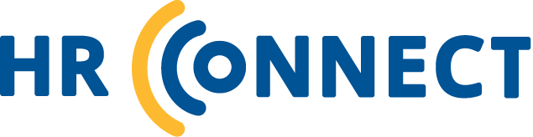
Contents
About Unum
The benefits experience of the past
Introducing HR Connect
Specific solutions
Value to employer
Value to employees

Slide 3

ABOUT UNUM
WORK WITH AN INDUSTRY LEADER
Our sights are set on transforming our benefits from the inside out
$80
million
We protect over
30 million employees and their families¹
We paid
$6 billion in benefits in 2018²
98% of our
clients are likely to renew with us³
We serve over
1 in 2 Fortune 100 companies⁴
A broad portfolio of benefits are compatible with HR Connect for Workday:
invested to transform our customer experience and
benefits technology¹
Employer-paid LTD & STD
Employer-paid Life & AD&D
Employee-paid Life & AD&D
Select STD & LTD
Flex Life, AD&D, LTD & STD
FMLA, ADA, & STD ASO
NY DBL, NY PFL, CA VDI, NJ TDB, HI TDI
Select Voluntary products (CCP only):
Issue Age Critical Illness
Attained Age Critical Illness
Group Hospital Indemnity
Accident
Whole Life
ISTD
1 Unum internal data, 2018.
2 Unum internal claims data, as of year end 2018.
3 Harris Insights & Analytics, 2017 Employer Loyalty Study, 2018. Based on Classic Group customers.
4 Fortune, Fortune 100, 2018.

Slide 4

THE BENEFITS EXPERIENCE
OF THE PAST
Time-consuming
Clients spend too much time manually entering enrollment data, reconciling bills, and tracking employee absences.
Inefficient
Keeping Unum and your Workday system’s data in alignment takes
manual effort, especially during the billing process.
Tedious
Tasks like manually validating employee eligibility during the claims process are tedious and annoying.
Notes:
Human error
Human error
Manually updating employee information in multiple systems is fraught with human error and creates a frustrating benefits experience.

Slide 5
INTRODUCING
MAXIMIZE YOUR
BENEFITS EXPERIENCE
With our suite of integrations:
Workday
ABSENCE
BILLING
EOI
LEAVE LOGIC
VOLUNTARY BENEFITS SOLUTION (Enrollment & Billing)
A secure connection between Unum and your Workday system that automates some of your most time-consuming HR activities

Slide 6
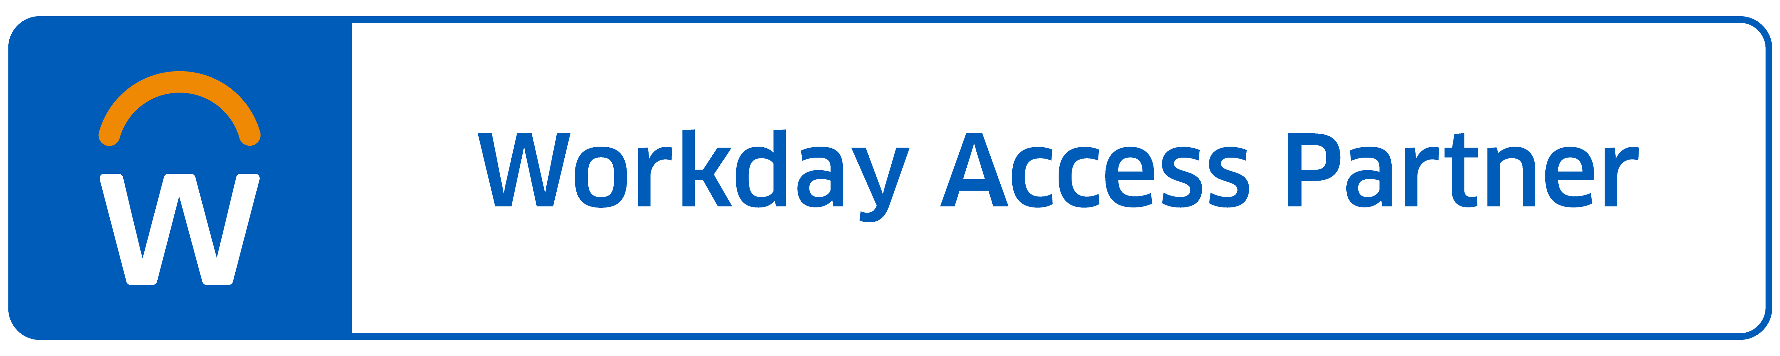
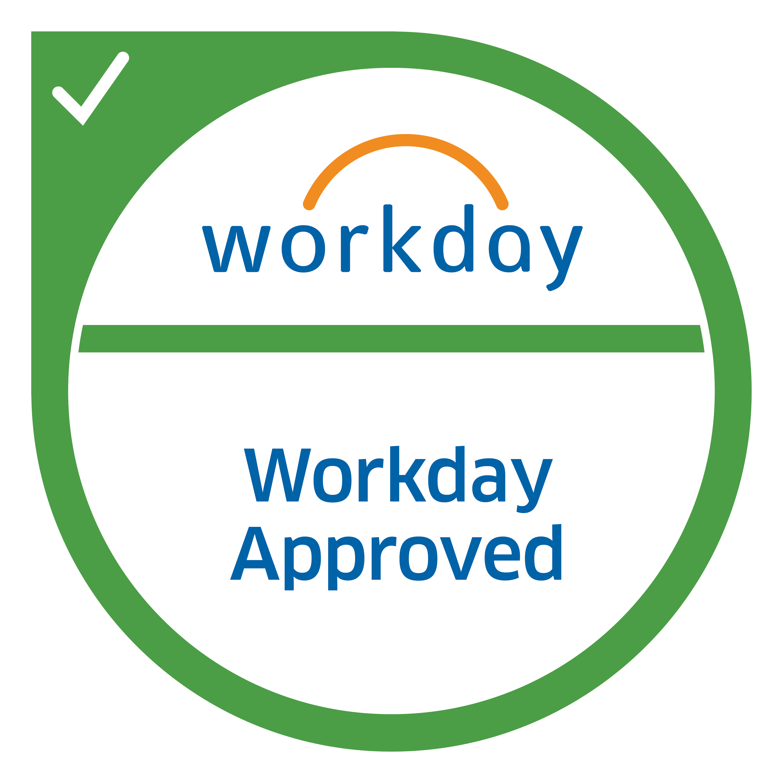


Absence Solution
THE OLD WAY…
WITH HR CONNECT…
Weekly or biweekly
updates about employee leave extensions and
return-to-work dates.
Manually coding and entering absences into your Workday system.
No way to capture or share return-to-work information with managers.
Real-time secure updates
on leave extensions and return-to-work plans.
Automated return-to-work notifications for managers.
Streamlined and consistent data exchange for all
absence types: STD, FMLA, state, corporate and paid family leave.
Our Workday-approved Absence solution
automatically updates your Workday system with employee absence information.
Workday

Slide 7
Voluntary Benefits Solution
THE OLD WAY…
WITH HR CONNECT…
You manually entered employee enrollment data and sent it to your insurance carrier via file feeds.
You spent hours every month reconciling your benefits bill to make sure it reflected changes in that period.
Employees enroll with a single sign-on directly from their Workday system.
Enrollment data is shared between Unum and your Workday system in real time.
Your bill is based on up-to-date information so it’s accurate each month. No more reconciliation. Easy online payment options are available, too.
  Automates the benefits experience from enrollment to billing
Workday

Slide 8
Enrollment Solution
THE OLD WAY…
WITH HR CONNECT…
You spend hours ensuring Unum and your Workday system are in sync.
Enrollment and eligibility data must be manually entered into multiple systems.
Changes/updates made to an employee’s absence case are automatically sent to your Workday system in real time.
Duplicate data entry is a thing of the past.
  Automates the
  exchange of enrollment and eligibility data
Workday

Slide 9
COMING SOON
Evidence of Insurability (EOI) Solution
THE OLD WAY…
WITH HR CONNECT…
The EOI process can
take weeks.
“Snail mail” slows communication.
Employers must monitor EOI status and manually enter data into their Workday systems.
Employees wait weeks for coverage decisions.
Majority of employees receive instant coverage decisions.
Easy, digital process that is completely paperless.
EOI-related claims issues are dramatically reduced.
  Shortens the EOI process from weeks to minutes — with no need for paper forms
Workday

Slide 10
Billing Solution
THE OLD WAY…
WITH HR CONNECT…
Labor-intensive process to reconcile shared data between Unum and your Workday system.
Billing challenges during
open enrollment due to the volume of updated employee information.
Error-prone data, causing inaccurate billing and HR frustration.
Changes/updates made in your Workday system are automatically sent to Unum in real time.
Your bill is accurate,
month after month.
You can drill down to policy, product and employee-level detail.
Simple online payment options.
  Calculates, summarizes and displays your Unum premium in an easy-to-use interface
Workday

Slide 11
LeaveLogic Solution
THE OLD WAY…
WITH HR CONNECT…
Employees had no easy
way to plan, prepare for,
or request leave.
Employees needing leave were not aware of available benefits
You had no easy way to track and manage leaves across the organization.
LeaveLogic provides employees with a simple, robust application for planning leaves and accessing resources.
LeaveLogic finds available benefits and shows employees how they work.
Leave requests and statuses are visible in real time on an easy-to-use employer dashboard.
A one-stop experience for leave planning and tracking, updated in your Workday system in real time.
Workday

Slide 12

EMPLOYER VALUE
1
Secure & automatic data transfer
2
No manual data entry
3
Easy billing

Slide 13

EMPLOYEE VALUE
1
One-stop leave solution
2
Easy enrollment
3
Digital EOI process

Slide 14
The material in this presentation is intended to outline our general product direction concerning HR Connect, and specific functionality may change at Unum’s sole discretion in the future. Also, certain information may contain forward-looking statements, and may include words such as “expects,” “anticipates,” “intends,” “plans,” and similar expressions. Such forward-looking statements involve known and unknown risk and uncertainties that may cause our actual future functionality to differ from that projected or contemplated in those forward-looking statements. This material is intended for informational purposes only and is not a contract, nor may it be incorporated into any contract, and any purchasing decisions should be made on features and functions that are currently available.
Insurance products are underwritten by the subsidiaries of Unum Group.
© 2019 Unum Group. All rights reserved. Unum is a registered trademark and marketing brand of Unum Group and its insuring subsidiaries.
NS-122707 (9-19) FOR BROKERS AND EMPLOYERS

