Slide 1
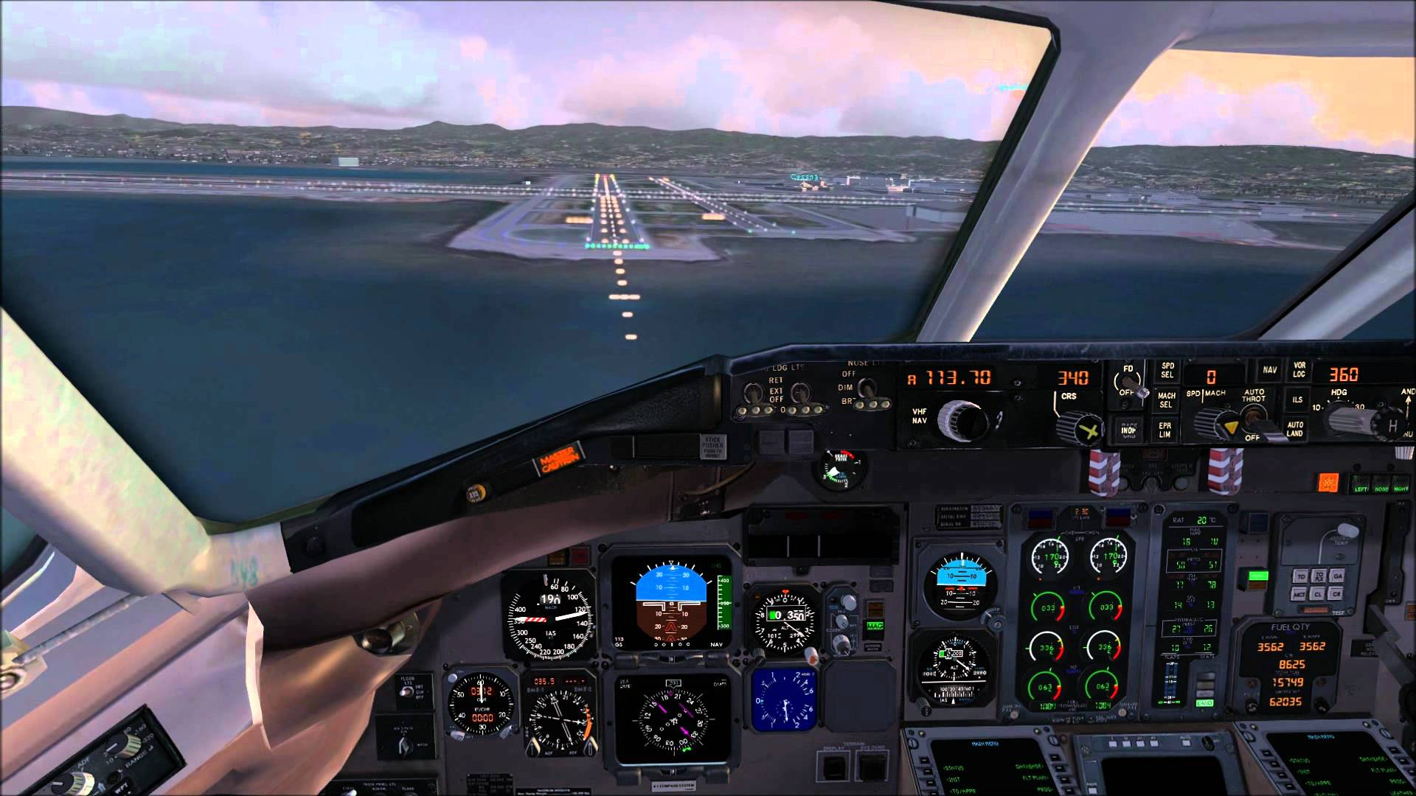
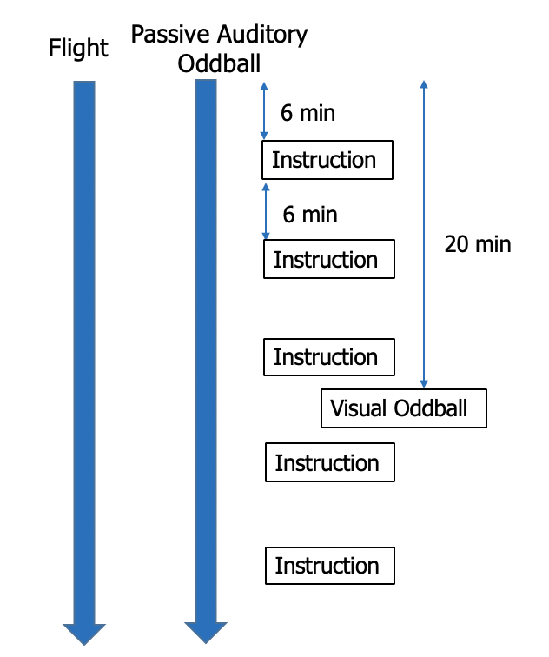
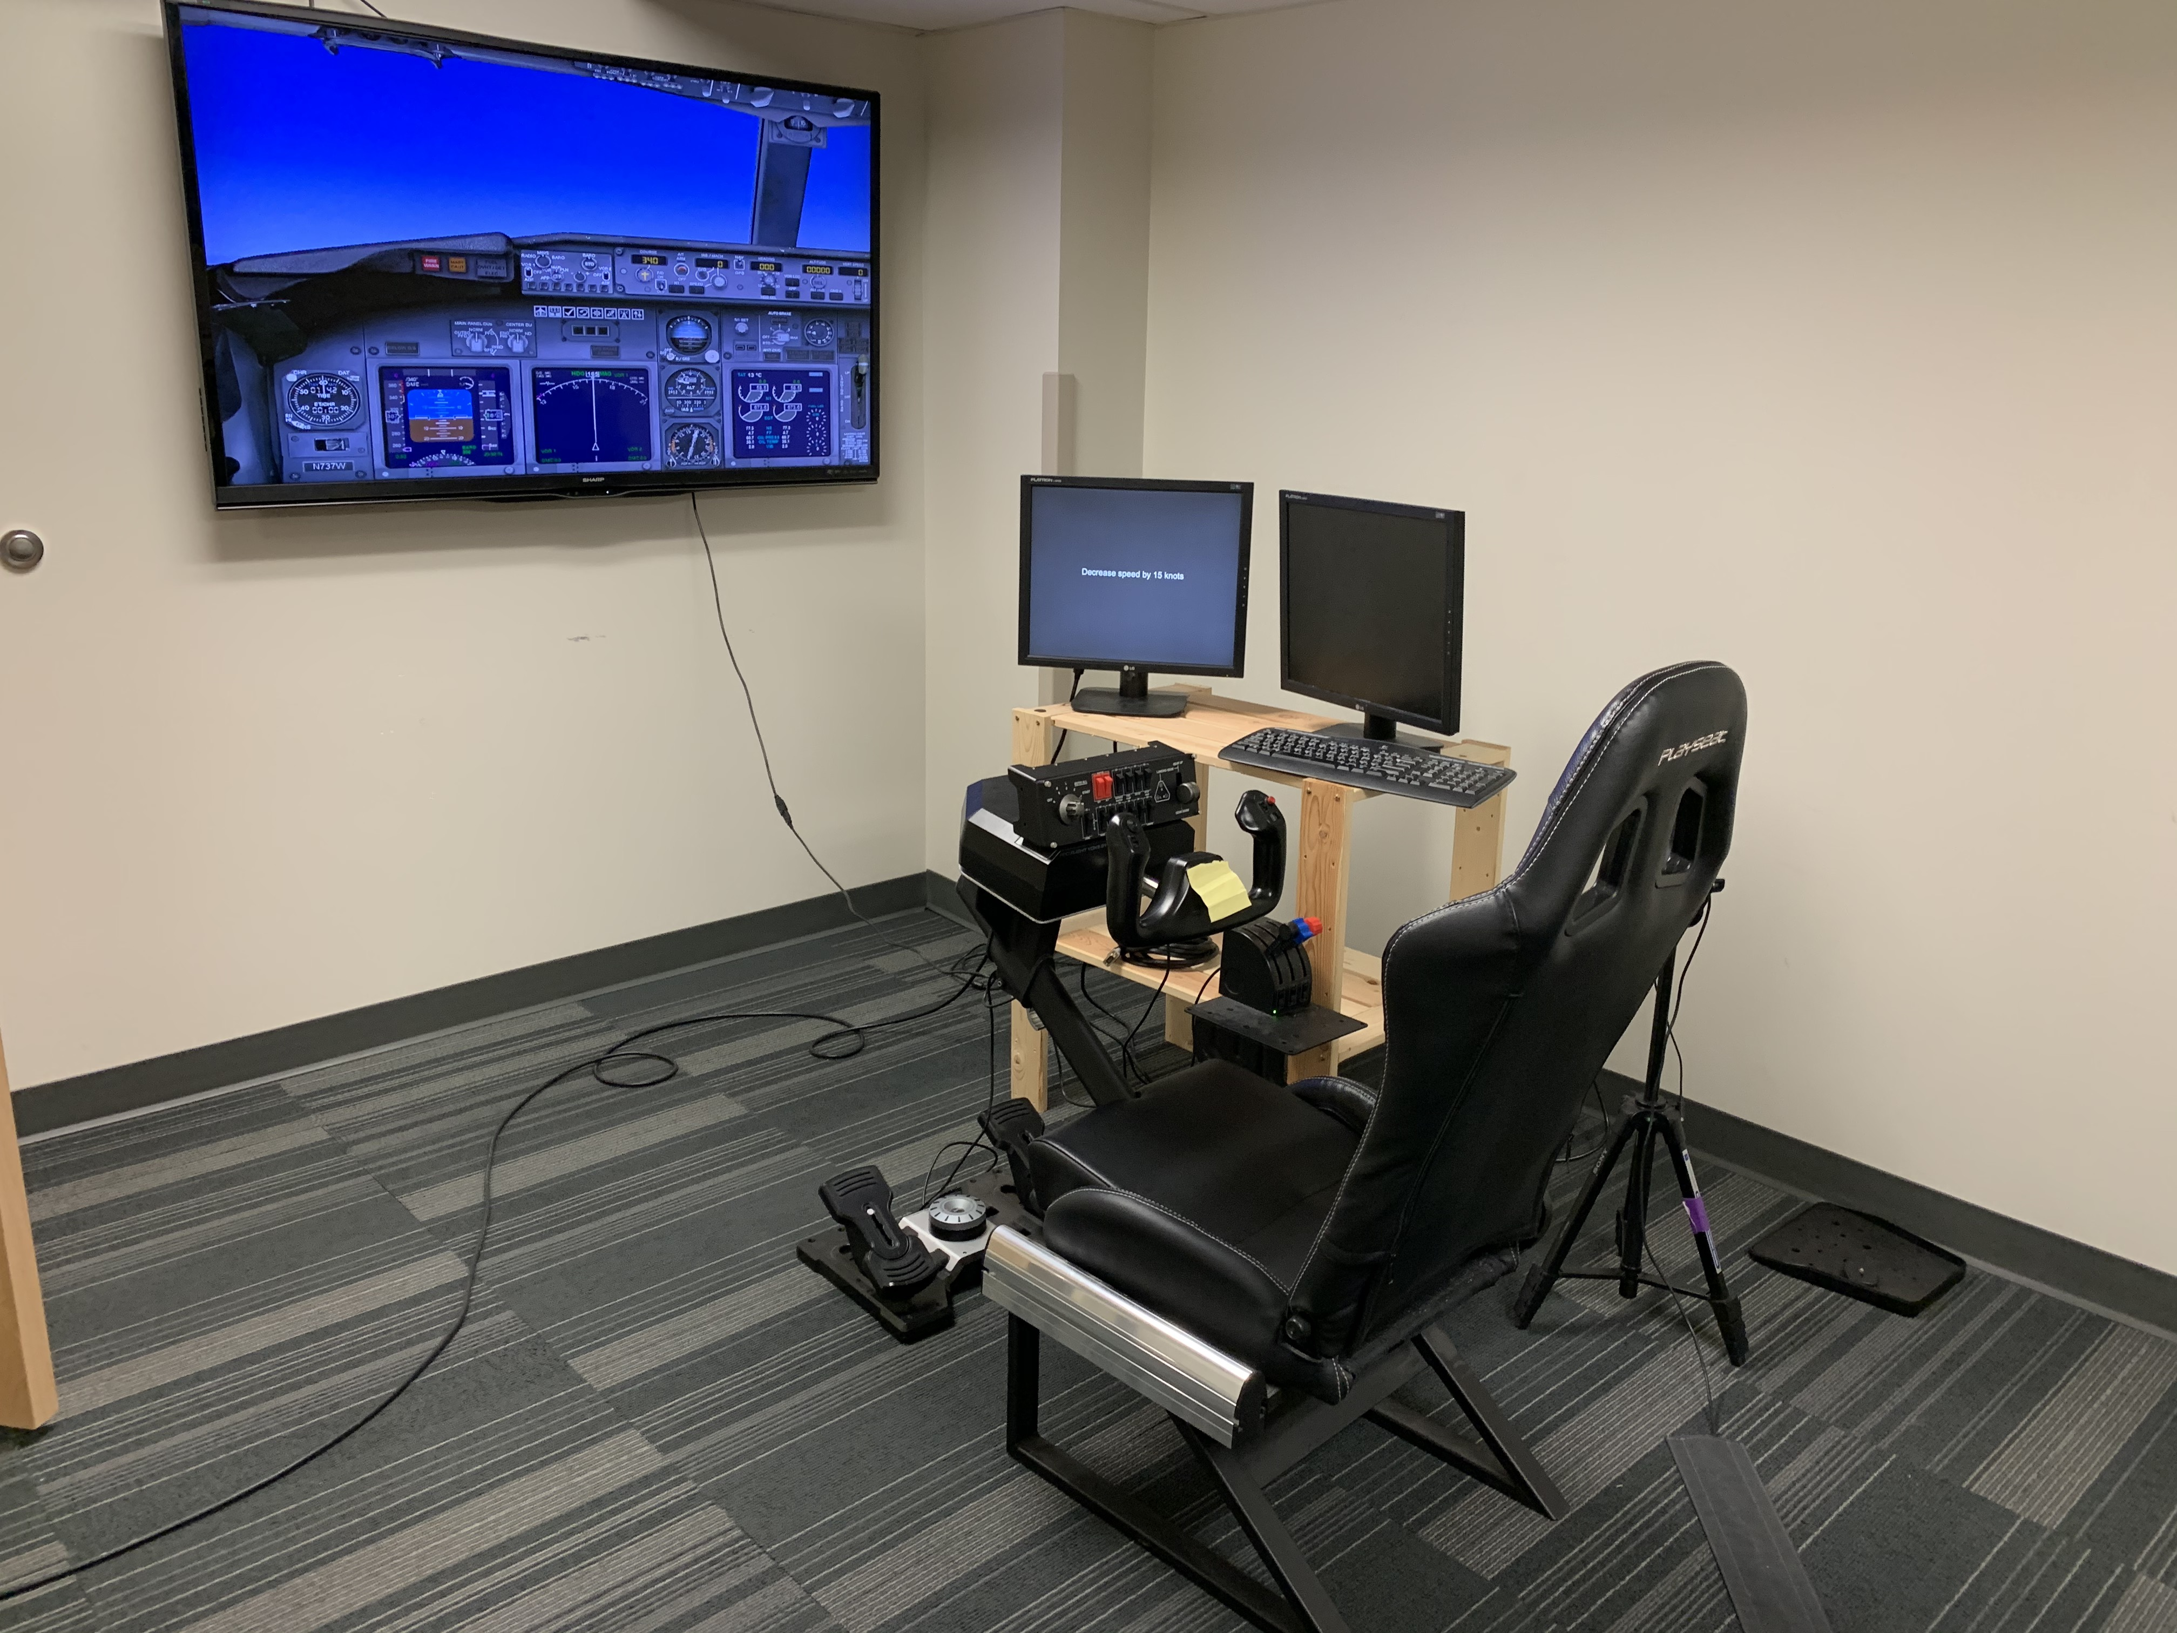
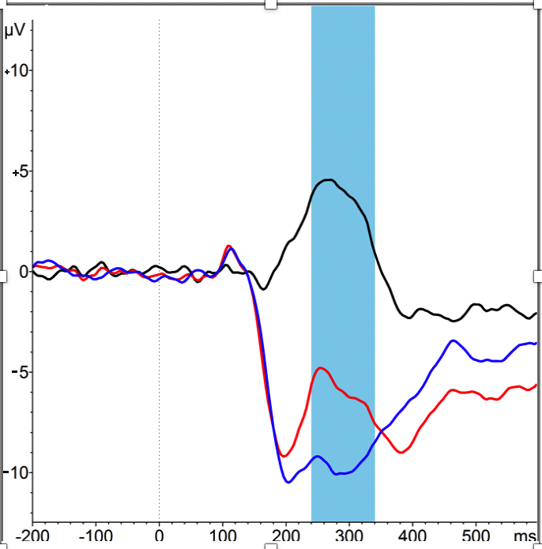
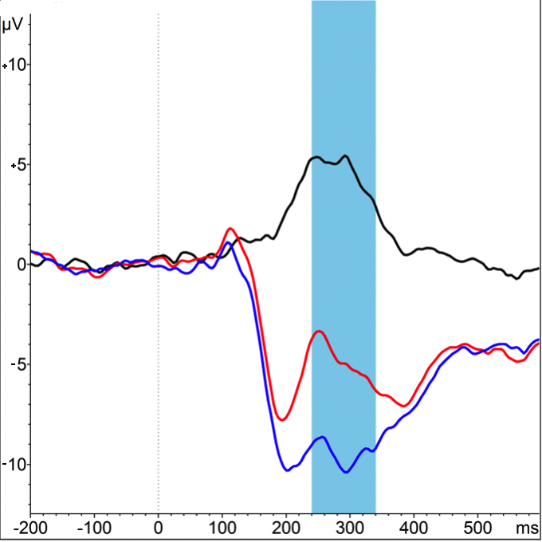
Highway to the Danger Zone: Fatigue Assessment in a Flight Simulation
Gregory W. Gill & Olave E. Krigolson
Centre for Biomedical Research, University of Victoria
INTRODUCTION
METHODS
Fatigue has been identified as one of the leading causes of accidents and performance impairment in the workplace with cognitive fatigue often experienced during prolonged tasks requiring high cognitive effort.¹⁻⁵
Pilot fatigue is a safety risk in aviation and responsible for 4-7% of civil accidents.⁶
Both active and passive auditory oddball tasks have been shown to elicit a P300 response, an ERP commonly associated with fatigue and cognitive performance, with the passive test having the advantage of being able to be run simultaneously with another task.⁸
These unattended tasks have a variety of uses for non-intrusive assessment, such as in fatigue assessment in medical and transport environments⁹
Purpose: Investigate fatigue during flight simulation using EEG and passive auditory oddball to elicit an examinable P300 response.
10 participants from the University of Victoria have been recruited to date
Participants completed 6-hour sessions in Microsoft Flight Simulator X Steam Edition, overlaid with a passive auditory oddball that they were not made aware of
Participants were instructed to fly the aircraft and attend to intermittent in-game instructions provided to them periodically by the experimenter, including a visual oddball
EEG data was recorded from a MUSE portable EEG device, a 5-channel system designed for portability
RESULTS
Figure 1. Left. A representation of alpha and theta power across time. As displayed, theta and alpha power increase after participants receive a break from the task. This is consistent with prior fatigue research indicating a pattern of decreased alpha and theta across time, despite the increase in activity immediately following the break.
Figure 2. P300 responses for visual oddball (left) and auditory oddball (right). The black line displayed is representative of the difference wave between the irregular stimulus and the regular stimulus.
CONCLUSIONS
While more data needs to be collected, our findings are in line with the previous consensus on theta and alpha power when it comes to fatigue and the general decrease in theta and alpha power across time
More data collection is needed to verify the trends seen in preliminary data collection in terms of trends across time
With more data collection, the trends evident in preliminaary data collection will become much more cleaf
www.krigolsonlab.com
Poster #C1
greggill@uvic.ca

