Slide 1
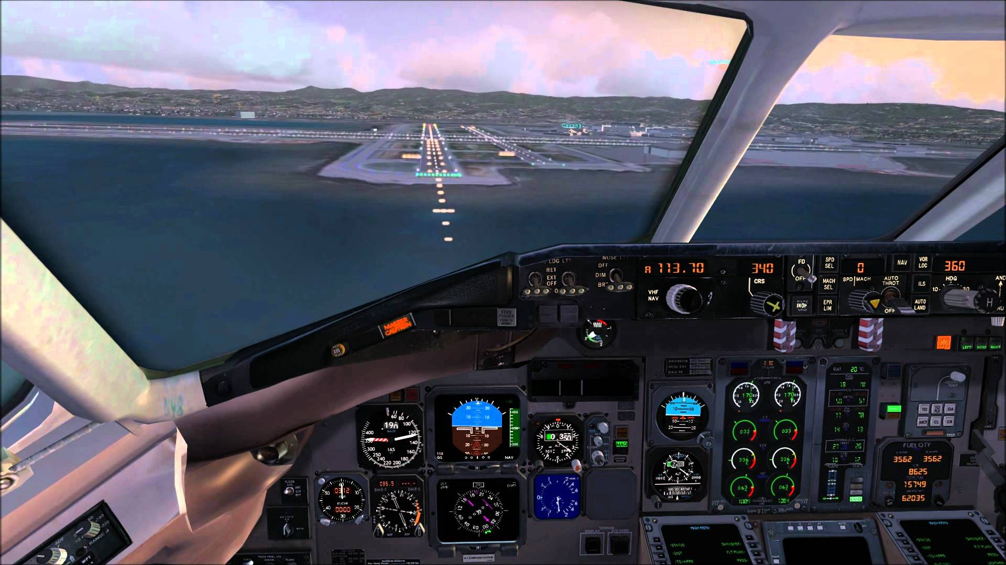
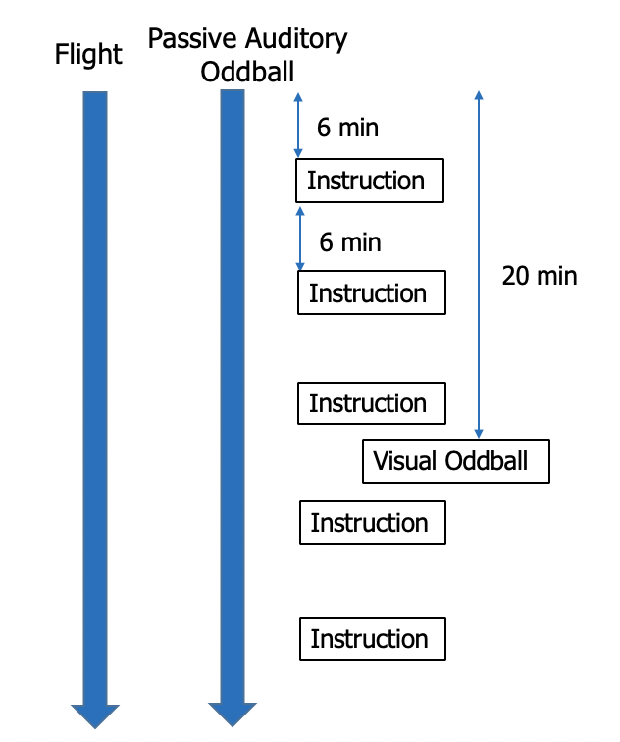
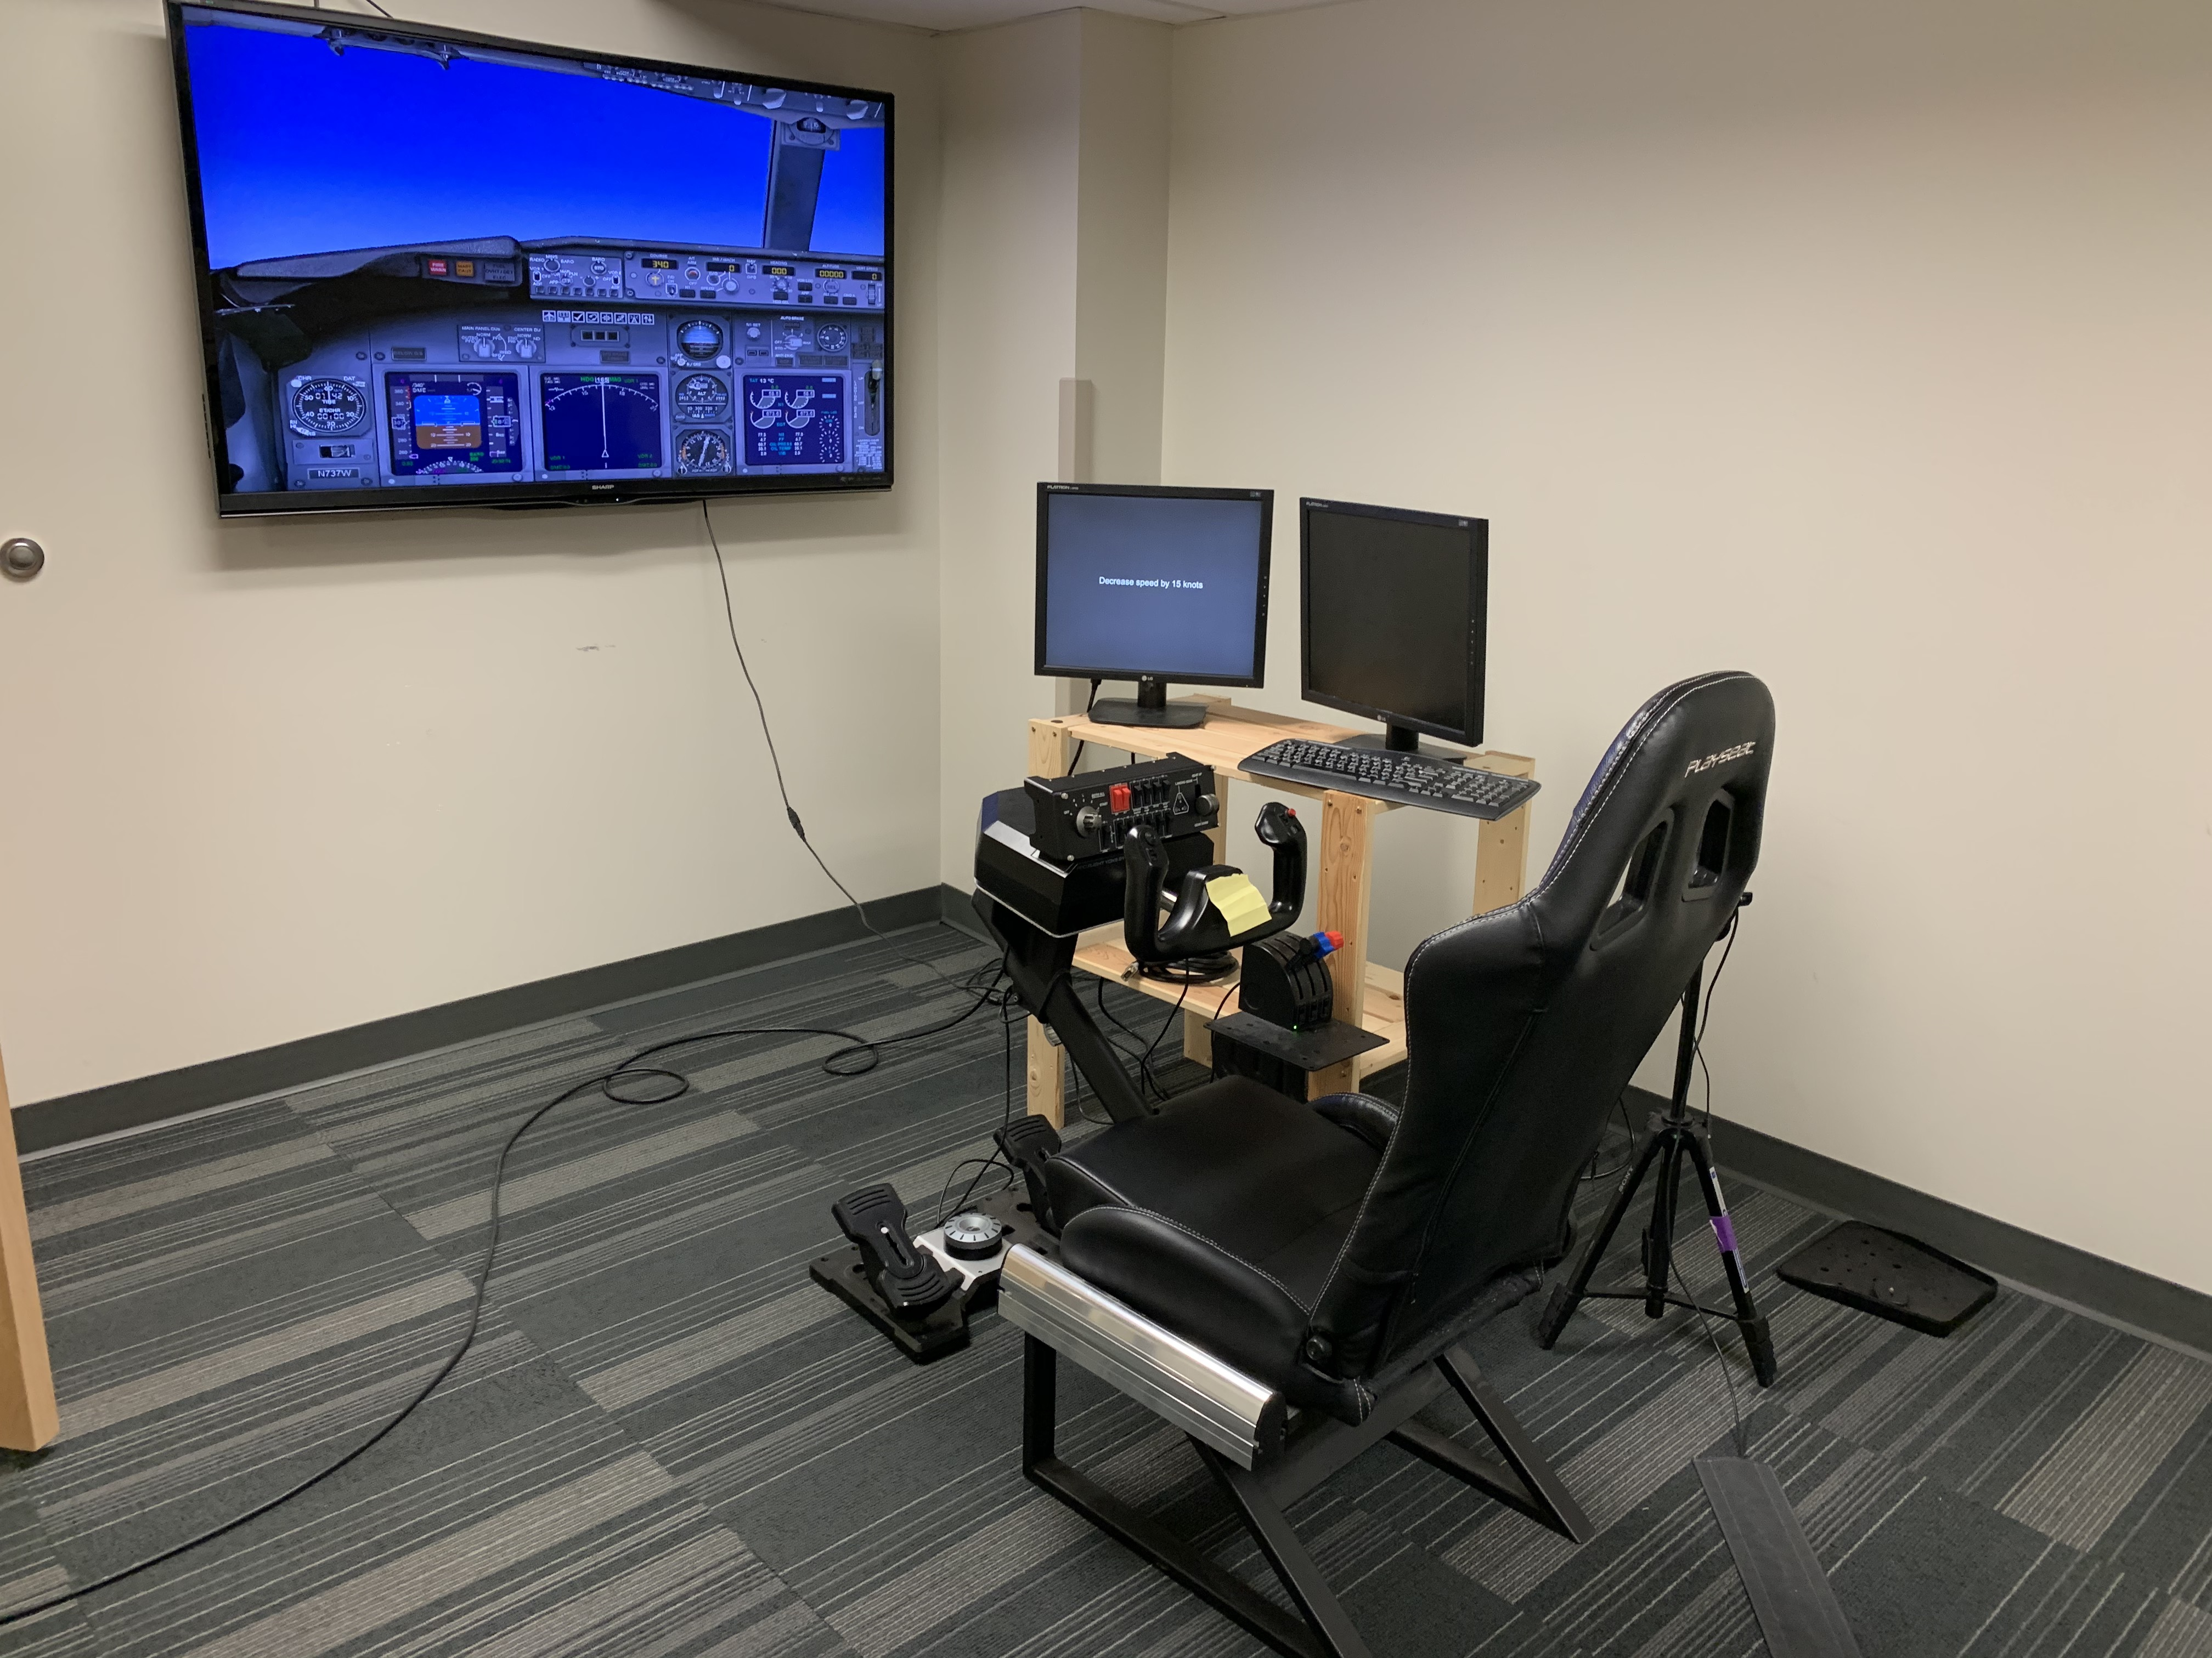
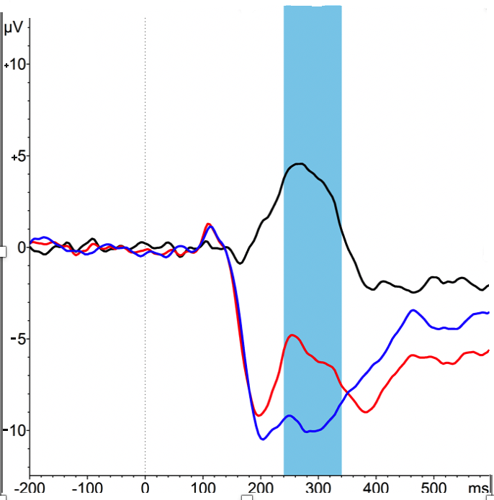
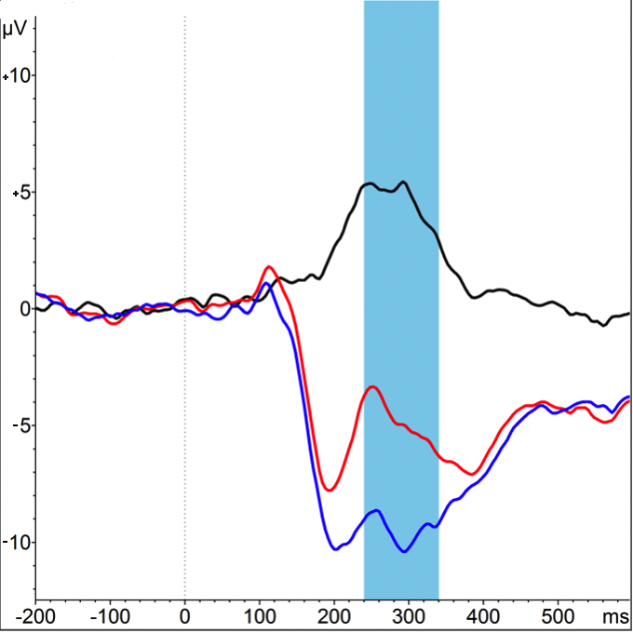
Highway to the Danger Zone: Fatigue Assessment in a Flight Simulation
Gregory W. Gill & Olave E. Krigolson
Centre for Biomedical Research, University of Victoria
INTRODUCTION
METHODS
Fatigue has been identified as one of the leading causes of accidents and performance impairment in the workplace with cognitive fatigue often experienced during prolonged tasks requiring high cognitive effort.¹⁻⁵
Pilot fatigue is a safety risk in aviation and responsible for 4-7% of civil accidents.⁶
Both active and passive auditory oddball tasks have been shown to elicit a P300 response, an ERP commonly associated with fatigue and cognitive performance, with the passive test having the advantage of being able to be run simultaneously with another task.⁸
These unattended tasks have a variety of uses for non-intrusive assessment, such as in fatigue assessment in medical and transport environments⁹
Purpose: Investigate fatigue during flight simulation using EEG and passive auditory oddball to elicit an examinable P300 response.
10 participants from the University of Victoria have been recruited to date
Participants completed 6-hour sessions in Microsoft Flight Simulator X Steam Edition, overlaid with a passive auditory oddball that they were not made aware of
Participants were instructed to fly the aircraft and attend to intermittent in-game instructions provided to them periodically by the experimenter, including a visual oddball
EEG data was recorded from a MUSE portable EEG device, a 5-channel system designed for portability
RESULTS
Figure 1. Left. A representation of theta (top) and alpha (bottom) power across time. As displayed, theta and alpha power increase after participants receive a break from the task in blocks 3, 6 and 9. This is consistent with prior fatigue research indicating a pattern of decreased alpha and theta across time, despite the jumps in activity immediately following the breaks.
Figure 2. Right. P300 responses for visual oddball (left) and passive auditory oddball (right) from one participant. The black line is representative of the difference wave between the irregular stimulus (the oddball, in red) and the regular stimulus (the control, in blue). Positive is plotted upwards on these plots.
REFERENCES
Borghini, G., Astolfi, L., Vecchiato, G., Mattia, D., & Babiloni, F. (2014). Measuring neurophysiological signals in aircraft pilots and car drivers for the assessment of mental workload, fatigue and drowsiness. Neuroscience and Biobehavioral Reviews, 44, 58-75.
Faber, L. G., Maurits, N. M., & Lorist, M. M. (2012). Mental fatigue affects visual selective attention. Plos One, 7(10), e48073.
Hopstaken, J., Linden, D. v. d., Bakker, A. B., & Kompier, M. A. J. (2015). A multifaceted investigation of the link between mental fatigue and task disengagement. Psychophysiology, 52(3), 305-315.
Möckel, T., Beste, C., & Wascher, E. (2015). The effects of time on task in response selection--an ERP study of mental fatigue. Scientific Reports, 5(1), 10113.
Sabeti, M., Boostani, R., & Rastgar, K. (2018). How mental fatigue affects the neural sources of P300 component? Journal of Integrative Neuroscience, 17(1), 93.
Schmidt, E. A., Schrauf, M., Simon M., Fritzsche, M., Buchner A., & Kincses W.E. (2009). Drivers’ misjudgement of vigilance state during prolonged monotonous daytime driving. Accident Analysis and Prevention. 41, 1087-1093.
Caldwell, J. A. (2005). Fatigue in aviation. Travel Medicine and Infectious Disease, 3(2), 85-96
Wester, A. E., Böcker, K. B. E., Volkerts, E. R., Verster, J. C., & Kenemans, J. L. (2008). Event-related potentials and secondary task performance during simulated driving. Accident Analysis and Prevention, 40(1), 1-7.
CONCLUSIONS
While more data needs to be collected, our findings are in line with previous findings that theta and alpha decrease across time as fatigue increases
More data collection is needed to verify the trends seen in the P300 waveforms in association with the visual and auditory oddball tasks, though preliminary data collection looks promising
Most importantly, further investigation of the changing amplitude of the P300 across time as fatigue increases is needed to demonstrate the validity of the current findings
www.krigolsonlab.com
Poster #C1
greggill@uvic.ca

