Slide 1
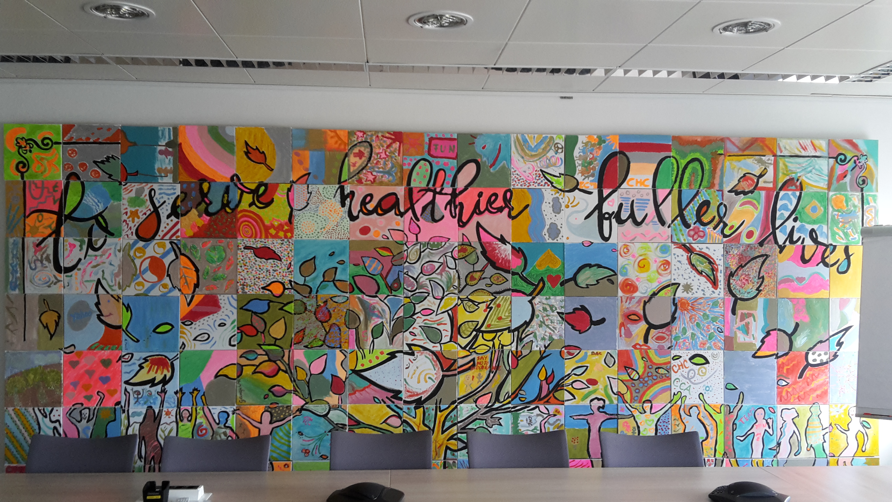
Purpose and Values
GSM Status and Activation plan
Notes:
Good morning

Slide 2
Purpose and Values GSM Activation
The Activation Team
Mentors
Gustavo Reichardt
Emmanuel Lebrun
Volunteers
Anne Charlotte Deyber
Marie Noelle de Beaudean
Stefan Pott
Céline Renaud
Ambassadors
Lisa Megner
Claudia Serafini
Olivier Dupuy
Alessandra Orgler
Mario Santos
Notes:
Thi sis the team involved in activating the P&V within the GSM team. Additionnally to mentors and ambassadors who are also participating throigh their cross function teams, other team members joined the team as volunteers to bring the P&V into life within the team

Slide 3
Purpose and Values GSM Activation
What have we done so far ?
After the presentation of the P&V by the GLT in Frankfurt (February 2017)
February 2nd : Leadership Team meeting reflection : Vision, meaning of P&V for the GSM team.
March 20th : Purpose and Values workshop with full GSM team on the meaning and how to activate it.
At the same time many ideas implemented to live the P&V within the different sub teams and across the different forums :
Reminders on P&V
Discussions on the meaning and how to bring it to live
Share behaviors and actions in line with the Values e.g. feedback culture
Social activities to foster team building
Notes:
So after the reveal of the P&V by yoursefle and the GLT in last February in Frankfuert we had a first meeting to reflect on the P&V and integrate it and work on the meaning for GSM and on the behaviors derived from the values that we

Slide 4
How are we living P&V within our team ?

Slide 5
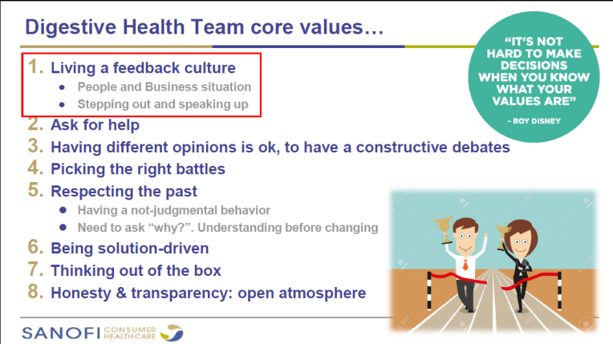

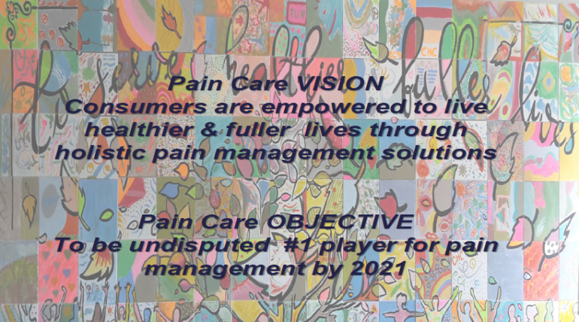
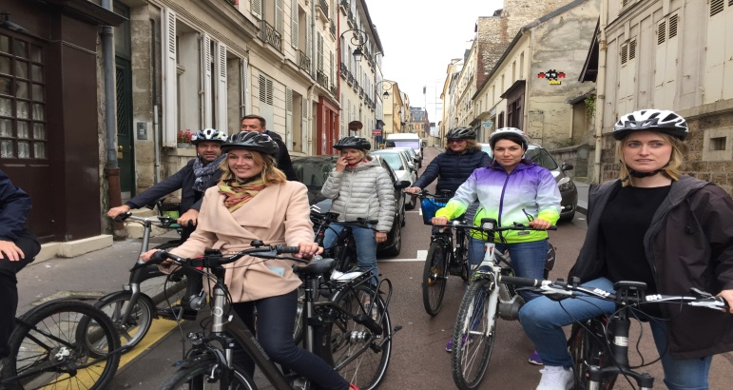
Purpose and Values GSM Activation
What have we done so far ?
Within our subteams and groups, many activities and intitiatives embedding the P&V into our daily work and life.
Notes:
A couple of exemples have been shared during GSM meeting in July by the ambassadors, Claudia from GI explained

Slide 6
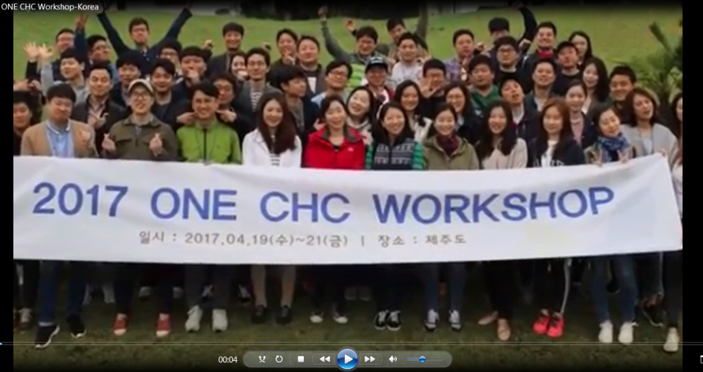
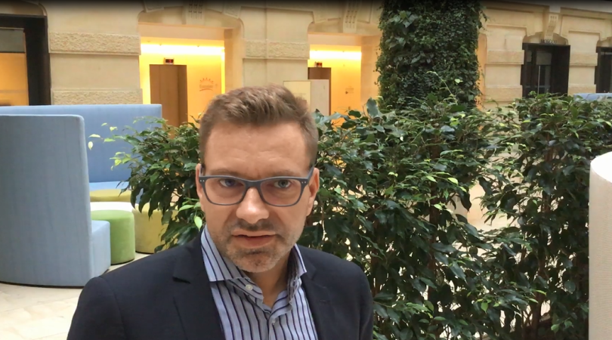
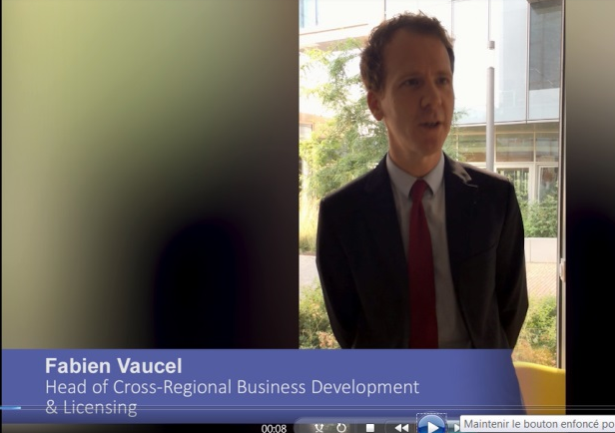
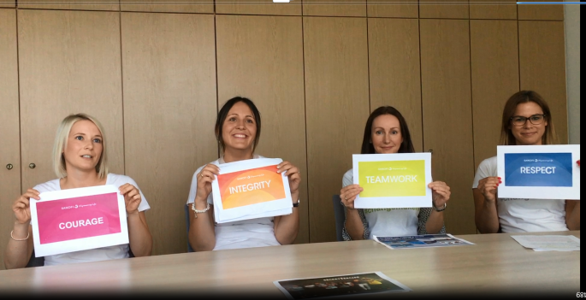
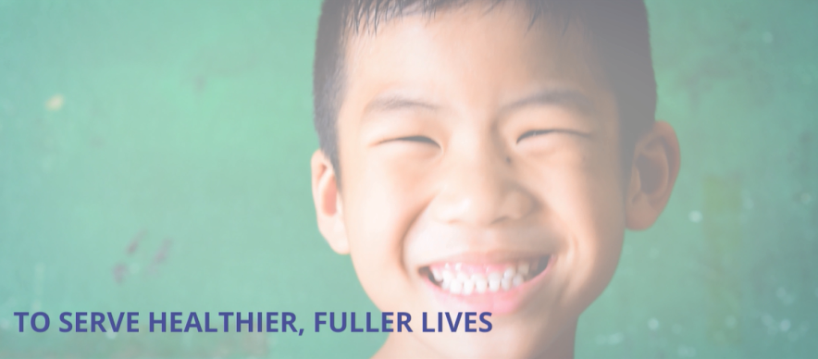
Purpose and Values GSM Activation
What have we done so far ?
GSM team, July 12th
External look to share and be inspired with exemples from all over the world
Diversity & Respect conference on cultural differences
Notes:
What we also did is to have a external look and get inspired by other exemples coming from different countries and functions, great exemples from Germany and the change makers, but also llooked in South Korea and international regaion how they are living the values or Global BD&L. this has alos been the opporutnity for some members of the team to share their own experience on P&V
Also linked with this external look and illustrating Divesrity and Respect, we had in July with the whole team a conference on cultural differences andhow to embrace them as source of enrichement

Slide 7
Where are we now and what does come next ?

Slide 8
Purpose and Values GSM Activation
What are we now in terms of activation?
We want to continue reflecting on P&V and bringing it to life on sub team level but also activate it at a higher level, as one GSM team, bringing and engaging people together.
GSM Team meeting „Respect“
GSM team training
P&V reminder and Pic contest
July
Aug
Sept
Oct
Nov
Dec
Summer activation :
Photo contest to illustrate our Values : Courage, Respect, Integrity and Team Work
Engage with NGO with purpose in line with Serve healthier, fuller lives
Consumer Centricity activities :
Put the consumer / Customer at the center of our action e.g. consummer immersion, Consumer day, …

Slide 9
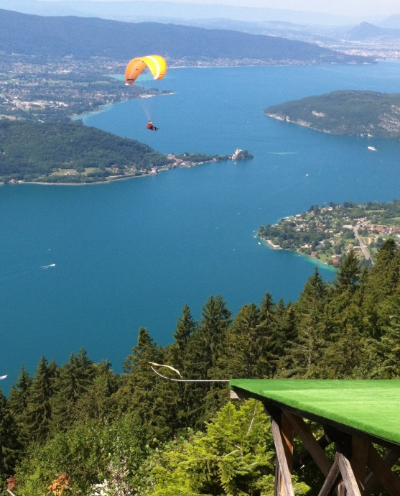
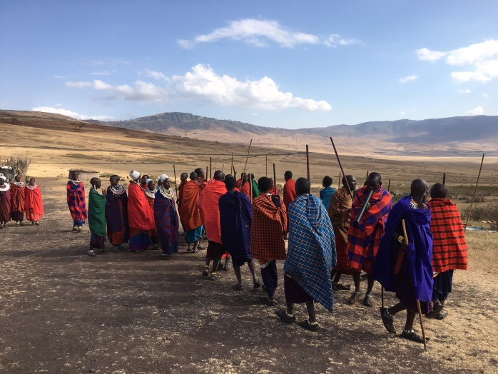
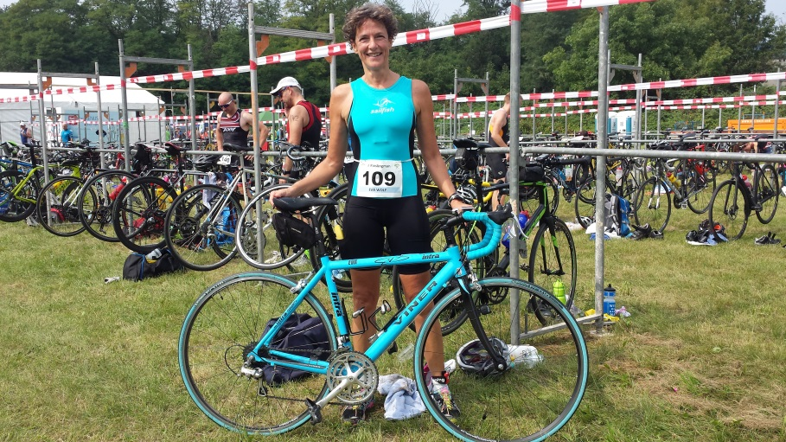
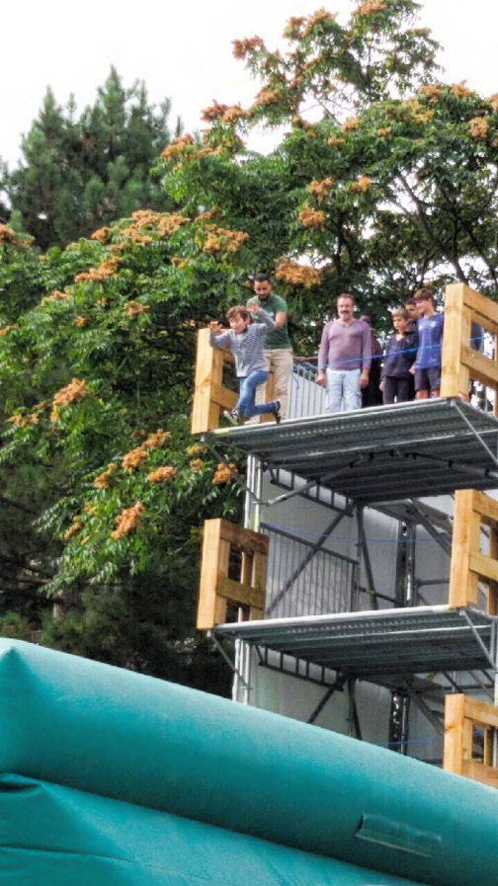
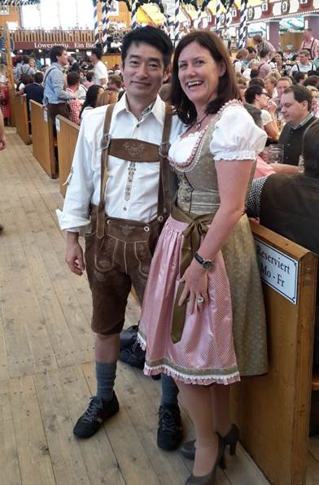
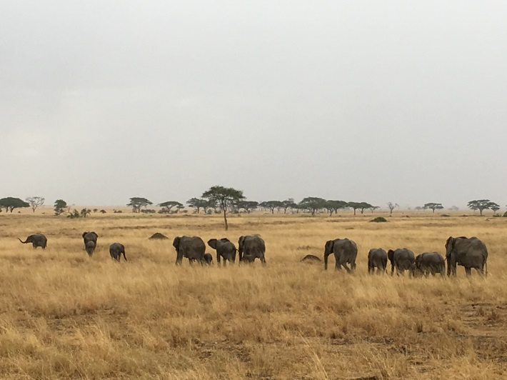
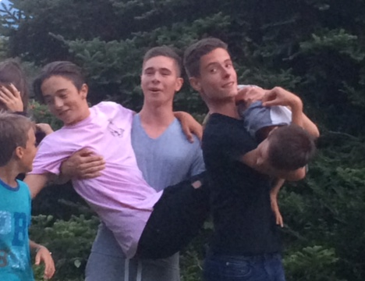
Courage
Respect & Diversity
ACHIEVED
Courage
Courage
Diversity
Team work
Team work
Notes:
I share with you here some exemples of the pictures received over the summertime illustrating in a very personnal way what our values mean and how in our daily life also outside our working environment we truly live it …
The next steps for the contest is to share the results with the all team in November during training sessions and

Slide 10
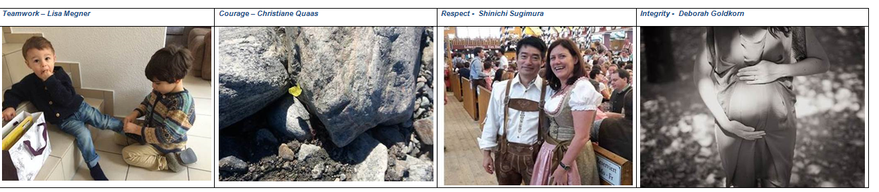
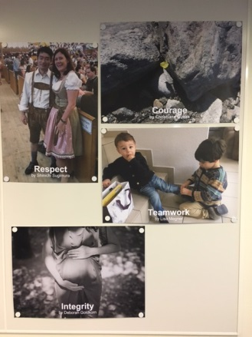
Purpose and Values GSM Activation
Summer photo contest
ACHIEVED
We have received more than 20 submissions from the team … and the winners are ….
As communicated by Manuela, posters have been produced and displayed in FFM and Gentilly offices.

Slide 11
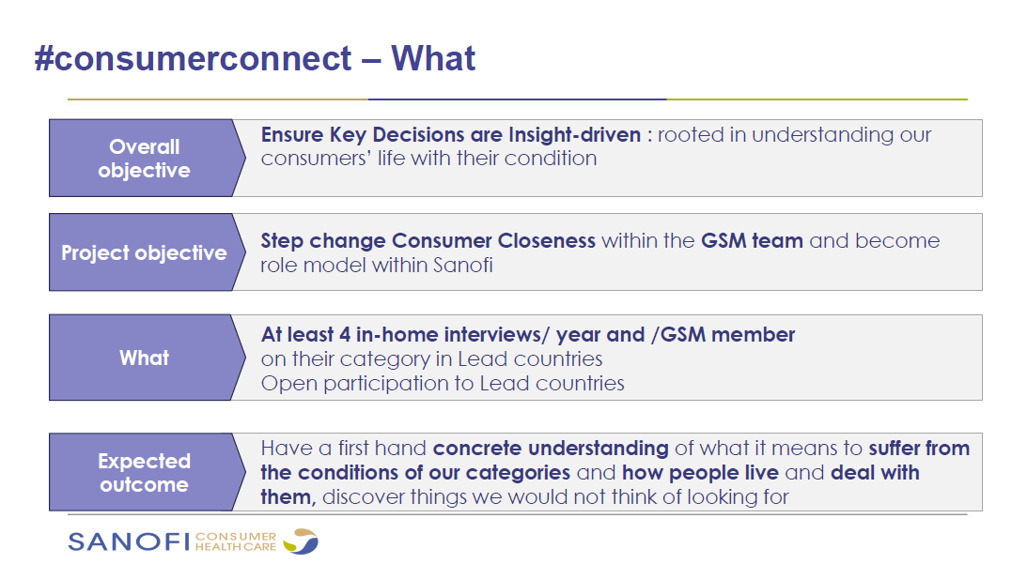
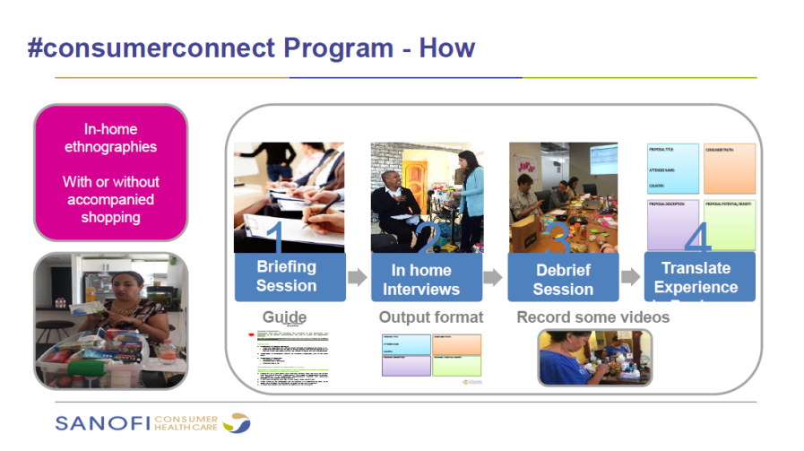
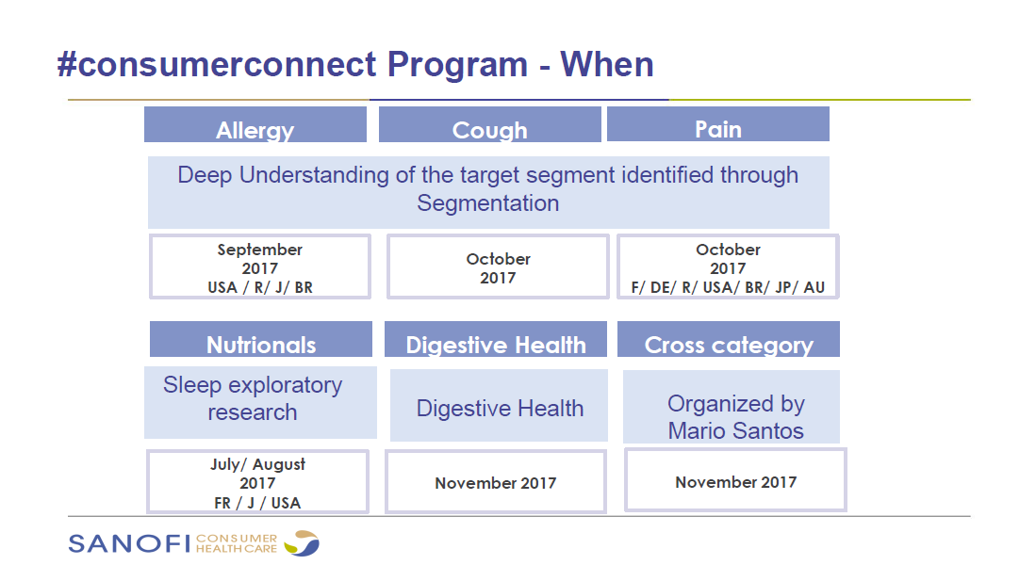
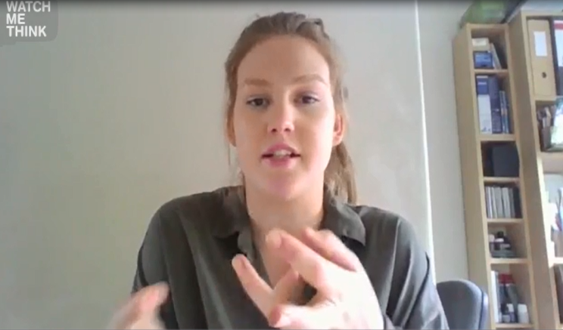
Purpose and Values GSM Activation
Consumer centric activities
ON GOING
Great innovations come from understanding the consumer's unmet needs and desires. You must develop an appreciation for who your consumers are and how they live, to know their needs and also their aspirations. Only then can you figure out how to deliver a product that can improve their lives
A.G Lafley former P&G CEO
Notes:
Another key initiatives which is on going is to put the consumers at the center of our action as they are the reason why we as company we are developing products and services. Our purpose is also strongly rooted into deep consumer insights which will help us to serve healthier and fuller lives.
Our colleagues from CMI led by Muriel has put in place an ambitious program to engage the whole GSM team into discovering and better understanding our consumers, via consumer immersion activities. I have personnally experienced the power to listen our consumers from their home, in Australia recently i attended a couple of in home interviews of consumers suffering from Pain back / muscle -> enlightening in the way

Slide 12
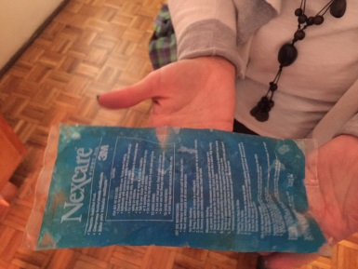
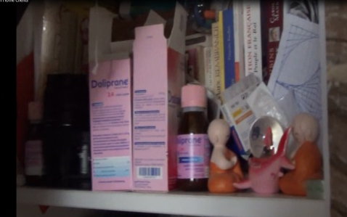
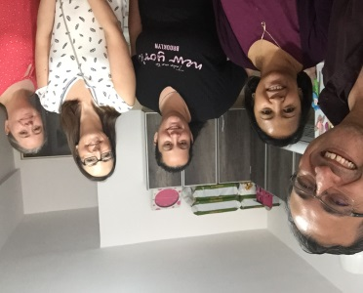
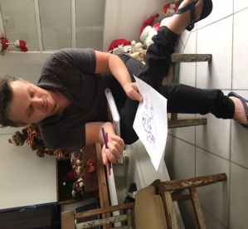
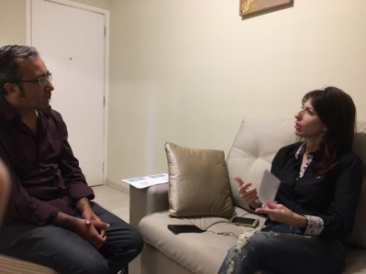


Purpose and Values GSM Activation
Consumer centric activities
#consumerconnect is on-going, especially in the frame of Growth Model and Segmentation gathering more than 300 consumer immersions.
Learnings : the power of consumer words and quotes :
  Andrea in Brazil “My headache is like a stripe around the head, very tight … it is like the crown of Christ”
  Roberta “I am still in good shape buy I am afraid of getting older, I want to stay independent and move the way I want”
  Pierre “Pain makes feel me lonely, it isolates me from the others, my friends, I do not want this”
  Liliana in Argentina “when I have belly pain, I feel guilty, what did I do wrong?”

Slide 13
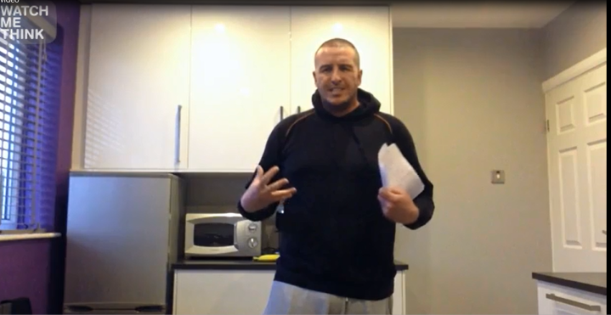
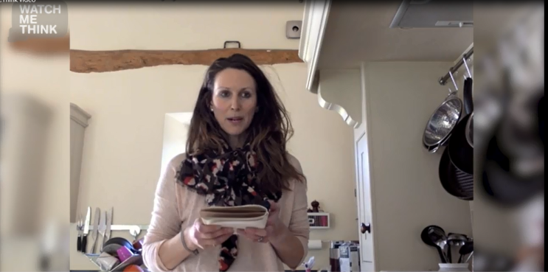
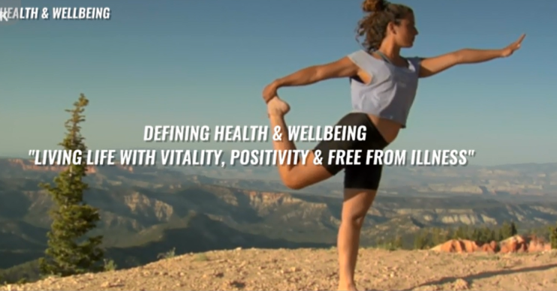
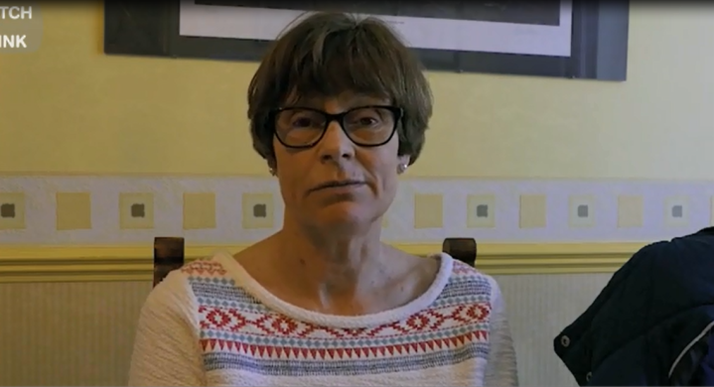
Purpose and Values GSM Activation
Consumer testimonials – Healthier and fuller life
ACHIEVED
Short video testimonials of sufferers from lead countries (USA, BR, FR, DE, RU, JP, AUS, …) explaining how they are approaching their ailements – 4 categories - and what to live healthier, fuller life means for us in terms of expectations, products, services, … from a company with such a purpose.
Notes:
In the same way and linked to consumer insights the CMI ambassadors are also working on the creating short video testimonials interviewing sufferers from lead countries explaining how they are approaching their ailments and what it means to live healthier, fuller life from their perspective, helping us to understand how as a company we can serve them better - this
Our colleagues from CMI led by Muriel has put in place an ambitious program to engage the whole GSM team into discovering and better understanding our consumers, via consumer immersion activities. I have personnally experienced the power to listen our consumers from their home, in Australia recently i attended a couple of in home interviews of consumers suffering from Pain back / muscle -> enlightening in the way

Slide 14
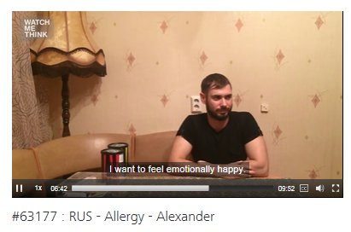
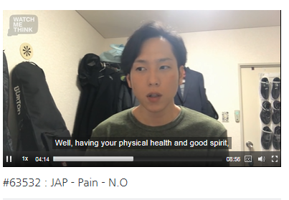
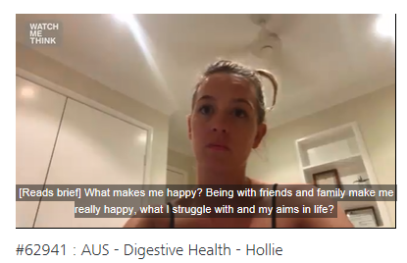
Purpose and Values GSM Activation
Consumer testimonials – Healthier and fuller life
ACHIEVED
Fieldwork for Consumer videos on Purpose and Values has been achieved by the end of 2017.
31 videos uploaded on watchmethink platform.
1 Final 3 min video to summarize consumer views and expectations
Next steps :
Presentation to GSM Team March 12
Share with broader CHC community via P&V website

Slide 15
Purpose and Values GSM Activation
Engagement with NGO
ON GOING
Objective : Live an engaging and meaningful experience serving those who truly need it contributing « modestly » to serve a healthier fuller life.
3 routes explored in parallel to organize pilot and full / half team events during the first half of 2018 with NGO in line with our Purpose & Values.
  1- Paris Croq’ L’espoir : cooking class for sick children in Paris Hospital specialized for Children (Necker and Trousseau) - http://croqlespoir.org/
  2 – Frankfurt BuergerInstitut : set contact with local NGO to support different causes.
https://www.buergerinstitut.de/corporate-volunteering/
3- Paris Siel Bleu an association promoting the mobility of elderly & disabled people through physical activity sessions in homes conducted by professionals - http://www.sielbleu.org/ /

Slide 16
Purpose and Values GSM Activation
Engagement with NGO
Next Steps :
Croq l’Espoir (Paris)
  Pilote : April 16th – 7 people
  Purpose Day with Paris Team : July 18th - around 30 people
Buerger Institut (Frankfurt)
  Meeting March 6th

Slide 17
Thank you
Let‘s live the Purpose and Values together !

