Slide 1
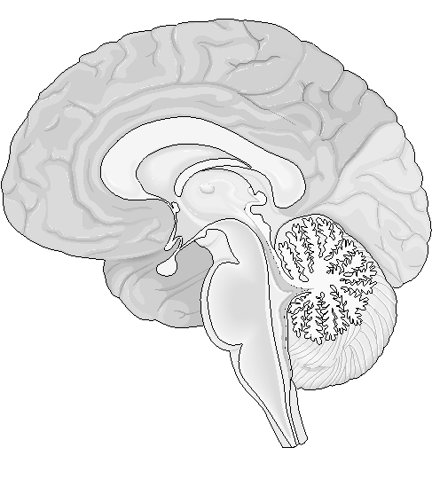
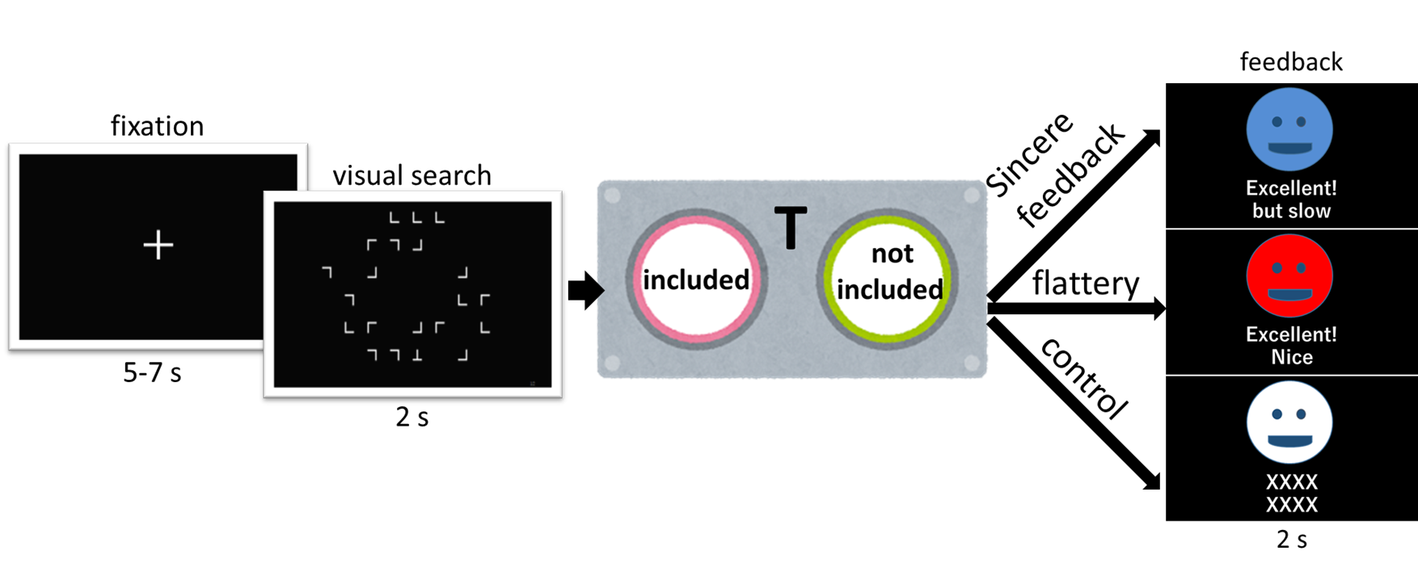
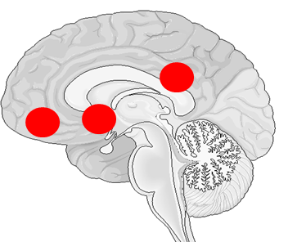
Tell me the truth: the effect of feedback reliability in praise words on neural activation in reward system Shotaro Fujiwara¹ Ryo Ishibashi^{2,3} Azumi Tanabe-Ishibashi³ RyutaKawashima^{2,3} Motoaki Sugiura^{2,3} 1. School of Medicine, Tohoku University, Japan 2. Smart-Aging Research Center, Tohoku University, Japan 3. Institute for Development, Aging, and Cancer, Tohoku University, Japan
Introduction
Methods
Results
Conclusion
Praise, a type of positive feedback in social interaction, is known to activate the reward system in the brain, which involves bilateral nucleus accumbens (NAc), bilateral medial orbitofrontal cortices, and posterior cingulate cortex (PCC). (Liu et al., 2011) Praise, however, does not always reflect the true evaluation by others. While sincere praise is based on the performance or status of the praised person, flattery is not based on such features (Fogg & Nass 1997). Therefore, the reliability of praises could vary from high (sincere praise) to low (flattery). To study if sincere praise and flattery are processed differently in the reward system, we examined the neural activity using functional magnetic resonance imaging (fMRI).
Task
Subjects performed a visual search task to find a letter “T” in “L”s and received different feedbacks that were either dependent on/independent of their performance. (Fig.2)
Stimuli
Visual Search: 144 pictures (alphabets “L” and “T” arranged randomly in an 8 x 6 grid: Half of the trials included the “T” as a target. (Fig.2)
Feedbacks: Face icons in different three colors associated with varying conditions of verbal feedback. (Fig.2)
Procedure
Participants performed 144 trials of visual search tasks in three fMRI sessions and received feedback after each trial. There were three feedback conditions (Sincere feedback, Flattery, and Control). In Sincere feedback condition, mean response time in the previous session/practice phase was utilized as a criterion to modify feedbacks. In Flattery condition, participants were always given the same praising feedback. A string of “X”s was given in Control condition . (Table 1)
After all sessions, subjects answered two questions on each of the three face icons that asked how much sincerity/ flattery they felt with the feedbacks (see Questionnaire below).
The IRB committee of Tohoku University approved the above procedure.
Questionnaire
There were significant differences between the three conditions both in Q1 and Q2 score.
(Fig.3: The statistical differences between conditions were examined with a t-test.)
The current results indicate that the two parts of the reward system (the right NAc and the PCC) respond to verbal praises when the receiver puts trust in the contents of the feedback. These regions, especially the PCC, potentially reflect the value of sincere evaluation of oneself by others, not responding to the superficial meaning of the praise words.
Flattery words, which are not based on the receiver’s performance or status, are not likely to activate the reward system as much as sincere praise. In essence, this indicates that they are not processed as positively as sincere reward.
In general, words with superficial meaning cannot have profound meaning at the same time. The current results indicate that the superficiality of the feedback is indeed associated with different degrees of brain activations.
Although the present study only focused on the particular words for praises/feedbacks, the superficiality of words or other social (even non-verbal) expressions, in general, may also be processed in the same parts of the reward system. Further study is needed to elucidate the role of these regions during sincere and flattery social communications.
**
**
**
**
Q1 score; perceived reliability
Q2 score; perceived flattery
sincere feedback
flattery
control
sincere feedback
flattery
control
Flattery has been used for a long time.
Fig.3 The mean scores of Q1 (left) and Q2 (right)
**p < 0.01
ROI analyses
The ROI analyses showed that the PCC and the right NAc were activated when subjects received sincere feedbacks, but not when they received flattery. (Fig.4)
**
Questionnaire (asked repeatedly for the three conditions)
(8-point Likert scale: strongly disagree 1 – 8 strongly agree)
Q1; “Did the feedbacks depend on your performance?” (feedbacks’ perceived reliability)
Q2; “Did you feel flattered when this face gave you feedbacks?” (perceived flattery)
The Emperor's New Clothes；a fairy tale by Andersen
Flattery does not work as sincere praise in our brain.
Flattery does not activate our reward system as much as sincere words.
Oh! How beautiful our Emperor's new clothes are!
sincere feedback
flattery
**p < 0.01
push
PCC
*
Medial OFC
Right &Left: n.s.
Flattery
But the Emperor isn’t wearing anything!
Fig.2 time course of an event
We adopted an event-related design.
NAc Left: n.s.
Fig.4 the activation in the reward system
“The Emperor was vexed, for he knew that the people were right”
sincere feedback
flattery
Sincere feedback
Table.1 Verbal feedbacks given in the three conditions (Sincere feedback/Flattery/Control)
*p<0.05
Performance | Sincere feedback (based on the performance) | Flattery (NOT based on the performance) | Control
Fast (RT< mean RT in the previous session) | "Excellent! Nice!" | "Excellent! Nice!" | "XXXXXXXX"
Slow (RT > mean RT in the previous session) | "Excellent! But slow."
False answer | "Incorrect."
No answer (time up) | "Time up"
NAc Right
The Emperor's New Clothes；a fairy tale by Andersen
Does flattery work similarly to sincere praise in our brain?
Does flattery activate our reward system?
The below scatterplot (Fig.5) shows the relationship between the activation in the PCC and the degree of the perceived sincerity in the ‘sincere’ feedbacks (compared to flattery). Among the five ROIs, the correlation was significant in the PCC activation only (r=0.43 p<0.01). This indicates that this part of the reward system represents the value of verbal feedbacks from others in relation with one’s own subjective evaluation of their task performance.
Please give me your “sincere” opinion about this study.
PCC [0,-22,32]
Participants
32 students in Tohoku University (11 females). Mean age:21.2.
All subjects gave informed consent before their participation.
The difference of β contrast value (sincerity feedback – flattery )
Reference
Bilateral NAc (Right[12,10,-6] & Left[-10,8,-4])
Andersen H. C., (1837) The Emperor’s New Clothes. Retrieved March 9, 2020, from http://ponce.sdsu.edu/the_emperors_new_clothes.html.
Fogg, B.J., Nass, C., 1997b. Silicon sycophants: the effects of computers that flatter. International Journal of Human Computer Studies 46, 551–561.
Liu X, Hairston J, Schrier M & Fan J 2011 Common and distinct networks underlying reward valence and processing stages: a meta-analysis of functional neuroimaging studies. Neurosci Biobehav Rev. Apr; 35(5):1219-36.
Fig.1 The centers of five sphere ROIs in the reward system. NAc: nucleus accumbens, OFC: orbitofrontal cortices, PCC: posterior cingulate cortex.
Analysis
Region of interest (ROI) analyses were carried out. The ROIs were determined by a large-scale meta analysis of the neuroimaging studies that reported reward-related neural activities. (Fig.1 ; Liu et al., 2011). We examined the activation difference between conditions in these ROIs, as well as the across-participant correlations between the activation of the ROIs and the scores from the questionnaire.
Q1 score(sincere feedback – flattery ):perceived feedbacks’ reliability
“The feedbacks depended on my performance.”
Bilateral Medial OFC
(Right[2,48,-14] & Left[-2,56,-6])
Fig.5 Correlation between the activation in the PCC and the feedbacks’ reliability

