Slide 1
The American College of Thessaloniki
Forum on Education Abroad Conference 2020
01

Slide 2
Who are we?
Mission
Our Student Population
Why ACT?
Thessaloniki
Academics
Community
Who We Partner With
Interested in Partnering?
Contact Information
Presentation Overview
02

Slide 3
ANATOLA COLLEGE
Anatolia College, a K through MBA educational institution, has been serving students in the region since 1886 and in Thessaloniki since 1924.
Who Are We?
ACT- THE AMERICAN COLLEGE OF THESSALONIKI
ACT- The American College of Thessaloniki is the post-secondary division of Anatolia College, an institution dating back to 1886. With its exceptional location, multinational student population, and vibrant community, it stands as the largest study abroad program for US students in Greece.
03
ACCREDITATION
ACT is accredited in the United States by NECHE (New England Commission of Higher Education) and the undergraduate programs delivered at ACT are also validated by Open University, UK

Slide 4
Drawing on the principles of the American liberal Arts educational philosophy we foster depth and breadth of knowledge, grounded on theory, scholarly research, and intellectual freedom. Our faculty members are passionate about teaching, value close relationships with our students, and strive to instill in them the desire to pursue academic and professional excellence and personal enrichment.
Paramount to our mission is our institution’s contribution to society by cultivating students’ democratic and civic awareness, enhancing a sense of individual and social responsibility, and creating a spirit of esteem for others, social institutions, and the environment.
Our Mission
04
OUR VALUES
Academic & Professional Excellence
Critical Thinking
Personal Enrichment
Respect & Responsibility
Appreciation of Diversity

Slide 5
Our Student Population
We have around 600 students who study at ACT to include our degree-seeking students and our study abroad students who study with us in the fall, spring, summer, or for an academic year.
Study Abroad Students
45%
Degree-seeking Students
55%
05

Slide 6
Other
3.8%
Southeast Europe
12.3%
Countries Represented
United States & Canada
44.8%
Out of our 600 students, we have over 25 countries represented on campus, making our multinational community an exceptional fit for students that really want to "live like a local".
Greece
39.2%
Southeast European Countries to include: Albania, Bulgaria, Croatia, Kosovo, Montenegro, The Republic of North Macedonia, Serbia
Other Countries to include: Armenia, Brazil, China, Congo, England, Georgia, Germany, Ireland, The Netherlands, Nigeria, Pakistan, Romania, Russia, Sweden, Syria, Turkey
06

Slide 7
Why ACT?
07
LOCATION
ACADEMICS
COMMUNITY
ACT's 60 acre campus, just minutes away from downtown Thessaloniki, provides students with a safe, beautiful campus to call home, but they're close enough to explore and venture into the vibrant city. It truly is the best of both worlds!
A true leader in academic excellence, ACT provides an active approach to academic learning that engages students within the classroom, and also immerses them into the world with hands-on experiential learning opportunities.
At ACT, we provide personalized attention from the moment our students apply to when they become alumni. Our small, tight-knit community allows each student to have a voice and make a difference on campus, and continue to develop as global citizens even after they depart from campus.

Slide 8
Thessaloniki
08
OFF THE BEATEN PATH
While Greece is a popular travel location, most travelers frequent our nation's capital, Athens, or the picturesque Aegean islands. Thessaloniki is Greece's hidden gem, a port city, paired with the hustle and bustle of downtown--making it the best of both worlds. Though it is Greece's second largest city, it is ideal for students who want to truly live like a local, especially with the student apartments located downtown..
HISTORY
Founded in 315 B.C., Thessaloniki is a true crossroad between East and West. With influence from the three empires that ruled it, the Romans, Byzantines, and Ottomans, and Christian, Jewish, and Muslim religions, it is no surprise that Thessaloniki has over 12 UNESCO world heritage sites. Thessaloniki is an exceptional city, where ancient meets modern, and students will never stop learning.
COLLEGE TOWN
Thessaloniki is Greece's largest college city, with over 100,000 university students, where 1 out of every 10 residents is a student. Downtown Thessaloniki is where the heart of youth beats, filled with restaurants, hip cafes, exciting night life, and elegant shops, making it an ideal city for students all over the world!

Slide 9
ACADEMICS
UNDERGRADUATE & STUDY ABROAD
09
BUSINESS ADMINISTRATION
COMMUNICATIONS & ENGLISH
COMPUTER SCIENCE & MATH
PSYCHOLOGY
POLITICAL SCIENCE & INTERNATIONAL RELATIONS
General Psychology
Development Psychology
Psychophysiology
Social Psychology
Research Methods
Forensic Psychology
International Business & Finance
Tourism
Entrepreneurial Management
Marketing
Human Resource Management
Business Law
Economics
Language & Literature
Communication & New Media
Lingustics
Teaching English as a Second Language
Business/Professional Communication
Computer Science
Business Computing
Programming
Databases & Modelling
Computing Systems & Networks
Web & Mobile Applications
Mathematics
Sea Sailing
Nutrition
Political Science
International Relations
Diplomacy
Foreign Policy
European Studies
Modern Greek Language
Politics
Human Rights
www.act.edu/business
www.act.edu/english
www.act.edu/computing
www.act.edu/psychology
www.act.edu/ir

Slide 10
ACADEMICS
GRADUATE COURSES
10
MBA - BUSINESS ADMINISTRATION
MS IN HOSPITALITY AND TOURISM MANAGEMENT
MS IN INDUSTRIAL ORGANIZATIONAL PSYCHOLOGY
Program Concentrations:
Corporate Finance
Operations Management
Applied Statistics & Quantitative Methods
Strategic Management
HR in Hotel & Tourism
Hospitality Management
Marketing for Tourism
Revenue Management
Events Management
Destination Management
Tourism E-Business
Industrial/Organizational Psychology
Applied Statistics for Business Decisions
Psychological Testing & Measurement
Psychology of Group Dynamics
Organizational Leadership & Change
Positive Psychology & Well-being Coaching
Conflict Management & Resolution
Emotional Intelligence in the Workplace
Banking and Finance
Entrepreneurship
Management
Marketing (in the Digital Era)
https://www.act.edu/academics/graduate-studies/

Slide 11
Academics
COMBINED DEGREES WITH
US INSTITUTIONS
COMBINED DEGREES WITH
EU INSTITUTIONS
ACT has exclusive partnerships with leading EU and US universities and colleges in their respective fields, offering degree-seeking students the opportunity to gain international experience while completing their studies abroad.
Dual Degrees in Engineering
3+2 Program with Washington University in St. Louis, MO
3 +3 Program with Washington University in St. Louis, MO
BS in Business Administration
2+2 Program with American University in Washington, DC
BBA in Sports Management
2+2 Program with St. Thomas University in Miami, FL
BA in Political Science
2+2 Program with St. Thomas University in Miami, FL
LL.M in Intercultural Human Rights
4+1 Program with St. Thomas University in Miami, FL
BS in International Business in Hotel and Tourism Management
2+1 Program with César Ritz Colleges Switzerland
Swiss Higher Diploma in International Hotel Management
2+1 Program with Hotel Institute Montreux Switzerland
11
https://www.act.edu/academics/combined-degrees

Slide 12
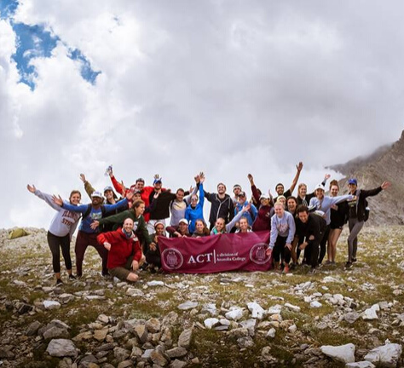
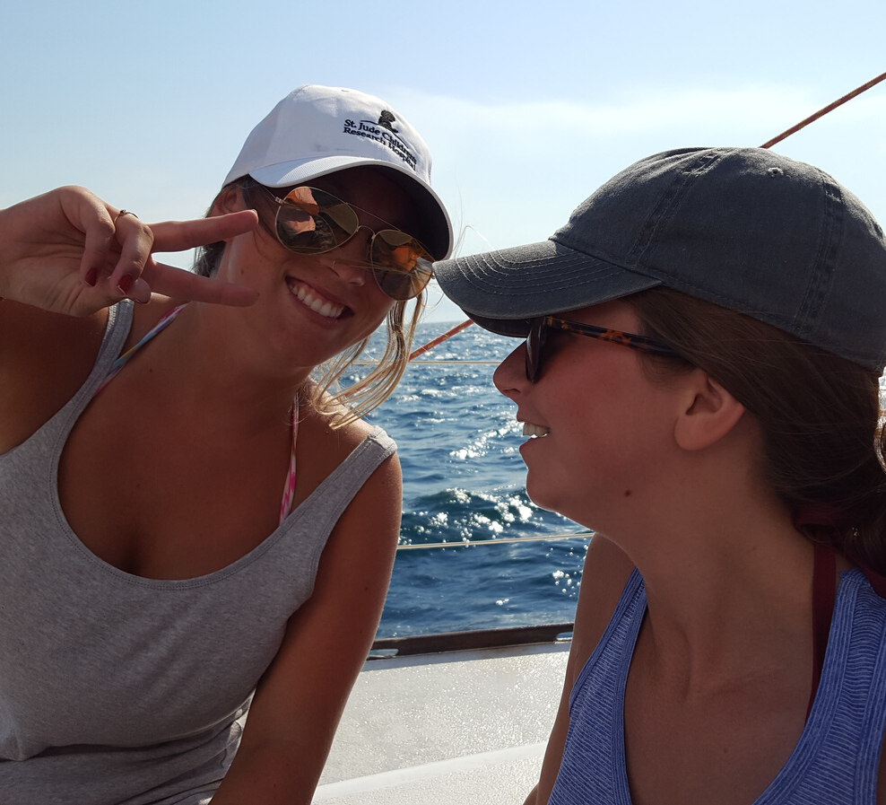
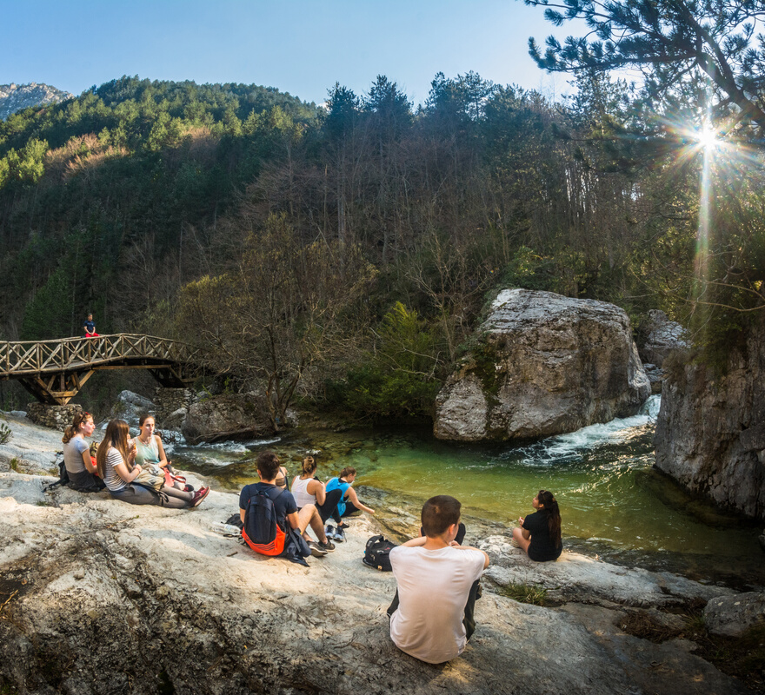
EXPERIENTIAL LEARNING
12
INTERNSHIPS/PRACTICUMS
Each major at ACT can include an internship or practicum as an active approach to academic learning that engages students in a hands-on learning experience. Additionally, students build a global professional network before they even graduate.
SERVICE LEARNING
ACT has one of the largest service learning programs in Greece, in collaboration with 40+ NGOS, providing students with the opportunity to volunteer and give back to the community, while gaining a global perspective.
EXCURSIONS
Our students can experience hassle-free travel around Greece alongside ACT classmates and staff. We include a program trip to Athens, Delphi, and Vergina, as well as optional trips to include: the monasteries of Meteora, hikes on Mt. Olympus, dipping into the Pozar hot springs, or sailing around the Aegean sea on a private sailboat.

Slide 13
WARM HOSPITALITY
Community
Greece is known for their hospitality, and once you join the ACT community, you'll understand why. We strive to make new students and staff feel welcoming and build a community that they will forever want to be a part of.
13
PERSONALIZED ATTENTION
Our average class consists of less than 20 students, which means that within the classroom, students are more than just a number. Additionally, our Program Staff and RAs work hard to get to know each student and provide them with guidance about ACT and Thessaloniki.
MULTI-CULTURAL ENVIRONMENT
Students, faculty, and staff come together from various backgrounds and promote learning through many perspectives. Since our campus is made up of 50% international students, it is an exceptional environment for the globally-minded student.

Slide 14
Who We Parter With
ACT is proud to partner with the following colleges, universities, and study abroad program providers:
Albion College • *American University (DC) • Babson College • Bentley University
• Butler University • Capacity Building International (CBI) • *Case Western Reserve University • Charleston Southern University• *Chonnam National University (South Korea)
• Claremont McKenna College • College of Staten Island • Concordia University of Irvine
• Consortium for Global Education (CGE) • DePauw University • Eastern Illinois
University • George Mason University • *Georgian Court University • Illinois State University
• Indiana State University • International Student Exchange Programs (ISEP) • Iowa State University • *John Cabot University(Rome, Italy) • Lorain County Community College
• Marymount Manhattan College • Merrimack College • Michigan State University
•Monmouth College • Northeastern University • Ohio University Athens •*Pace University
• Park University • Pennsylvania Center for International Exchange and Partnership (PCIEP)
• Rutgers University • Salve Regina University • Simmons College •*St. Louis University (Madrid, Spain)• St. Thomas University •*Suffolk University • Texas Tech University
• The College of Staten Island • The College Consortium for International Studies (CCIS)
• University of Hartford • University of Illinois at Chicago • University of Iowa •*University of Mississippi •University of Mount Union • University of New Hampshire • University of North Dakota •*University of Northern Florida •*University of Northern Iowa • University of Scranton • University of South Florida • *University of Texas at San Antonio •*University of Wisconsin - Eau Claire • *Upper Iowa University
14

Slide 15
OUR COLLABORATION
DOWNLOAD OUR BROCHURES
15
Need more information? Take a look at our degree-seeking and study abroad brochures for more in-depth information about our program.
We welcome the possibility of partnering with new colleges, universities, or study abroad program providers. We know that in collaboration with other schools, we will be able to provide even more opportunities for our students and build global citizens.
REVIEW OUR COURSE OFFERINGS
What types of courses can your students take? Download our course offerings and review the course descriptions. We are certain that there are a plethora of courses that would fulfill major and general education requirements, as well as particular niche courses that students will be excited to take while abroad.
CONTACT US
If you think our organization would be a good fit, or you'd like to ask us more questions, please do not hesitate to reach out! We'd be happy to answer your questions and hopefully build a new partnership.

Slide 16
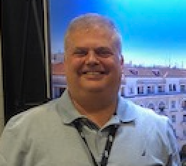
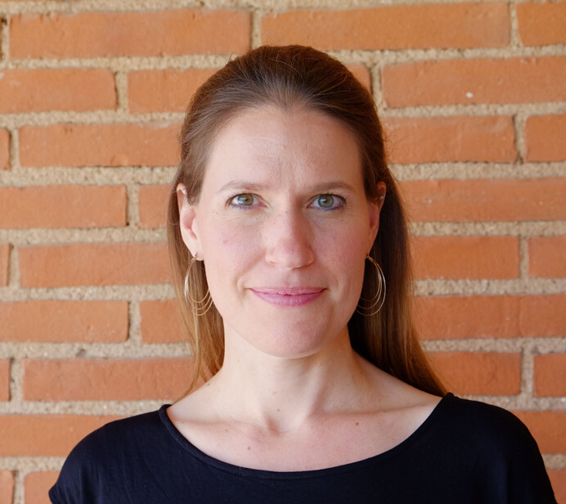
EMMANUEL MAOU
Director of Enrollment
emaou@act.edu
For any inquiries for organizations outside of North America
Contact
VANESSA CONSTANTINIDIS
Associate Director of Enrollment
vancon@act.edu
16
For any inquiries for organizations in North America
HEATHER FUNK
Director of International Programs
heather@act.edu
For any inquiries in regard to partnership agreements

Slide 17
Thank you!
Let us know if you havequestions or concerns.
We hope to welcome you to Thessaloniki soon!

