Slide 1



o
OSEP 2015 Project Directors’ Conference
Sharon Raimondi, Project Director
University at Buffalo
raimondi@buffalo.edu
http://gse.buffalo.edu/org/sped/
Notes:
Preparing leaders for the digital age is an OSEP funded leadership project. It is a joint doctoral program operated by the University at Buffalo and Buffalo State. Our goal today is to share the basic principles that drive this project now in its last year.

Slide 2
begin with a vision
Notes:
We first began with a vision. Leadership personnel are the driving force behind the excellence of teacher preparation programs. The field needs more faculty, but what attributes should these individuals possess to effectively serve as leaders, researchers and teachers in the 21st century?

Slide 3

think
outside
the box
Notes:
This requires one to think outside the box. Technology affords numerous possibilities as a catalyst for transforming education. While 90% of children “participate fluidly in online, interactive digital environments, and virtual spaces; many of our faculty do not. Since the role of technology has become paramount in the personal lives of today’s students, it is imperative to integrate technology into the educational environment. Technology is integrated into all our our doctoral courses as well as into our teacher preparation courses. We embrace the TPACK framework in that technology must not be separate from, but rather, must enhance existing content and pedagogy.

Slide 4
Select Scholars Wisely
http://eofdreams.com/chocolate.html
Notes:
Given limited funding, how do you select 6 doctoral scholars from a pool of 90? How do you select those with the greatest potential? And those with the greatest promise? In addition to traditional measures – GREs, GPA, writing samples, we were looking for dynamic individuals, who were not only intelligent, but also tech savvy and curious. From 90 we narrowed the pool to 20, conducted interviews and selected our final 6.

Slide 5
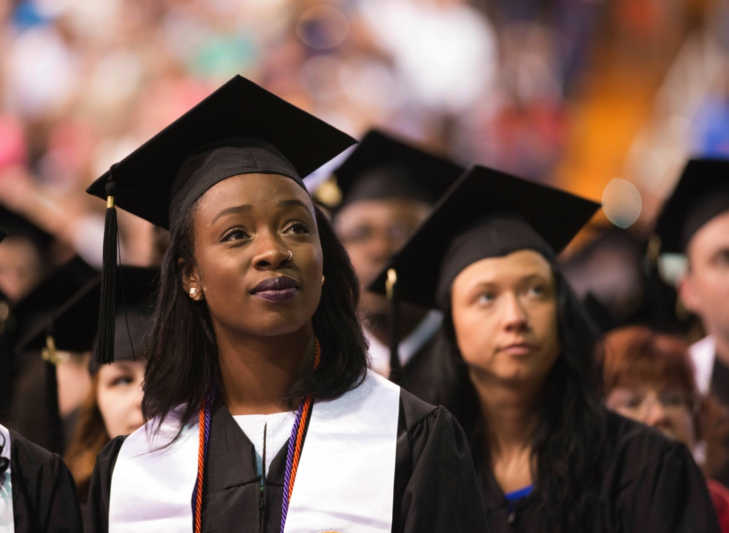
Prepare for
Success!
Prepare for Success
must FINISH in 2015
Notes:
Once selected, our challenge was to prepare them for success. We’ll share a few strategies. The first step was to create a sense of community. We used a cohort model. For the first two years, they were joined at the hip – experiencing all aspects of their personal and programmatic lives together. Goal setting is very important. Timelines were created - MUST FINISH in 2015! Became the mantra. They will finish this May, four are already employed.

Slide 6

Equip with Multiple Tools
http://www.bing.com/images/search?q=technology+based+tools&qs=n&form=QBIR&pq=technology+based+tools&sc=8-21&sp=-1&sk=#view=detail&id=898C23458146DD6A5328D7CF051357D9433FAF29&selectedIndex=7
Notes:
To serve as digital leaders, scholars needed tools. Each year scholars selected individual tools to assist them in research, we began with smart pens and ipads. Later we added ipods, netbooks, and more memory!

Slide 7
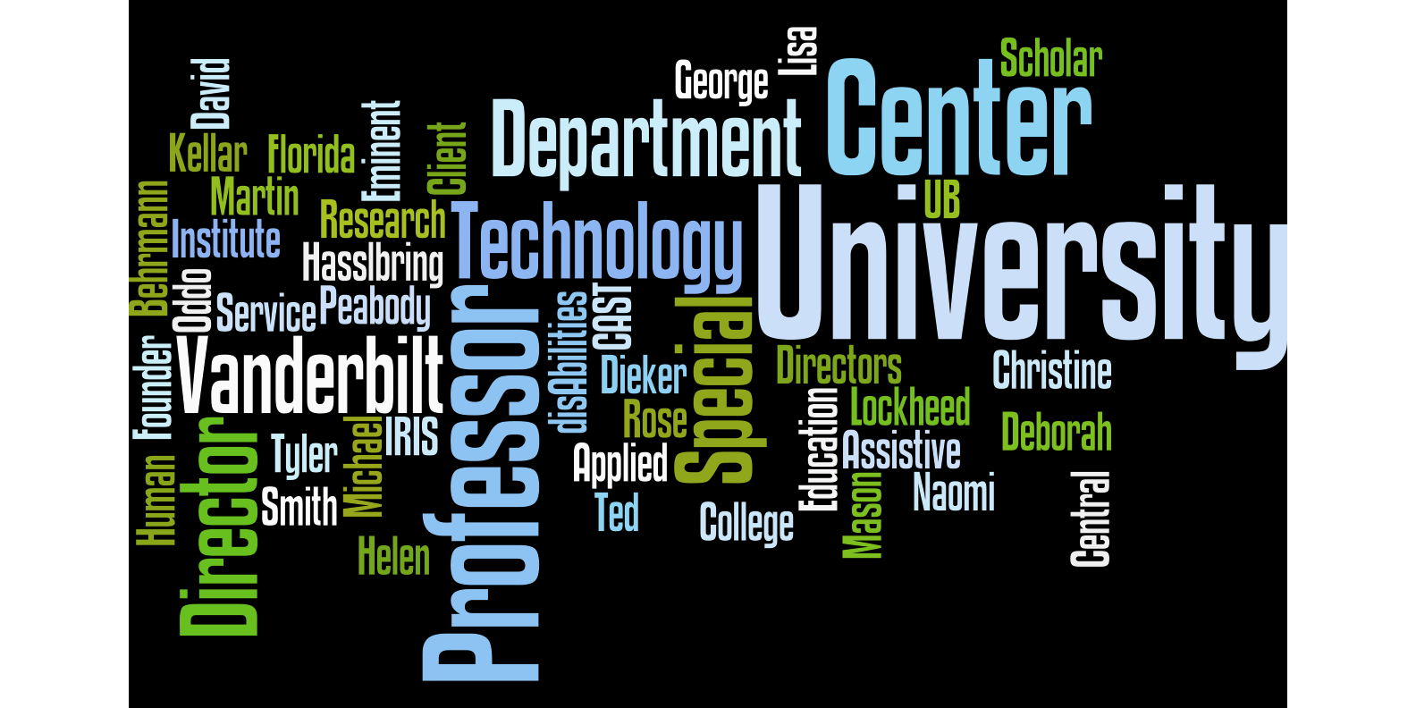

Notes:
As a small program, we reached out to others within and outside of the university. Our advisory board members Lisa Dieker, Michael Behrmann, and Ted Hasselbring are very generous with their time. Many others have also joined this noteworthy group.

Slide 8
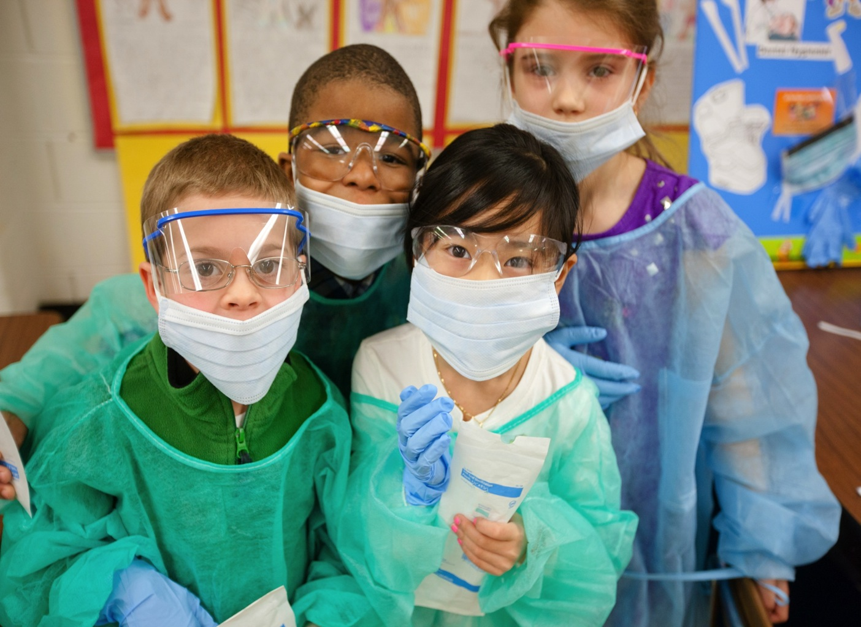
Provide Internships and Research Opportunities
Notes:
Yearly scholars complete a tech internship. These included working with Skip Stahl at CAST, working with an international video coding software company - studiocode, and a host of other enriching opportunities. As part of the grant requirement, scholars conducted research in a high needs low performing district exploring the use of an online Explicit Instruction math program and conducted an exploratory pilot study of an iPad-based intervention they coined “eWorkbook.

Slide 9
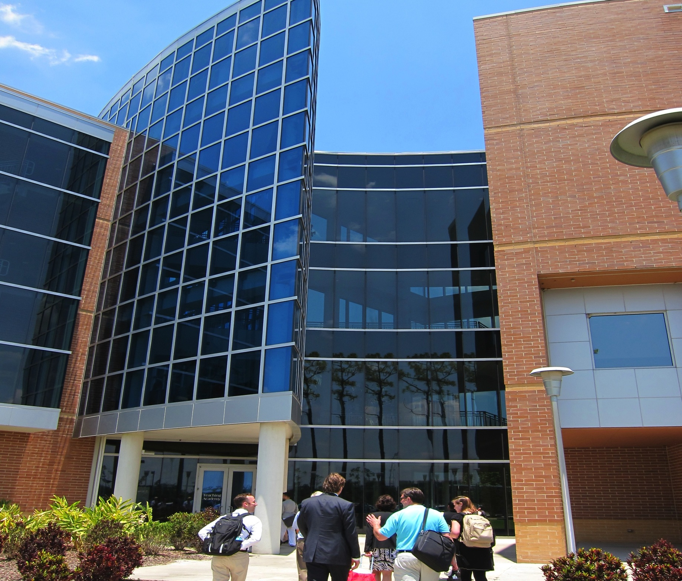

Summer Institutes
Notes:
The summer institutes are a highlight of this program. Traveling to the experts we explore innovation first hand. At the University of Central Florida. Dr. Lisa Dieker and her colleagues shared their work with teachlive and other innovations. Doctoral scholars at both institutions exchanged research ideas quickly forming lasting partnerships. We visited with the University of Kentucky where Dr. Margaret Bausch immersed us in AT. Our last visit was with Dr. Behrman from George Mason who also shared his expertise.

Slide 10
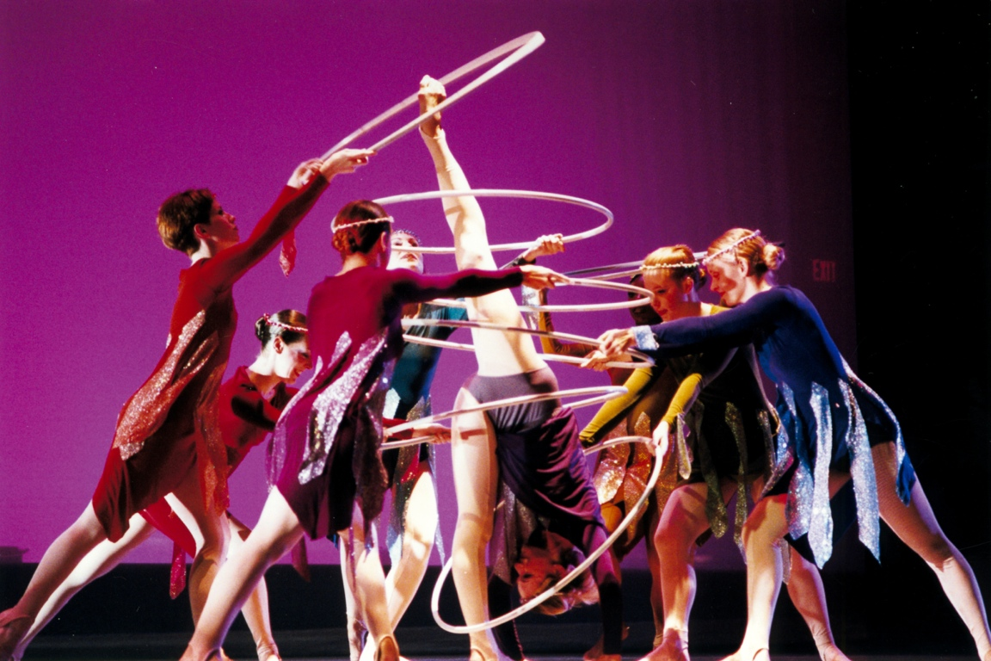

Communication
Notes:
Communication with all stakeholders is key to our success. Scholars meet weekly as a cohort and individually as necessary. They share their expertise with new cohort members perpetuating knowledge and sustaining the long term effects of this project.

Slide 11


This project was completed and funded as a technology internship by the US Department of Education, Office of Special Education Programs #HD 325D100026.
This project is supported by the U.S. Department of Education, Office of Special Education Programs (OSEP). Opinions expressed herein are those of the authors and do not necessarily represent the position of the U.S. Department of Education.
Notes:
Our doctoral scholars are leaders in the digital age making a big splash the field of special education. This project is supported by the U.S. Department of Education, Office of Special Education Programs (OSEP). Opinions expressed herein are those of the authors and do not necessarily represent the position of the U.S. Department of Education. A special thanks to Terry Jackson, our project director.

