Slide 1
Project SEED: A community-based birth-to-three undergraduate teacher education sequence
Project SEED
A community-based birth-to-three undergraduate teacher education sequence
Adam S. Kennedy akenne5@luc.edu
Anna T. Lees amorrish@luc.edu
Loyola University Chicago

Slide 2
Shifts in the focus of preparation of effective ECSE teachers
Background
Shift from preparation to engagement with the profession (Darling-Hammond & Baratz-Snowden, 2004)
Failures: linking theory and preparation to context and continuum of teachers’ lives (AACTE, 2010; Rust, 2010)
‘21st Century’ challenges require new approaches

Slide 3
TLLSC Study Focus: Universal preparation program and ECSE program
The present study
Universal preparation program
Designed around levels of teacher development
8 Field-based sequences over four years
Birth to grade 12 experiences for every candidate
Professional Learning Communities
ECSE program
Fully blended
IL teaching license with endorsements in ECE, ECSE, and ESL
State PD system credentials
EI credentialing

Slide 4
Features of the TLLSC Program and Goals for Continued Evolution
Features of this program and goals for our continued evolution
(Kennedy & Heineke, 2014)
4

Slide 5
Sequence 4 in Phase 2: Concentration of the TLLSC Study

Slide 6
Method: Inclusive Early Head Start Module
Paired placements in EHS classrooms
3 mornings each week for 6 weeks
4 ½ to 5 hours each visit
Candidate plan and lead routines and semi-structured activities
Video feedback system including peer groups
Co-mentored by teachers and faculty
Formative narrative and quantitative feedback weekly
CLASS (LaParo et al, 2012) used as outcome measure

Slide 7
Method: Tiered approach to candidate supports
Universal curriculum
Module itself and feedback mechanisms
Targeted supports
Candidates who did not make progress by week 2
Tailored to individual needs
Intensive supports
Candidates who failed to respond
Candidates who have difficulty later in the sequence

Slide 8
Results: Teacher candidate pre/post CLASS scores (N=13 female undergraduate ECSE candidates)
CLASS Dimension | Mean score at pretest (SD) | Pre range | Mean score at posttest (SD) | Post range | t (p)
Positive Climate | 4.13 (1.02) | 2-5 | 6.69 (0.48) | 5-7 | 10.41 (.000)*
Negative Climate | 5.85 (1.21) | 4-7 | 6.92 (0.28) | 6-7 | 3.09 (.009)
Teacher Sensitivity | 4.23 (0.93) | 3-5 | 6.38 (0.77) | 5-7 | 7.87 (.000)*
Regard for child perspectives | 4.36 (1.36) | 3-6 | 6.36 (0.67) | 5-7 | 6.06 (.000)*
Behavioral Guidance | 4.20(1.14) | 3-6 | 6.20 (0.79) | 5-7 | 5.07 (.001)
Facilitating Learning and Development | 3.85 (1.07) | 2-6 | 5.69 (0.75) | 5-7 | 8.31 (.000)*
Quality of Feedback | 3.27 (1.19) | 2-5 | 5.91 (0.70) | 5-7 | 9.46 (.000)*
Language Support | 3.23 (1.36) | 2-6 | 6.08 (0.64) | 5-7 | 9.61 (.000)*
Table 1
*p < .001

Slide 9
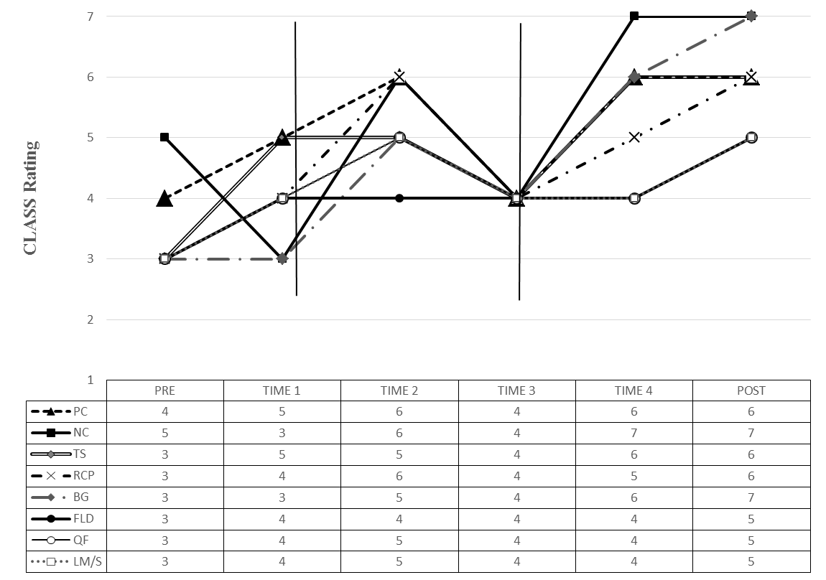
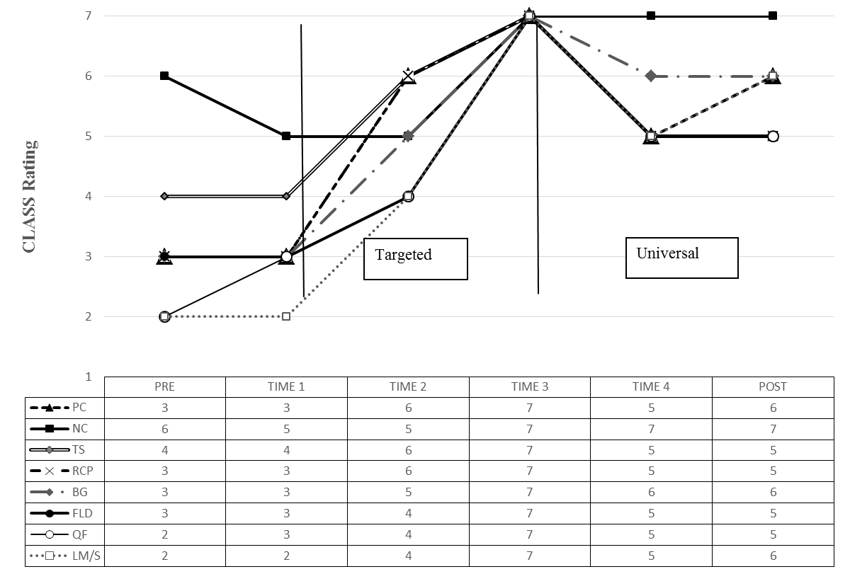
Candidate progress with universal program
Results, continued
Candidate progress with intensive supports
Candidate progress with targeted supports
Intensive

Slide 10
Conclusions
Positive results for development of DAPs in inclusive infant-toddler settings
Candidates already enter Sequence 4 with strong skills
Promising results for candidates still early in their preparation
Redesigned universal program and tiered supports were effective for each candidate

