Slide 1
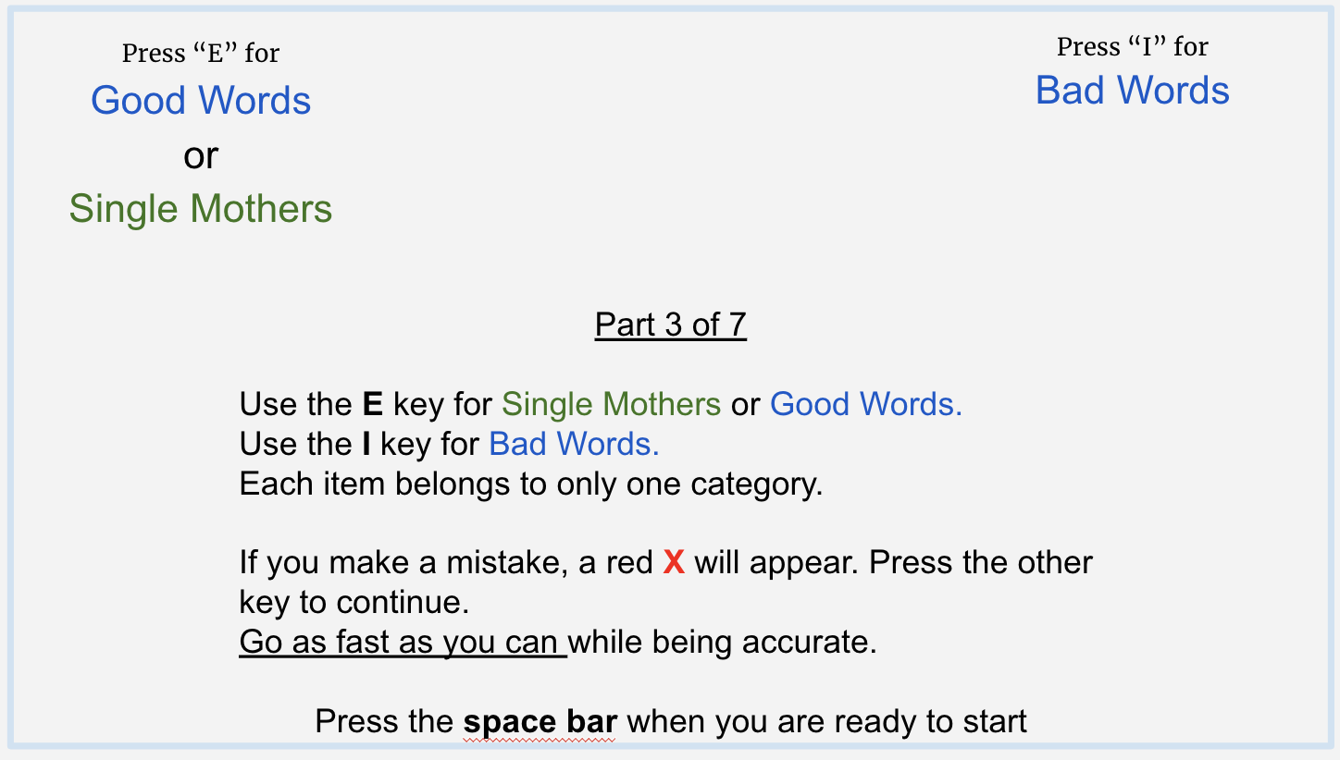
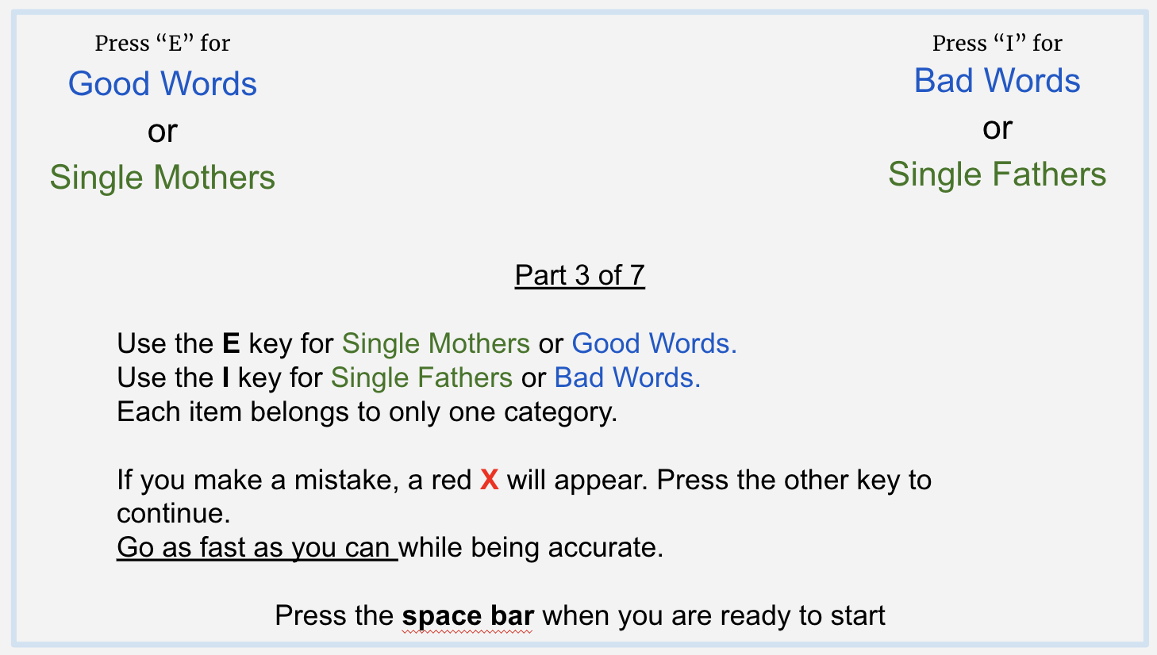
Using the Implicit Associations Task to Investigate Implicit Bias Towards Single Parents
Mary Cassidy, Lane Berisford, Michael Andreychik, & Shannon Harding
Fairfield University
Background
Measure of explicit attitudes: Participants also completed a single-item measure of explicit preference for Single Mothers compared to Single Fathers
Discussion
Implicit attitudes are spontaneously activated evaluations toward an attitude object, while explicit attitudes are conscious attitudes that are formed deliberately. Research examining the degree of correspondence between implicit and explicit attitudes suggests at least some degree of discrepancy between people’s implicit and explicit attitudes (Forscher, et al., 2019). Although existing research has examined implicit attitudes in a wide range of domains, to our knowledge no studies have been conducted examining implicit and explicit attitudes toward single parents.
The present study aims to contribute to existing literature on implicit attitudes by examining the extent of implicit bias toward single parents, as well the degree of correspondence between implicit and explicit attitudes toward single parents.
Recent years have seen a great deal of research on implicit attitudes. This research has consistently shown only small correlations between people’s implicit and explicit attitudes. To date, no research exists examining implicit attitudes toward single parents.
Study 1 showed that people hold more positive implicit associations with Single Mothers than with Single Fathers.
Study 2 showed that the reason for participants’ implicit preference for Single Mothers is that people have positive implicit associations with Single Mothers, but neutral implicit associations with Single Fathers. And, consistent with past work, both studies showed almost no correlation between implicit and explicit attitudes toward single parents.
Future work is needed to better understand the source of people’s implicit attitudes toward single parents as well as how (and whether) these attitudes might relate to behavior.
Study 1 Results
We found that participants showed stronger automatic associations between Single Mothers and Positive (and Single Fathers and Negative) than between Single Mothers and Negative (and Single Fathers and Positive), t(162)=-1.74, p=.08, d=-.14.
However, participants did not show an explicit preference for Single Mothers relative to Single Fathers, t(162)=-.62, p=54, d=-.05.
In addition, there was a weak and non-significant correlation between participants’ implicit and explicit preferences for Single Mothers relative to Single Fathers, r(162)=0.03, p=.71
Measure of explicit attitudes: Participants also completed measures of their feelings toward Single Mothers and, separately, toward Single Fathers.
Study 2 Results
Our results indicated that participants displayed neutral associations with Single Fathers,
t(99)= -.32, p=.75, d=-.03, but that they displayed positive associations with Single Mothers,
t(99)= 3.44, p<.001, d=.34.
In addition, there was no difference between participants’ absolute feelings toward Single Fathers and Single Mothers, t(99)=.56, p=.58, d=.06.
There were weak and non-significant correlations between participants’ implicit and explicit attitudes toward both Single Fathers, r(99)=.09,p=.36, and Single Mothers, r(99)=-.17, p=10.
Study 1 Method
Stronger Association between Single Mothers and Negative (and Single Fathers and Positive)
Participants: 163 participants (approximately half men and half women) drawn from Amazon’s Mechanical Turk
Measure of implicit attitudes: Participants completed an Implicit Association Test (IAT; Greenwald, McGhee, & Schwartz, 1998) that measured the strength of their automatic associations between the concepts “Good” and “Bad” and the categories “Single Mother” and “Single Father”
References
0 = Neutral
← Associations →
Forscher, P. S., Lai, C. K., Axt, J. R., Ebersole, C. R., Herman, M., Devine, P. G., & Nosek, B. A. (2019). A meta-analysis of procedures to change implicit measures. Journal of Personality and Social Psychology, 117(3), 522-559. https://doi.org/10.1037/pspa0000160
Greenwald, A. G., McGhee, D. E., & Schwartz, J. L. K. (1998). Measuring individual differences in implicit cognition: The implicit association test. Journal of Personality and Social Psychology, 74(6), 1464-1480. https://doi.org/10.1037/0022-3514.74.6.1464
Stronger Association between Single Mothers and Positive (and Single Fathers and Negative)
Implicit associations
were marginally
different from neutral (p=.08)
Study 2 Method
More Positive Associations
Funding for this project generously provided by: The Brinkman Family Foundation, the Fairfield University Science Institute, and the Katherine B. Trainor Psychology Fellowship
Participants: 106 participants (approximately half men and half women) drawn from Amazon’s Mechanical Turk
Measure of implicit attitudes: All participants completed the Single Category Implicit Association Test (SCIAT; ) which measured associations between the concepts ”Good” and “Bad” and only one category (e.g., “Single Mother”) at a time.
0 = Neutral
← Associations →
Implicit associations
with Single Mothers
were significantly
more positive than
neutral (p<.001)
Implicit associations
with Single Fathers
did not differ
from neutral
More Negative Associations

