Slide 1
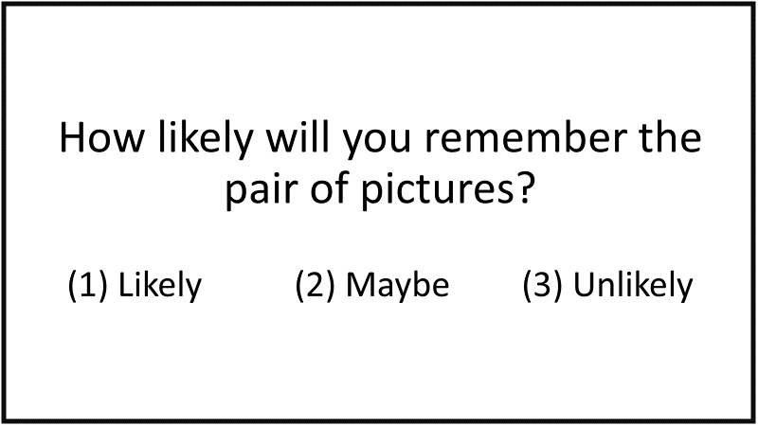
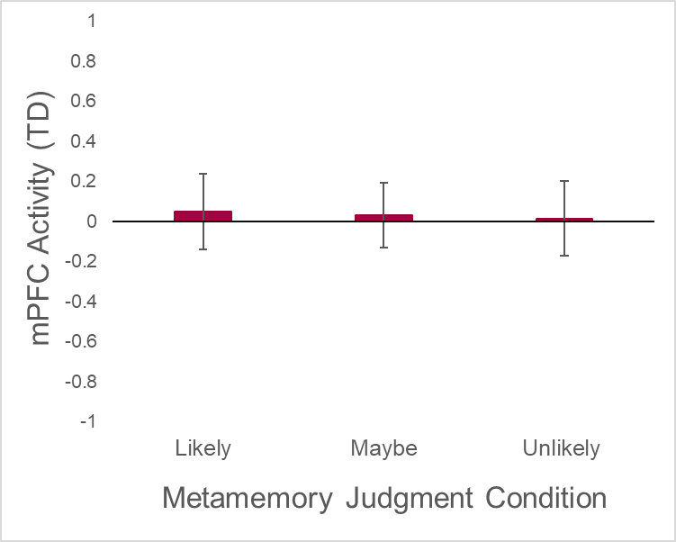
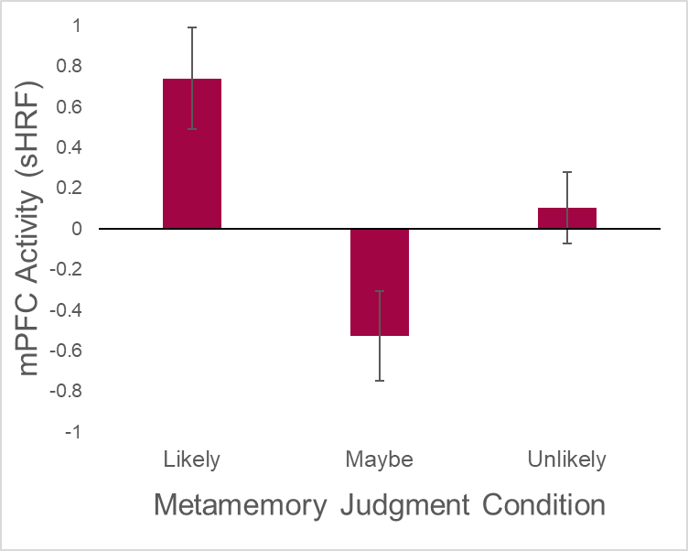
Clarifying the role of the Medial Prefrontal Cortex During Metacognition: Revelations from a “Maybe” Judgment
Hillary Erwin¹, Tasnuva Enam¹, Deborah Eakin², & Ian McDonough¹
The University of Alabama¹, Mississippi State University²
Introduction
Method
Whole Brain Results
Metacognition refers to awareness of one’s own knowledge and one’s ability to understand, control, and manipulate one’s cognitive processes. One common way to measure metacognition is to directly ask people to predict their current learning state via judgments of learning (JOLs). JOLs are metamemory predictions about how likely an individual believes they will later remember information.⁶
Few studies have addressed the neural correlates involved in the cognitive process of making JOLs. The investigation of neural correlates involved when individuals give JOLs is important when aiming to understand the underlying cognitive processes and why some people make poorer metacognitive judgments than others.
The small pool of prior research suggests that the Default Mode Network (DMN) is involved when making JOLs. In particular, much of the research has consistently implicated the medial prefrontal cortex (mPFC), a region in the DMN involved with emotional processing. Additionally, evidence suggests that greater mPFC activation is associated with both higher JOL ratings.^{2, 4, 7}
An open question concerns the role that the mPFC plays when making a JOL. More specifically, we are interested in why the mPFC is activated when individuals provide JOLs.
Participants:
N = 20 (M age = 23)
Participants were recruited through advertisements on the University of Alabama campus and other areas in Tuscaloosa and Birmingham, AL, via Facebook, and word of mouth.
MRI Scan Procedure:
Encoding Phase
Checkerboard Task: Participants were asked to press a button continuously when shown a flashing checkerboard on a screen in the scanner. The purpose of this task was to obtain participants’ specific hemodynamic response function (sHRF) which measures the onset of visual stimulation in the occipital cortex. Using the sHRF often increases the sensitivity to find significant voxel clusters.
Open Science Framework (OSF) Preregistration:
Hypotheses and method were preregistered
prior to data access (https://osf.io/sp5hn).
Likely > Maybe
Figure 1.
Encoding task:
Participants were
shown a face paired
with a target scene
or object.
Figure 2.
Metamemory judgment (JOLs): Participants were asked to estimate how likely they were to remember the previously shown picture pair.
Medial Prefrontal Cortex
Putamen
Superior Frontal Gyrus
Conclusions
Greater mPFC activation was associated with “likely” judgments as compared to “maybe” and “unlikely” judgments.
Lowest mPFC activation was associated with “maybe” judgments.
These findings partially support the Feeling of Rightness Hypothesis, which suggests that participants could be relying on what feels “right” or “more correct” when making “likely” and “unlikely” judgments. It seems however that they may be capitalizing on uncertainty when making “maybe” judgments.
Hypotheses
ROI Results
References
Hypothesis 1: Somatic Marker Hypothesis¹ (Maybe > Likely > Unlikely)
Hypothesis 2: Feeling of Rightness Hypothesis³ (Likely > Maybe >= Unlikely)
Hypothesis 3: Task Engagement Hypothesis⁵ (Maybe >= Likely > Unlikely)
To adjudicate among these three hypotheses, we altered the standard JOL paradigm used in neuroimaging studies investigating JOLs by including a “maybe” judgment (in addition to the “likely” and “unlikely” judgments given in most studies).
We reason that, although each of the hypotheses predicts greater brain activity in the mPFC for “likely” than “unlikely” judgments, the relative brain activity in the mPFC for “maybe” responses would differ for each hypothesis.
Bechara, A., & Damasio, A. R. (2005). The somatic marker hypothesis: A neural theory of economic decision. Games and Economic Behavior, 52(2), 336–372. https://doiorg.libdata.lib.ua.edu/10.1016/j.geb.2004.06.010 ¹
Do Lam, A. T., Axmacher, N., Fell, J., Staresina, B. P., Gauggel, S., Wagner, T., ... & Weis, S. (2012). Monitoring the mind: The neurocognitive correlates of metamemory. PloS one, 7(1), doi:10.1371/journal.pone.0030009 ²
Higgins, E. T. (2000). Making a good decision: Value from fit. American Psychologist, 55(11), 1217–1230. https://doi-org.libdata.lib.ua.edu/10.1037/0003-066X.55.11.1217 ³
Kao, Y. C., Davis, E. S., & Gabrieli, J. D. (2005). Neural correlates of actual and predicted memory formation. Nature neuroscience, 8(12), 1776-1783. doi: 10.1038//nn1595 ⁴
Matthews, G., Warm, J. S., Reinerman, L. E., Langheim, L. K., & Saxby, D. J. (2010). Task engagement, attention, and executive control. In A. Gruszka, G. Matthews, & B. Szymura (Eds.), Handbook of individual differences in cognition: Attention, memory, and executive control. (pp. 205–230). New York, NY: Springer Science + Business Media. https://doi-org.libdata.lib.ua.edu/10.1007/978-1-4419-1210-7_13 ⁵
Nelson, T. O., & Narens, L. (1990). Metamemory: A theoretical framework and new findings. The Psychology of Learning and Motivation, 26, 125–141. doi:10.1016/S0079–7421(08)60053–510.1016/S0079-7421(08)60053-5 ⁶
Yang, H., Cai, Y., Liu, Q., Zhao, X., Wang, Q., Chen, C., & Xue, G. (2015). Differential neural correlates underlie judgment of learning and subsequent memory performance. Frontiers in psychology, 6:1699. doi: 10.3389/fpsyg.2015.01699 ⁷
F(2,17) = .013, p = .987
F(2,17) = 13.02, p < .001
Email: hberwin@crimson.ua.edu

