Slide 1
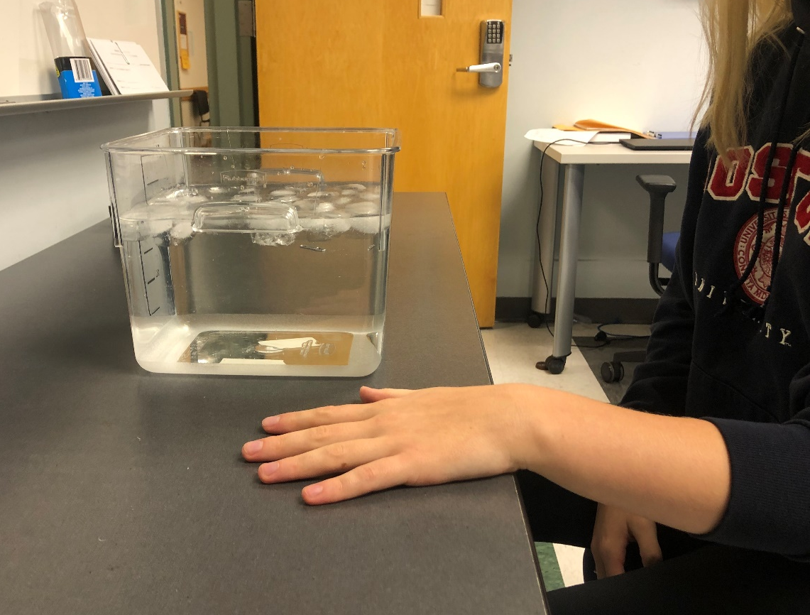
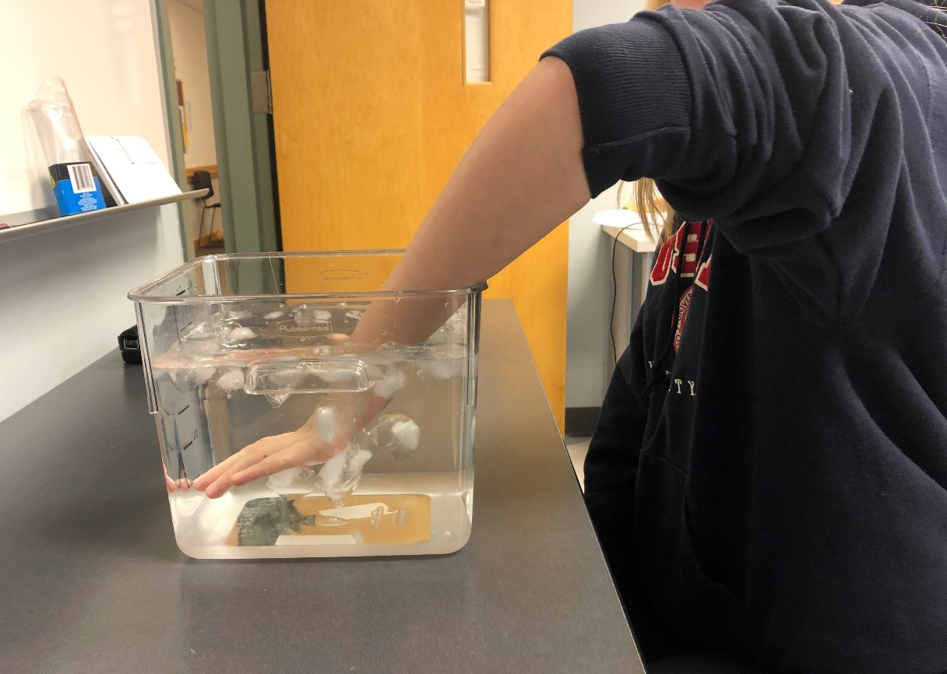
The Link Between Sleep Quality and Stress Reactivity
Emily Whitman and Harlan Fichtenholtz
Keene State College
Introduction
Results
When we don’t get enough sleep, our health is negatively impacted. Our sleep quality predicts how we experience and cope with stress and its impact on health (Barber, Munz, Bagsby, & Powell, 2010). Poor sleep quality has been associated with increased levels of stress and suicide risk (Mullan, 2014; Nadorff et. al, 2013). One way to effectively elicit a stress response in the lab is with the Cold Pressor Task (McRae et al, 2006). Higher levels of stress have been correlated to lower pain thresholds. Pain sensitivity has also been linked to high anxiety symptoms (Keogh et al, 2006).
The purpose of this study is to understand the association between sleep quality, anxiety, and acute stress reactivity. Anxiety is defined, in this study, by a score of 22 or higher on the Beck Anxiety Inventory. Insomnia is defined by a score of 15 or higher on the Insomnia Severity Index.
Methods
N = 36 (Mean age 19.88 years, SD 1.55 years) completed assessments of sleep quality (PSQI: overall sleep quality, insomnia), anxiety, and depression.
Participants then completed the Cold Pressor task
2-minute Baseline
2-minute Stress Induction
left hand in ice water
2-minute Recovery
ECG was recorded during all phases from the Lead II position
Inter-beat interval (time between heart beats, IBI) and heart-rate variability (HRV) measures were calculated from the ECG signal.
Discussion
This study suggests that sleep quality and anxiety both play a role in an individuals’ cardiac response during an acutely stressful situation. IBI data showed that individuals with lower quality sleep had a larger response to the stress of the cold pressor task from baseline compared to individuals with higher sleep quality. As sleep quality decreased the participants reactivity to stress increased. A similar pattern is seen in the analysis of the individuals who score in the moderate-severe range on the assessments of anxiety symptoms. There was a significant correlation between baseline HRV and change in IBI, as well as anxiety and change in IBI.
References
Baseline and Recovery Position
Cold Pressor Task Position
Barber, L. K., Munz, D. C., Bagsby, P. G., & Powell, E. D. (2010). Sleep consistency and sufﬁciency: Are both
necessary for less psychological strain? Stress and Health, 26(3), 186–193
Keogh, E., Barlow, C., Mounce, C., & Bond, F. W. (2006). Assessing the relationship between cold pressor pain responses and dimensions of the Anxiety Sensitivity Profile in healthy men and women. Cognitive Behaviour Therapy, 35(4), 198–206. https://doi.org/10.1080/16506070600898330
McRae, A. L., Saladin, M. E., Brady, K. T., Upadhyaya, H., Back, S. E., & Timmerman, M. A. (2006). Stress reactivity: Biological and subjective responses to the cold pressor and Trier Social stressors. Human Psychopharmacology: Clinical and Experimental, 21(6), 377–385.
Foxen-Craft, E., & Dahlquist, L. M. (2017). Brief submaximal isometric exercise improves cold pressor pain tolerance. Journal of Behavioral Medicine, 40(5), 760–771.
Mullan, B. A. (2014). Sleep, stress and health: A commentary. Stress and Health: Journal of the International Society for the Investigation of Stress, 30(5), 433-435.
Nadorff, M. R., Nazem, S., & Fiske, A. (2013). Insomnia symptoms, nightmares, and suicide risk: Duration of sleep disturbance matters. Suicide and Life-Threatening Behavior, 43(2), 139-149.

