Slide 1
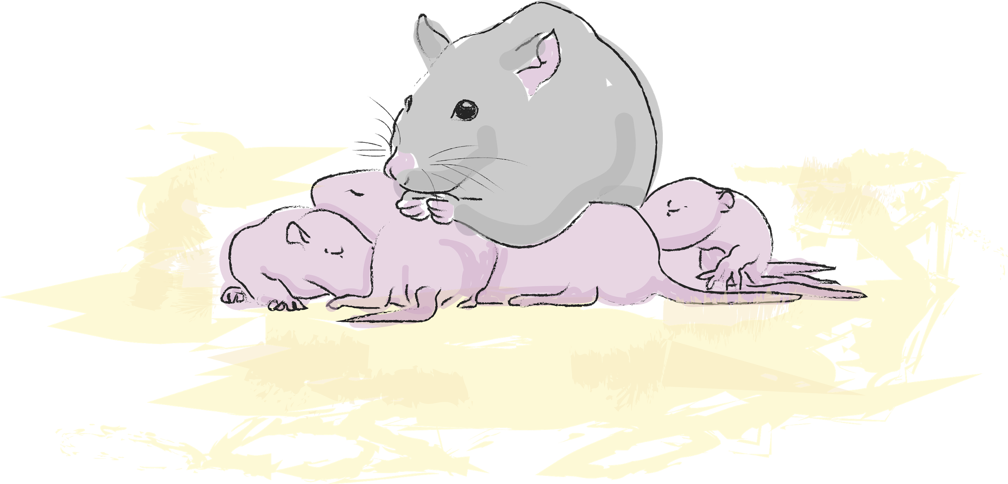
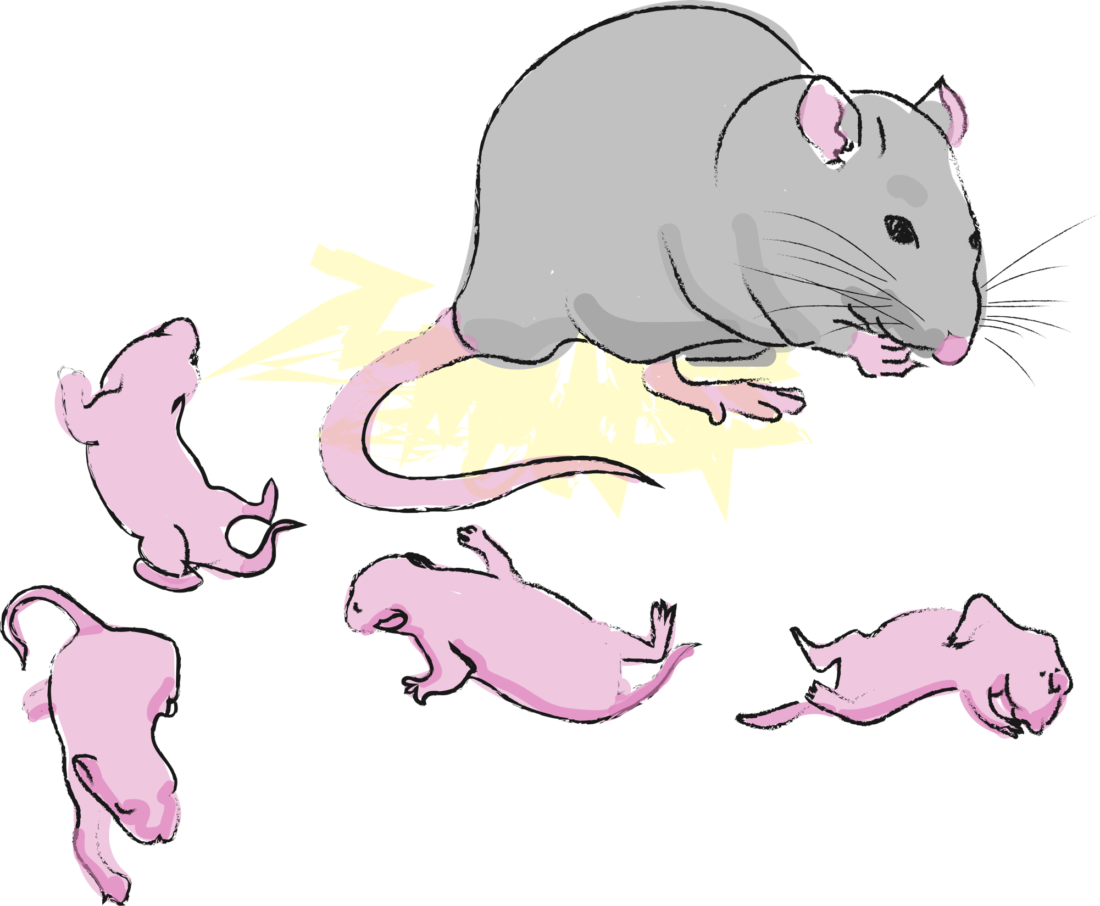
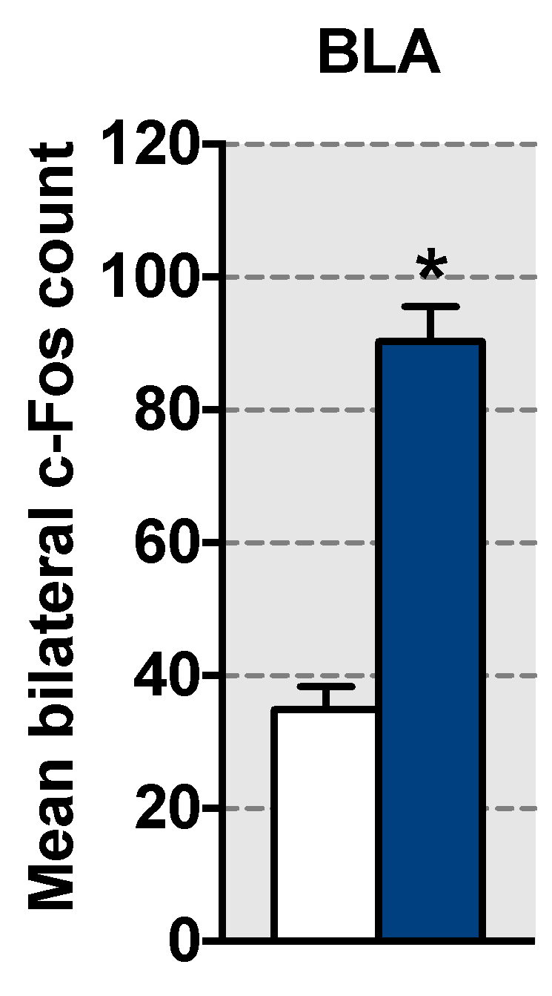
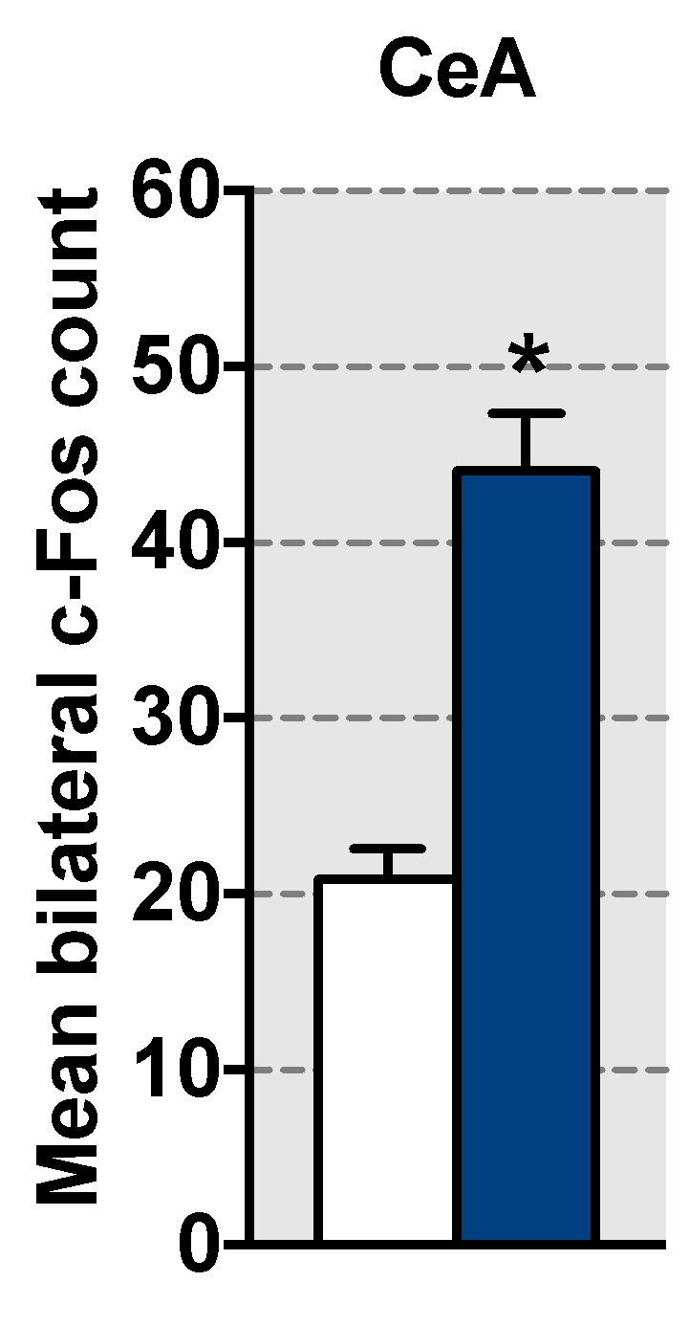
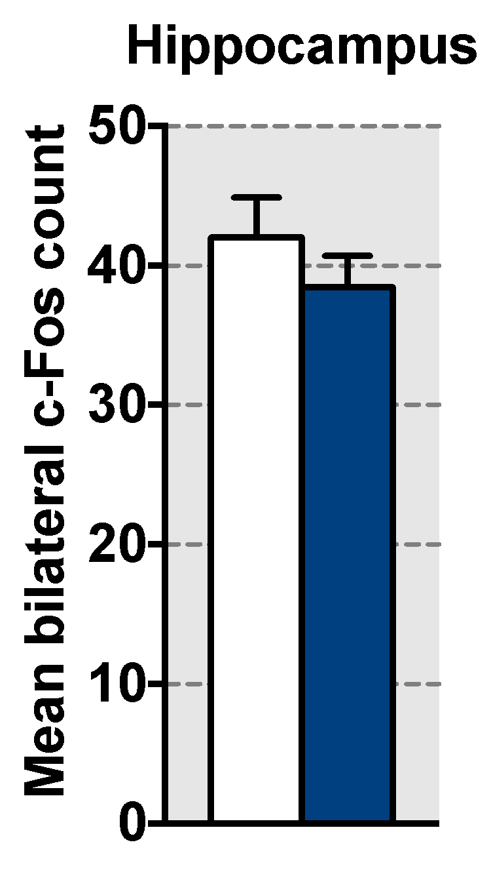
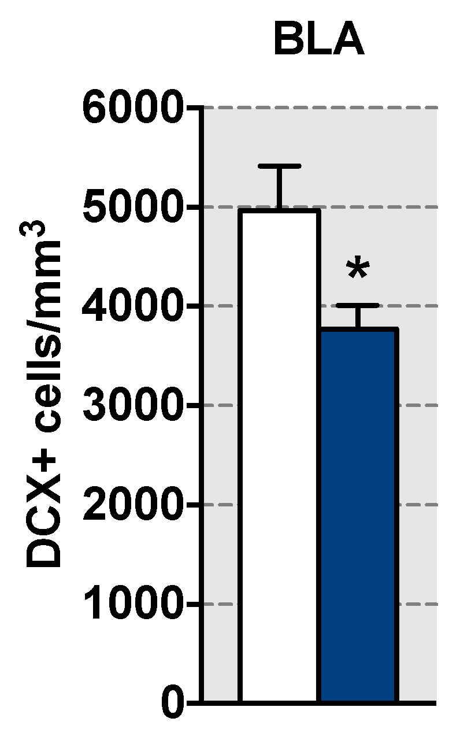
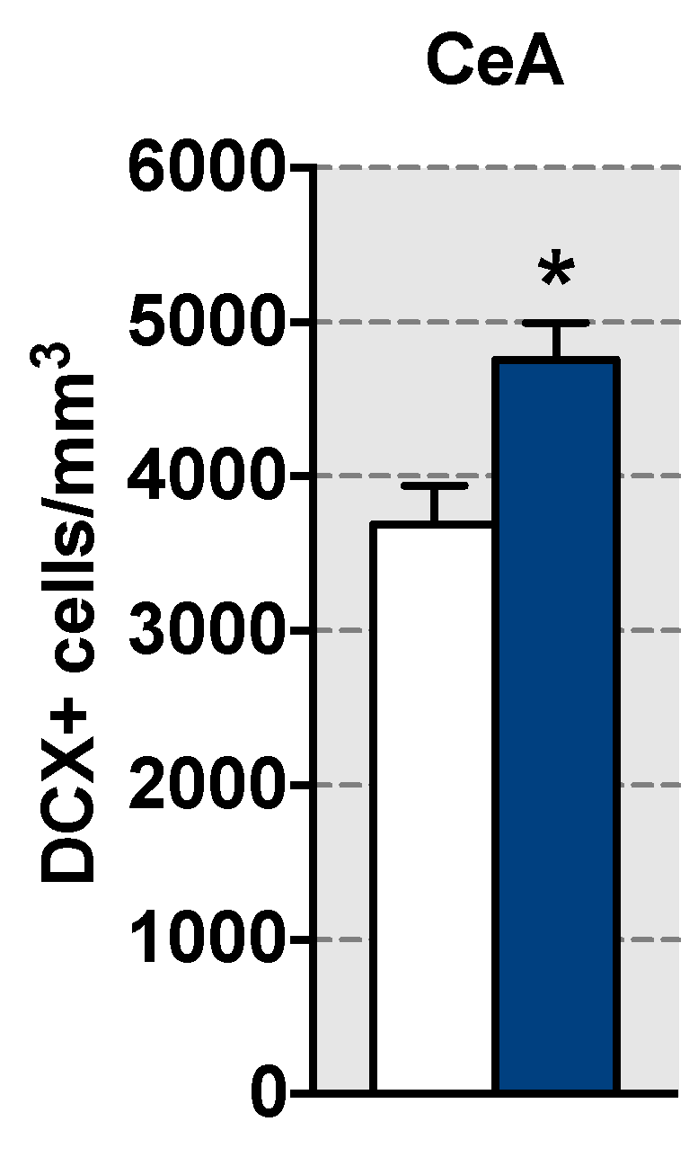
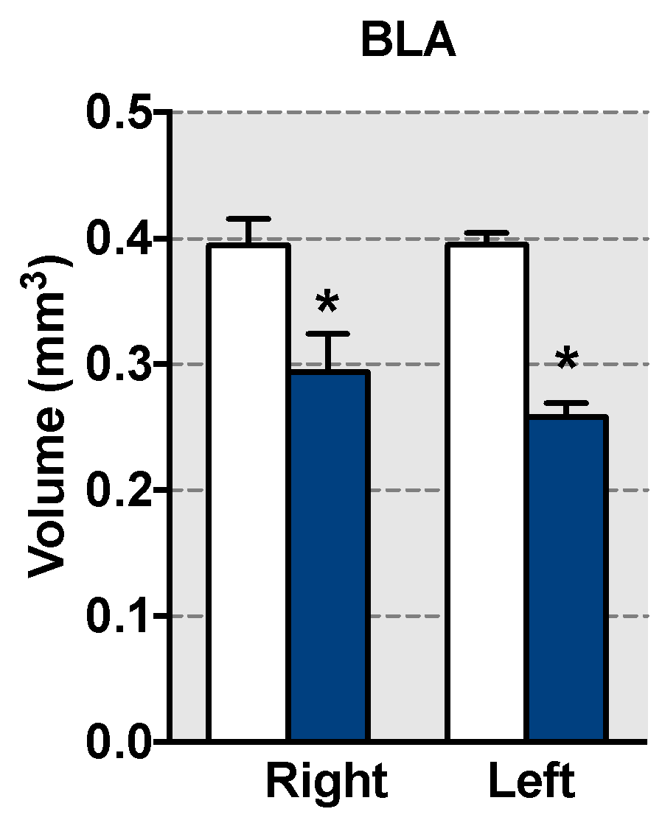
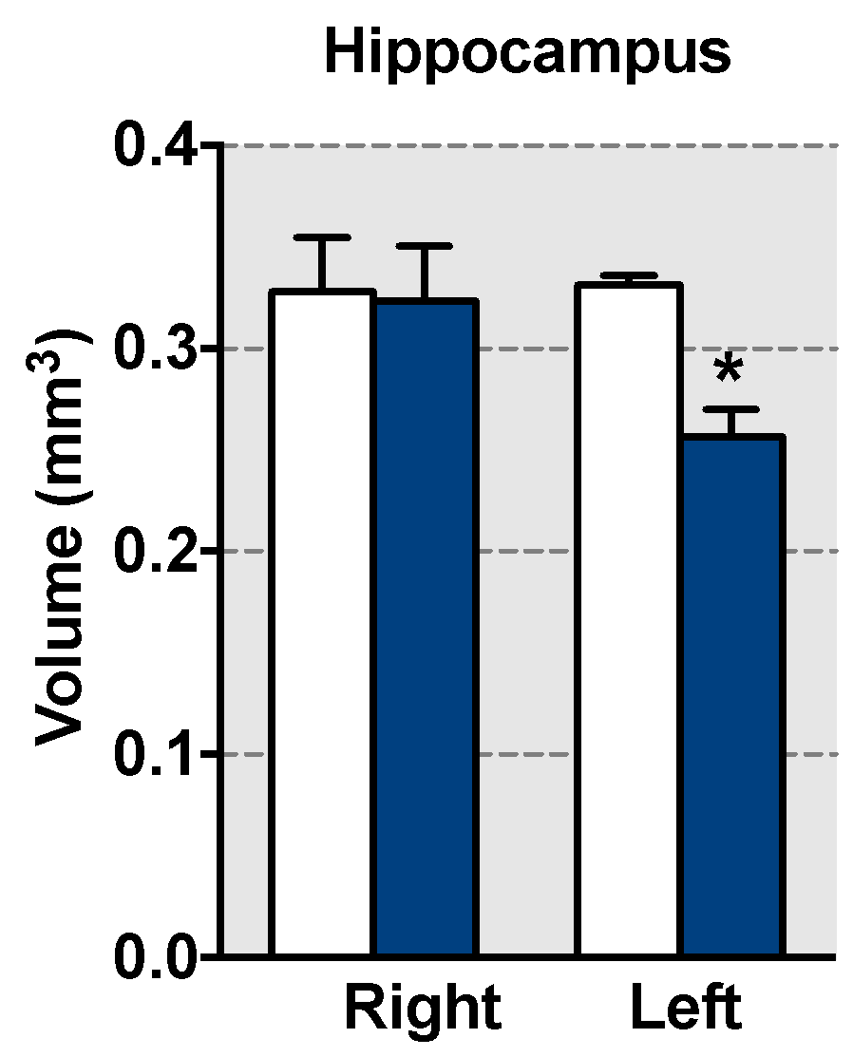
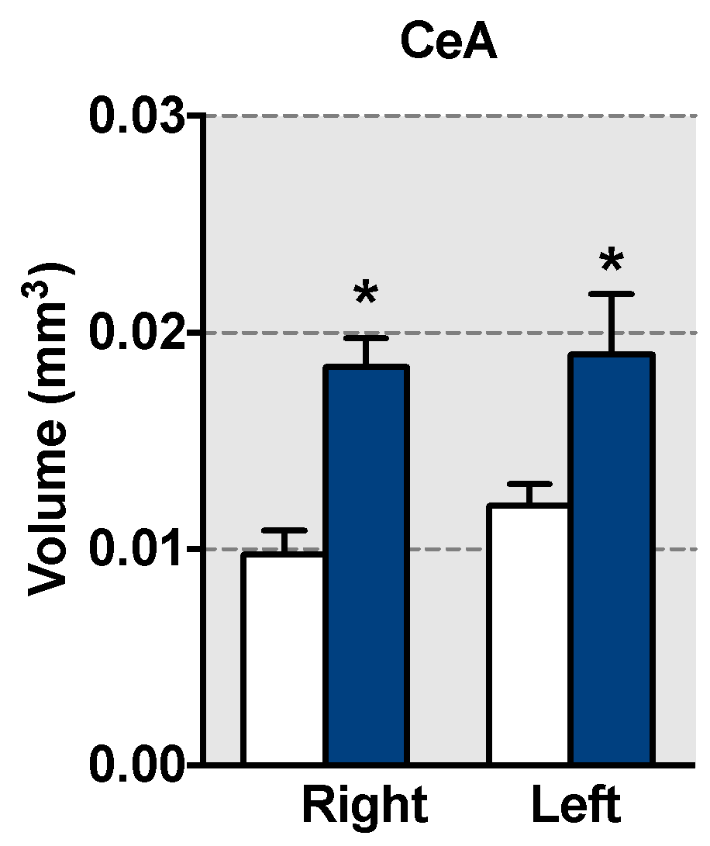
ENHANCED AMYGDALA RESPONSE OCCURS DURING EARLY LIFE ADVERSITY
Emma Wood^{1,2,3}, Kevin Bui^{2,3}, Maya Opendak^{2,3}, and Regina M. Sullivan^{2,3}
¹ College of the Holy Cross, ²Child and Adolescent Psychiatry, NYUMC, New York, USA; ³Emotional Brain Institute, NKI, New York, USA
Introduction
Animal models designed to simulate early-life abuse have provided insight into the role of parental care in determining the trajectory of a child’s neurobehavioral development. However, we know little about how the brain responds during the abuse that initiate the pathway to pathology and later-life outcome.
Thus, the goal of the present study is to explore amygdala activity during the actual early life abuse, at an age we know causes the later life deficits: from postnatal day (PN)8-12. Due to the role of the amygdala in attachment, we hypothesize that the amygdala will be activated during the maltreatment and only after repeated maltreatment known to produce later life pathology.
1 – Abusive rearing
 | Normal rearing | Adverse rearing
Mother abnormal behaviors
Steps or jumps on | 1.65% | 27.90%
Rough handling | 0.00% | 4.43%
Nest building | 2.80% | 14.30%
Mother normal behaviors
Mother’s time in nest | 77.80% | 52.47%
Nursing | 71.15% | 40.63%
Pup vocalization | 2.22% | 59.40%
Pup body weight (g) | 28.80±0.29 | 28.90±0.78
PN 8-12
Normal rearing
Adequate bedding
Adverse rearing
Low bedding
PN 12
45-min mother-infant social behavior test
Fos
Volume
Amygdala neurogenesis
Methods
15 Long Evans rat pups, with equal male and females, were distributed between two treatment groups: control rearing or use of the Scarcity-Adversity model of insufficient resources for nest building in rat pups aged PN8-12. This adversity-rearing results in the mother adopting abusive behaviors towards the pups including stepping on the pups, dragging the pups, and transporting the pups roughly compared to controls. The control cages contain sufficient bedding for the mother to make a nest. BORIS ethology software and Ethovision are used to characterize and score mother and pup activity and interactions.
To assess changes in the brain during the abuse at PN12, pups are injected with 2-Deoxy-D-glucose (2-DG) on the fifth day of the abusive condition (PN12). Following 2-DG injection, the pup is returned to the litter, behavior is recorded for 45 minutes, brains are removed-sliced-exposed to x-ray film for 5 days. The autoradiographs produced by the x-ray film is then digitized with greater areas of 2-DG uptake indicated by darker gray levels.
Regions of the amygdala were quantitatively assessed for neural activity, including the lateral amygdala in the dorsal lateral areas, subdivisions of the basolateral amygdala and the central amygdala.
2 - Brain Analysis
Adverse rearing increased amygdala neural activity (c-Fos expression) in response to the mother-pup interaction test, but no change was observed in the hippocampus
Adverse rearing decreased neurogenesis in the BLA and increased neurogenesis in the CeA
Adverse rearing reduced BLA volume and increased CeA volume bilaterally, but only the left hippocampus showed reduced volume
Conclusions
Acknowledgements
The increased amygdala activation suggests enhanced utilization of fear processing and emotional memory during the period of abuse. As the brain is still maturing during this period in the infants life, these changes in the amygdala may become increasingly pronounced over the developmental trajectory and maturation of abused pups. For pups that have experienced early life abuse, further amygdala development may be impaired because of the enhanced amygdala activation experienced in infancy.
Supported by NIH/NIMCHDH R37 RMS, NARSAD to MO and funding from Holy Cross to EW.

