Slide 1
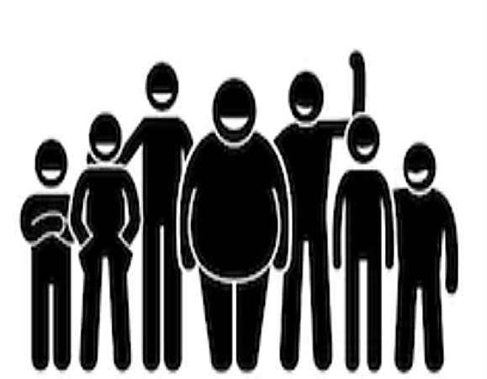
Introduction
Results
Higher body-weight individuals are frequently stigmatized and face prejudice and discrimination in various domains.
Less is known about effective means for reducing weight bias.
One strategy that has shown success in other areas of prejudice reduction, yet is less tested for weight bias reduction, is intergroup contact.
The purpose of this study was to examine the differential effects of positive and negative intergroup contact on weight bias.
Both regression models were significant:
Negative judgement, adjusted R² = .24, F(2,314) = 50.31, p <.001.
Dislike, adjusted R² = .30, F(2,314) = 70.14, p <.001.
Among the predictors, negative contact had a stronger impact on weight bias than positive contact.
None of the personality variables moderated the association between positive contact and weight bias.
Only SDO moderated the association between negative contact and weight bias.
Sometimes it’s good, sometimes it’s bad: Intergroup contact, personality, and weight bias Caitlyn Kliniewski, Aliyah Jones, Tyler Chui, German Laverde, Robert Hughes, Israr Ahmad, Carly Demarco, & Jamie Dunaev Rutgers University-Camden
Methods
Participants (N = 317) were recruited from a northeastern university, and the study was completed entirely online.
The sample was majority female (72.2%), the average age was 19.79 (sd = 3.57), and the average BMI was 21.62 (sd = 1.93) (*only data for participants who did not identify as ‘overweight’ or ‘obese’ were used in these analyses)
After providing consent, participants completed the Need for Cognitive Closure scale (NCF; Roets & Van Hiel, 2011), the Right Wing Authoritarianism scale (RWA; Altemeyer, 1981, modified by Roets and Van Hiel), and the Social Dominance Orientation scale (SDO; Pratto, Sidanius, Stallworth, & Malle, 1994) presented in a random order.
Participants then reported on their experiences with positive and negative contact with higher body-weight individuals using 8 items adapted from Dhont & Van Hiel (2009).
Lastly, participants reported on their explicit weight bias via the negative judgement subscale of the Universal Measure of Bias (UMB; Latner et. al., 2008) and the dislike subscale of the Antifat Attitudes scale (Crandall, 1994)
Standardized regression coefficients (β) for predictors of weight bias
Independent Variables | B | SE B | β | p
Negative Judgement (DV)
Positive Contact | -0.29 | 0.03 | -0.32 | <.001
Negative Contact | 0.38 | 0.04 | 0.37 | <.001
Dislike (DV)
Positive Contact | -0.37 | 0.04 | -0.37 | <.001
Negative Contact | 0.46 | 0.04 | 0.41 | <.001
N = 317
Positive intergroup contact was more frequent than negative contact, but negative contact had a stronger influence on negative weight-based attitudes.
Discussion
This study builds upon the existing literature by examining the effects of positive and negative contact on weight bias.
Consistent with previous studies, we found that although positive contact with higher body weight individuals is more common than negative contact, negative contact has a stronger influence on negative weight-based attitudes.
We found that none of the personality variables influenced the impact of positive contact on weight bias reduction, and negative contact had a significantly stronger impact for individuals higher in social dominance orientation.
These results may be useful for building future weight bias reduction interventions involving contact.
Means, Standard Deviations, and Correlations for Study Variables
 | PC | NC | NFC | RWA | SDO | NJ | D
Positive Contact (PC) | ---
Negative Contact (NC) | -.01 | ---
Need for Closure (NFC) | .09 | -.03 | ---
Right Wing Authoritarianism (RWA) | -.11 | .06 | .36** | ---
Social Dominance Orientation (SDO) | -.18** | .29** | .09 | .39** | ---
Negative Judgement (NJ) | -.32** | .38** | .00 | .18** | .40** | ---
Dislike (D) | -.38** | .42** | -.01 | .09** | .42** | .73** | ---
M (SD) | 4.58 (1.29) | 2.35 (1.17) | 3.99 (0.66) | 4.10 (0.92) | 2.64 (0.97) | 2.62 (1.20) | 3.06 (1.30)
N = 317. *p < .05, **p < .01
Presented at the Annual Meeting of the Eastern Psychological Association 2020, Boston, MA. For further information, contact jamie.dunaev@gmail.com

