Slide 1
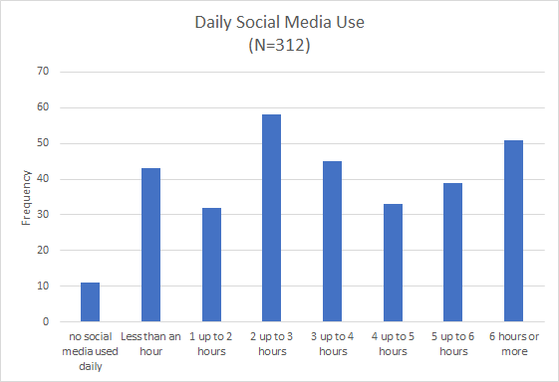
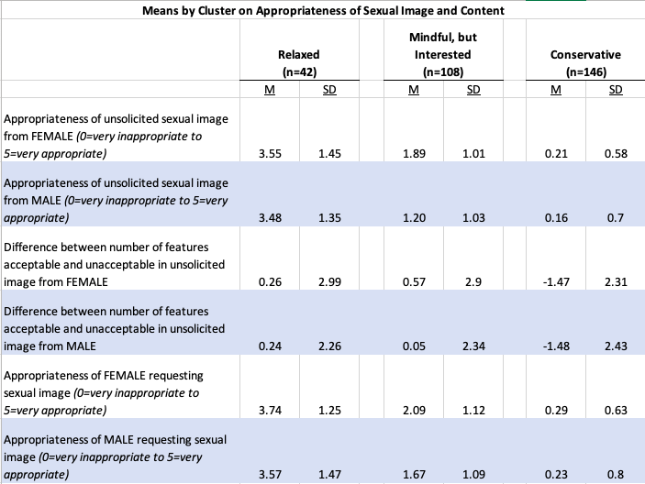
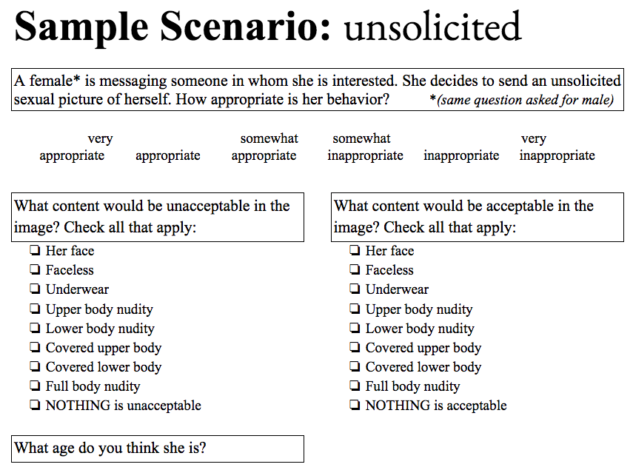
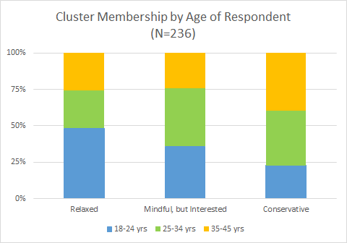
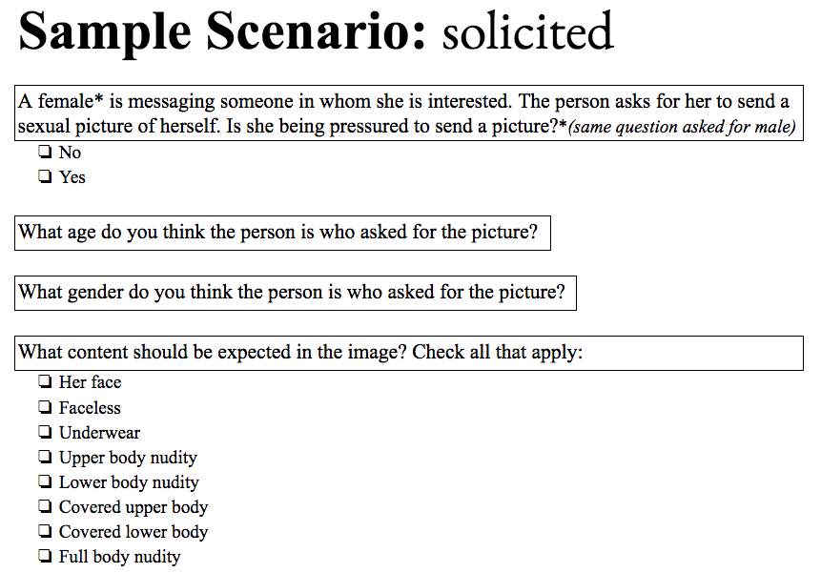
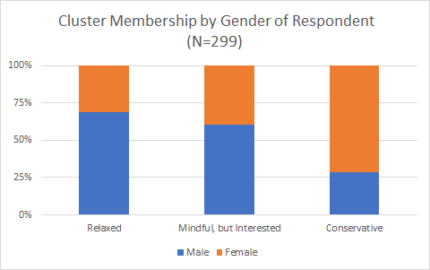
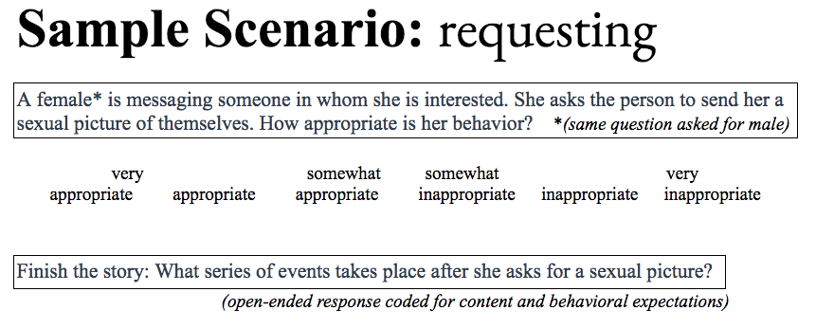
Sexual Scripts and Technology
Valeria M. de L. Mercado Medina & Alicia Drais-Parrillo, Ph.D
The Pennsylvania State University
Abstract
Interested in understanding how social media use and digital communication are affecting our perceptions of norms related to relationships and sexuality
Traditionally, research has focused on pornography, leaving a gap in the literature regarding changes in social norms, specifically sexual scripts, in relation to online communication (i.e. sexting)
This research collected data through SurveyMonkey’s Audience product; participants completed an anonymous, online questionnaire
Based on the self-report data, we were unable to utilize social media as a predictor for changing sexual scripts, but we identified three groups that best fit the data based on the responses from the hypothetical scenarios: Relaxed, Mindful but Interested, and Conservative.
Method
Research Questions
Is there a relationship between changing sexual scripts and social media usage?
Does gender and/or age play a role in predicting sexual scripts?
Participants
Using SurveyMonkey’s Audience product, we recruited a sample of 312 participants, balanced for age (18-45) and gender (males=47%, females=53%). The majority of our participants were White (64%) and identified as heterosexual (85%). All respondents ranged between ages 18-45 (M=30.28, SD=7.7)
Design
Participants completed an anonymous, online questionnaire that included demographic items, queries about communication, and hypothetical scenarios (e.g. images below).
Some scenarios asked participants to envision a male responding, a female responding, and how they themselves would respond depending on the context. Variables
The variables are derived from an online questionnaire:
Demographics (gender, sexual orientation, age, race/ethnicity)
Extroversion-Introversion
Social Media Use (estimated daily usage, primary purposes, applications)
Communication (preferred methods by friend, current partner, and potential partner)
Sexual Communication (frequency for sending and receiving, comfort with receiving)
Sexual Scripts Social Norms (behavioral; content; presumed age, gender, and social pressure of sender/recipient)
This exploratory research provided a broader understanding of sexual scripts, specifically the categories participants fit based on their sexual communication similarities and norms.
Given our dependence on technology as a common channel to engage with others, it is logical that our norms are reflected and amplified therein.
There may even be a resulting shift in sexual norms, such as increased expectations for sharing nude images with potential partners. Thus, technology and social media may birth new sexual scripts that align with gender norms and the practices in which people are engaging.
As the platforms for communication and social media continue to advance, it is pivotal to research its interconnectedness to sexual scripts, which affects the way humans are perceiving relationships and sexuality
Some debate if the double standard for sexuality is collapsing. It is more likely that it prevails but covertly and in nuanced ways. However, the double standard made its appearance in group membership (e.g., more males in the Relaxed and Mindful but Interested), in assessments of social pressure and in the content expectations of sexual messages.
Results
We used basic statistical methods (e.g., means, frequencies, chi-square, ANOVA) to describe our sample and explore the data.
The majority (56%) used social media between 2-5 hours daily and few used it for less than an hour (13%) or not at all (3.5%).
As a result, social media use appeared to be ubiquitous - we were unable to utilize social media use as a predictor.
Using cluster analysis based on responses from our hypothetical scenarios, we derived three groups that fit best: Relaxed (n=42), Mindful but Interested (n=109), and Conservative (n=148). Groups significantly differed (p=0.000) on several variables as shown in the table below.
In addition, the clusters appeared to differ by gender and by age. Relaxed and Mindful, but Interested individuals were predominantly male (69% and 61%, respectively) and younger (M=28.0, SD=7.7 and M=28.8, SD=7.3, respectively) compared to Conservative (28% male and M=31.7 yrs, SD=7.7)
Results
We used basic statistical methods (e.g., means, frequencies, chi-square, ANOVA) to describe our sample and explore the data.
The majority (56%) used social media between 2-5 hours daily and few used it for less than an hour (13%) or not at all (3.5%).
As a result, social media use appeared to be ubiquitous - we were unable to utilize social media use as a predictor.
Using cluster analysis based on responses from our hypothetical scenarios, we derived three groups that fit best: Relaxed (n=42), Mindful but Interested (n=109), and Conservative (n=148). Groups significantly differed (p=0.000) on several variables as shown in the table below.
In addition, the clusters appeared to differ by gender and by age. Relaxed and Mindful, but Interested individuals were predominantly male (69% and 61%, respectively) and younger (M=28.0, SD=7.7 and M=28.8, SD=7.3, respectively) compared to Conservative (28% male and M=31.7 yrs, SD=7.7)
Background Research
As humans, we are social beings that need relationships
Social media and digital communication is changing these relationships and the psychology of individuals involved
What differentiates humans from animals, in regard to sexual behavior, is the influence of desire and pleasure
As Gender Schema Theory explains, individuals become gendered through sex-linked characteristics that are culturally preserved and transferred to others (Bem, 1981).
The original formulation of the Media Practice Model suggests that the media that adolescents consume and engage with relate to how they make sense of their lives, including their sexual selves (Steele & Brown, 1995).
According to this model, the adolescent’s interaction with a piece of media will depend on how much the content reflects their identity (Shafer, Bobkowski, & Brown, 2013).
Combining Gender Schema Theory with the Media Practice Model, social media use predicts their inclination to self-sexualization (Trekels, Karsay, Eggermont, & Vandenbosch, 2018) and enforces double standards for females
Males → promulgate a form of digital currency and value, increase in social status and rating, and are more likely to ask, rather than send sexual images (Ringrose, Harvey, Gill, & Livingstone, 2013)
Females → femininity is linked to the male gaze, yet when they send the images, they are prone to ‘slutshaming’, moral criticism, and possible legal consequences (Ringrose et al., 2013)
The ideas and norms about how individuals are supposed to interact with each other, including gender behavior, in sexual and romantic situations are known as sexual scripts
These indicate the assigned roles and possible consequences that will follow
Social networking sites facilitate the visual and textual construction of a cyber subjectivity, which gains significance through its embedding in a digitally ‘networked public’ (Ringrose et al., 2013)
More than 80% of teens are estimated to frequently use social media, in some form (Pennsylvania Youth Survey, 2017)
Among adolescents, almost 25% of the 10th to 12th graders reported inappropriate sexual contact through these networks (Pennsylvania Youth Survey, 2017)
More so, in a survey conducted by Martin and colleagues (2018) middle schoolers reported frequent usage of popular social networks: Instagram (73%), Snapchat (65%), YouTube (65%), Facebook (31%) with Snapchat reported as the favorite and smartphones as the most cited (85%) device to access social media.
.
Conclusions
References
Martin, F., Wang, C., Petty, T., Wang, W., & Wilkins, P. (2018). Middle school students’ social media use. Educational Technology & Society, 21(1), 213–224.
Ringrose, J., Harvey, L., Gill, R., & Livingstone, S. (2013). Teen girls, sexual double standards and ‘sexting’: Gendered value in digital image exchange. Feminist Theory, 14(3), 305-323.
Shafer, A., Bobkowski, P., & Brown, J. D. (2013). Sexual media practice: How adolescents select, engage with, and are affected by sexual media. In K. E. Gill (Ed.), The Oxford Handbook of Media Psychology (pp. 223-251). New York, NY: Oxford University Press.
Steele, J. R., & Brown, J. D. (1995). Adolescent room culture: Studying media in the context of everyday life. Journal of Youth and Adolescence, 24(5), 551-576. http://dx.doi.org/10.1007/bf01537056.
Trekels, J., Karsay, K., Eggermont, S., & Vandenbosch, L. (2018). How social and mass media relate to youth’s self-sexualization: Taking a cross-national perspective on rewarded appearance ideals. Journal of Youth and Adolescence, 47(7), 1440-1455. http://dx.doi.org/10.1007/s10964-018-0844-3.
United States, Pennsylvania Commission on Crime and Delinquency, Pennsylvania Department of Drug and Alcohol Programs, and Pennsylvania Department of Education. (2017). 2017 Pennsylvania Youth Survey. Retrieved from https://www.pccd.pa.gov/Juvenile-Justice/Pages/Pennsylvania-Youth-Survey-(PAYS)-2017.aspx
Chi-square tests of independence suggested that cluster membership and gender were related (Χ² (2, N=299)=36.8, p=.000) as were cluster and age (Χ² (4, N=236)=11.5, p=.02).

