Slide 1
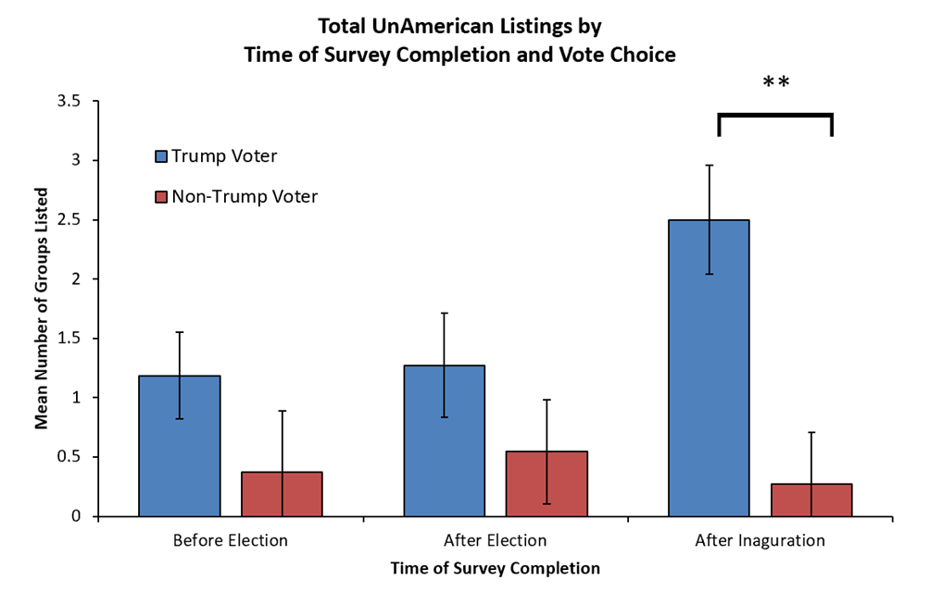
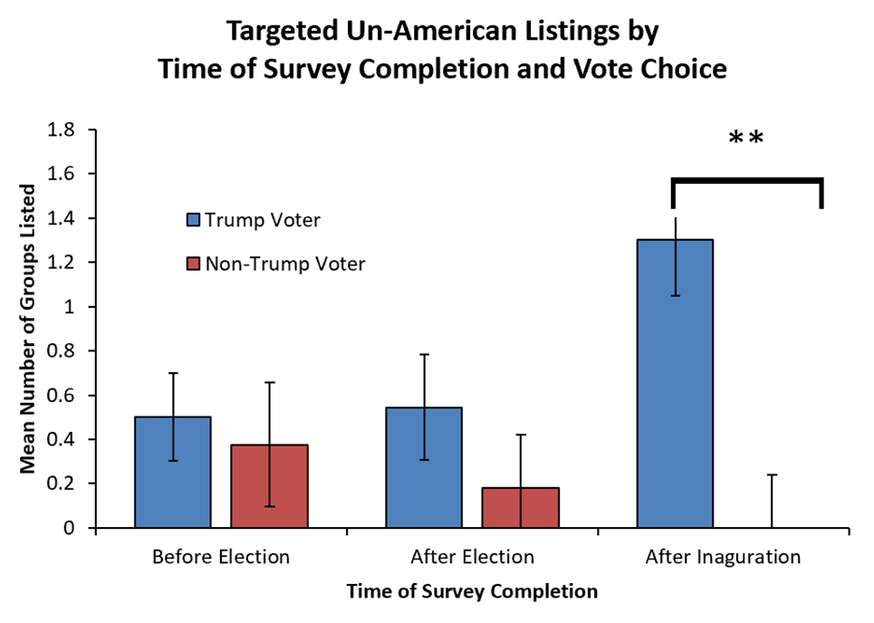
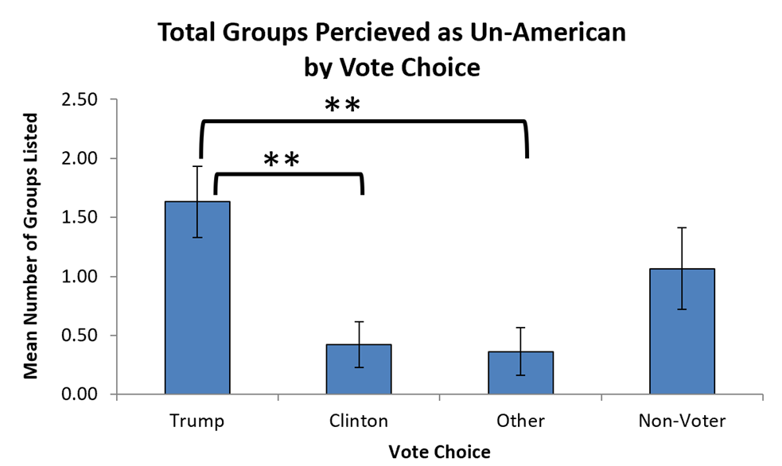
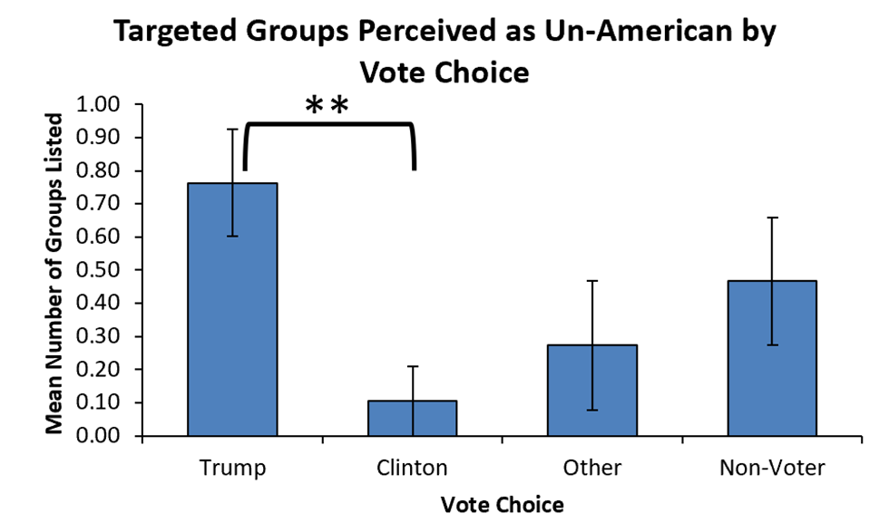
Follow the Leader? The impact of
candidate rhetoric on voters' prejudice
Michaela Sencindiver
Lindsey Levitan, PhD
Abstract
The role of elections in prejudice expression was examined in 83 students. Participants selected groups they deemed “Un-American” either before or directly after the 2016 election, or after inauguration. There was a significant interaction whereby participants identified more groups targeted by candidate rhetoric as un-American after the inauguration, but only if they voted for the candidate using more prejudiced rhetoric. This suggests political rhetoric’s power to shape the values of individuals who vote for candidates using that rhetoric.
Results
Did voters’ prejudice expression change over time?
Notes: “Non-Trump Voters” combines Clinton and “Other” voters; Non-Voters (15) were not included in the following analysis due to small N.
A factorial ANOVA indicated no significant effects of Vote Choice and Participation Time on Total Un-American Listings, F (2, 66) = 1.80, p = .18.
Follow-up a priori independent t-tests with equal variances not assumed were conducted with a Bonferroni corrected alpha = .017.
The number of Total Un-American Listings, t(9.93) = 3.51, p = .006, were significantly greater for Trump voters than non-Trump voters only after inauguration.
There were no significant differences between Trump voters and non-Trump voters before, t(21.27) = 1.97, p = .06, or right after the election, t(13.95) = 0.96, p = .35.
Results (cont.)
Similar analyses indicate significant differences in Targeted Un-American Listings across voter groups, F (3, 32.09) = 3.93, p = .02.
Trump voters listed significantly more targeted groups as Un-American than Clinton voters, p = .007.
Non-voters and “Other” voters were not significantly different than any other voter type (ps > .20).
Introduction
There was a 226% increase of reported hate crimes in counties that hosted a campaign rally for the soon-to-be President (Feinberg, Branton, & Martinez-Ebers, 2019).
• Studies of prejudice indicate changes since the 2016 election.
○ Perceived acceptability of prejudice expression increased after the election, especially towards groups that had been targeted by campaign rhetoric (Crandall, Miller, & White, 2018).
○ The target of prejudice is linked to party ID (Wronksi, 2018).
○ Trump supporters exhibited a small but significant increase in sexism after the presidential campaign (Georgeac, Rattan, & Effron, 2018).
This suggests that the election of a candidate who uses prejudiced rhetoric may lend legitimacy to prejudice. The current study aims to examine if people are more willing to express prejudice following the election of a candidate who uses prejudiced rhetoric.
Discussion
The display of prejudice increased after inauguration for Trump voters compared to non-Trump Voters. The increase was shown especially towards groups targeted by President Trump’s rhetoric.
The significant increase in prejudice expression among Trump supporters suggests the power public figures possess to influence the views of their followers. Expression of prejudice can change to match the rhetoric.
This was not an experiment so we cannot determine this effect to be causal. However, because we observed significantly more prejudice expression only among supporters of a candidate using prejudiced rhetoric, and specifically towards the groups his rhetoric targeted, this does support the argument that political rhetoric guided this change.
Further research should determine whether this represents a change in the underlying degree of prejudice, or merely the expression of prejudice. This effect may represent a change in underlying prejudice, a change in understanding of social norms and what is acceptable, or some combination of the two.
The words of public figures may have a strong influence on their supporters’ understanding of current norms and can change the expression of such views within this group.
Hypotheses
Trump supporters (but not non-Trump supporters) will be more willing to label groups as un-American after the election as compared to before the election.
The above was expected to be especially true for groups targeted by the candidate’s rhetoric.
Similar analyses on Targeted Un-American Listings indicated significant effects of Vote Choice and Participation Time, F (2, 66) = 3.24, p = .05.
The number of Targeted Un-American Listings, t(9.00) = 3.55, p = .006 were significantly greater for Trump voters only after inauguration.
There were no significant effects before, t(15.37) = 0.38, p = .71, or right after the election, t(17.10) = 1.09, p = .29.
Did non-voters, Clinton voters, Trump voters, and “other” voters differ overall?
Total un-American Listings differed significantly across voter groups, F (3, 35.96) = 4.94, p = .006, according to a one-way Welch’s ANOVA.
Games-Howell post-hoc tests were used due to unequal variances.
Trump voters listed significantly more groups as Un-American than Clinton, (p = .007) and “Other” voters (p = .006).
Non-voters’ Total Un-American Listings were not significantly different from any other voter type (ps > .30).
Method
Participants
• 94 undergraduates
• 49 men, 45 women.
• Party ID: 35 Republican, 18 Democrat, 37 independent, and 4 did not provide party preference.
• Exclusions: 11 excluded for missing information or failure to follow instructions, leaving 83 participants.
Measures
• Vote Choice: Participants indicated which candidate they voted for or planned to vote for.
• Participation Time:
There were three groups of times for survey completion: before the election, right after the election, and after inauguration.
One participant participated after some polls had closed on election night, and so was excluded from analyses involving time.
Prejudice Measures (Wronski, 2019)
Participants were asked to select groups they felt were American and Un-American from a list.
Total Un-American Listings: Number of Groups Listed as Unamerican was recorded
Total Targeted Groups Un-American Listings was also recorded: Asian American, Latino, and Muslim (see Crandall, Miller, & White, 2018).
References
Crandall, C., Miller, J., & White, M., II., (2018). Changing norms following the 2016 US Presidential election: The Trump effect on prejudice. Social Psychological and Personality Science, 9(2), 186–192. https://doi.org/10.1177/1948550617750735
Feinberg, A., Branton, R., & Martinez-Ebers, V., (2019). Counties that hosted a 2016 Trump rally saw a 226 percent increase in hate crimes. Retrieved from: https://beta.washingtonpost.com/politics/2019/03/22/trumps-rhetoric-does-inspire-more-hate-crimes/
Georgeac, O., Rattan, A., & Effron, D., (2019). An Exploratory Investigation of Americans’ Expression of Gender Bias Before and After the 2016 Presidential Election. Social Psychological and Personality Science, 10(5), 632–642. https://doi.org/10.1177/1948550618776624
Lipscomb, J., (2017). Hate-Fueled Attacks Rattle Florida After Trump’s Election. Retrieved from: https://www.miaminewtimes.com/news/florida-sen-rick-scott-brags-about-his-climate-change-record-11263292
Wronski, J., (2018, August 30 – September 2). Who Doesn’t Count as an American: An Exclusionary Approach to National Identity [Paper presentation]. Paper presented at the American Political Science Association Annual Meeting, Boston, MA, United States.
Acknowledgements
This research presentation was made possible by an award from the Samuel O. Legreid Fund, and the assistance of Lauren Duckworth.
The authors would also like to thank Julie Wronski, Alexa Bankert, Karyn Amira, and April Johnson. The first wave of data was originally gathered in conjunction with a collaboration with these colleagues:
Wronski, J., Bankert, A., Amira, K., Johnson, A. A., & Levitan, L. C. (2018). A tale of two Democrats: How authoritarianism divides the Democratic Party. The Journal of Politics, 80(4), 1384-1388.

