Slide 1
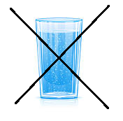
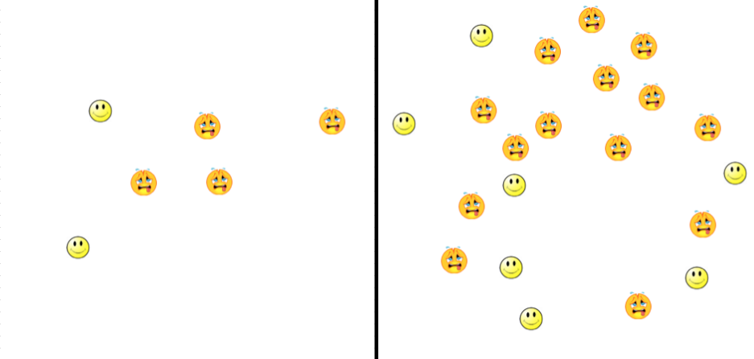
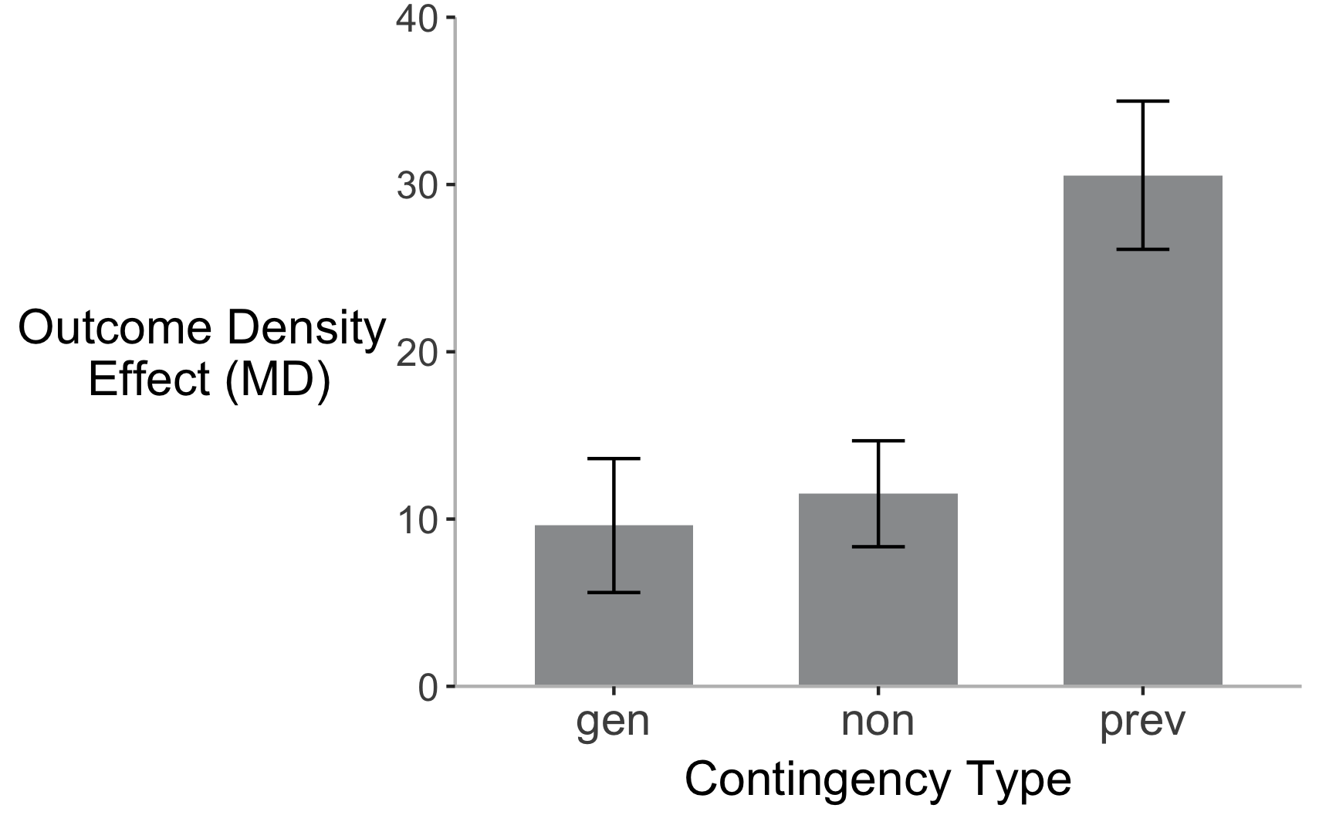
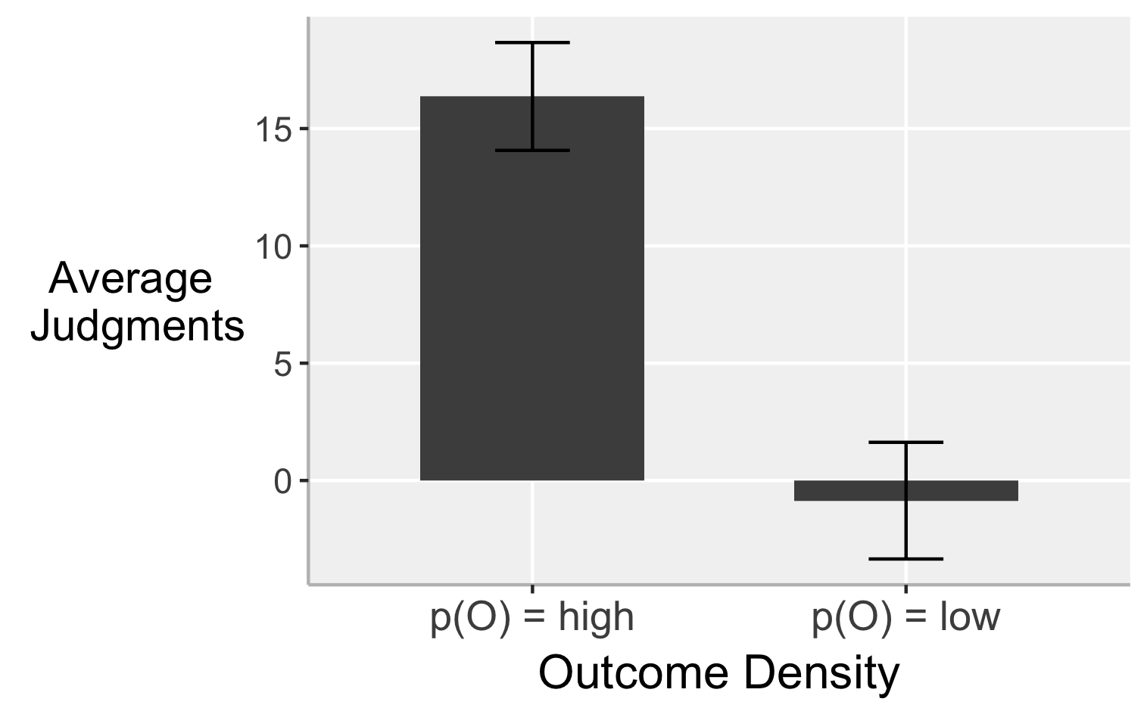
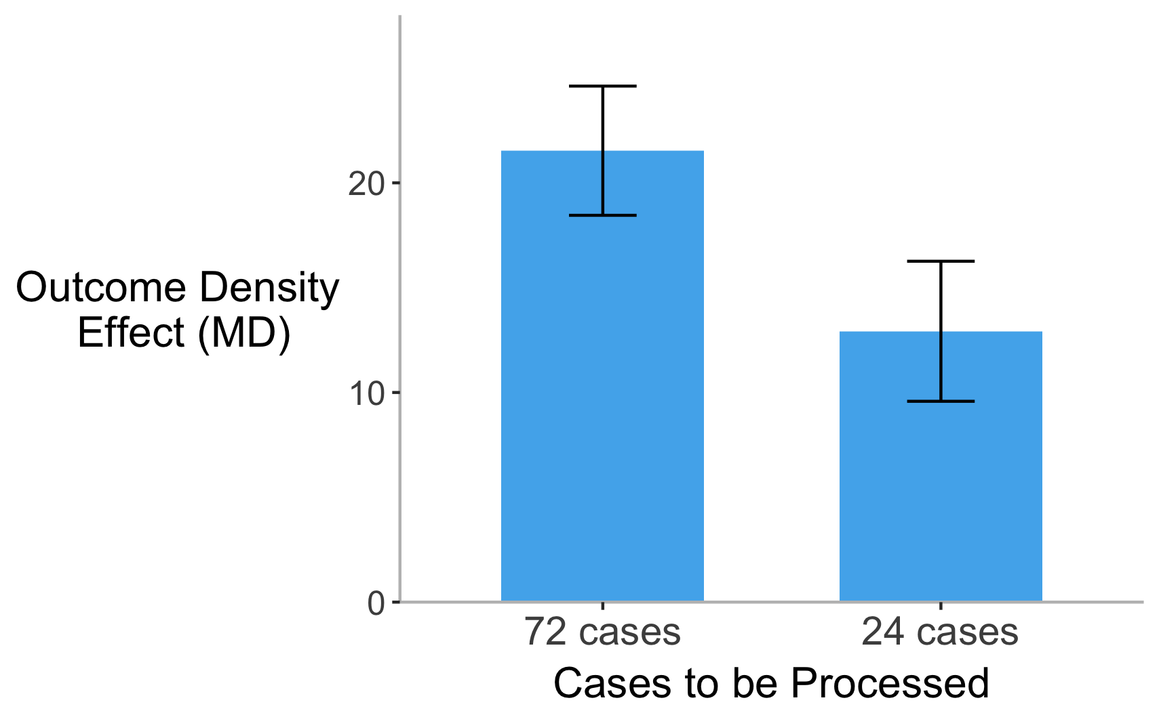
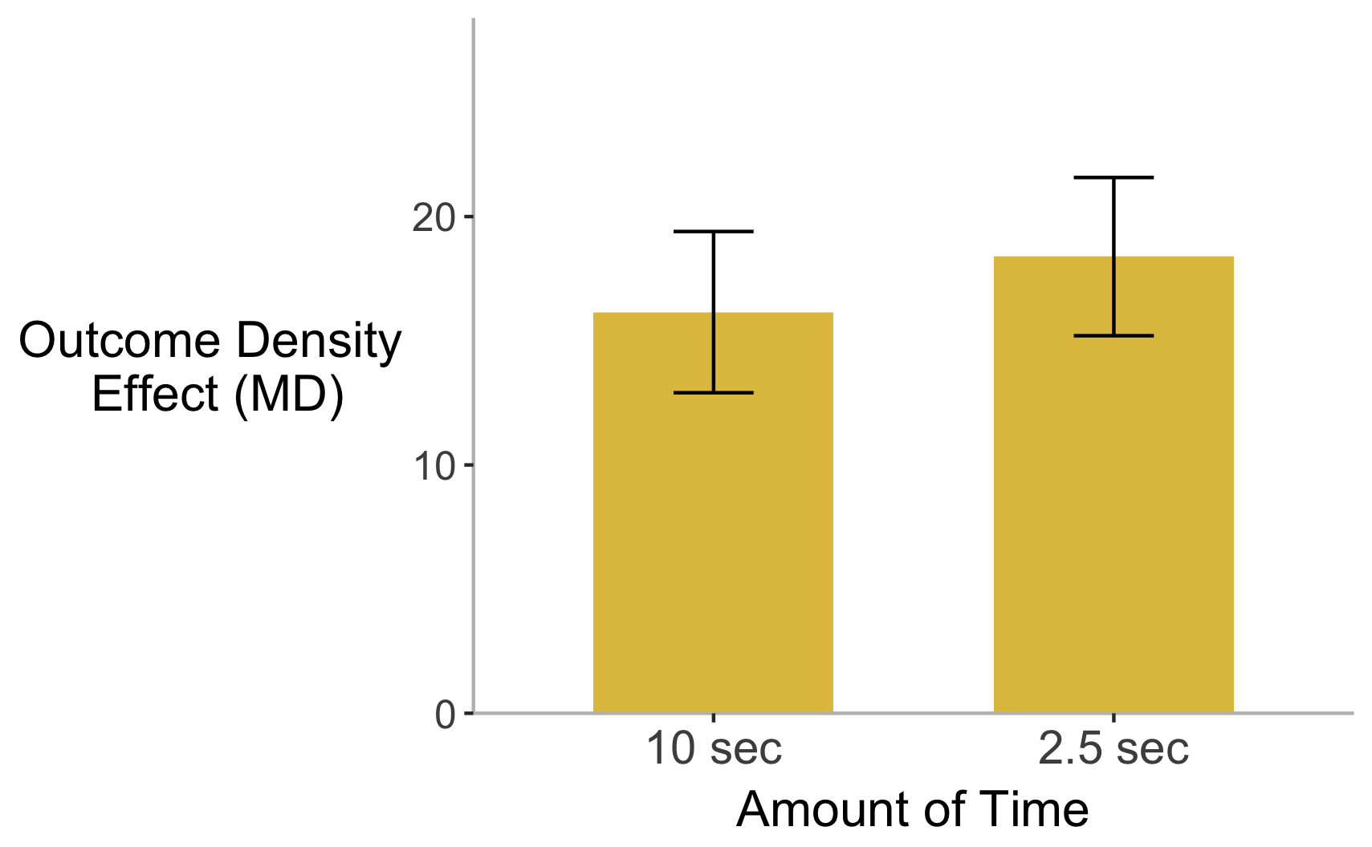
Investigating Heuristics in Causal Learning
Natalie J. Alessi¹, Ciara Willett², Amber Benevento¹, Angelina DeModna¹, Atley Fortney¹, Taylor Heuer¹, Katharine Laplaski¹, Kelly M. Murphy¹, Harshal Patel¹, Donald Regan¹, Kelly M. Goedert¹
Seton Hall University¹ & University of Pittsburgh²
Background
On each trial:
Results (cont.)
People often rely on heuristics, or reasoning shortcuts¹ when reasoning or making decisions in cognitively demanding situations, such as:
Increased time-pressure to make a judgment²
Increased amount of information to be processed^{3, 4}
= No Mineral
= Mineral
Followed by a causal judgment on the following scale:
Greater Outcome Density Effect for Preventive Contingency
**
*
-100
0
100
One common phenomenon in causal reasoning is the outcome density effect
As the probability of the outcome increases, people increase their causal strength judgments, even when the contingency or correlation between the cause and effect remains constant.⁵
Perfectly Preventive
No contingency
Perfectly Generative
Dependent Variable – Magnitude of Outcome Density Effect – Computed as judgment when outcome density was high minus when it was low. Values greater than zero indicate an outcome density effect.
Illustrating Outcome Density
Design:
Imagine a pharmaceutical company is testing whether certain minerals cause headaches. Each face (below) indicates one patient or “case”.
Time: participants saw stimuli for 2.5 sec or 10 sec (between-groups)
Amount of information to be process: half trials had lots of information (72 cases) and half had small amount of information (32 cases)
Contingency: each trial was generative, non-contingent, or preventive (within-groups)
Error bars indicate standard error of the mean (SEM)
MD = Mean Difference
*p<0.01, **p<0.001
Discussion
= No headache
= Headache
Is outcome density a heuristic?
No Mineral
Received Mineral
Results
No difference with increased cognitive demand (time-pressure and amount of cases)
No indication that outcome density is a heuristic
Mineral A
Overall Outcome Density Effect
Minerals judged more causal when probability of outcome high vs. low (p < .001, d = 0.62).
Mineral B
Then, what is it?
It may be a more central part of causal inference
Outcome Density Occurs when People Report Causal Judgments of Mineral A < Mineral B
No Influence of Cognitive Demand Manipulations:
Type of contingency was only manipulation that affected outcome density
Hypothesis:
If outcome density behaves like a heuristic, limited time and an increase in amount of cases to be processed will lead to an increased outcome density effect.
Amount of cases (left): No difference between 72 and 24 cases (p = .051 d = .139).
Time (right): No difference between the 10 and 2.5 seconds participants (p = .658, , d = .036).
Preventive judgments > Noncontingent = Generative
Preventive judgments may be more difficult
Future experiments should further examine preventive judgments’ influence on the outcome density effect
Possibly manipulating the strength of the preventive relationship
n.s., d = .139
n.s., d = .036
Methods
References
Procedure
Participants (N = 125) imagined working for a pharmaceutical company investigating whether different minerals cause headaches as a side effect. Participants saw fictional data about people who had received or had not received the mineral. Participants saw 16 trials total.
1. Kao, S. F., & Wasserman, E. A. (1993). Journal of Experimental Psychology: Learning, Memory, and Cognition, 19(6), 1363-1386.
2. Finucane, M. L., et al. (2000). Journal of Behavioral Decision Making, 13(1), 1-17.
3. Liljeholm, M., & Cheng, P. W. (2009). JEP: Learning Memory and Cognition, 35(1), 57–172.
4. Nieder, A., & Merten, K. (2007). The Journal of Neuroscience, 27(22), 5986-5993.
5. Jenkins, H., & Ward, W. (1965). Psychological Monographs: General and Applied, 79(1), 1–17.
Error bars indicate standard error of the mean (SEM)
MD = Mean Difference

