Slide 1

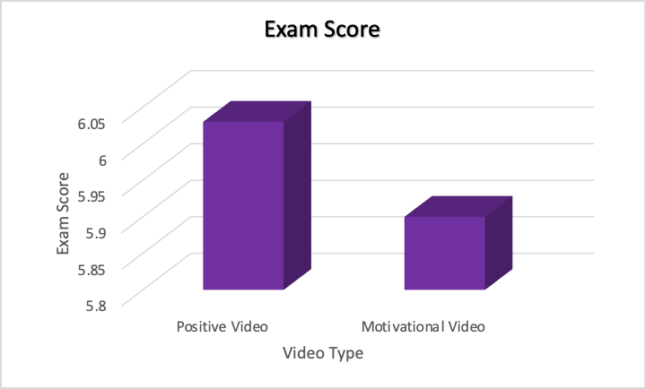
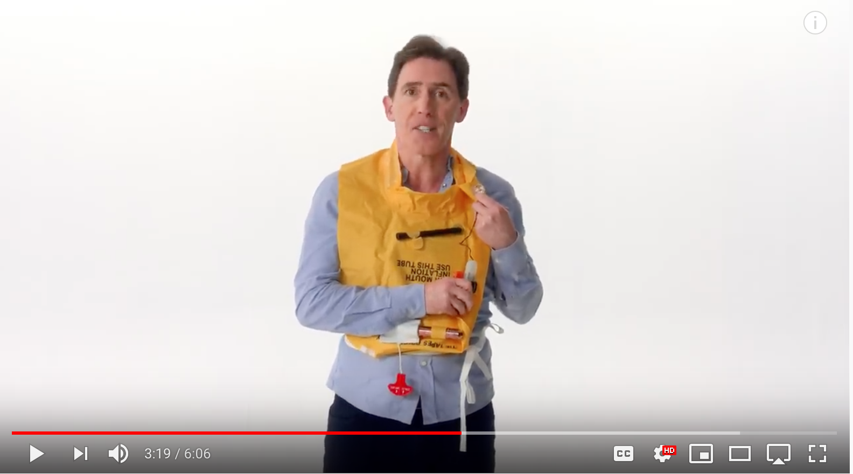
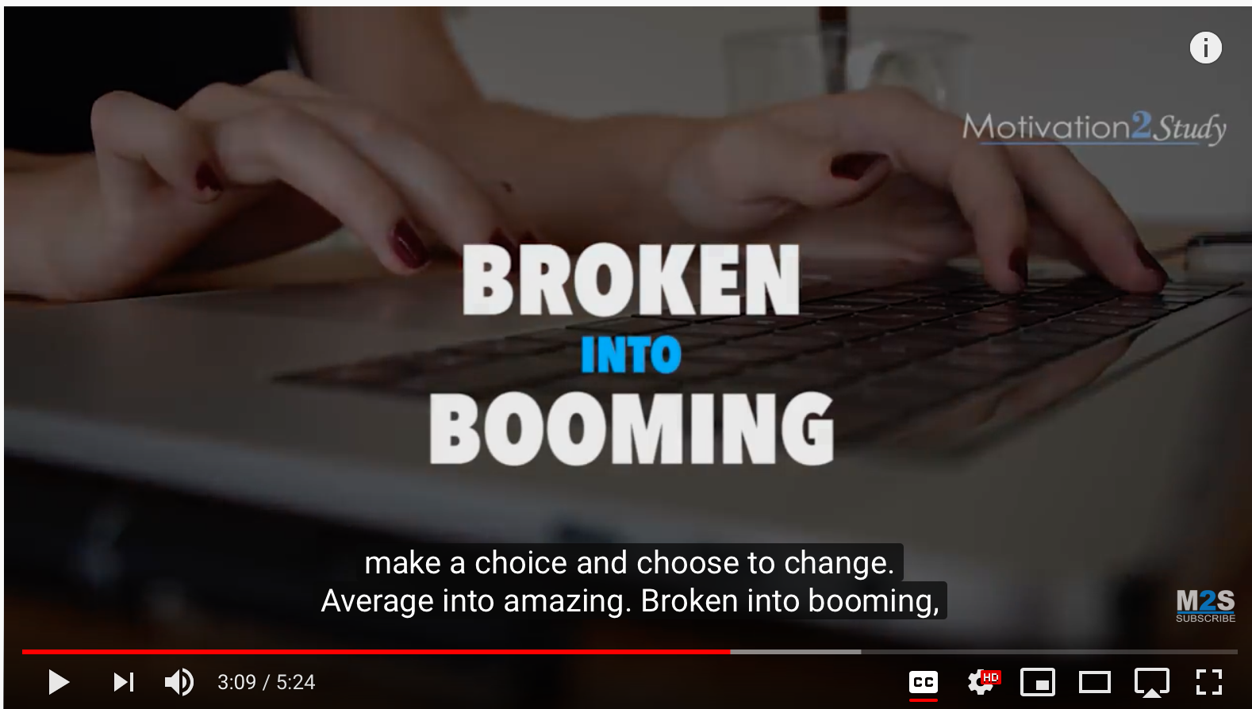
Effect of Motivation on Exam Scores in College Students
Mariel Mustello
Dr. Ryan O’Loughlin
Introduction
Method
Results
Students at any level are primarily interested in the grade they receive on an assignment (academic success) rather than instructor feedback (MacDonald, 1991). Abdulghani and colleagues (2014) identified a number of factors that contribute to academic success including prioritization of learning needs, time management, and family support.
One of the most common themes among studies assessing academic success is motivation. A number of studies have shown that higher motivation is associated with positive academic outcomes (Alivernini & Lucidi, 2011; Frymier & Shulman, 1995; Wolf, Smith, & Birnbaum, 1995).
One factor that increases motivation is media (Al-Eisa et al., 2016). Grant (2015) assessed the effect of motivational media on students in psychology classes. She did not find a significant effect of motivation on exam scores, however there were some limitations to her design. The manipulation of motivation was confounded with affect and presence of a video. Additionally, the test scores from her participants that were in different classes may not have been equivalent.
The current investigation addressed a number of the limitations of Grant’s (2015) study: participants in both conditions were exposed to a video and completed the same dependent variables.
It was hypothesized that those who watched a motivational video would perform better on an exam than those who watched a positive video.
Participants
Sixty-one (58 females and 3 males) psychology students participated in the research for extra credit.
Materials and Procedure
Participants watched one of two five-minute videos. Those in the control group watched a funny video by British Airways about flight safety (see Figure 1). Those in the experimental group watched a motivational video by ‘Motivation 2 Study’ (see Figure 2), which consisted of encouraging messages from a motivational speaker and inspiring music.
At the conclusion of the video, each participant was given a multiple-choice reading comprehension test with two passages, and questions following each. The first passage was about Ferdinand Magellan and land exploration, and the second was about Marie Curie. There were seven multiple choice questions associated with each passage.
The number of correct responses across both reading passages was added to create a total performance score (possible range 0-14).
Data was analyzed using an independent-samples t-test. There was no significant difference in exam score between those who watched the positive video and those who watched the motivational video (t (59) = 0.858, p > 0.05; d = 0.05). See the graph below for means.
Discussion
The hypothesis that those who watched a motivational video would perform better on a test than those who watched a positive video was not supported. The type of video viewed prior to taking an exam had no significant effect on exam score.
These results support previous research showing no overall effect of motivational media on academic success (Grant, 2015).
Future directions could include replicating this study in a real class environment to see if the results generalize when participation is not voluntary or incentivized with something other than a grade.
Figure 1: Funny video
Figure 2: Motivational video
“Now the air in this rather wonderful jacket can be topped up using this neat little mouthpiece. There’s also a charming whistle and light combination for attracting attention, should you be one of those people who enjoys attention.”
“I dare you, yes you, to make a choice and choose to change. Average into amazing. Broken into booming …”
Notes:
General Guidelines for Creating an Effective Poster
Posters need to be read by attendees from a distance of 3 feet or more, so lettering
on illustrations should be large and legible.
The title should be in very large type, 84 pt. or larger.
Do NOT use all capitals for titles and headings. It makes them hard to read.
Text on panels should be between 18 and 24 pt. to be legible.
Use double or 1.5 spacing between lines of text.
Keep each panel relatively short and to the point. More than 25 lines won't
get read, but 15 to 18 usually will.
Framing the text by putting a box around it will also help readers to focus.
Choose a simple font such as Times, Helvetica or Prestige Elite and stick with it.
Avoid overuse of outlining and shadowing, it can be distracting.
To make something stand out, use a larger font size, bold or underline instead.
Whenever possible, use graphs, charts, tables, figures, pictures or lists instead of
text to get your points across.
Make sure your presentation flows in a logical sequence. It should have an
introduction, body and conclusion, just like any other presentation.
Posters don’t need to be "arty". Simplicity, ease of reading, etc., are more
important than artistic flair.
In a room full of posters, consider the visual impact your presentation needs to
make in order to attract readers.
Use colors behind panels to increase contrast and impact, but avoid fluorescent
colors which will make things hard to read when someone gets closer.
Consider bringing extra copies of your data and conclusions.

