Slide 1
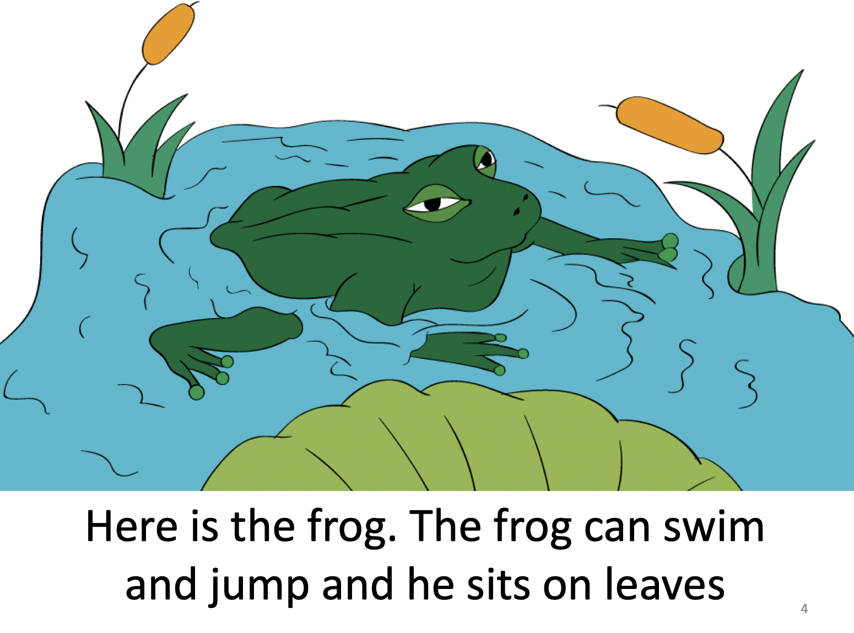
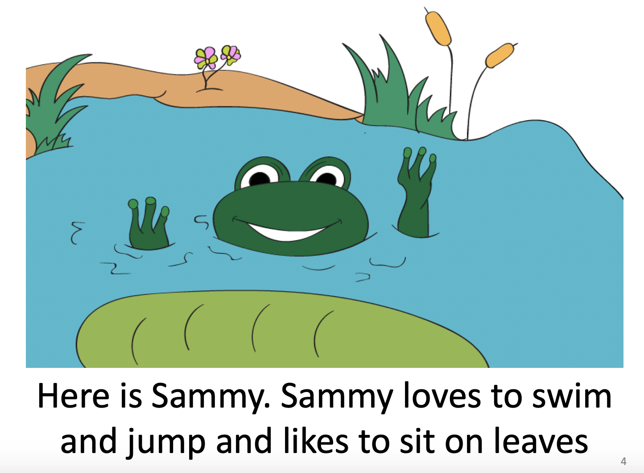
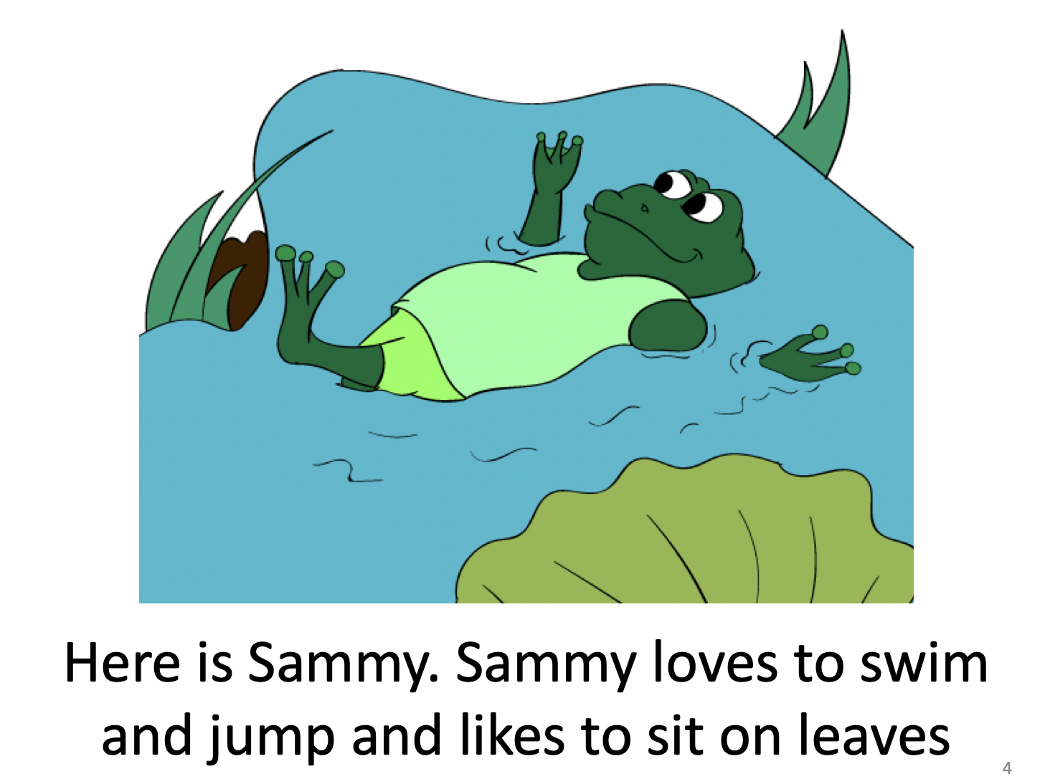
Children better recalled relevant facts about color camouflage from a realistic storybook than anthropomorphic books. Individual differences also influenced learning.
Lessons from Storybook Animals: Understanding the Influence of Anthropomorphic Media on Children’s Learning
Megan Conrad, Emily Trachtenberg, Sabrina Ramos, Victoria Vlassakis
William Paterson University
INTRODUCTION
Many children begin to engage with the natural world through storytelling
Understanding the impact of anthropomorphic representations of non-human animals in storybooks
Some previous studies have found that anthropomorphism has a negative impact on factual learning and biological reasoning (Ganea, Canfield, Simons & Chou, 2014; Waxman, Herrmann, Woodring, & Medin, 2014)
Other studies find that constrained anthropomorphism does not impact learning (Ganea, Ma, & DeLoache, 2011; Geerdts & Marcovitch, 2015; Geerdts, Van de Walle, & Lobue, 2016)
Current study goal: include multiple levels of anthropomorphism; considering the role of individual differences in anthropomorphism
RESULTS
Anthropomorphic Language (AL)
Pre: No children spontaneously used AL
Recall: No children in Storybook A used AL; 42% in Storybook B and 33% in Storybook C Explanation post-test: 17% in each of condition
Color Camouflage in Story Recall
83% in Storybook A, but only 33% in Storybook B and 42% in Storybook C; X² (2, N = 36) = 6.91, p = .032.
Camouflage Knowledge: Generalization
Generalization scores were low in Storybook B (M = 3.50, SD = 1.62) ; but high in Storybook A (M = 5.42, SD = 1.51) and Storybook C (M = 5.75, SD = 1.60); F(2,35) = 7.11, p = .003
More used color camouflage as justification in Storybook A (42%) than in Storybooks B and C (23%), chi-square p = .086
Camouflage Knowledge: Explanation
Explicit camouflage knowledge was low both at pre-test (2.8%) and post-test (11.1%) across all conditions
Individual Differences
Higher IDAQ scores were found in those who used anthropomorphism at post-test, t(34) = 1.74, p = .045
METHOD
Participants: Thirty-six preschool-aged children (M = 4.7 years, 18 female)
Baseline Measures: The Individual Differences in Anthropomorphism - Child Questionnaire (IDAQ-CF; Severson & Lemm, 2016)
Experimental Storybook Conditions:
Storybook A: non-anthropomorphic Storybook B: slightly anthropomorphic Storybook C: heavily anthropomorphic
Post-test Measures:
Storybook free recall
Camouflage generalization task
Which of these frogs would the bird eat? Why? What is camouflage?
DISCUSSION
Need larger sample size
Explore other individual differences (animal interest and knowledge, pets)
Books about non-biological properties
Examine differences in explanation/recall versus generalization
Other kinds of anthropomorphic representation
Storybook A
Storybook B
Storybook C
To obtain a copy of this poster,
scan this QR code OR email
Dr. Megan Conrad geerdtsm@wpunj.edu

