Slide 1
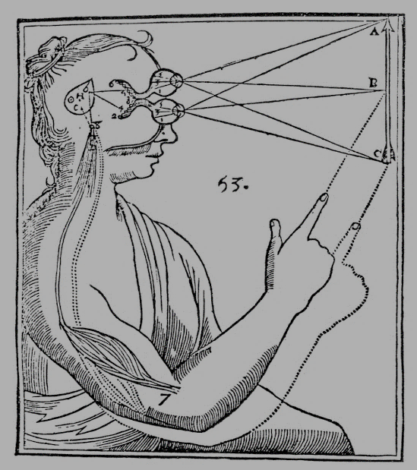
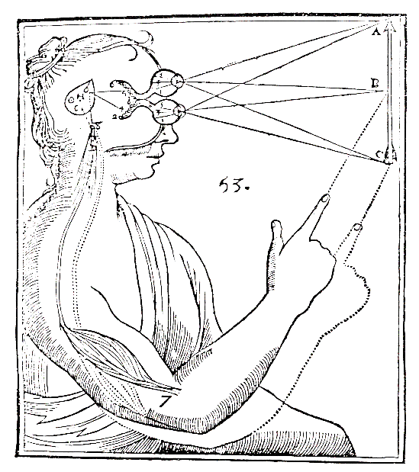
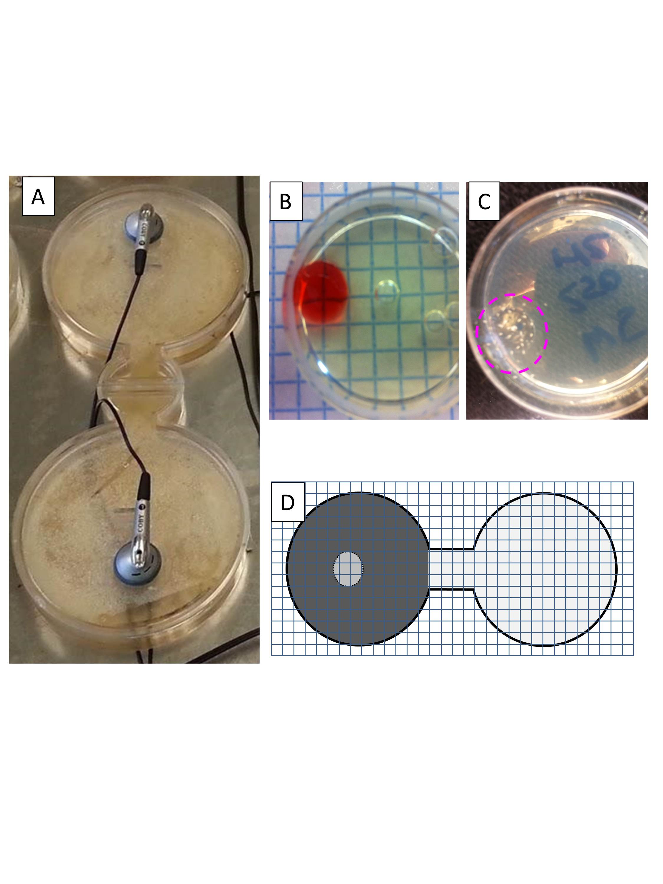
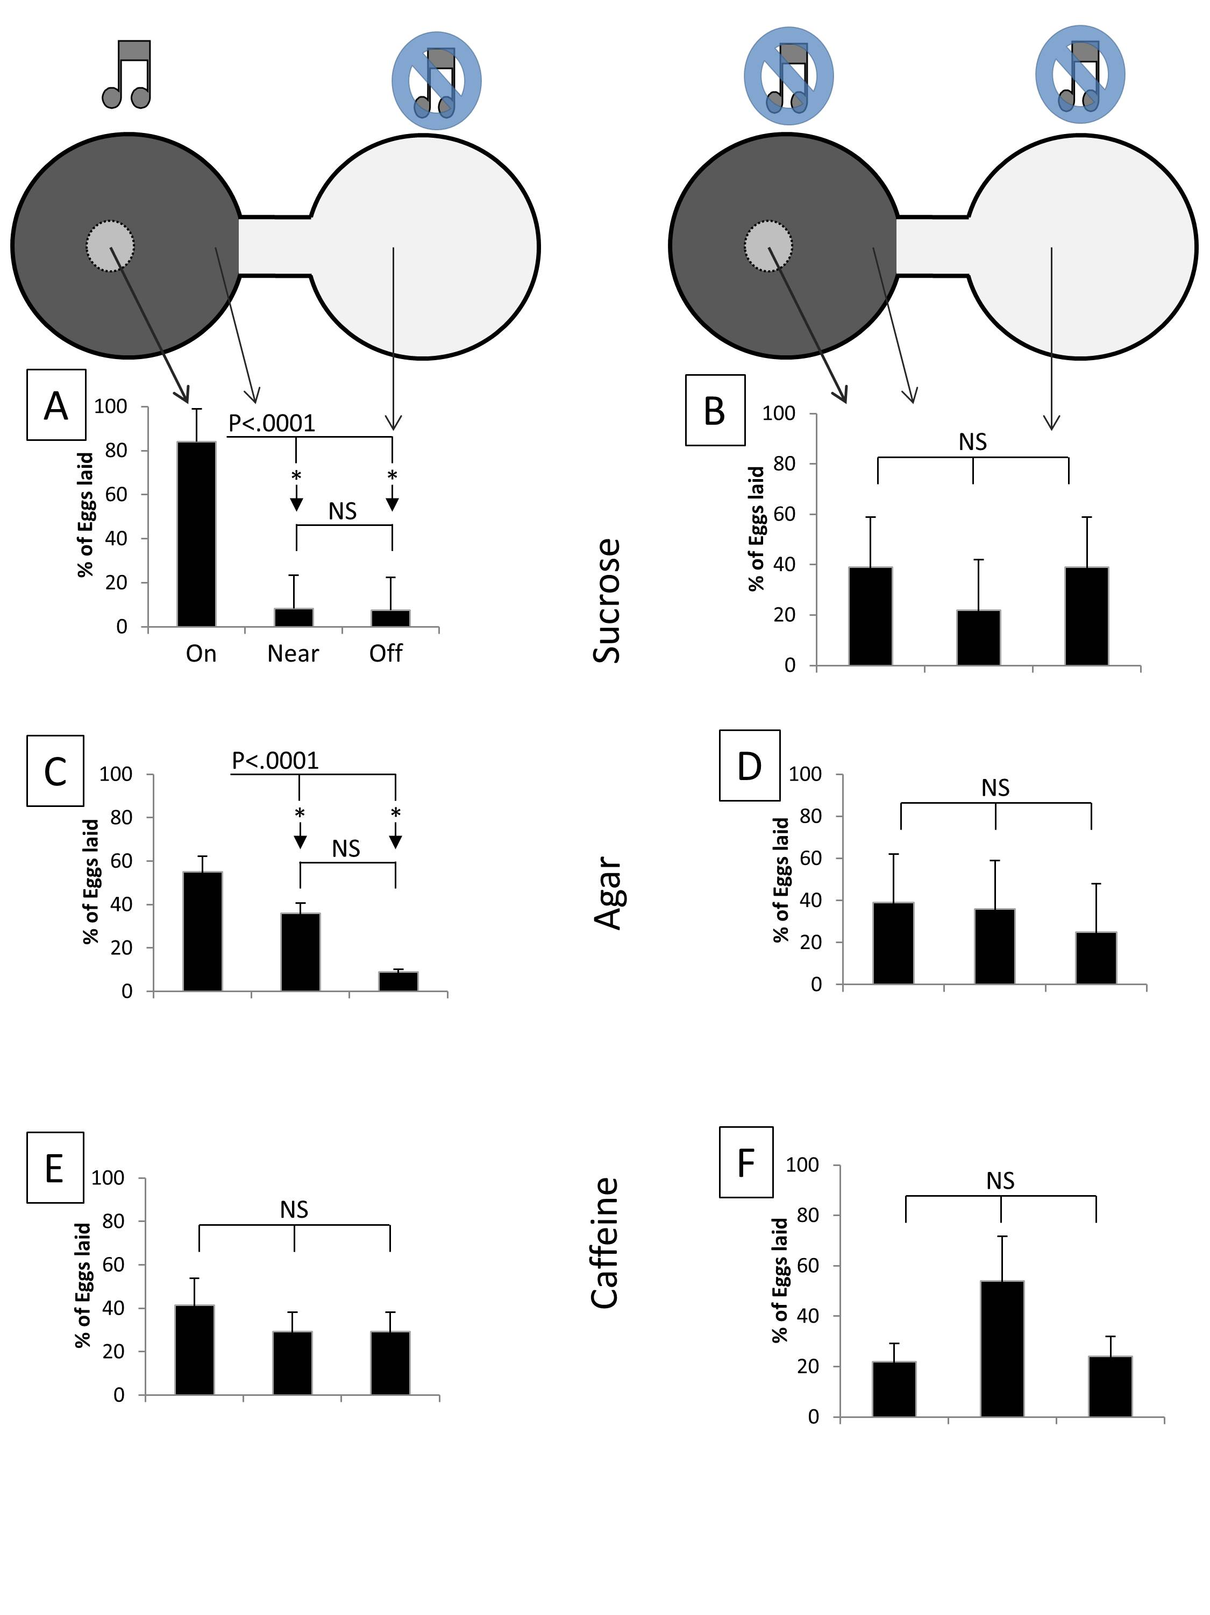
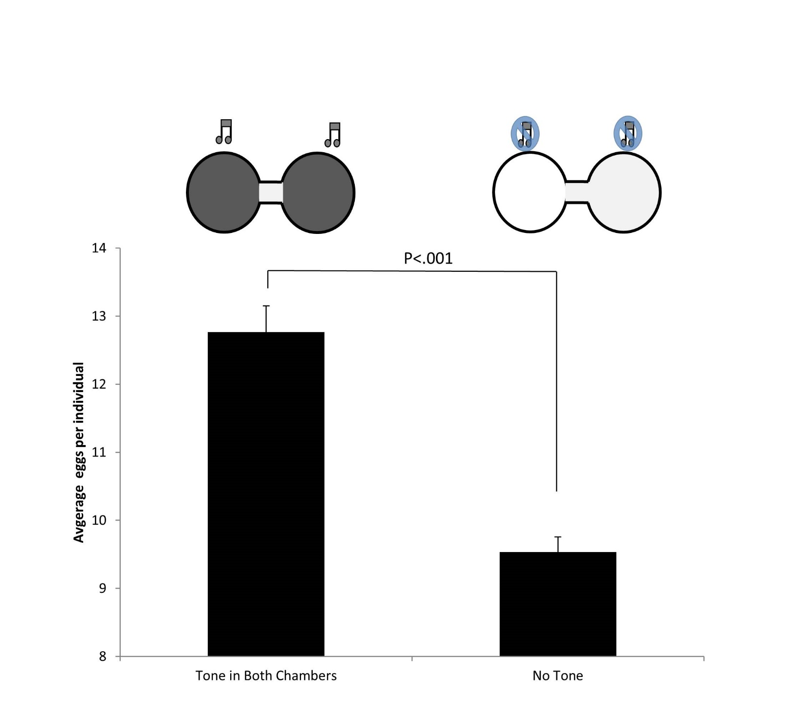
Acoustic stimulus influences ovipositioning in Drosophila melanogaster Caroline Dial, Alex Kuhl, Sydney Rosen, Maria Linietsky, Abigail Straus, Alexa Decker & Julian Paul Keenan Cognitive Neuroimaging Lab Montclair State University , Montclair NJ
The Cognitive Neuroimaging Laboratory
Biology and Molecular Biology
Montclair State University
The Cognitive Neuroimaging Laboratory
Biology and Molecular Biology
Montclair State University
In a Glance
The actual plates used (A) had speakers affixed in all condition. To demonstrate the spread and location of the substrate dye was employed (B) in a separate series of dishes to confirm the near zone. Actual eggs laid (C) and the overall cartooned representation (D) of the experiment are displayed.
Drosophila melanogaster utilize numerous environmental factors to assess the available resources while simultaneously evaluating protection for their offspring in determining ovipositioning. While a number of physical stimuli have been examined, auditory stimuli has not. In order to assess their tone preference and to confirm previous findings, 120 female Drosophila melanogaster were tested. Their ovipositioning preferences were measured by counting the amount of eggs laid in areas categorized as On, Near, and Off relative to tone location. A 250 Hz tone was presented either to one side of a forced choice chamber, presented on both sides, or there was no tone. Also within the study, substrates (sucrose, caffeine, and none) were varied. It was found that Drosophila melanogaster laid significantly more eggs under the tone (p < 0.001) compared to controls. This study demonstrates that female Drosophila melanogaster may positively associate 250 Hz tone. The evolutionary implications of such behavior are investigated.
The most dramatic interaction of conditions was when the tone was paired with sucrose. Drosophila melanogaster laid significantly more eggs in the On position with this pairing (p<.0001) compared to the other conditions (A). With Agar only, tone also had a significant resulting in more eggs laid under the tone (C). In all other conditions (B, D, E, F), there were no differences. Not shown are conditions with tones played to both chambers or tones played to the opposite chamber.
In Drosophila, acoustic information is relayed by Johnston organ neurons from the antenna to the antennal mechanosensory and motor center (AMMC) in the brain (Matsuo et al., 2014).
Activation of female-specific oviposition descending neurons (oviDNs) is necessary and sufficient for egg laying, and is equally potent in virgin and mated females. After mating, sex peptide—a protein from the male seminal fluid—triggers many behavioral and physiological changes in the female, including the onset of egg laying. Sex peptide is detected by sensory neurons in the uterus and silences these neurons and their postsynaptic ascending neurons in the abdominal ganglion (Wang et al., 2020).
Drosophila melanogaster laid the greatest number of eggs when tone was presented to both chambers compared to no tone (p<.001; see text). Data are presented across all level of substrate.
Please contact Julian Paul Keenan with any questions: julianpaulkeenan@gmail.com
www.cognitiveneuroimaginlab.com

