Slide 1


MySQL Advantages for Delivering a HA &
Scalable Database Solution
Presented by Srinivasa (Krishna) Mamillapalli Senior MySQL DBA
Datavail, ©2015

Slide 2

Srinivasa “Krishna” Mamillapalli
Sr. MySQL DBA with 10+ years of DBA Experience.
MySQL 4.x to 5.6.x
Percona MySQL
MongoDB
Amazon Redshift
About Me

Slide 3
- Largest pure-play database services provider in North America
- More than 300 clients
- More than 400 DBAs
- 24×7 managed database services, database design, architecture, and staffing.
About Datavail

Slide 4
MySQL Introduction
The world's most popular open source database.
Provides a free, open source relational database management system.
Can virtually run on almost any hardware.
Easy to install, manage and maintain.
MySQL is very fast, extremely reliable, scalable.
Widely deployed by many companies and organizations throughout the world.

Slide 5
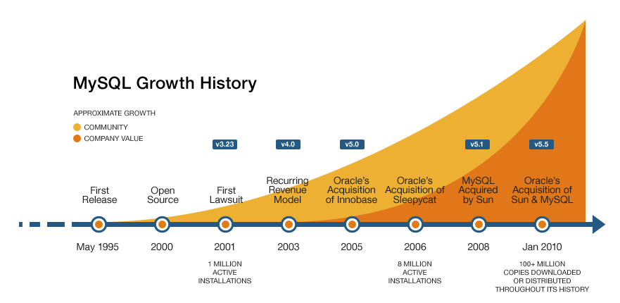
MySQL Evolution

Slide 6

MySQL 5.6 : 2010
5.6.10 : GA release - 2011
MySQL 5.7 : 2013
5.7.9 : GA release Oct 2015 (NEW)
MySQL Evolution Continues…
Other MySQL Forks
Percona/TokuTek
MariaDB
Galera
Drizzle

Slide 7
MySQL Solutions used in..
Education
HealthCare
Technology (SW/HW)
Financial Services
Ecommerce
Gaming/Entertainment
Telecom
Travel
Social Networking and so on…

Slide 8



























MySQL Customers

Slide 9
MySQL Merits
Easy to Use
Portable – Supports Almost Every Physical and Virtual Environment
Open Source/Cost Effective
Very Flexible – Pluggable Storage Engines
Highly Secure
Oracle made a lot of Improvements to the Enterprise Model
Many Contributions from the Open Source Groups

Slide 10
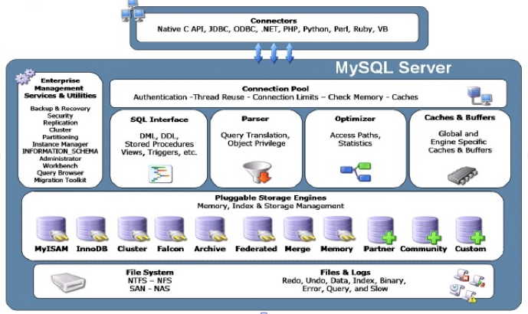
MySQL Architecture

Slide 11
MySQL Storage Engines
MyISAM
InnoDB/XtraDB
TokuDB
MariaDB
Memory
NDB
CSV and so on…

Slide 12
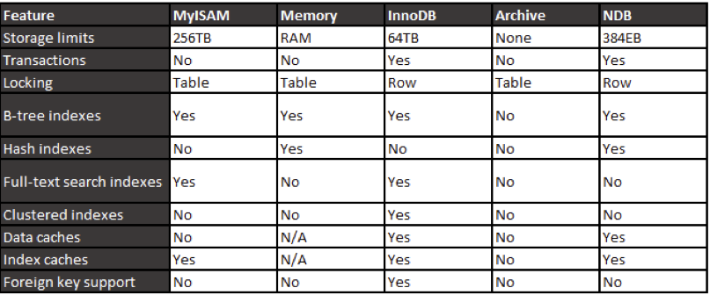
Quick Comparison

Slide 13
MySQL Supports..
Views
Indexing Types
Stored Functions
Stored Procedures
Cursors
Triggers
Event Scheduler

Slide 14
InnoDB-TokuDB-MariaDB
Transaction Safe
MVCC,ACID support
InnoDB compression
TokuDB
  Significant IO reduction
  5x Compression, 90% reduction in size
MariaDB – More Enhanced

Slide 15
MySQL High Availability
Replication Topologies
M-S,M-M and Chained Replication, etc.
Data integrity with GTID
Multi-threaded replication slave
Faster Failover/Failback support
Geographic Redundancy for DR
mysqlfabric
MHA
MMM, etc.

Slide 16
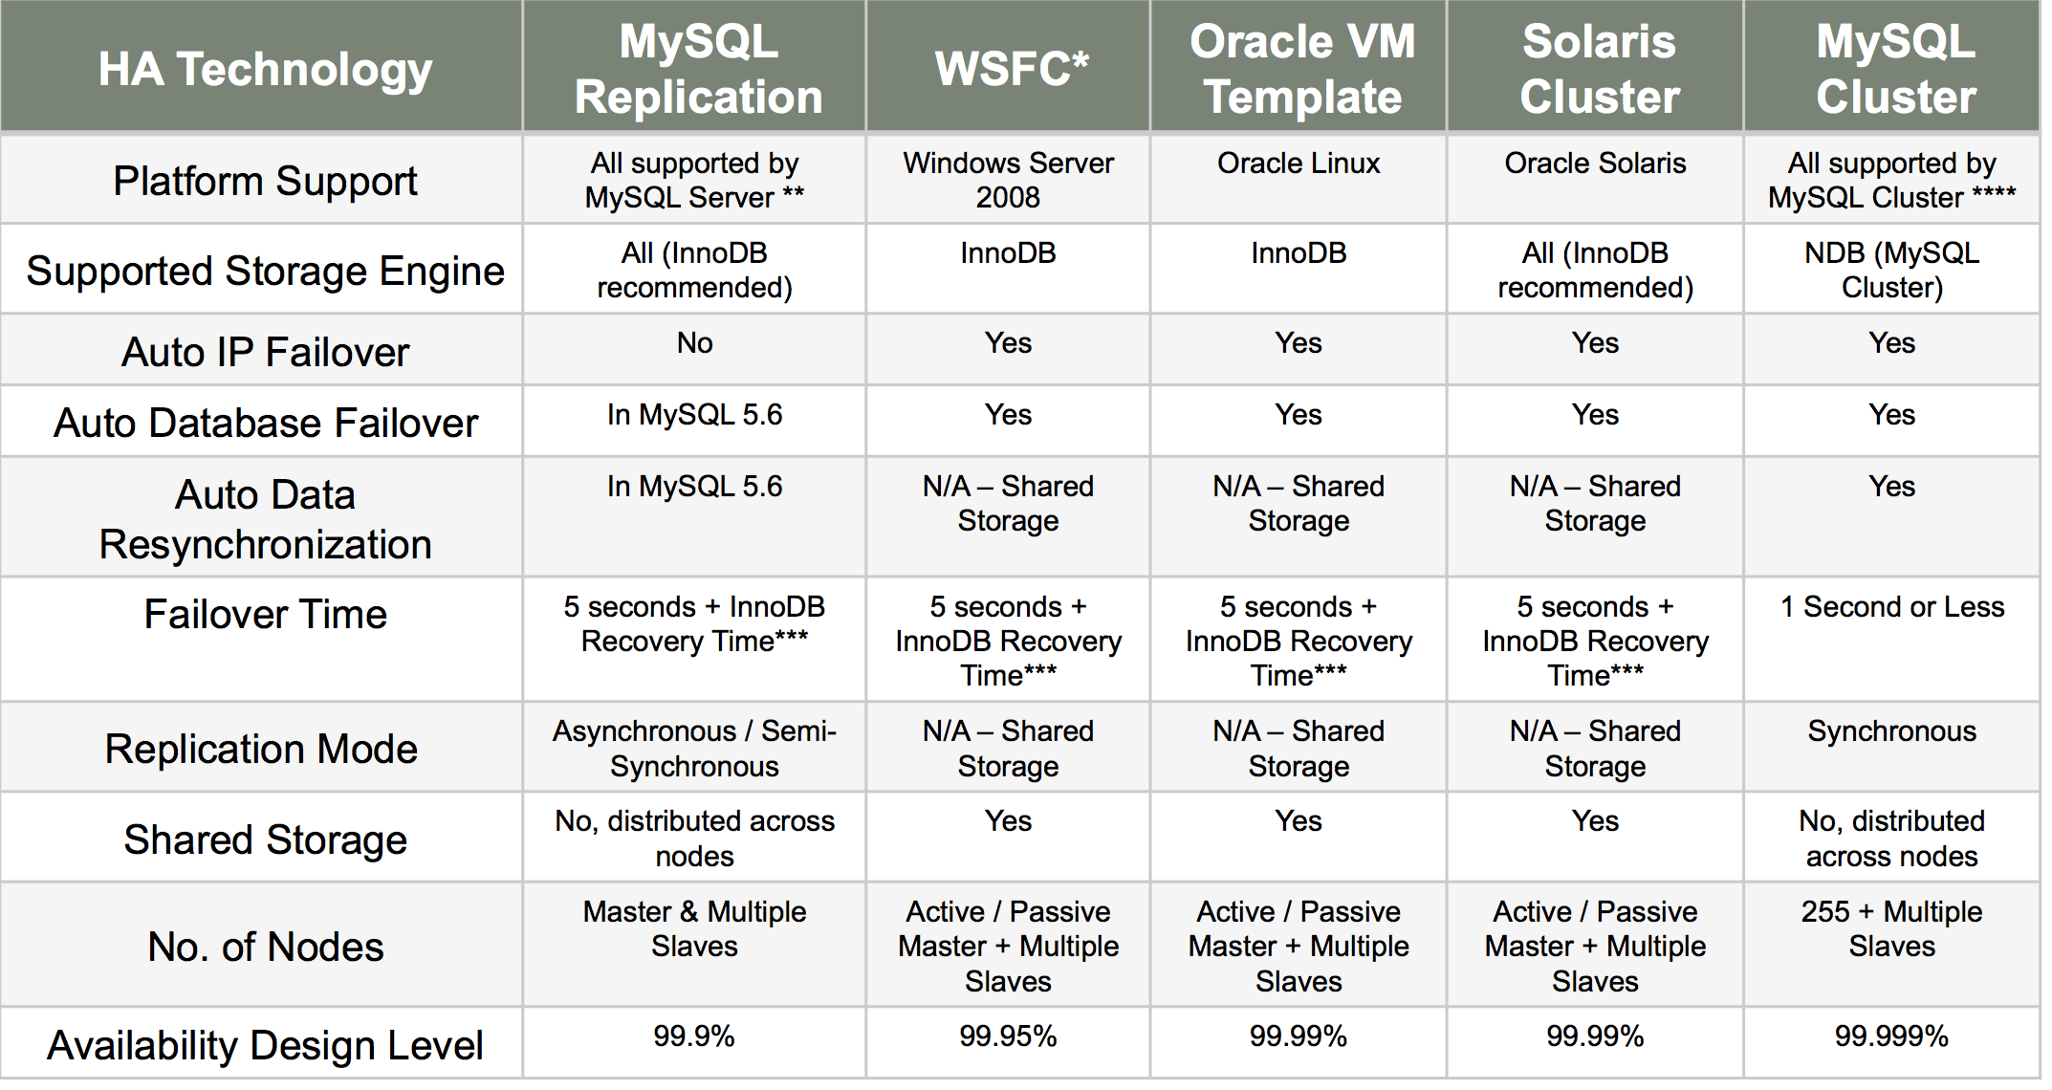
MySQL HA Comparison

Slide 17
HA Clustering solutions
MySQL NDB Cluster
Percona XtraDB Cluster
MySQL Galera Cluster
MySQL/DRBD
Cloud based – AWS RDS/EC2,etc.
Supports Windows Clustering
Oracle Enterprise VMs

Slide 18
MySQL Scalability
  Distribute Traffic on Replicated Nodes(Slaves).
  Synchronous Replication
  Supports Multiple CPU cores
  Supports High read-write intensive work loads
  Supports Partitioning and Sharding
  MySQL and Memcached
  Oracle Benchmarking Results:
  MySQL InnoDB scale up to…
    250K QPS(5.6.x, 32 cores), 500K QPS(5.7.x, 64 cores)
    10K Tnx/sec for OLTP Read/Write
    14K Tnx/sec for OLTP Reads
    8K Concurrent User Connections
  MySQL Cluster 7.4
  200 Million NoSQL QPS
  2.5 Million SQL statements per second

Slide 19
Performance Metrics
INFORMATION_SCHEMA Objects
Profiling
PERFRMANCE_SCHEMA Objects
SYS Schema
Benchmarking - mysqlslap
Load balancing - mysqlproxy

Slide 20
MySQL APIs/Connectors
Supports Development interfaces include
Connectors
  Java,
  C,C++
  .NET
  Python
  ODBC
PHP
Perl
XML support

Slide 21
MySQL - Big data approach
InnoDB + NoSQL support
MySQL and Hadoop
MySQL Cluster: NoSQL API
JSON support
HandlerSocket NoSQL - Percona Plugin
Cassandra NoSQL - MariaDB Plugin

Slide 22
MySQL Backup/Recovery
Logical backups
  mysqldump
  mydumper/myloader
Physical Hot backup/Consistent backups
  MEB – MySQL Enterprise Backup
  PXB – Percona Xtrabackup.
Snapshot backups: LVM and FS snaps.

Slide 23
MySQL Security
User/Host specific login
Access Control/Privilege based access
Secure Password authentication/hashing
Password Validation/Expiry.
PAM/LDAP Authentication.

Slide 24
MySQL Tools
Oracle MySQL Workbench utilities
  migration toolkit
  mysqlserverclone
  mysqlreplicate
  mysqlfailover
  mysqlrplsync
Pecona Toolkit
  pt-online-schema-change
  pt-query-digest
  pt-table-checksum
  pt-table-sync

Slide 25
MySQL Limitations
No limits on number of databases/tables. Matches FS limits.
Max Table size cannot grow past to 64TB(InnoDB), MyISAM(>256TB/OS limits).
Max Row size 65,535 bytes.
MyISAM – Table Level Locks.
InnoDB limits on 1000 columns/table.
Consistency issues with a mix of non-Tnx(MyISAM) queries inside a Tnx(InnoDB).
Might be slow on systems with Larger Tnx sizes with fewer commits.
Performance issues on Cloud-RDS.

Slide 26
MySQL Enterprise Solutions/Tools
MySQL Enterprise Monitor
MySQL Enterprise Backup
MySQL Enterprise HA/Scalability
MySQL Enterprise Authentication
MySQL Enterprise Encryption
MySQL Enterprise Firewall
MySQL Enterprise Audit

Slide 27
What's New in MySQL 5.7.9 (GA) Just last week
JSON support
Multi-Source Replication
Virtual Columns
Multiple Triggers/multiple events per table
Optimizer improvements
1,600,000 queries per second (QPS)
3x faster than MySQL 5.6

Slide 28
MySQL Support
Many OpenSource Groups
User Groups/Forums
Community Support
Enterprise Support
Datavail Support

Slide 29
MySQL Customer Case Study 1
$20 Billion in revenue
Fortune 150 company
KIND OF COMPANY (ie financial services)
16,500 employees worldwide
Datavail supports this MySQL environment.
  Geographically distributed.
  Multiple regions for availability and scalability
  DR Solutions.

Slide 30
MySQL Customer Case Study 2
$300 Million in revenue
17 Million customers worldwide
Datavail supports this MySQL environment, which is one of the world’s largest MySQL Enterprise customer.
  Using MySQL 5.6.x
  Geographically distributed.
  Multiple regions for scalability and availability.

Slide 31
References
www.mysql.com
www.oracle.com
www.percona.com
www.databasefriends.co
Questions?

