Slide 1
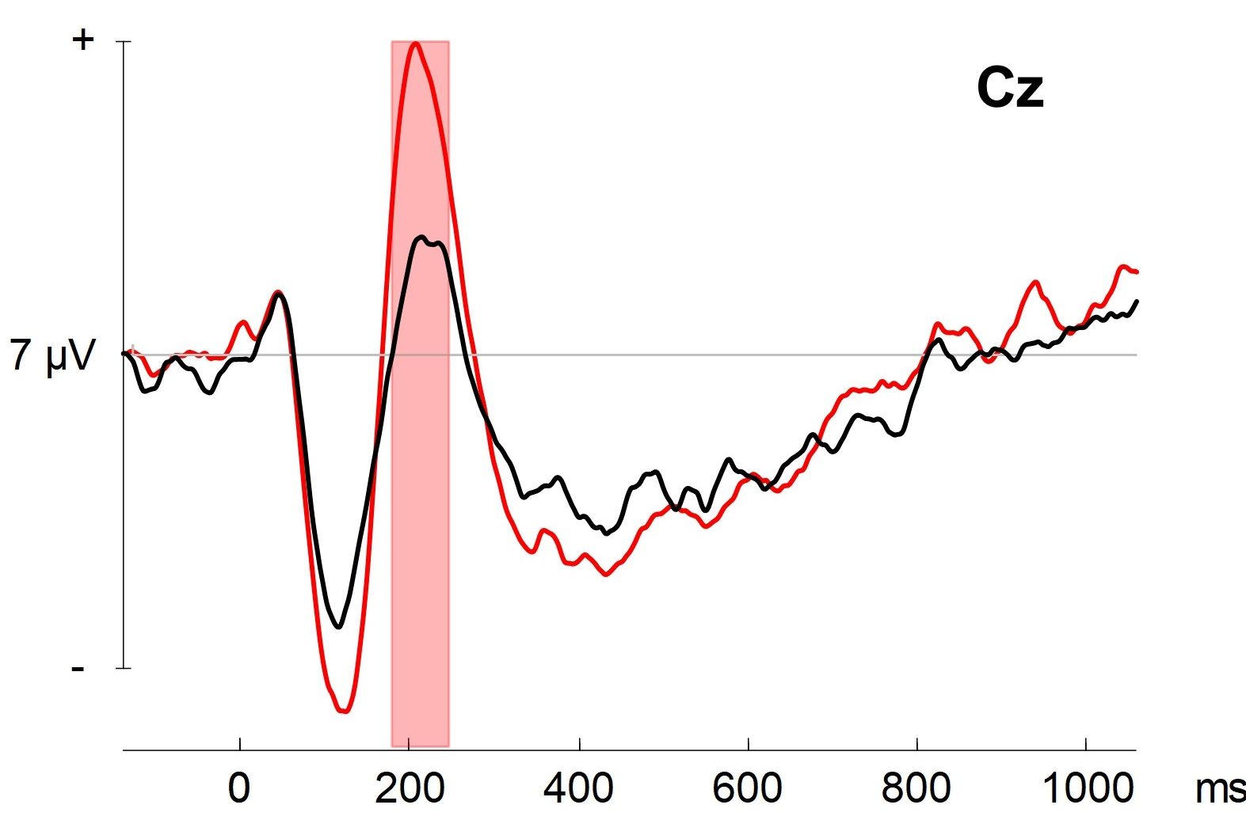
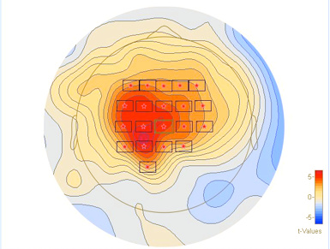
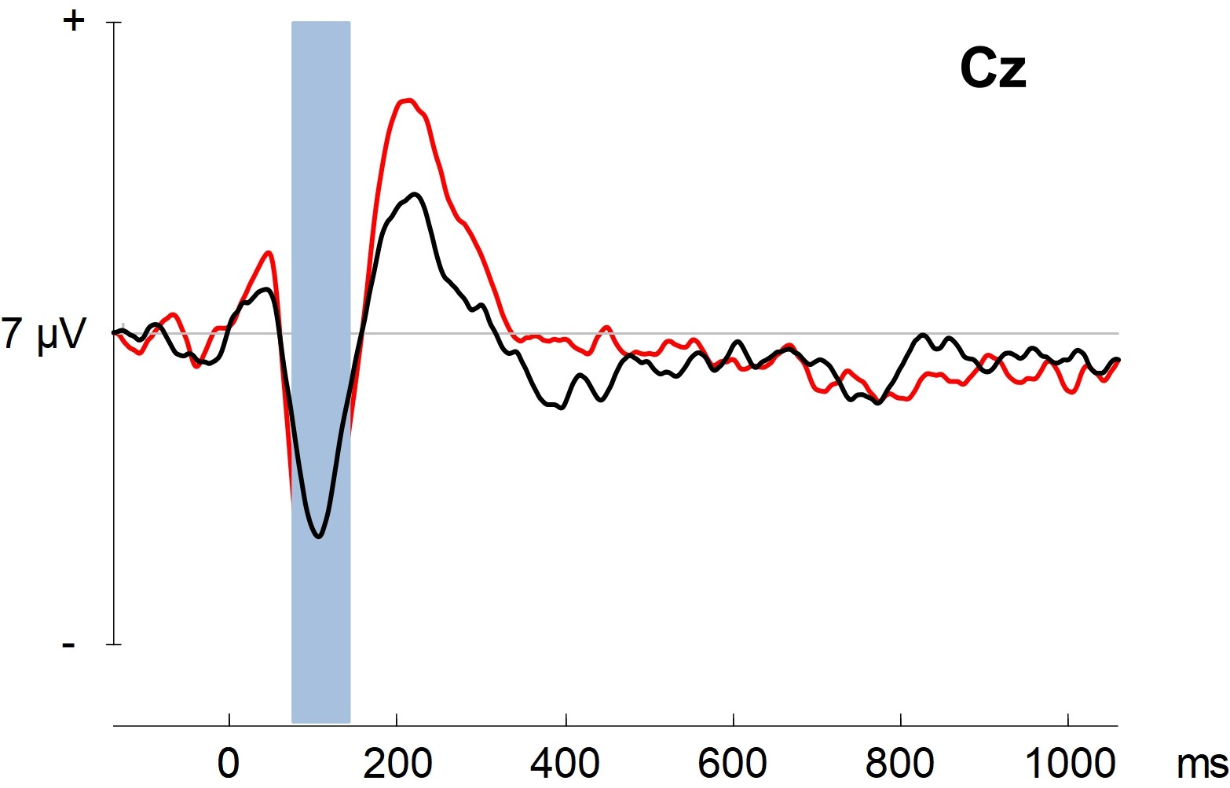
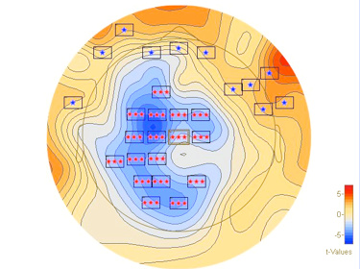
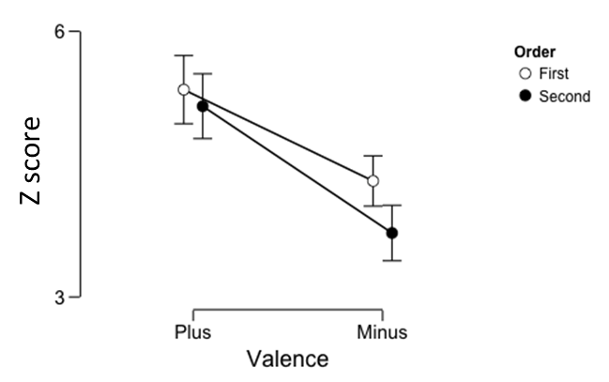
Distinct Electrophysiological Responses to Aversive First-Order and Higher-Order Conditioned Stimuli
Prateek Dhamija^{1,2}, Allison Wong^{1,2} and Asaf gilboa^{1,2}
^{1.}Rotman Research Institute; Baycrest Health Sciences ^{2.} Department of Psychology; University of Toronto
Introduction
Results
Research Question I: Can we establish Higher Order conditioning in Humans?
Research Question II: Do first order and higher order conditioning elicit distinct ERP’s?
Distinct Timing of ERP responses
CS+ and HO+ Have
Distinct Sources
First Order Test
Behaviour motivated by higher order associations, rarely first order learning
Higher order (HO) stimuli indirectly associated with a reward/punishment
HO stimuli acquire value from a first order (FO) stimuli that is directly associated.
Higher order associations are not well understood and difficult to observe in humans.
First Order Conditioning and Higher Order conditioning are mediated by distinct neural structures in rodents.
Hippocampal lesions prevent anterograde and retrograde higher order conditioning only
Suggests they are distinct processes ⁽¹⁾
FO+
FO-
Bootstrap Cluster p = .002; Max Right Basal Ganglia/Insula
Higher Order Test
FOC:
US
CS
HOC:
CS
HO
Method
HO+
HO-
Bootstrap Cluster p = .04; Max Right Hippocampus
Participants hear 2 tones on each trial.
Participants establish FO conditioning using variable schedule punishment
24 hours later for higher order conditioning, first order tone testing and higher order tone testing
Greater Pupil Dilation in CS+ and HO+ than CS- and HO-
Correlated Mean ERP Amplitude and Max Pupillometry Z-scores at Early and Late Peak
Pupil Dilation to examine autonomic responses to FO± to HO± tones
ERP to examine neural responses
n = 13, age = 54.42 years
95 ms - 165 ms
2nd Order
1st Order
195 ms – 265 ms
2nd Order
Day 1
FOC
CS± →US±
80 trials
FOR
CS± → US±
20 trials
HOC
CS± → HO±
48 trials
FOT
HOT
CS± alone
48 trials
HO± alone
48 trials
p = .309
p = .085
p = .049
p = .868
*
Z-score of Pupil Dilation from Baseline
Day 2
Stimuli
US+ | Burst of white noise
US - | Tone 1
CS + | Tone 2
CS - | Tone 3
HO + | Tone 4
HO - | Tone 5
Conclusions
Research Question I: Participants transferred value from an acquired CS+ to an HO+
evidence of higher order conditioning in humans
Research Question II: First order and higher order conditioning may elicit distinct ERP’s from distinct sources. →Insula for FOC and hippocampus for HOC.
Understanding FOC and HOC as separate processes may help understand instigation of addiction-related behaviours.
References: 1. Gilboa, A., Sekeres, M., Moscovitch, M., & Winocur, G. (2014). Higher-order conditioning is impaired by hippocampal lesions. Current Biology, 24(18), 2202-2207.
Notes:
So in this experiment, we examined higher order conditioning. There has been a lot of research investigating first order associations, or the connections between a stimulus and its direct outcome.
Higher order associations are stimuli that are indirectly associated to a reward or punishment through a conditioned, first order stimulus. In fact, much of our behaviour is thought to be motivated by these higher order associations, rather than first order associations. Unfortunately, higher order conditioning is not well understood.
Previous rodent literature suggests that first order and higher order conditioning take place in distinct regions. Namely that first order conditioning does not require the hippocampus, however higher order conditioning does.
In this experiment, we aimed to establish first order and higher order conditioning in humans using aversive auditory stimuli and to determine if first order and second order conditioning elicit distinct electrophysiological responses.

