Slide 1
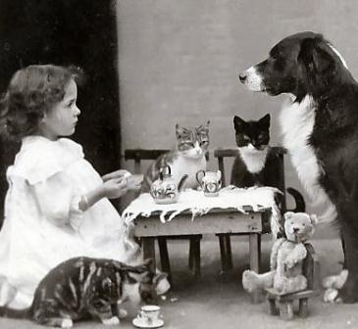
Culturally-Responsive EI/ECSE Teams
Dr. Jennifer Kilgo
University of Alabama at Birmingham (UAB)
jkilgo@uab.edu

Slide 2
Abstract
This session will highlight effective strategies to prepare transdisciplinary teams of scholars to:
Provide services to children and families representing increasingly diverse cultural backgrounds and structures.
Think outside the box about:
HYBRID FAMILIES,
CULTURAL ASPECTS OF FAMILIES, and
PREPARATION FOR SERVING FAMILIES REPRESENTING DIVERSE BACKGROUNDS AND STRUCTURES.
Use a team-based problem-solving approach to engage in meaningful collaboration designed to honor family diversity in providing culturally responsive services.

Slide 3
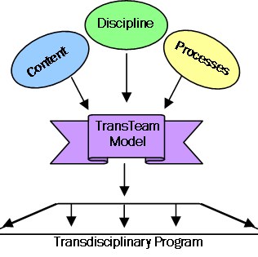
Project TransTeam at UAB
School of Education
Early Childhood Special Education
General Early Childhood Education
Health Related Professions
Physical Therapy
Occupational Therapy
Communication Disorders

Slide 4
Project TransTeam Program Components
Transdisciplinary Courses and Seminars
Teaming Skills (e.g., role sharing, role release, conflict resolution, problem-solving)
Evidence-based Practices
Transdisciplinary Applications
Transdisciplinary Field Experiences

Slide 5
Focus on Dimensions of Culture
Ethnicity
Family Structure
Religion
Socioeconomic (Poverty)
Linguistic
Disability
Age
Gender
Sexual Orientation

Slide 6
Visible and Other Aspects of Culture
--VISIBLE
Appearance
Dress
Food
Dance
Language
Music
Activities
--OTHER ASPECTS
Time
Emotion
Status
Importance of the Individual vs. the Group
Communication Style
Autonomy

Slide 7
Hybrid Families
What are hybrid families?
Hybrid families are NOT just blended families. Blended families are like The Brady Bunch, even if Mike and Carol Brady had children from their new marriage.
Hybrid families have, produce, or experience more than one culture OR have, produce, or experience one of more additional dimensions beyond The Brady Bunch.
Aldridge, Kilgo, & Bruton (in press)

Slide 8
How Scholars Can be Prepared?
READ AND LEARN as much as you can about the cultural background of the families and other team members with whom you work.
(NOTE: We cannot possibly be familiar with every cultural background.)
UNDERSTAND that in the 21st century there are many “hybrid” families and cultures.
When meeting with the family, let them know you are prepared AND ready to LISTEN and LEARN from them.
ASK appropriate questions and really LISTEN to the families.
“I read that people who practice the Sikh faith believe that all of life is sacred and that playing with food, such as eggs, is not appropriate. Is that true with your family? …Because ‘eating solid foods’ is a goal, what should we know to assist with this?“
Consider the nature of COMPROMISE. How much is required?

Slide 9
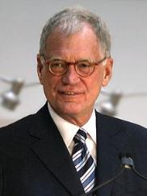
Our Top Ten List of Learning Strategies
10. Use “Know-Need to Know-Learn” (KNL)
9. Explore Definition of Family (including hybrid families)
8. Understand Dimensions of Diversity
7. Focus on Ethnic, Religious, Family, and Team Diversity
6. Use Specific Scenarios (one dimension of diversity)
5. Use Complex Cases (multiple dimensions of diversity)
4. Create Dissonance
3. Utilize Resources
2. Teach Specific Strategies
1. Use Team-Based Problem Solving

Slide 10
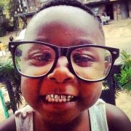
Project TransTeam Outcomes
Data collected from the following:
Over 300 scholars prepared
Scholars
Faculty
Employers
Family members
Community stakeholders

