Slide 1
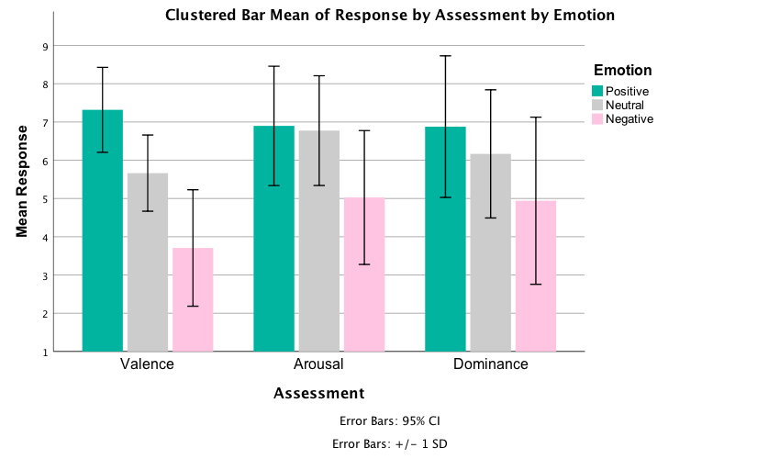
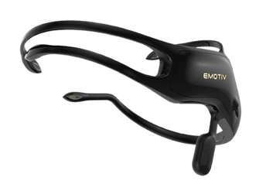
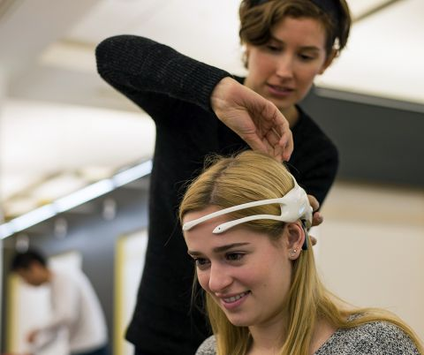
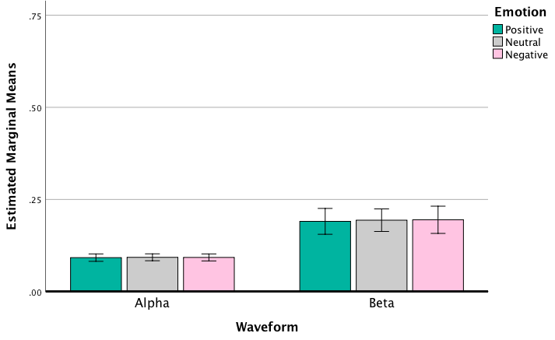
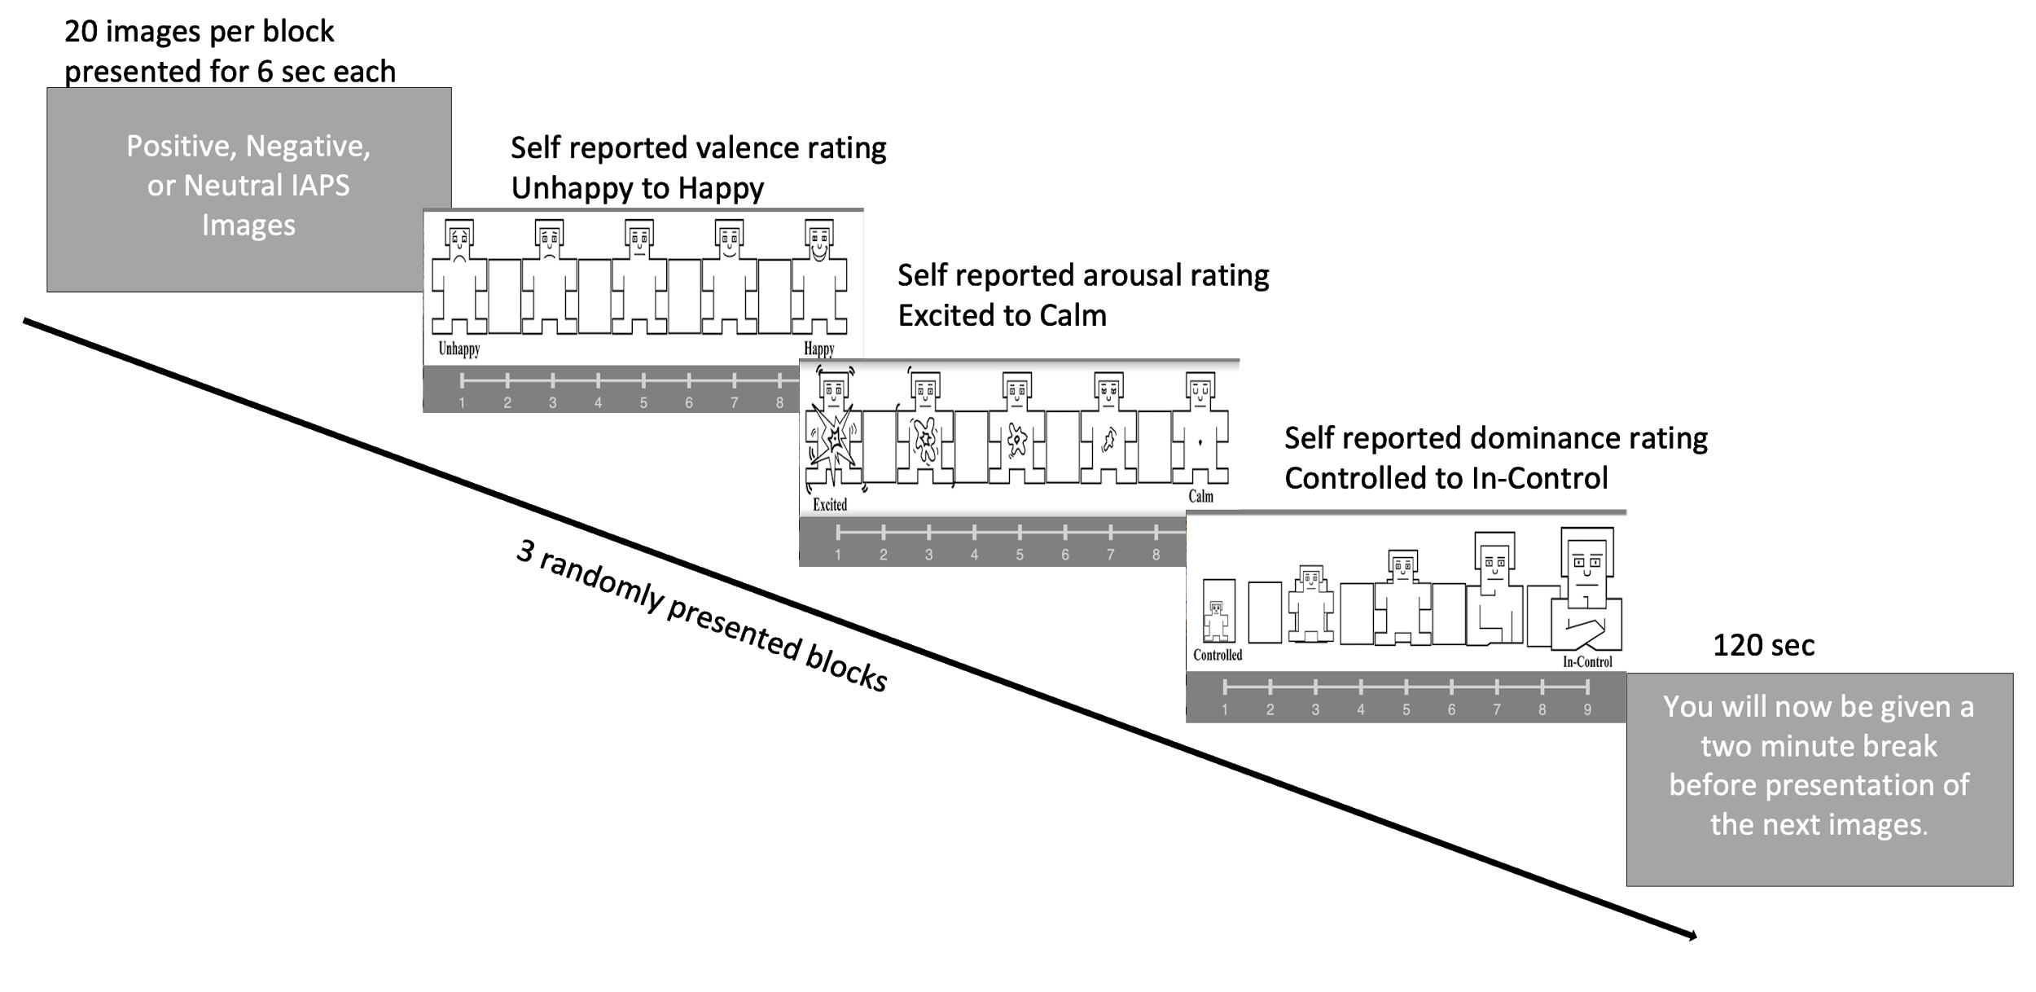
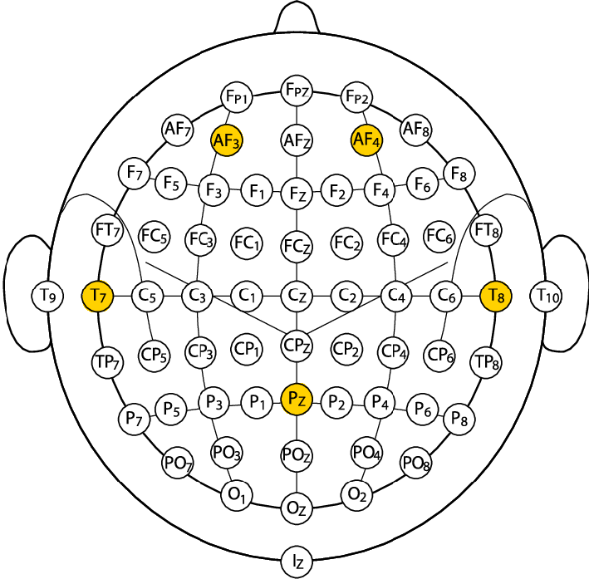
Efficacy of Consumer-Based EEG Devices for Conducting Future Research
Claire Simmons¹, Shenyang Huang¹, William L.D. Krenzer, PhD¹ & Nita A. Farahany, PhD, JD^{1,2}
¹ Duke University, ² Duke University School of Law
Introduction
Numerous electroencephalogram (EEG) studies have been done to detect fluctuations in individuals’ emotions, but few studies have been conducted which use cost effective consumer-based EEG devices to detect these emotions.
.
Objective
To evaluate the validity of a consumer-based EEG device, the Emotiv Insight, as a research tool.
Emotion: Self-Report Results
Materials and Methods
We recorded the brain activity from 29 participants (Female = 10; M_{AGE} = 26.34, SD_{AGE} = 12.93) while they randomly viewed three emotional blocks (positive, negative, and neutral) of 20 images each selected from the International Affective Picture System (IAPS) database, After each block, participants were asked to self-report emotional state (valence, arousal, and dominance) using the Self-Assessment Manikin scale.
Repeated measures ANOVA looking at the interaction between Emotional stimuli (Positive, Negative, and Neutral) by Assessment (Valence, Arousal, and Dominance) was statistically significant, F (4, 234) = 2.999, p = .019. Specifically we see that the Positive stimuli had significantly higher ratings of valence compared to both Neutral and Negative stimuli (all p ≤ .001). Additionally, both Positive and Neutral stimuli has significantly higher ratings in Arousal and Dominance compared to Negative stimuli (p < .001 and p ≤ .016 respectively).
Emotion: EEG Results
Positive
Negative
Neutral
A Repeated Measures ANOVA with the variables Emotional stimuli (Positive, Negative, and Neutral), Waveform (Alpha, Beta, Delta, Theta), and Electrode (AF3, T7, Pz, T8, AF4) showed the interaction between Emotion and Waveform was trending towards significant, F (6, 66) = 1.856, p = .17. This effect is being driven by the difference in Alpha power between the Positive and Neutral stimuli, t(66) = 3.57 , p = .015.
Conclusions
Emotion: Self-report survey responses indicate that emotional changes are occurring, EEG results show trending towards significant
This specific 5-channel consumer-based EEG device may not accurately detect emotion at a level consistent with use in research.
Contact Claire Simmons at cs568@duke.edu for questions
References
Zhang, X., Li, J., Liu, Y., Zhang, Z., Wang, Z., Luo, D., ... & Wang, C. (2017). Design of a fatigue detection system for high-speed trains based on driver vigilance using a wireless wearable EEG. Sensors, 17(3), 486.
Loo, S. K., Specter, E., Smolen, A., Hopfer, C., Teale, P. D., & Reite, M. L. (2003). Functional effects of the DAT1 polymorphism on EEG measures in ADHD. Journal of the American Academy of Child & Adolescent Psychiatry, 42(8), 986-993.
Lang, P.J., Bradley, M.M., & Cuthbert, B.N. (2008). International affective picture system (IAPS): Affective ratings of pictures and instruction manual. Technical Report A-8. University of Florida, Gainesville, FL.
Bradley, M. M., & Lang, P. J. (1994). Measuring emotion: the self-assessment manikin and the semantic differential. Journal of behavior therapy and experimental psychiatry, 25(1), 49-59.

