Slide 1
CARLETON GLOBAL ENGAGEMENT PROGRAMS
13-week fall programs offering Carleton College academic credit equivalent to 16 semester credits
Buddhist Studies in India
Women’s and Gender Studies in Europe
Ecology and Anthropology in Tanzania

Slide 2
Women’s and gender studies In europe
Utrecht, the Netherlands
Berlin, Germany
Krakow, Poland
Prague, the Czech Republic
Early September to late November

Slide 3
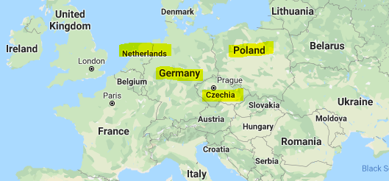

Slide 4
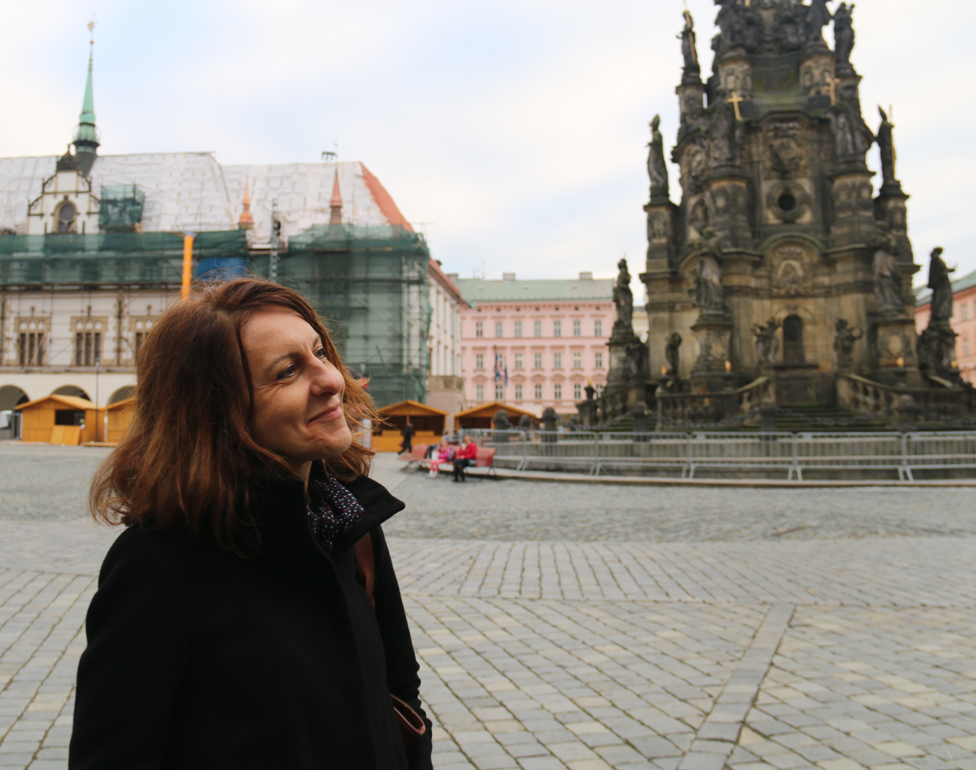
Dr. Iveta Jusová Director, Women's and Gender Studies Program in Europe Professor of Women's and Gender Studies

Slide 5
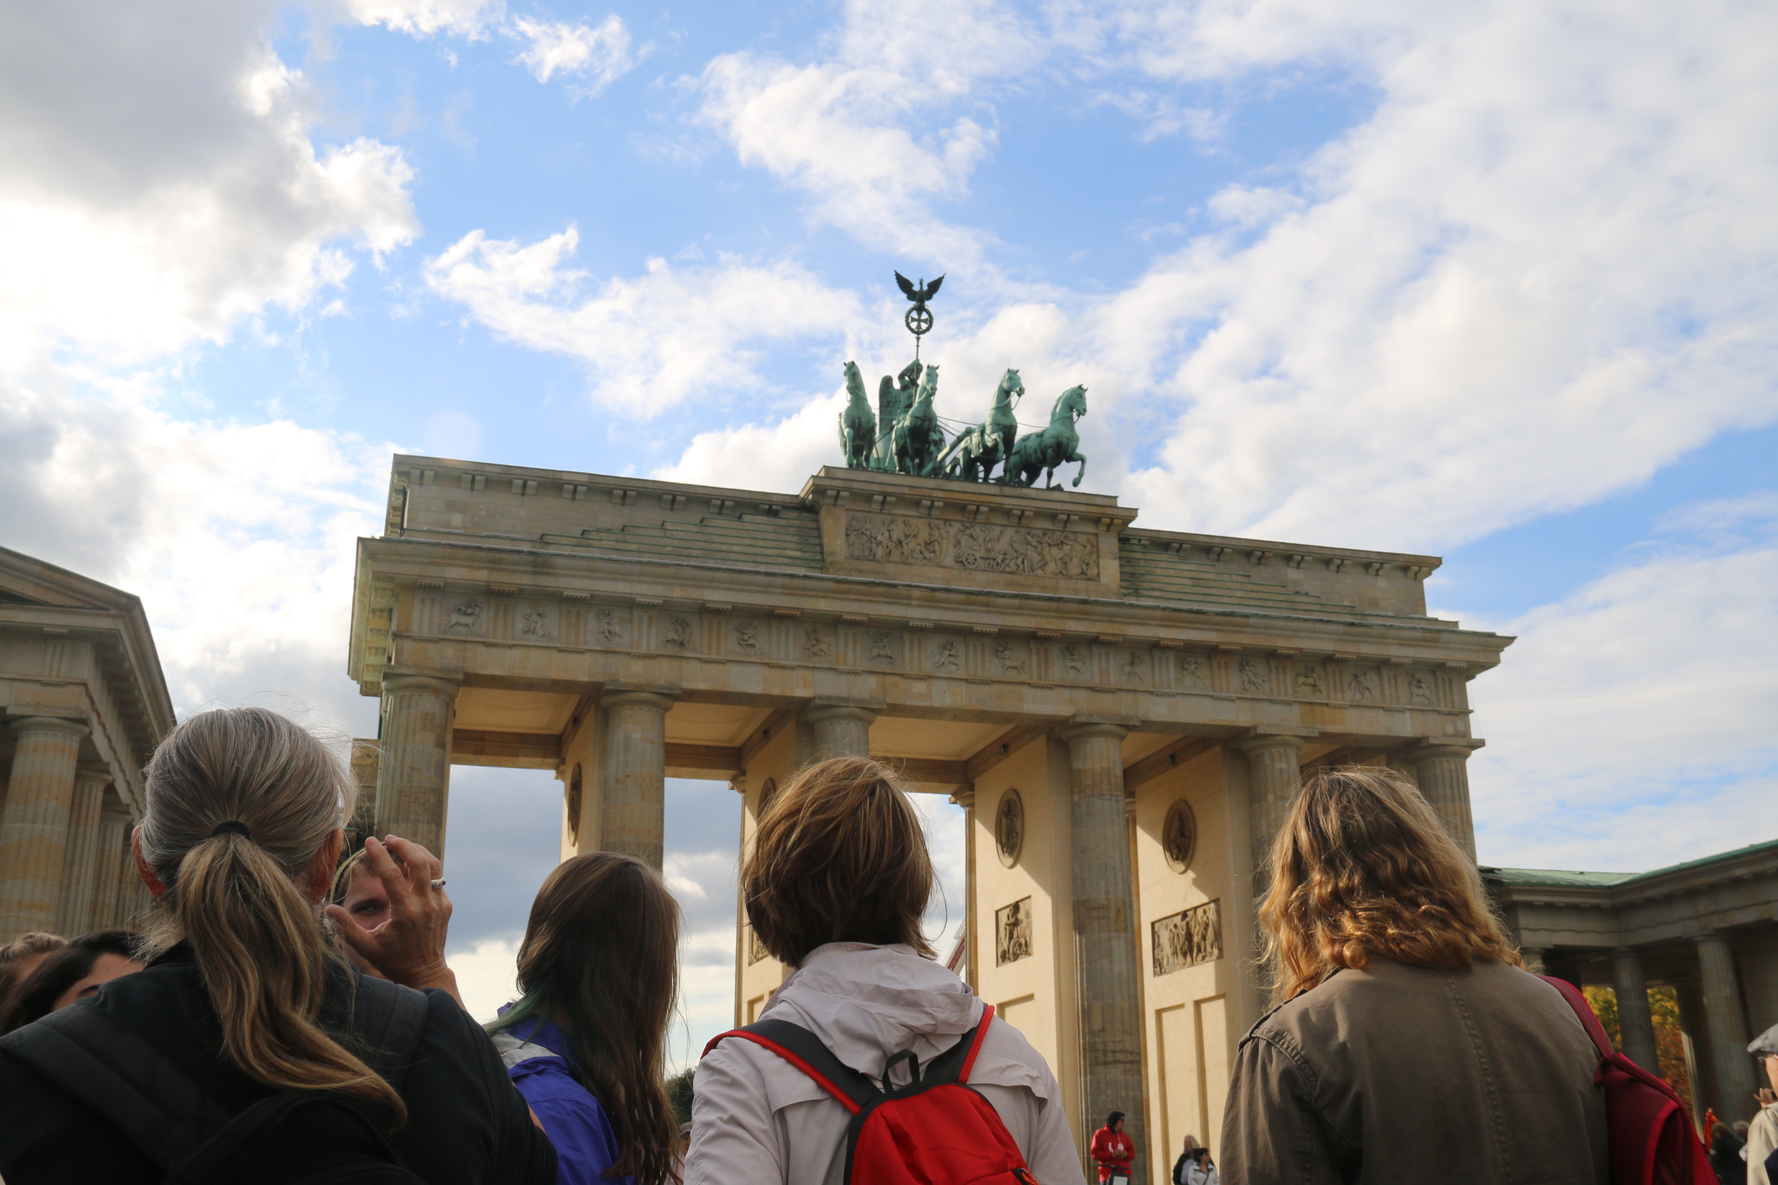

Slide 6
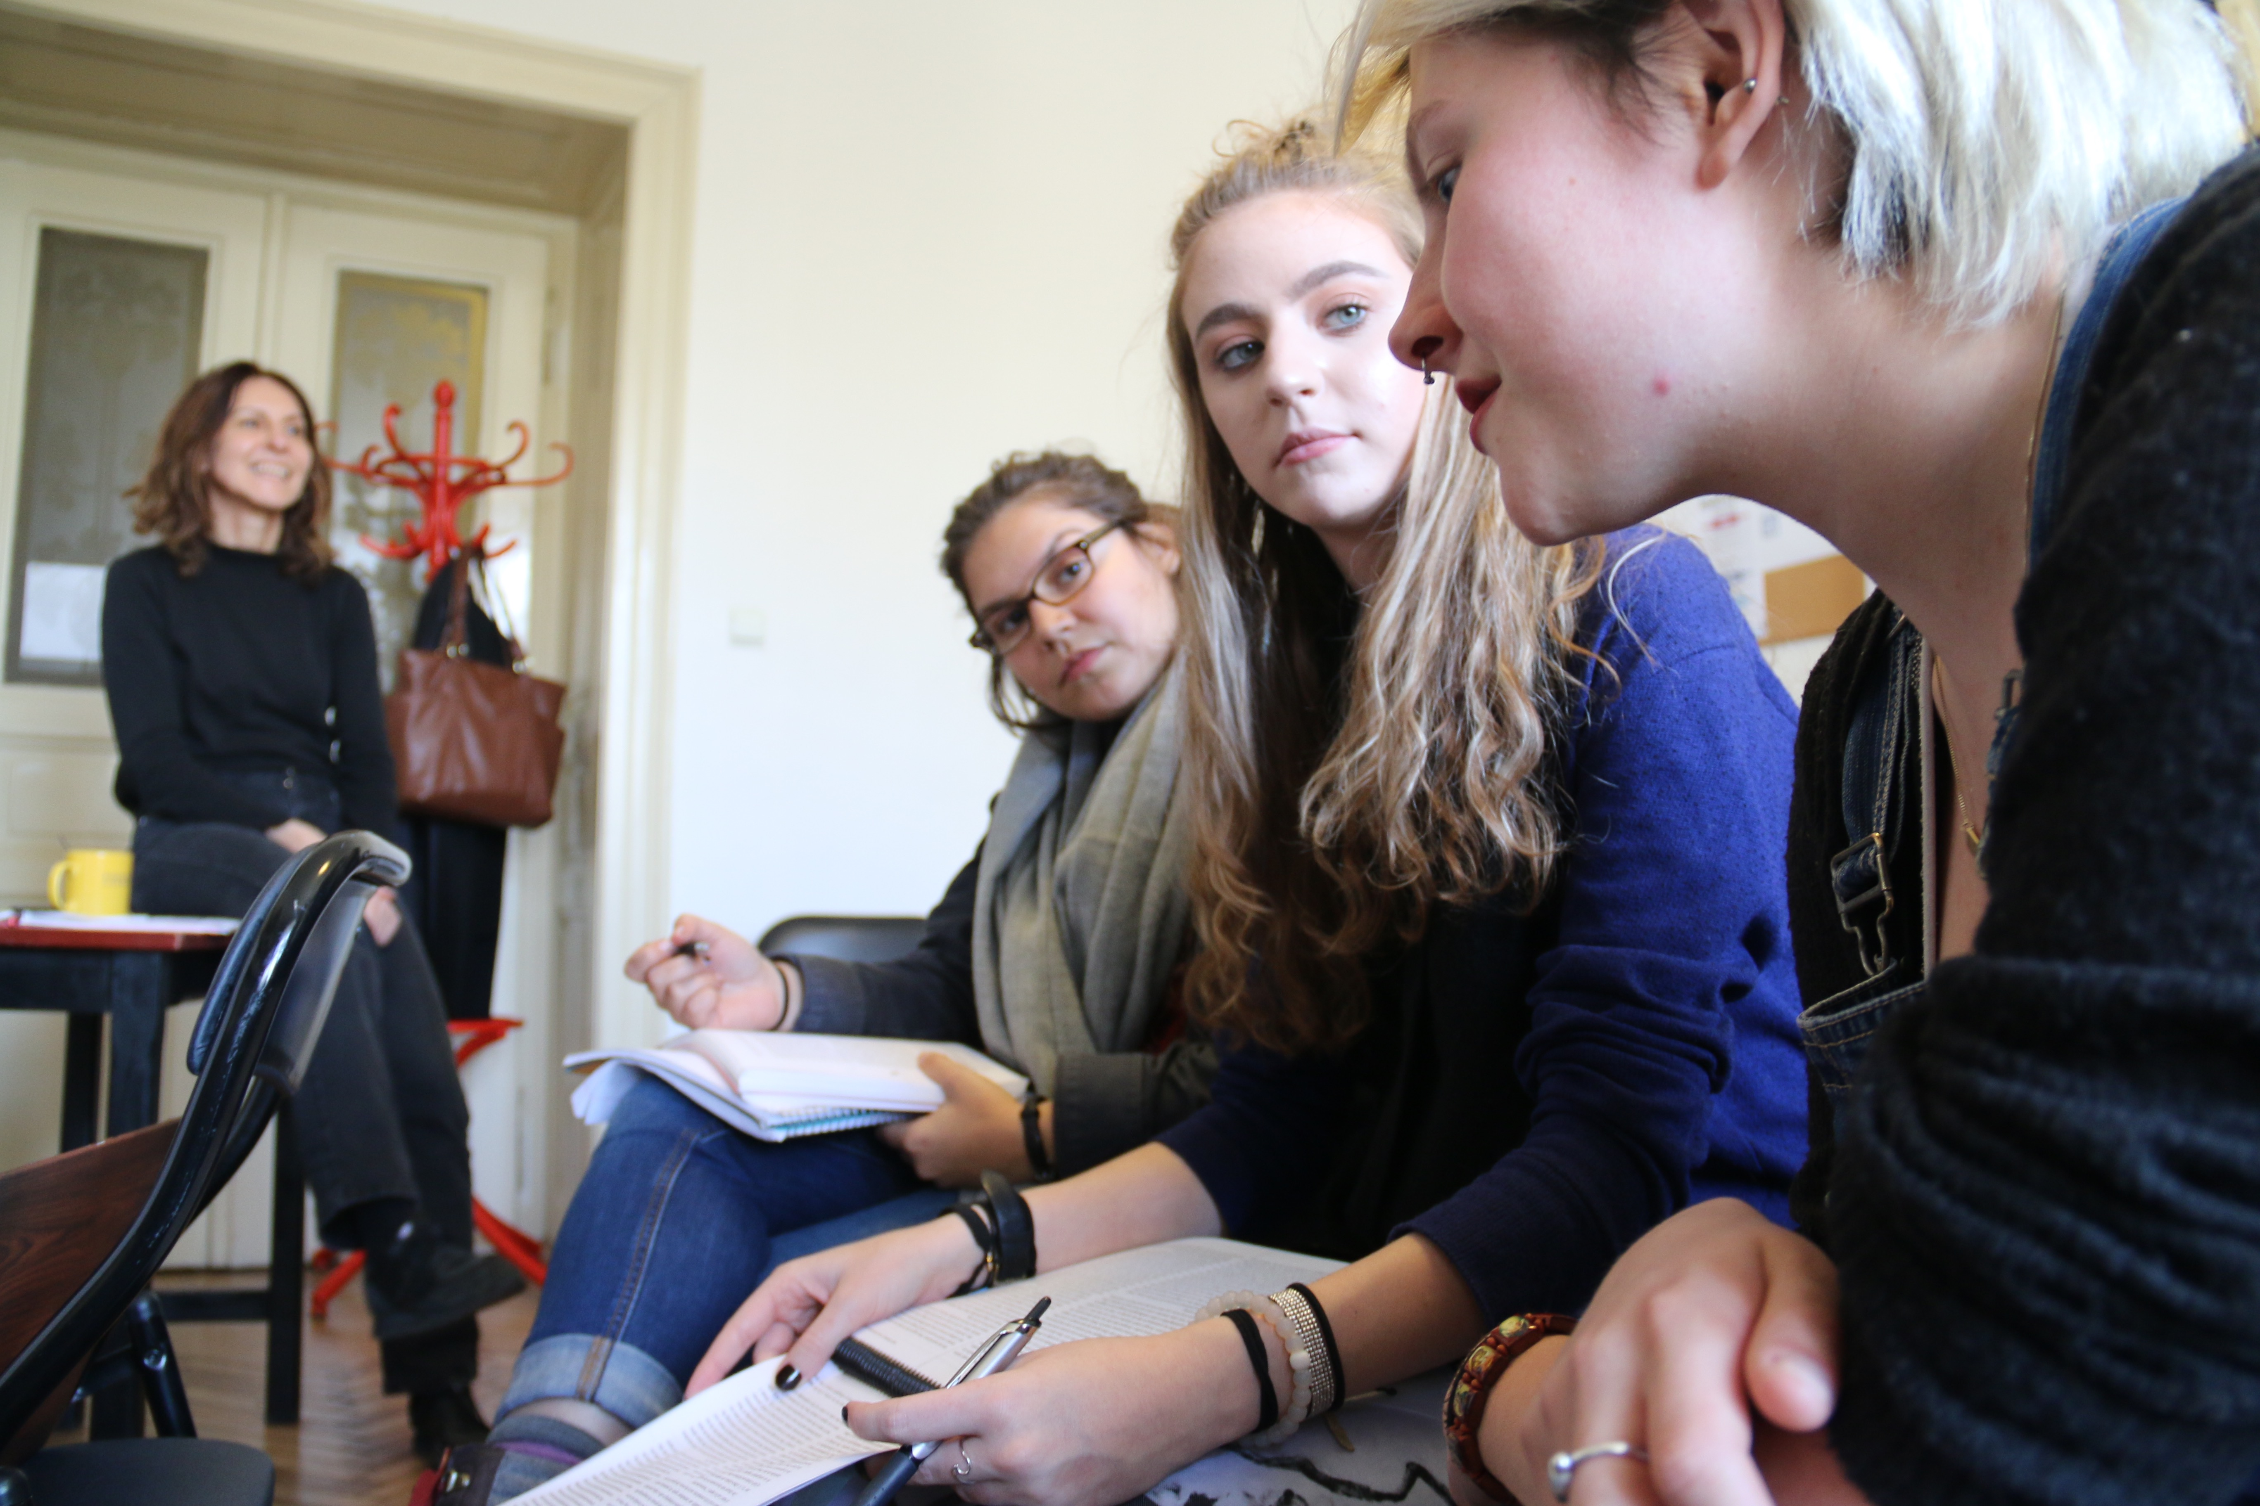

Slide 7
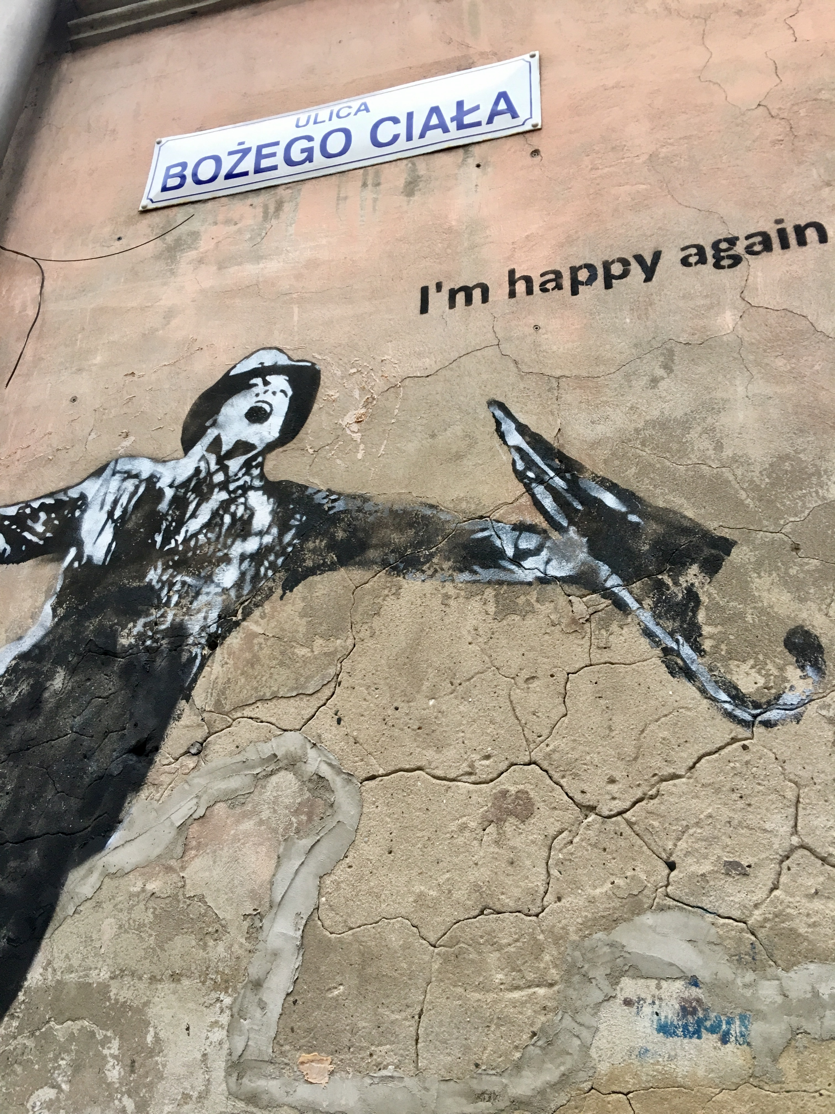
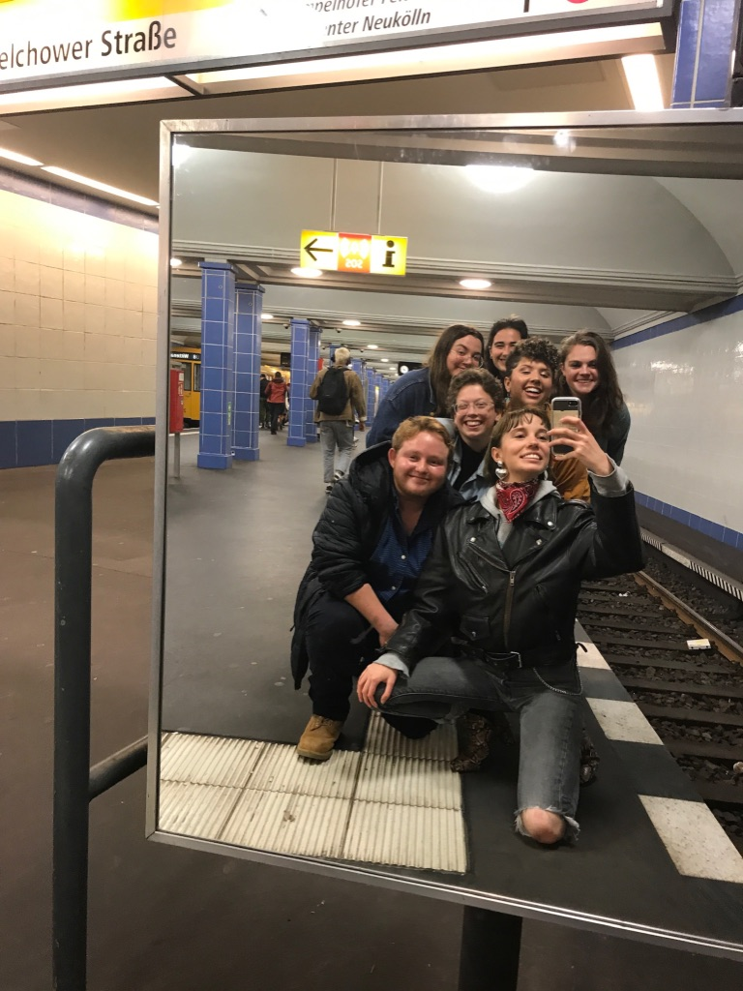

Slide 9
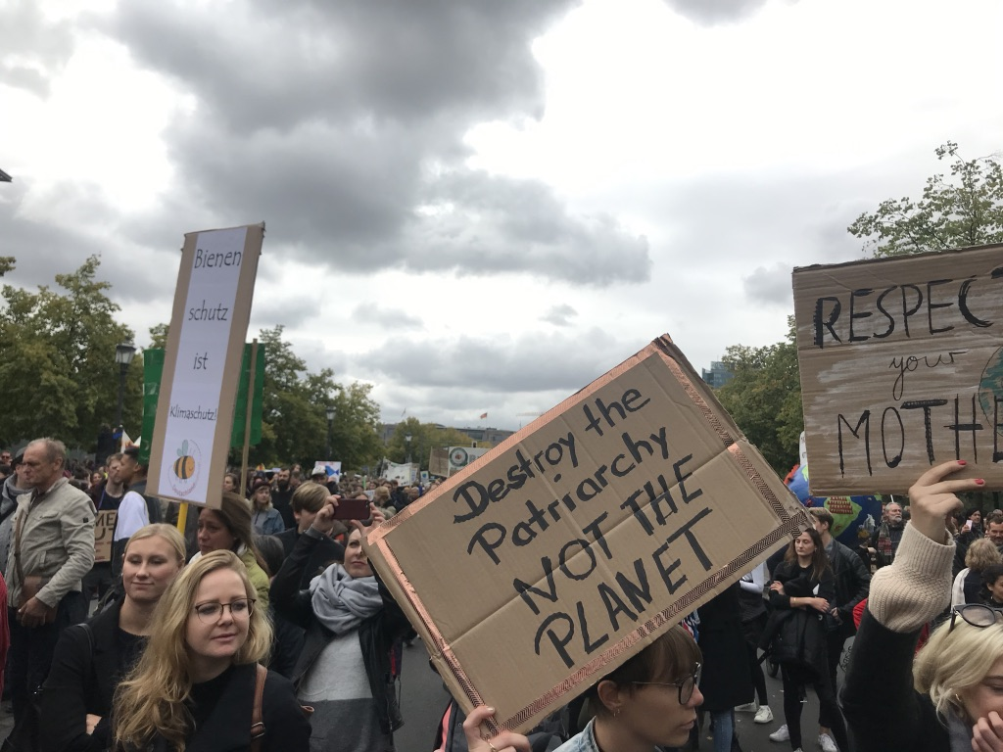

Slide 10
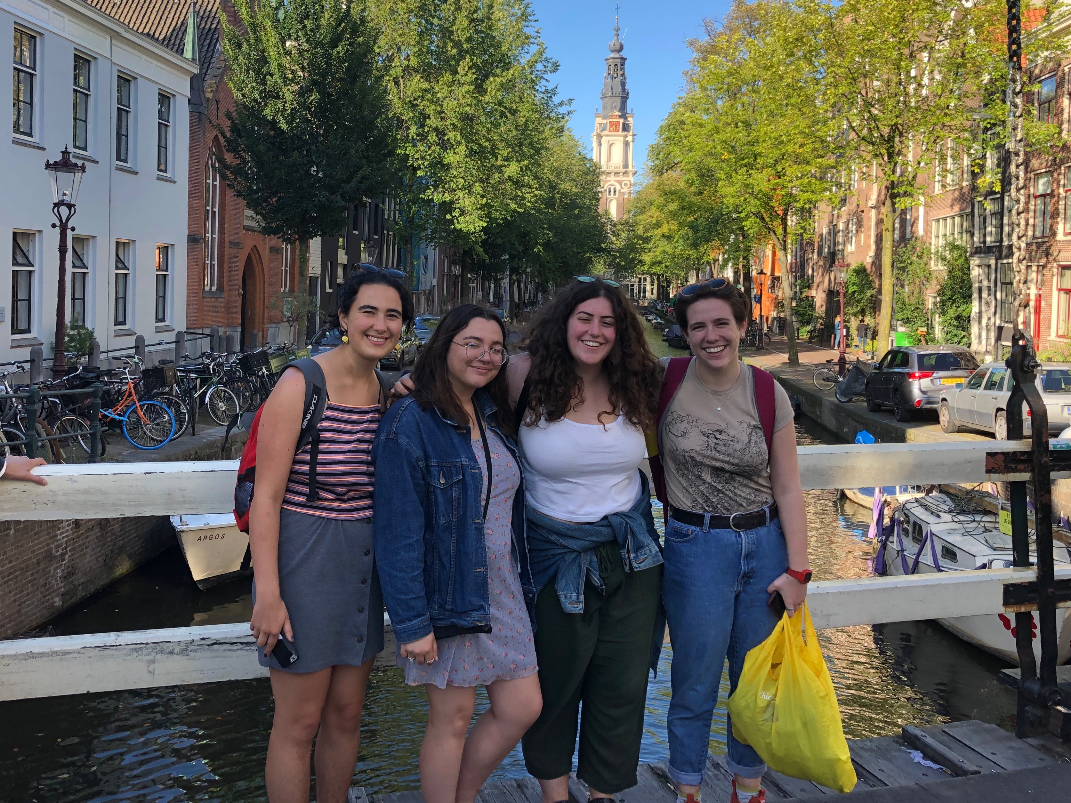

Slide 11
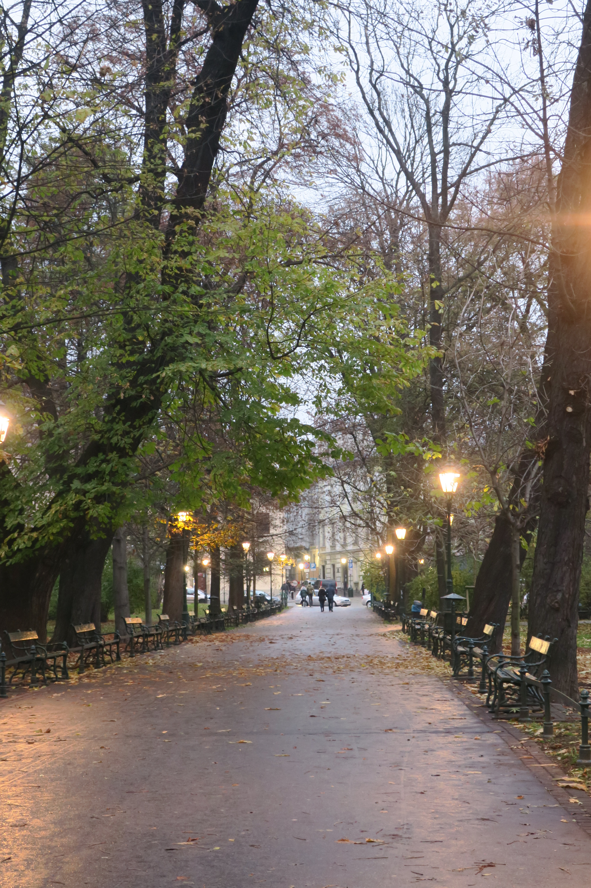
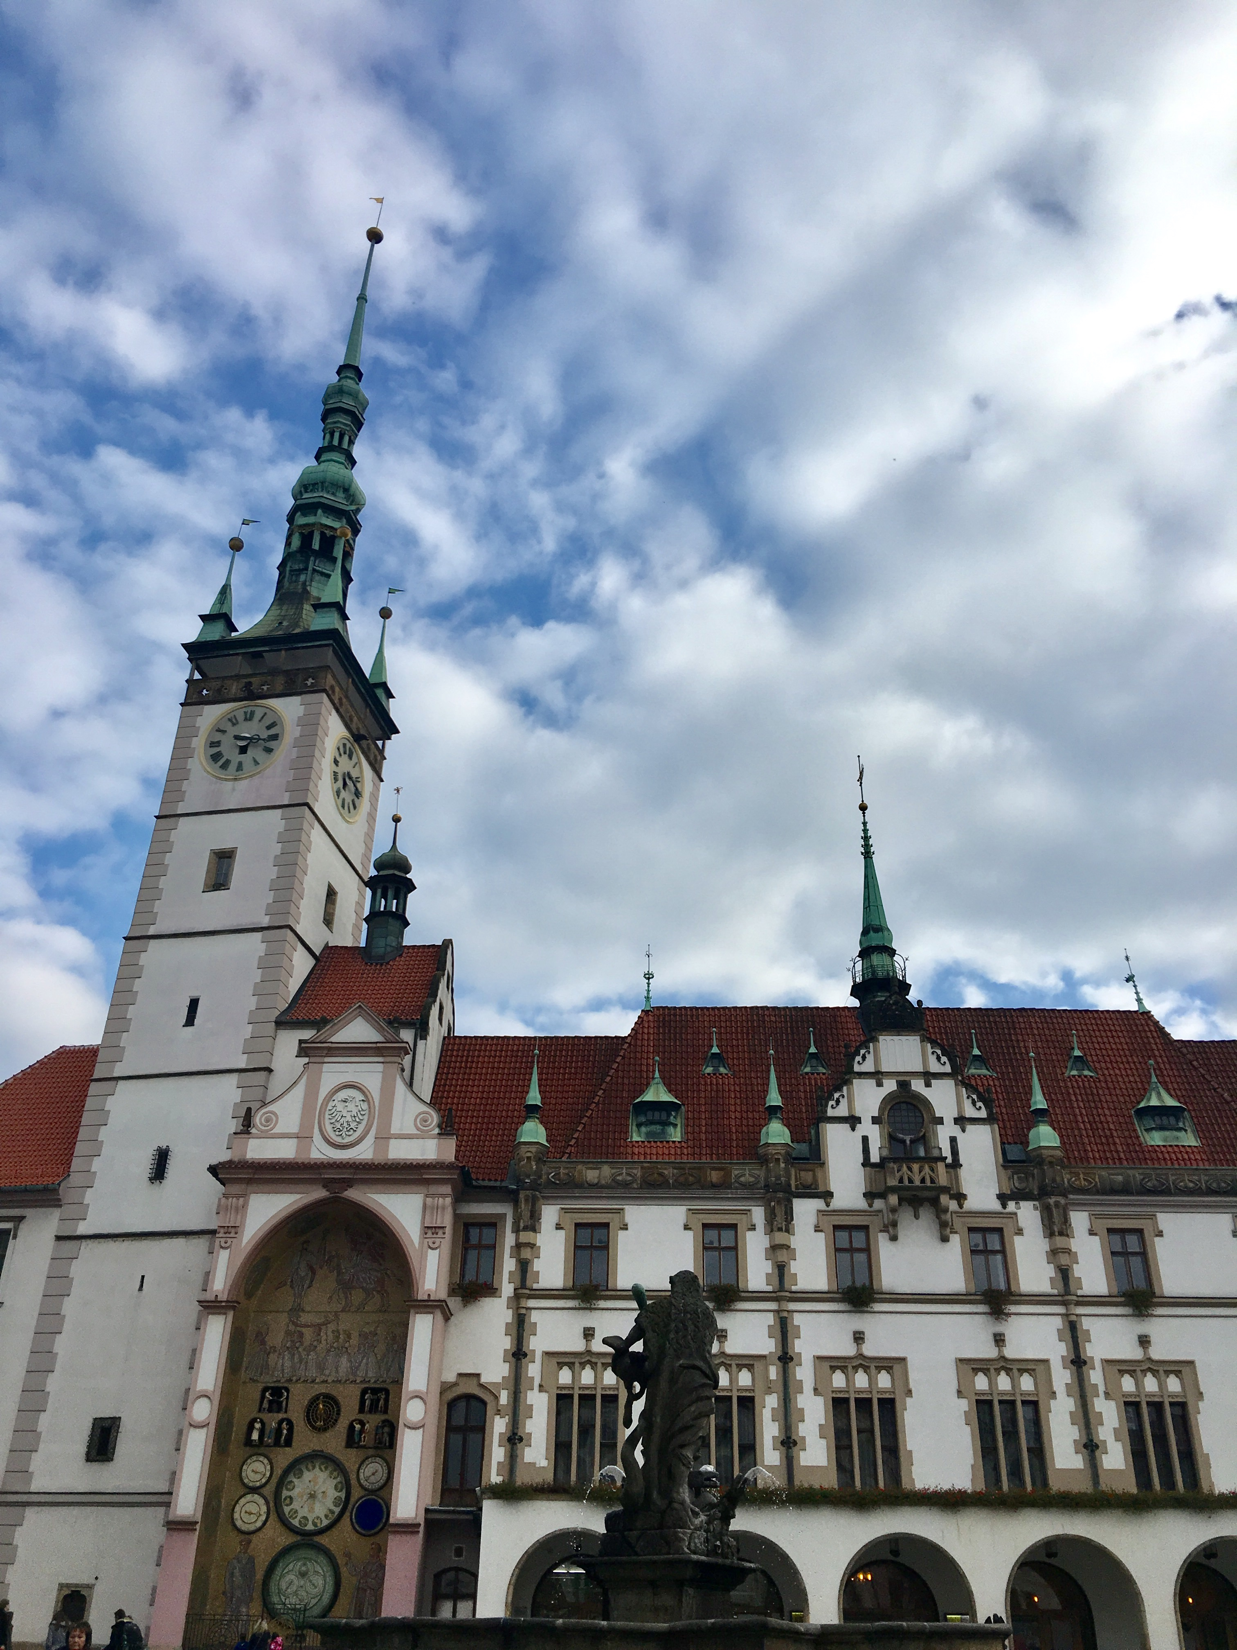

Slide 12
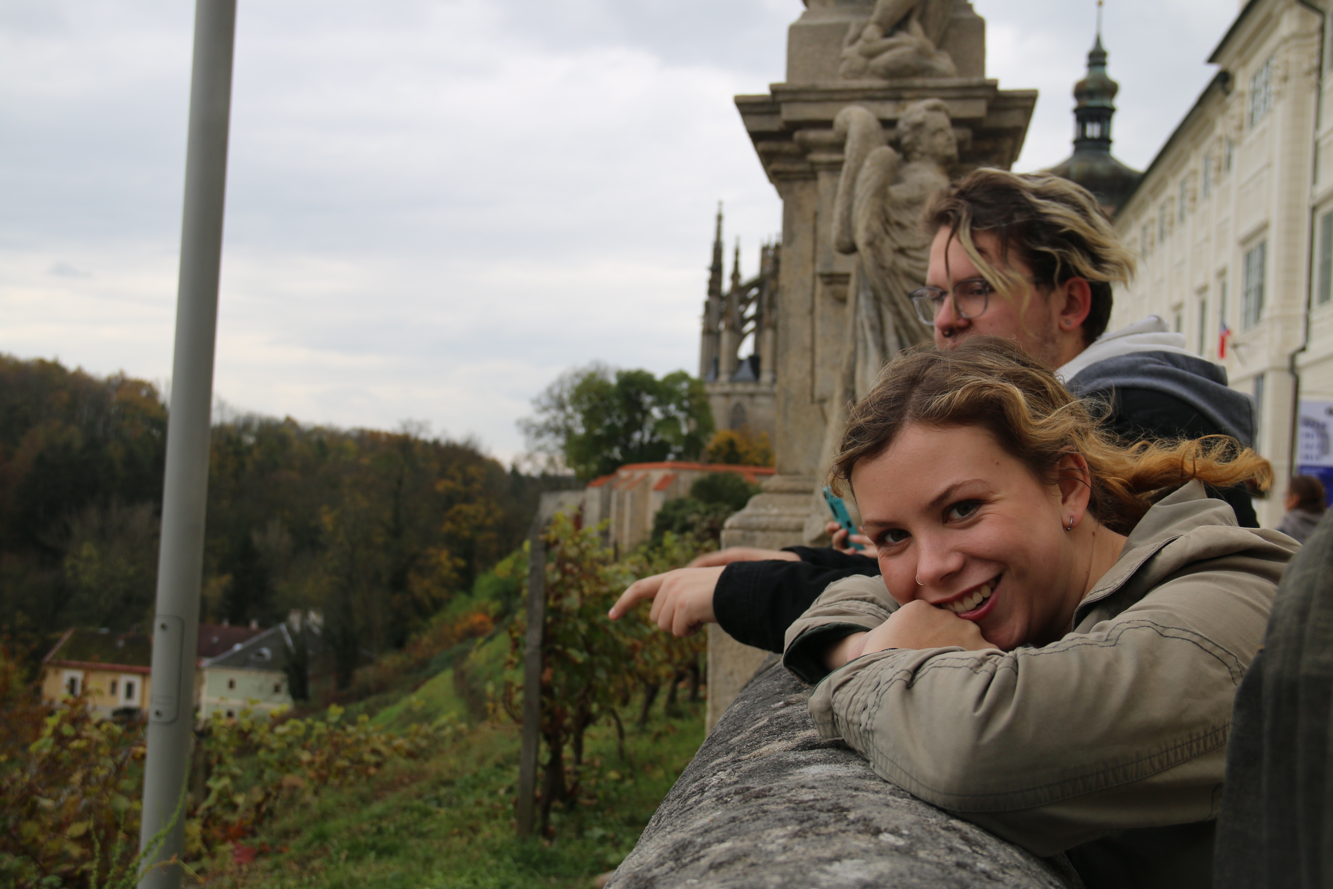

Slide 13
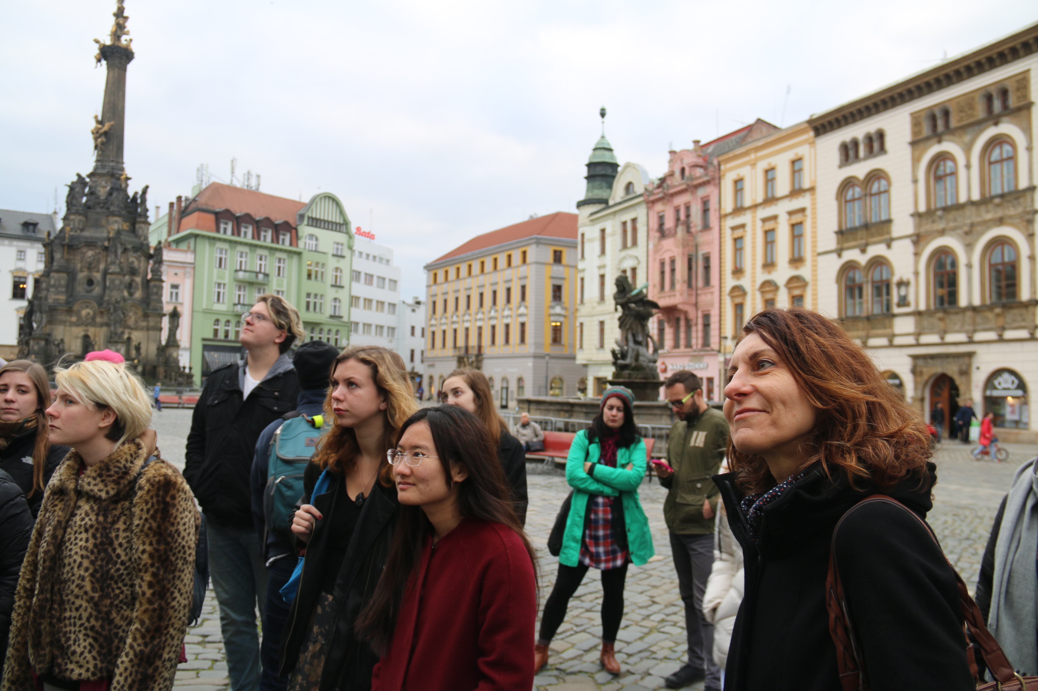

Slide 14
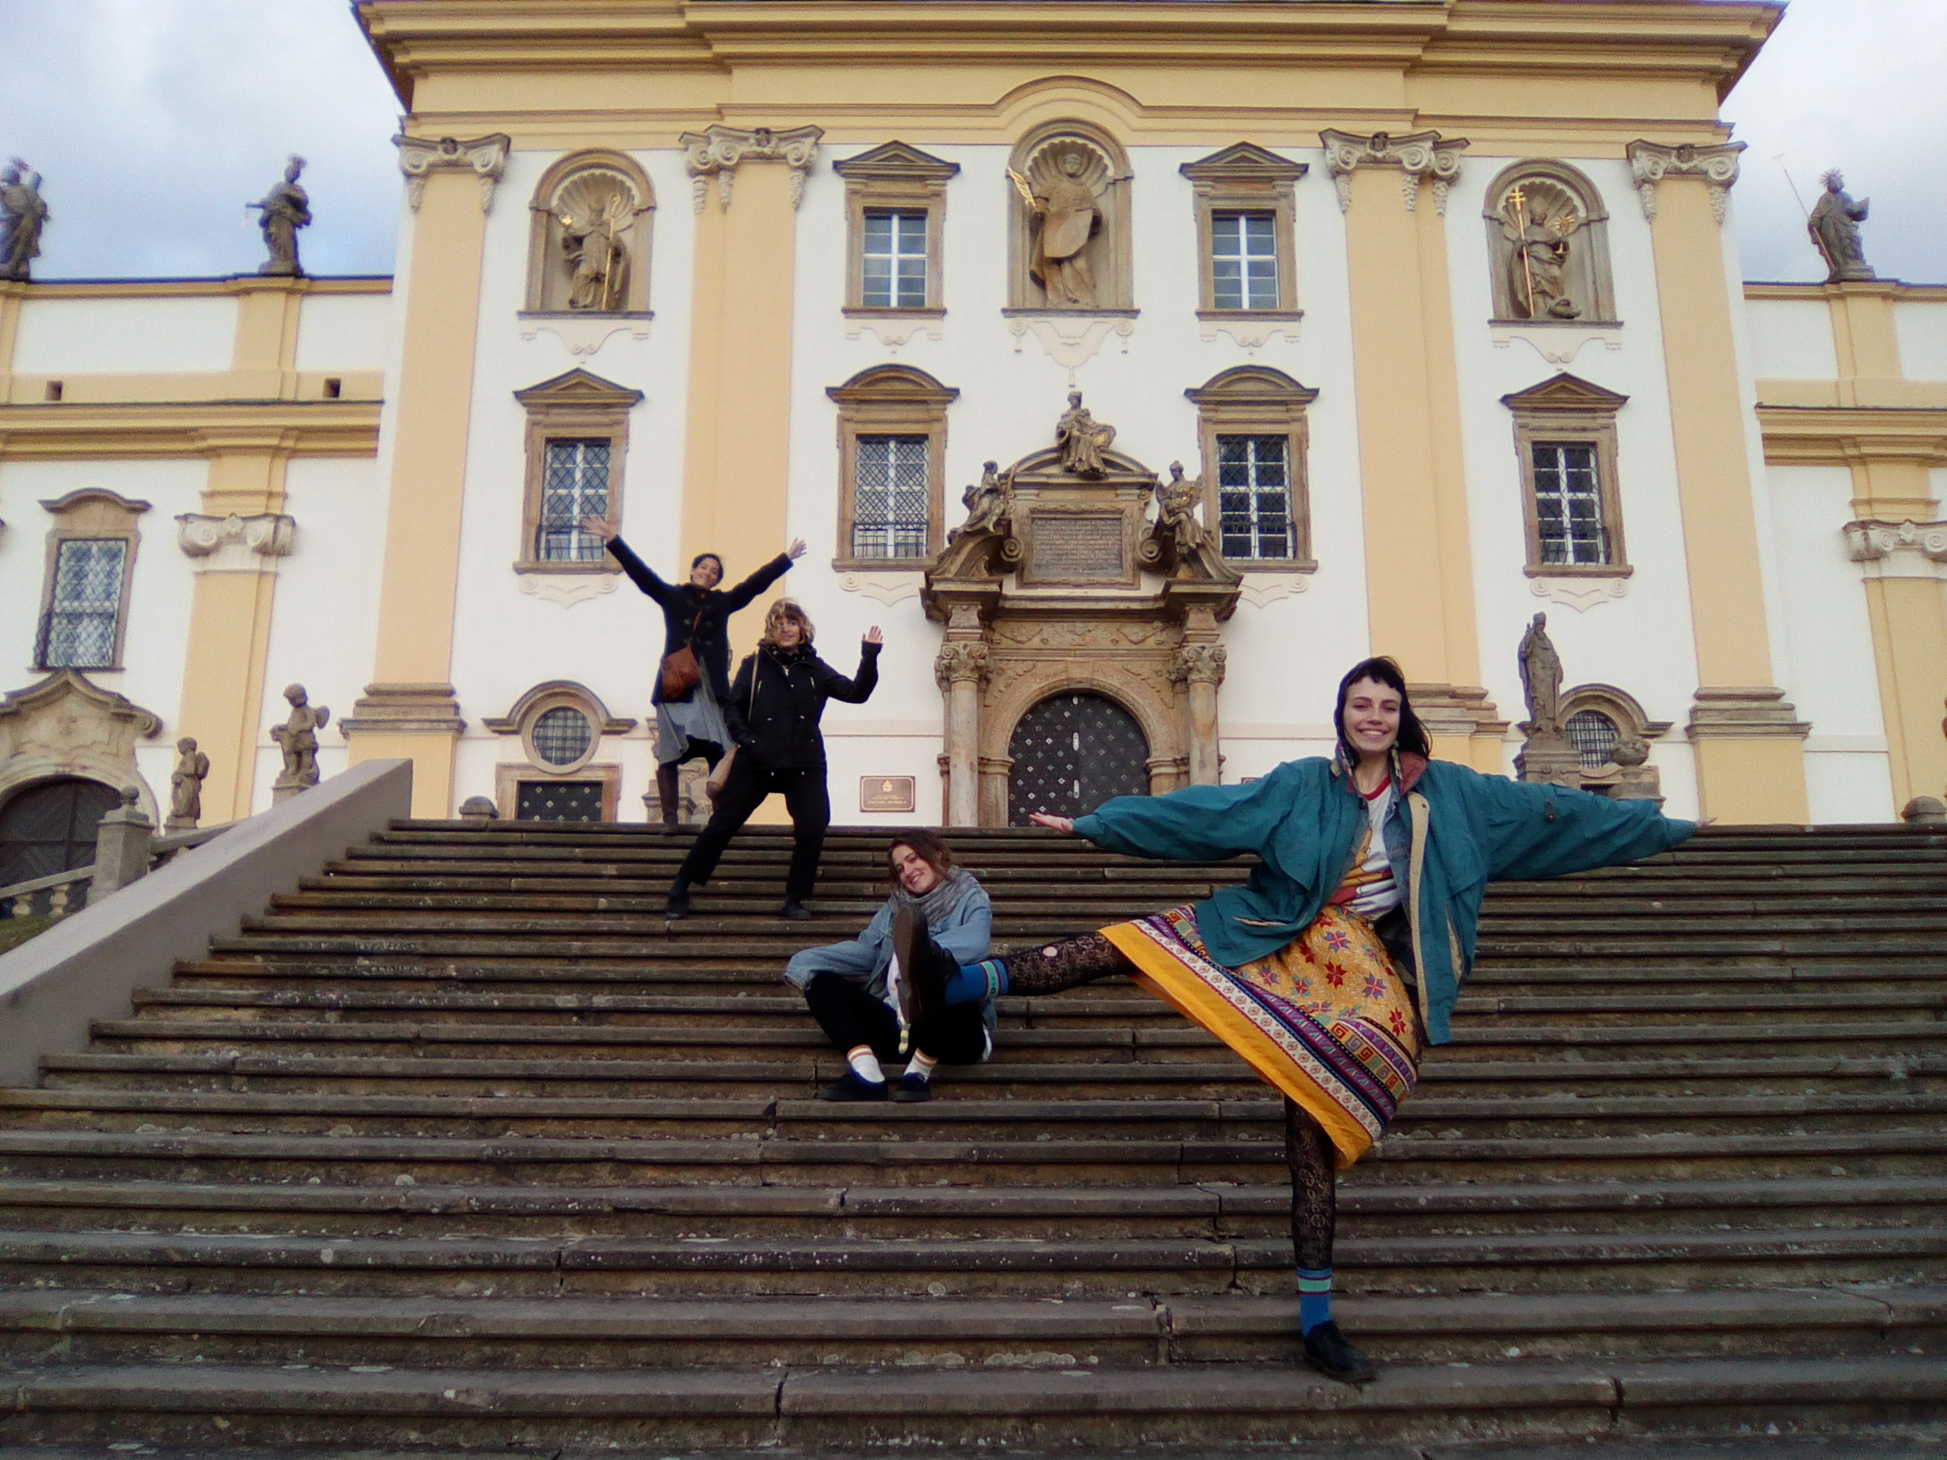

Slide 15
CARLETON GLOBAL ENGAGEMENT PROGRAMS
go.Carleton.edu/engage
507-222-4435
Carleton College
Northfield, Minnesota

