Slide 1
CARLETON GLOBAL ENGAGEMENT PROGRAMS
13-week fall programs offering Carleton College academic credit equivalent to 16 semester credits
Buddhist Studies in India
Women’s and Gender Studies in Europe
Ecology and Anthropology in Tanzania

Slide 2
BUDDHIST STUDIES IN INDIA
London and Delhi (orientation)
Bodh Gaya, India
Various locations in South Asia (ISP)
Early September to Mid-December

Slide 3
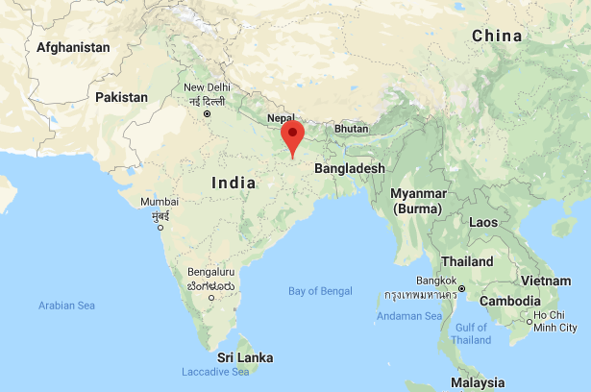

Slide 4
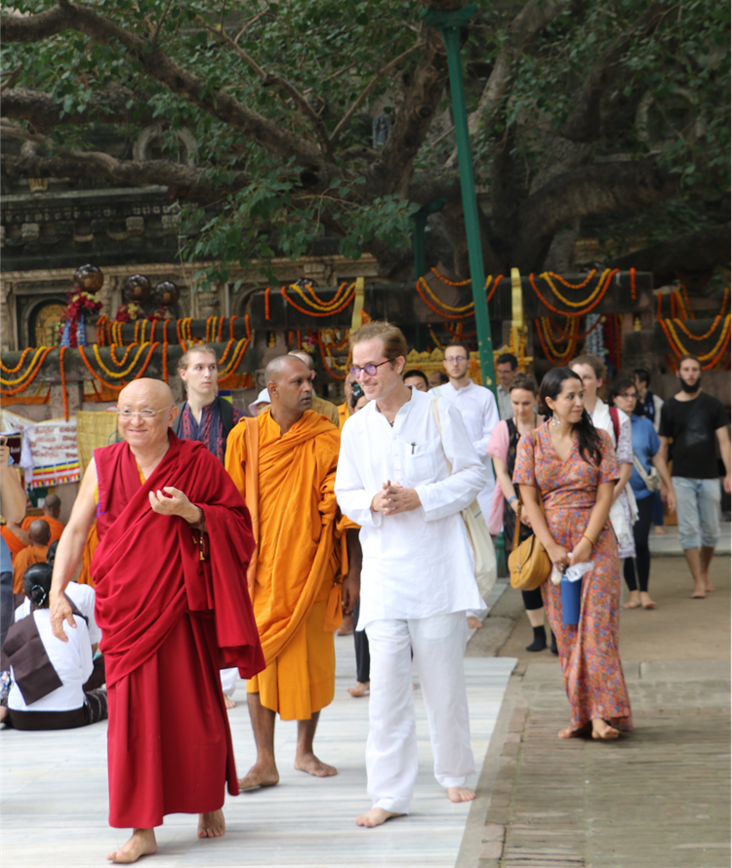
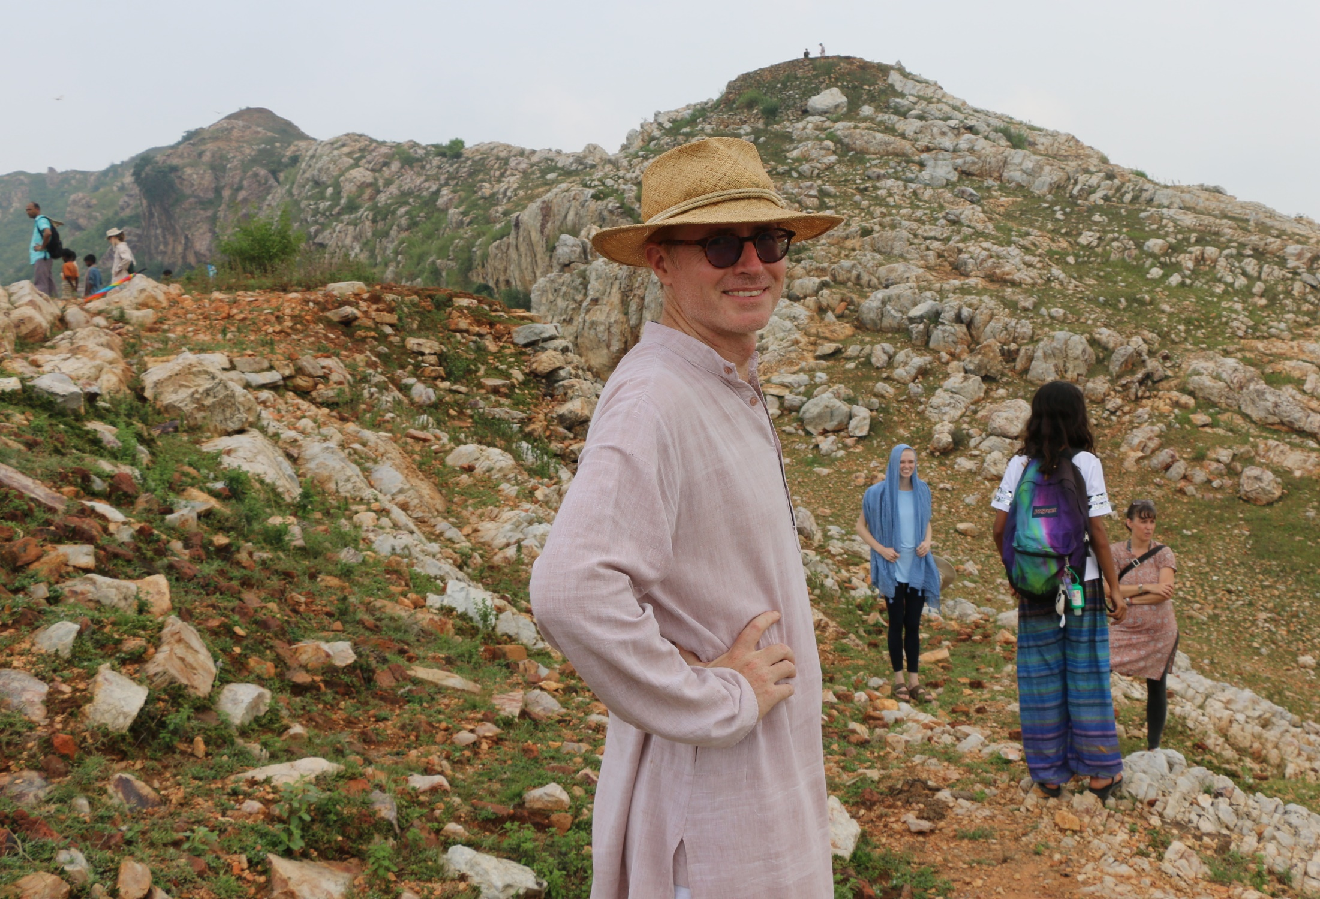
Dr. Arthur McKeown Director, Buddhist Studies Program in India Associate Professor of Asian Studies

Slide 5
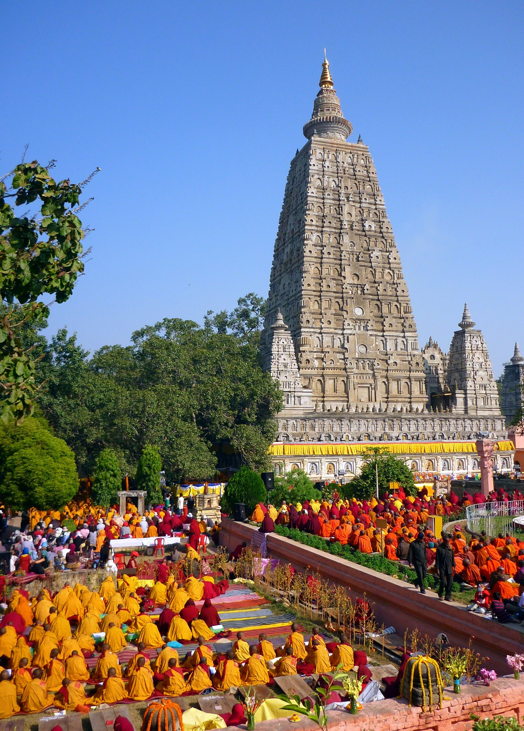
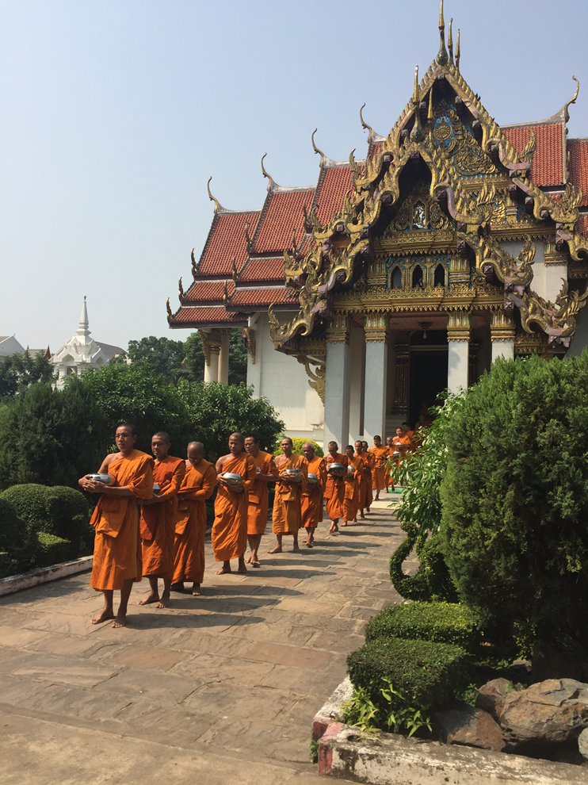

Slide 6
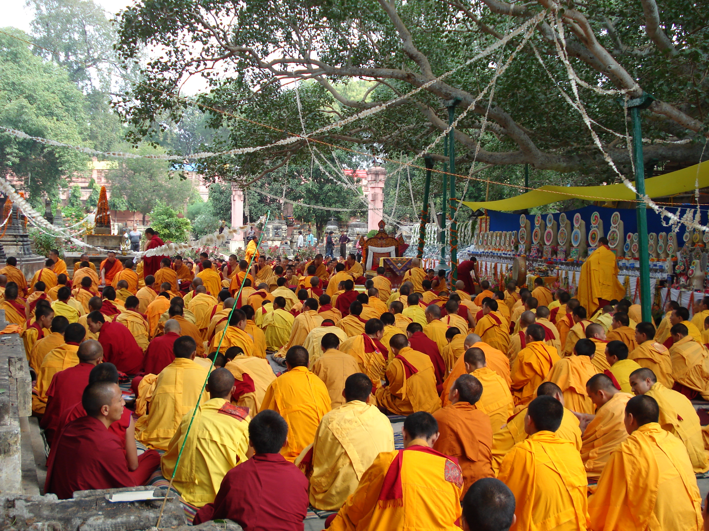

Slide 7
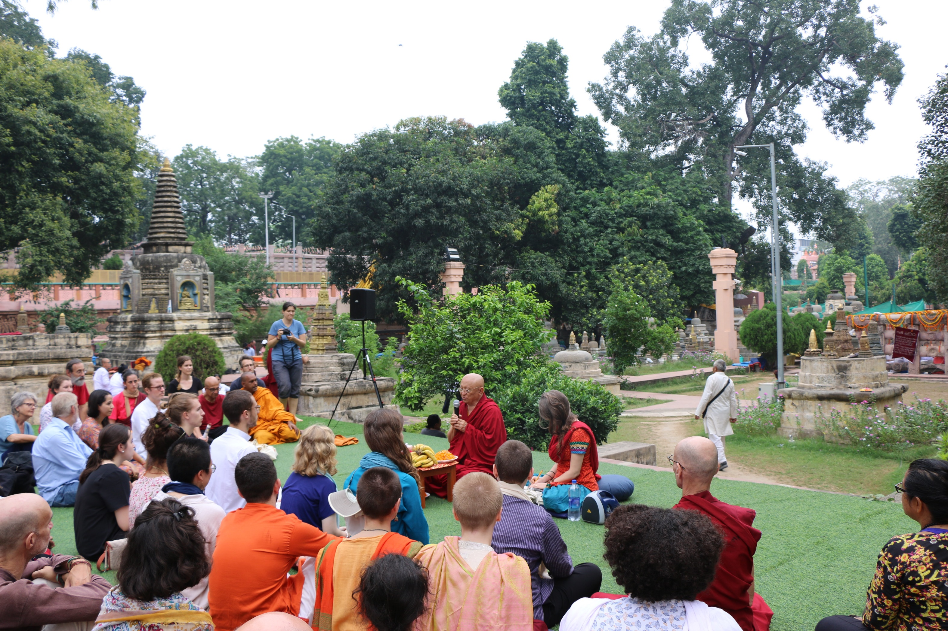

Slide 8
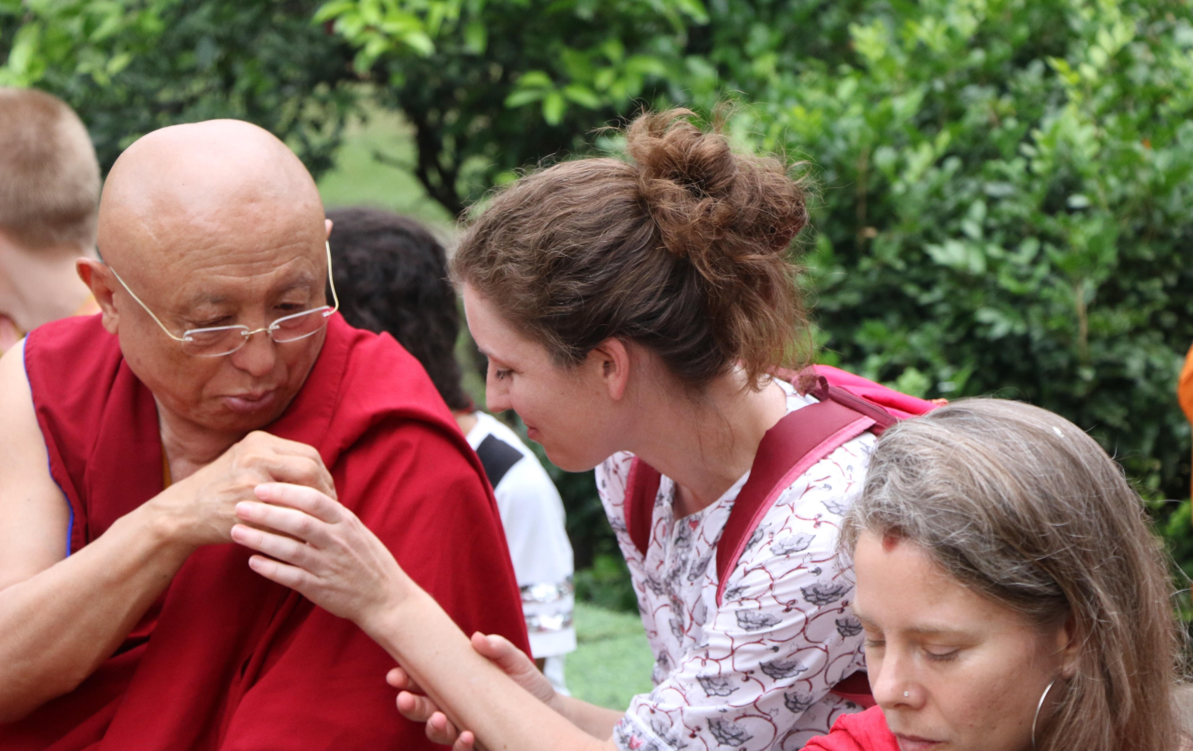

Slide 9
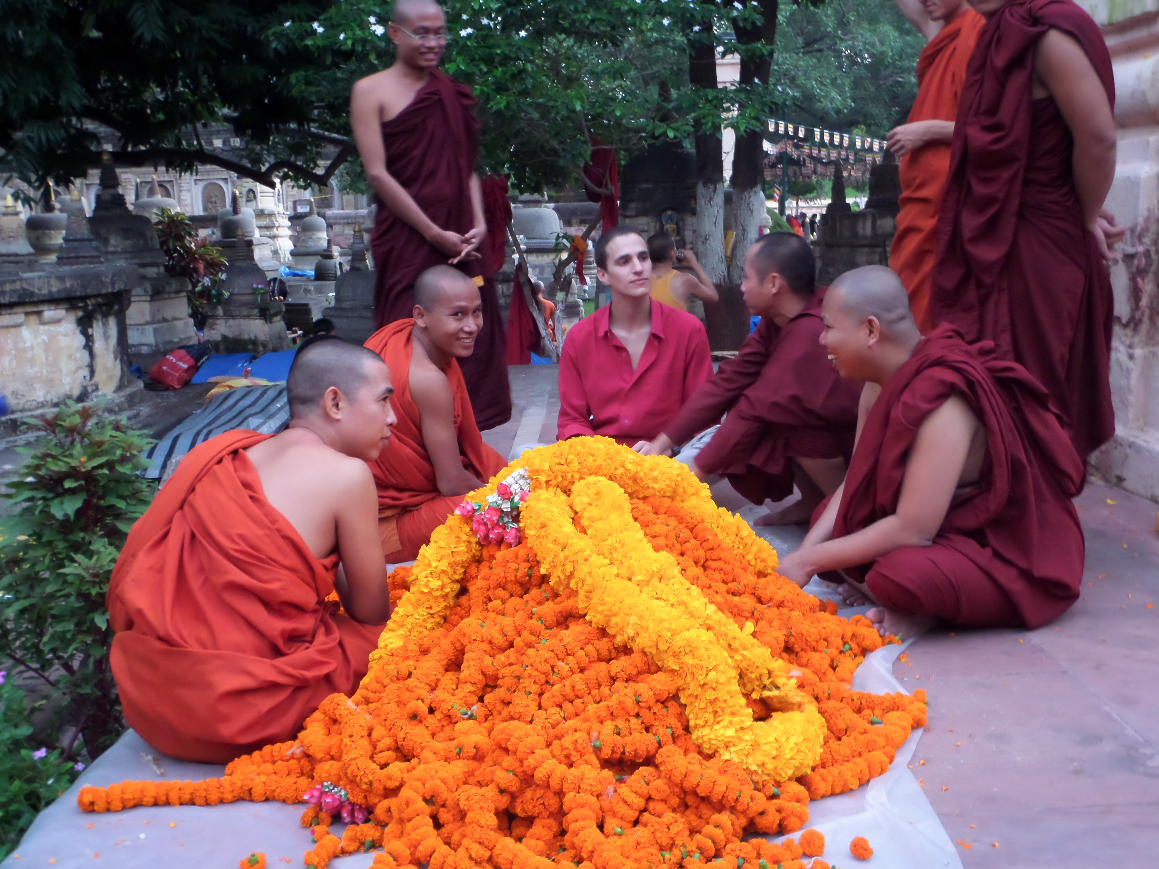

Slide 10
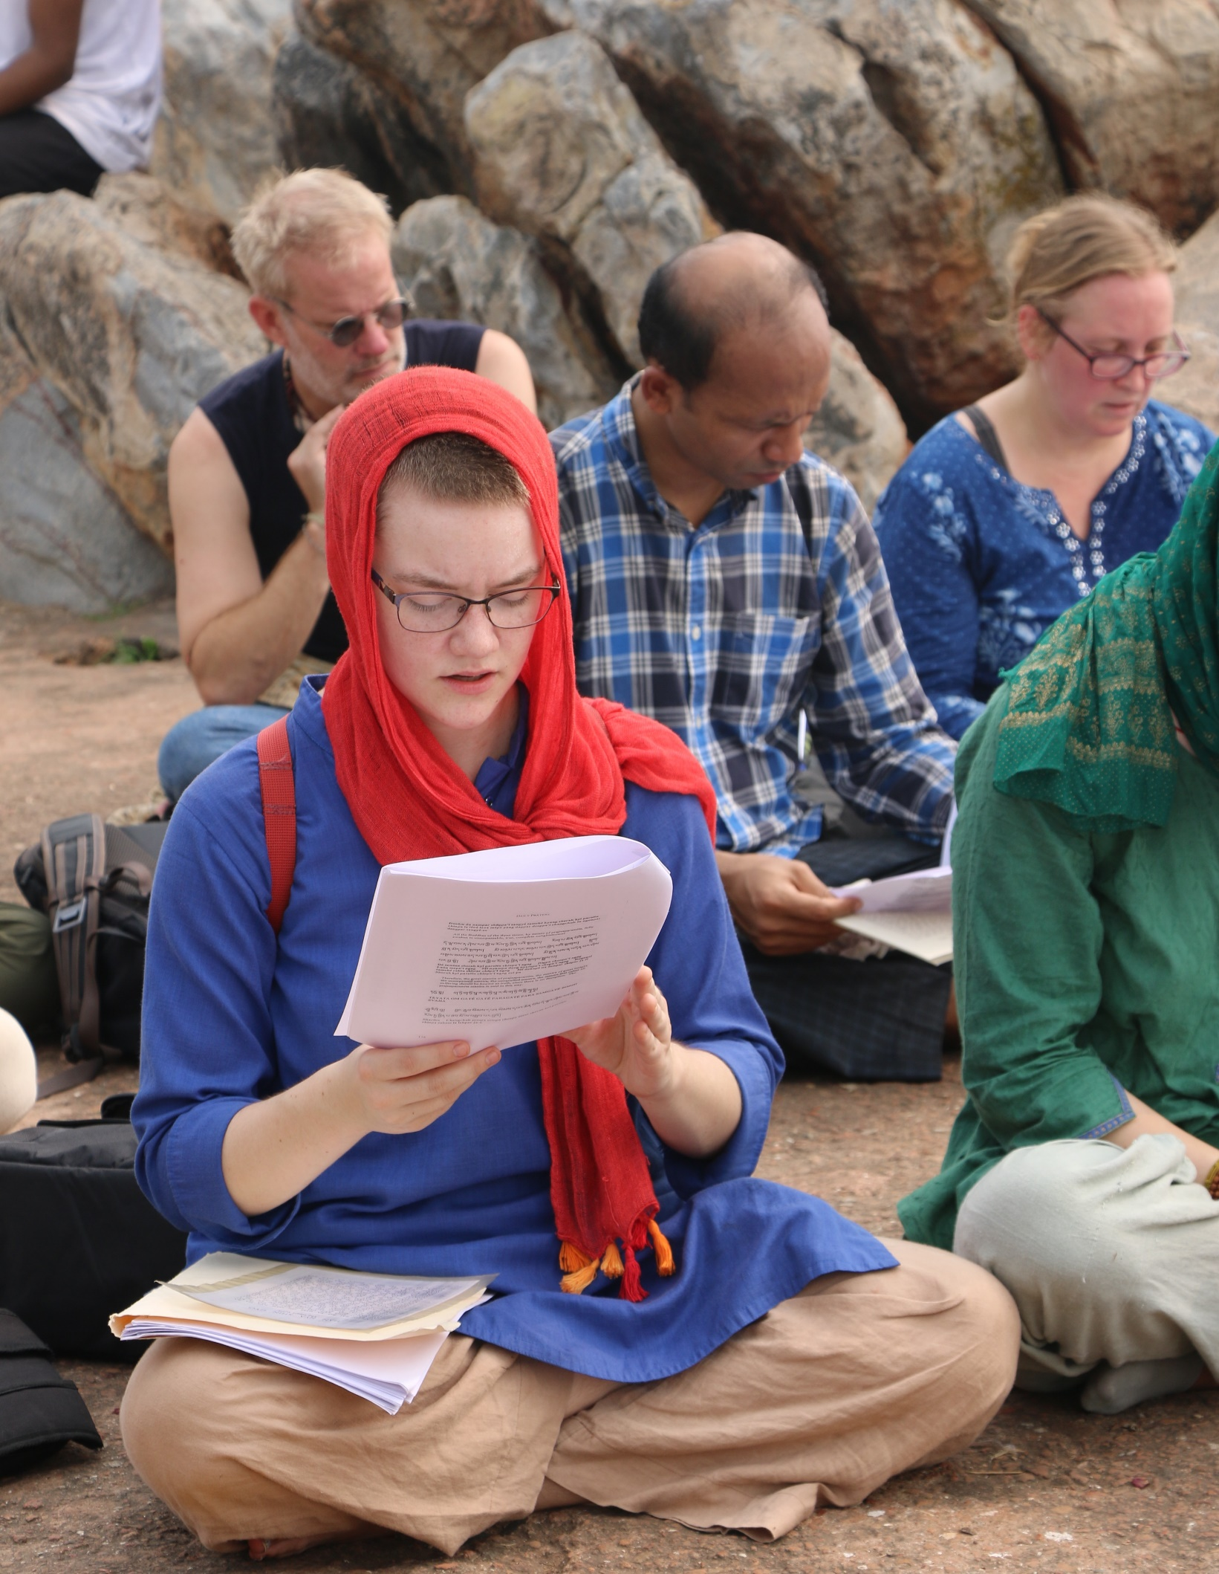
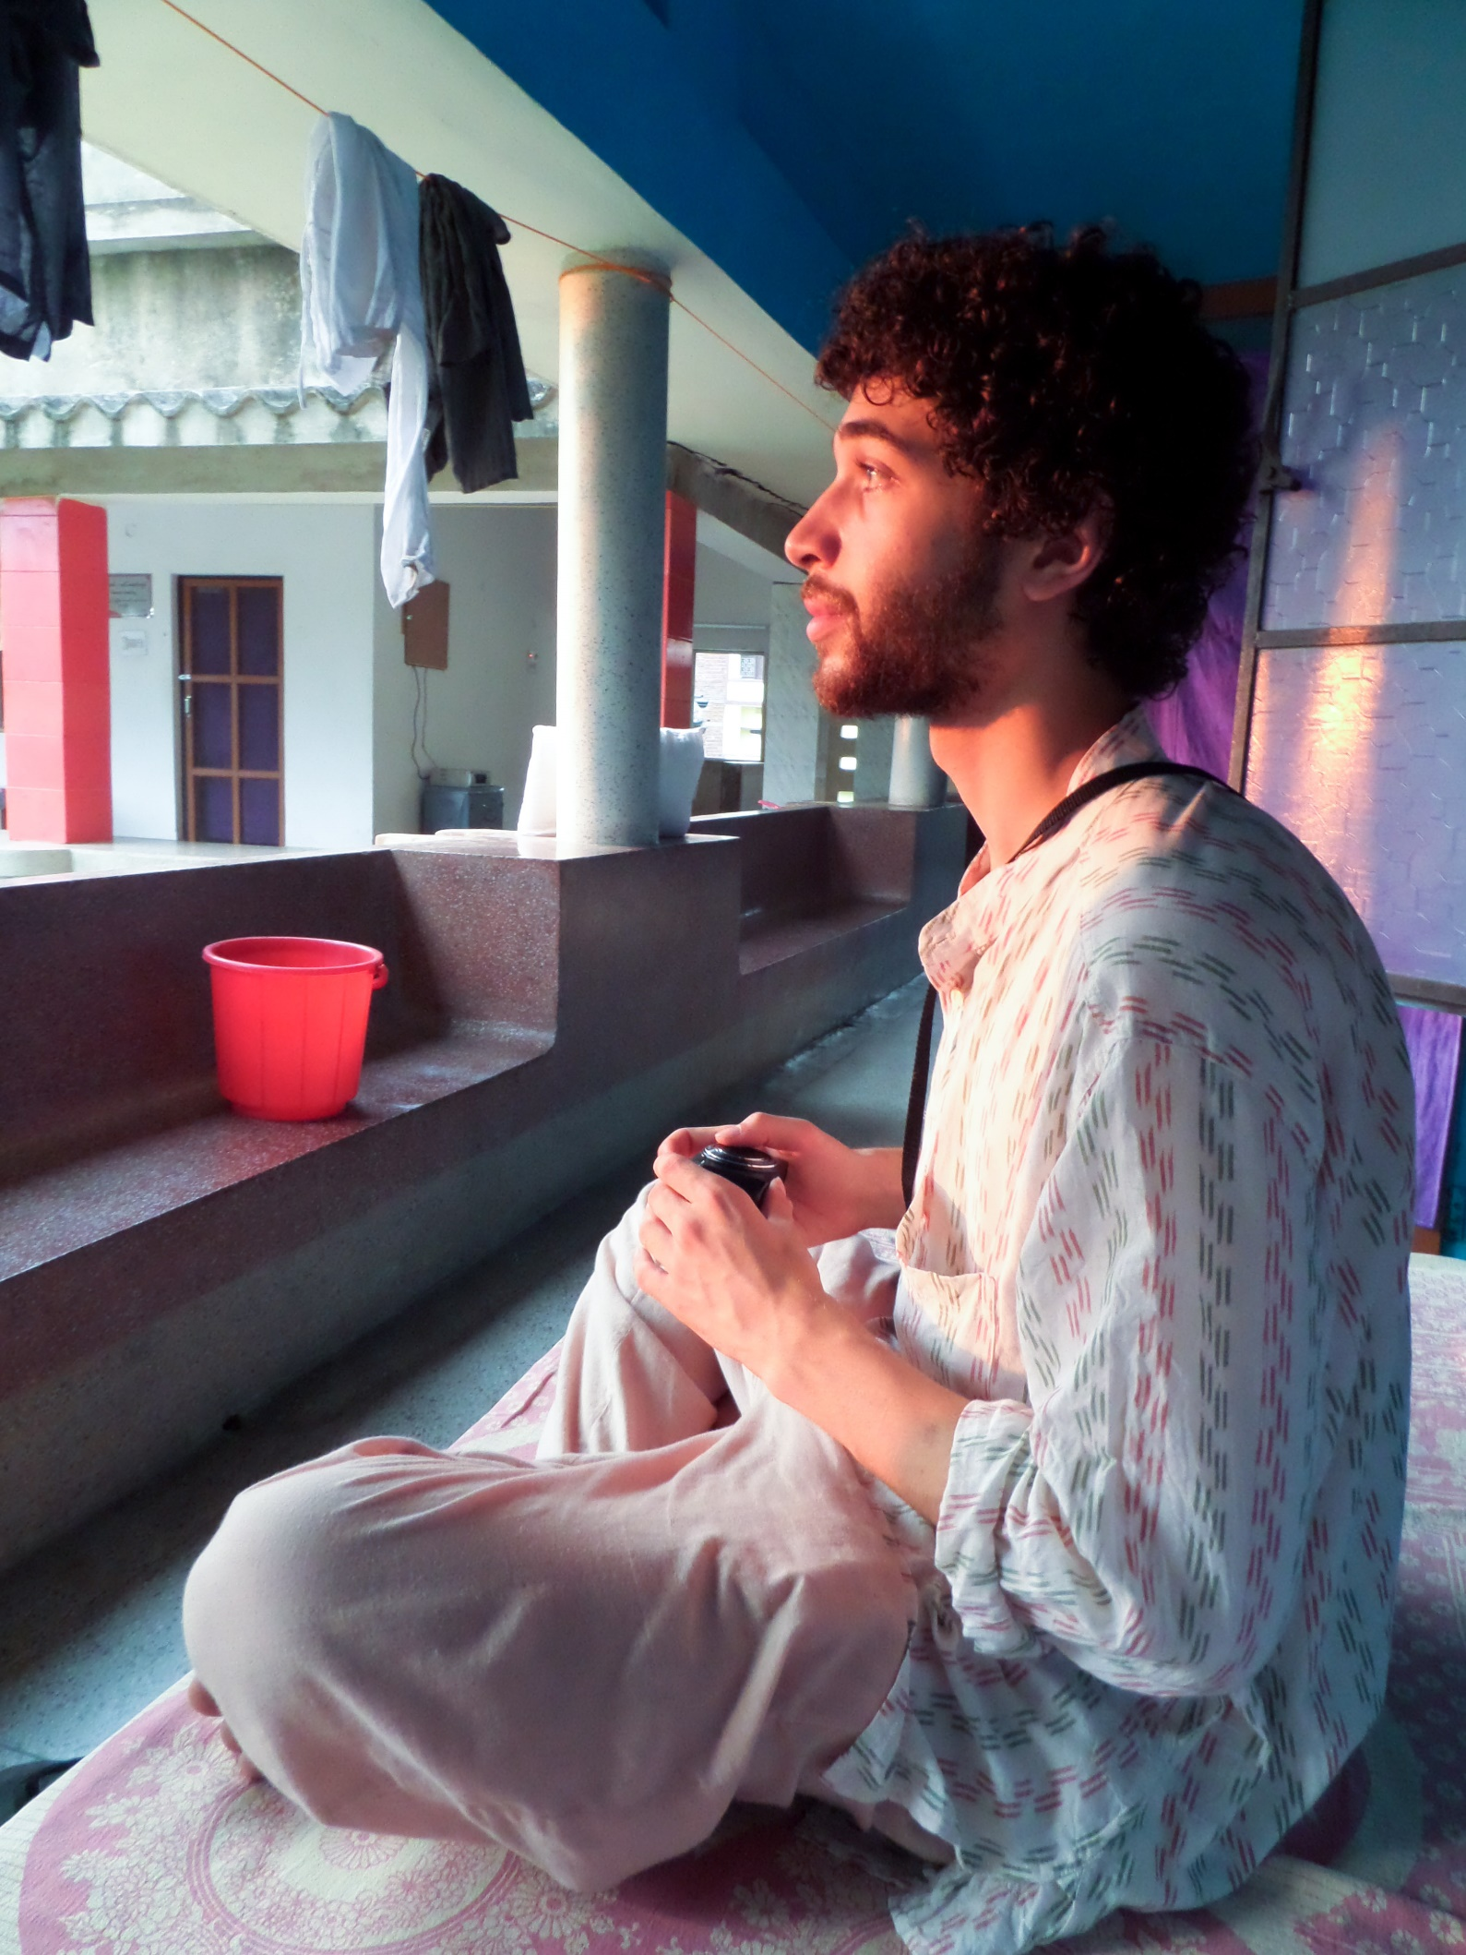

Slide 11
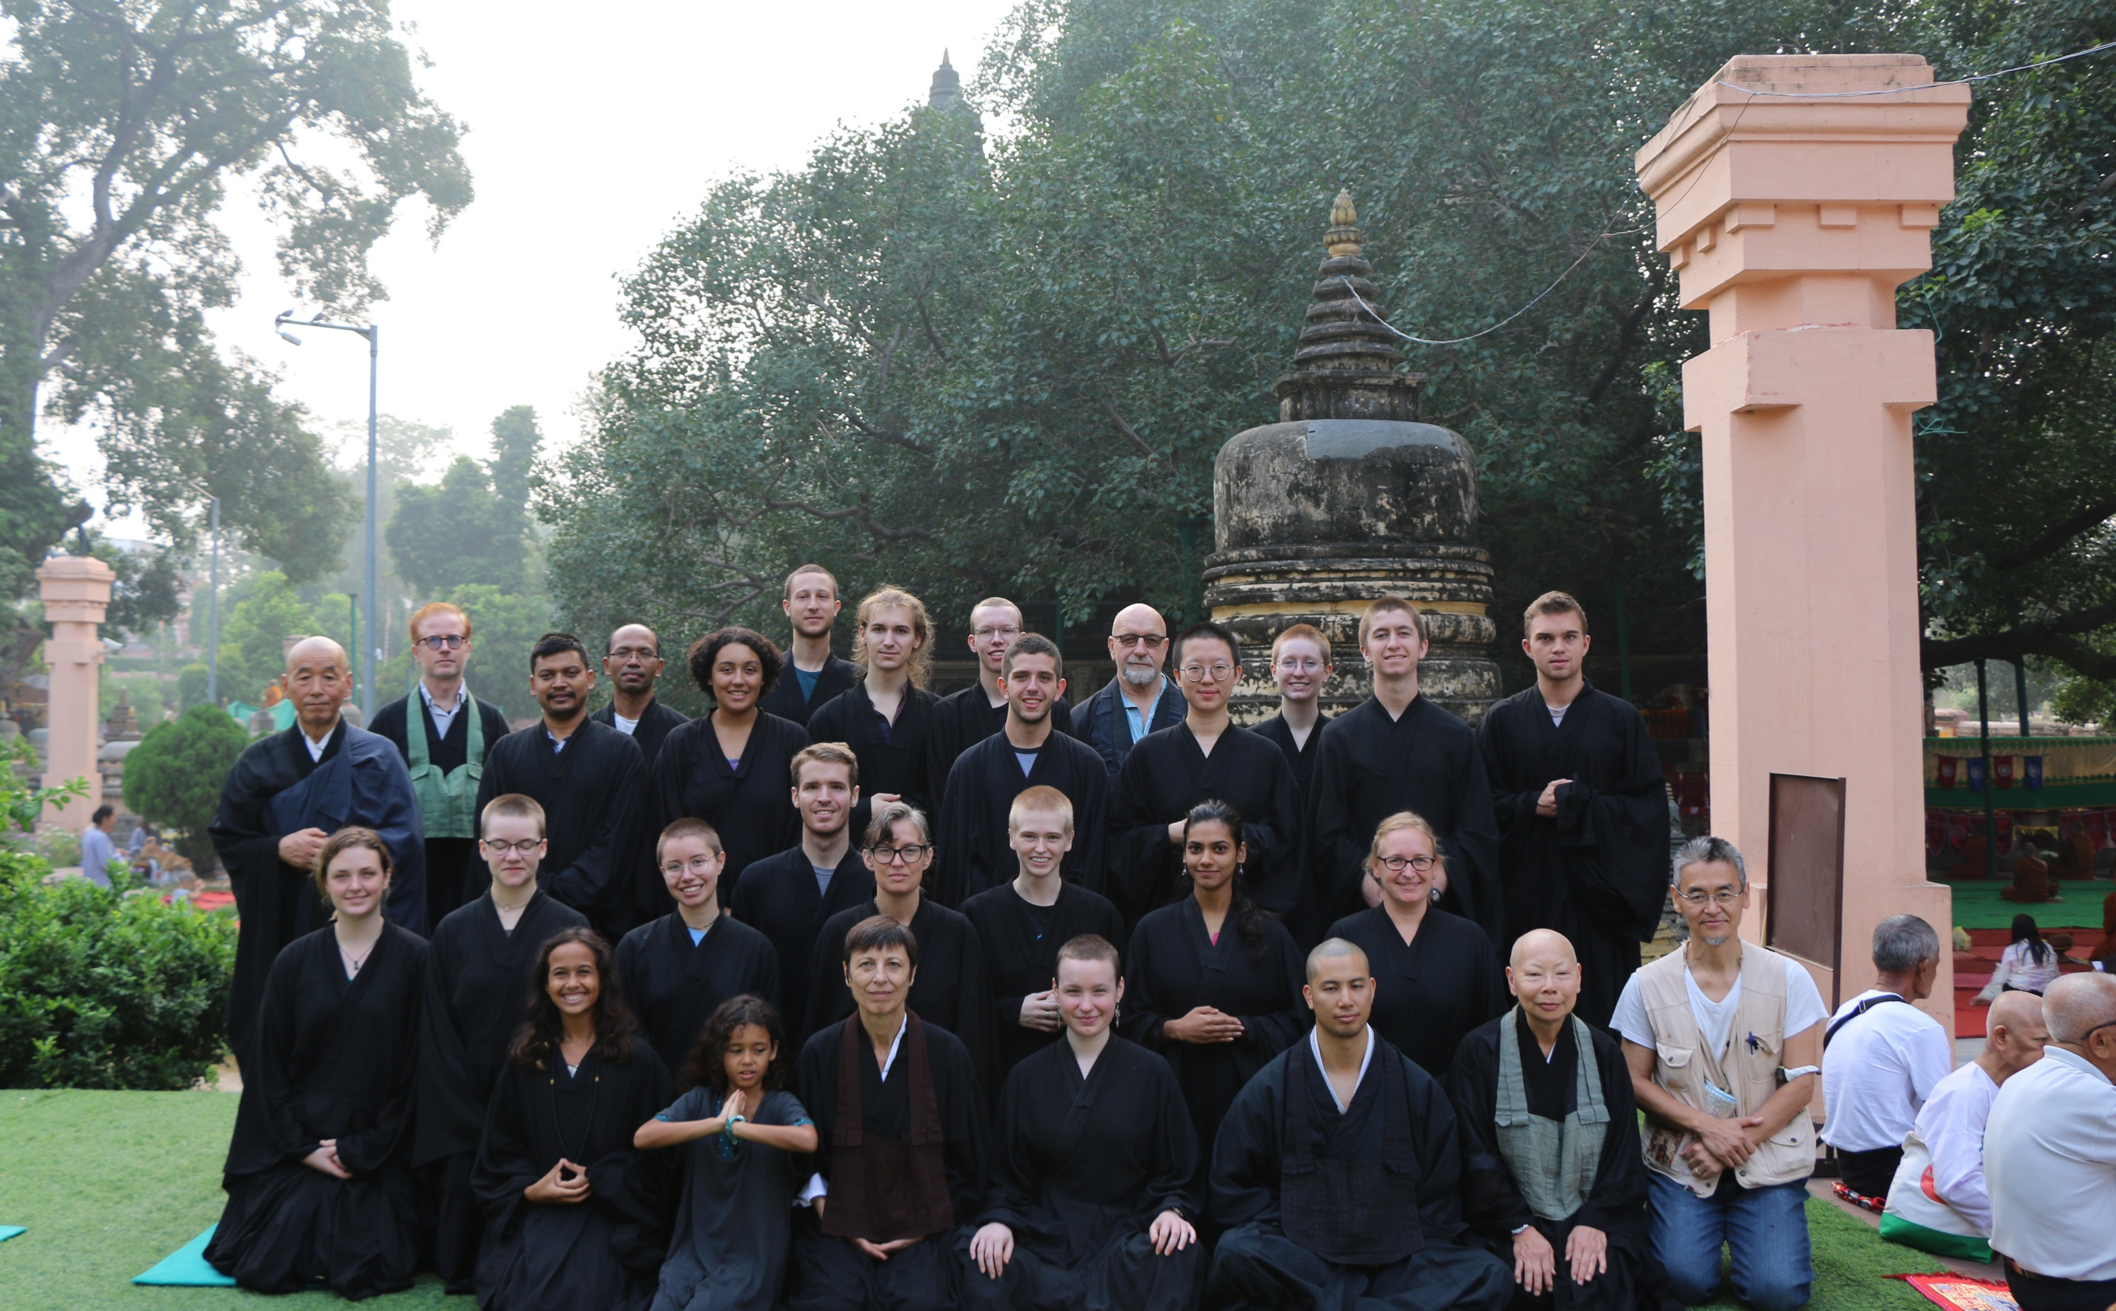

Slide 12
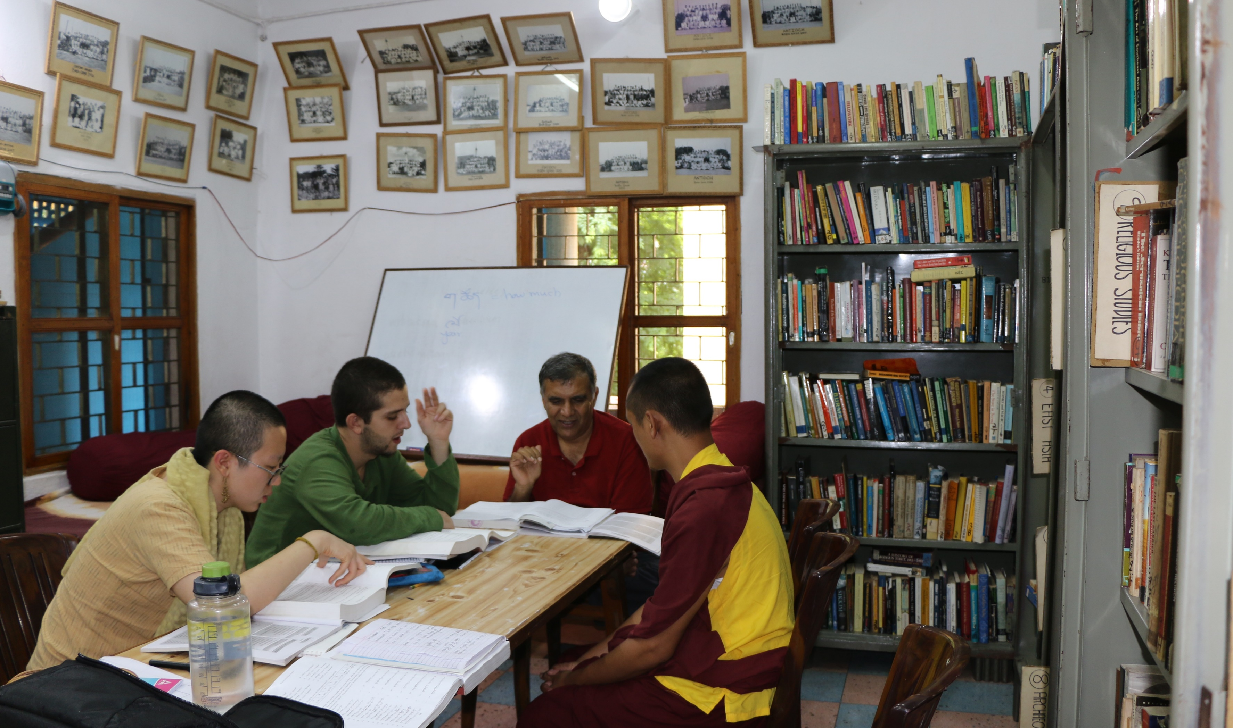

Slide 13
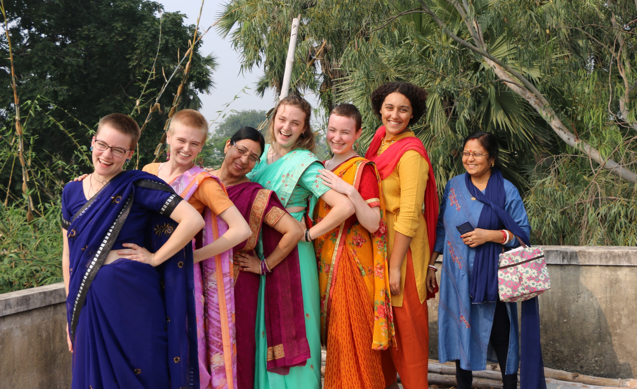

Slide 14
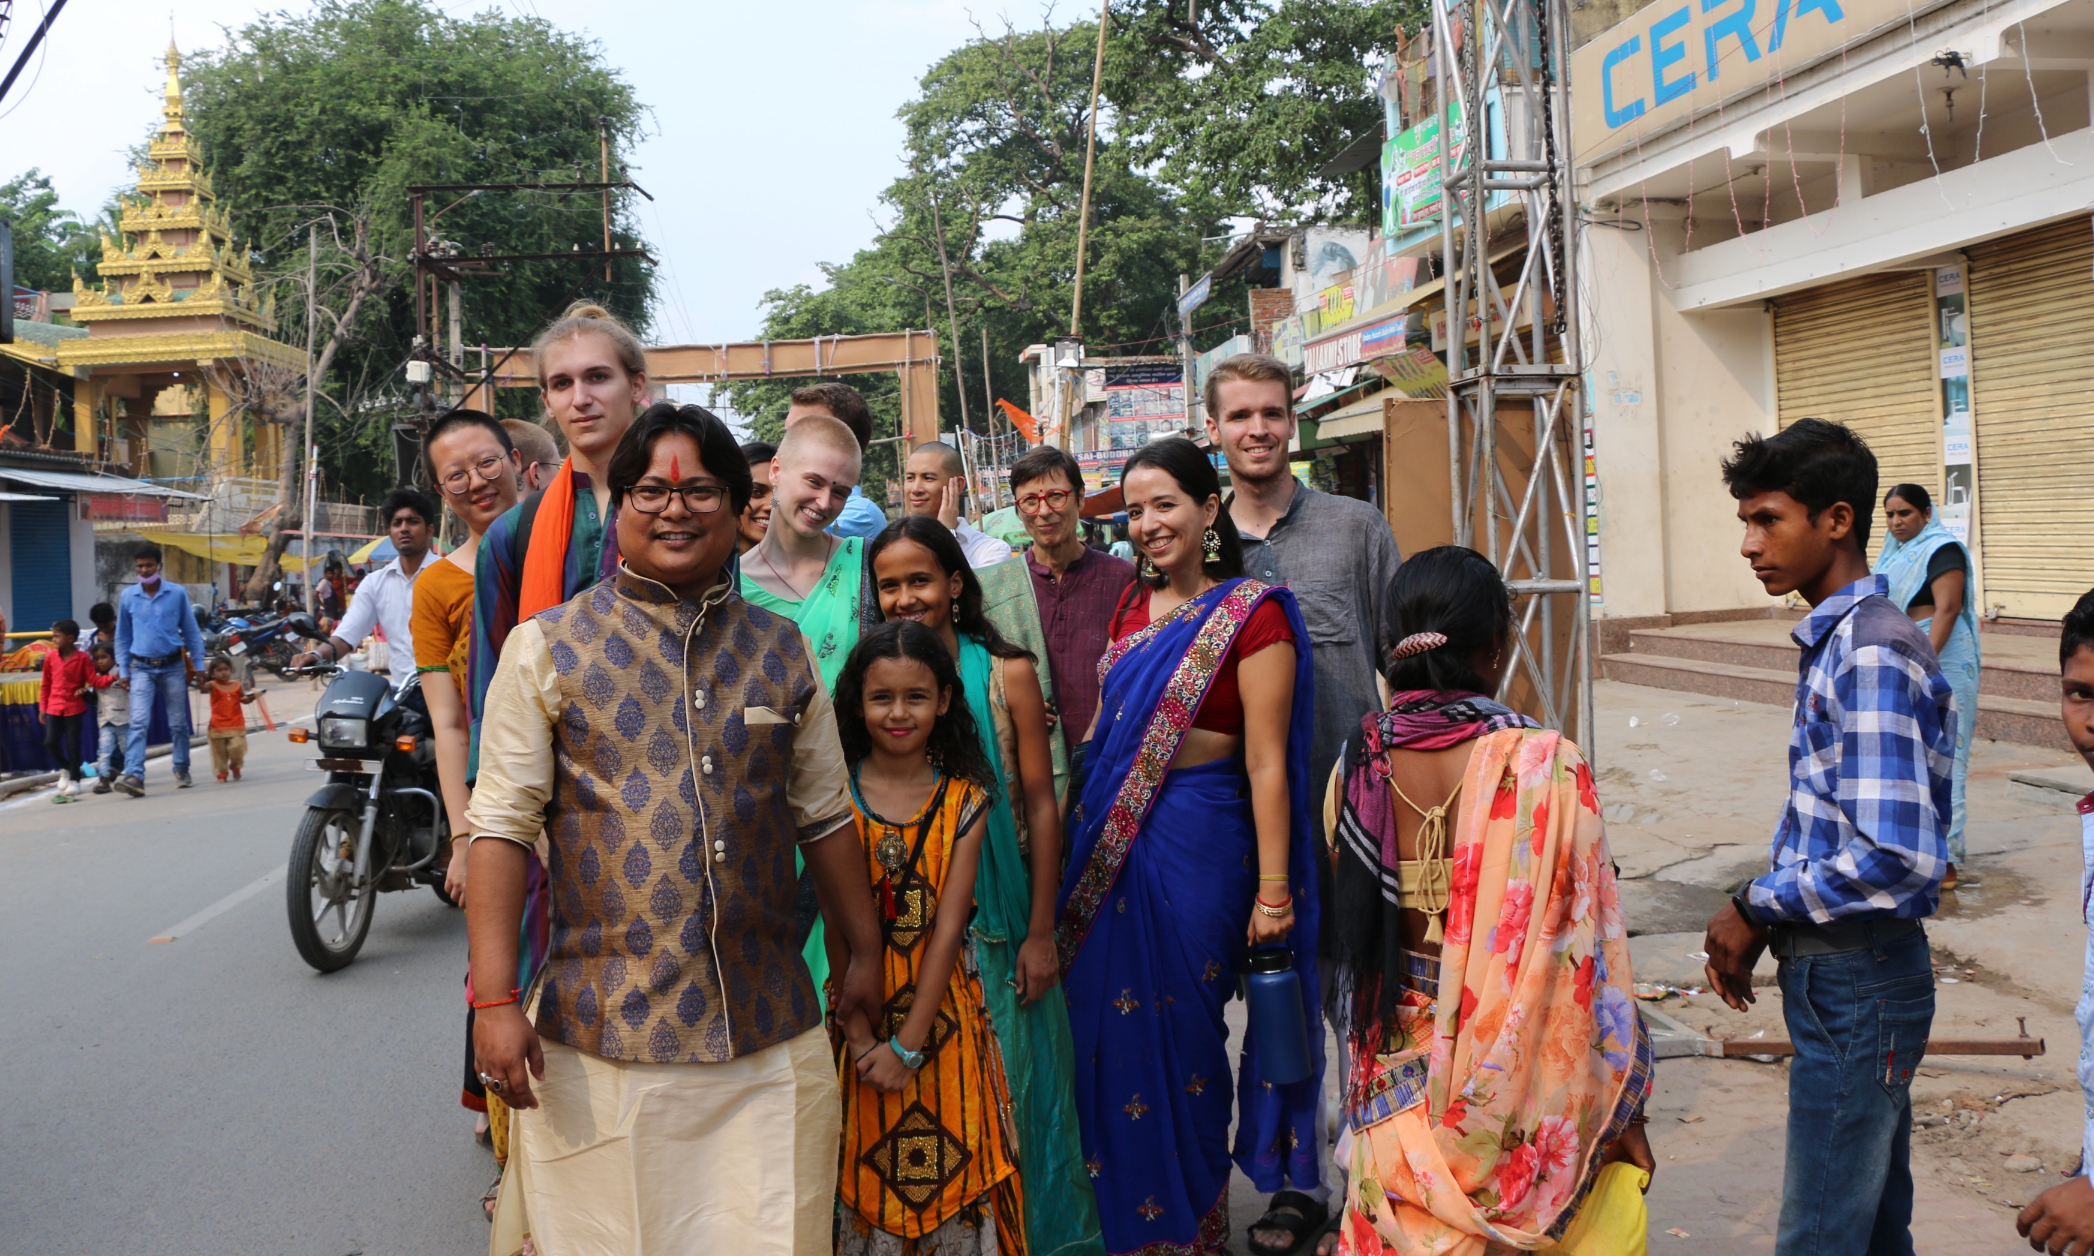

Slide 15
Women’s and gender studies In europe
Utrecht, the Netherlands
Berlin, Germany
Krakow, Poland
Prague, the Czech Republic
Early September to late November

Slide 16
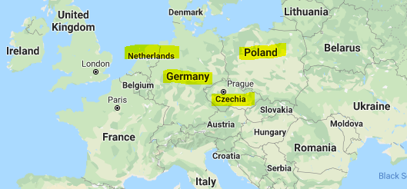

Slide 17
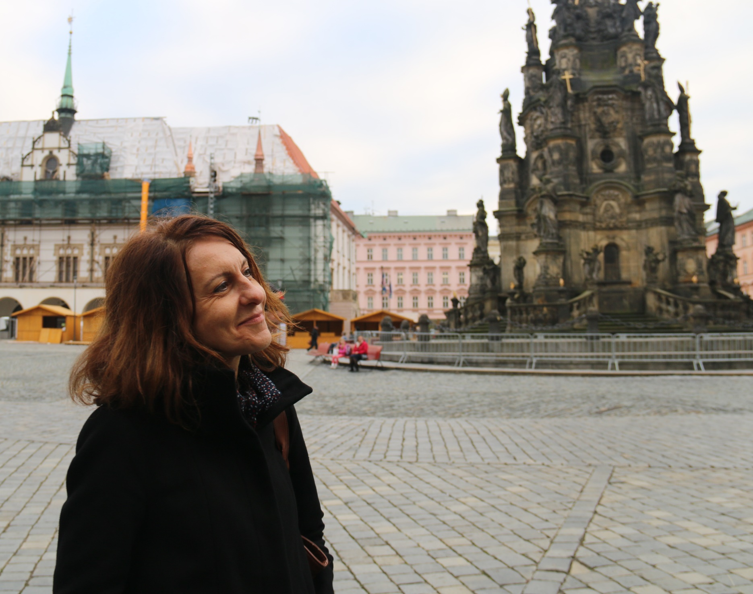
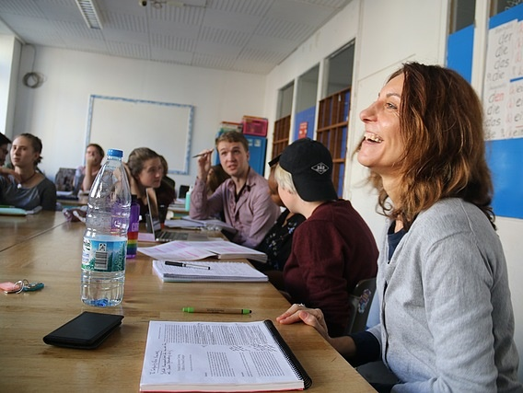
Dr. Iveta Jusová Director, Women's and Gender Studies Program in Europe Professor of Women's and Gender Studies

Slide 18
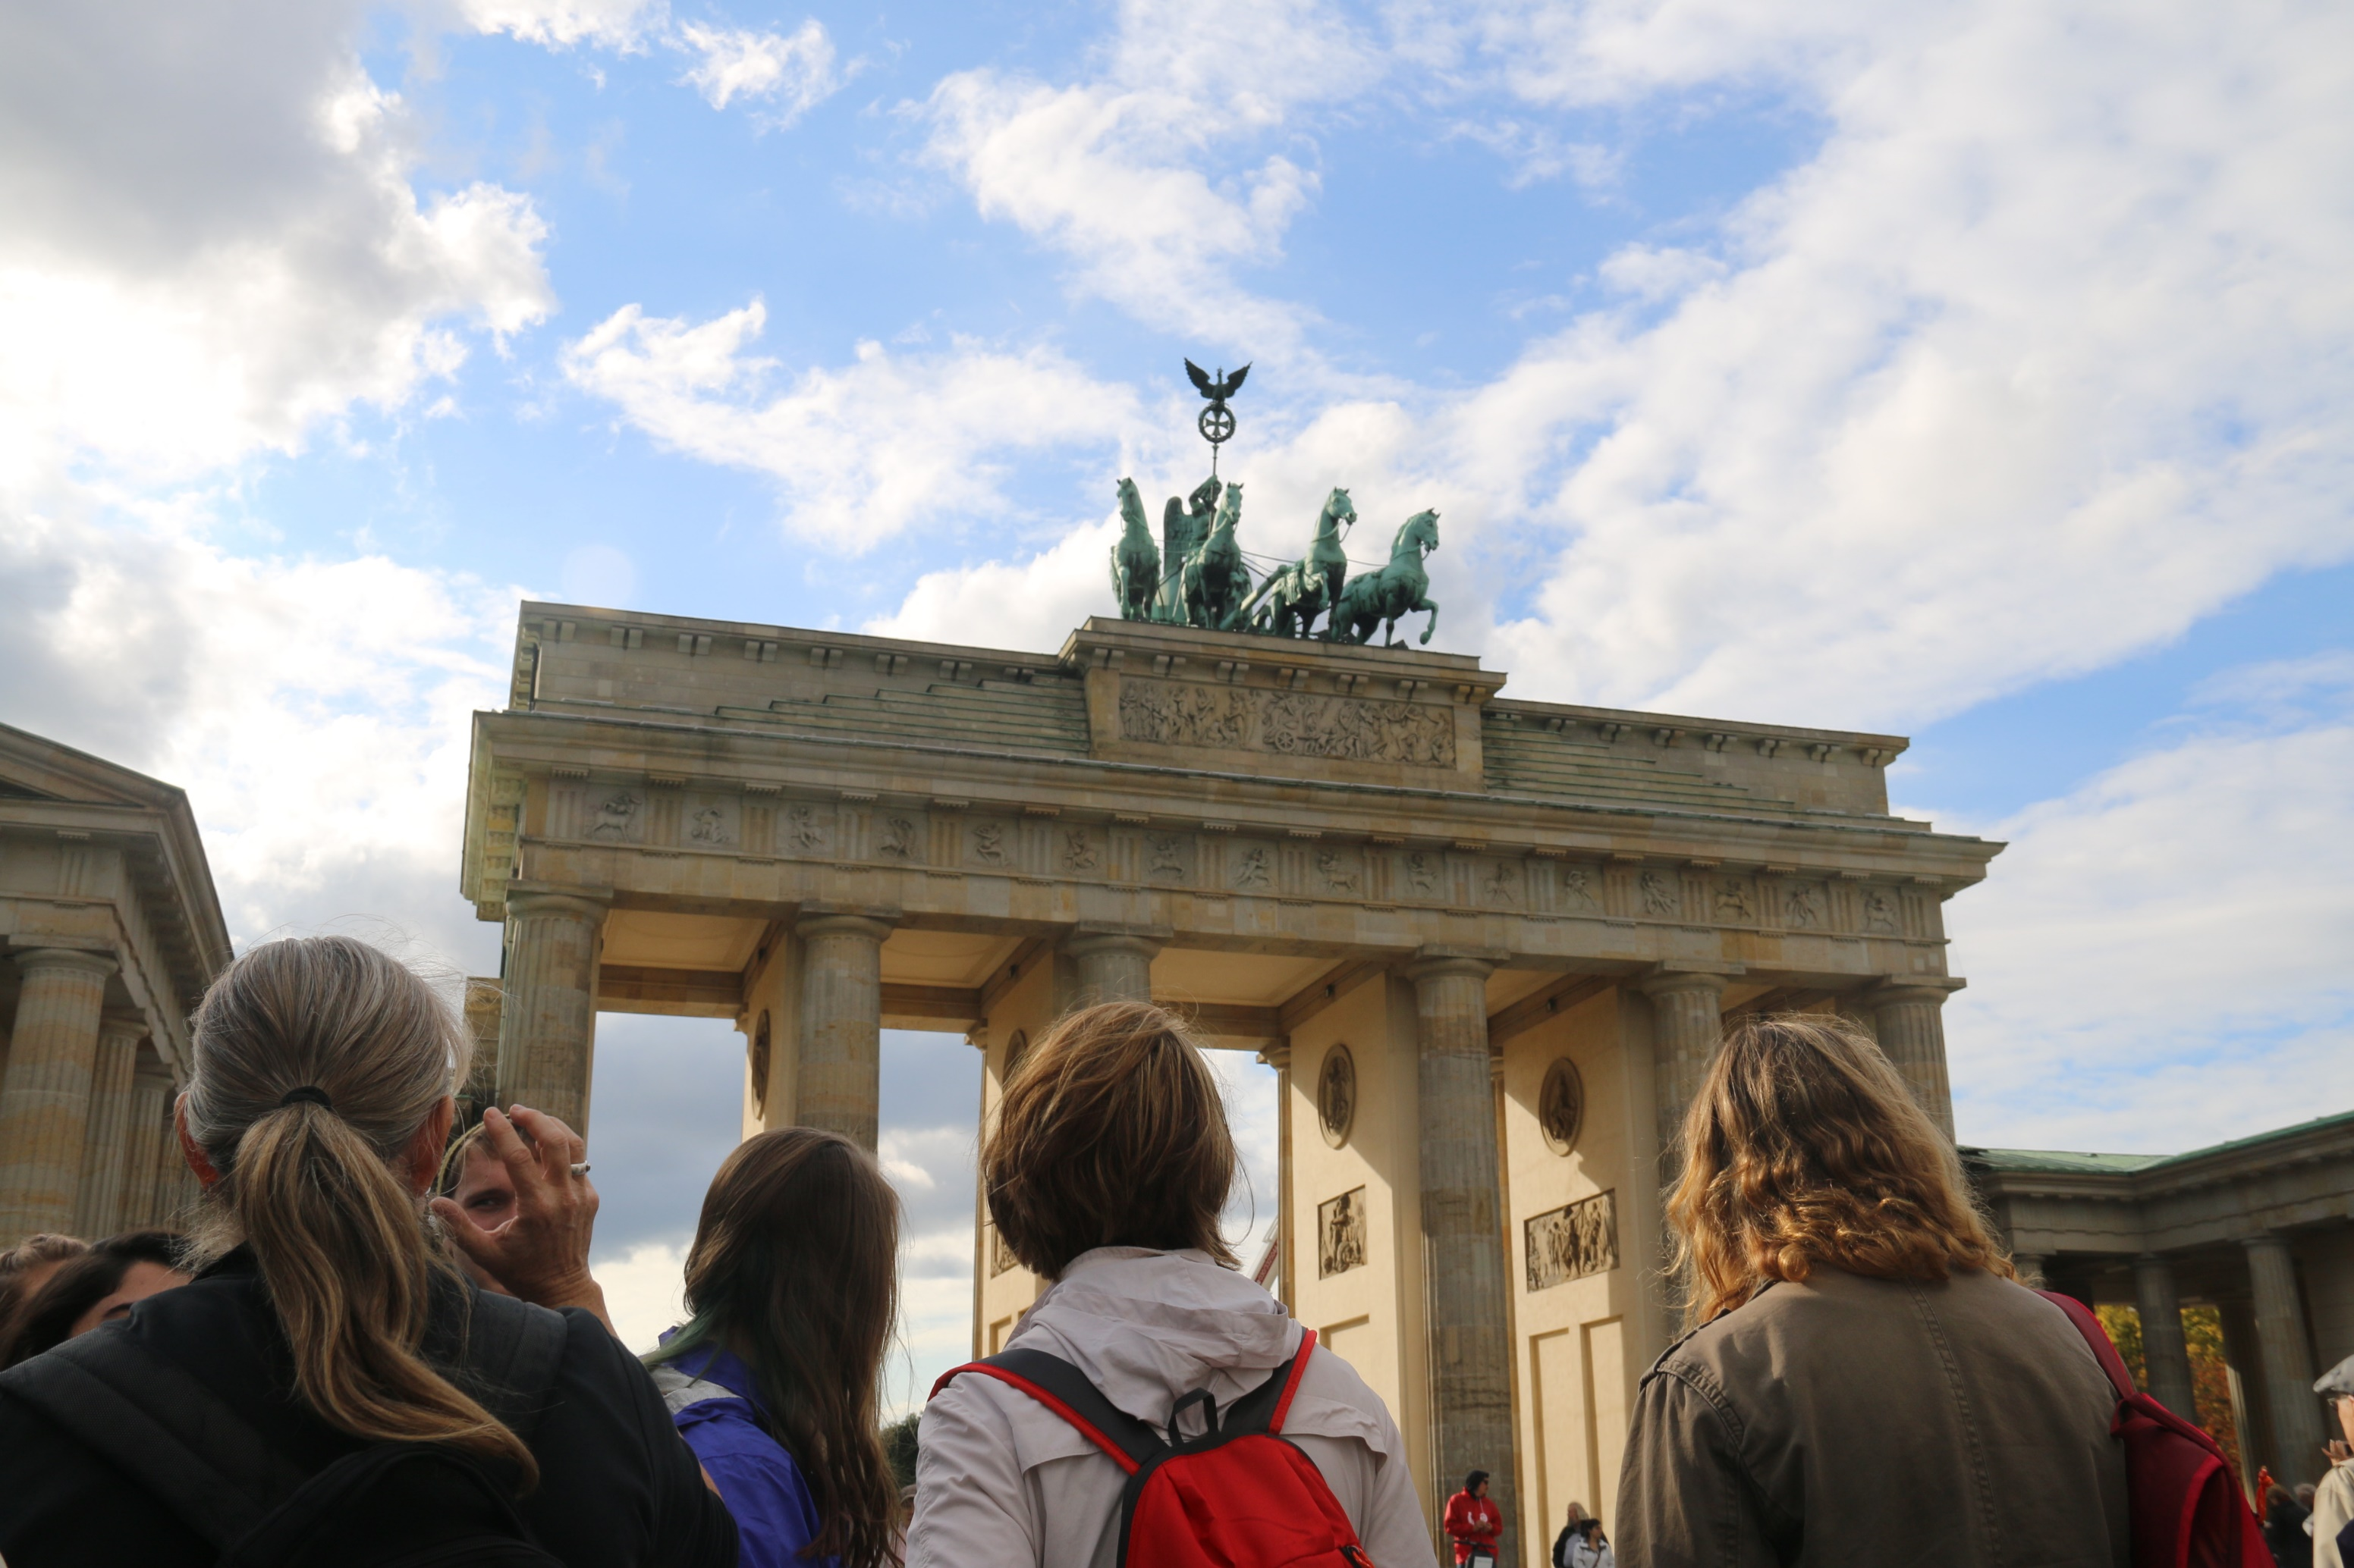

Slide 19
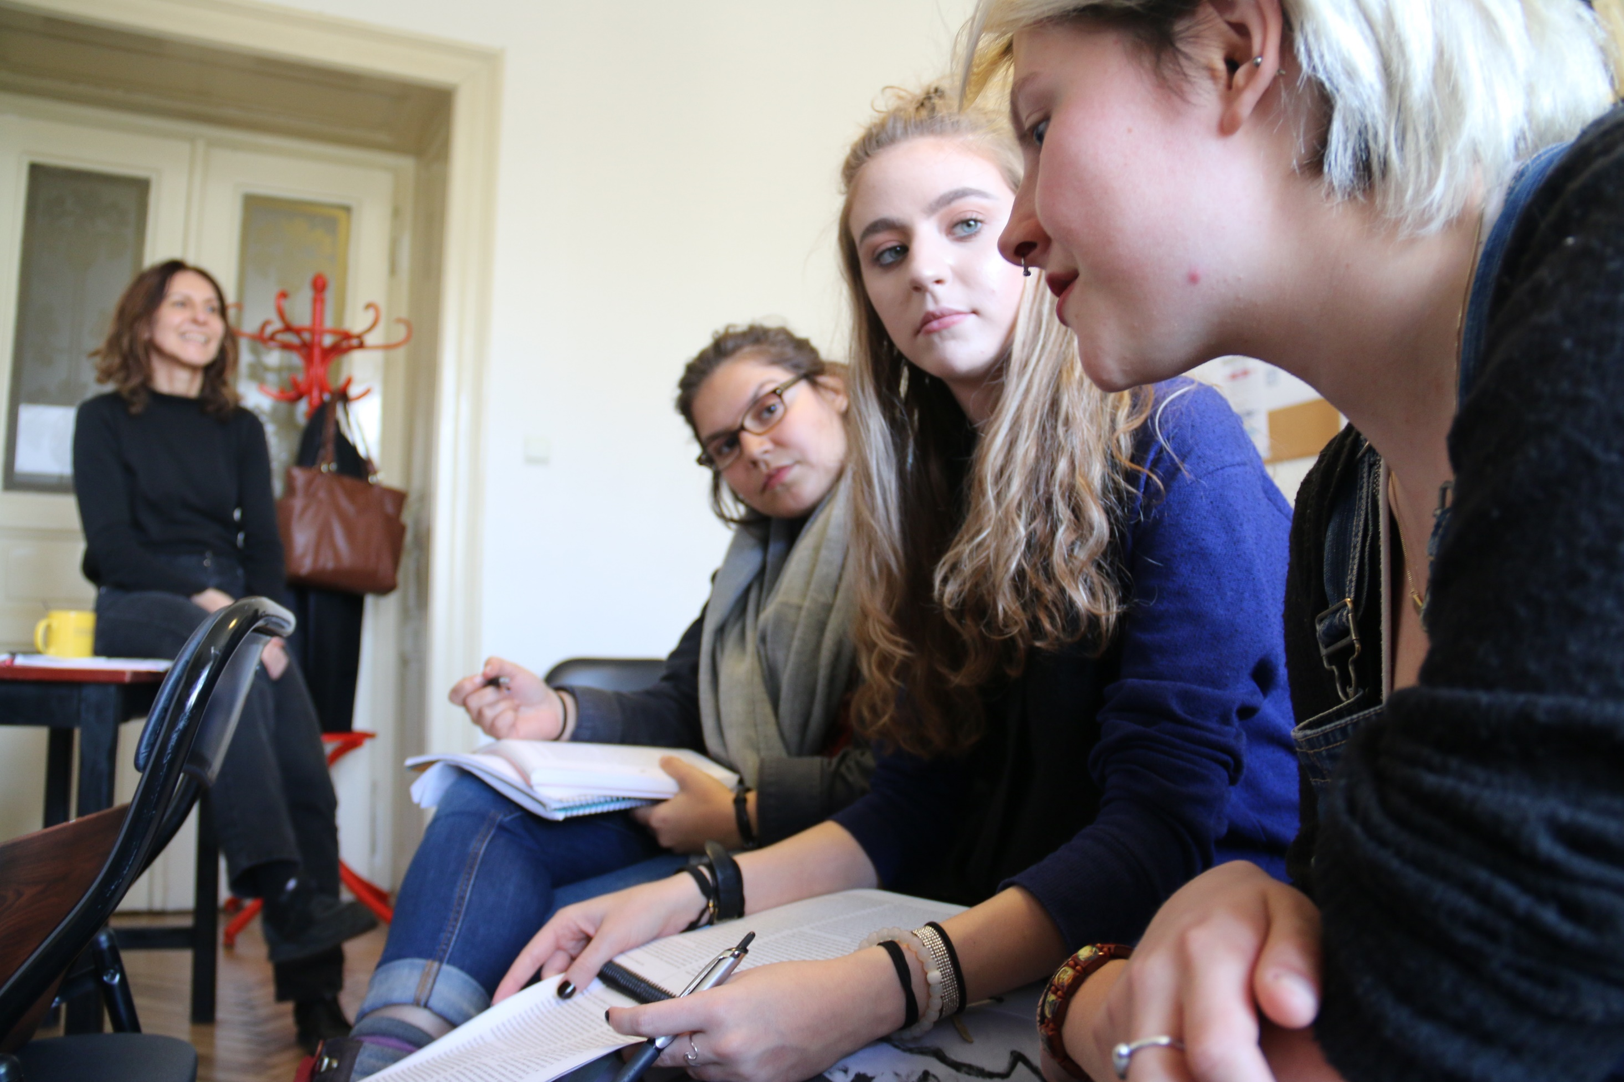

Slide 20
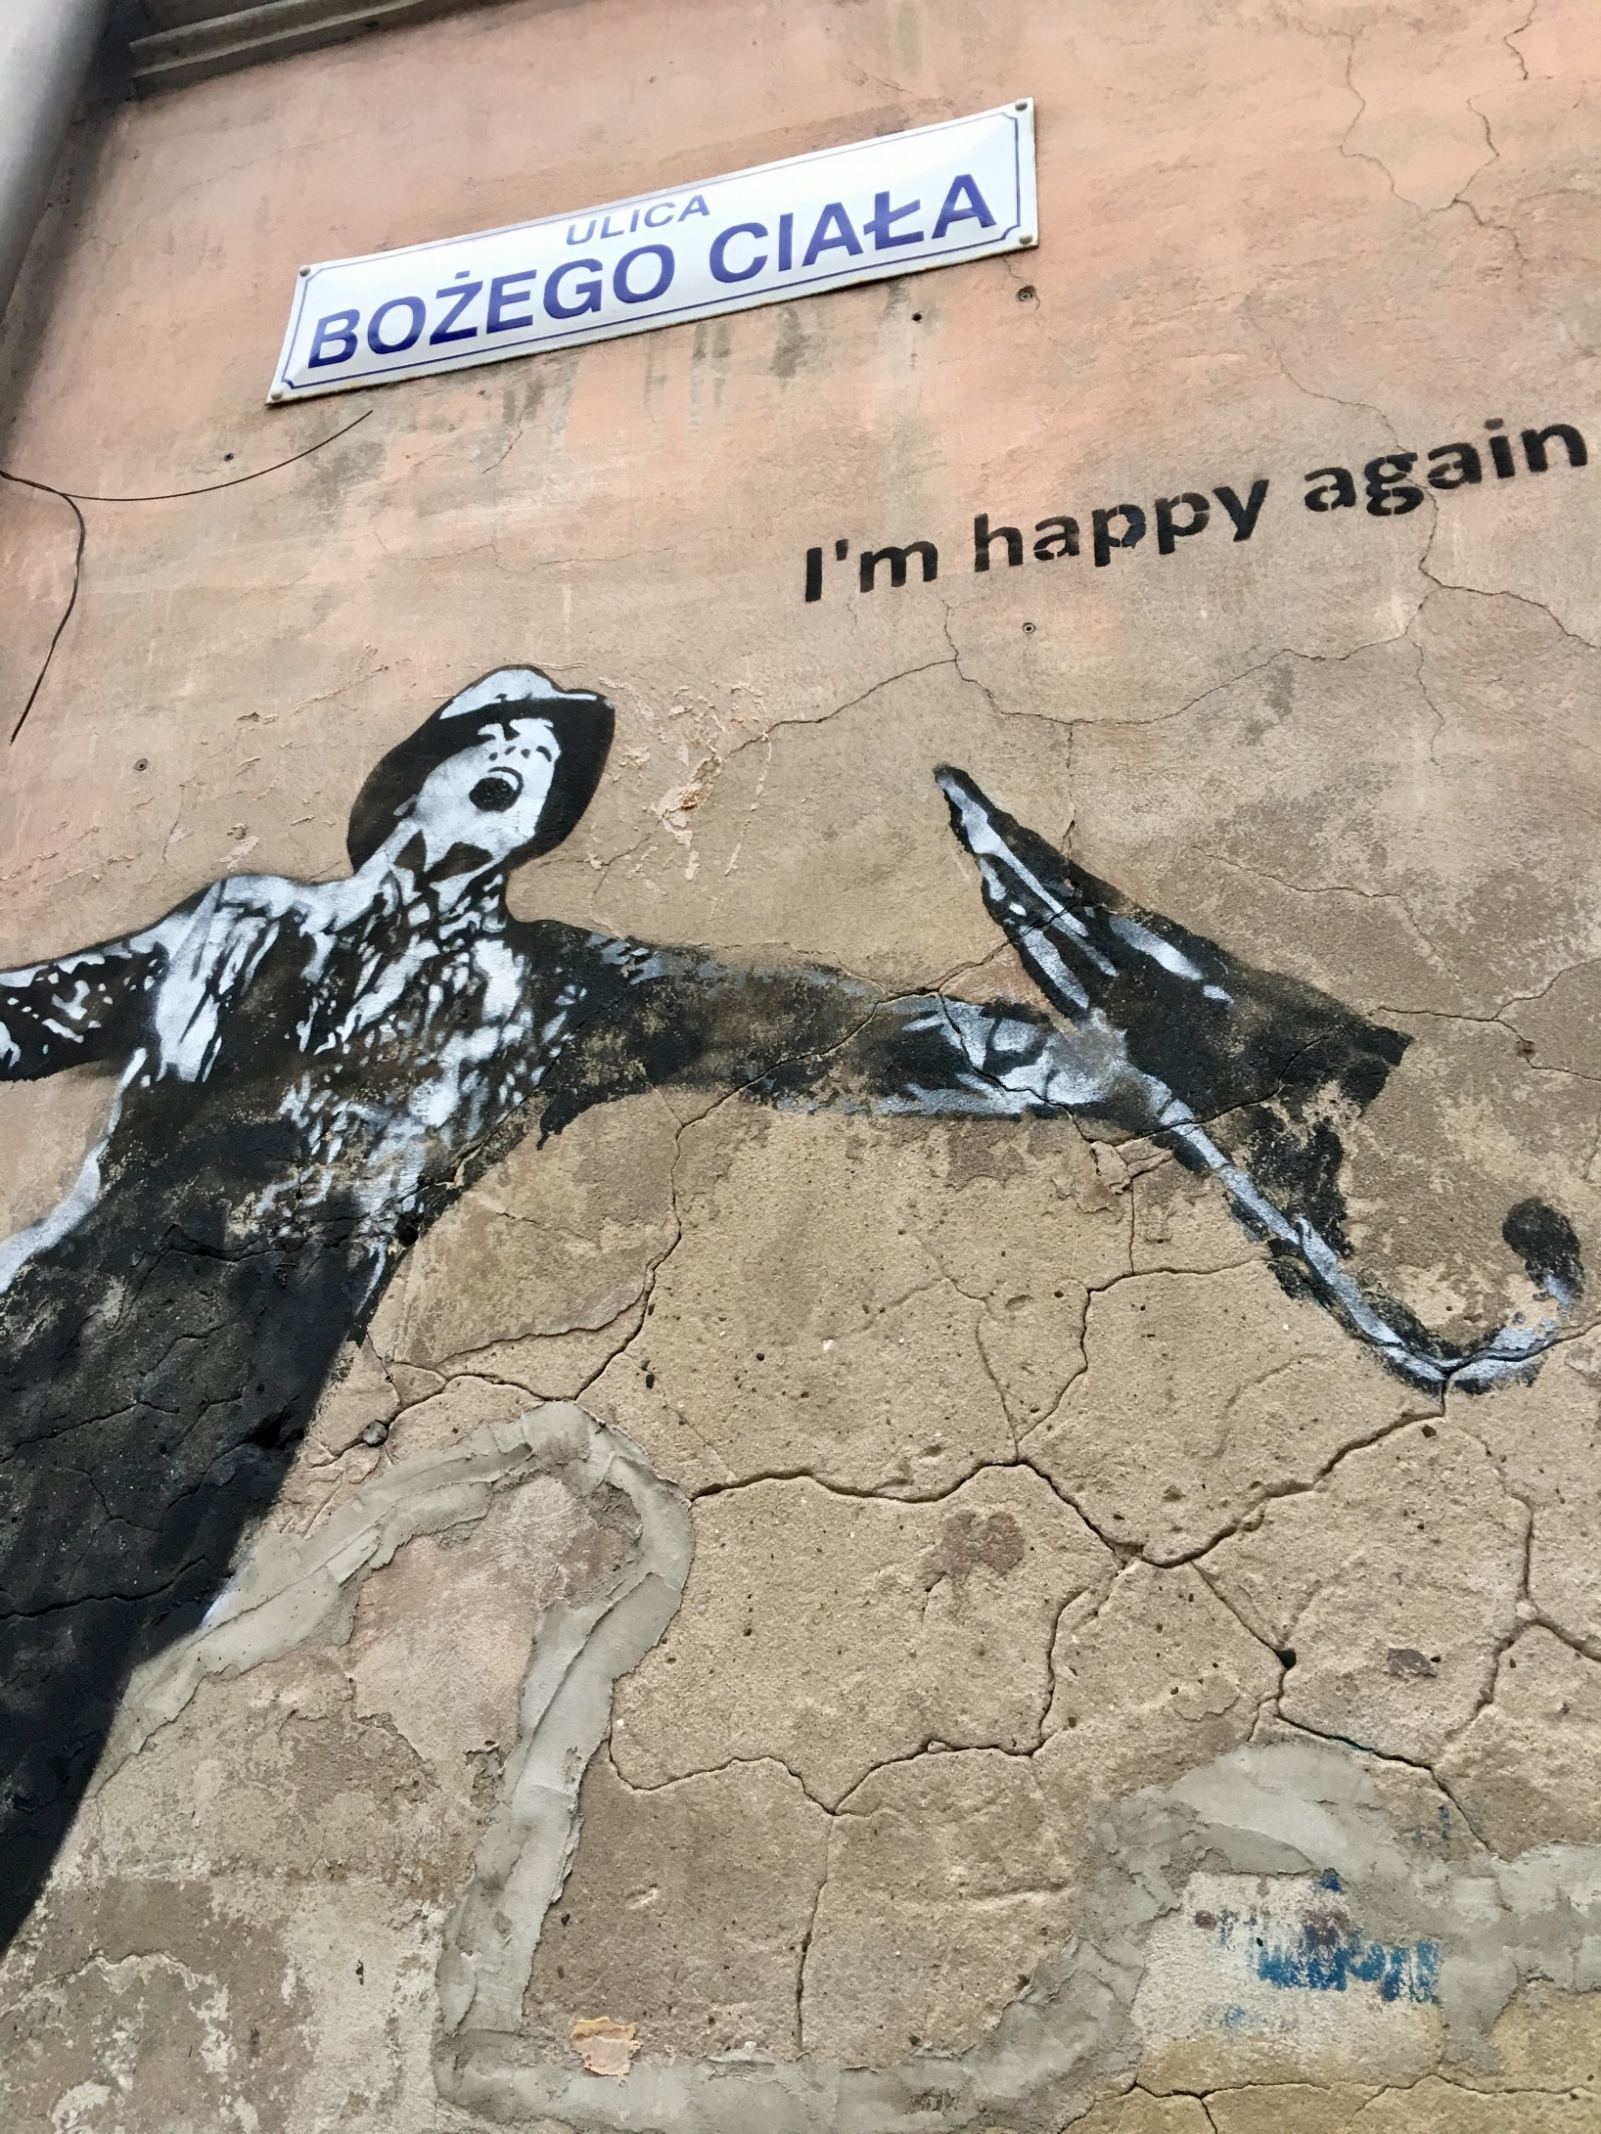
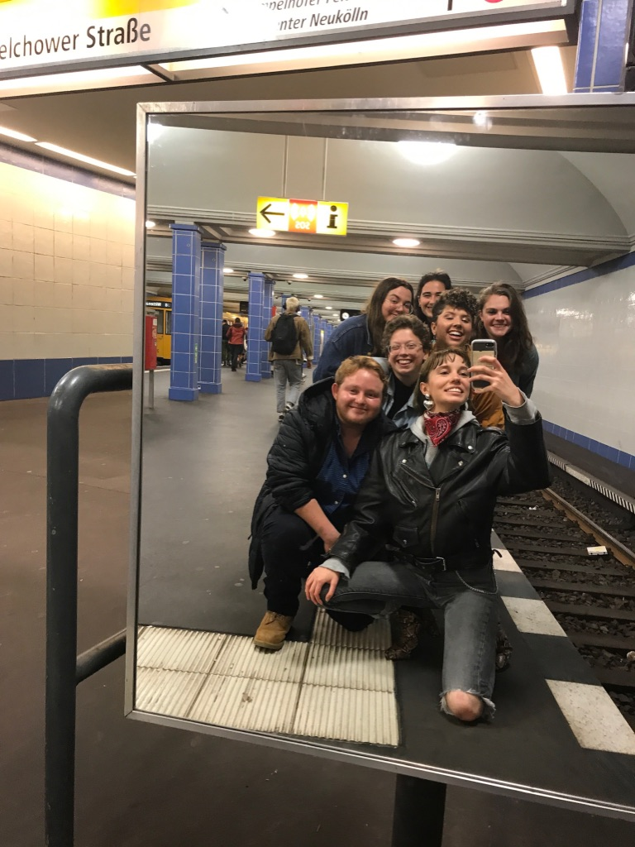

Slide 22
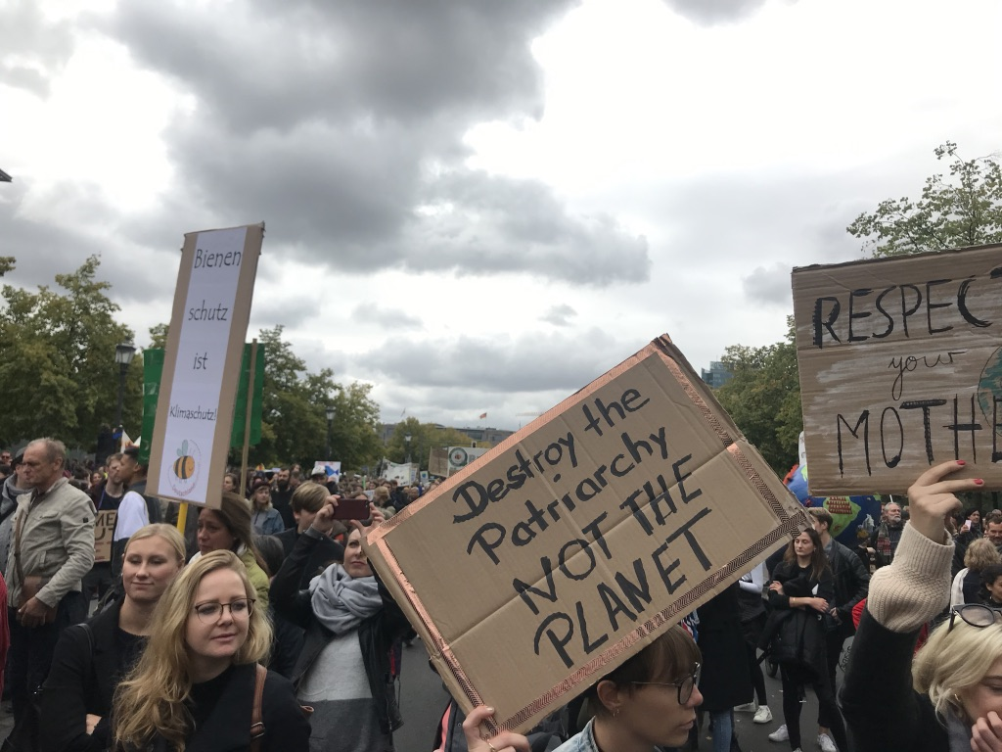

Slide 23
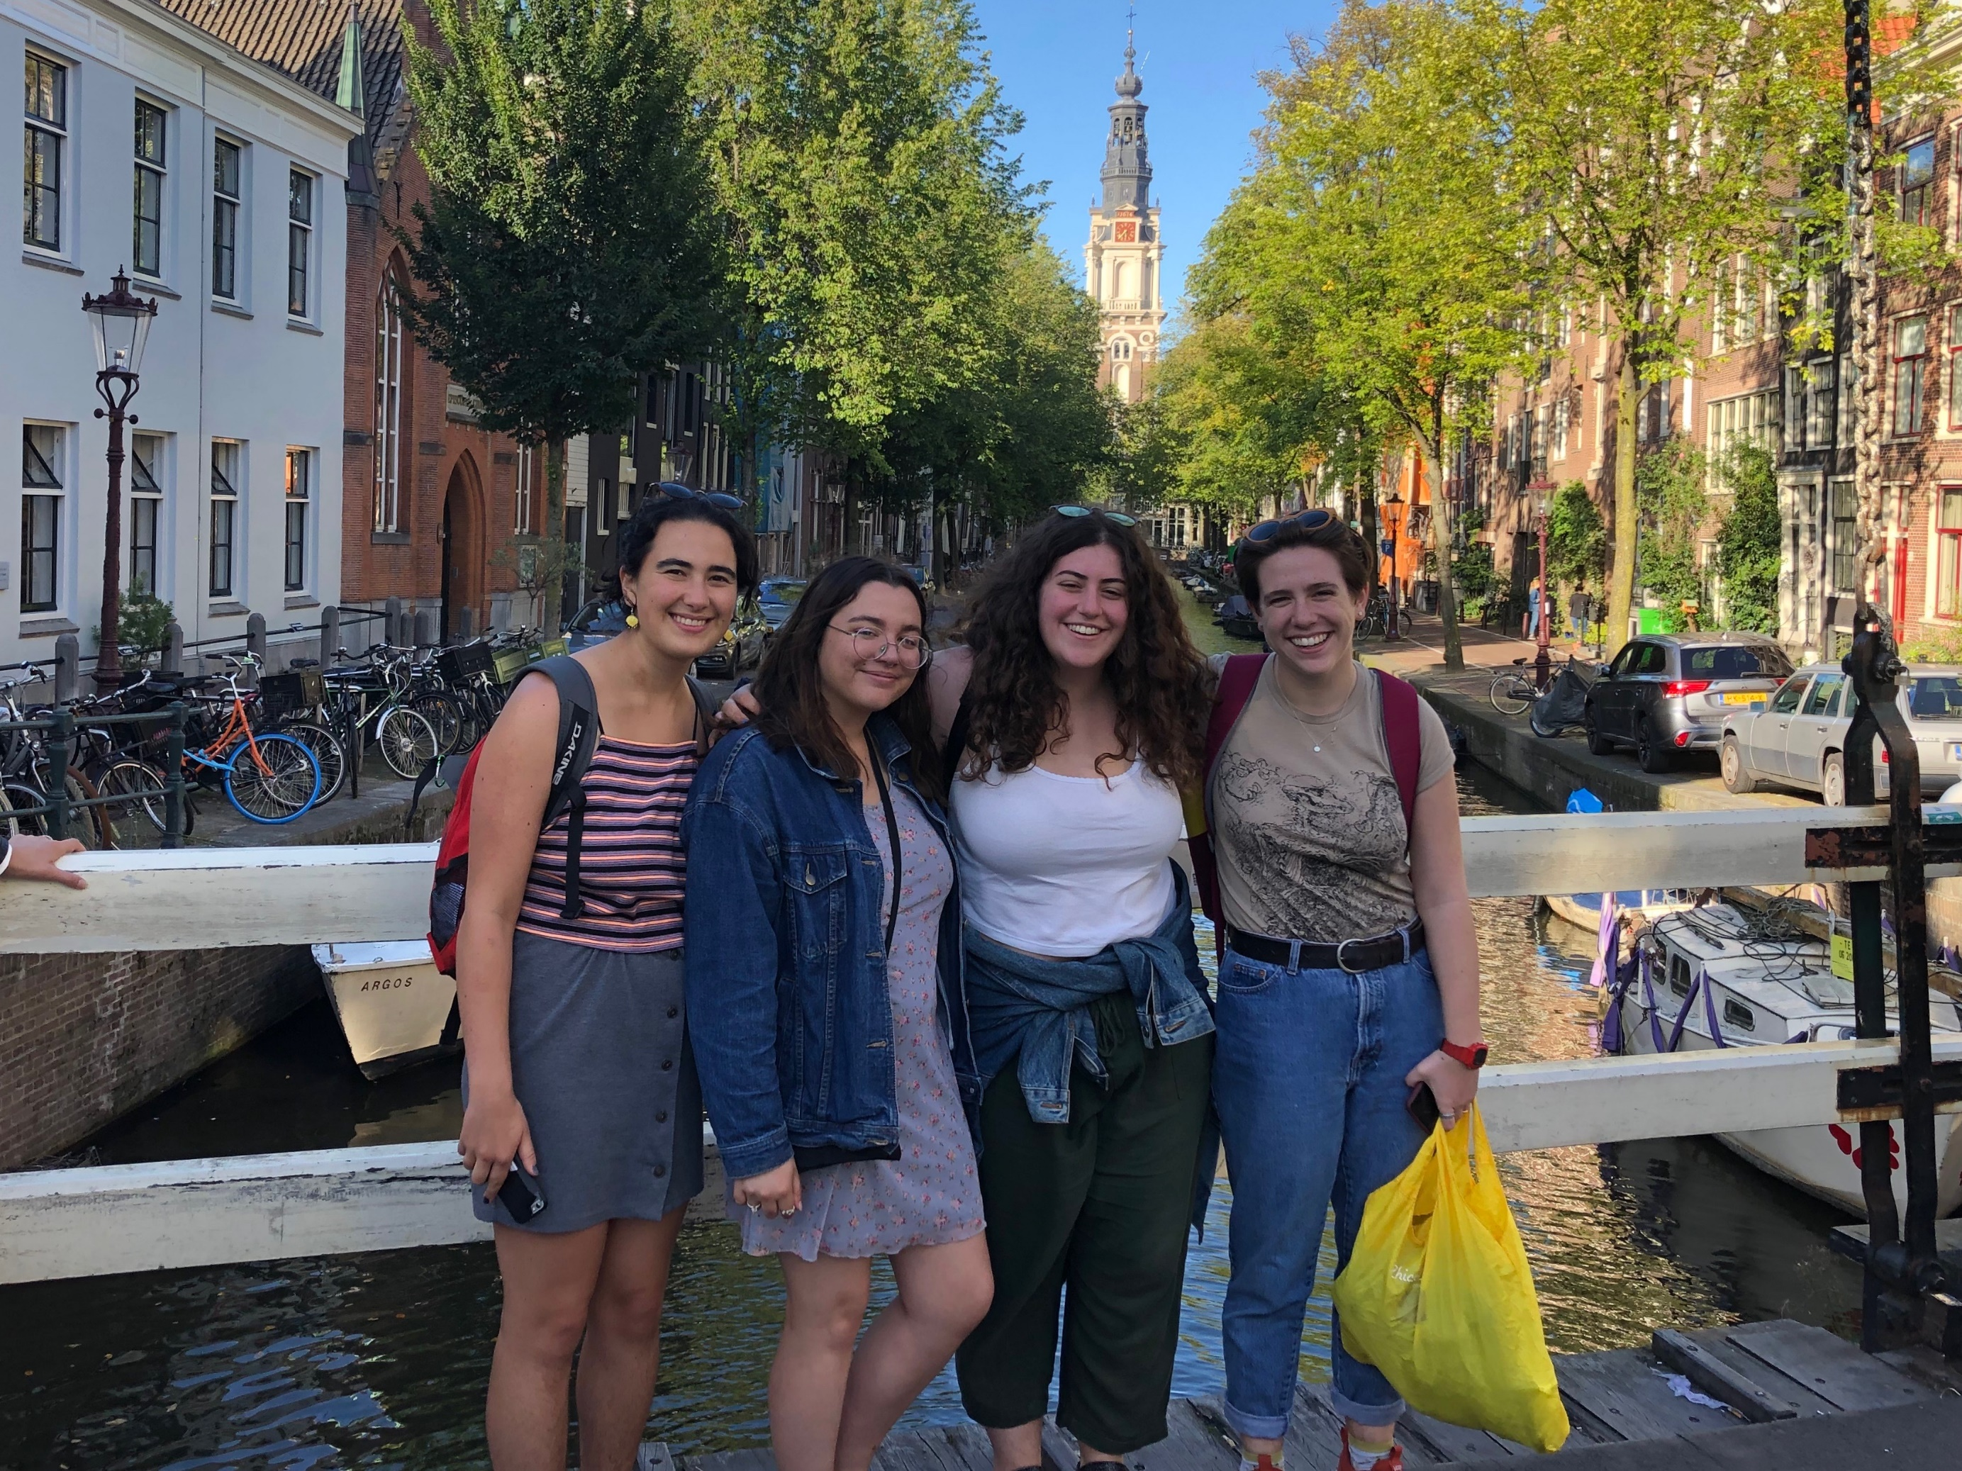

Slide 25
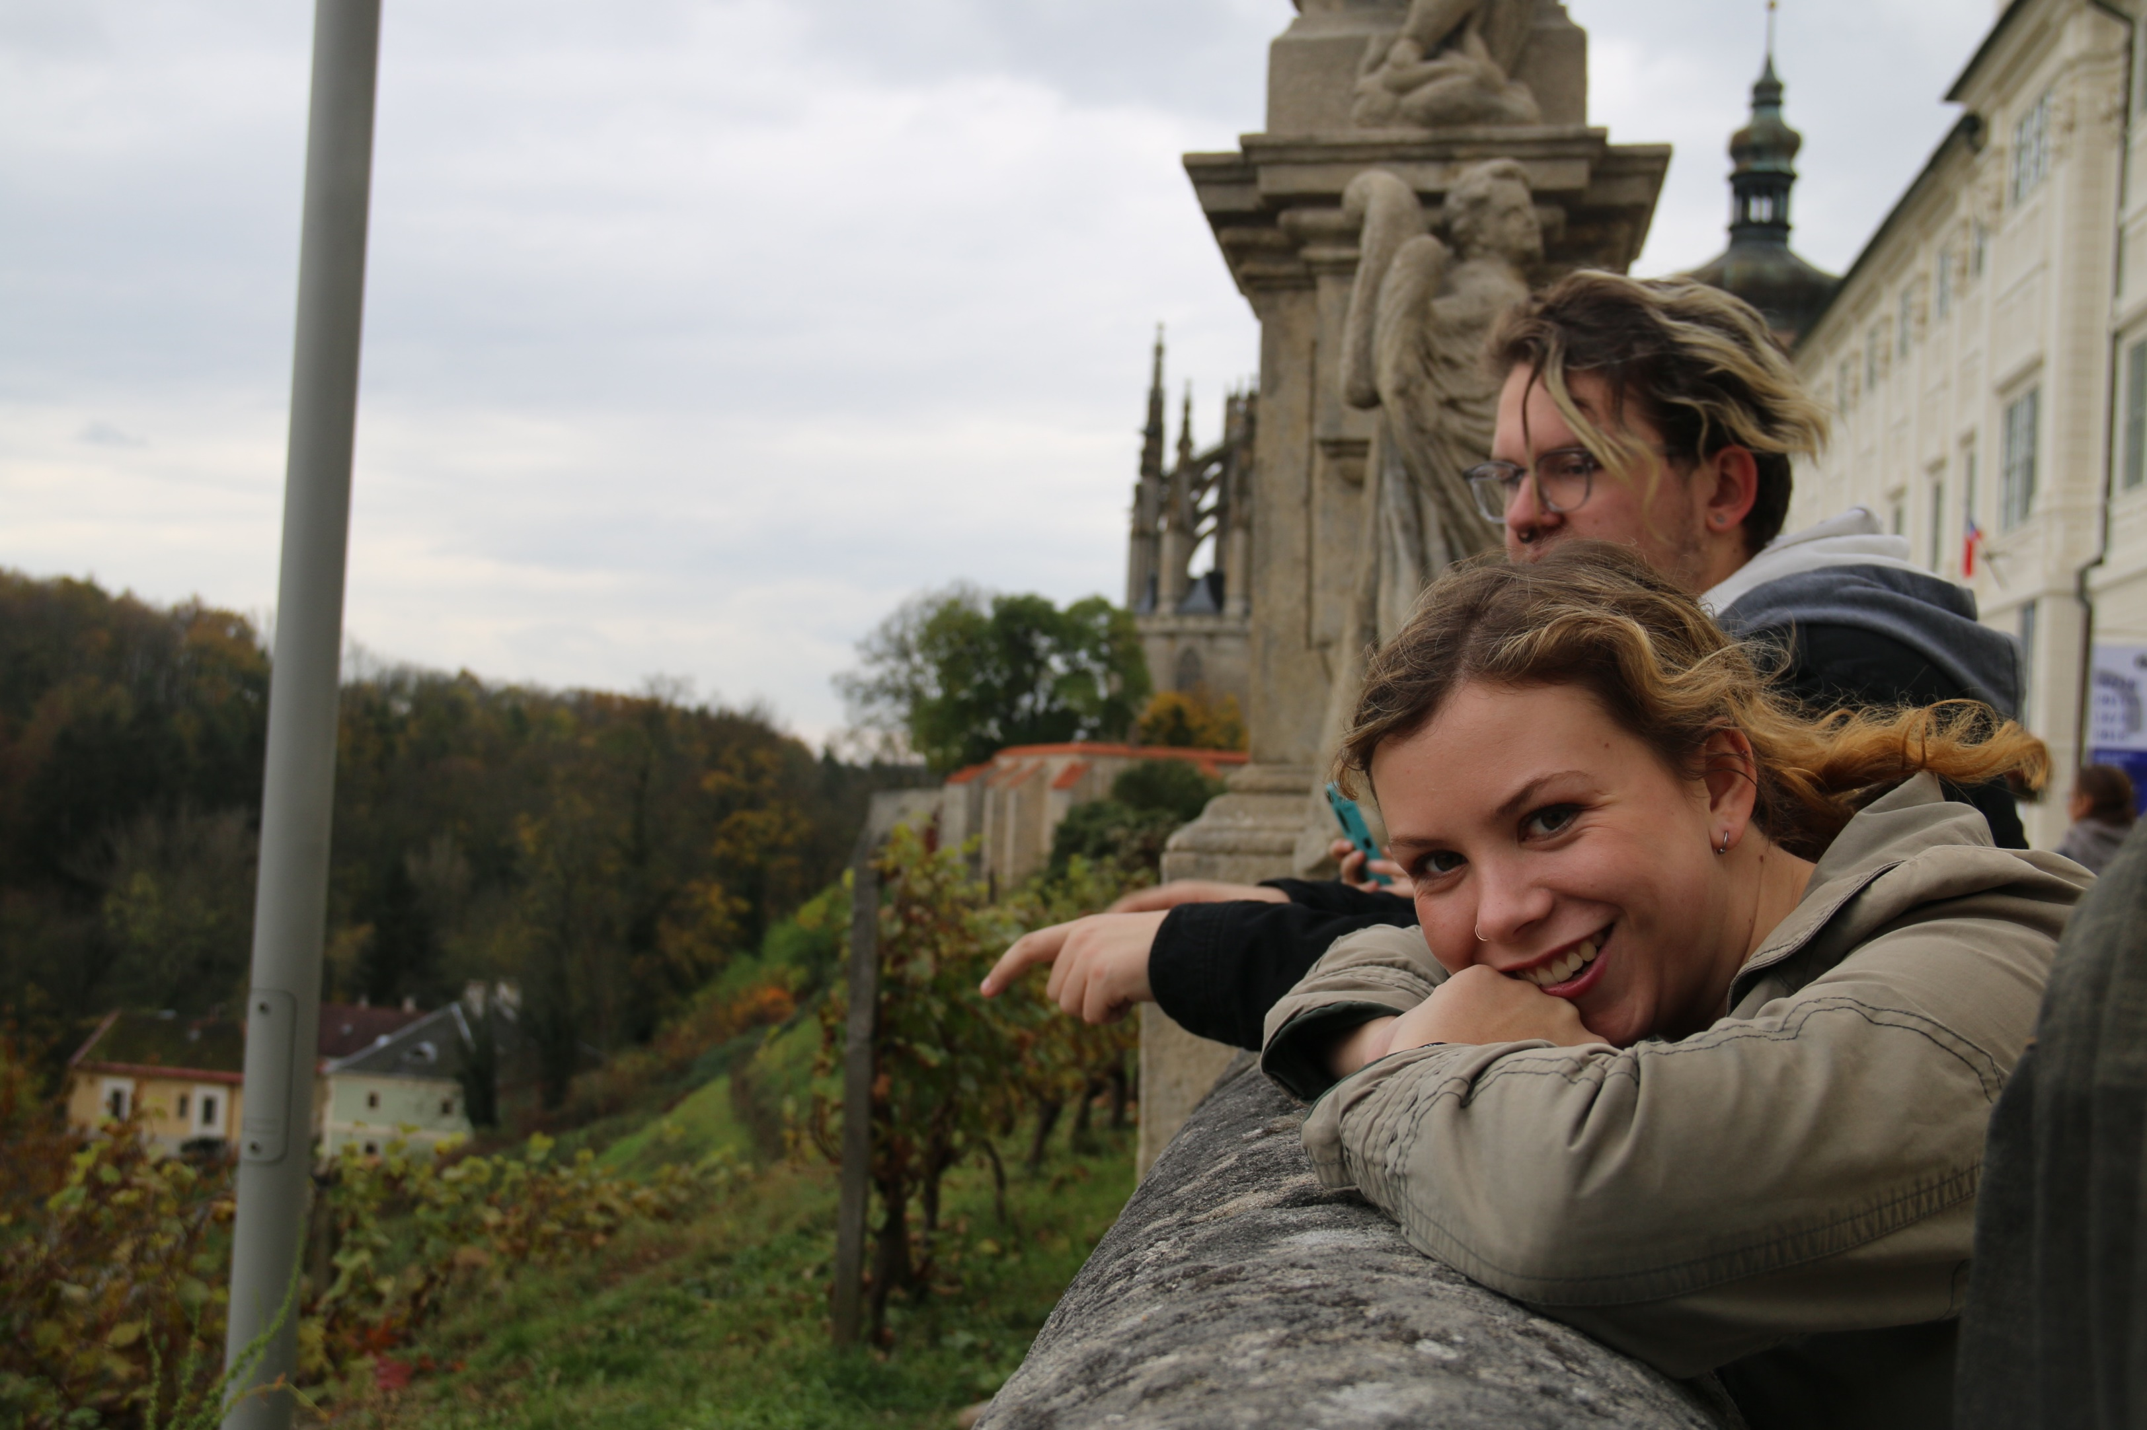

Slide 26
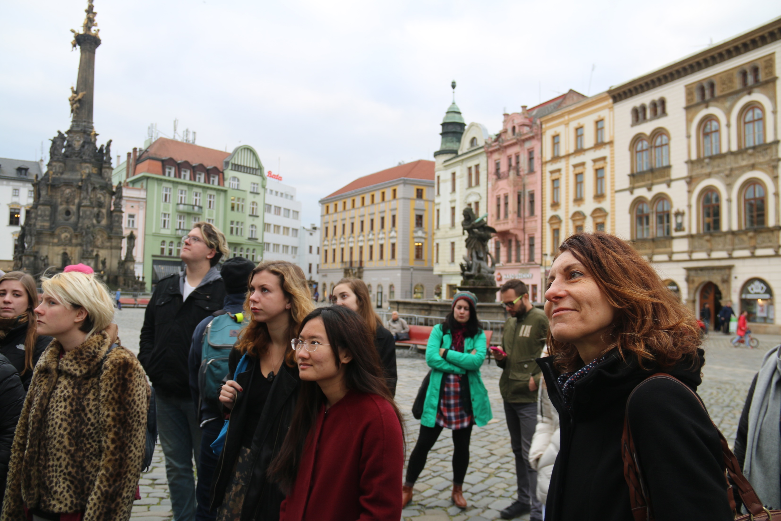

Slide 27
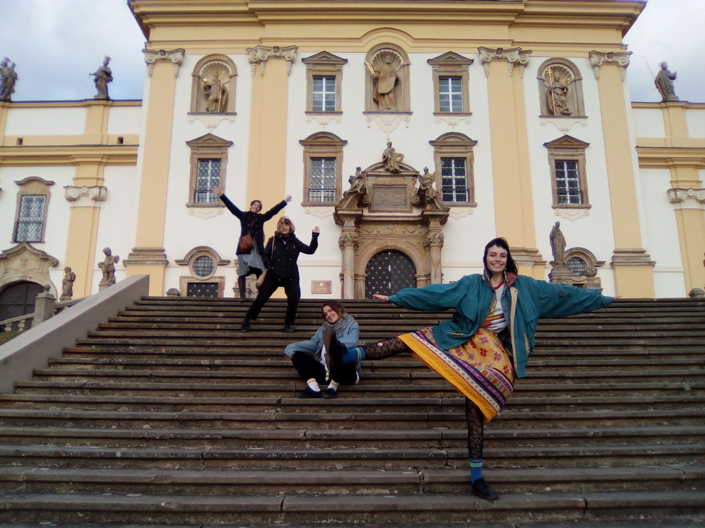

Slide 28
Ecology and anthropology in Tanzania
Arusha and Usa River, Tanzania
National Parks of Northern Tanzania (excursions)
Early September to Mid-December

Slide 29
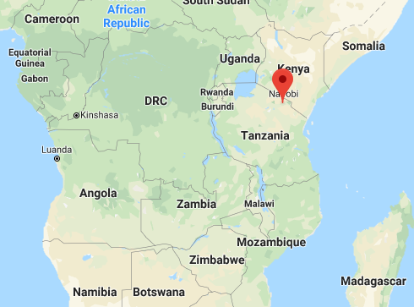

Slide 30
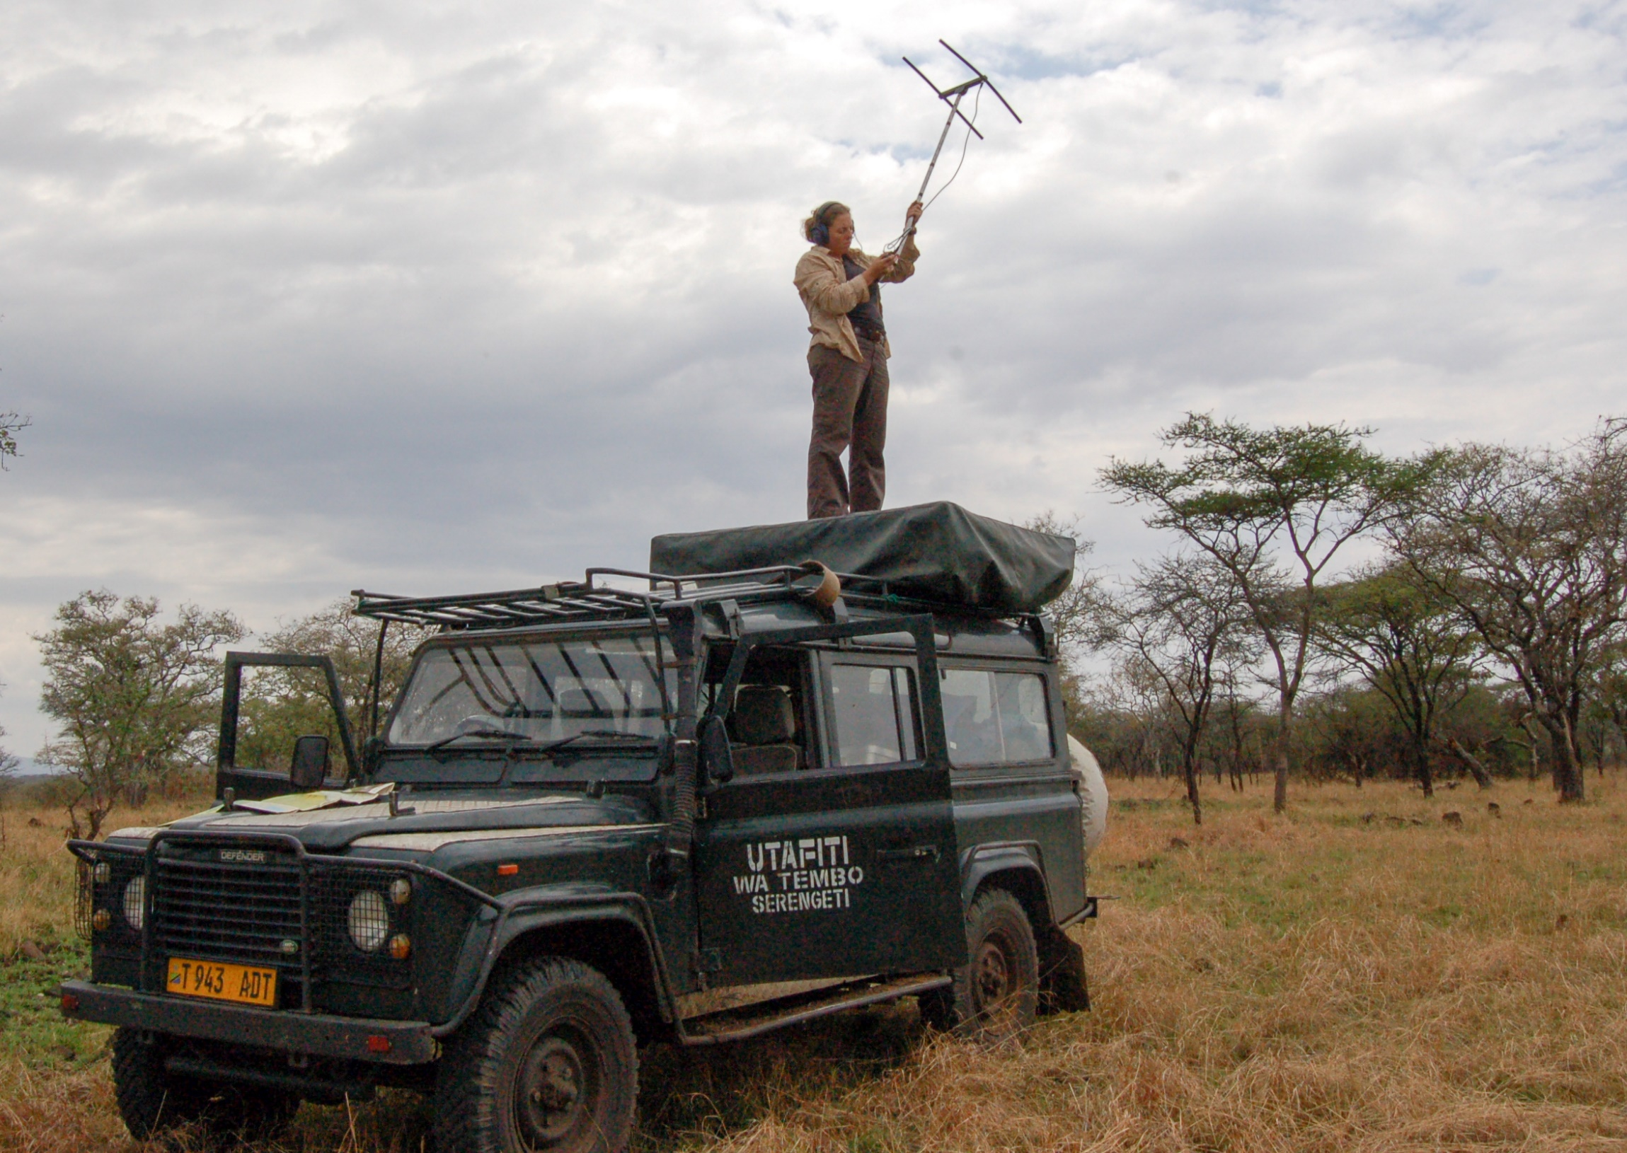
Dr. Anna Estes Director, Ecology and Anthropology in Tanzania Assistant Professor of Environmental Studies

Slide 31
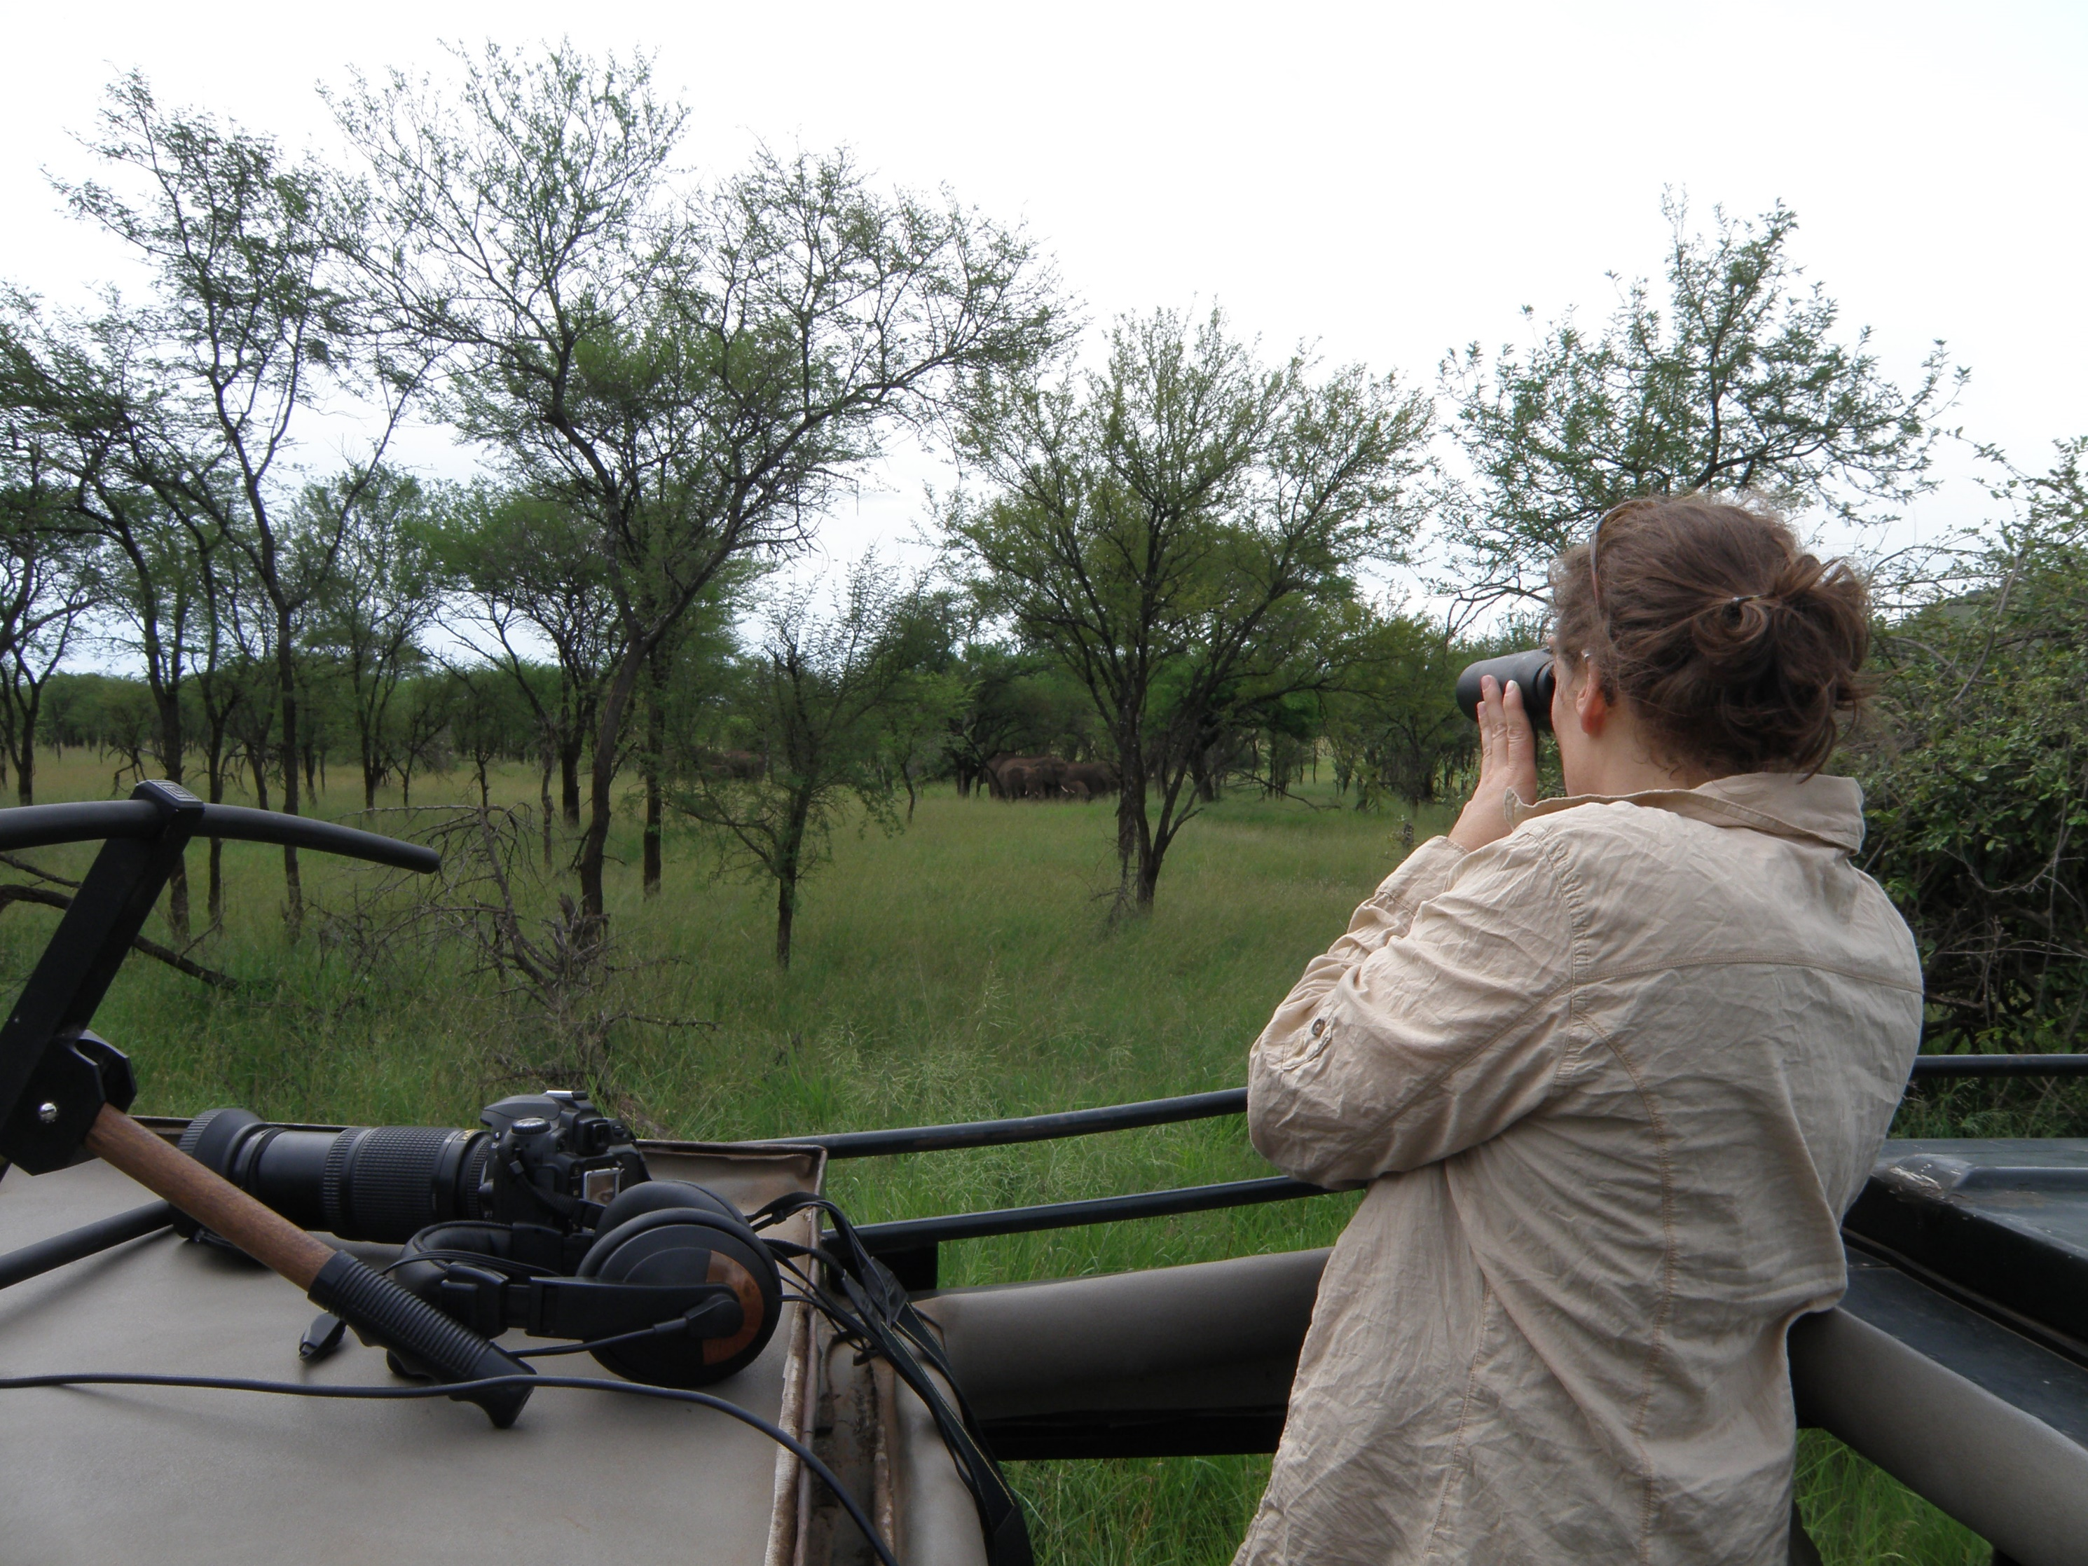

Slide 32
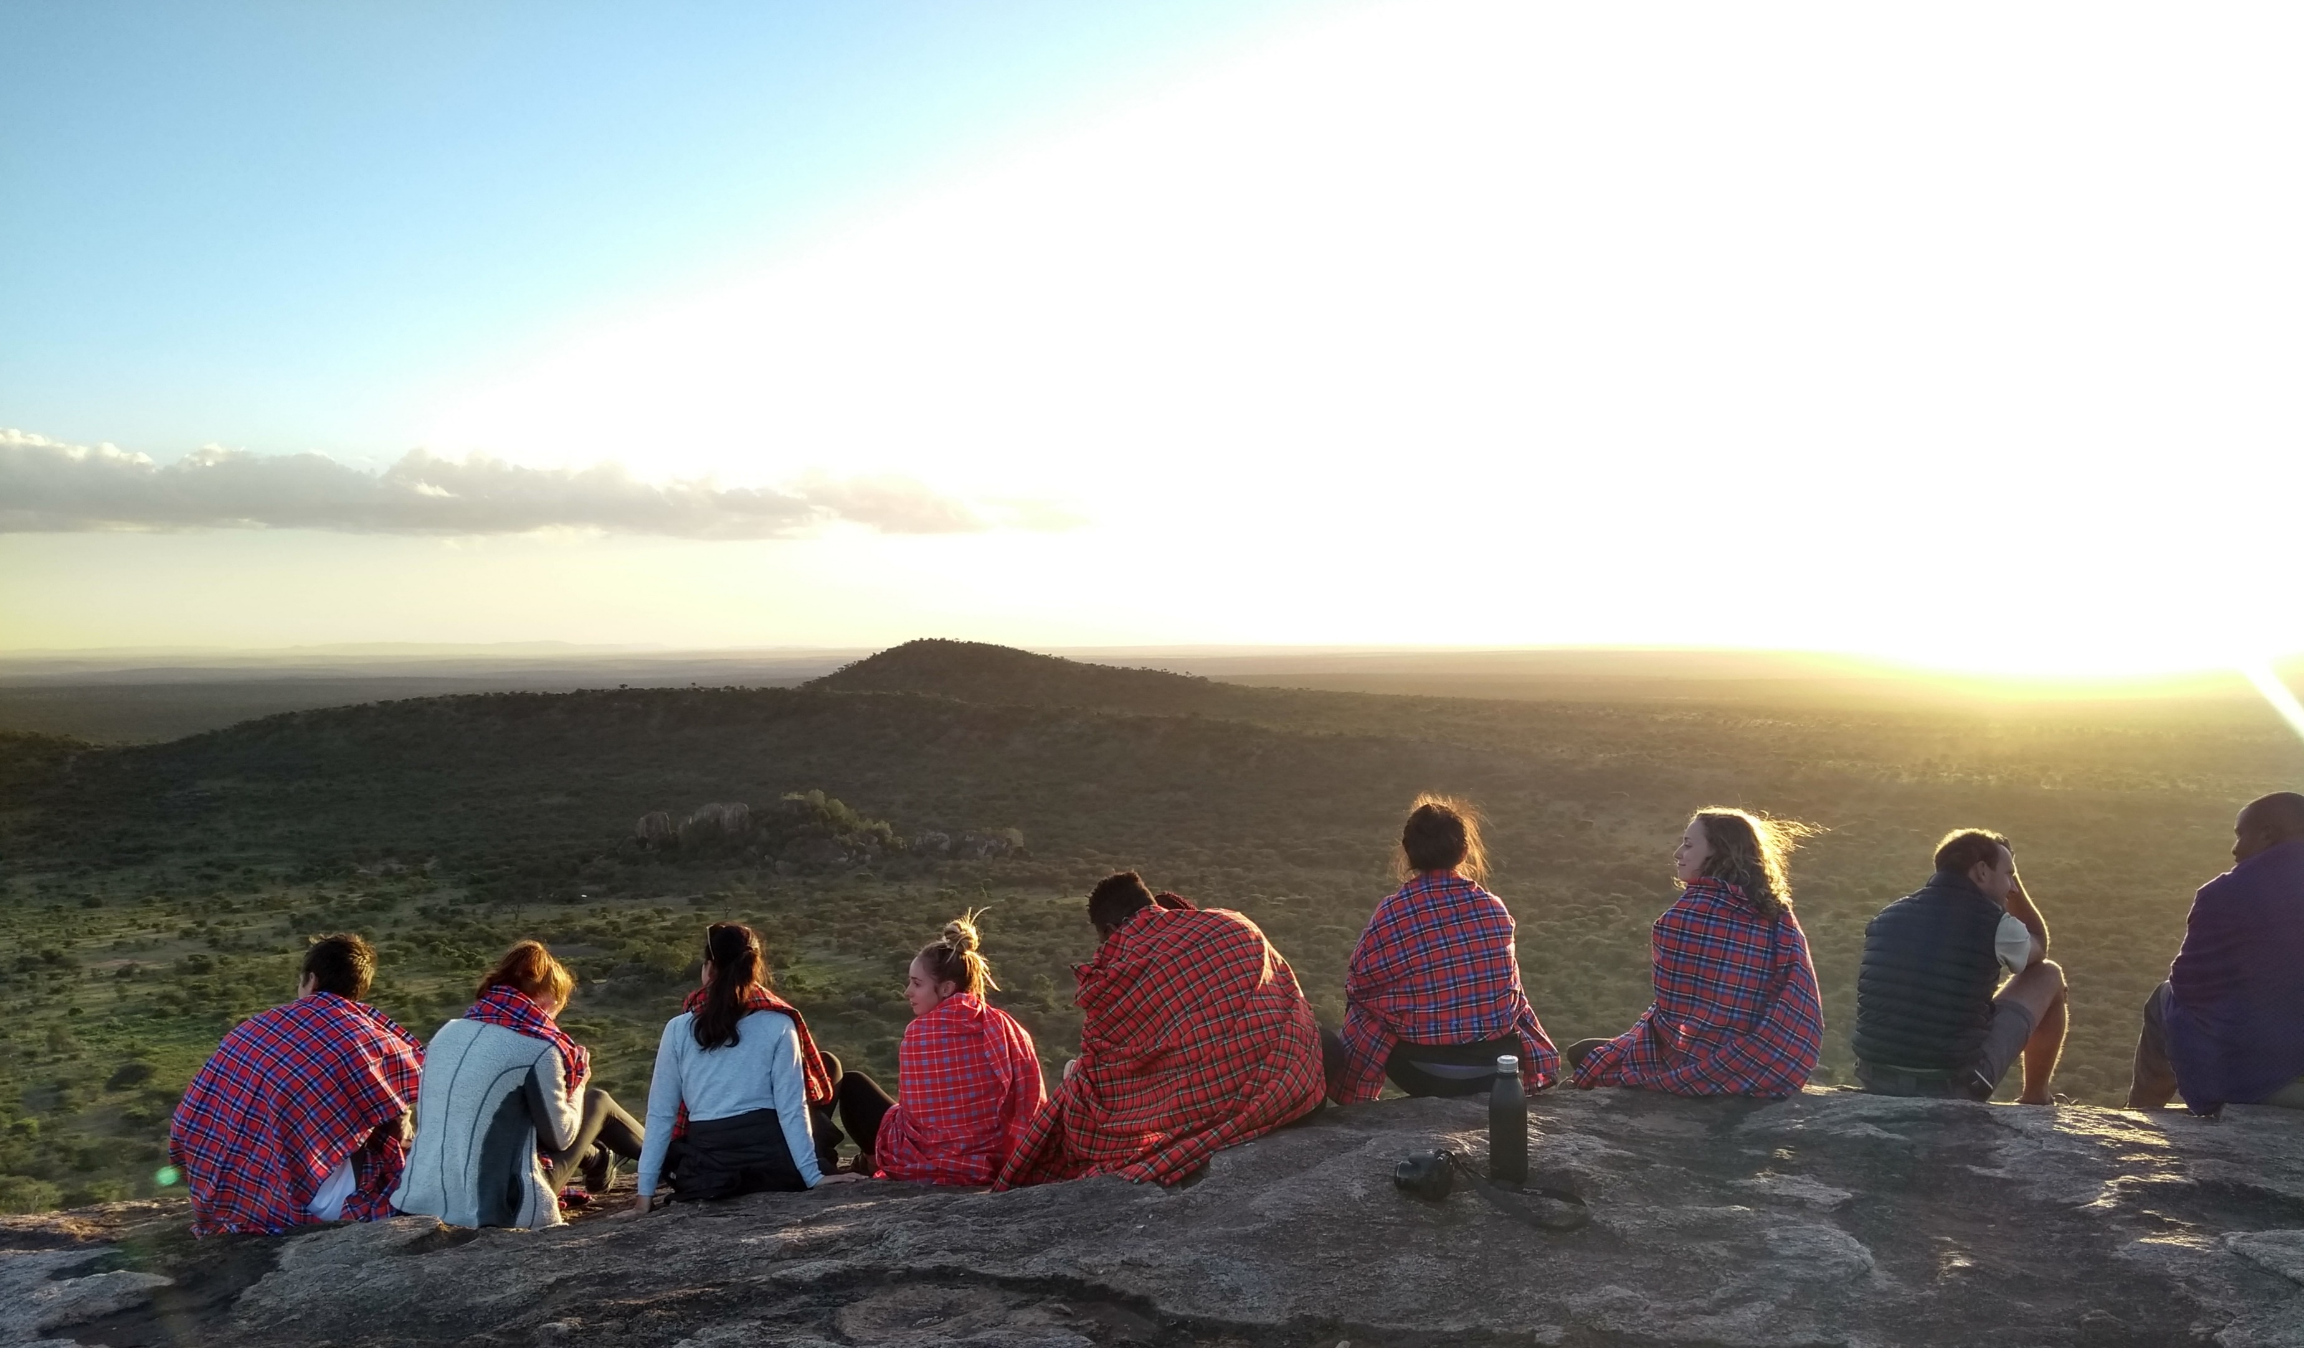

Slide 33
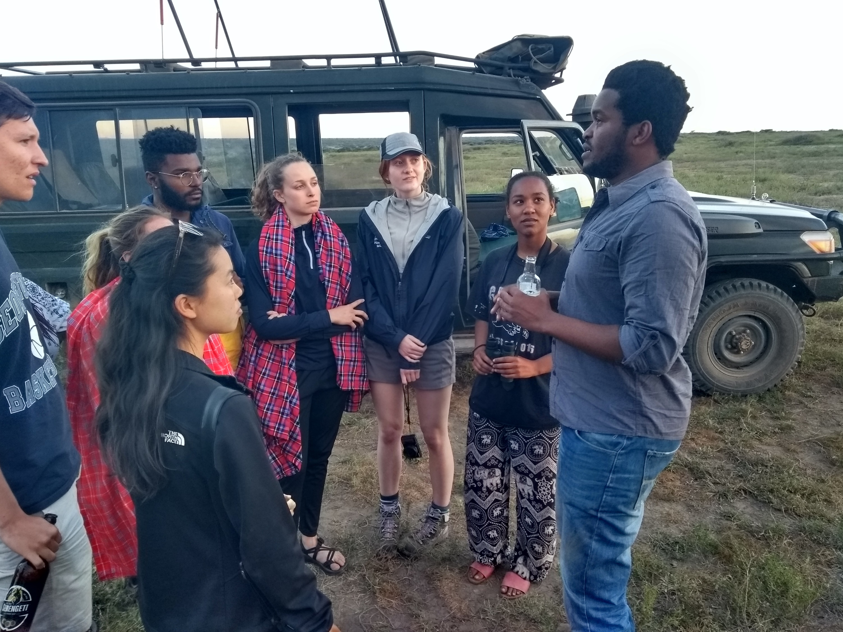

Slide 34
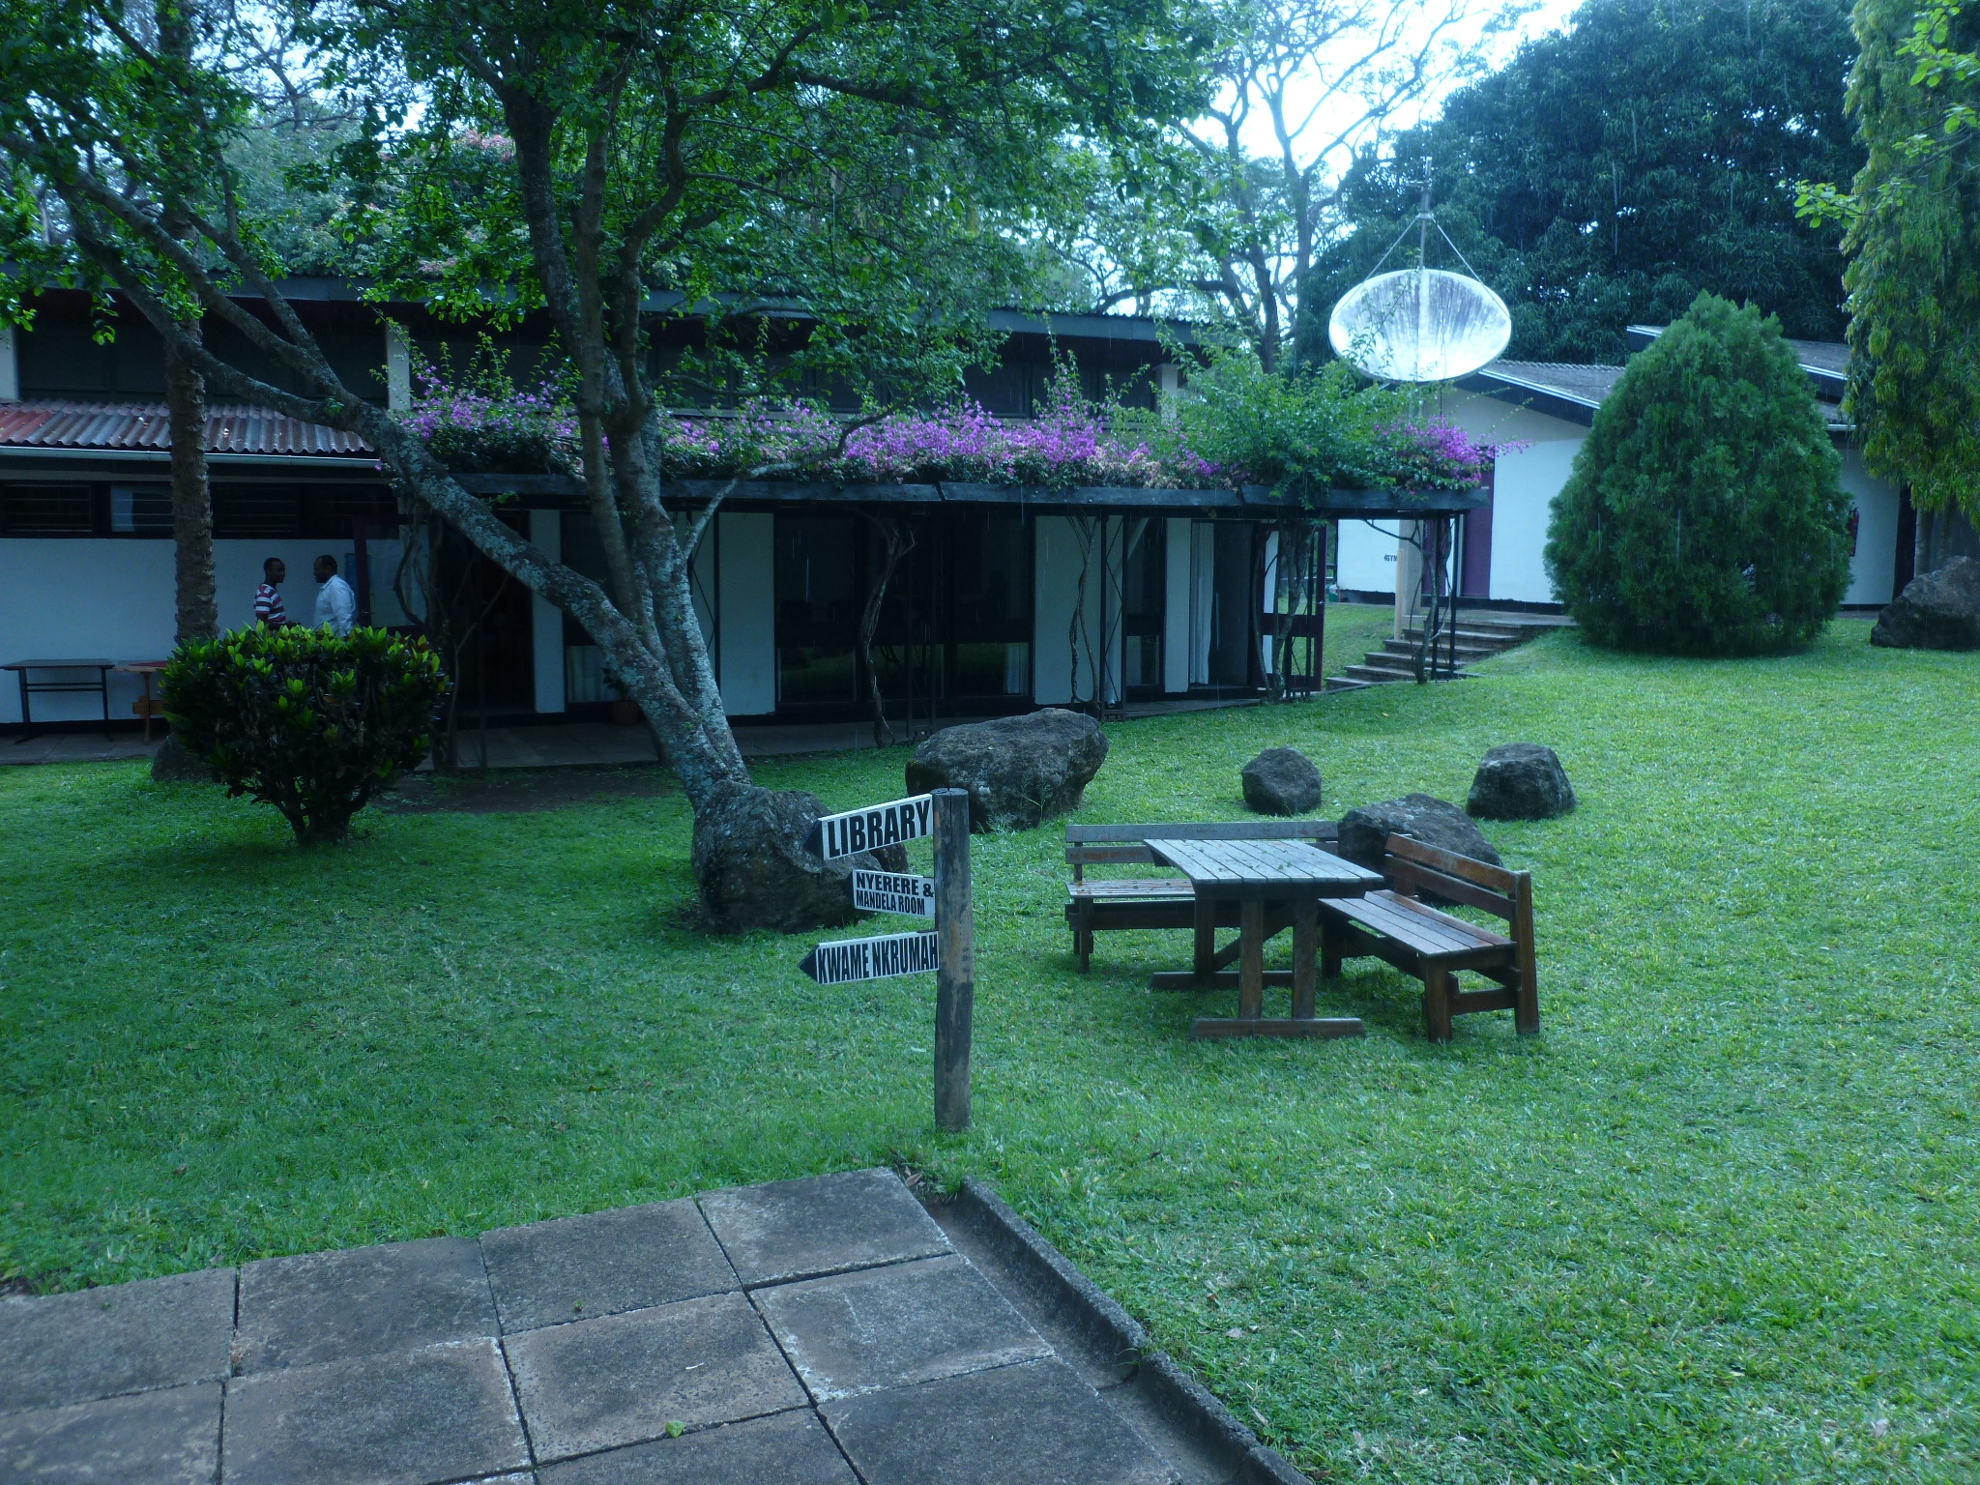

Slide 35
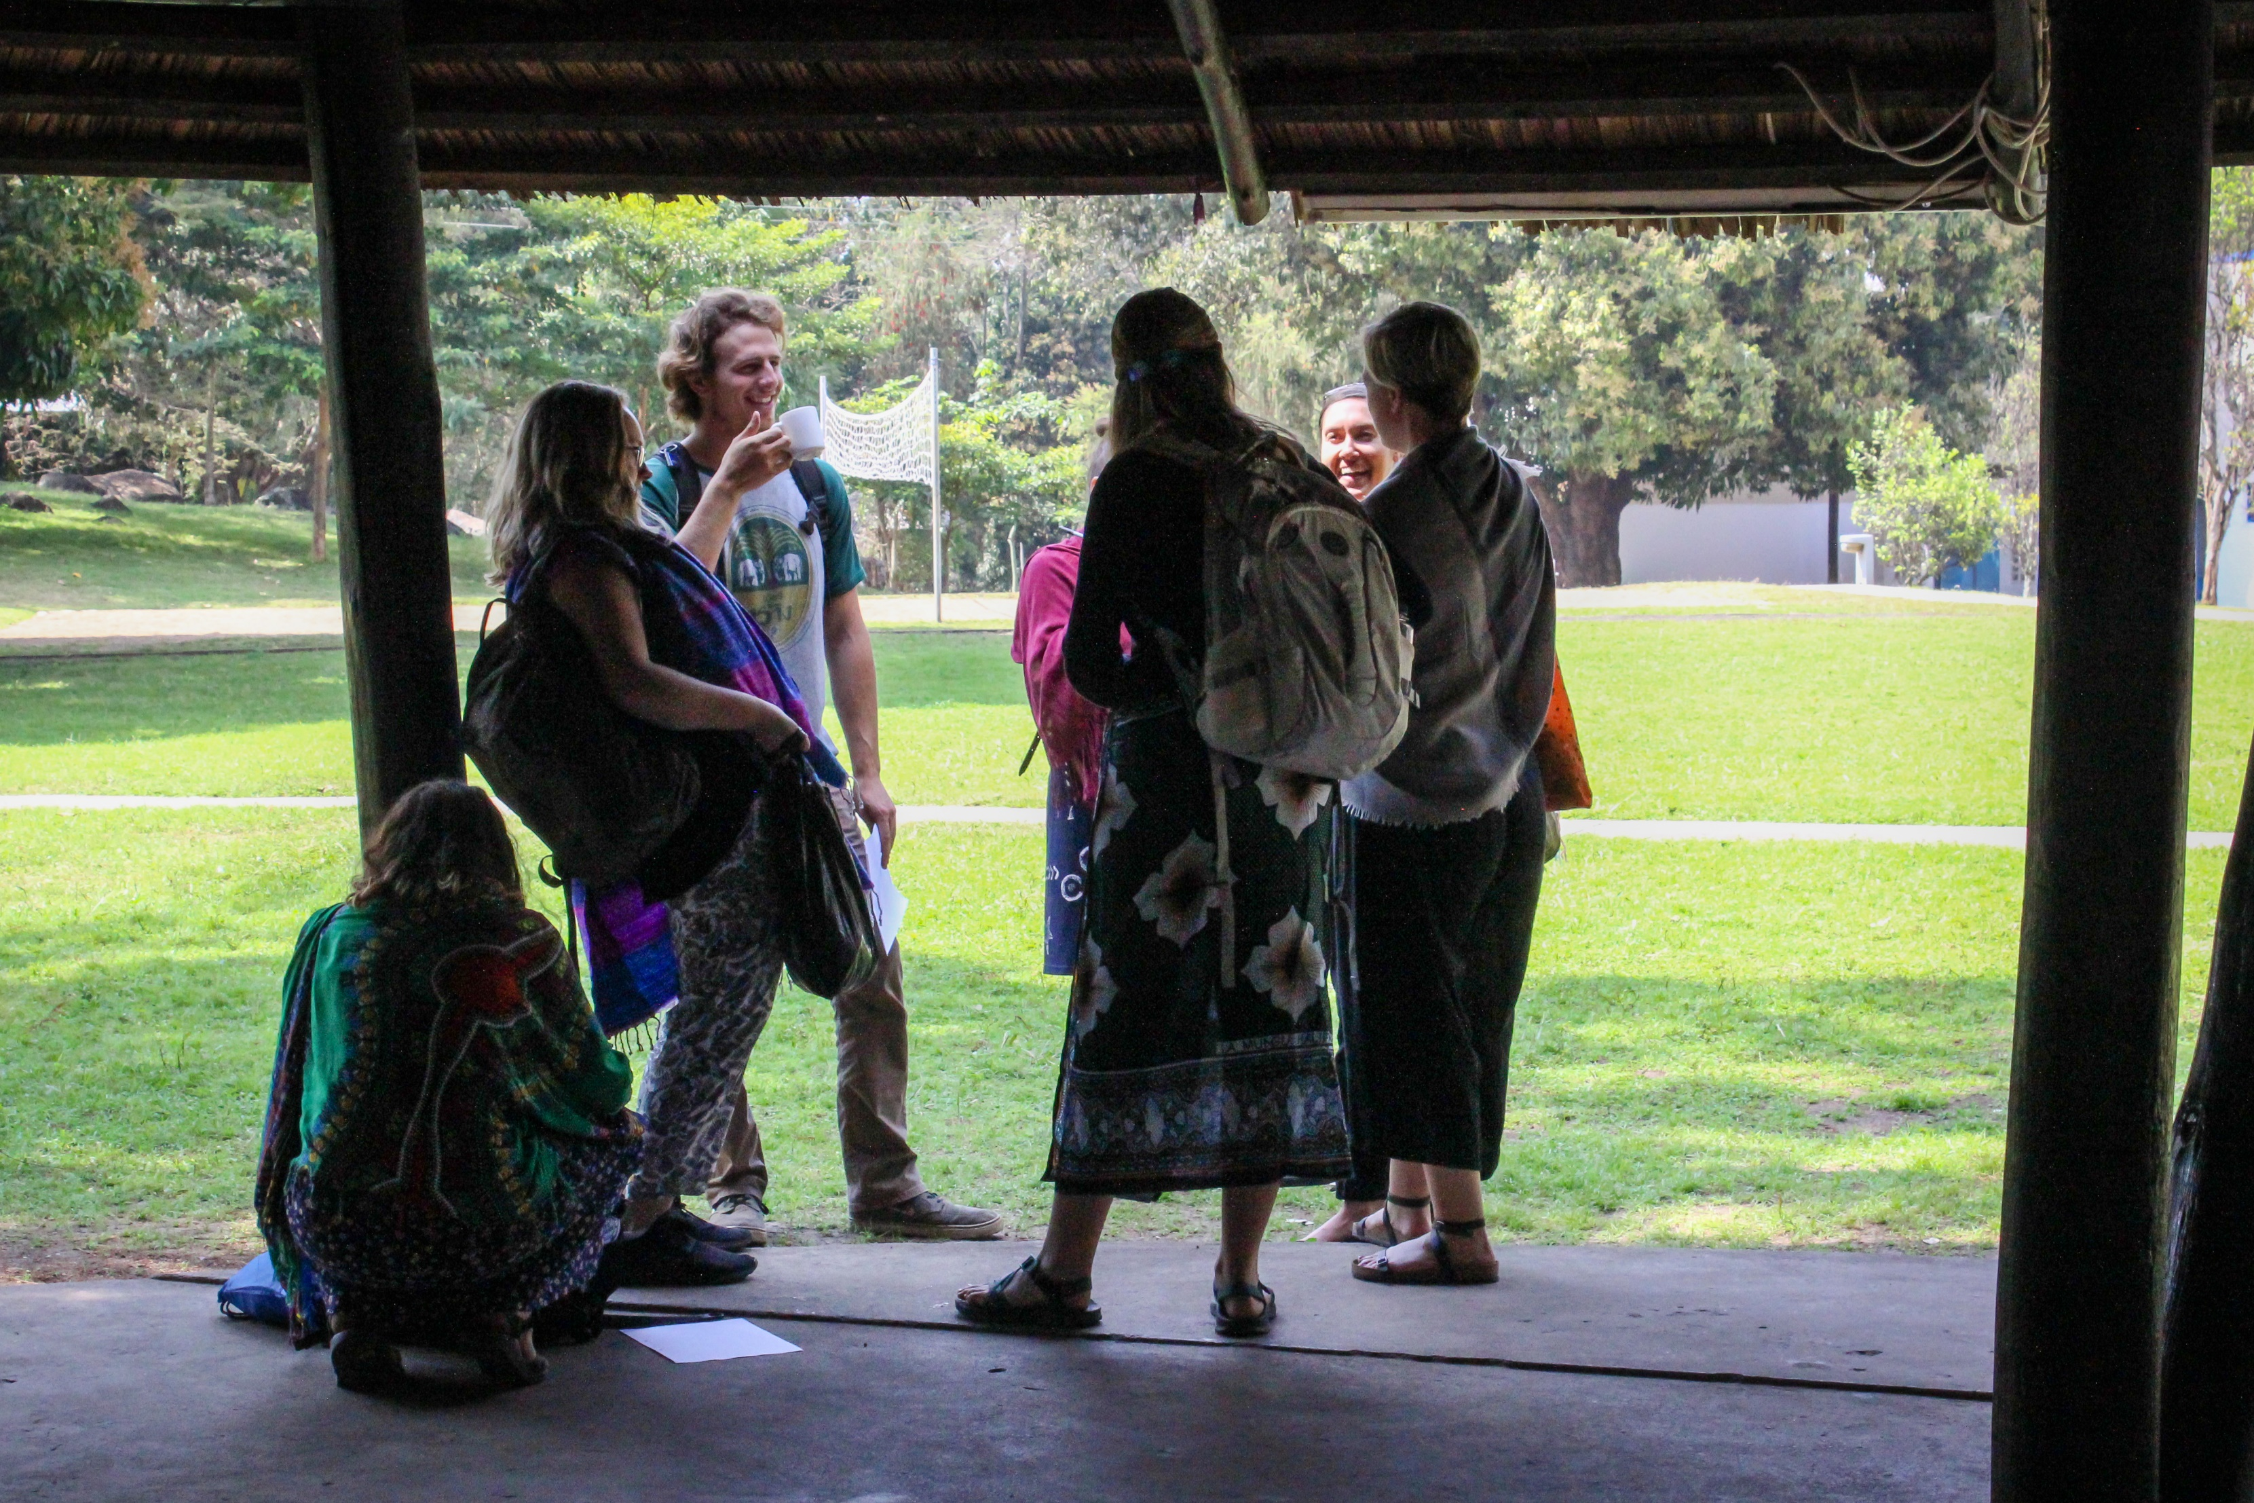

Slide 36
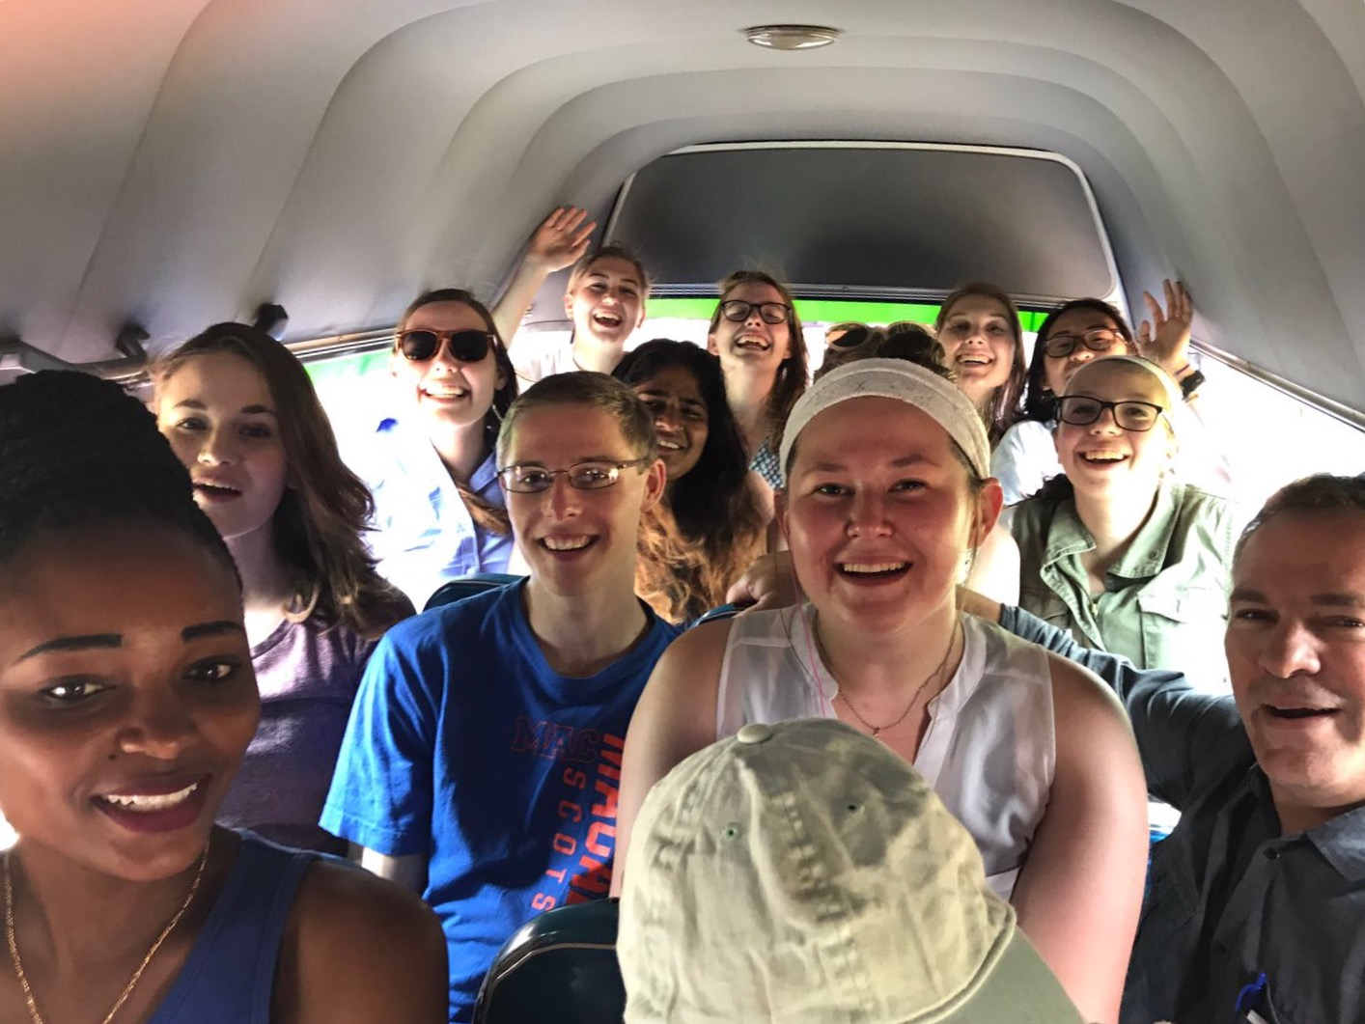

Slide 37
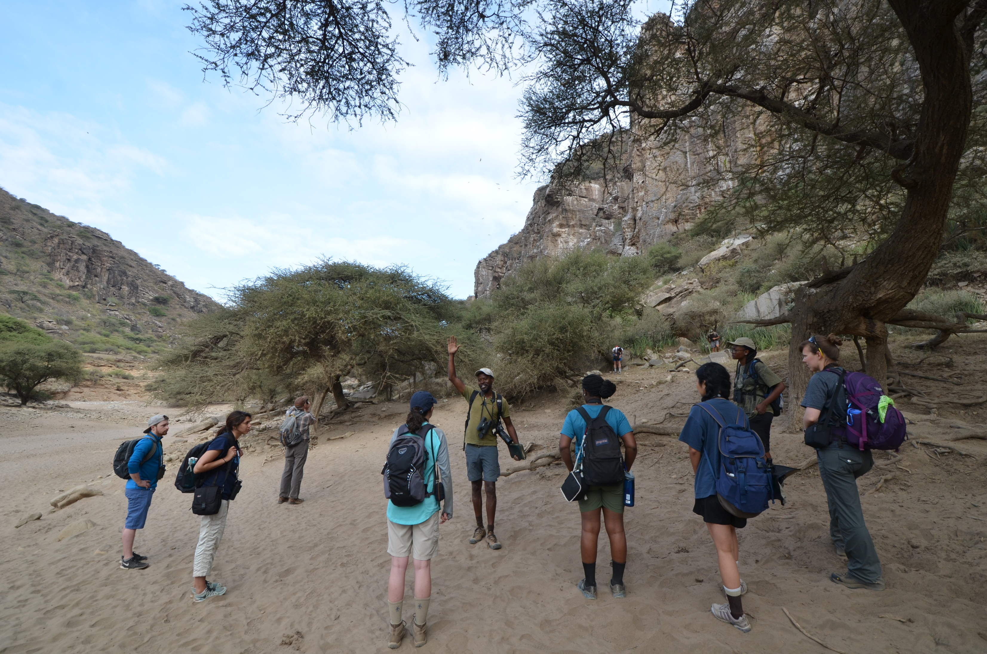

Slide 38
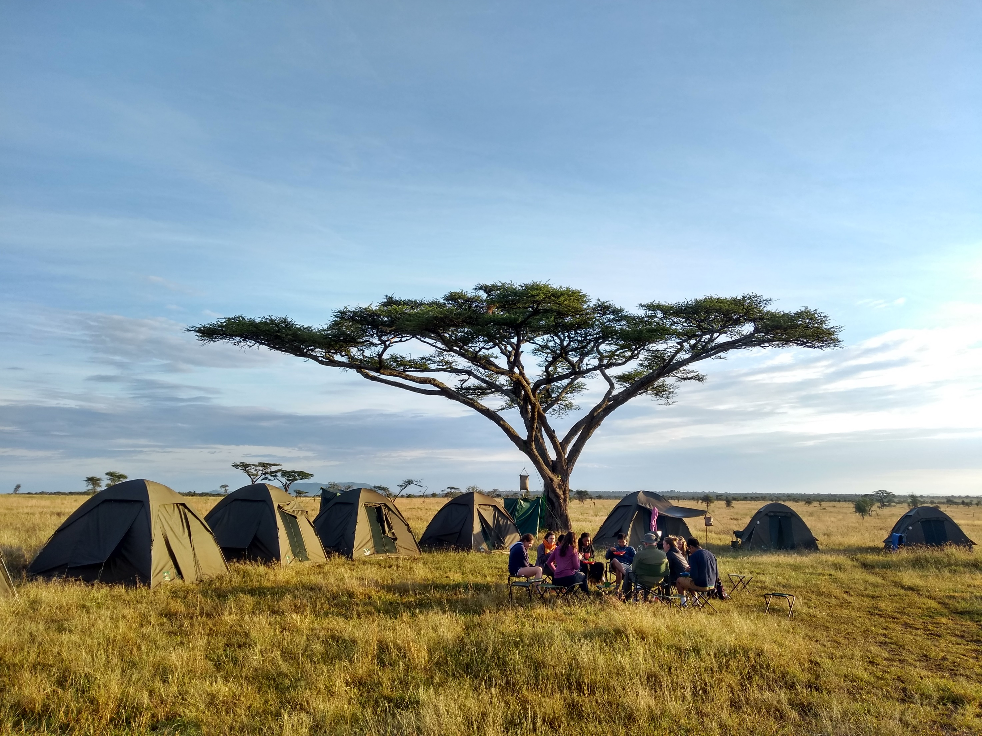

Slide 39
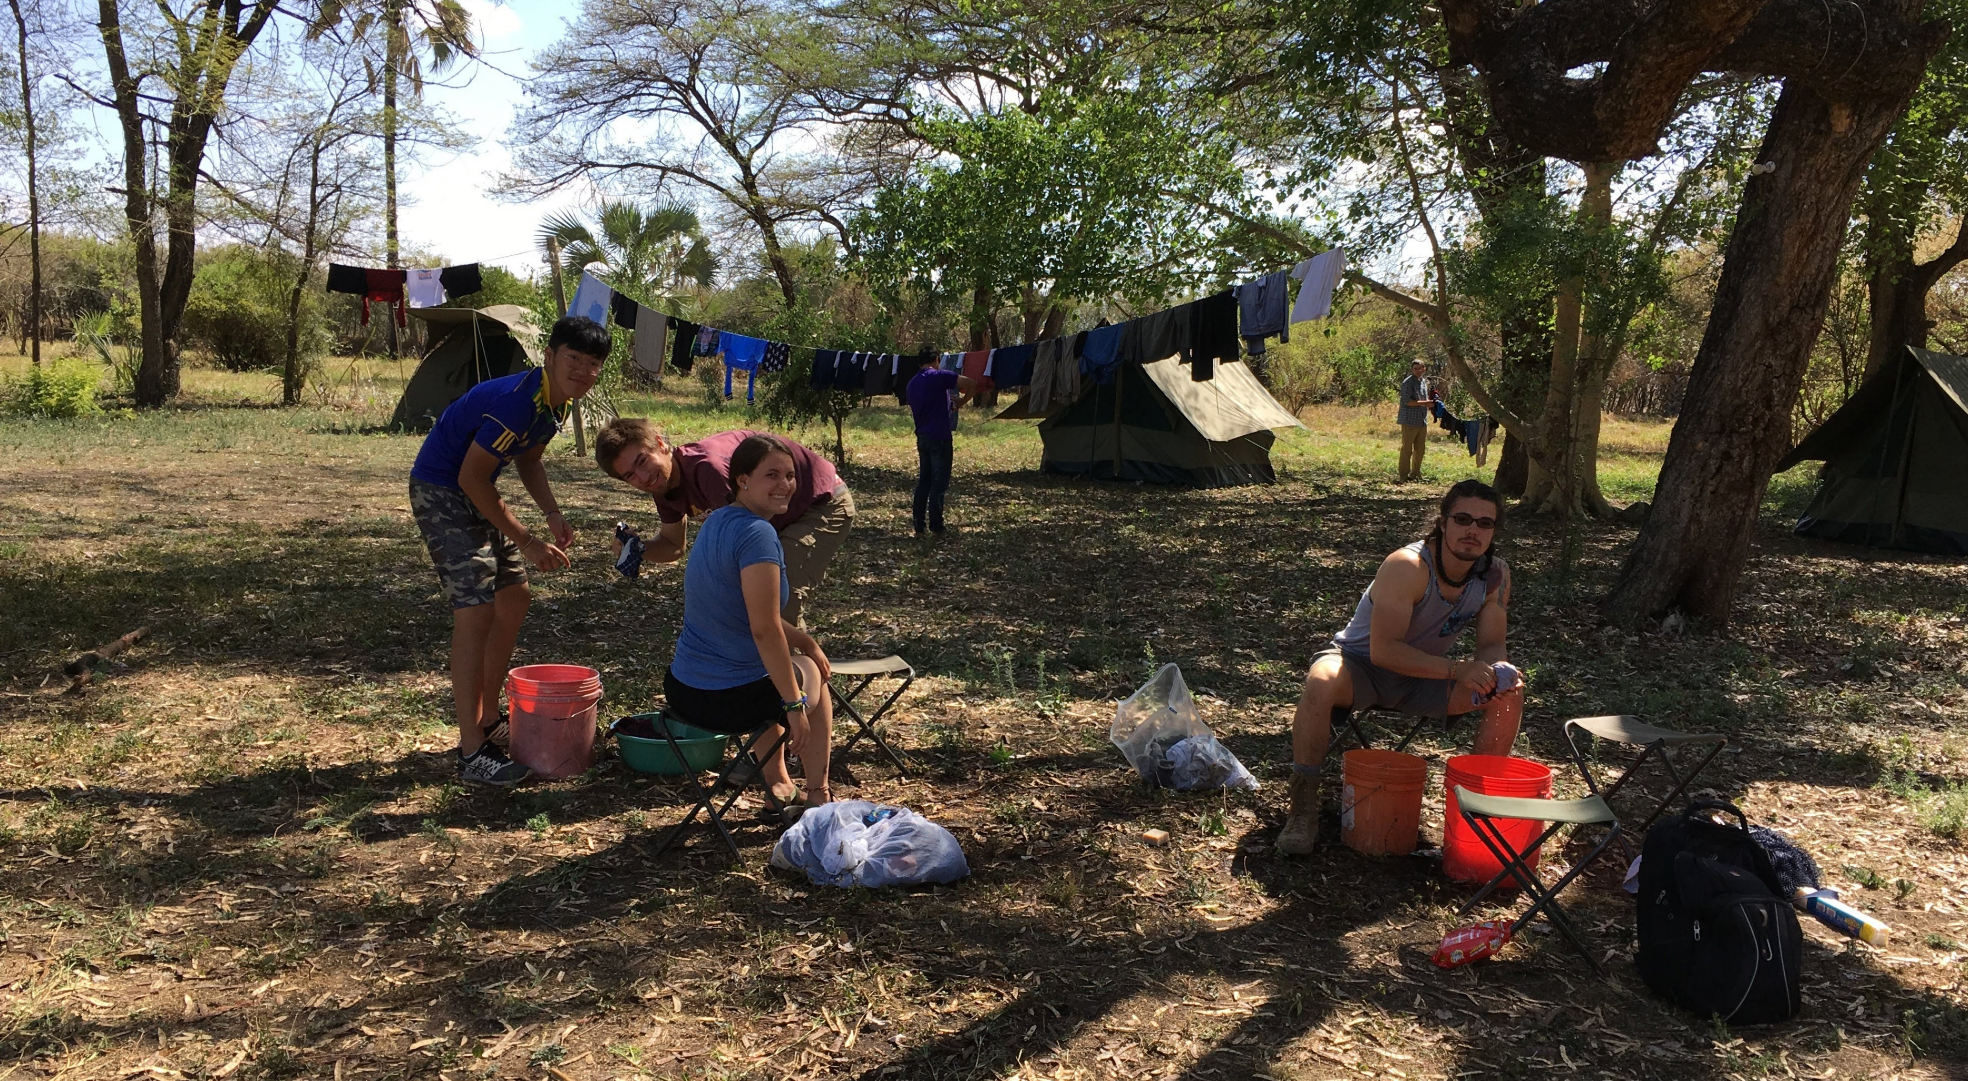

Slide 40
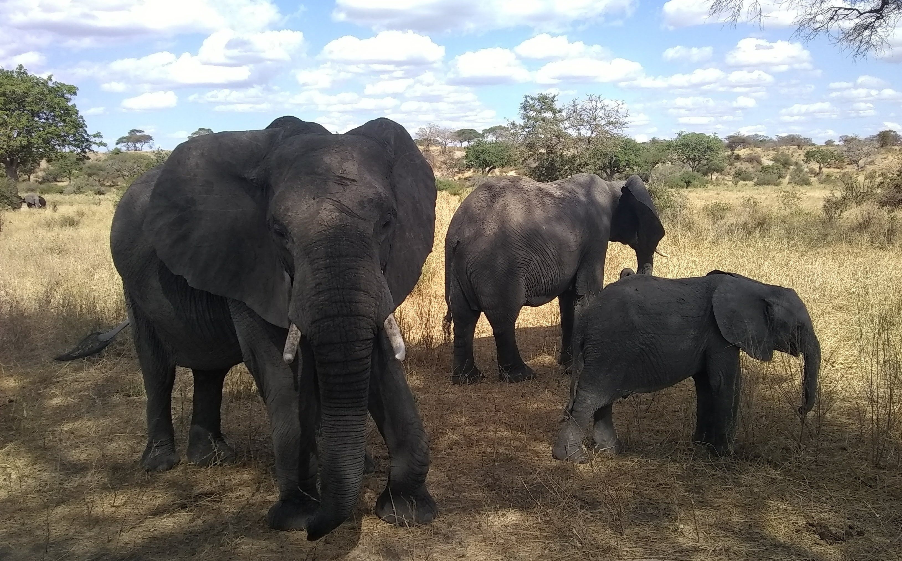

Slide 41
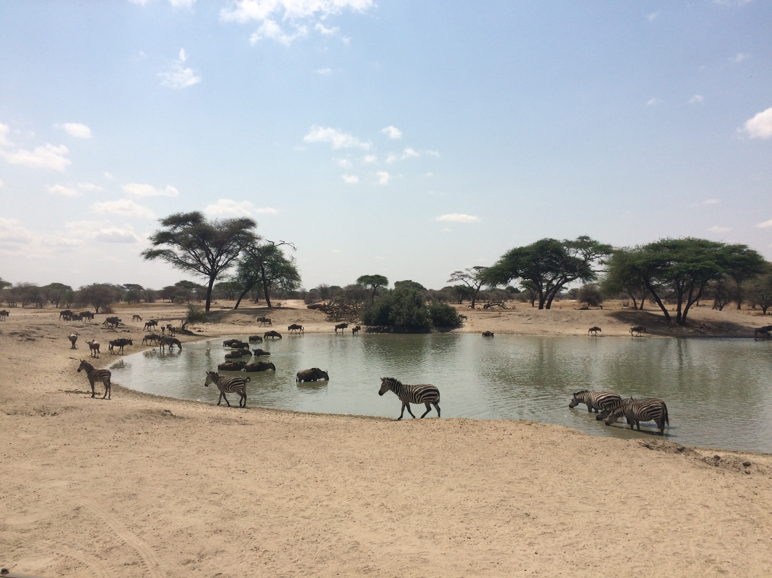

Slide 42
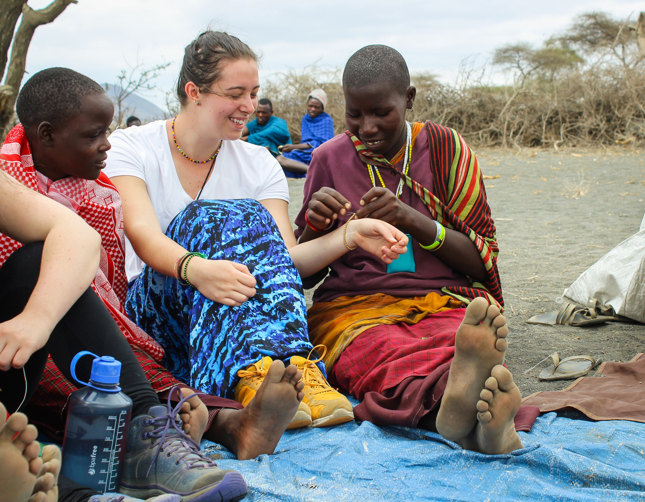

Slide 43
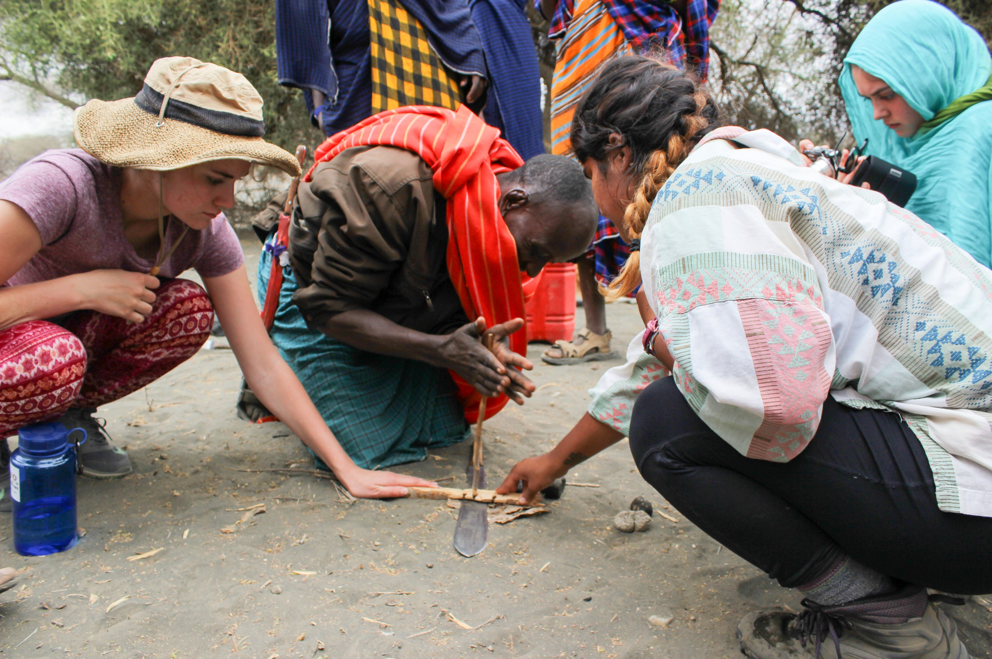

Slide 44
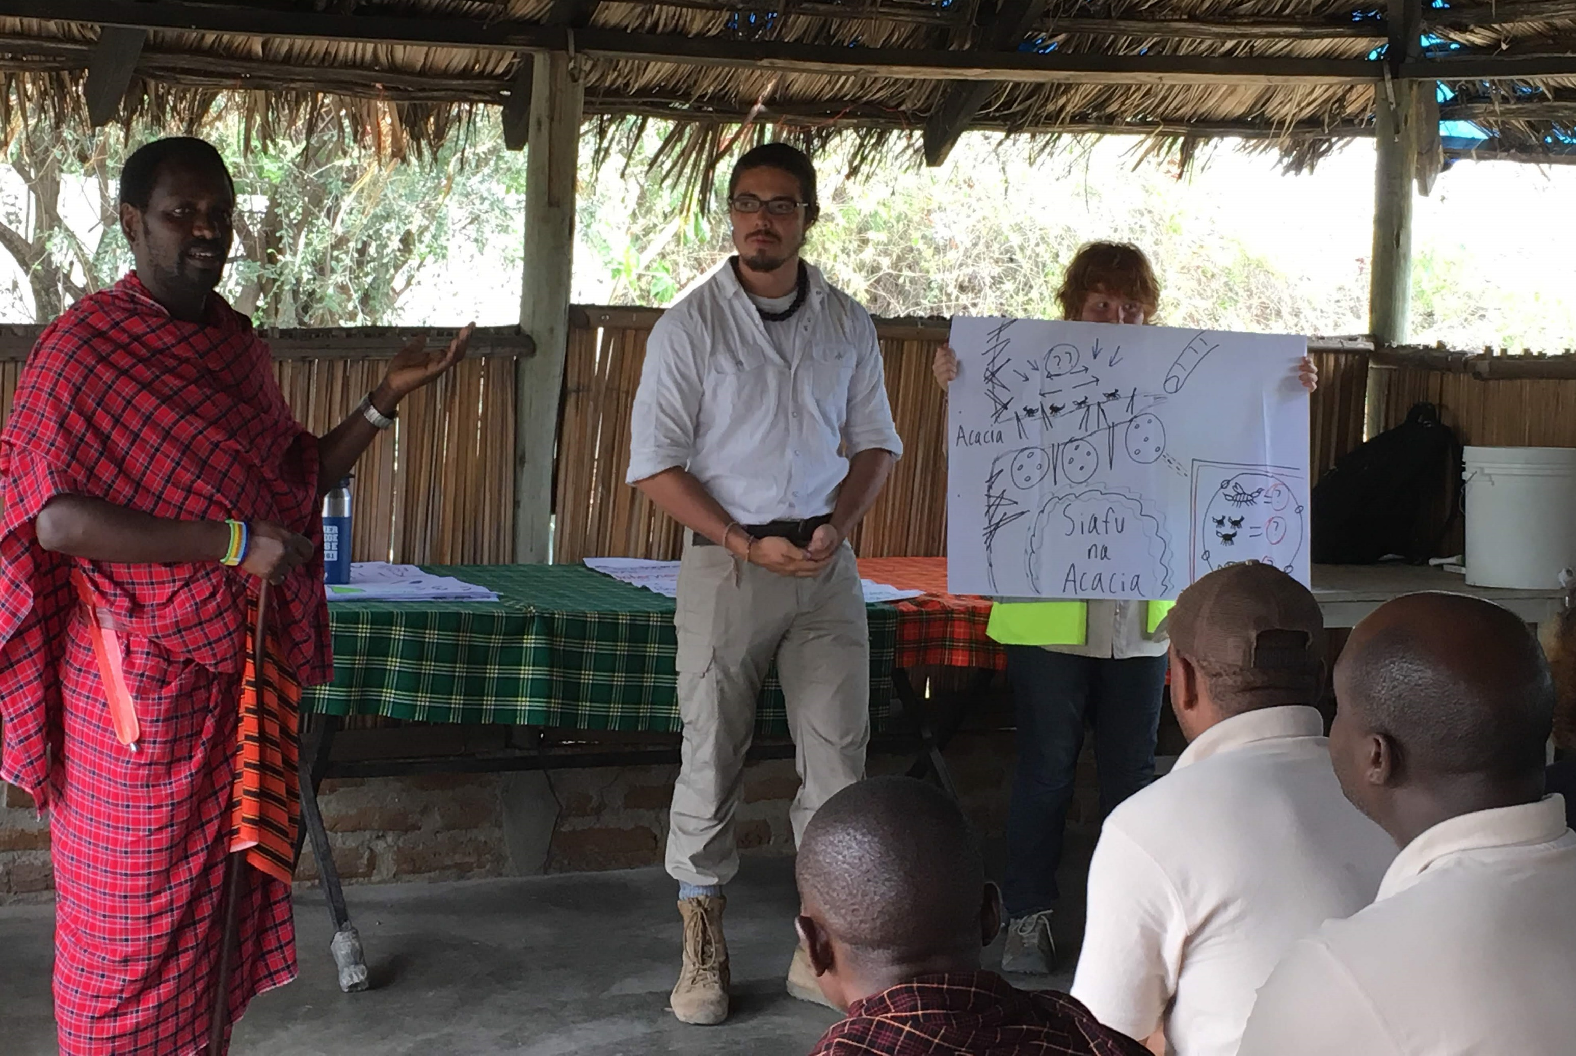

Slide 45
CARLETON GLOBAL ENGAGEMENT PROGRAMS
go.Carleton.edu/engage
507-222-4435
Carleton College
Northfield, Minnesota

