Slide 1
CARLETON GLOBAL ENGAGEMENT PROGRAMS
13-week fall programs offering Carleton College academic credit equivalent to 16 semester credits
Buddhist Studies in India
Women’s and Gender Studies in Europe
Ecology and Anthropology in Tanzania

Slide 2
Ecology and anthropology in Tanzania
Arusha and Usa River, Tanzania
National Parks of Northern Tanzania (excursions)
Early September to Mid-December

Slide 3
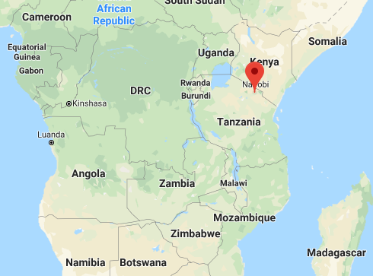

Slide 4
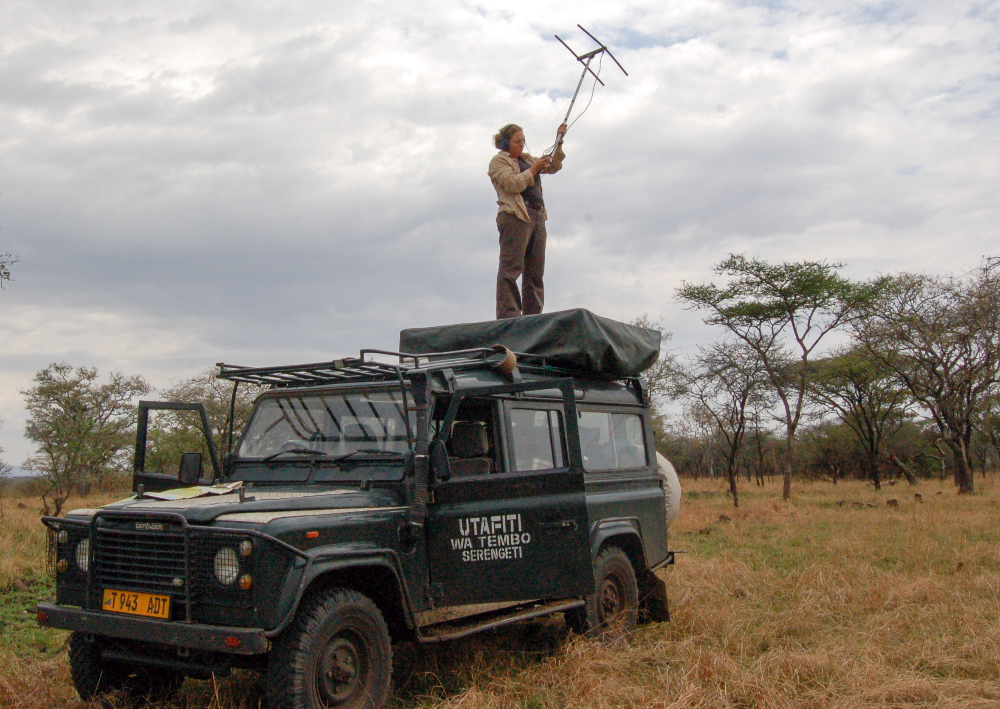
Dr. Anna Estes Director, Ecology and Anthropology in Tanzania Assistant Professor of Environmental Studies

Slide 5
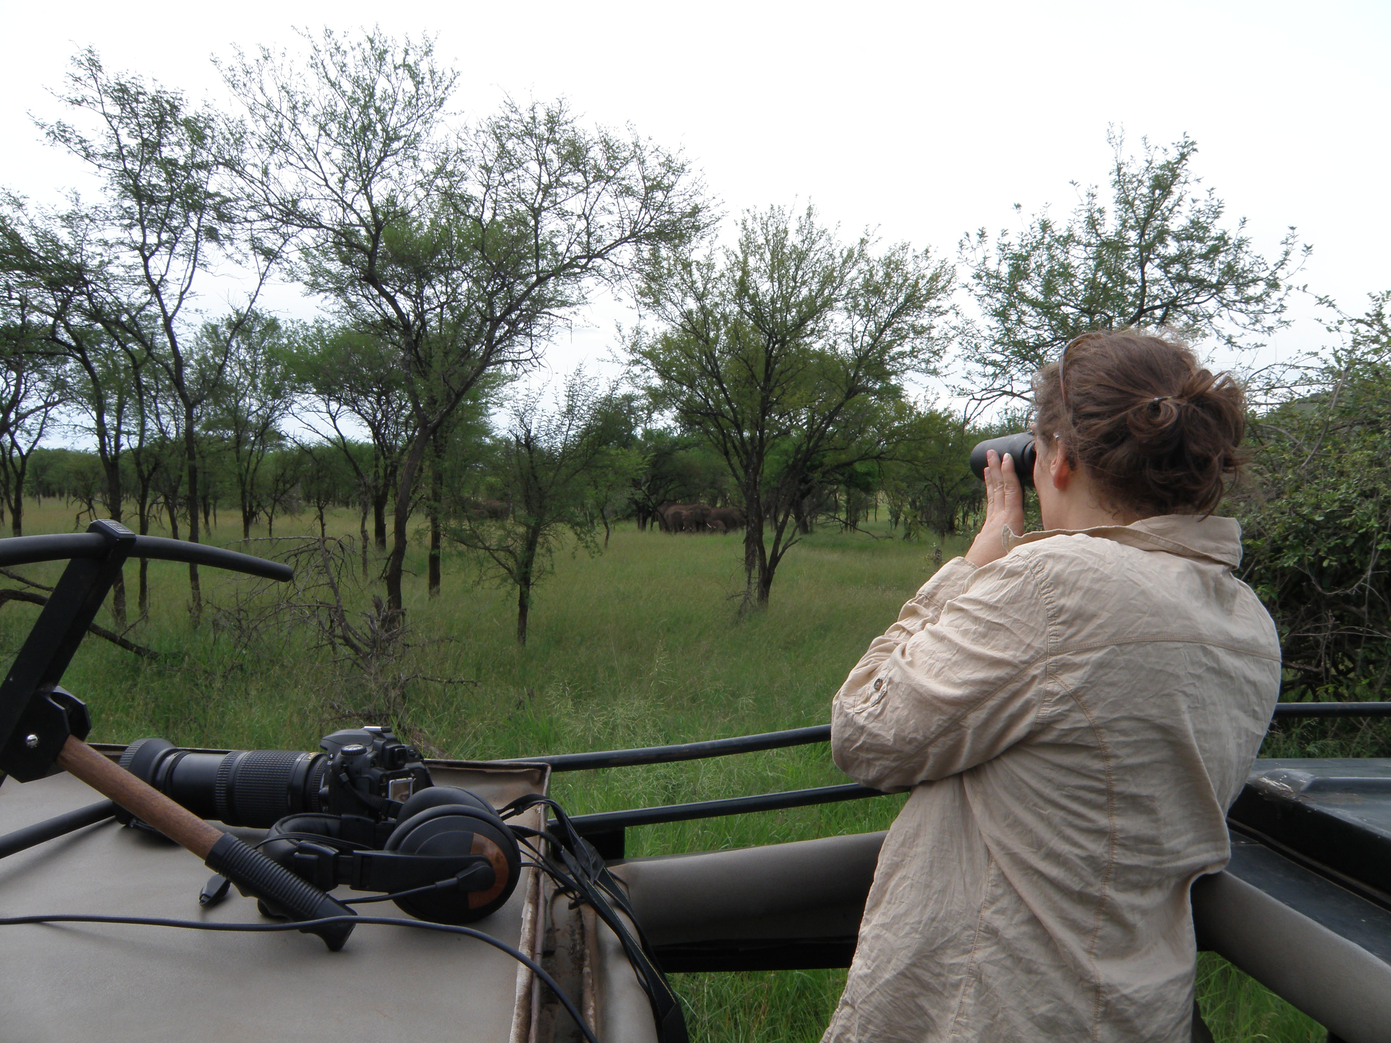

Slide 6
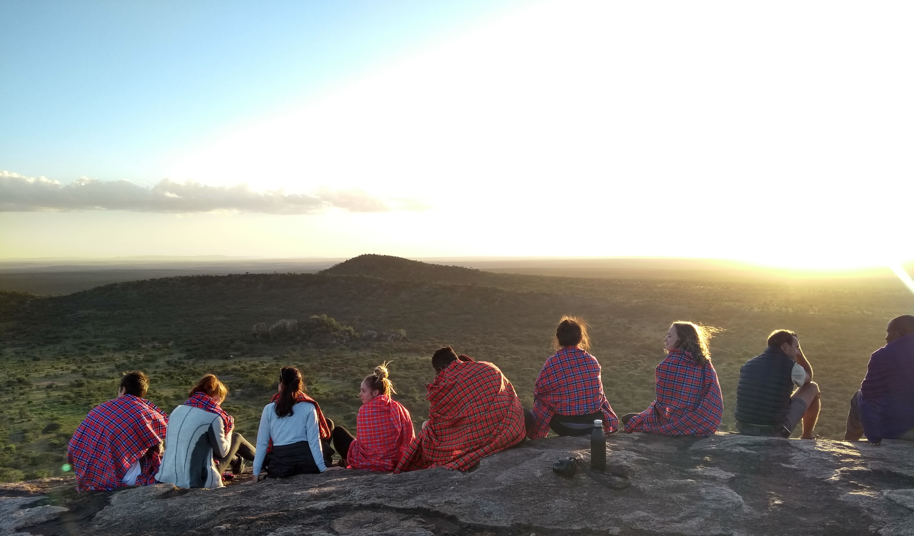

Slide 7
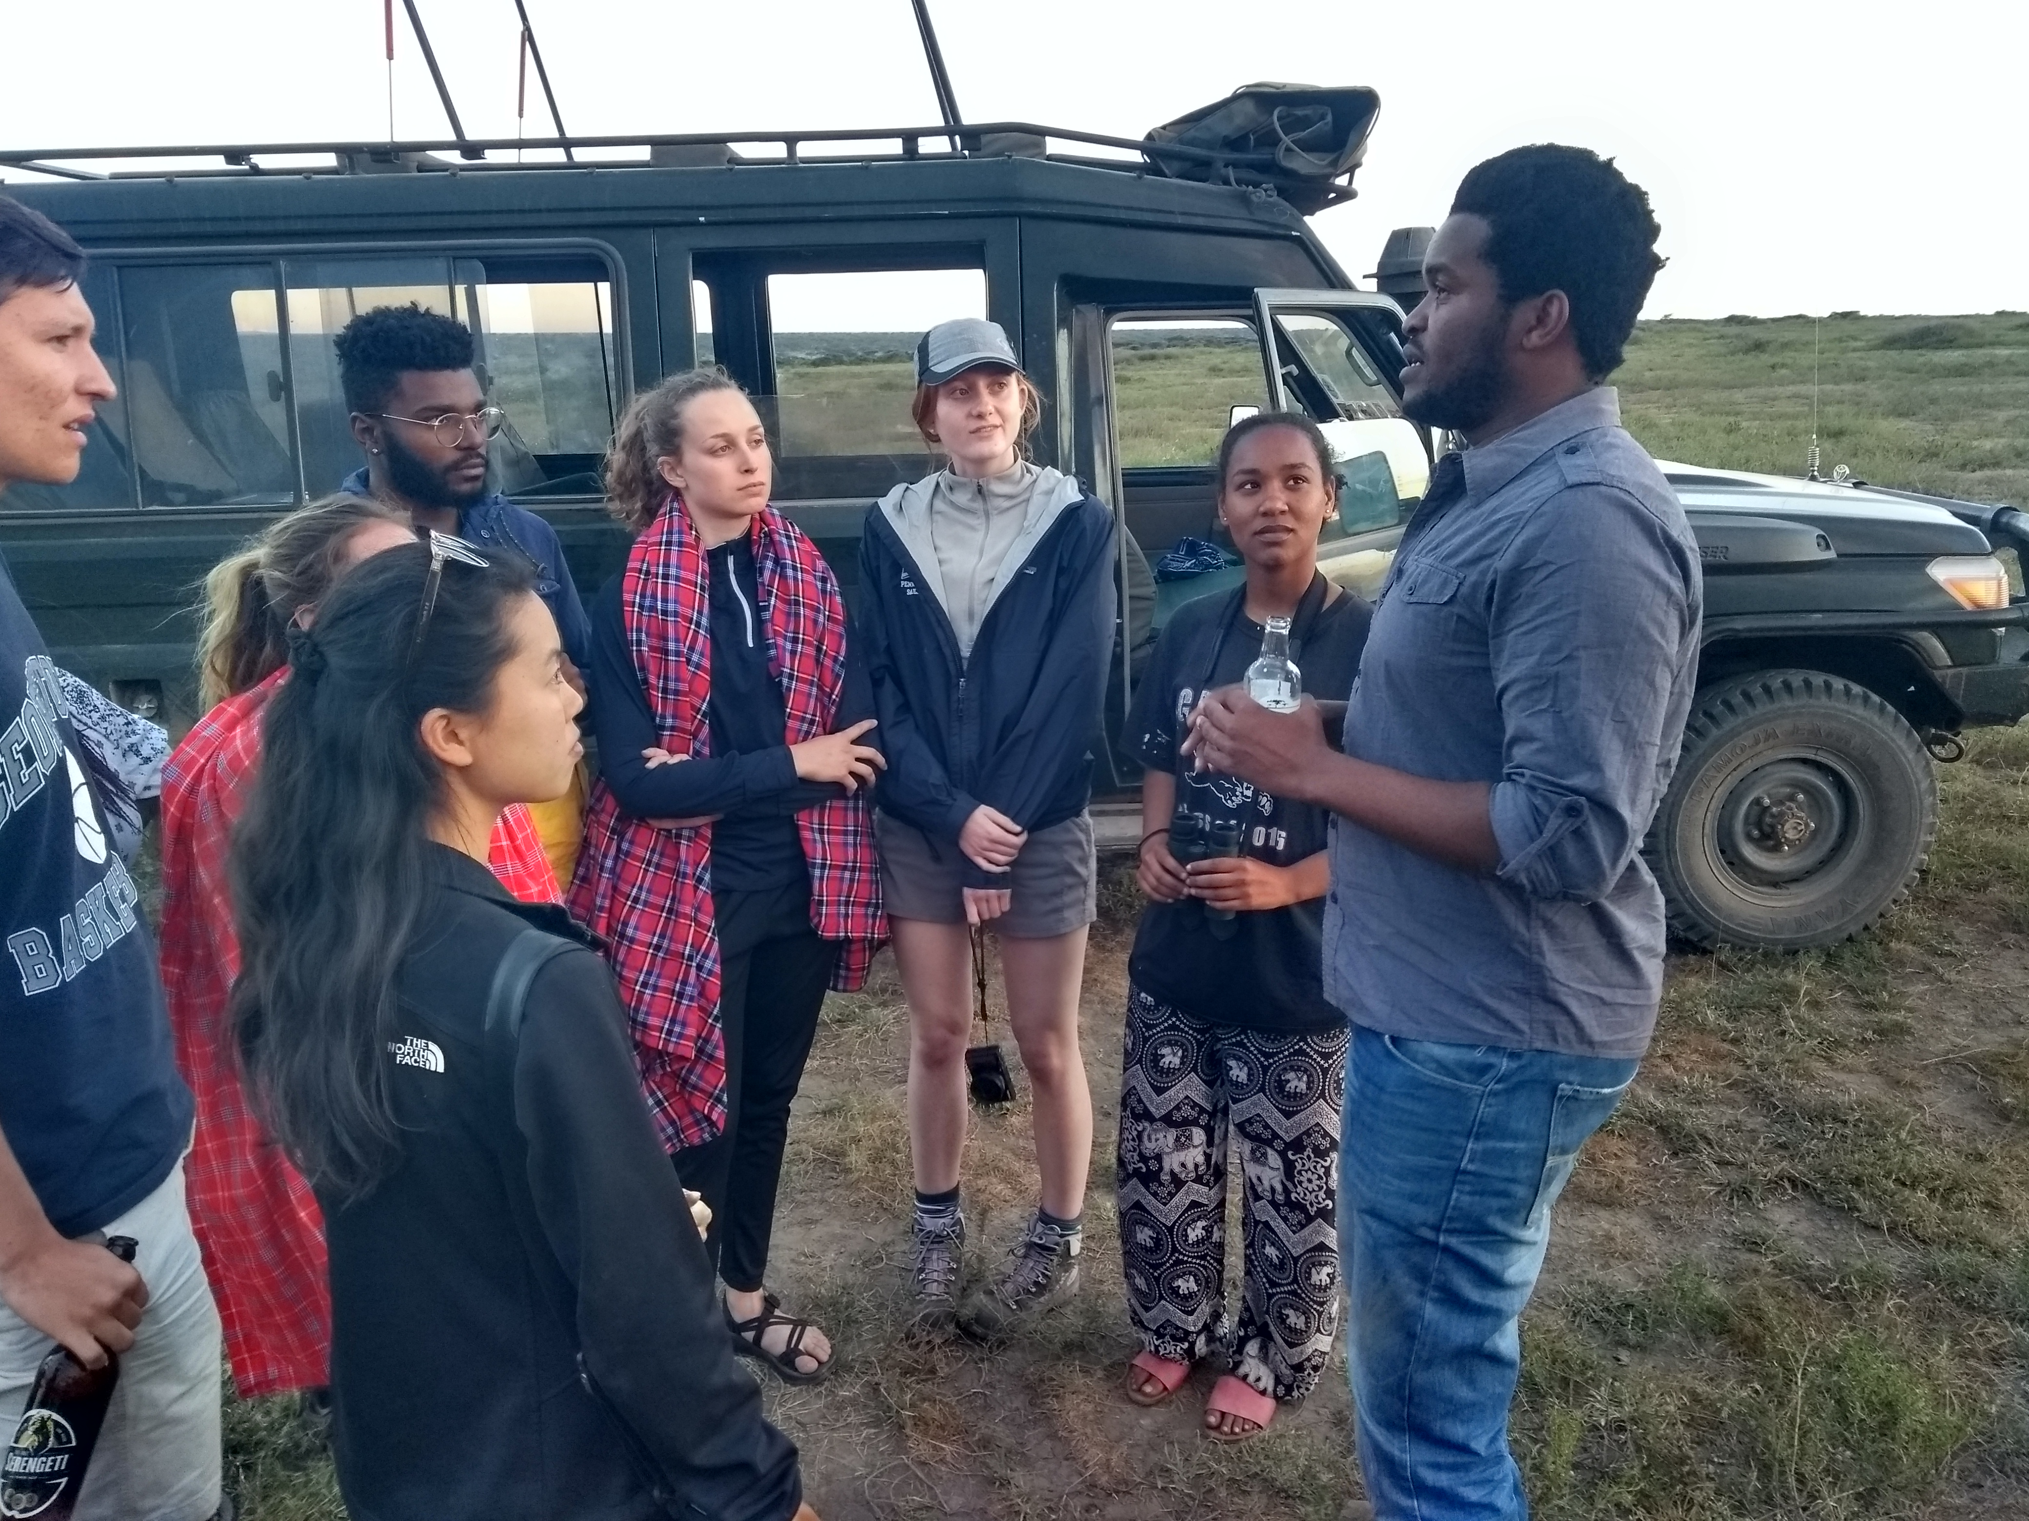

Slide 8
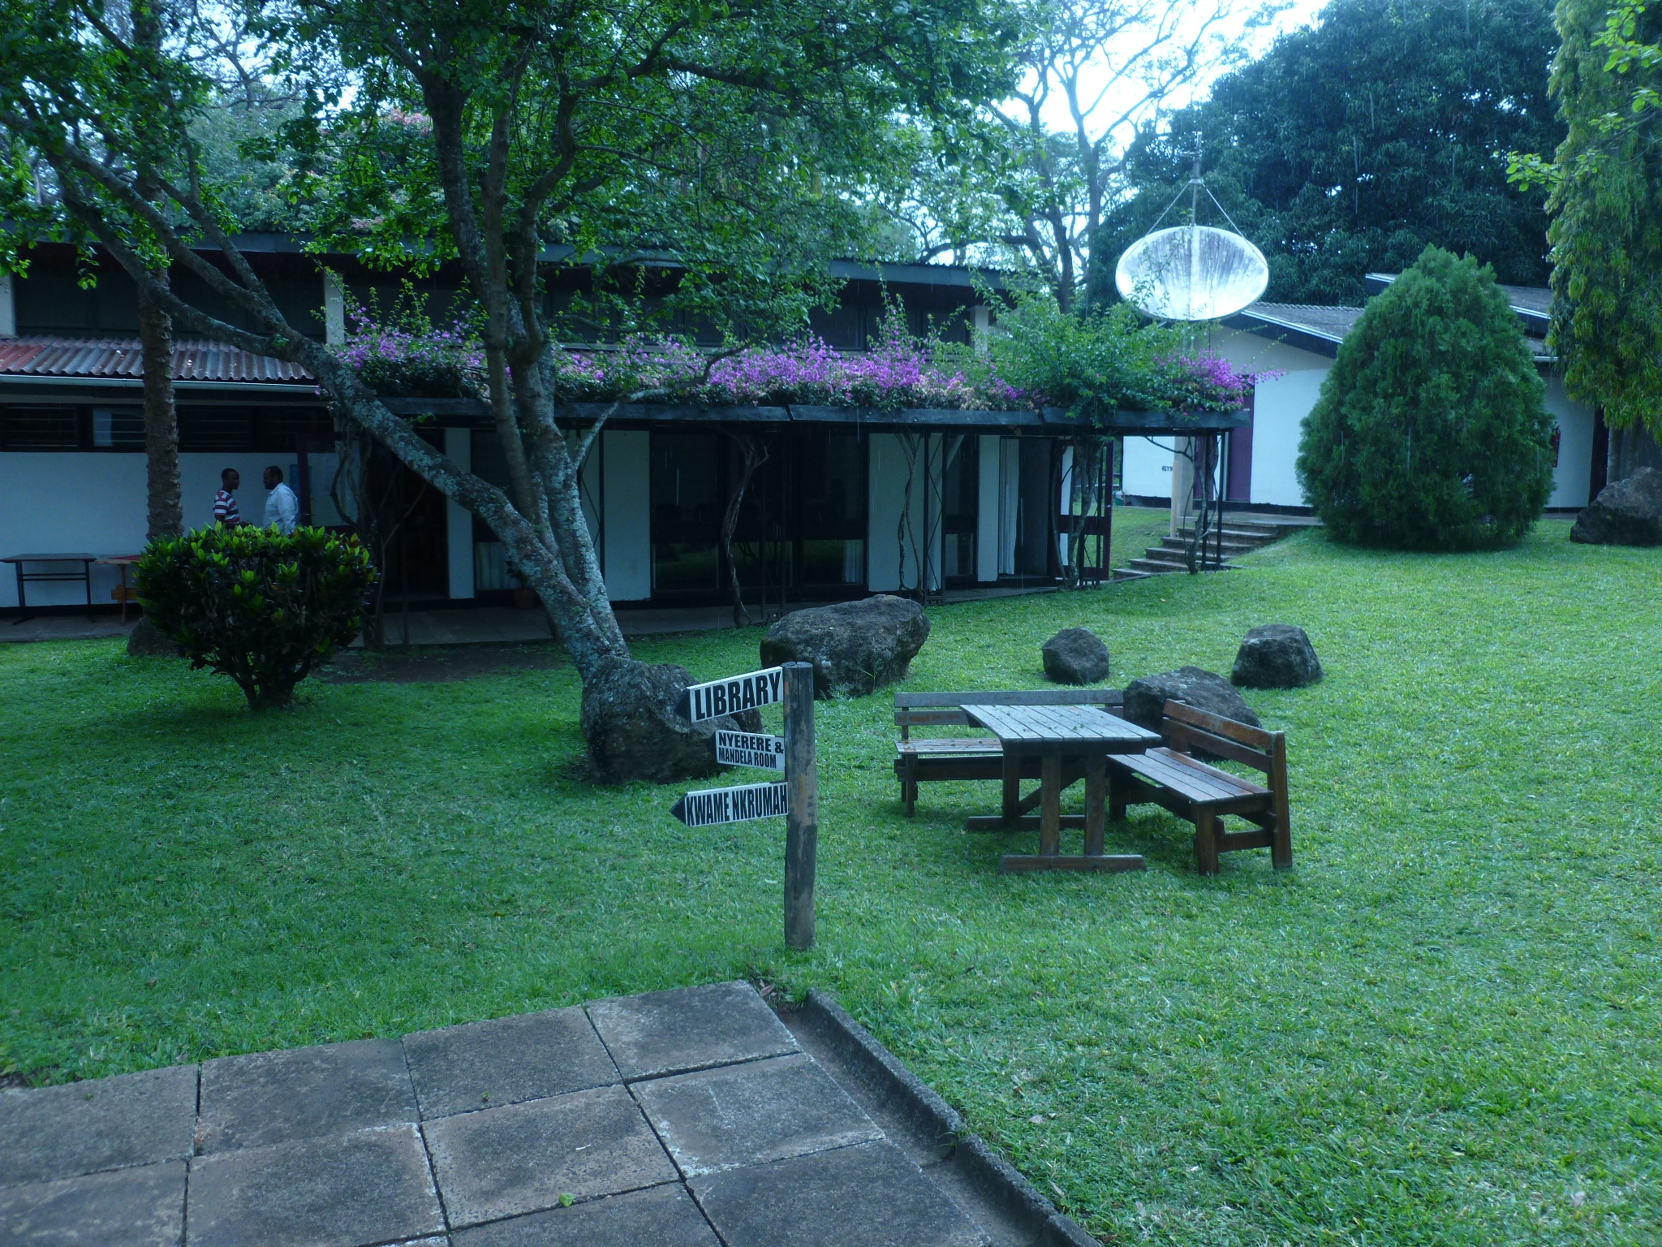

Slide 9
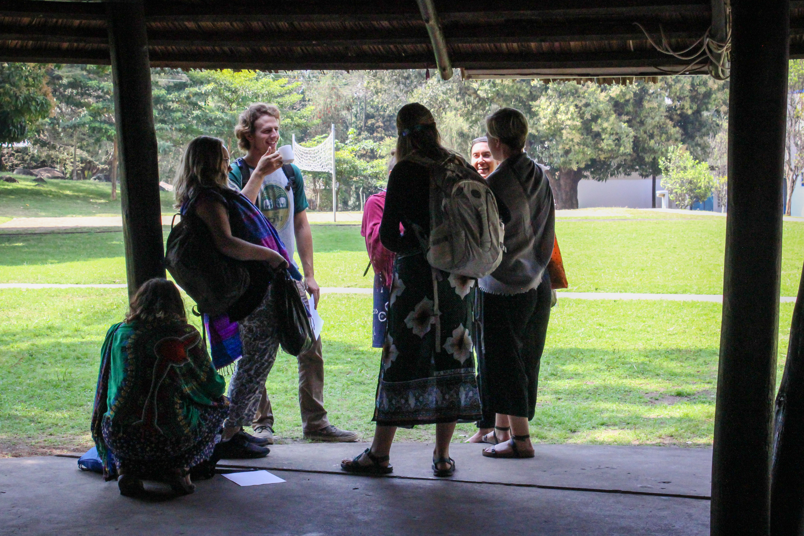

Slide 10
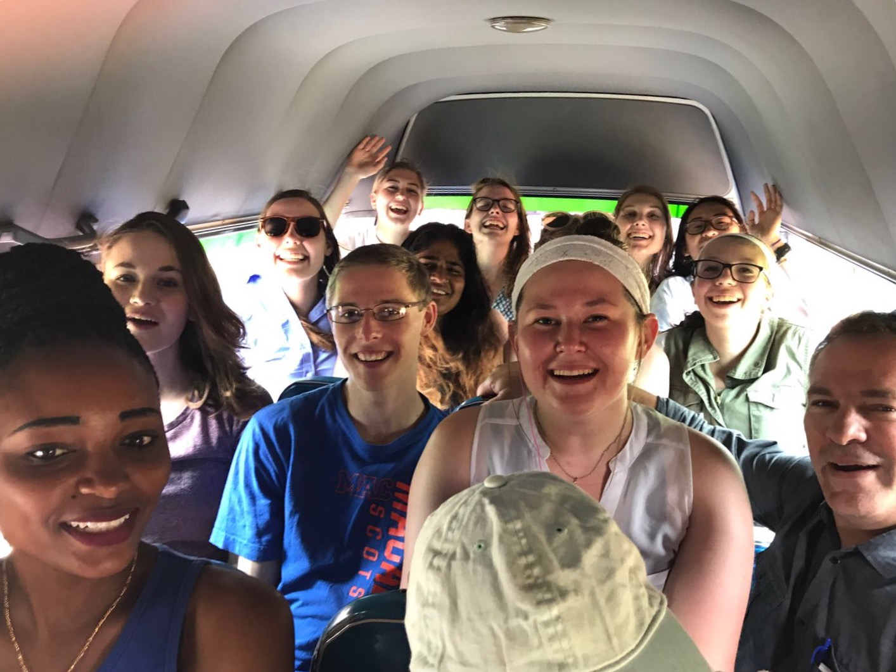

Slide 11
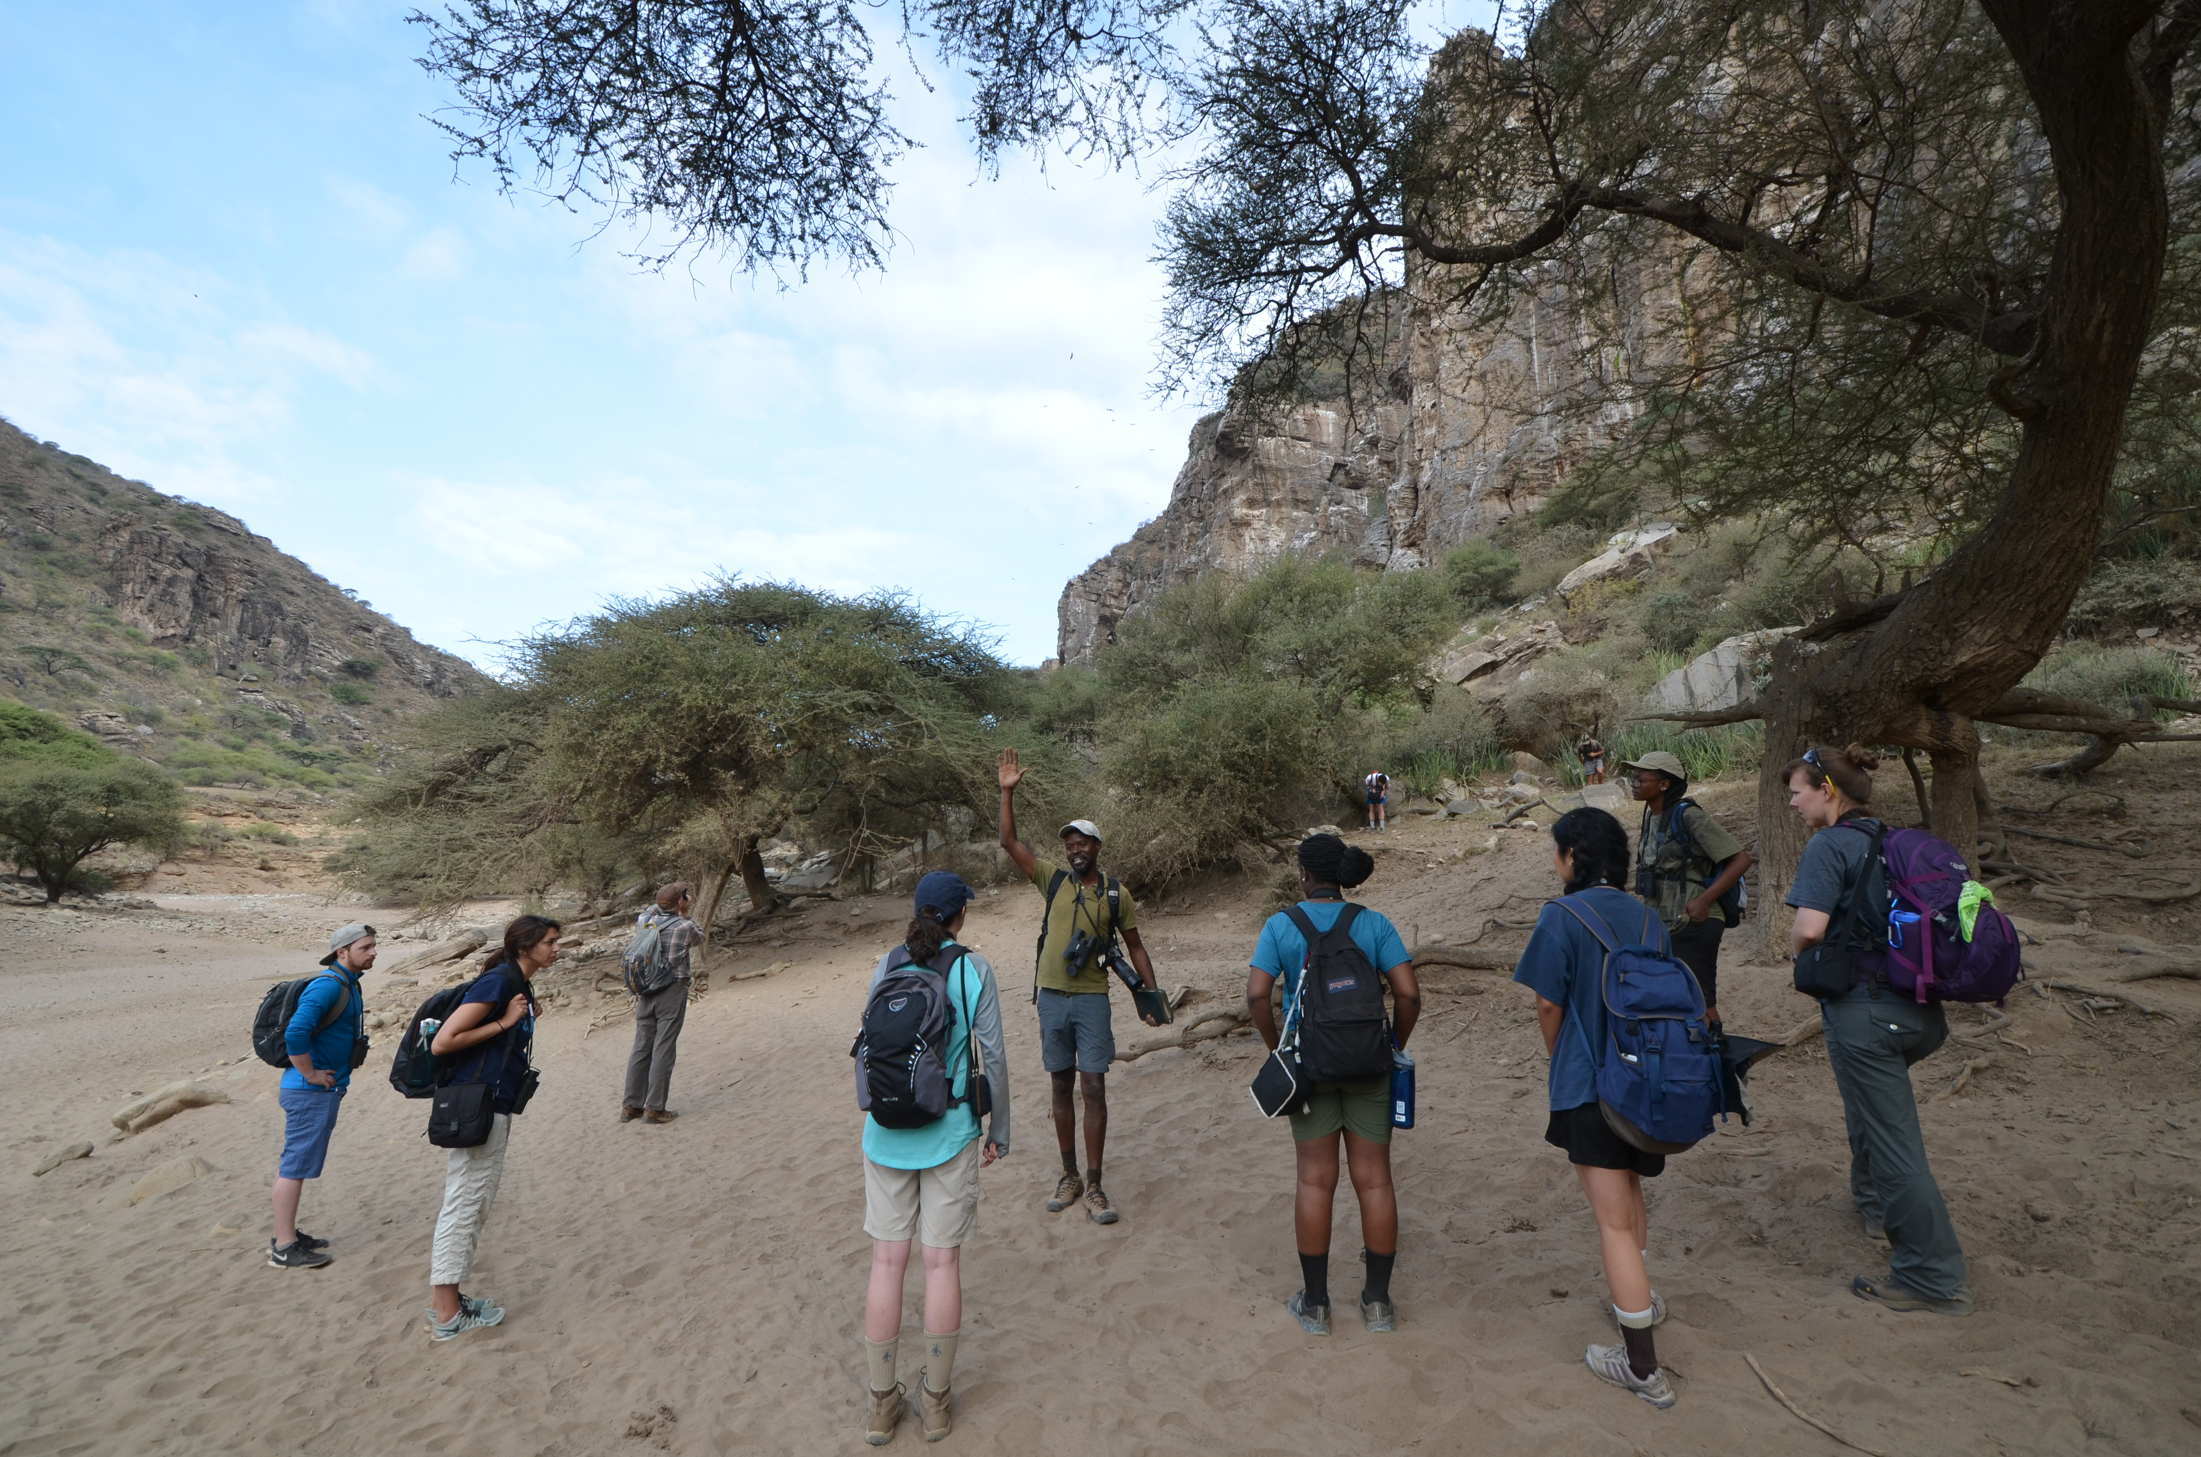

Slide 12
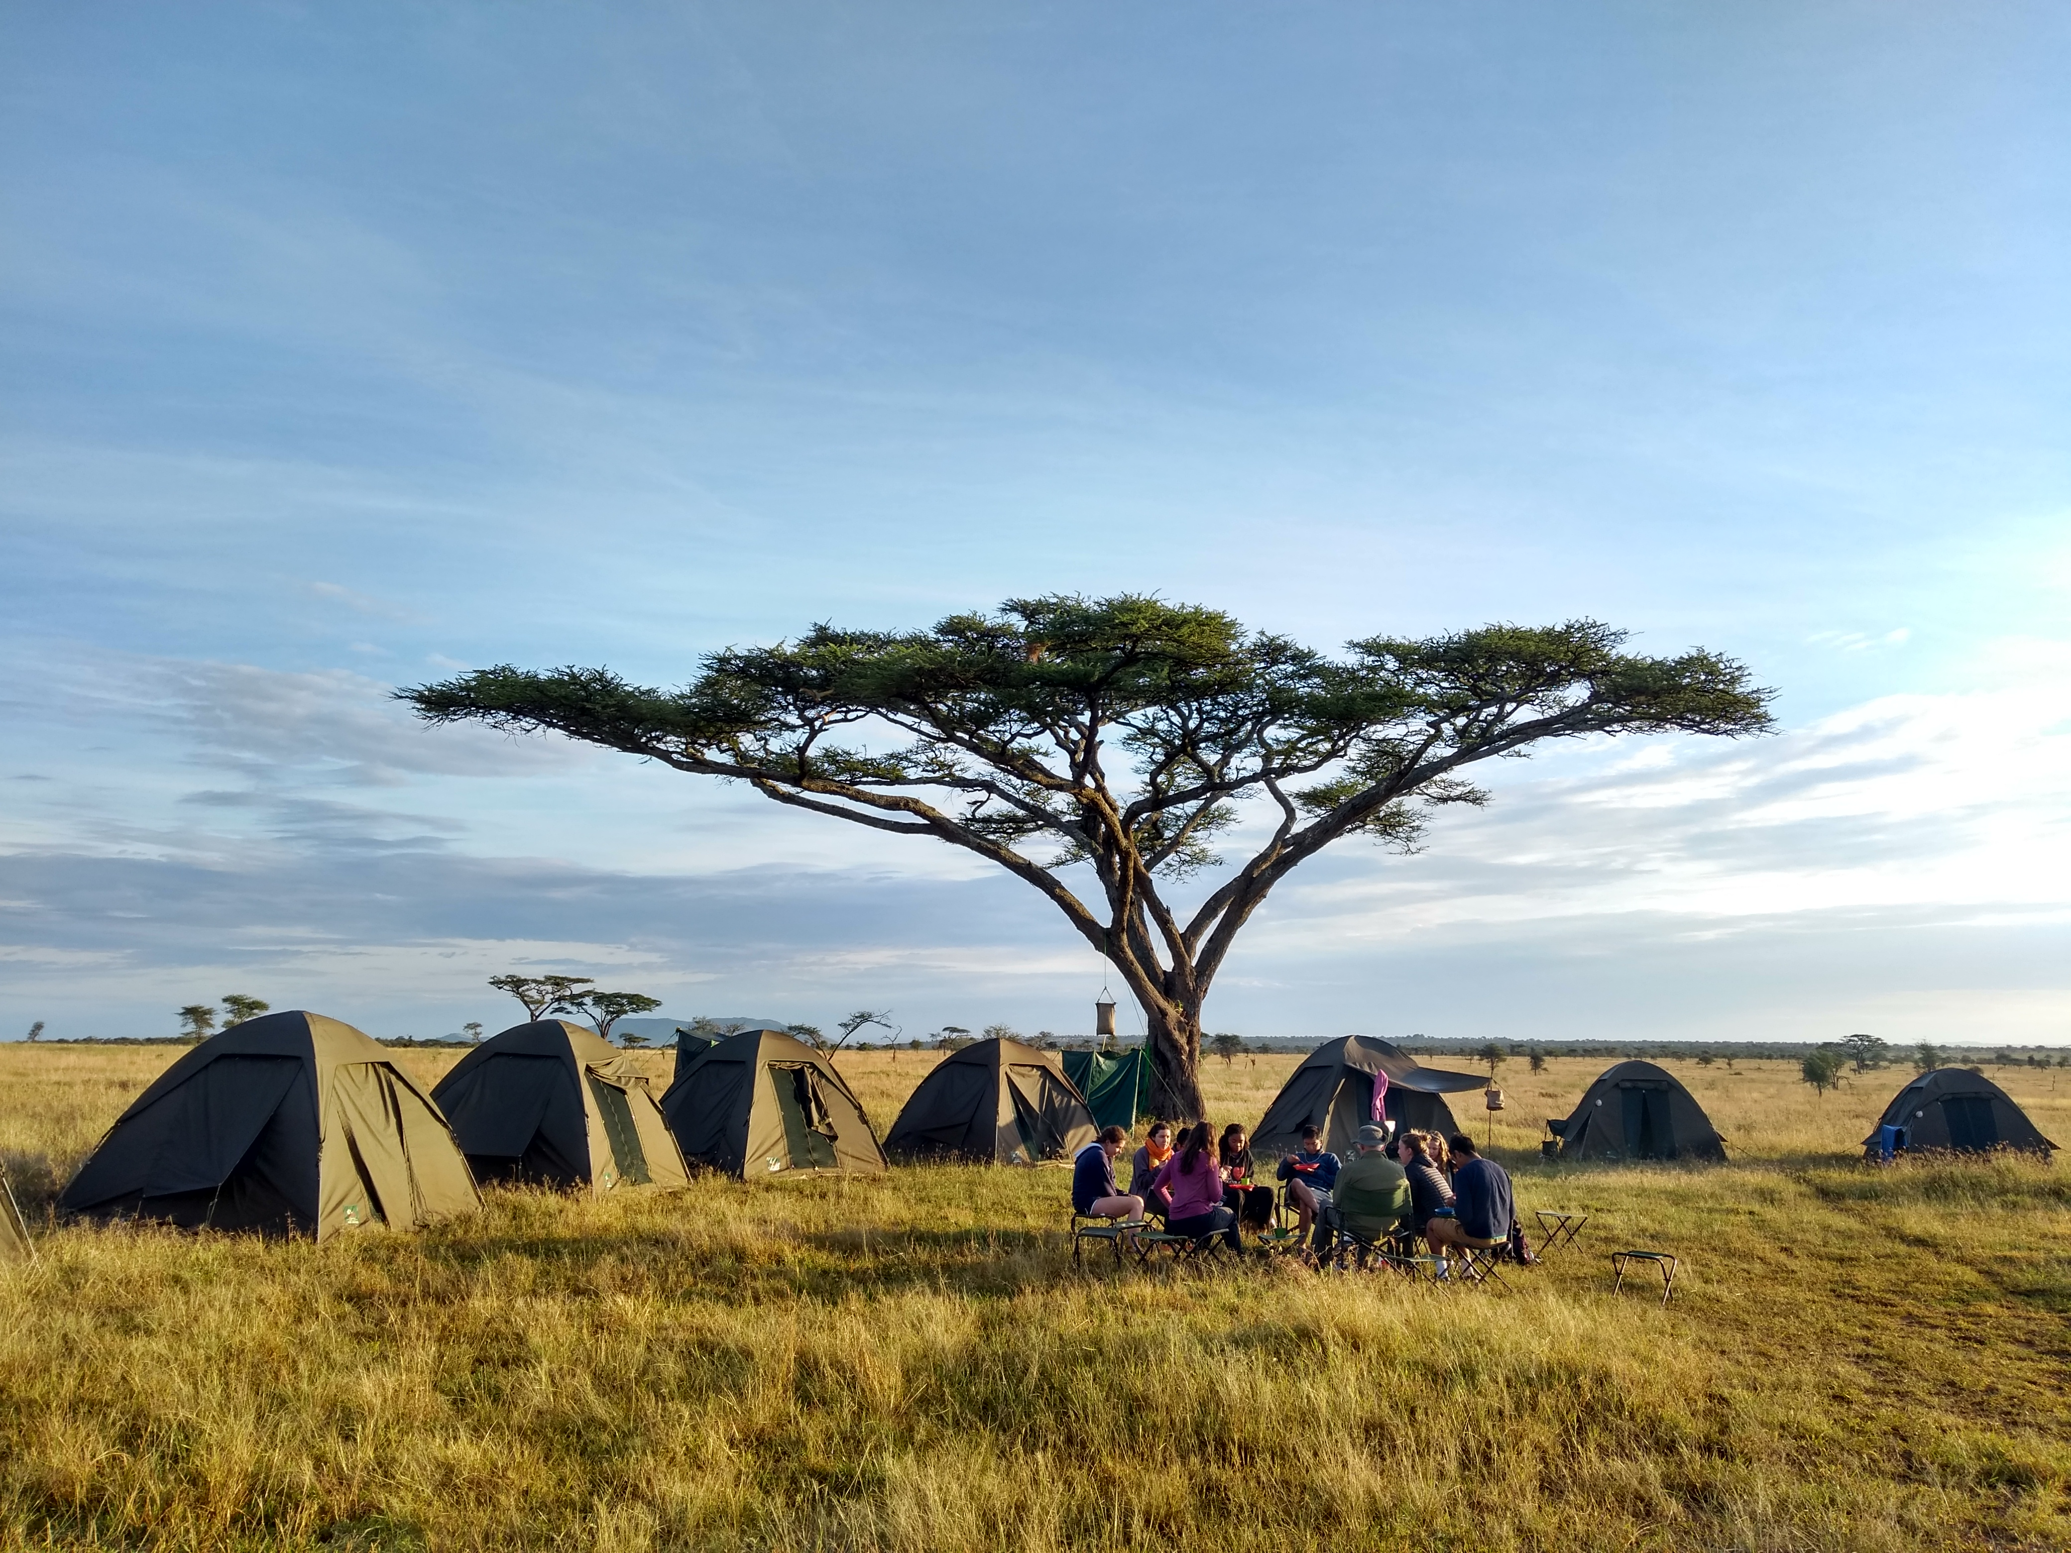

Slide 13
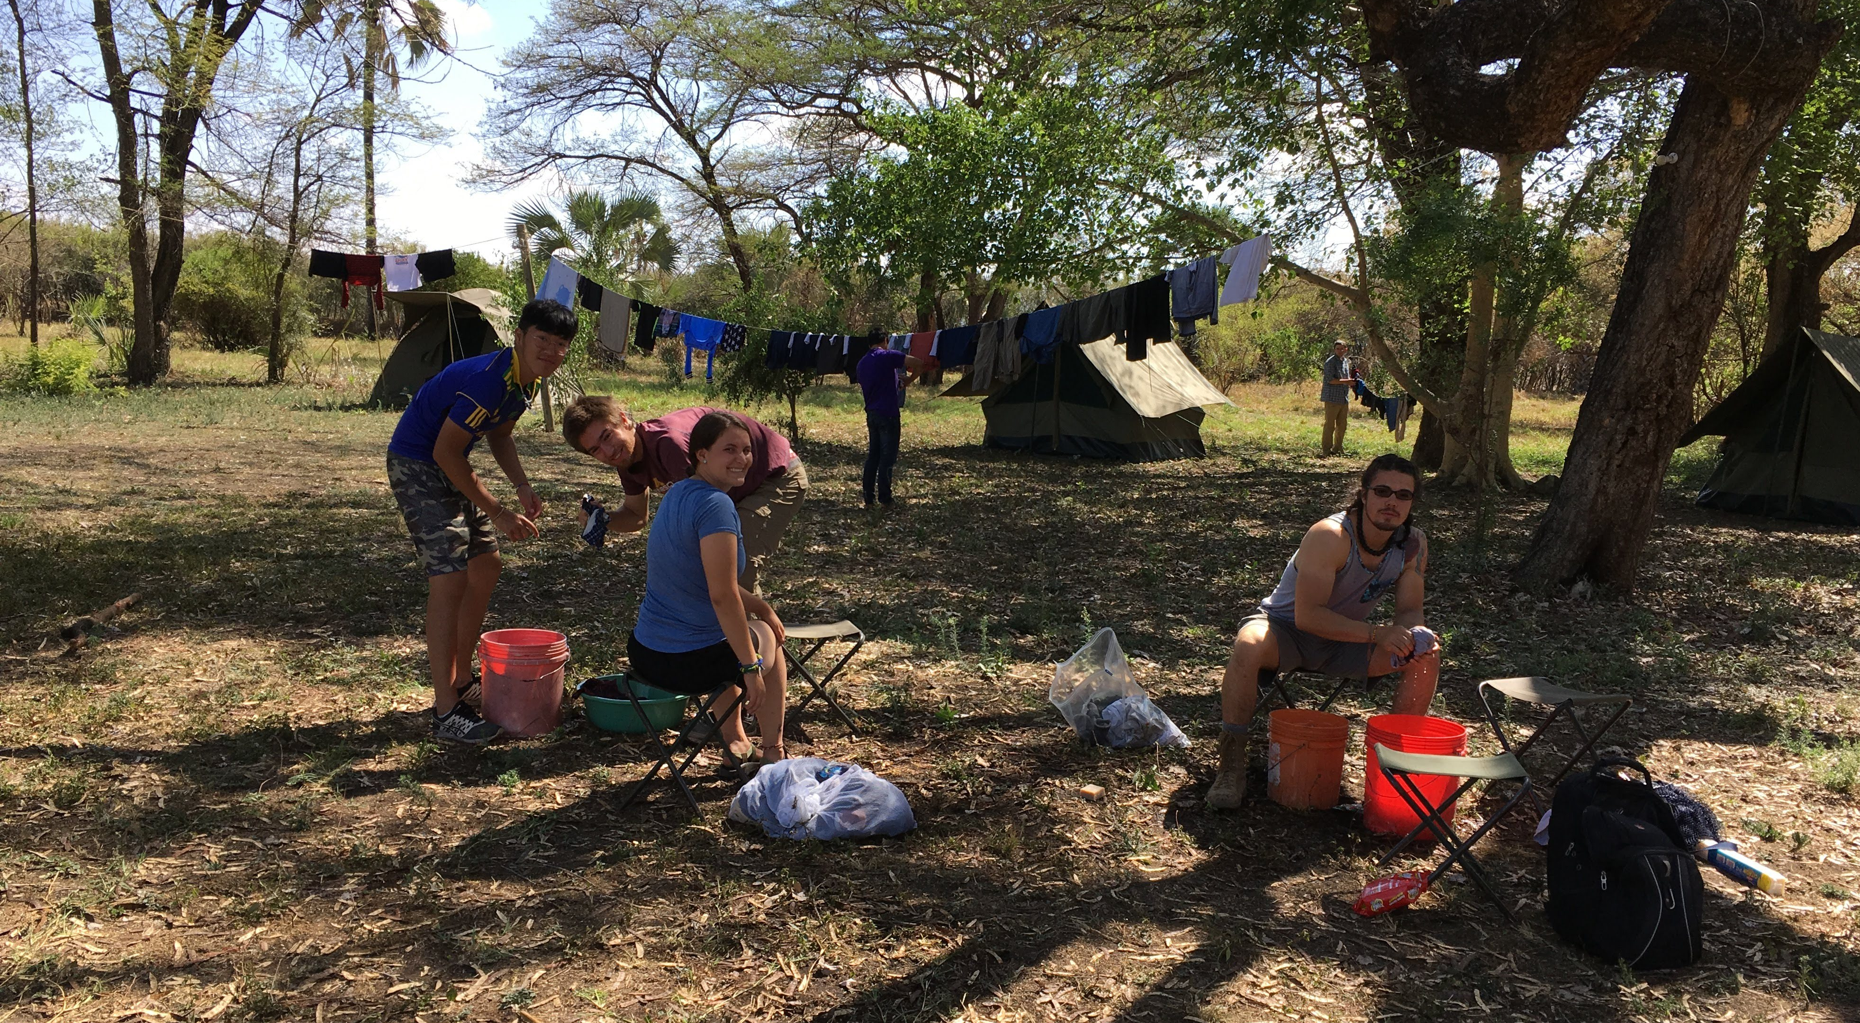

Slide 14
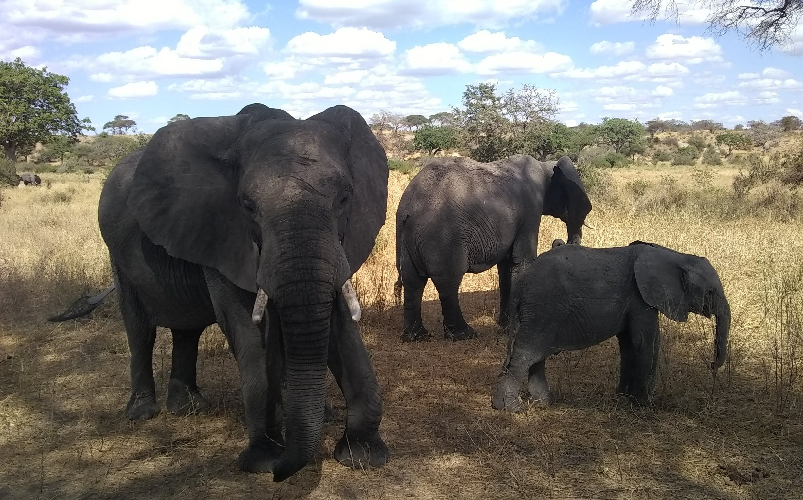

Slide 15
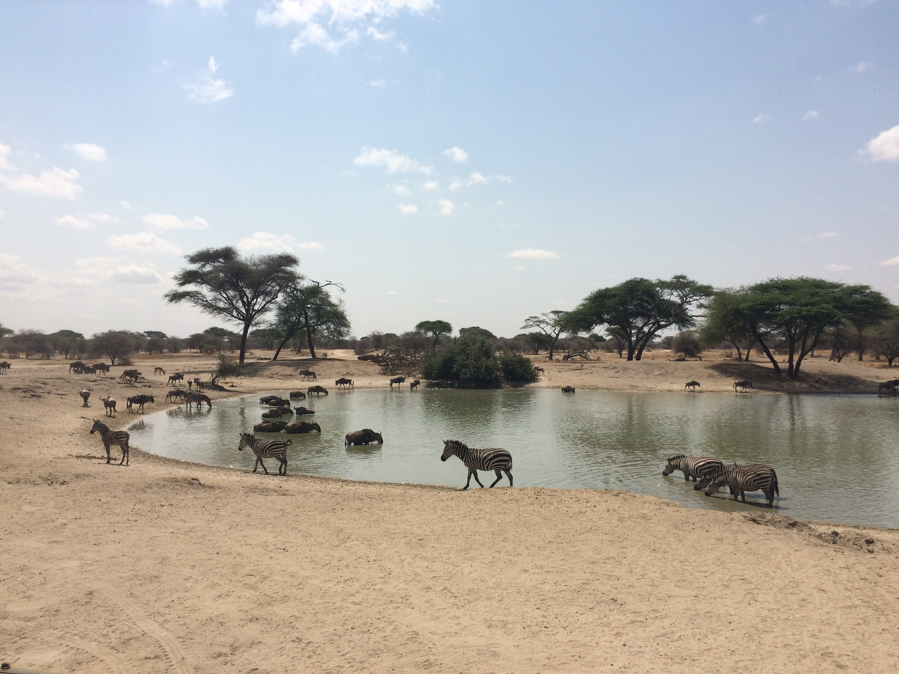

Slide 16
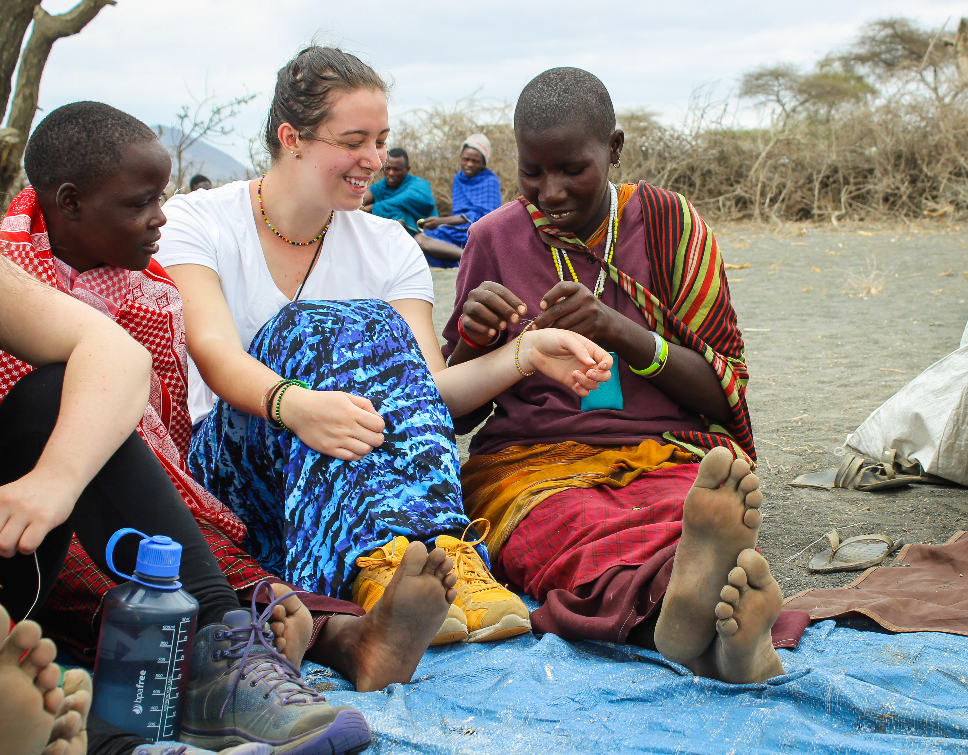

Slide 17
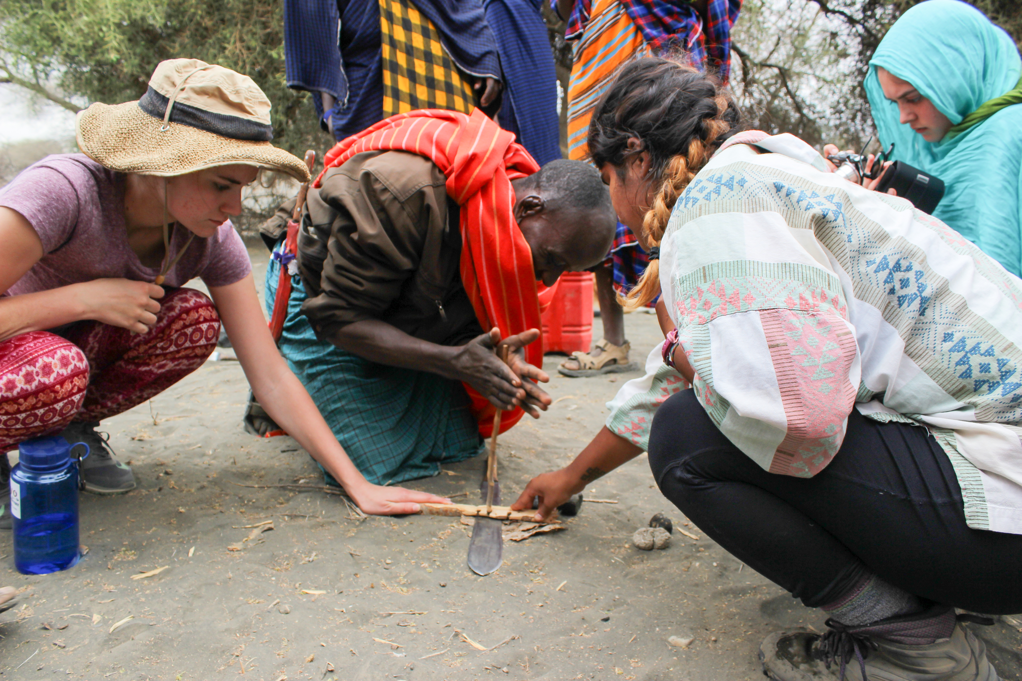

Slide 18
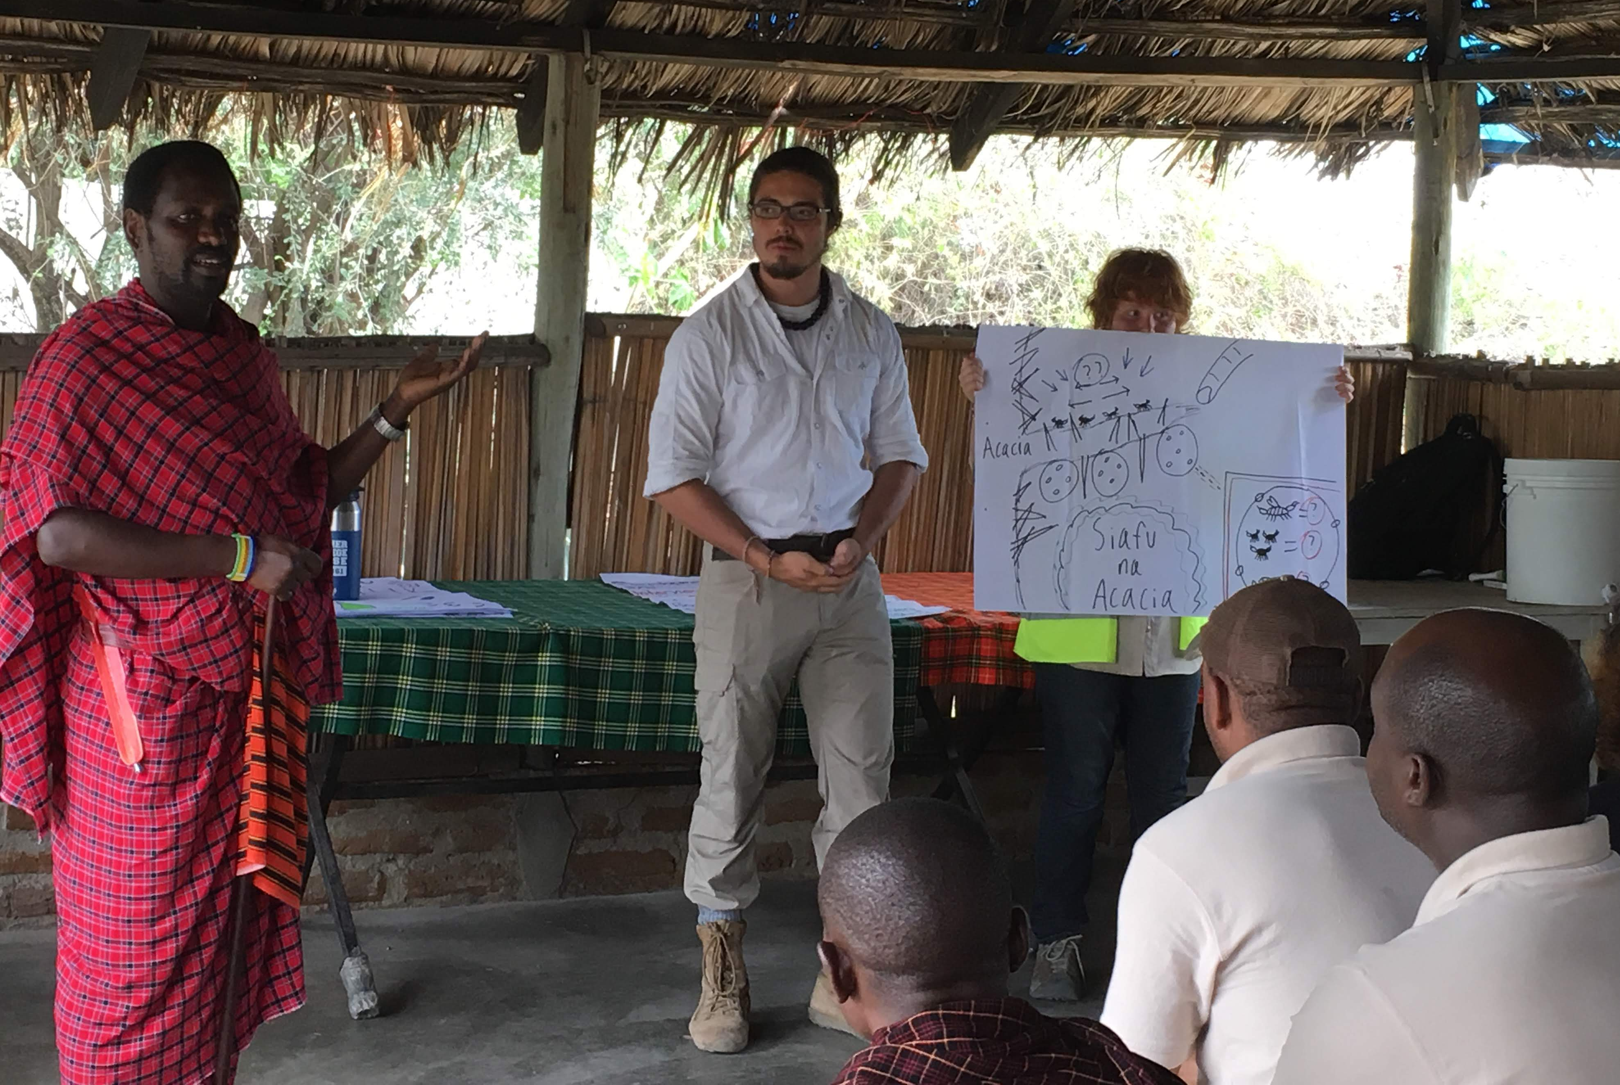

Slide 19
CARLETON GLOBAL ENGAGEMENT PROGRAMS
go.Carleton.edu/engage
507-222-4435
Carleton College
Northfield, Minnesota

