Slide 1
CARLETON GLOBAL ENGAGEMENT PROGRAMS
13-week fall programs offering Carleton College academic credit equivalent to 16 semester credits
Buddhist Studies in India
Women’s and Gender Studies in Europe
Ecology and Anthropology in Tanzania

Slide 2
BUDDHIST STUDIES IN INDIA
London and Delhi (orientation)
Bodh Gaya, India
Various locations in South Asia (ISP)
Early September to Mid-December

Slide 3
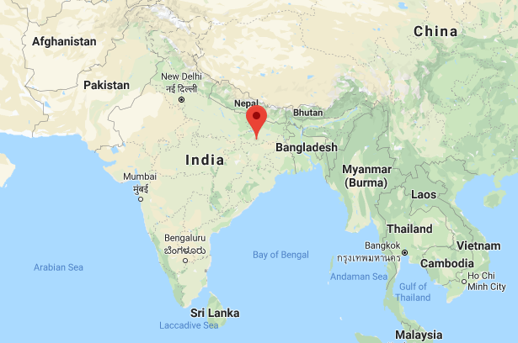

Slide 4
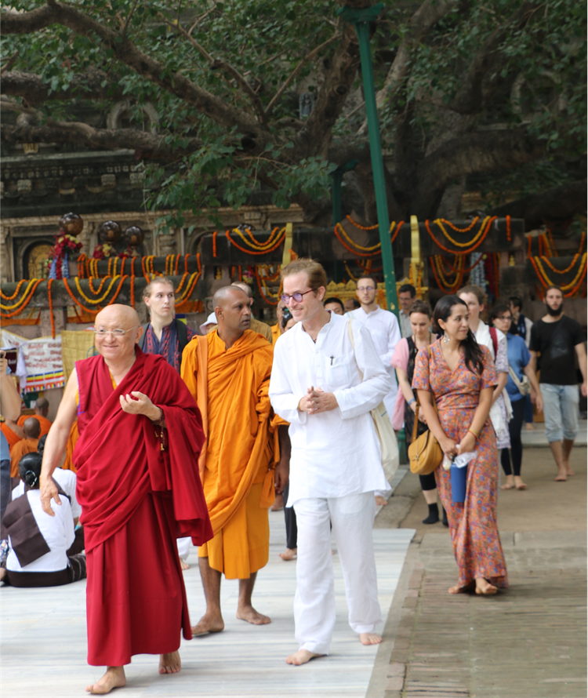
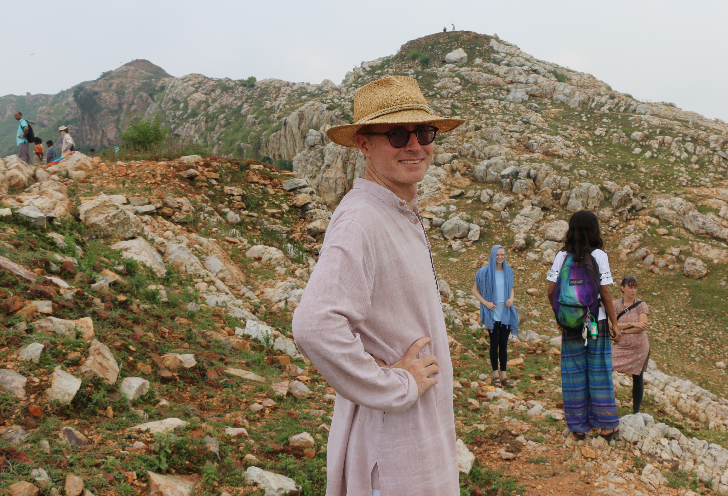
Dr. Arthur McKeown Director, Buddhist Studies Program in India Associate Professor of Asian Studies

Slide 5
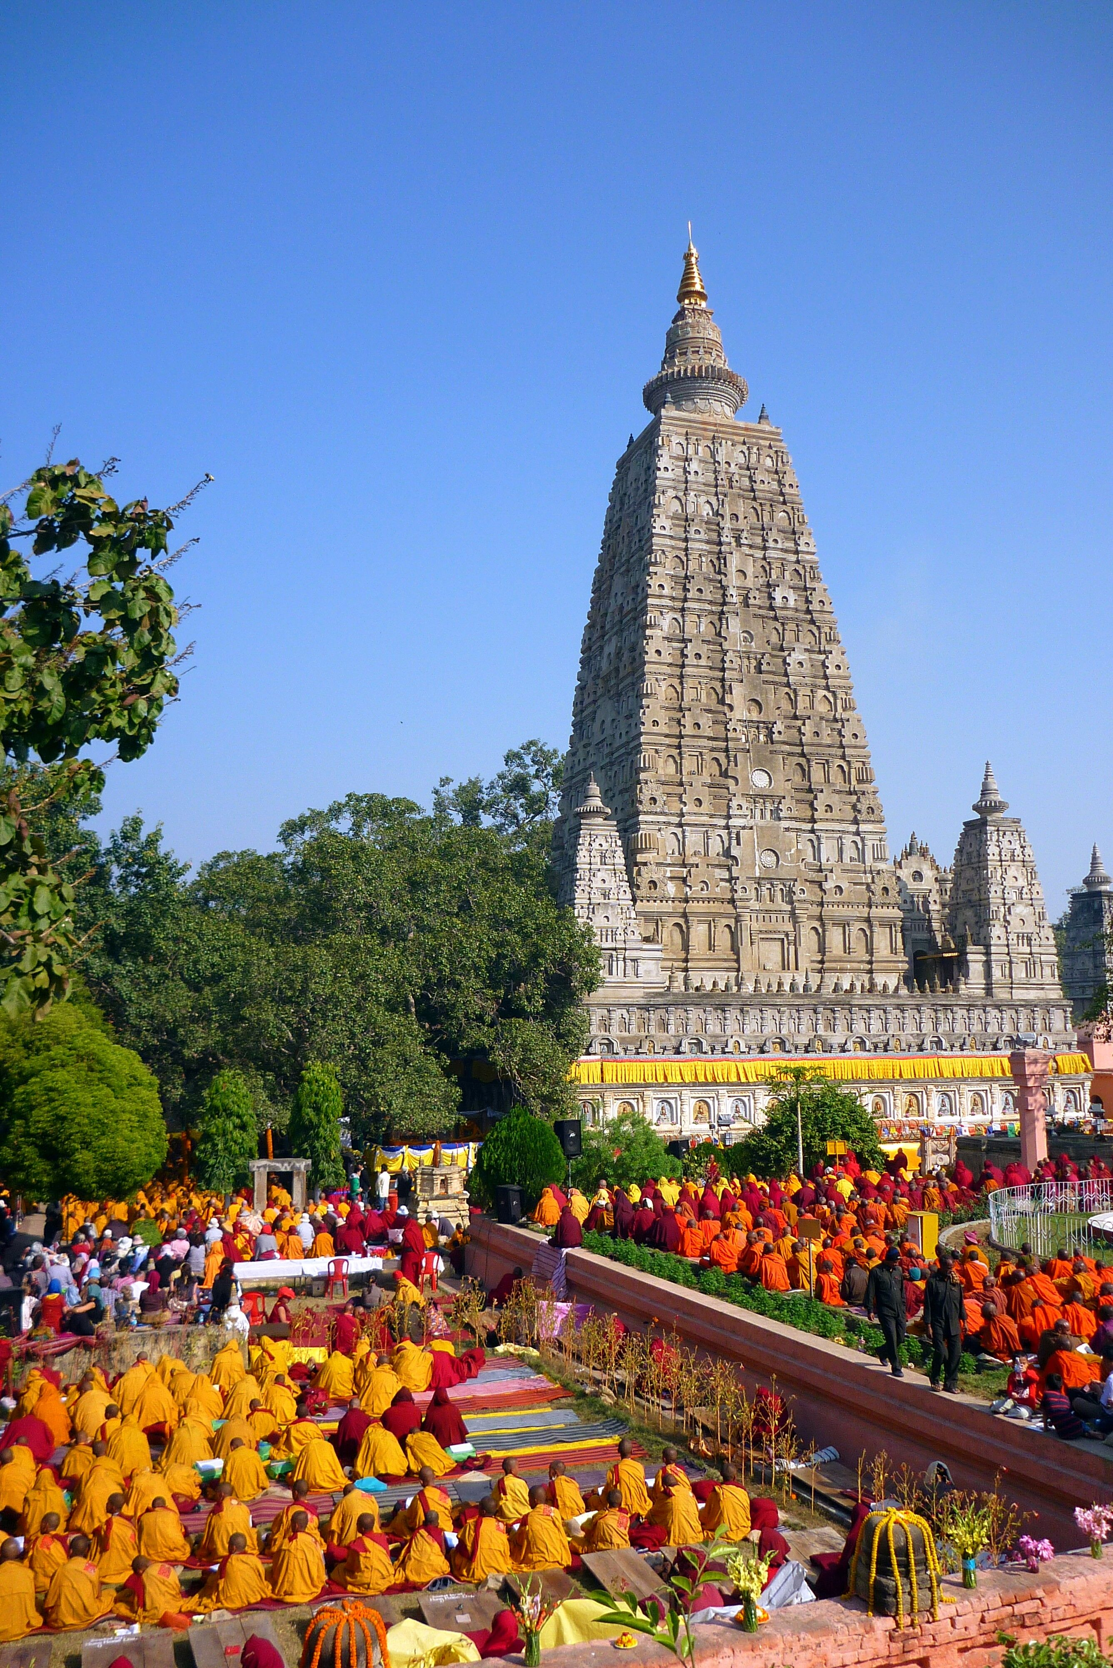
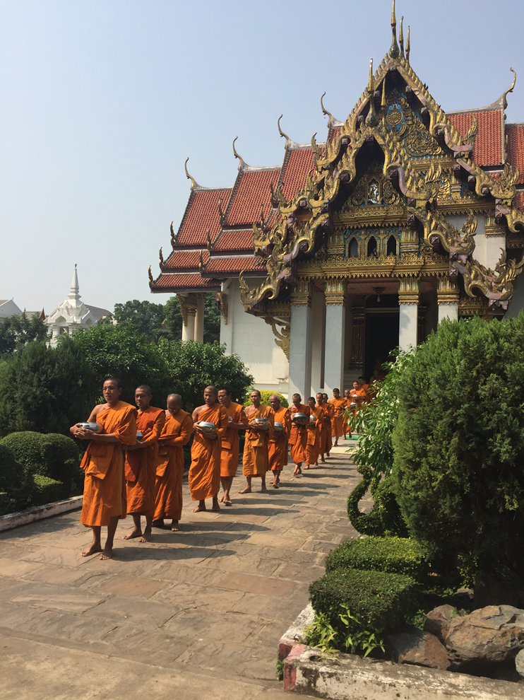

Slide 6
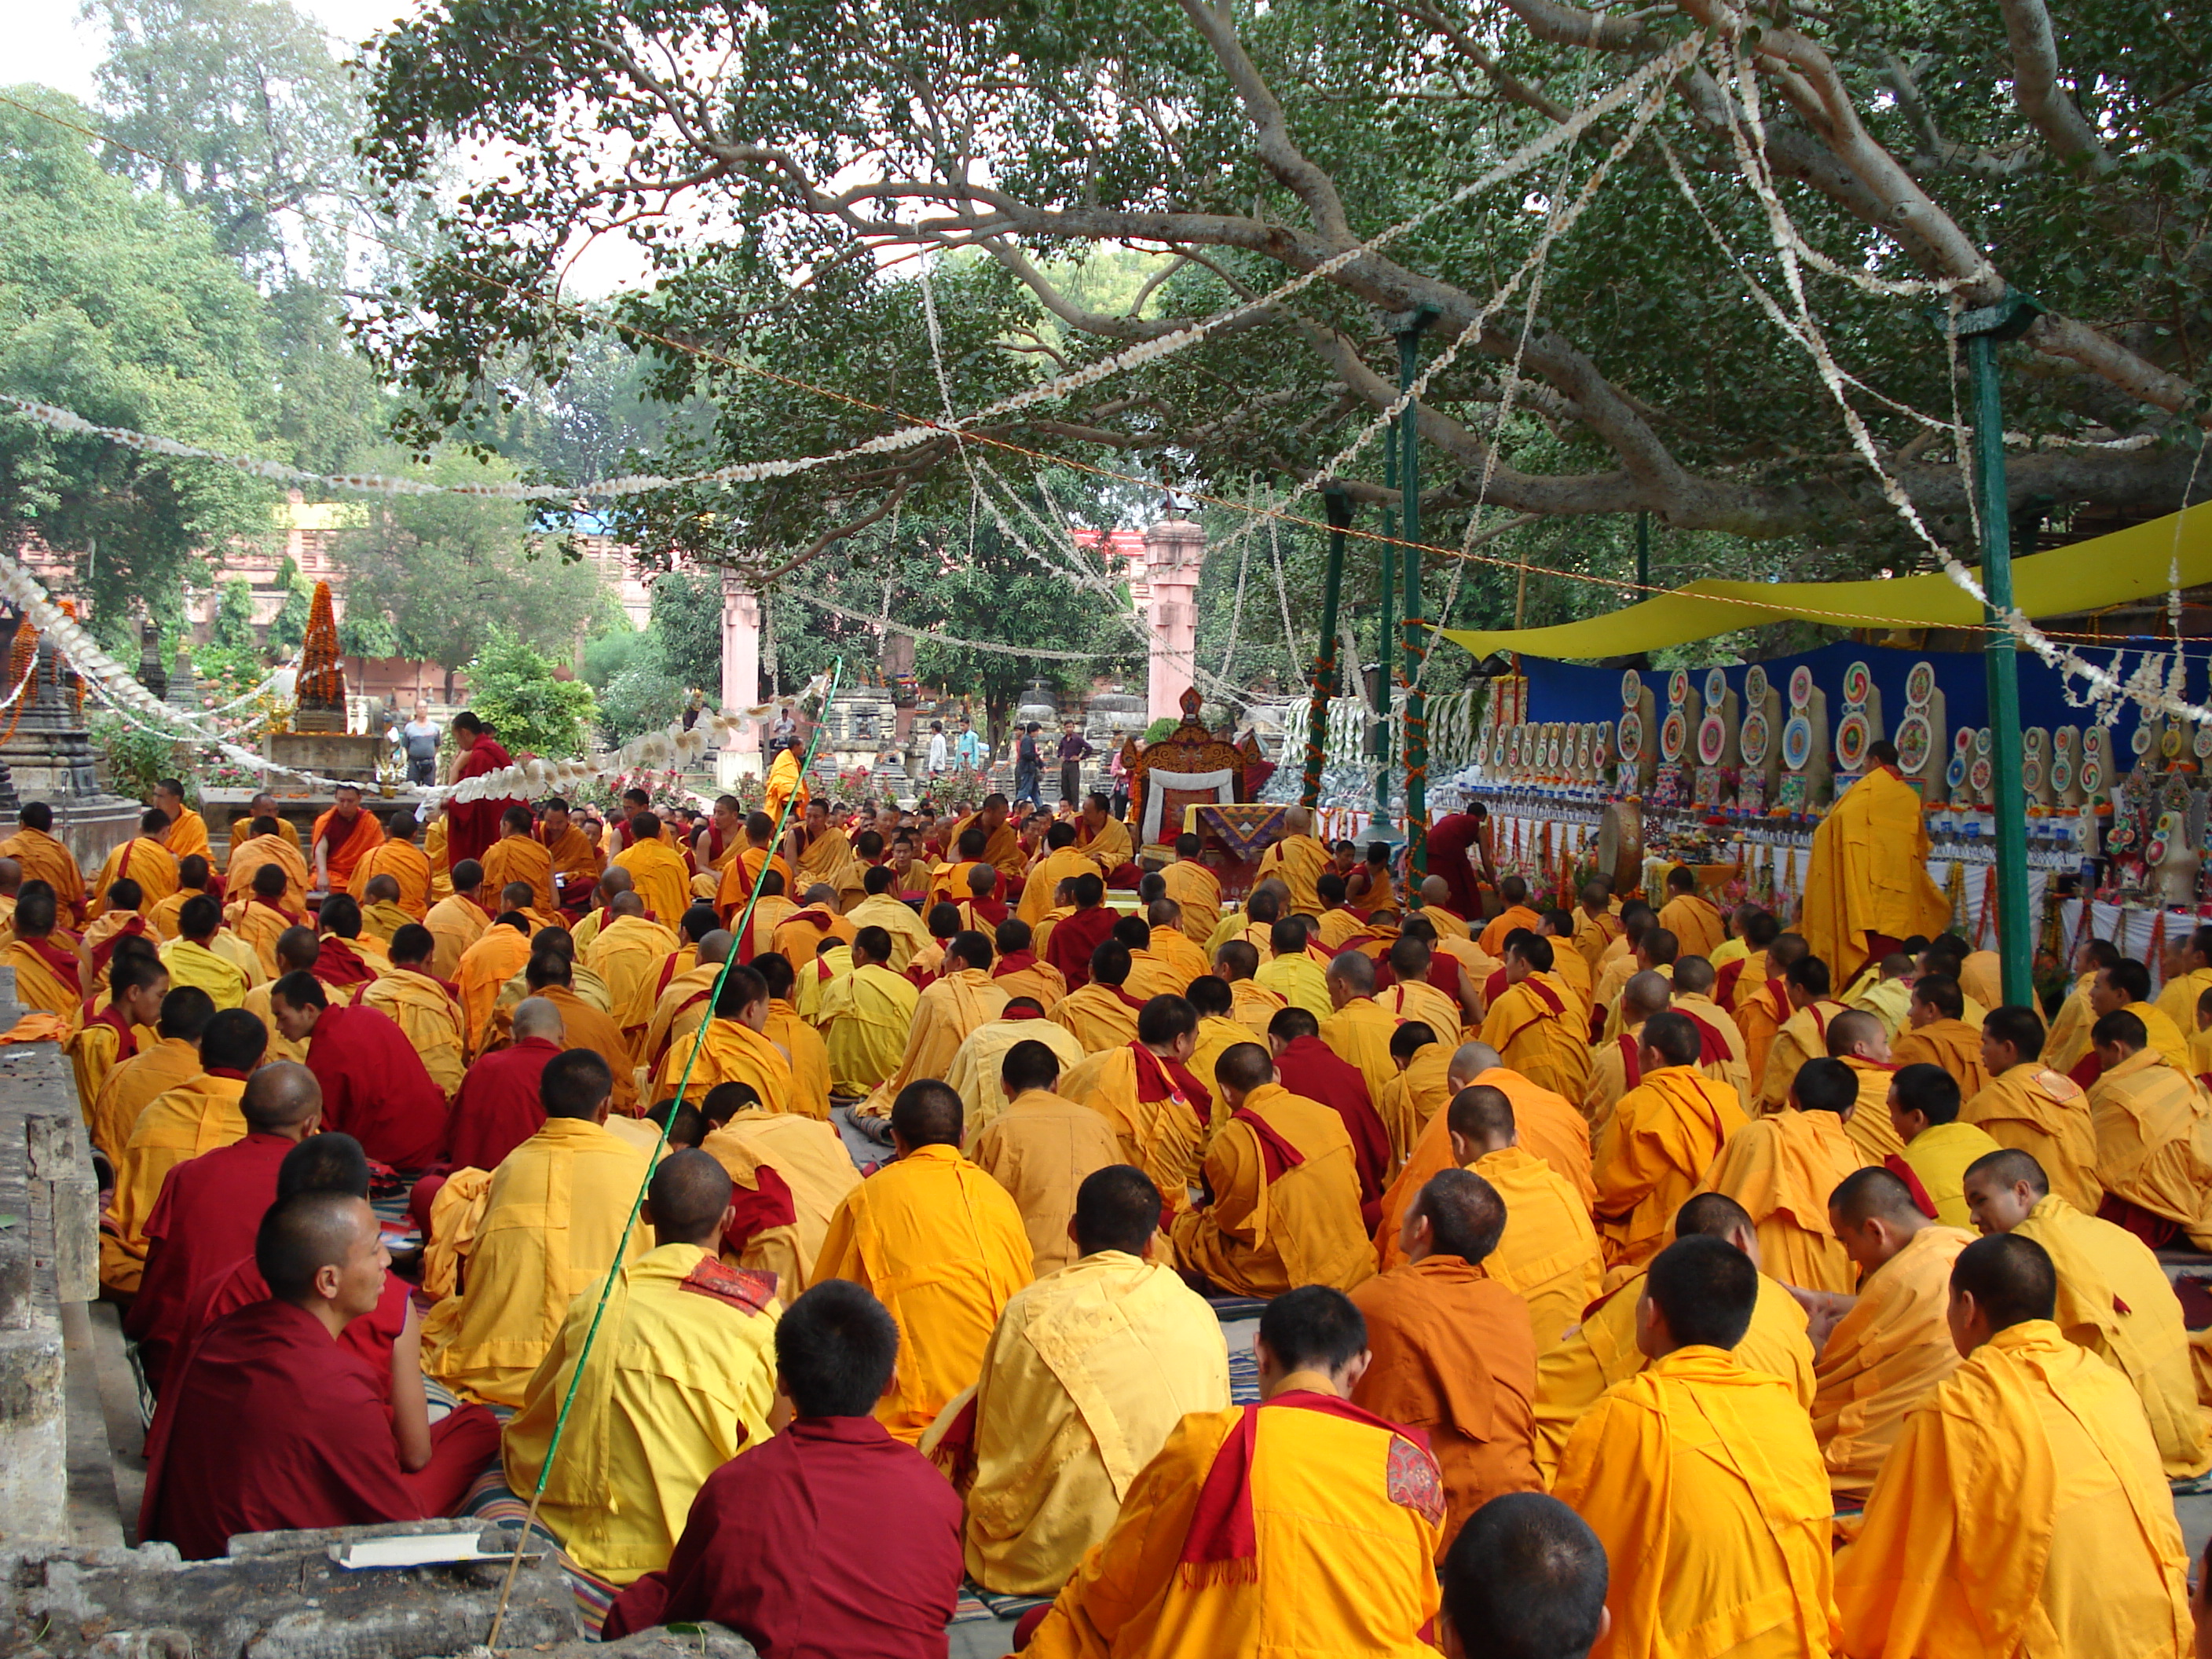

Slide 7
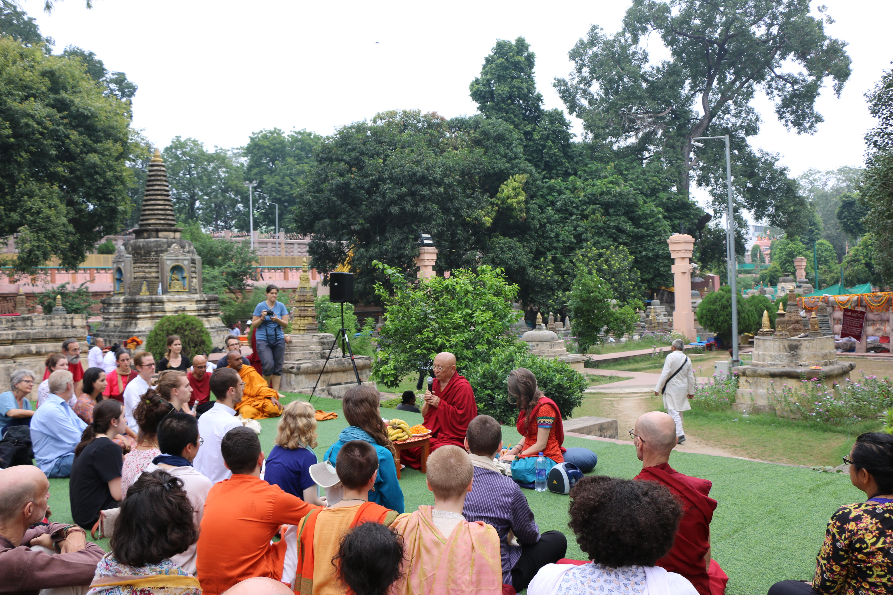

Slide 8
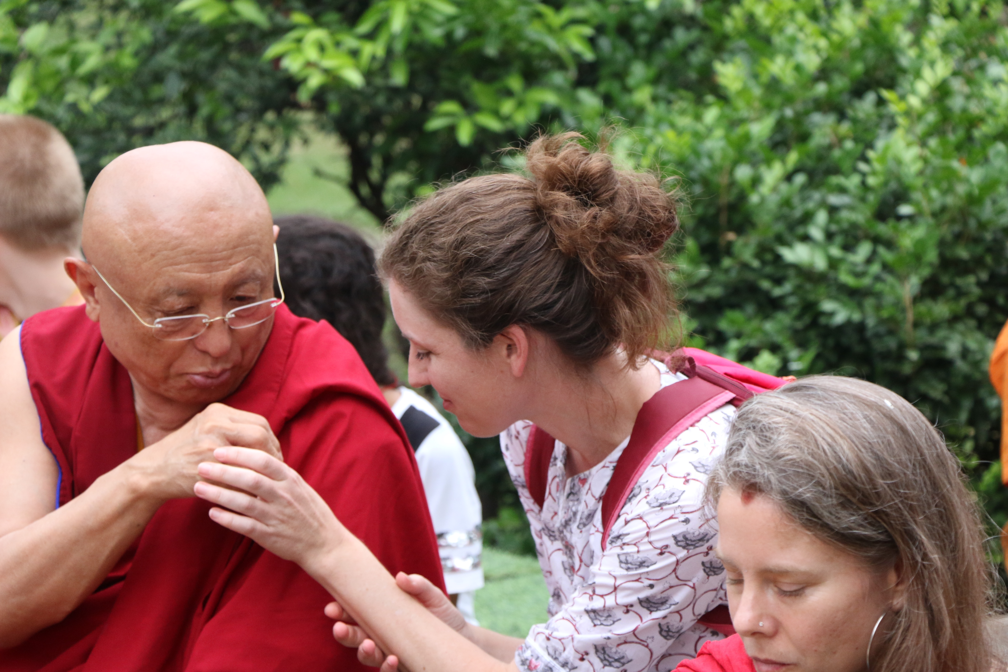

Slide 9
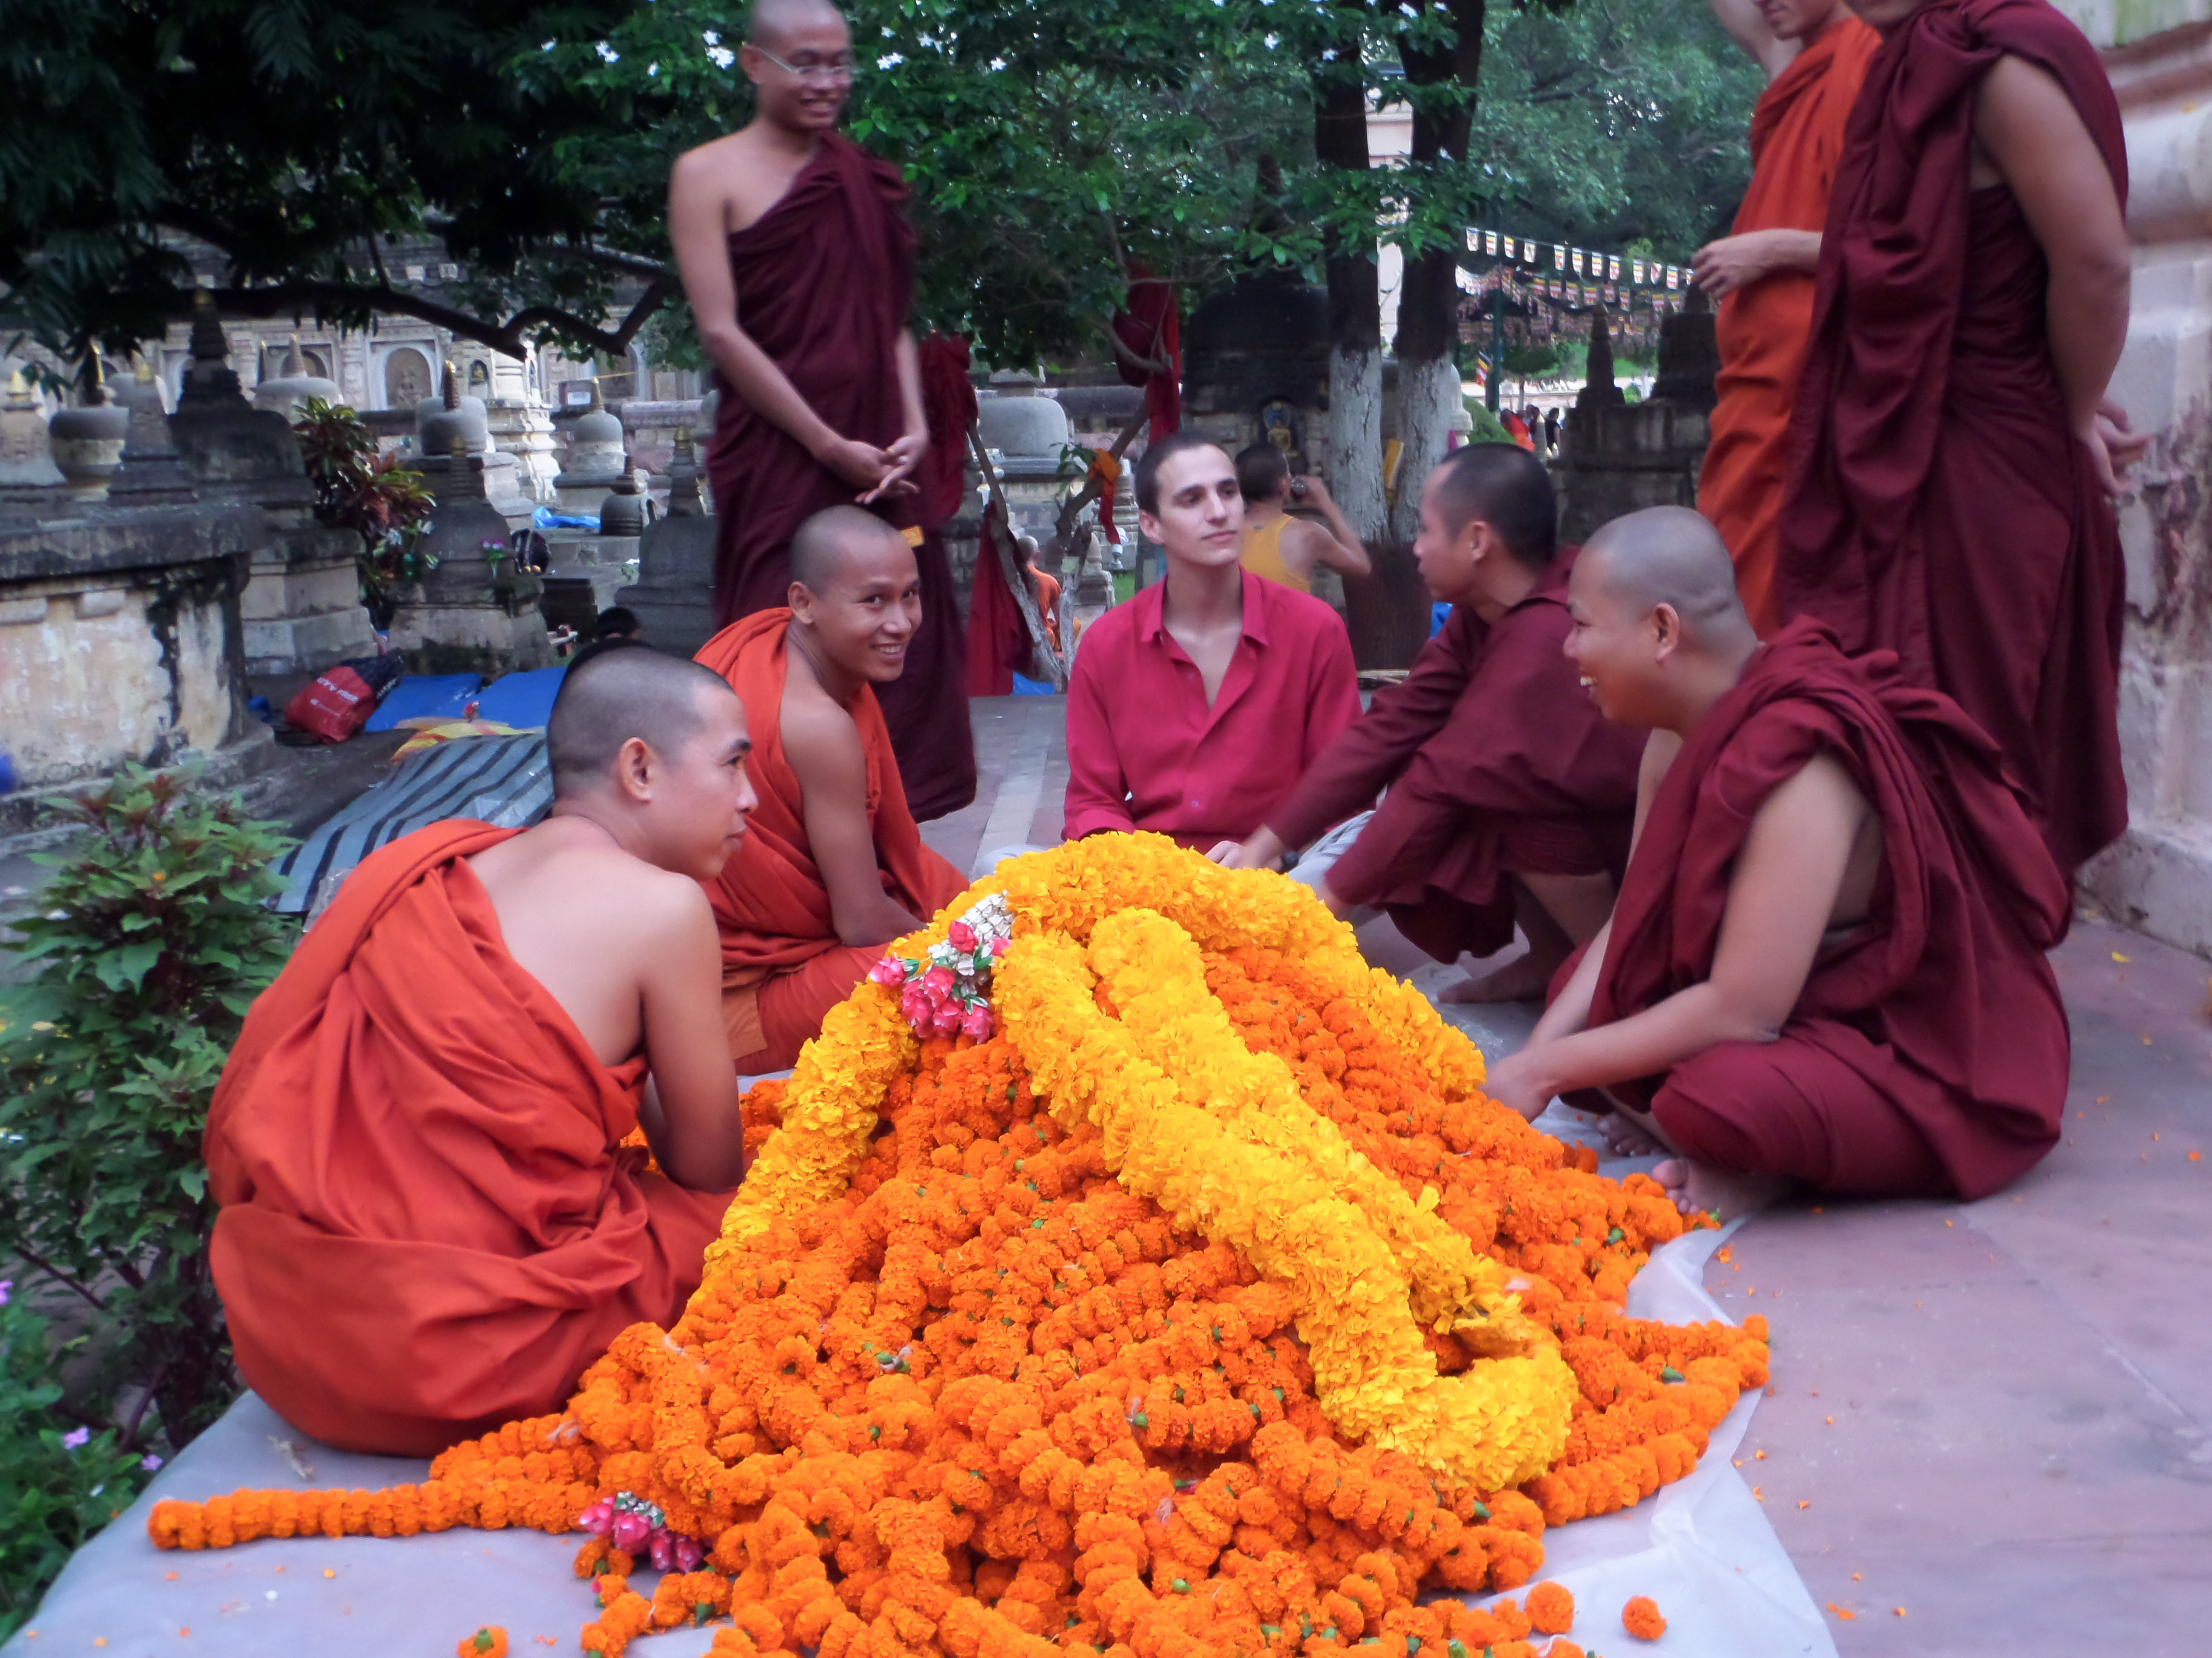

Slide 10
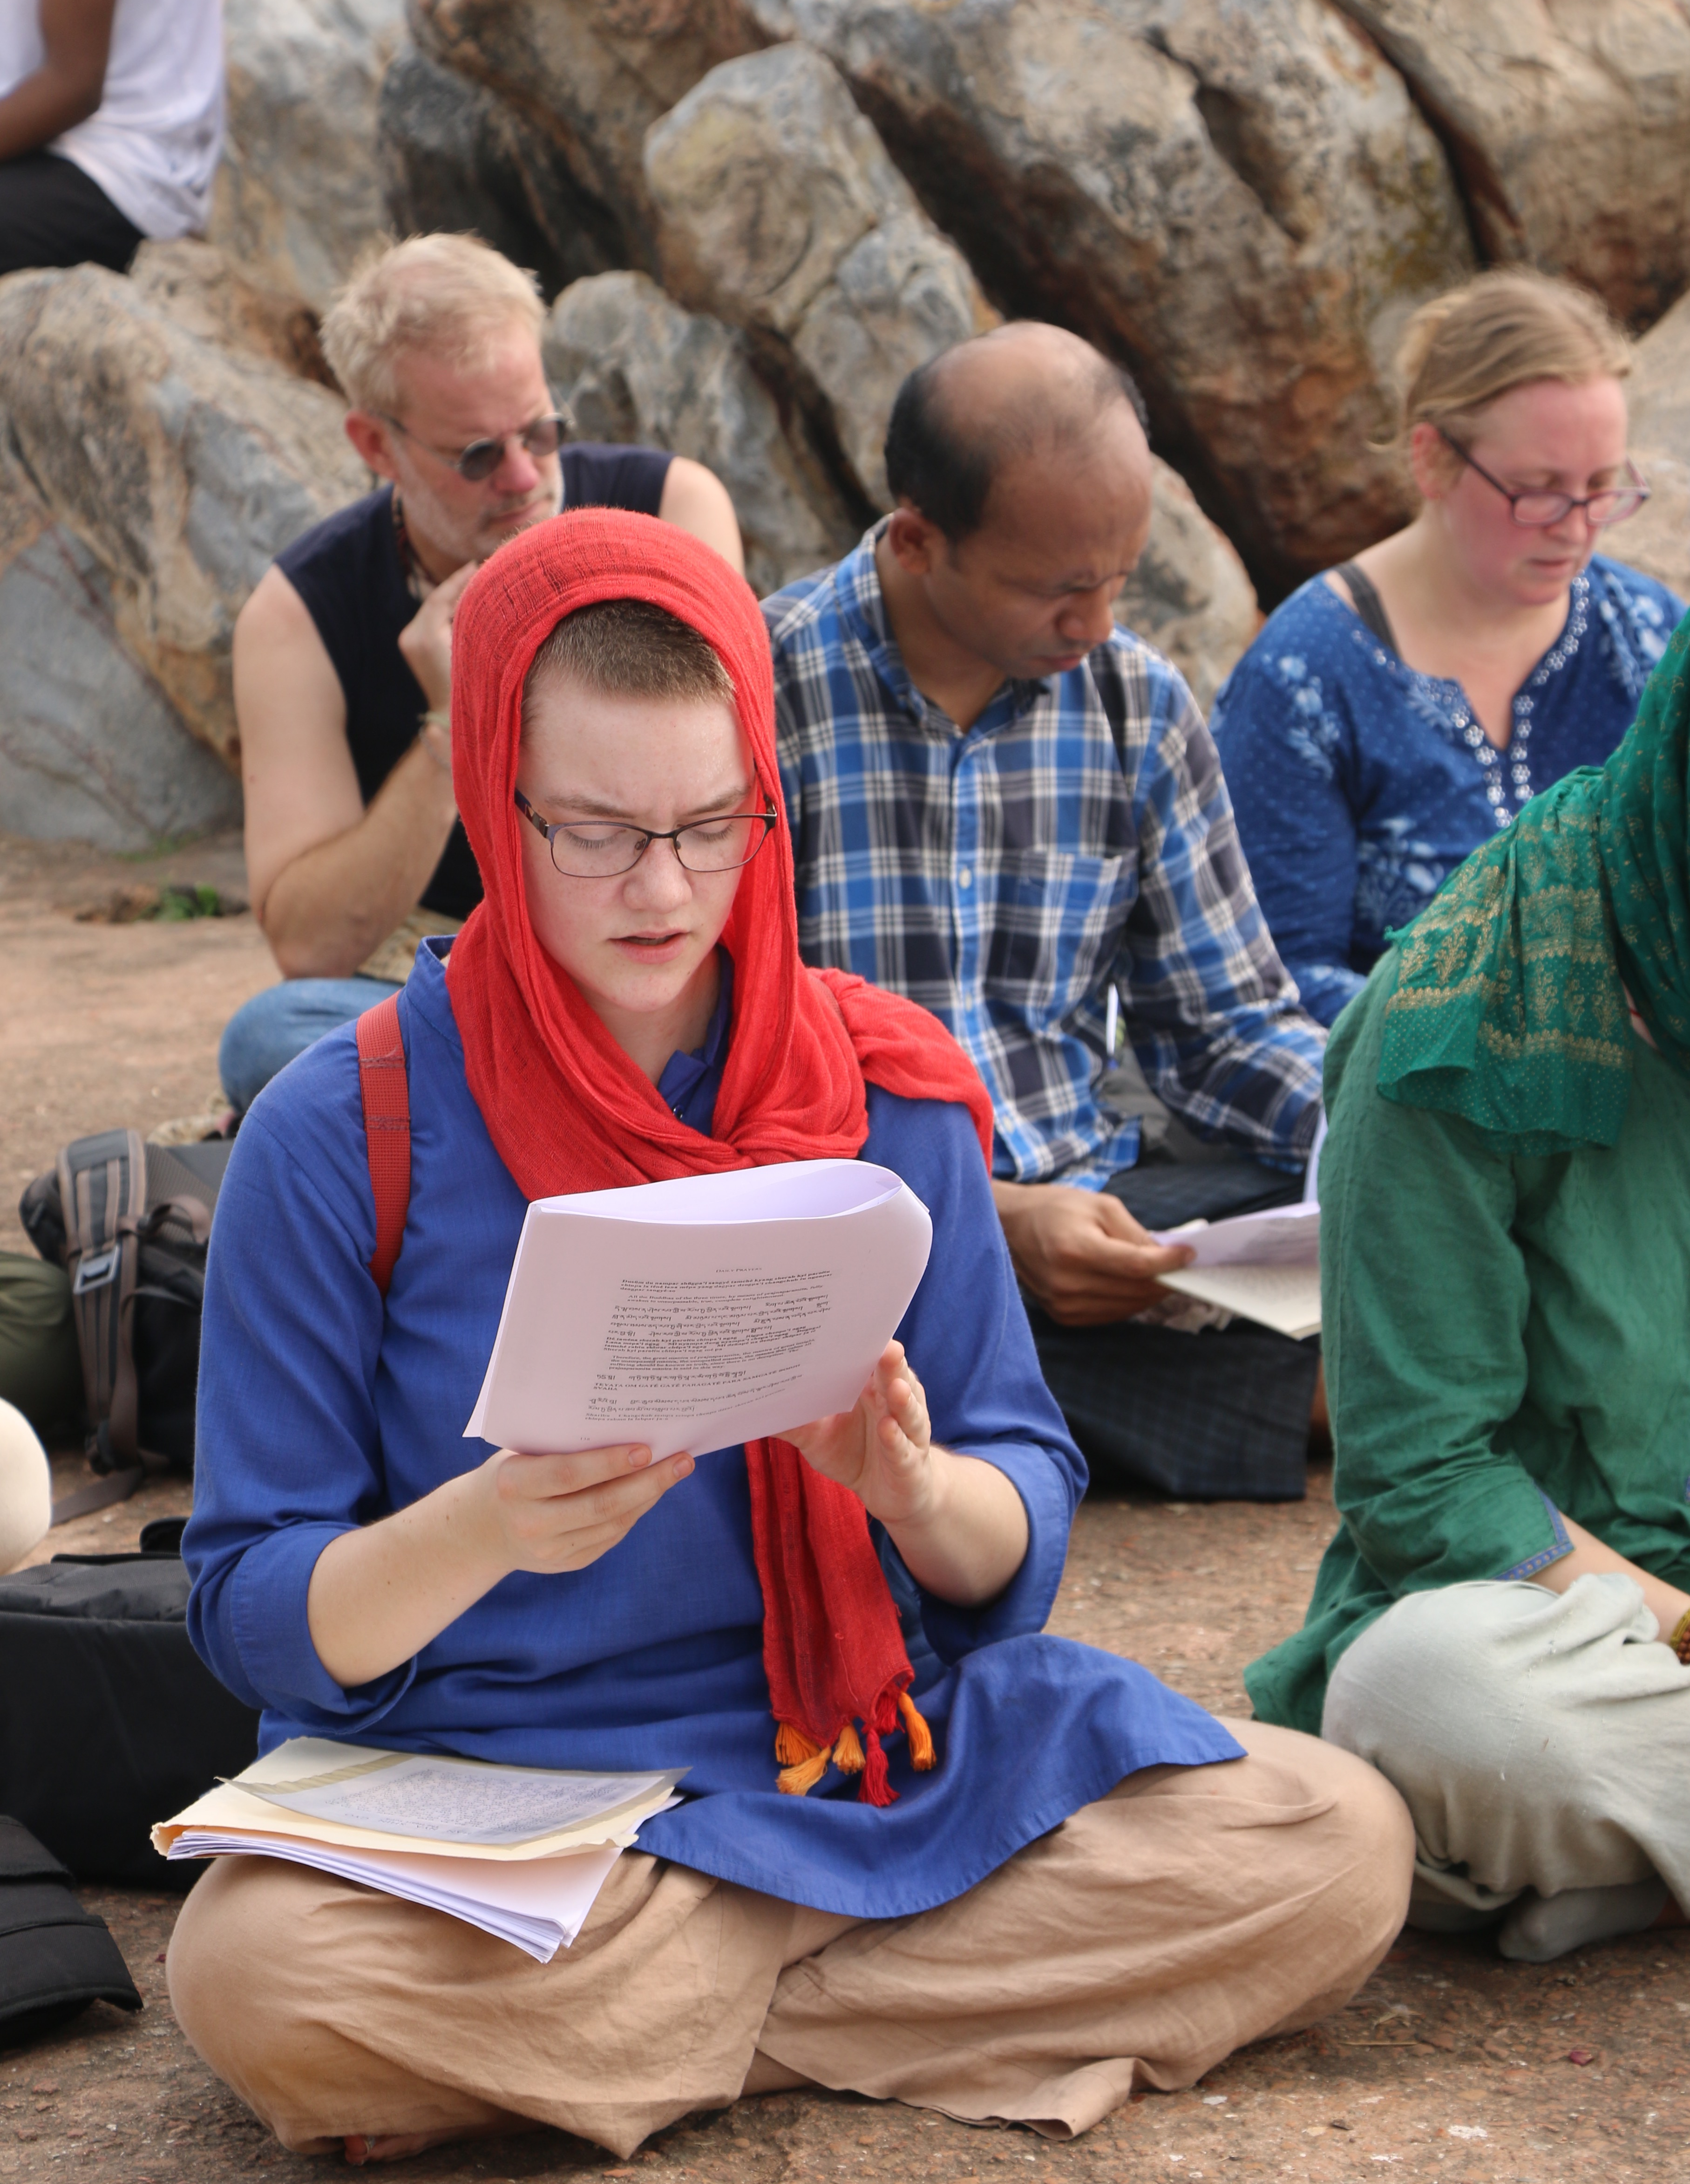
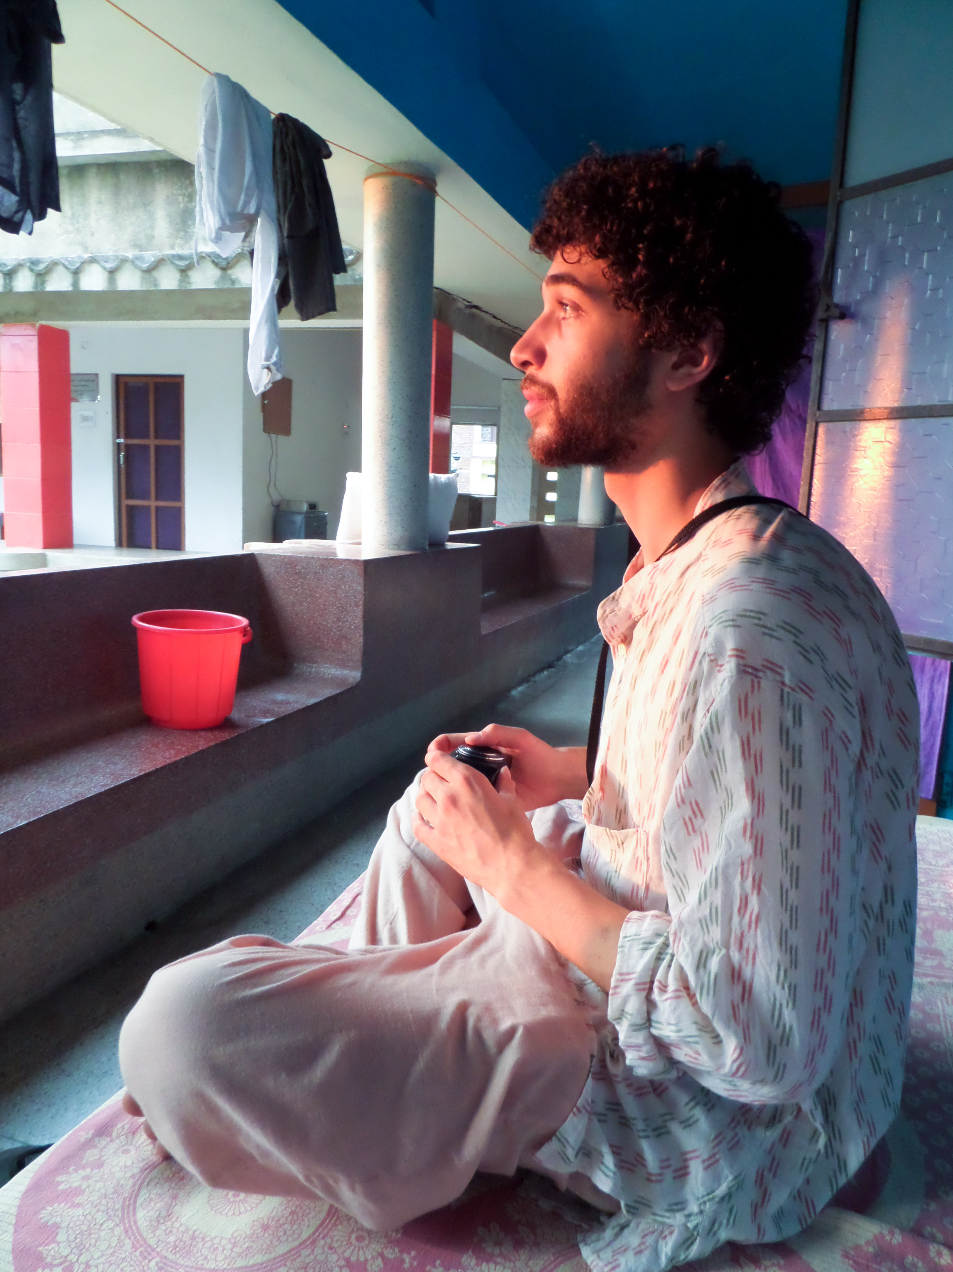

Slide 11
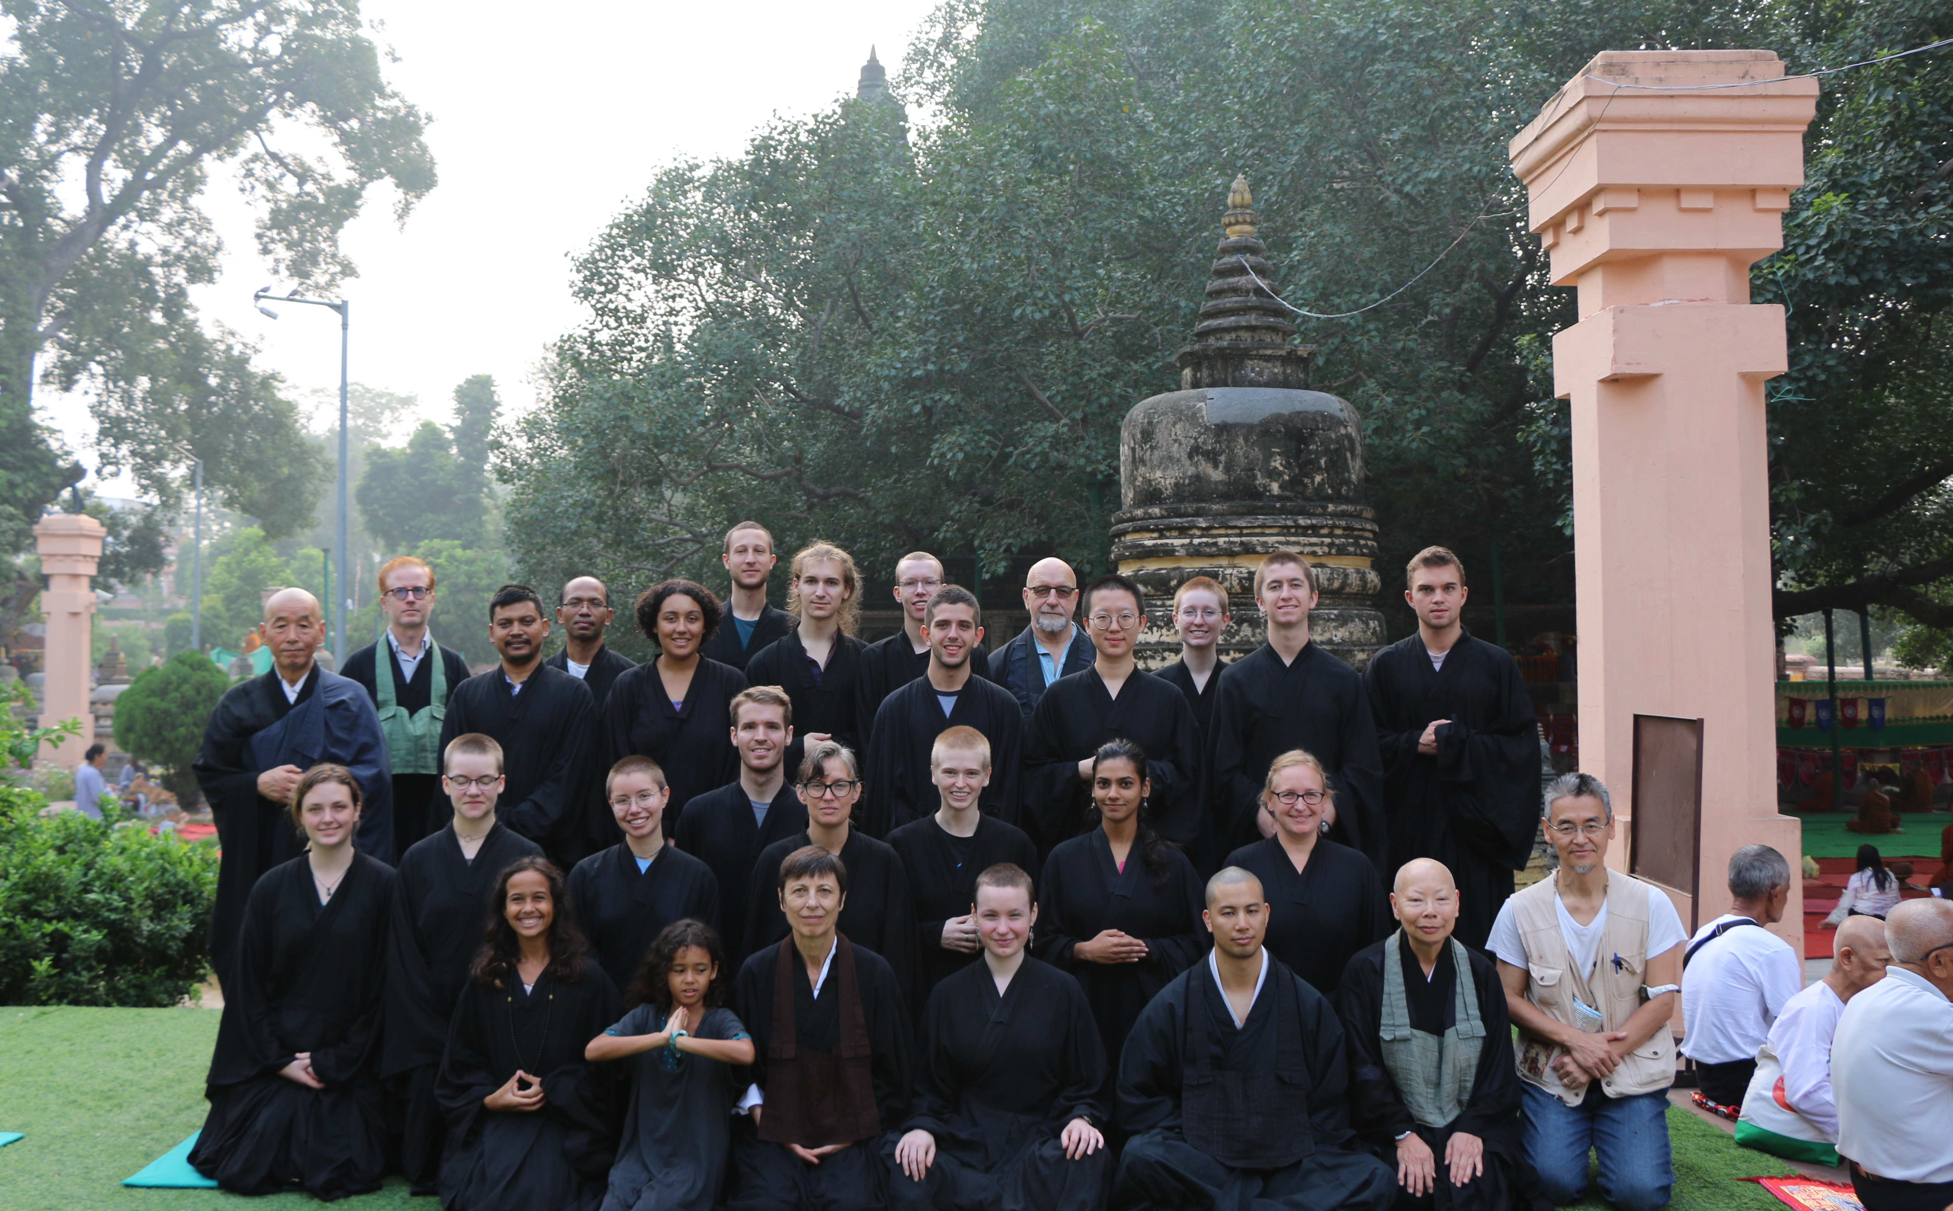

Slide 12
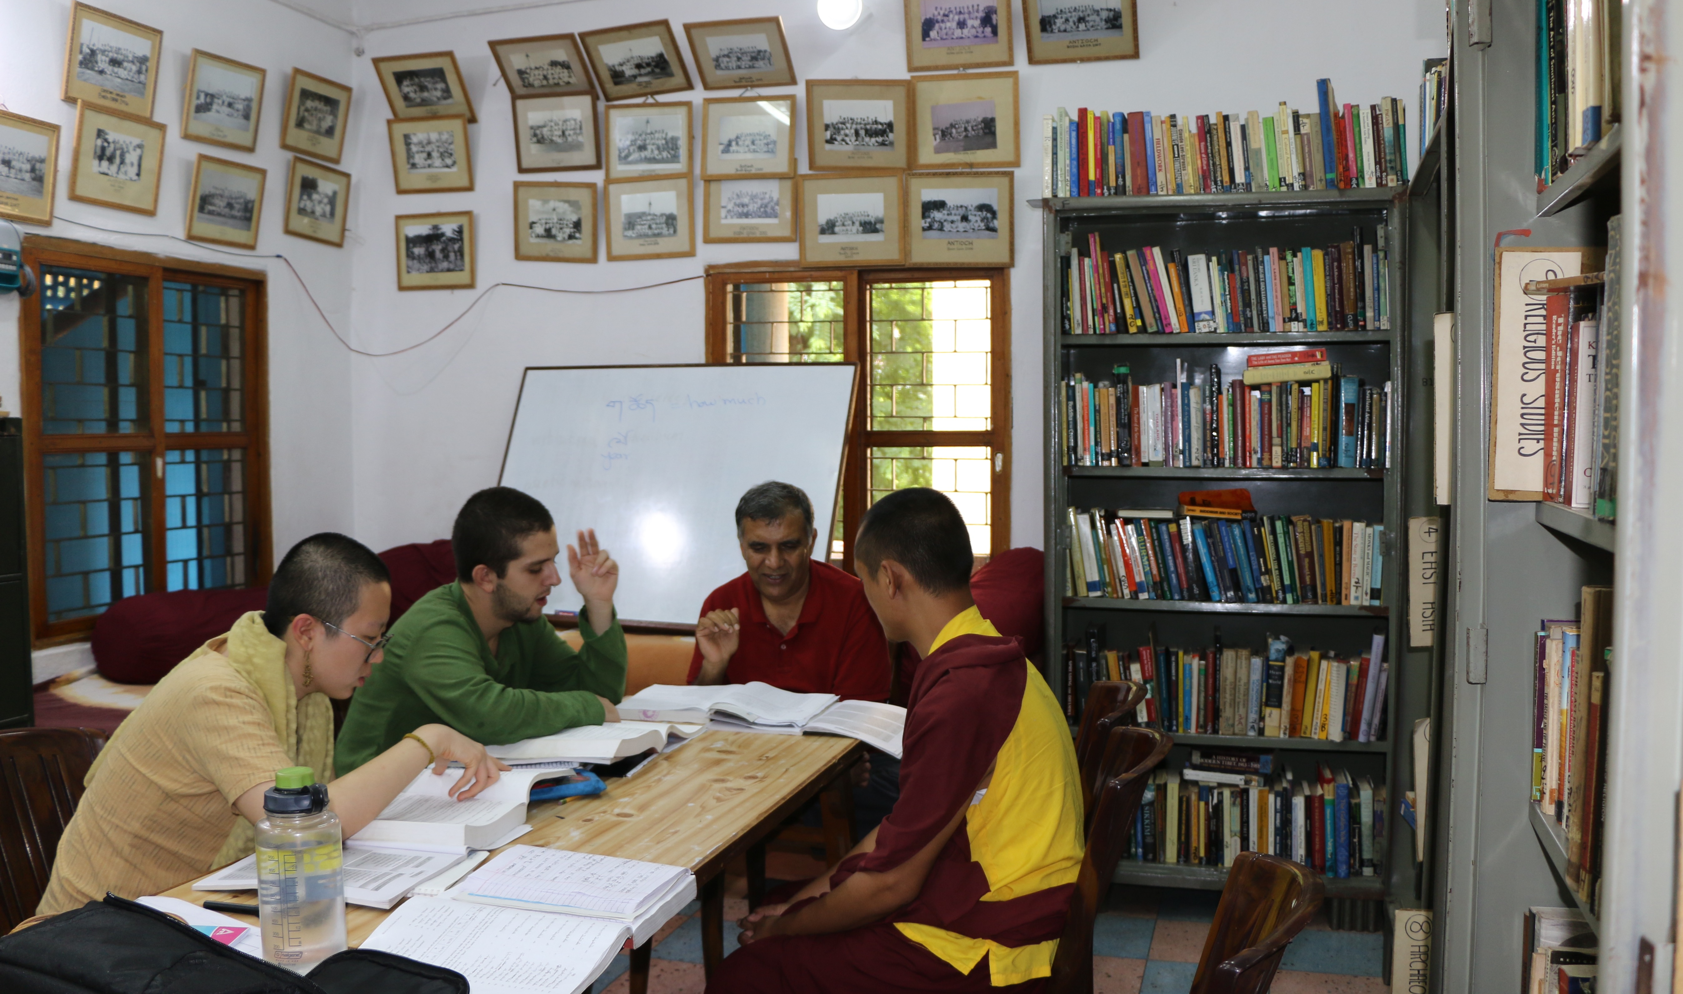

Slide 14
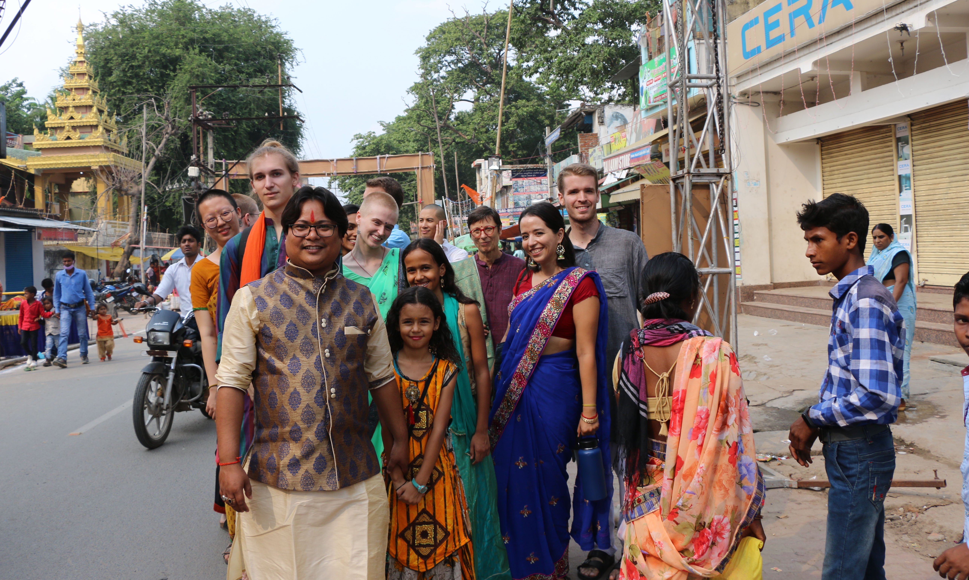

Slide 15
CARLETON GLOBAL ENGAGEMENT PROGRAMS
go.Carleton.edu/engage
507-222-4435
Carleton College
Northfield, Minnesota

