Slide 1
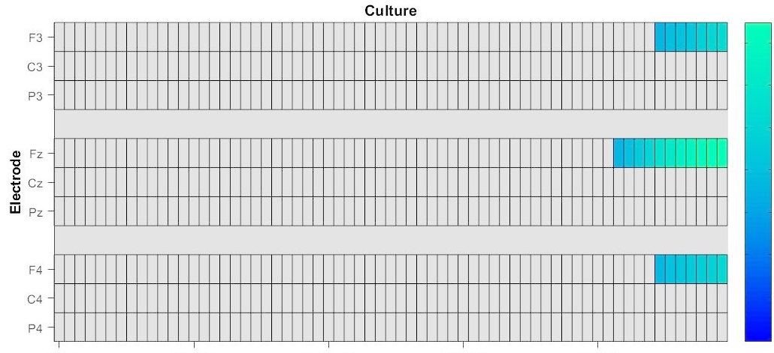
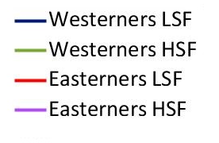
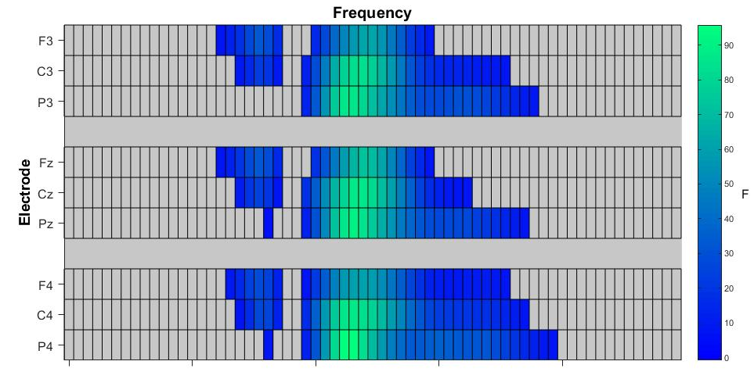
Culture and Spatial Frequency Impact
Perceptual and Attentional ERP Components
Tong Lin, Xin Zhang, Eric Fields, Robert Sekuler, & Angela Gutchess
Brandeis University, Waltham, Massachusetts
Introduction
Factorial Mass Univariate ERP
We used a mass univariate analysis that conducts statistical tests at each electrode and time point, applying multiple comparison corrections. Significant main effects of culture and spatial frequency emerged, with East Asians exhibiting a larger P3a component over frontal channels compared to Americans, and LSF evoking widespread effects between 200-300 msec compared to HSF, and indexing allocation of attention and expectations.
Results
Although cross-cultural differences in 'higher-level' processes have been repeatedly demonstrated, recent work suggests that culture also may influence 'lower-level' perceptual processes, such as sensitivity to different spatial frequencies. The holistic processes utilized by Easterners and the analytical processes utilized by Westerners may influence how Easterners and Westerners attend to their visual world.
Visual scenes can be decomposed into global and local information. East Asians have a strong global preference relative to Caucasian Westerners.
(McKone et al., 2010).
Easterners were tuned toward lower spatial frequencies than Westerners during face recognition tasks
(Tardif et al., 2017)
Main effects of Spatial Frequency and Culture
Grand averaged ERPs from 13 electrodes that showed a main effect of culture from the mass univariate analysis (Fp1, AF3, F7, F3, FC1, Fz, Cz, Fp2, AF4, F8, F4, FC6,FC2).
The topographic maps depict the distribution of voltage differences from 0 ms to 600 ms post stimulus onset.
Westerners LSF
Westerners HSF
Easterners LSF
Easterners HSF
The Effect of Culture (Eastern > Western)
Goal of Present Study
F
Americans will prioritize HSF information and East Asians will prioritize LSF information
This may be reflected in ERP components related to perception (P1, N1) and expectation (P3)
Potential (µv)
The Effect of Culture (Easterners > Westerner)
on Fz
Potential (µv)
The Effect of SF (LSF > HSF)
on Pz
0 100 200 300 400 500
Time (ms)
-2
0
2
4
6
8
Westerners LSF
Westerners HSF
Easterners LSF
Easterners HSF
-2
0
2
4
6
8
Westerners LSF
Westerners HSF
Easterners LSF
Easterners HSF
Fig. 1. ERP results using mass univariate analysis to look at nine electrodes of interest chosen based on existing literature about P3a. The raster plots presented here show a graphic representation of results, where the warmer the colors, the larger the F-value is at a given time point in the electrode. Within the 0–500 ms time window post stimulus onset, response from Easterners was more positive than response from Westerners at F3, Fz and F4 towards the end of the selected time window (∼450 ms).
Methods
Participants
24 Americans and 35 East Asians, recruited from Brandeis University.
Stimuli
Stimuli were Gabor patches of 4-degree angular size, with spatial frequencies ranging from 0.5 cycle per degree to 4 cpd.
Procedure
Participants fixated centrally, and Gabor patches (of varying spatial frequencies) were presented on either the left or right side of the screen for 100ms. To ensure participants were on task, participants were instructed to use peripheral vision to monitor onset of an intermittent red dot slightly below the fixation cross, and to press a button as soon as it appeared.
Analysis
We tested the effects of cultural background (Easterners, Westerners),spatial frequency (LSF, HSF), and lateralization (Left, Right) in a 2 x 2 x 2 ANOVA.
The Effect of Frequency (LSF > HSF )
F
-100 0 100 200 300 400 500 600 700
-100 0 100 200 300 400 500 600 700
Time (ms)
Time (ms)
Discussion
Culture influences attentional processes regarding expectation, although the differences were not found to be modulated by spatial frequency, as predicted.
The paradigm was sensitive to the effects of spatial frequency, with low spatial frequencies inducing a greater P3a than high spatial frequency over widespread channels, including Fz and Pz.
Results provide some evidence of heightened attentional processing by East Asians.
0 100 200 300 400 500
Time (ms)
Fig. 2. ERP results using mass univariate analysis to look at nine electrodes of interest using a raster plots, where the warmer the colors, the larger the F-value is at a given time point in the electrode. Within the 0–500 ms time window post stimulus onset, response to LSF was more positive than response to HSF at all the tested electrodes from ∼150 ms to ∼400 ms.
Funding
This research was made possible with support from the National Science Foundation (BCS - 1921644).

