Slide 1
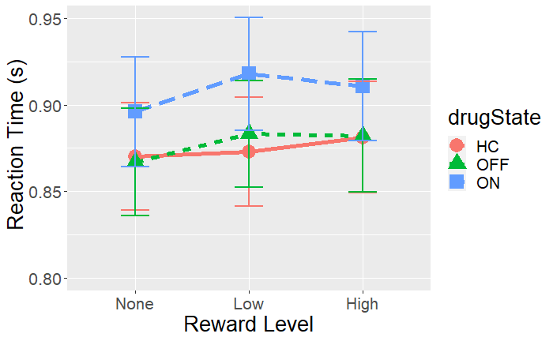
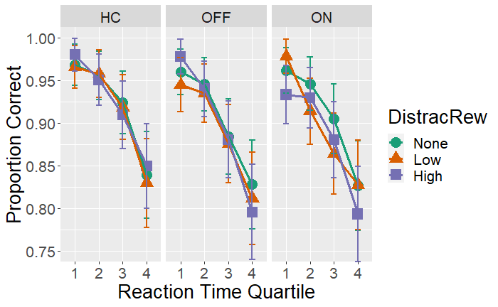
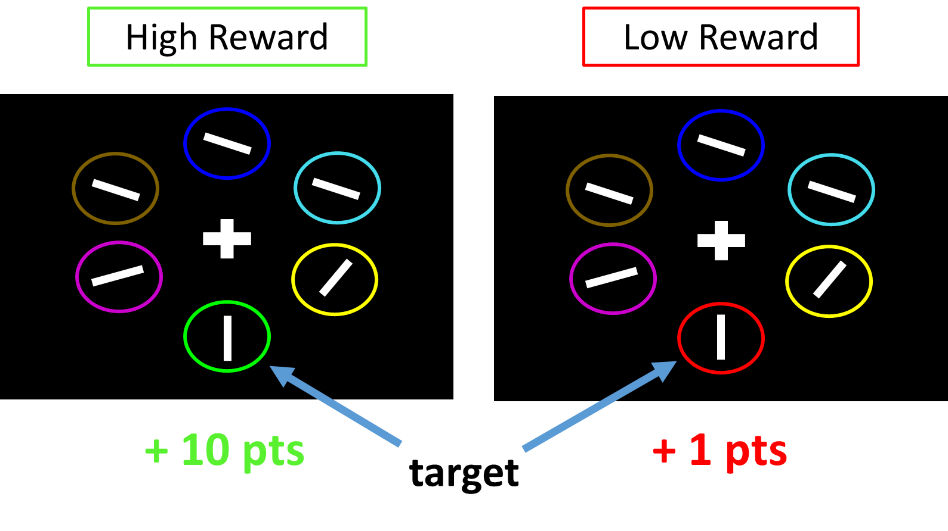
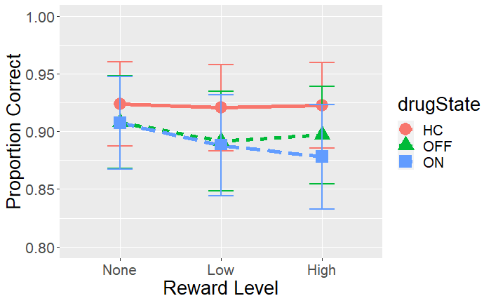
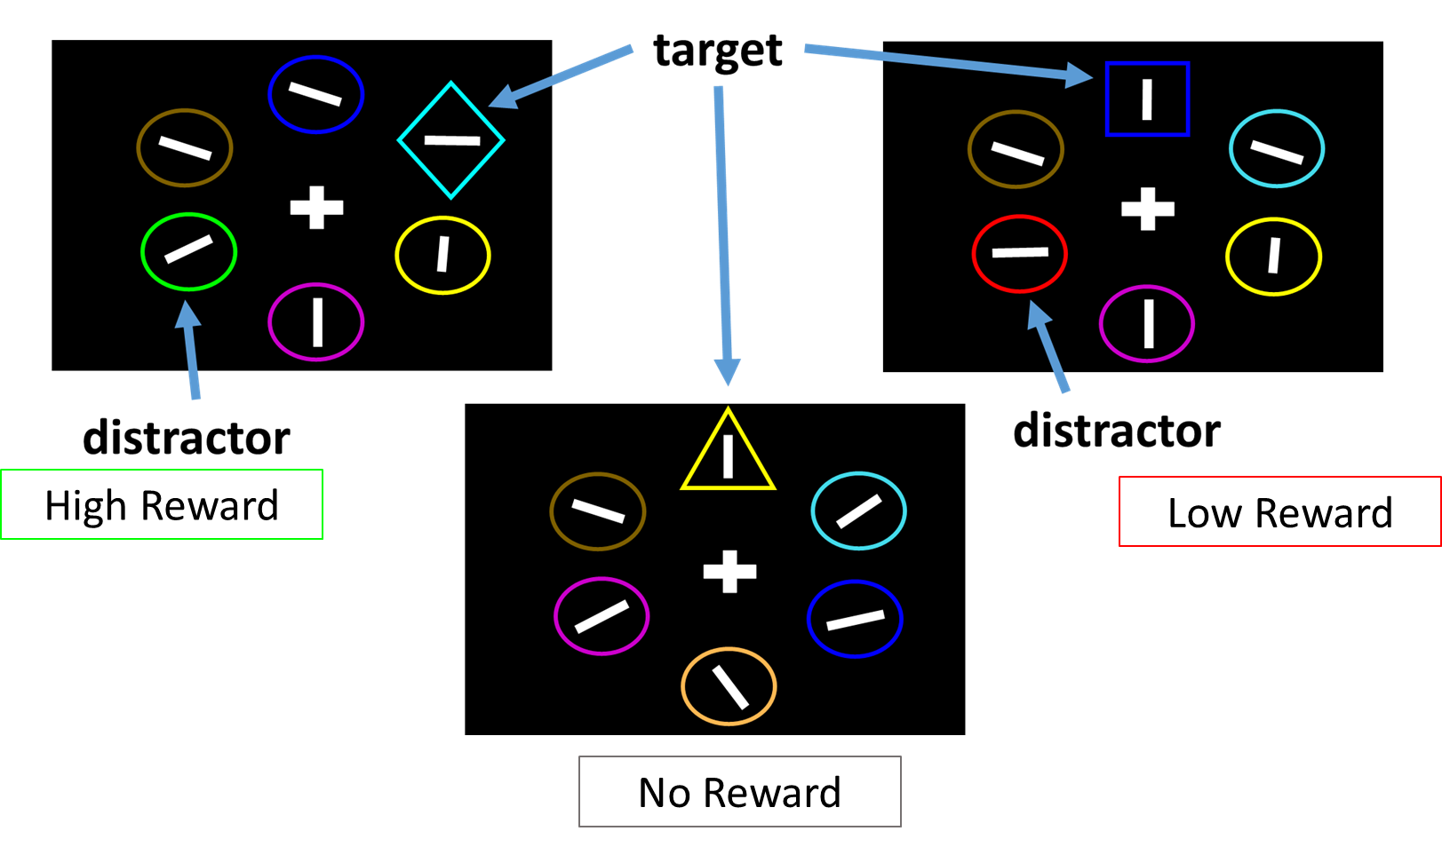
Influence of Reward on Attention Selectivity in Parkinson’s Disease
Matthew Pilgrim, Andy Ou, Madeleine Sharp
Department of Neurology and Neurosurgery, McGill University
Background
Results
Results
Executive function deficits are common in Parkinson’s disease, even early in the course of disease¹. Among these, attention impairments are common².
Dopamine-dependent reward processing is also disrupted in Parkinson’s disease³ but how this directly contributes to early executive dysfunction is unknown.
The allocation of attention resources, i.e. selective attention, is known to be guided by environmental reward signals ⁴.
Effect of reward and dopamine on attention: Reaction Time
Effect of reward and dopamine on attention: Speed-Accuracy Trade-Off
β = .004, p = .011
β = -2 .647 p < 0.001
Are Parkinson’s patients impaired at using reward information to guide the allocation of attentional resources?
Does dopamine replacement alter the allocation of attentional resources?
Reward
Methods
Slower reaction times are more accurate for Patients compared to Controls (p < 0.001)
When taking dopamine medication, faster reactions times in High reward trials are more accurate compared to the grand mean (p = 0.047)
Increased reaction time decreases accuracy (p < 0.001)
Having Parkinson’s decreases accuracy (p < 0.001)
Task: A two-phase selective attention task. Patients (n=24) tested twice: with (ON) and without (OFF) dopamine medication.
Reward Learning Phase (240 trials)
Report the orientation of a white bar in either a red or green target
Subjects are differentially rewarded for correct answers depending on the target color (1 vs. 10 points)
Participants learn to associate each color with either a low or high reward
Attention Test (240 trials)
Report the orientation of a white bar inside a target.
Target = “The Unique Shape”
On 2/3 trials either a Low or High reward distractor (i.e. a shape that is either red or green) is present. On 1/3 trials, no distractor is present.
Slowing of responses occurs when previously rewarded colors are present, and depends on reward level
Healthy controls were sensitive to reward level: they were slowed by high (p=0.049) but not by low (p=0.58) reward distractors
Parkinson’s patients were not sensitive to reward level: responses were similarly slowed for both high (p=0.016) and low (p<0.001) reward distractors
Collapsing across reward levels reveals that slowing due to the presence of a distractor was similar across groups, i.e. patients were not more ‘distractible’ than controls
Though dopamine medication caused overall response slowing, dopamine did not modulate the effect of reward on attention, nor did it modulate overall distractibility
Summary and Discussion
Parkinson’s Disease influences how reward captures attention
We found that Patients were distracted by both levels of reward while Controls were only distracted by higher levels of reward
This seemingly paradoxical result might be explained by Parkinsonian biases in reward learning: patients in a dopamine depleted state are more influences by losses than gains. Patients may have interpreted the “Low Reward” as a loss in the context of the experiment.
Dopamine medication does not affect how reward guides attention nor overall distractibility
We found that Levodopa slowed reaction times but did not interact with reward or the presence of a distractor
This finding might indicate that reward-related attention mechanisms in Parkinson’s might rely more on dopamine connections in the mesocortical pathway than the nigrostriatal pathway which is thought to be the target of dopamine medications
Effect of reward and dopamine on attention: Accuracy
β = -.071, p = .130
References:
Kalia, L. V., & Lang, A. E. (2015). Parkinson’s disease. The Lancet, 386(9996), 896–912. https://doi.org/10.1016/S0140-6736(14)61393-3
Fallon, S. J., Bor, D., Hampshire, A., Barker, R. A., & Owen, A. M. (2017). Spatial structure normalises working memory performance in Parkinson’s disease. Cortex, 96, 73–82. https://doi.org/10.1016/j.cortex.2017.08.023
Frank, M. J., Seeberger, L. C., & O’Reilly, R. C. (2004). By Carrot or by Stick: Cognitive Reinforcement Learning in Parkinsonism. Science, 306(5703), 1940–1943. https://doi.org/10.1126/science.1102941
Anderson, B. A., Laurent, P. A., & Yantis, S. (2011). Value-driven attentional capture. Proceedings of the National Academy of Sciences, 108(25), 10367–10371. https://doi.org/10.1073/pnas.1104047108
Reward does not influence accuracy in either Patients (p = 0.130) or Controls (p = 0.162)
Dopamine does not affect accuracy (p = 0.470)
Funding: Canadian Institutes of Health Research (MP), Parkinson Society Canada (MS)

