Slide 1



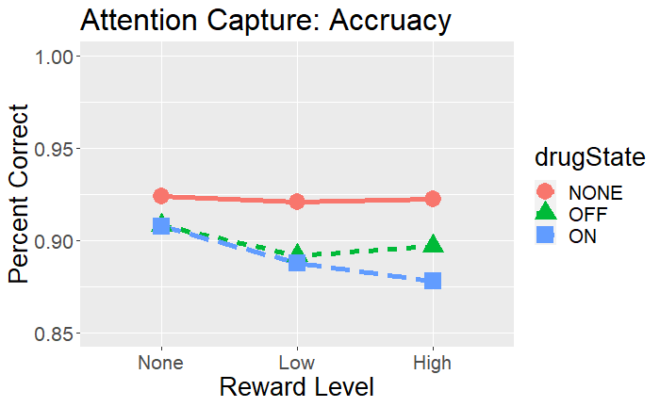
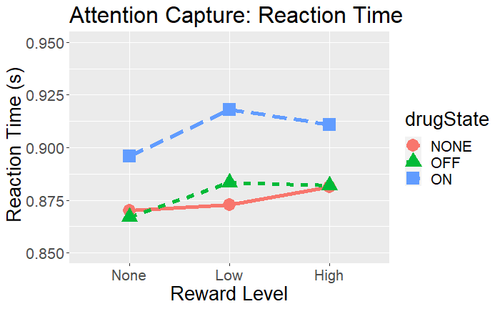
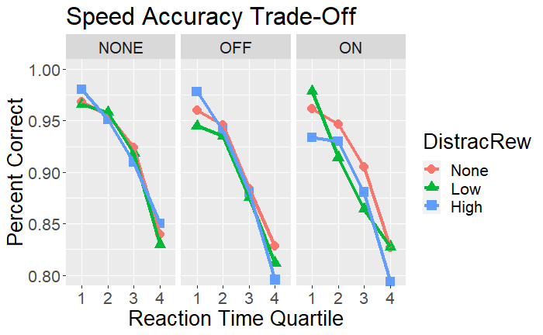
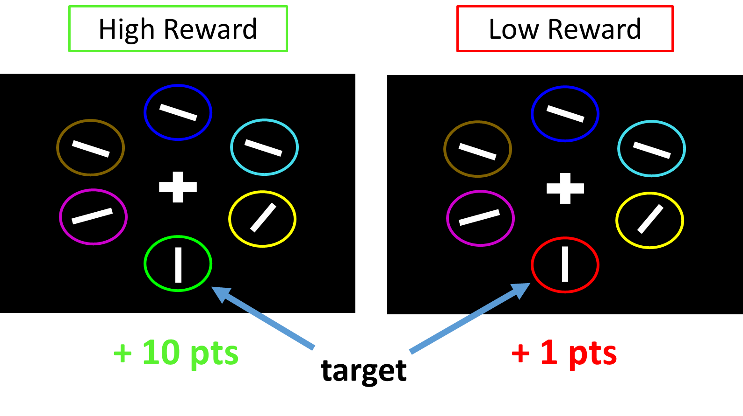
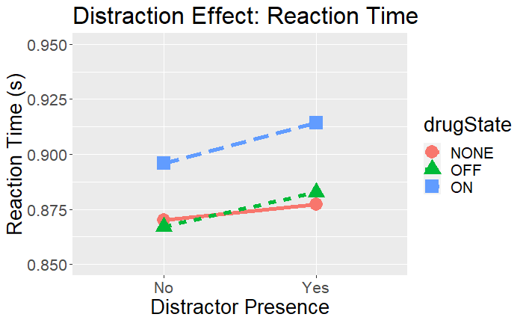
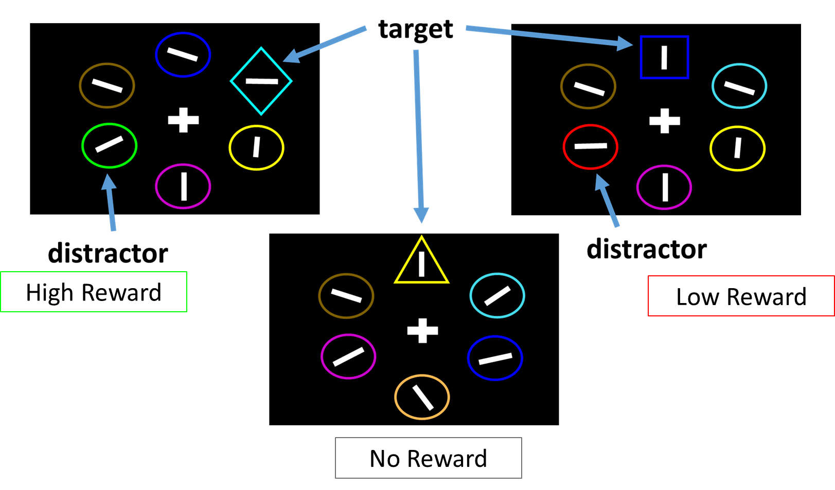
Altered Reward-Driven Attention Capture in Parkinson’s Disease Patients
Matthew Pilgrim, Andy Ou, Madeleine Sharp
Department of Neurology and Neurosurgery, McGill University
Background
Results - Primary
Results - Supplementary
Parkinson’s disease patients suffer from multiple cognitive deficits, often early in disease progression¹.
Selective attention² impairments are common among early executive deficits.
Dopamine-dependent reward signals are disrupted in Parkinson’s disease³ but how this directly contributes to early executive function deficits is unknown.
Reward has been proposed as an important environmental signal that guides the allocation of attention resources⁴.
Does Disease Status or Dopamine Medication impact initial reward learning?
Parkinson’s disease patients perform less accurately than Controls (NONE) on the learning task
There is a trend for High Reward increasing reaction time in Patients (p = 0.07) and decreasing reaction time in Controls ( p = 0.061).
There was no effect of dopamine medication on learning
No difference in accuracy between Controls and Patients
Reward does not affect accuracy in any group
Does Reward Differentially Capture Attention in Parkinson’s Disease?
Are Parkinson’s patients impaired at using reward information to guide the allocation of attentional resources?
Is this deficit dopamine-dependent? i.e. can dopamine replacement therapy rescue reward-driven attention allocation?
No Speed-Accuracy Trade-Off identified (subjects perform worse on trials they answer more slowly
Reward does not affect the relationship between speed and accuracy
Methods
Task: A two-phase attention capture task, Patients tested with (ON) and without (OFF) dopamine medication, 2-5 month delay.
Reward Learning Phase: Trials = 240
Report the orientation of a white bar in a red or green target
Only one target is present at a time
Subjects are differentially rewarded for correct answers within the time limit depending on the target color
Goal: Associate two levels of reward with two specific colors
Attention Capture Phase: Trials = 240
Report the orientation of a white bar inside a target.
Target = “The Unique Shape”
On two types of trials either a Low or High reward distractor (i.e. a shape that is either red or green) is present
Goal: Use previously reward colors as distractors to capture attention
Summary and Dicussion
Low Reward causes reaction time slowing in Patients compared to other conditions.
High Reward causes reaction time slowing in Controls compared to the neutral condition
Dopamine medication increased reaction time but had no effect on attention capture
Parkinson’s Disease influences how reward captures attention
We found that Patients were only distracted by lower levels of reward while Controls were only distracted by higher levels of reward
This seemingly paradoxical result might be explained by Parkinsonian biases in reward learning: patients in a dopamine depleted state are more influences by losses than gains. Patients may have interpreted the “Low Reward” as a loss in the context of the experiment.
Dopamine medication does not affect reward-driven attention-capture nor overall distractibility
We found that Levodopa slowed reaction times but did not interact with reward or the presence of a distractor
This finding might indicate that reward-related attention mechanisms in Parkinson’s might rely more on dopamine connections in the mesocortical pathway than the nigrostriatal pathway which is thought to be the target of dopamine medications
References:
Does Disease Status or Dopamine Medication Affect Distractibility?
Collapsing across reward levels reveals that overall patients are not more distracted by controls
Additionally, dopamine medication state does not affect distractibility
Kalia, L. V., & Lang, A. E. (2015). Parkinson’s disease. The Lancet, 386(9996), 896–912. https://doi.org/10.1016/S0140-6736(14)61393-3
Fallon, S. J., Bor, D., Hampshire, A., Barker, R. A., & Owen, A. M. (2017). Spatial structure normalises working memory performance in Parkinson’s disease. Cortex, 96, 73–82. https://doi.org/10.1016/j.cortex.2017.08.023
Frank, M. J., Seeberger, L. C., & O’Reilly, R. C. (2004). By Carrot or by Stick: Cognitive Reinforcement Learning in Parkinsonism. Science, 306(5703), 1940–1943. https://doi.org/10.1126/science.1102941
Anderson, B. A., Laurent, P. A., & Yantis, S. (2011). Value-driven attentional capture. Proceedings of the National Academy of Sciences, 108(25), 10367–10371. https://doi.org/10.1073/pnas.1104047108

Slide 2
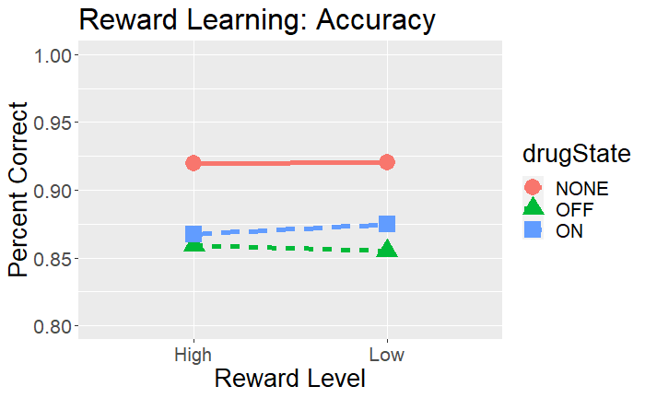
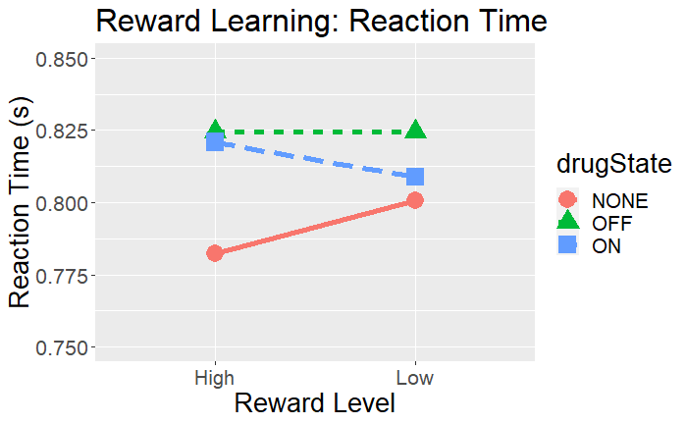
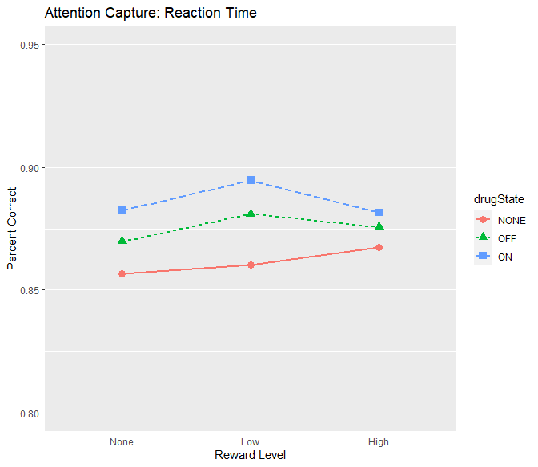
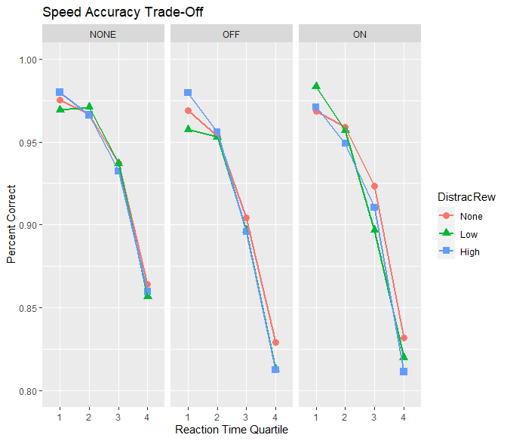
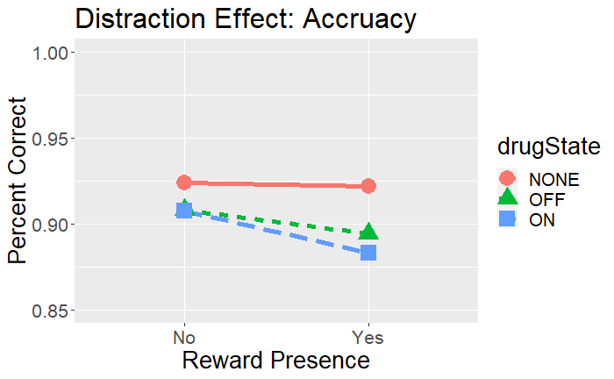
Altered Reward-Driven Attention Capture in Parkinson’s Disease Patients
Matthew Pilgrim, Andy Ou, Madeleine Sharp
Department of Neurology and Neurosurgery, McGill University
Background
Results – Reward Learning Phase
Background
Parkinson’s disease patients suffer from multiple cognitive deficits, often early in disease progression¹.
Selective attention² impairments are common among early executive deficits.
Dopamine-dependent reward signals are disrupted in Parkinson’s disease³ but how this directly contributes to early executive function deficits is unknown.
Reward has been proposed as an important environmental signal that guides the allocation of attention resources⁴.
Does Disease Status or Dopamine Medication impact initial reward learning?
Are Parkinson’s patients impaired at using reward information to guide the allocation of attentional resources?
Is this deficit dopamine-dependent? i.e. can dopamine replacement therapy rescue reward-driven attention allocation?
Parkinson’s disease patients perform less accurately than Controls (NONE) on the learning task
There is a trend for High Reward increasing reaction time in Patients (p = 0.07) and decreasing reaction time in Controls ( p = 0.061).
There was no effect of dopamine medication on learning
Figure 3. Accuracy in the Attention Capture Phase. Data is displayed for Controls as well Patients in both medication states (ON and OFF).
LME Results:
Patients and Older controls differentially affected by Reward Level in terms of Reaction Time:
  Having the disease positively interacts with Low Reward (OR = 1.002, p < 0.01)
  Having the disease negatively interacts with High Reward (OR = 0.99, p < 0.05)
In Patients: Low Reward increases reaction time compared to the grand condition mean (OR = 1.004, p <0.001)
In Patients: Dopamine medication does not affect Reaction Time (OR = 1.001, p = 0.327)
Methods
Results – Attention Capture Phase
Task: A two-phase attention capture task, Patients tested with (ON) and without (OFF) dopamine medication, 2-5 month delay.
Reward Learning Phase: Trials = 240
Report the orientation of a white bar in a red or green target
Only one target is present at a time
Subjects are differentially rewarded for correct answers within the time limit depending on the target color
Goal: Associate two levels of reward with two specific colors
Attention Capture Phase: Trials = 240
Report the orientation of a white bar inside a target.
Target = “The Unique Shape”
On two types of trials either a Low or High reward distractor (i.e. a shape that is either red or green) is present
Goal: Use previously reward colors as distractors to capture attention
Does Reward Differentially Capture Attention in Parkinson’s Disease?
Figure 4. Reaction Time in the Attention Capture Phase. Data is displayed for Controls as well Patients in both medication states (ON and OFF).
LME Results:
Slower Reaction Times decrease the likelihood of correct responses (OR = 0.001, p < 0.0001) indicating that there is no “Trade Off” between speed and accuracy but rather that subjects are simply more faster on trials they are more accurate.
Low Reward causes reaction time slowing in Patients compared to other conditions.
High Reward causes reaction time slowing in Controls compared to the neutral condition
Dopamine medication increased reaction time but had no effect on attention capture
Figure 5. Speed-Accuracy Trade-Off in the Attention Capture Task. Data is displayed for Controls as well Patients in both medication states (ON and OFF).
Does Disease Status or Dopamine Medication Affect Distractibility?
Discussion
Attention is capture differently by rewarding information in Parkinson’s disease patients compared to Older Controls.
  In Patients, low reward distractors (which might have been learned as losses ) capture attention
  In Controls, high reward distractors capture attention
This effect is not dopamine dependent as there were no differences between ON and OFF states
References
Kalia, L. V., & Lang, A. E. (2015). Parkinson’s disease. The Lancet, 386(9996), 896–912. https://doi.org/10.1016/S0140-6736(14)61393-3
Fallon, S. J., Bor, D., Hampshire, A., Barker, R. A., & Owen, A. M. (2017). Spatial structure normalises working memory performance in Parkinson’s disease. Cortex, 96, 73–82. https://doi.org/10.1016/j.cortex.2017.08.023
Frank, M. J., Seeberger, L. C., & O’Reilly, R. C. (2004). By Carrot or by Stick: Cognitive Reinforcement Learning in Parkinsonism. Science, 306(5703), 1940–1943. https://doi.org/10.1126/science.1102941
Anderson, B. A., Laurent, P. A., & Yantis, S. (2011). Value-driven attentional capture. Proceedings of the National Academy of Sciences, 108(25), 10367–10371. https://doi.org/10.1073/pnas.1104047108

Slide 3
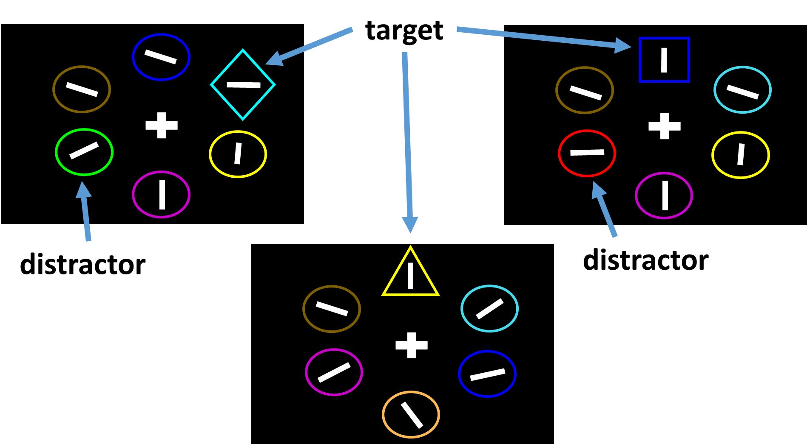
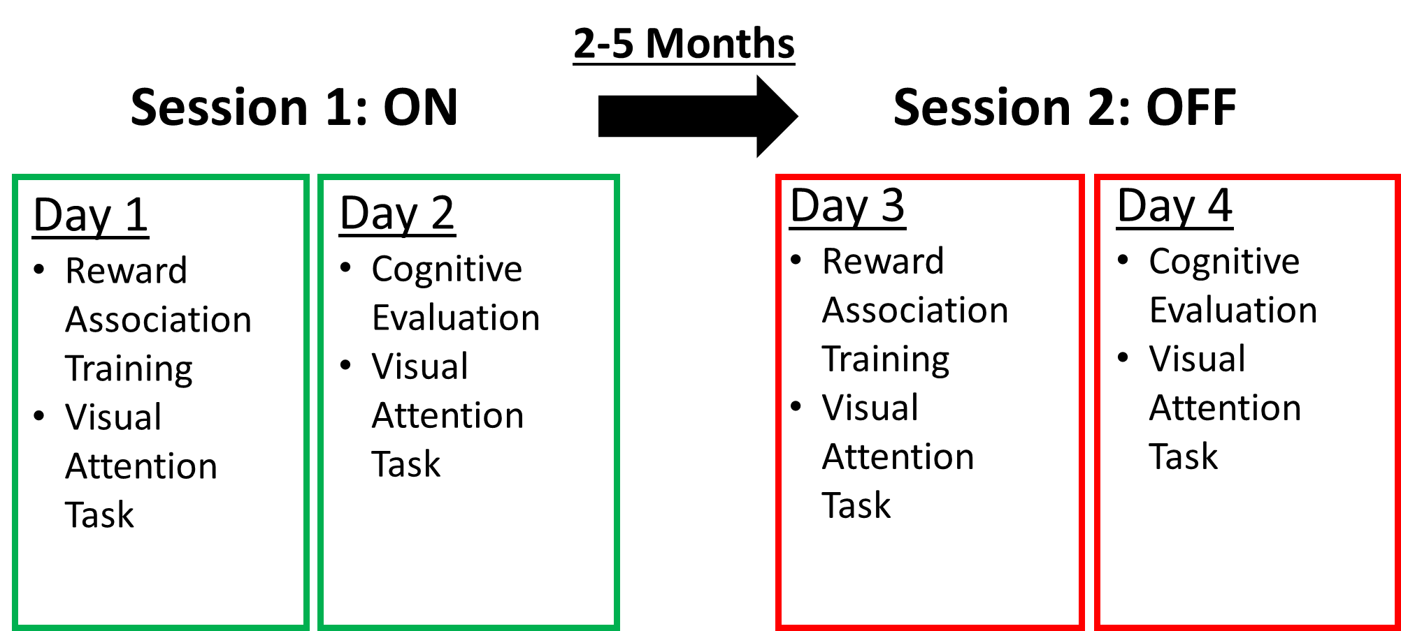
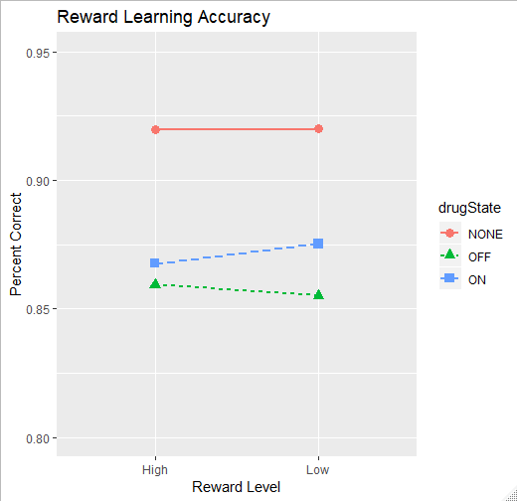
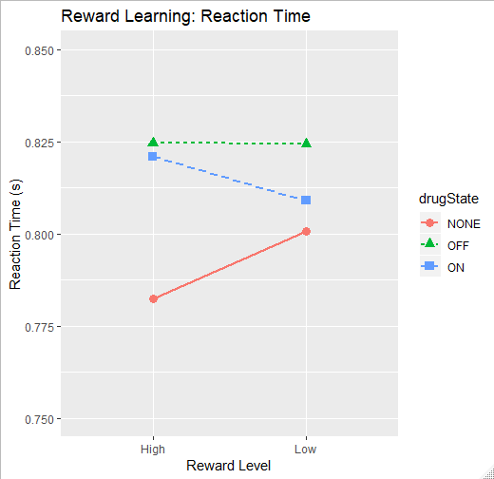
Altered Reward-Driven Attention Capture in Parkinson’s Disease Patients
Matthew Pilgrim, Andy Ou, Madeleine Sharp
Department of Neurology and Neurosurgery, McGill University
Background
Methods
Results
Parkinson’s disease patients suffer from multiple cognitive deficits with between 20-60% of patients showing symptoms as early as 2.5 years after diagnosis¹.
Selective attention² impairments are common among early executive deficits.
It is well established that dopamine-dependent reward signals are disrupted in Parkinson’s disease³ but how this directly contributes to early executive function deficits is unknown.
Meanwhile, reward has been proposed as an important environmental signal that guides the allocation of attention resources⁴.
Attention Capture Phase: Trials = 240
Does Reward Differentially Capture Attention in Parkinson’s Disease?
LME Results:
Having Parkinson’s disease trends to decreases the likelihood of correct responses (OR = 0.837, p = 0.071)
In Patients: Low Reward trends to decrease the likelihood of correct responses (OR = 0.933, p = 0.061) compared to the grand condition mean
In Patients: Dopamine medication does not affect accuracy (OR = 1.016, p = 0.702 )
High Reward
Low Reward
Questions
Are Parkinson’s patients impaired at using reward information to guide the allocation of attentional resources?
Is this deficit dopamine-dependent? i.e. can dopamine replacement therapy rescue reward-driven attention allocation?
No Reward
Figure 3. Accuracy in the Attention Capture Phase. Data is displayed for Controls as well Patients in both medication states (ON and OFF).
Study design: (Counterbalanced)
LME Results:
Patients and Older controls differentially affected by Reward Level in terms of Reaction Time:
  Having the disease positively interacts with Low Reward (OR = 1.002, p < 0.01)
  Having the disease negatively interacts with High Reward (OR = 0.99, p < 0.05)
In Patients: Low Reward increases reaction time compared to the grand condition mean (OR = 1.004, p <0.001)
In Patients: Dopamine medication does not affect Reaction Time (OR = 1.001, p = 0.327)
Methods
Subjects
Healthy Older Controls: N = 28
  45 – 75 years old
  No current psychiatric or neurological condition
Parkinson’s Disease Patients: N = 24 *Recruitment ongoing
  Same criteria as Healthy Controls
  Current Levodopa medication prescription
  No hallucination symptoms present
  Comfortable coming off of their medication
Results
Does disease or drug state impact initial reward learning?
LME Results:
Having Parkinson’s disease decreases the likelihood of correct responses in the learning task (OR = 0.705, p < 0.001)
In Patients: Dopamine medication (OR = 1.06, p = 0.527 ) nor reward level ( OR = 1.04, p = 0.320) affect accuracy in the learning task
Figure 4. Reaction Time in the Attention Capture Phase. Data is displayed for Controls as well Patients in both medication states (ON and OFF).
Task: A two-phase attentional capture task previously used in young healthy controls to show that reward guides attention
Reward Learning Phase: Trials = 240
Subjects report the orientation, either horizontal or vertical, of a white bar contained within either the red or green target
Only one target is present at a time
Subjects are differentially rewarded for making the correct answer within the time limit depending on the target color
Goal: Associate to levels of reward with two specific colors
LME Results:
Slower Reaction Times decrease the likelihood of correct responses (OR = 0.001, p < 0.0001) indicating that there is no “Trade Off” between speed and accuracy but rather that subjects are simply more faster on trials they are more accurate.
Figure 1. Accuracy in the Reward Learning Phase. Data is displayed for Controls as well Patients in both medication states (ON and OFF).
Figure 5. Speed-Accuracy Trade-Off in the Attention Capture Task. Data is displayed for Controls as well Patients in both medication states (ON and OFF).
LME Results:
Having Parkinson’s disease trends towards increasing reaction time in the learning task (OR = 1.018, p = 0.099)
Having Parkinson’s disease and Reward level trend to interact to increase reaction time (OR = 1.01, p = 0.098)
In Patients: Dopamine medication (OR = 0.99, p = 0.541 ) does not affect reaction time
In Patients: Reward level trends to increase reaction time (OR = 1.004, p = 0.0695
Discussion
Attention is capture differently by rewarding information in Parkinson’s disease patients compared to Older Controls.
  In Patients, low reward distractors (which might have been learned as losses ) capture attention
  In Controls, high reward distractors capture attention
This effect is not dopamine dependent as there were no differences between ON and OFF states
Attention Capture Phase: Trials = 240
Subjects once again are asked to report the orientation of a white bar inside a target.
The target shape is defined as the unique shape displayed
Subjects are told that color is no longer important for the task
On two types of trials either a Low or High reward distractor (i.e. a shape that is either red or green) is present
Goal: Use previously reward colors as distractors to capture attention
References
Kalia, L. V., & Lang, A. E. (2015). Parkinson’s disease. The Lancet, 386(9996), 896–912. https://doi.org/10.1016/S0140-6736(14)61393-3
Fallon, S. J., Bor, D., Hampshire, A., Barker, R. A., & Owen, A. M. (2017). Spatial structure normalises working memory performance in Parkinson’s disease. Cortex, 96, 73–82. https://doi.org/10.1016/j.cortex.2017.08.023
Frank, M. J., Seeberger, L. C., & O’Reilly, R. C. (2004). By Carrot or by Stick: Cognitive Reinforcement Learning in Parkinsonism. Science, 306(5703), 1940–1943. https://doi.org/10.1126/science.1102941
Anderson, B. A., Laurent, P. A., & Yantis, S. (2011). Value-driven attentional capture. Proceedings of the National Academy of Sciences, 108(25), 10367–10371. https://doi.org/10.1073/pnas.1104047108
Figure 4. Reaction Time in the Reward Learning Phase. Data is displayed for Controls as well Patients in both medication states (ON and OFF).

