Slide 1


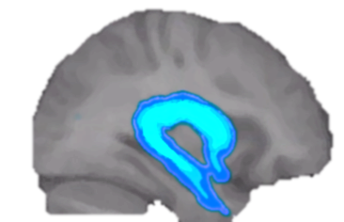
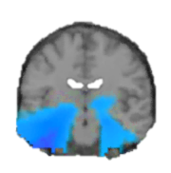
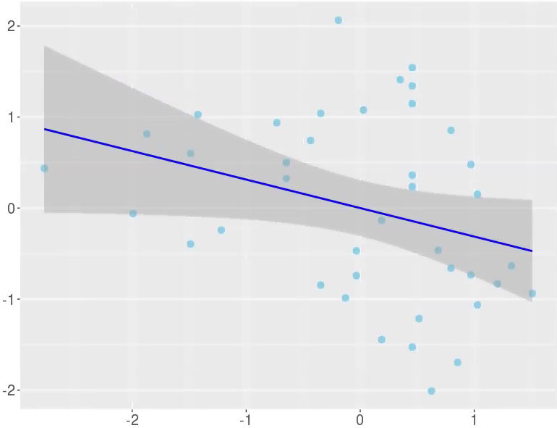
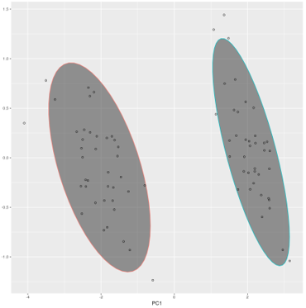
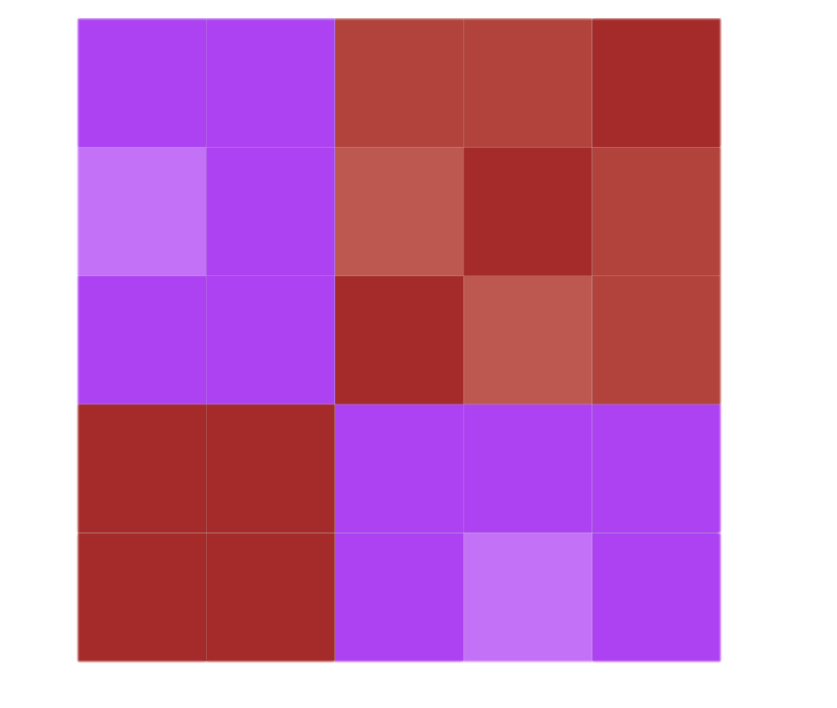

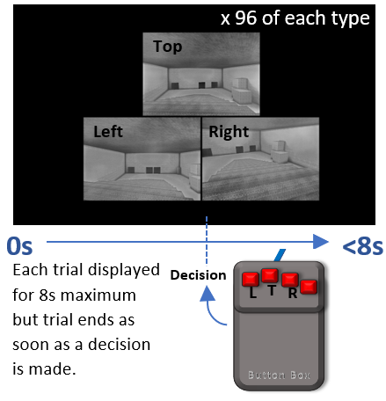
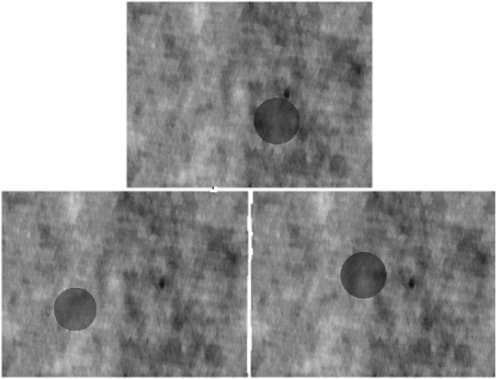
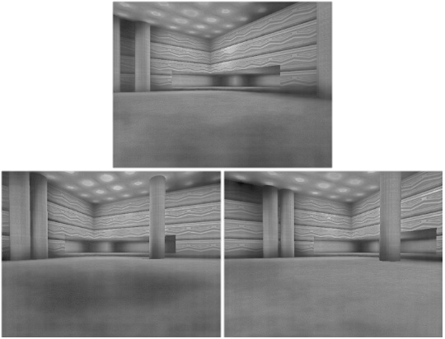
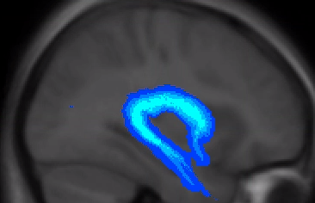
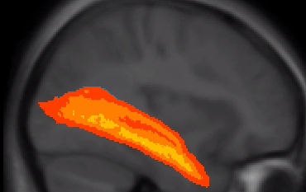
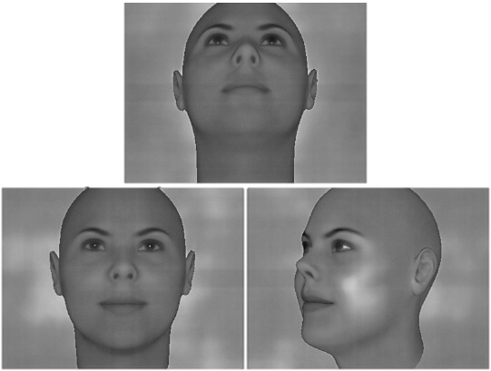
Applying microstructural models to understand the role of the fornix white matter in online scene processing
Marie-Lucie Read, Andrew Lawrence, Krish Singh, John Evans, Kim Graham, Katja Umla-Runge
BACKGROUND
Aims
Contact: readms2@cardiff.ac.uk
The Evolutionary Accretion Model[1] proposes two overlapping networks which extend from the Medial Temporal Lobe (MTL) and aid perception and memory of two different modalities:
The Extended hippocampal navigation system creates internal models for spatiotemporal associations. The fornix connects the hippocampus with network areas including the prefrontal cortex and thalamus[1].
The Feature System creates internal models for meaning. The Inferior Longitudinal Fasciculus (ILF) connects the perirhinal cortex with network areas including temporal and occipital poles[1].
Previous Diffusion Tensor Imaging (DTI) work: fornix and ILF Mean Diffusivity (MD) and Fractional Anisotropy (FA) were associated with scene and face perceptual task performance, respectively[2]. However, DTI measures are nonspecific: e.g. FA can be influenced by axon density, myelination and fibre crossing[3]. We aimed to reassess these relations while including more biologically meaningful microstructure models.
Fornix connection supports hippocampal theta rhythm[4], and theta power in the MTL is associated with hippocampal functions[5]. We explored whether the relationship between fornix microstructure and scene processing was mediated by MTL theta.
    Extended Hippocampal Navigation System
Fornix microstructure and MTL theta power independently relate to scene task performance
    Reduce microstructure measures into biologically
    informative components.
    Investigate the importance of fornix microstructure in
    scene processing to contrast this with relationships
    between ILF microstructure and face perception.
    Explore whether the relationship between fornix microstructure and scene accuracy is mediated by MTL theta.
⚫Angular Gyrus
⚫ Posterior cingulate cortex
⚫ Medial prefrontal cortex
⚫ Retrosplenial Cortex
⚫ Thalamus, mamillary bodies
⚫ Hippocampus
⚫ Parahippocampus
⚋ Fornix
Significant MTL theta decrease in scene task
versus the control task,
and negative relationship between scene task theta
and scene accuracy, support the involvement of MTL areas in online scene processing.
Scene Task MTL Theta
Networks based upon ideas of [1;6] and images adapted from a Natbrainlab brain atlas image [7]
Hypothesis: The Extended Hippocampal navigation system is involved in online scene processing. Fornix microstructure should relate to scene task performance.
Significant decrease in MTL theta power during scene task trials compared with control task trials.
alpha = 0.0125 corrected for 2 tails. Cluster alpha = 0.01. 5000 permutations.
r = -0.31
p = 0.049
Scene Accuracy
Results
Microstructure measures were reduced to a single component, capturing a restrictedness-related property
Average MTL theta during fist 2s of scene trials negatively relates to scene accuracy
MTL scene task theta power does not mediate the relationship between fornix PC1 and scene accuracy.
Five microstructure measures:
FA and MD – Influenced by axon density, myelin, fibre crossing.
Radial Diffusivity (RD) – sensitive to myelin permeability.
Molecular Volume Fraction (MVF) – indicates myelin proportion.
Restricted Fraction (FR) – indicates axon density.
MTL Theta power during scene trials
Alpha = 0.05
5000 permutations
A =0.04
p=0.82
B= -0.33
p=0.033
MVF
FR
FR
Equivalent tests predicting face accuracy were not significant.
Fornix PC1
C = 0.31
p=0.049
Scene accuracy
RD
FA
PC2 →
C’ = 0.32
p=0.034
MVF
PCA Data Reduction
MD
Conclusions
Methods
RD
Fornix
ILF
The results are consistent with the Evolutionary Accretion Model.
The fornix connects the hippocampus to other areas of the Extended Hippocampal Navigation System and the ILF connects areas of the Feature System.
Fornix microstructure relates to online scene processing whereas the ILF microstructure relates to online face processing.
Microstructure properties are important for healthy network functioning.
Through PCA, measures sensitive to axon density and myelin proportion, along with non-specific DTI measures, contributed to a major component which appears to represent tract restrictedness. This property of the tracts related to behaviour performance, indicating its importance in network functioning.
MTL theta did not mediate the relationship between fornix microstructure and scene performance.
Although the fornix is known to be important for MTL theta, the restrictedness property of the fornix did not relate to MTL theta during the scene task.
What’s next?
FA and MD are also influenced by fibre organisation. We plan to add complexity measures (e.g. Orientation Dispersion) to the analysis to understand how tract organisation affects network functioning.
Other correlates of neural activity may relate fornix microstructure to behaviour (e.g. theta-gamma coupling). We plan to examine other frequency bands and cross-frequency coupling.
Oddity Perceptual Tasks
MD
FA
40 healthy participants undertook a ‘pick the odd-one-out’ oddity task during MEG. 39 underwent structural MRI.
MD
RD
MVF
FA
FR
PC1 (restriction) →
Correlation matrix of fornix and ILF microstructure measures shows two clusters suggesting that the microstructure data can be reduced using PCA.
PC1, explains 93% of the variance and is mostly contributed to by MVF, FR, MD and RD. It may represent fibre restriction.
Triplet images of 3 conditions. 3 scenes and faces shown at 3 different angles, one odd. These tasks incite internal model construction.
Control task had 3 circles, one differing in size.
(* indicates the odd-one-out)
Fornix microstructure relates to online scene task accuracy
*
*
Fornix PC1 correlates with scene accuracy and not face accuracy. ILF PC1 correlates with face accuracy and not scene accuracy. Neither correlated with control task accuracy.
The results indicate:
The specific role of the fornix and, therefore, the Extended Hippocampal Navigation Network in online scene processing.
The importance of axon density and myelin proportion in healthy human network functioning.
Fornix
Control trial example
Examining Microstructure of the Fornix and ILF
Multi-shell diffusion-weighted imaging sequence analysed using CHARMED (composite hindered and restricted model of diffusion) to give Restricted Fraction values[11]. qMT (quantitative magnetisation transfer)[12] imaging used to give Molecular Volume Fraction values.
Whole brain deterministic constrained spherical deconvolution tractography[13] used to create streamlines representing tracts.
Fornix and ILF streamlines isolated using Boolean gates[14].and average microstructure values extracted.
Correlation statistics, Principal Components Analysis (PCA) and image generation, with Rstudio and packages ggplot2 and psych.
r = 0.32
p = 0.0248
Scene accuracy
Fornix PC1
ns
ns
ILF PC1
r = 0.37
p = 0.0102
Face accuracy
References
References
Murray, E. A., Wise, S. P., & Graham, K. S. (2017). The evolution of memory systems: Ancestors, anatomy, and adaptations. Oxford, UK: Oxford University Press.
Hodgetts, C. J., M. Postans, J. P. Shine, D. K. Jones, A. D. Lawrence, and K. S. Graham, 2015, Dissociable roles of the inferior longitudinal fasciculus and fornix in face and place perception: Elife, v. 4.
Beaulieu, C., 2002, The basis of anisotropic water diffusion in the nervous system - a technical review: NMR Biomed, v. 15, p. 435-55.
Zimmerman, G. A., S. E. Fox, L. A. Freed, and D. L. Dow-Edwards, 1992, Hippocampal laminar glucose utilization and theta rhythm following unilateral fimbria-fornix lesions in rats: Brain Res, v. 584, p. 117-22.
Pu, Y., B. R. Cornwell, D. Cheyne, and B. W. Johnson, 2017, The functional role of human right hippocampal/parahippocampal theta rhythm in environmental encoding during virtual spatial navigation: Hum Brain Mapp, v. 38, p. 1347-1361.
Ranganath, C., and M. Ritchey, 2012, Two cortical systems for memory-guided behaviour: Nat Rev Neurosci, v. 13, p. 713-26.
Natbrainlab Atlas Maps. https://www.natbrainlab.co.uk/atlas-maps. Catani, M. & Thiebaut de Schotten, M. (2008) A diffusion tensor atlas for virtual in vivo dissections. Cortex 44(8):1105-1132.
Ion Storm, 2000, Deus Ex, Unreal Engine (add-on Software Development Kit).
Lee, A. C., K. H. Brodersen, and S. R. Rudebeck, 2013, Disentangling spatial perception and spatial memory in the hippocampus: a univariate and multivariate pattern analysis fMRI study: J Cogn Neurosci, v. 25, p. 534-46.
FaceGen. Singular Inversions, Toronto
Assaf, Y., and P. J. Basser, 2005, Composite hindered and restricted model of diffusion (CHARMED) MR imaging of the human brain: Neuroimage, v. 27, p. 48-58.
Cercignani, M., and D. C. Alexander, 2006, Optimal acquisition schemes for in vivo quantitative magnetization transfer MRI: Magn Reson Med, v. 56, p. 803-10.
Dell'acqua F, Scifo P, Rizzo G, Catani M, Simmons A, Scotti G, Fazio F. (2010). A modified damped Richardson-Lucy algorithm to reduce isotropic background effects in spherical deconvolution. NeuroImage. 49 (2), 1446-58.
Leemans A, Jeurissen B, Sijbers J, Jones DK. “ExploreDTI: A graphical toolbox for processing, analyzing, and visualizing diffusion MR data.
Oostenveld, R., P. Fries, E. Maris, and J. M. Schoffelen, 2011, FieldTrip: Open source software for advanced analysis of MEG, EEG, and invasive electrophysiological data: Comput Intell Neurosci, v. 2011, p. 156869.
Frequency Power Analysis
ILF
Analysis carried out in Fieldtrip[15] for MATLAB.
Source localisation of stimulus-induced theta (4-8Hz) performed using LCMV (Linearly-Constrained Minimum Variance) beamformer, common filters across conditions. Cluster-based permutation test for condition comparison.
First 2 seconds of trials analysed and compared across conditions.
Average theta power within bilateral MTL areas calculated for each participant.
*
SEED AND NOT
Example tract images generated using Natbrainlab maps [7]. Example gates superimposed.
One-way Pearson’s correlations with alpha level 0.025 (0.05/2 tracts)
Scenes made with [8] adapted from [9]. Faces made with [10].

