Slide 1
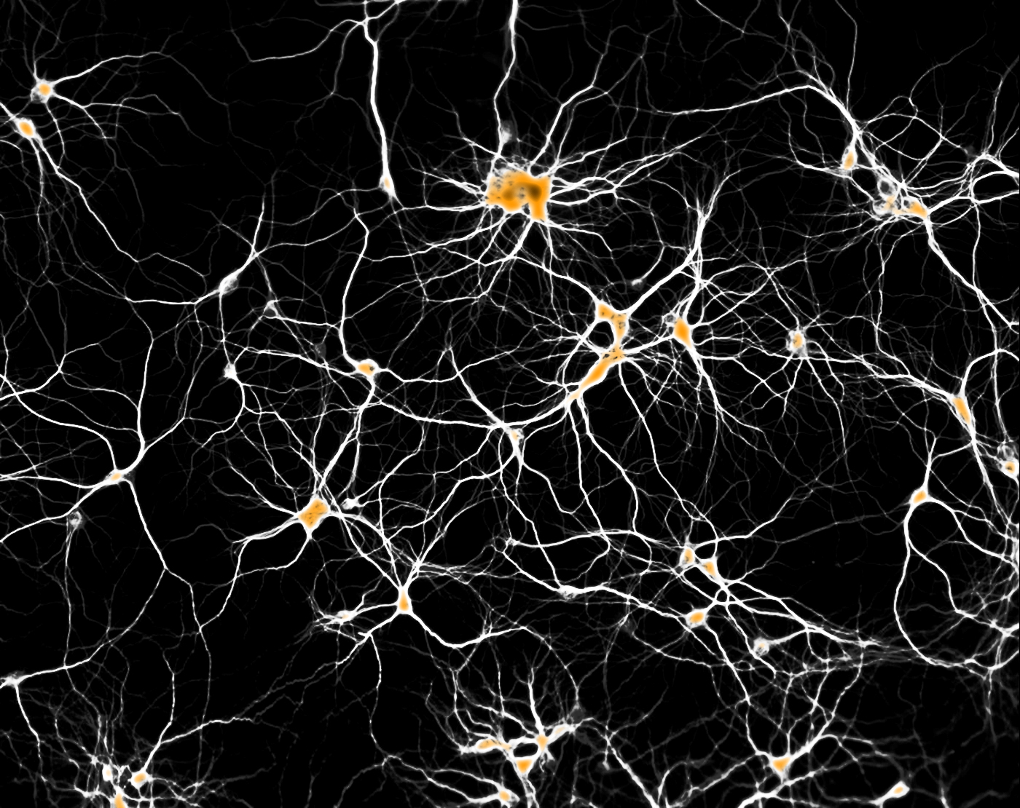
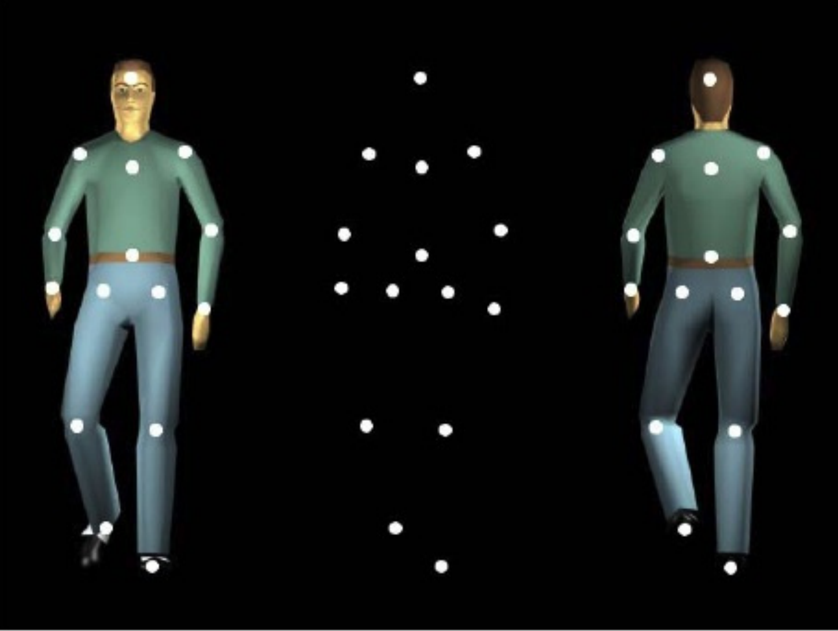
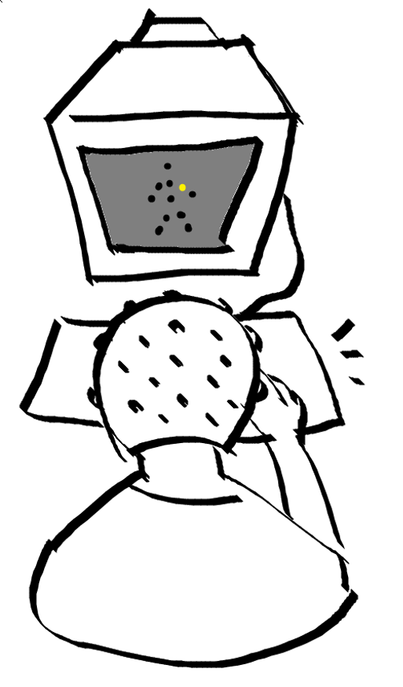
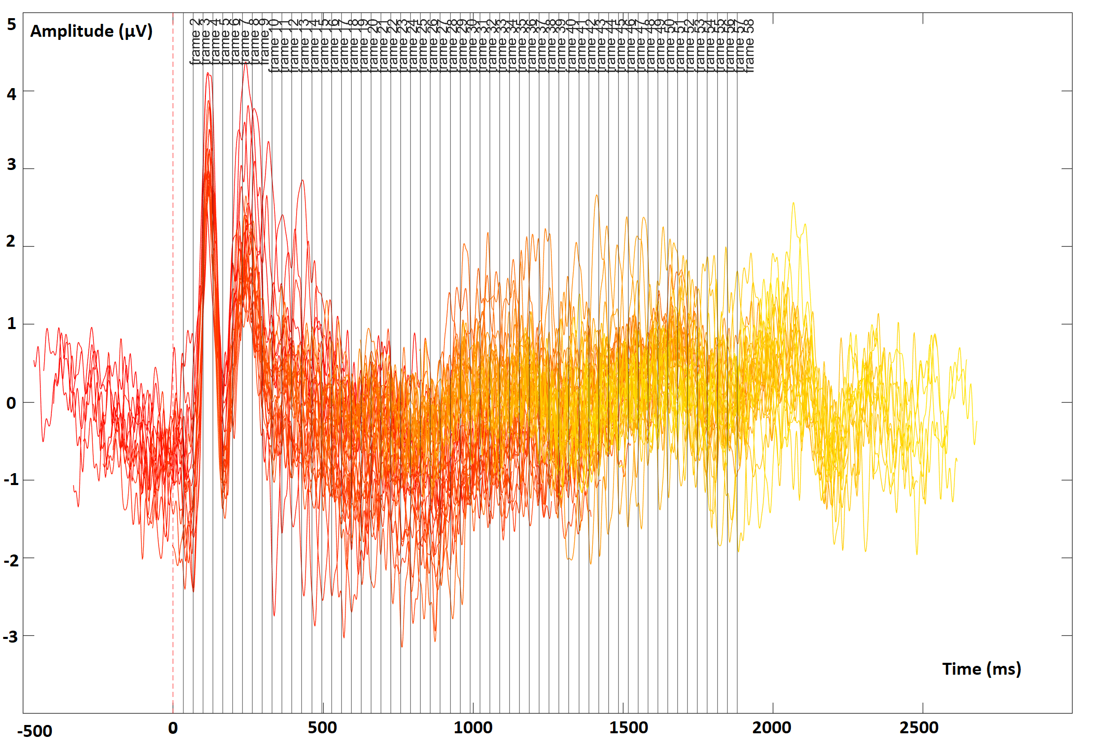
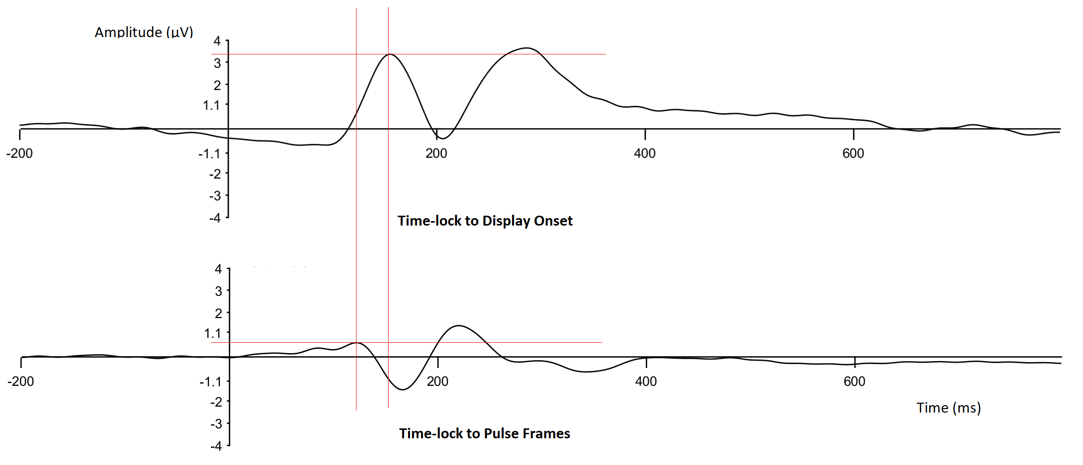
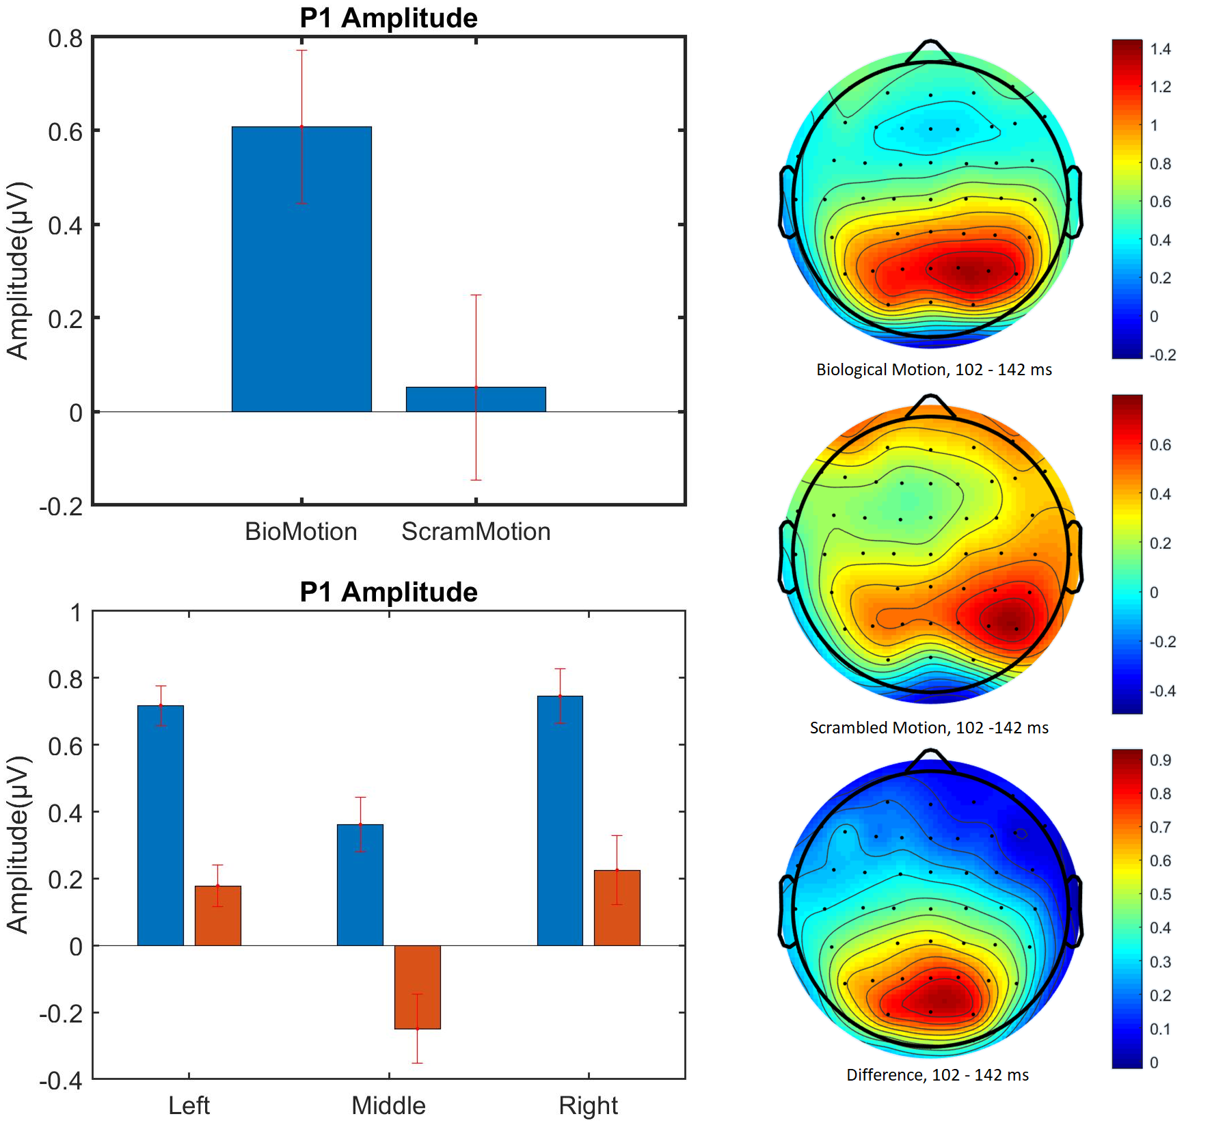
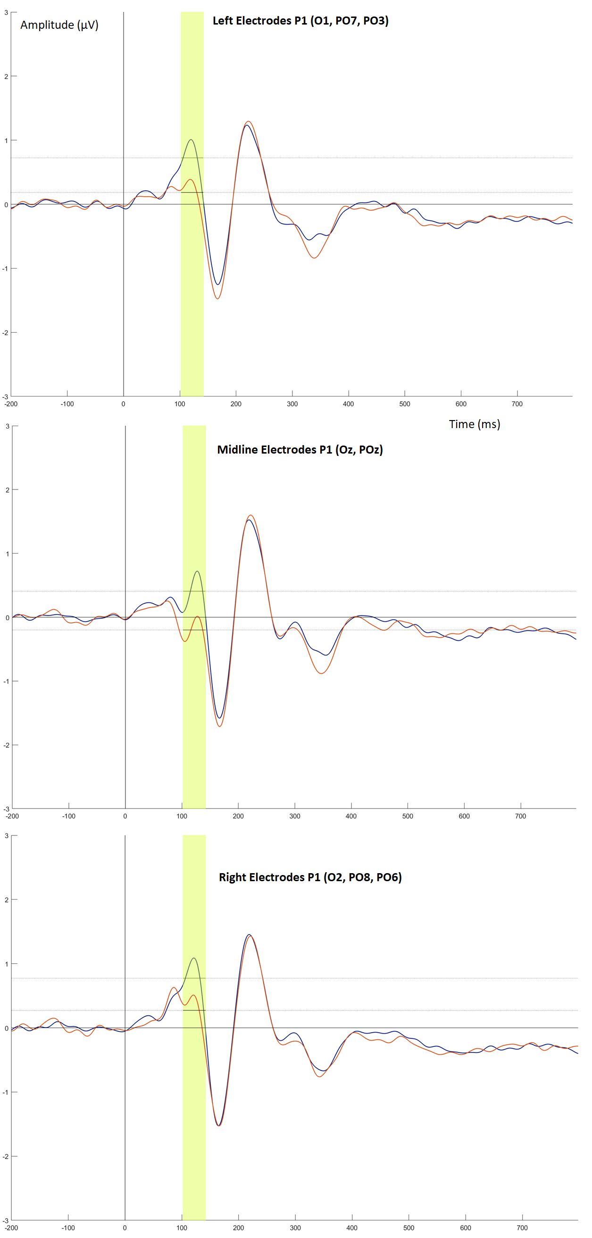
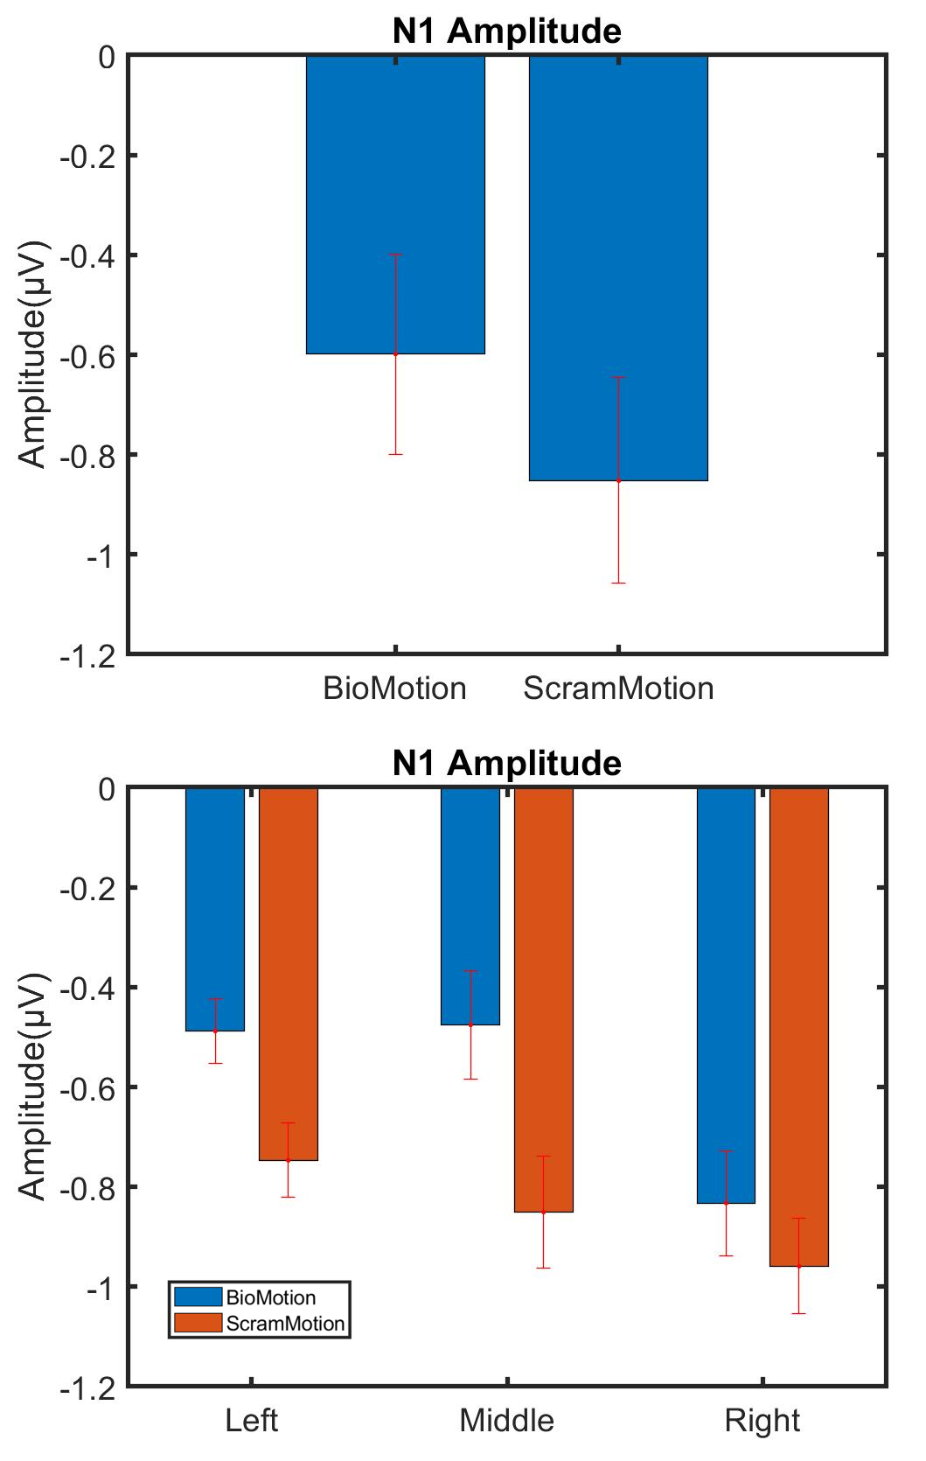
Catching the Visual System in Action:
A Modified Event-Related Potential Paradigm for Dynamic Stimuli
Shan Zhang Ayse P. SAYGIN
Department of Cognitive Science, University of California, San Diego
Introduction
New Paradigm: the Sparse Pulse ERP (spERP)
Method
The body movements or biological motion (BM) performed by other living entities has both ecological and sociological significance. Point-­light displays are commonly used to study biological motion in vision research.
Conventional ERP on dynamic stimulus (Fig 1a. )
Time-locking at the first frame of the display, treat the dynamic stimulus as if it’s a static picture.
One trial will contribute to at most one single ERP.
Analysis could only be performed at the trial level.
Sparse Pulse ERP on dynamic stimulus (Fig 1b.)
Changing the contrast of the stimulus at individual frames (“pulse frames”) could elicit VEPSs at different time points along with the unfolding of the stimulus temporally.
Time-locking at the “pulse frames”.
One trial of display could produce multiple ERPs, increasing SNR.
Analysis could be performed at frame-level.
ERP Event lock:
N = 17
Condition: 2 (left vs. right) * 2 (biological vs. scramble)
Pulse Probability = 0.1 (Each trail consist of 60 frames of a display, containing two complete 30-frame cycles. Each frame of the display has a probability of 10% to undergo a contrast reversal, meaning on average 6 pulse frames per trial).
Pulse frames are assigned pseudo-randomly across each display with a control of no pulse frame at the beginning, the ending, as well as the adjacent 2 frames.
Subjects were asked to perform a keypress if they detect a single dot changes its color to yellow. The task serves as attention control, and it not the main interest of the experiment.
a.
To investigate the timing of how the brain processes such a dynamic stimulus requires a temporally sensitive method.
Event-Related Potential (ERP) paradigm, obtained by time-locking and averaging EEG epochs to specific events can be used to study the study the temporal mechanisms of BM perception (Hirai et al., 2003, 2005; Hirai et al. 2009; Krakowski et al., 2011). However, time-locking at the onset of a temporally-unfolding stimulus does not fully capture its dynamic nature.
We aimed to develop a variant of the ERP method that can still help us track BM processing with temporal precision, perhaps even at the frame level.
Proximo-distal
b.
Figure 1. Still frames depicting PL-BM stimuli and the conventional ERP and the modified spERP paradigms. a. Conventional ERP would time-lock the EEG at the onset of display of each PL-BM stimulus (i.e., one event within one trial). b. spERP paradigm would time-lock to the pulse (here, white) frames within the PL-BM stimuli, such that there are multiple events within each trial.
Experimental Results
General Summary
Componentry and Latencies
spERP showed similar componentry to the conventional ERP (time-lock to the onset frame), including typical P1, N1, P2, and N2.
Overall, spERP components had smaller amplitudes and earlier peak onsets.
P1 Component
Analysis: 2 (Stimulus type: BioMotion, ScramMotion) by 3 (Electrode location: Left, Mid, Right) repeated measure ANOVA
At occipital and occipital parietal sites, biological motion pulse frames create a significantly larger P1 compared to scrambled motion. (F(1,101) = 15.56; p = <0.001).
Main effect of electrode location and interaction between stimulus type and electrode location was not significant.
spERP
The contrast reversal of a single frame is sufficient to evoke a VEP, which allows us to actively probe different stages of processing and increase the applicability of the ERP paradigm on dynamic stimuli.
The frame-level visualization illustrates that the onset issue still exists in the current manipulation. Distributing pulse frames randomly will not entirely solve the onset issue. Different designs are required to entirely solve the issue to answer questions about the early stage of processing.
P1
P1 amplitude was modulated by stimulus type, with a larger amplitude for biological motion condition compared to spatially scrambled control.
The sensitivity of P1 to dynamic biological motion is likely not a function of the presence of motion cues per se, considering the early stage this component reflects. This finding echoed with previously reported P1 modulation by a static point-light figure (Buzzell et al. 2013; White et al. 2014) and may serve as evidence for the ‘snapshot’ neurons suggested by a computational model of biological motion (Giese & Poggio, 2003) as well as neurophysiological studies (Vangeneugden et al., 2014)
3
2
1
0
-1
-2
-3
Left Electrodes P1
(O1, PO7, PO5)
**
Figure 2. ERPs averaged across conditions and subjects using different event-lock. Upper: time-lock to the display onset frame; Lower: time-lock to the pulse frames.
BioMotion, 102 – 144 ms
Proximo-distal
3
2
1
0
-1
-2
-3
Middle Electrodes P1
(Oz, POz)
Figure5. Overlay of spERPs of each frame for Biological Motion condition (from frame 2 to frame 58) reveals a relatively clean profile for each. X-axis represents time (one trial). Vertical gridlines mark individual motion frames.
N1 Component
Analysis: 2 (Stimulus type: BioMotion, ScramMotion) by 3 (Electrode location: Left, Mid, Right) repeated measure ANOVA
No main effect of stimulus type and electrode location. No significant interaction.
Frame-Level Visualization
With the pulse frames distributed randomly along the stimuli, the spERP can enable constructing a visual ERP for all frames of the stimuli (except for the very first and last frames), provided there are a sufficient number of trials .
By overlaying the pulse ERPs on the time scale of the stimulus display (one animation with 60 frames), we can see that the early frames are largely dominated by the “onset” ERP elicited by the first frame of the stimuli (Figure 5)
3
2
1
0
-1
-2
-3
Right Electrodes P1
(O2, PO8, PO6)
ScramMotion, 102 – 144 ms
Summary:
References
Difference, 102 – 144 ms
Figure 3. P1 Left column: ERP waveforms time-locked to pulse frames for the two conditions (orange: Biological, blue: Sscrambled) at left, midline and right electrodes (O1, Oz, O2). The shaded areas denote the analysis window (+/-20 ms mean peak latency from grand ave); Middle column: Simulus type and Stimulus type plotted separately at left, midline and right electrode locations. Right column: The scalp topography plots illustrating the distribution of the mean component amplitudes of Biological and Scrambled Motion conditions and their difference during the corresponding time window.
Hirai, M., Fukushima, H., & Hiraki, K. (2003). An event-related potentials study of biological motion perception in humans. Neuroscience Letters, 344(1), 41–44.
Hirai, M., Senju, A., Fukushima, H., & Hiraki, K. (2005). Active processing of biological motion perception: an ERP study. Cognitive Brain Research, 23(2), 387–396.
Hirai, M., Watanabe, S., Honda, Y., & Kakigi, R. (2009). Developmental changes in point-light walker processing during childhood and adolescence: An event-related potential study. Neuroscience, 161(1), 311–325.
Krakowski, A. I., Ross, L. A., Snyder, A. C., Sehatpour, P., Kelly, S. P., & Foxe, J. J. (2011). The neurophysiology of human biological motion processing: A high-density electrical mapping study. NeuroImage, 56(1), 373–383.
Buzzell, G., Chubb, L., Safford, A. S., Thompson, J. C., & Mcdonald, C. G. (2013). Speed of Human Biological Form and Motion Processing. PLoS ONE, 8(7), 69396.
White, N. C., Fawcett, J. M., & Newman, A. J. (2014). Electrophysiological markers of biological motion and human form recognition. NeuroImage, 84, 854–867.
Giese MA, Poggio T (2003) Neural mechanisms for the recognition of biological movements. Nat Rev Neurosci;4:179-192.
Vangeneugden, J., Peelen, M. V., Tadin, D., & Battelli, L. (2014). Distinct neural mechanisms for body form and body motion discriminations. Journal of Neuroscience, 34(2), 574-585.
ACKNOWLEDGMENTS: NSF CAREER BCS 1151805. We thank Luke Miller, Steve Hillyard, Marta Kutas, Wayne Khoe, Alvin Li, Burcu A. Urgen, Chaolan Lin, for helpful discussions, help with data collection, technical assistance, or feedback.
Figure 4. N1 A.. Stimulus type: (Biological and Scrambled); B. Stimulus type at left, middle, and right electrode locations (O1, Oz, O2)

