Slide 1
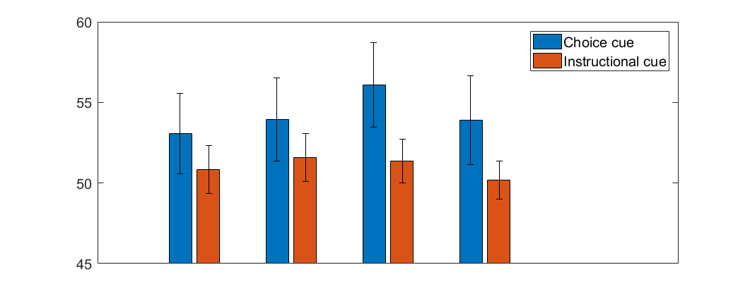
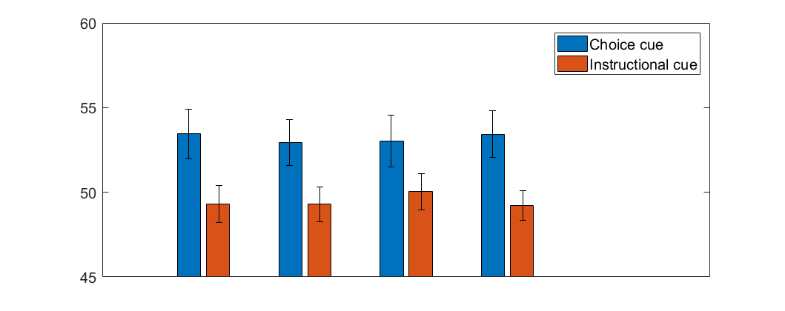
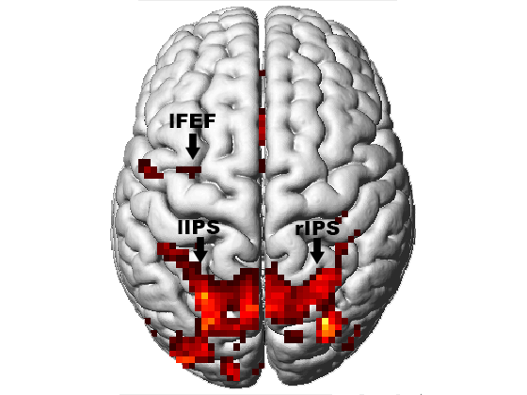
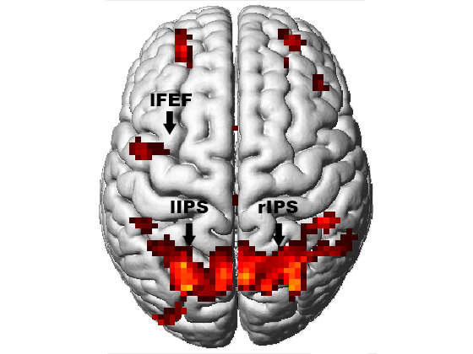
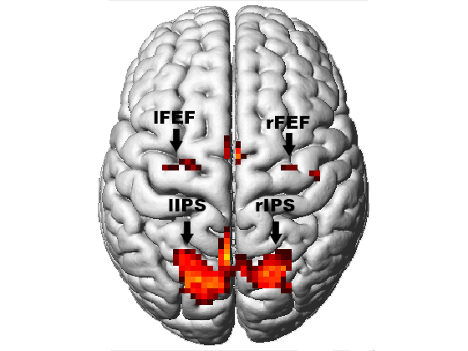
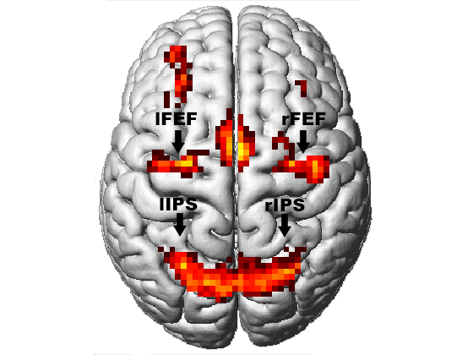
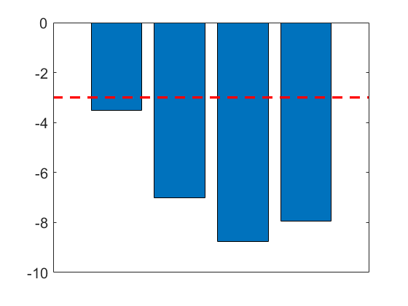
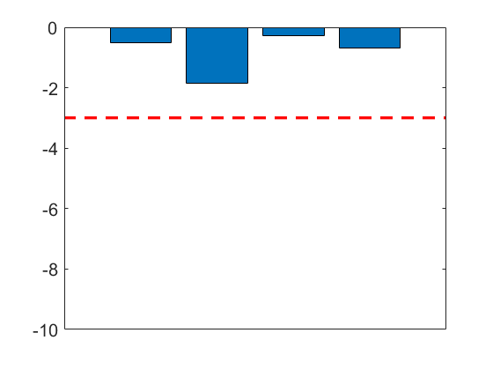
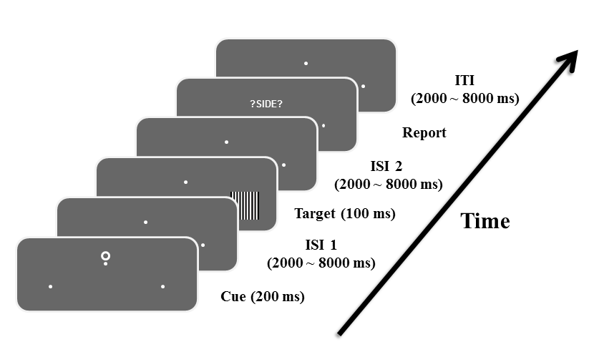
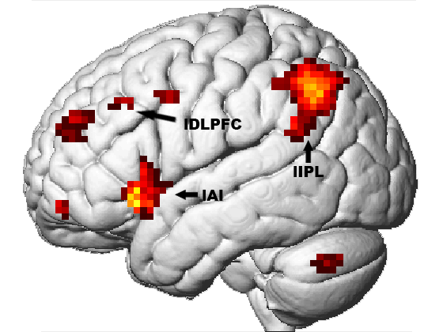
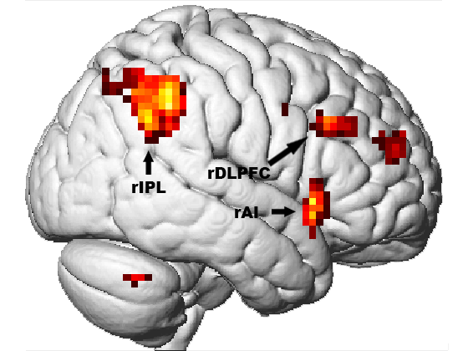
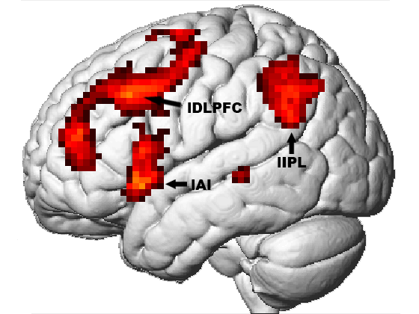
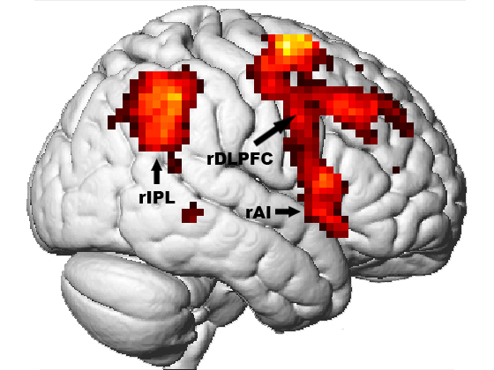
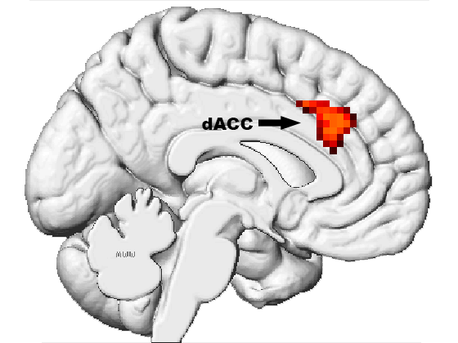
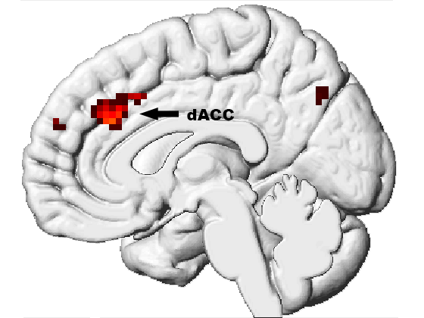
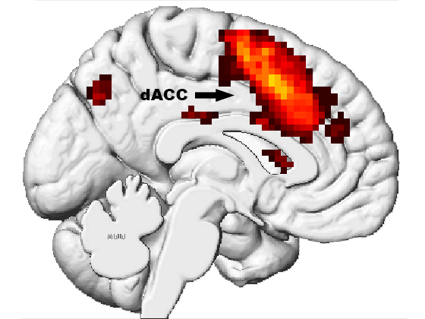
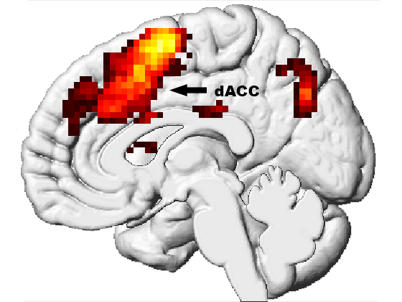
Frontoparietal Control of Willed Attention
Qiang Yang¹, Sreenivasan Meyyappan¹, Jesse J. Bengson², George R Mangun³ , Mingzhou Ding¹
¹ J. Crayton Pruitt Family Department of Biomedical Engineering, University of Florida, Gainesville, FL, USA; Department of Psychology, Sonoma State University, Rohnert Park, CA, USA; ³ Center for Mind and Brain, University of California, Davis, CA, USA
Introduction
Single trial BOLD responses (beta values) to the cue were estimated using GLM approach (Rissman et al., 2004)
Linear support vector machines (SVM) were used to perform MVPA on ROIs additionally activated by choice cue to classify the attended spatial location (attend left versus attend right).
A meta analysis was performed by applying the Liptak-Stouffer Z-score method in order to combine two data sets (Liptak, 1958).
A
UF
*
*
Fig. 4. MVPA decoding accuracy. (A) The decoding accuracy between choice left and choice right was above chance level in DLPFC and AI for UF dataset (p<0.05). (B) The decoding accuracy between choice left and choice right was above chance level in DLPFC and AI for UF dataset (p<0.05).
Cueing paradigms are commonly used to study the neural mechanisms of visual spatial attention.
Consistently activated following the cue, the dorsal attention network (DAN) has been shown to play a key role in controlling visual spatial attention.
Recent work has introduced a new form of cueing which asks the subject to spontaneously decide the spatial location to attend (willed attention) (Rajan et al., 2019; Liu et al., 2017; Bengson et al., 2015, 2014; Hopfinger et al., 2010; Taylor et al., 2008). The underlying neural mechanisms remain to be better understood.
We addressed this problem by applying univariate and multivariate techniques to fMRI data recorded at two institutions (UF and UC Davis) using the same willed attention paradigm.
Decoding accuracy
B
dACC
DLPFC
AI
IPL
*
*
UCD
Results
*
*
Decoding accuracy
UF dataset
UCD dataset
A
Instructional cue
B
Choice cue
C
Instructional cue
D
Choice cue
dACC
DLPFC
AI
IPL
Choice cue
Instructional cue
P=0.05
P=0.05
Methods
Log(p)
Log(p)
0 5 10
0 4 8
0 5 10
0 4 8
*
*
*
*
Fig. 2. Cue-evoked BOLD activation. (A,B) Cue-evoked significant BOLD activation (p<0.05, FDR) for UF dataset. (C,D) Cue-evoked significant BOLD activation (p<0.05, FDR) for UCD dataset. In both datasets, the dorsal attention network is activated.
dACC
DLPFC
AI
IPL
dACC
DLPFC
AI
IPL
Fig. 5. P-value from the meta-analysis combining the two datasets. Decoding accuracy of choice cue in ROIs is above chance level. (p<0.05)
A
UF dataset
B
UCD dataset
Summary and Discussion
Choice cue > Instructional cue
Choice cue > Instructional cue
Fig. 1. Experimental paradigm
Both instructional cues and choice cue activated the DAN. Choice cue additionally activated frontoparietal regions including dACC, AI, DLPFC, and IPL.
An MVPA analysis showed that in these frontoparietal regions, the accuracy of decoding between attend left and attend right is significantly above chance level for choice cue but not for instructional cues.
These results, consistent across the two datasets, suggest that willed visual spatial attention is controlled by three major brain networks: the salience network (dACC and AI), the central executive network (DLPFC and IPL), and the DAN (Menon, 2011).
There were two types of cues: instructional cues instructed the participant to covertly pay attention to either the left or the right visual hemifield and a choice cue prompted the subject to choose the side of the visual field to attend.
After a random delay, a vertical grating pattern were presented, and the subject was asked to report the spatial frequency of the grating (5 vs 5.5 cycles/degree) in the attended location using a button press.
Functional MRI data were recorded in two different location: UF (N=13) and UC Davis (N=18).
Data were preprocessed using SPM. BOLD responses elicited by experimental events were modeled with the general linear model (GLM).
0 5 10
0 5 10
Fig. 3. Brain regions activated by willed attention. (A) Choice cue>instructional cue (p<0.05, FDR) for UF dataset. (B) Choice cue>instructional cue (p<0.05, FDR) for UCD dataset. Consistent across the two datasets, the activated regions include: dorsolateral prefrontal cortex (DLPFC), inferior parietal lobule (IPL), anterior insula (AI) and dorsal anterior cingulate cortex (dACC). Note that DAN does not appear in this contrast.
Supported by NIH grant MH117991

