Slide 1
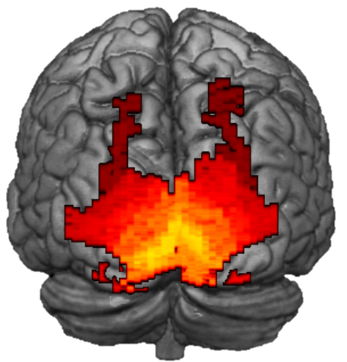
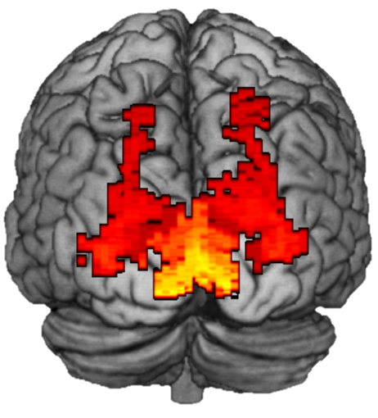
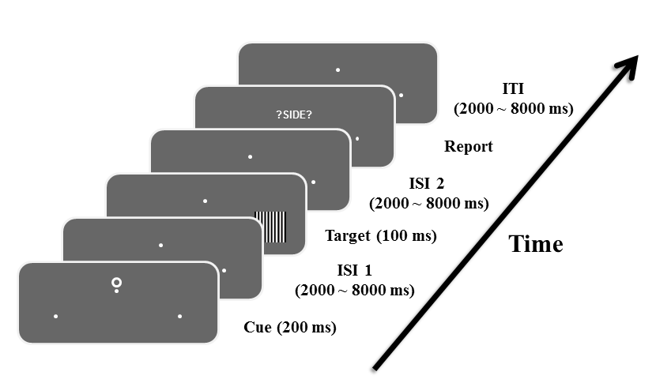
Decoding Visual Spatial Attention Control
Sreenivasan Meyyappan¹, Abhijit Rajan¹, Jesse Bengson³, George R Mangun² , Mingzhou Ding¹
¹ J. Crayton Pruitt Family Department of Biomedical Engineering, Univ. of Florida, Gainesville, FL ; ²Center for Mind and Brain Univ. of California, Davis, CA; ³Department of Psychology, Sonoma State University, Rohnert Park, CA
Introduction
ROIs in the visual cortex were defined according to a recently published visuo-topic atlas (Wang et al., 2014).
Linear support vector machines (SVM) were used to perform MVPA on a given ROI to classify the attended spatial location (attend left versus attend right).
A non-parametric permutation-based statistic (Stelzer et al. 2013) was used to test the significance of classification results.
Principal Component Analysis was performed on the classification accuracies across the ROIs. The loading on the first principal component was then correlated (Spearman rank) with the behavioral efficiency (accuracy/RT) to assess the functional relevance of decoding accuracy.
A
UF
B
UCD
Deploying anticipatory visual spatial attention in advance of stimulus onset enhances the processing of task-relevant stimuli and suppresses distraction.
This selective processing of information is thought to be achieved by top-down signals issued by the frontoparietal attention control networks that bias sensory neurons according to behavioral goals.
How such attention control signals are distributed throughout the visual cortex and in what way they influence behavioral performance remains to be understood.
In this study we addressed these questions by applying multi-voxel pattern analysis (MVPA) to fMRI data recorded from subjects performing a cued visual spatial attention task.
% of variance explained
% of variance explained
C
r = 0.58
p = 0.04
Principal component
D
r = 0.66
p = 0.003
Principal component
1st component of PCA
1st component of PCA
r = -0.46 p = 0.05
Results
Z scored behav. Efficiency (accuracy/RT)
Inverse efficiency (RT/Accuracy)
Z scored behav. Efficiency (accuracy/RT)
A
B
C
Fig. 4. MVPA classifier performance for visuo-topic ROIs vs behavior for both datasets. (A) Plot of percentage of variance explained by the principal components for UF dataset. (B) Plot of percentage of variance explained by the principal components for UCD dataset. (C) Scatter plot of classification accuracy vs behavioral efficiency for UF dataset. (D) Scatter plot of classification accuracy vs behavioral efficiency for UCD dataset.
UF
UCD
A
B
C
Decoding accuracies UF Data
Methods
r = 0.75 p = 0.001
r = 0.75 p = 0.001
Summary
0.55
0.65
0.75
0.55
0.625
0.70
Decoding accuracies UCD Data
How are attention control signals distributed in different visual cortical regions? How do they influence behavior?
We addressed these questions by analyzing fMRI data from two experiments utilizing the same paradigm but conducted at two different sites using scanners from different manufacturers.
Applying MVPA to single-trial, cue-evoked beta values to decode between two attentional states: attend left vs attend right, we found, consistent across two datasets, the following results:
Attention control signals are present in all visuo-topic ROIs, ranging from V1 to PHC.
Decoding accuracy predicts behavioral performance, namely, higher decoding accuracy, better performance.
Regions in the dorsal visual pathway appear to be more predictive of the attentional state than regions in the ventral visual pathway.
Lower-order visual regions appear to be more predictive of the attentional state than higher-order visual regions.
Fig. 2. Decoding accuracy of attend left vs right using visuo-topic ROIs. (A) Posterior view of decoding accuracies using UF Dataset. (B) Posterior view of decoding accuracies using UCD Dataset. (C) Scatter plot comparing UF vs UCD decoding accuracies.
A
Dorsal stream
B
Ventral stream
Decoding accuracy
UF
Decoding accuracy
A visual cue instructed the subjects to covertly pay attention to either the left or the right hemi-field.
A stimulus was presented after a delay and the subjects were asked to discriminate the spatial frequency of the gratings if they appeared in the attended hemi-field.
Functional MRI data were recorded in two different locations: UF (N=13) and UC Davis (N=18).
Data were pre-processed using SPM. Single trial BOLD responses (beta values) to the cue were estimated using GLM approach (Rissman et al., 2004).
C
D
Dorsal stream
Ventral stream
Decoding accuracy
UCD
Decoding accuracy
Fig. 3. Decoding accuracy comparison between different visuo-topic ROIs along the dorsal and ventral pathways; early to late visual regions are listed from left to right. (A,C) Dorsal stream. (B,D) Ventral stream.
Supported by NIH grant MH117991
J. Crayton Pruitt Family Department of Biomedical Engineering

