Slide 1
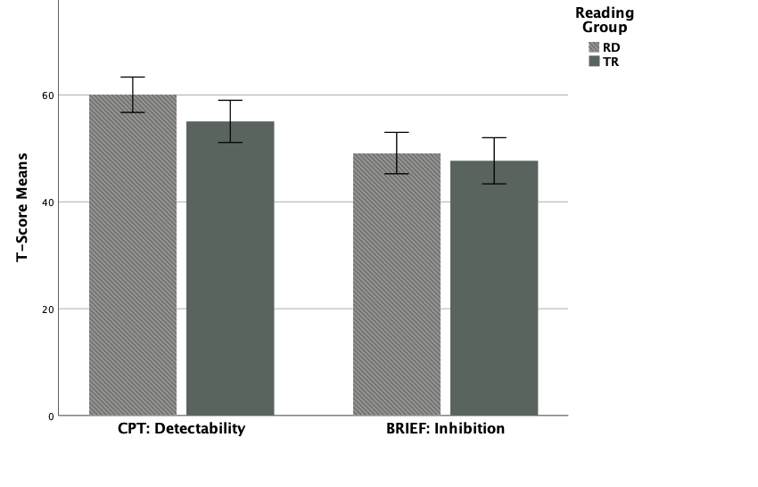
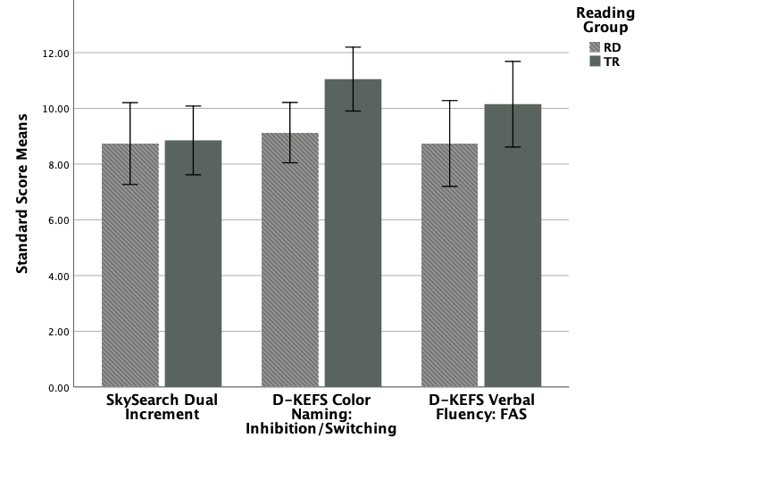
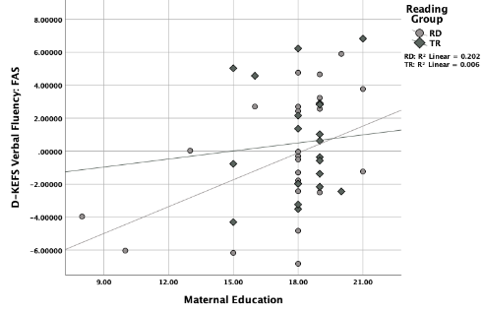
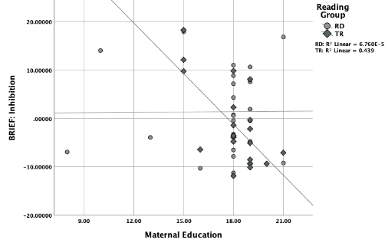
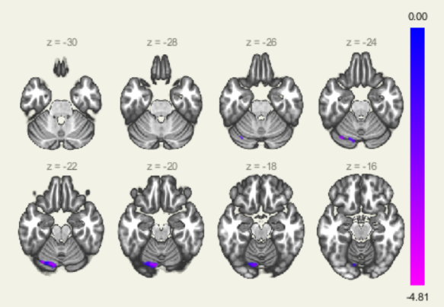
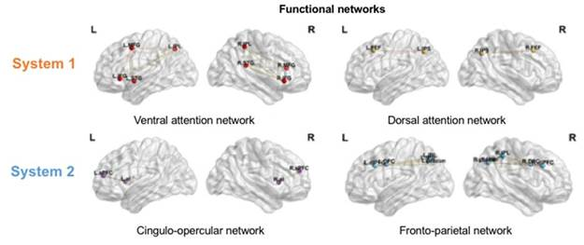
Higher maternal education is related to greater executive functions and decreased functional connectivity between cognitive control networks and reading related regions in children with reading difficulties.
Paige B. Greenwood¹, Mark DiFrancesco², Mekibib Altaye³, Elisha Scott⁴, John Hutton⁴, Jonathan Dudley⁴, Jennifer Vannest⁵, & Tzipi Horowitz-Kraus^{1,4,6}
¹College of Medicine, University of Cincinnati, Cincinnati, OH; ²Department of Radiology; ³Division of Biostatistics and Epidemiology;⁴Reading and Literacy Discovery Center; ⁵Department of Neurology, Cincinnati Children’s Hospital Medical Center, Cincinnati, Ohio; ⁶Educational Neuroimaging Center, Technion-Israel Institute of Technology, Haifa, Israel
Introduction
Reading difficulty (RD or dyslexia) is characterized by deficits in language processing and executive functions (EFs) [1]. EFs include cognitive abilities underlying learning such as working memory, inhibition and switching, as well as attention [2] Networks such as Dorsal Attention (DAN) and Ventral Attention (VAN) are involved in basic orienting attention and Fronto-Parietal (FP) and Cingulo-opercular (CO) are involved in executive control [3]. Children can have RD also due to environmental effects of inadequate resources, lack of stimulation or motivation [4]. Socioeconomic status (SES) consists of household income, maternal education, and occupation [5]. Maternal education is associated with parent-child interaction and cognitive developmental outcomes [6].
Methods
Forty-six children, 25 RD (x=9.76±1.42; F=13) and 21 typical readers (TRs) (age=10.05±1.47; F=6). No history of attention deficits, neurological or psychiatric disorders. Maternal education was collected as a construct of SES. All participants had intact non-verbal intelligence ≥85 (TONI-4) [7]. RD participants scored <25th percentile on two or more reading tests [8].
Results
Discussion
Children with RD whose mothers’ have higher educational attainment performed better on tasks that phonemic fluency. TRs whose mothers’ have higher educational attainment had reduced impulsivity. Children with RD with mothers who have higher educational attainment may rely less on top-down networks related to EFs. Results point at maternal education having different roles in cognitive control for children with RD and TRs during reading. Higher maternal education may be a compensatory mechanism for children with RD by engaging abilities that support reading (EFs).
Behavioral Measures:
*
Behavioral Measures
Executive functions:
BRIEF Inhibition [9]
CPT detectability [10]
TEA-Ch Sky Search Dual Increment Task [11]
DKEFS Color Naming Inhibition/Switching [12]
DKEFS Verbal Fluency: FAS [12]
Figure 2. Mean differences in EFs measures for children with RD and TRs (*P<0.05).
Higher maternal education is related to greater EFs abilities in children with RD and TRs.
A). Phonemic Fluency
B). Impulsivity
Behavioral Data Analysis:
Compared EFs measures between RD and TRs using independent t-tests.
To determine the correlations between EFs measures with maternal education for RD and TRs.
Data is corrected for multiple comparisons.
Figure 3. Correlations between EFs measures and maternal education for children with RD and TRs.
(A). Phonemic fluency [RD: *P<.05, r=.448], (B). impulsivity [TRs: *P<.05, r=-0.646]. BRIEF impulsivity for TRs survived multiple comparisons *P<.01
References
Shaywitz, S.E. The Education of Dyslexic Children from Childhood to Young Adulthood. Annual Review of Psychology. 2008;59. Horowitz-Kraus, T., et al. Increased Resting-State Functional Connectivity in the Cingulo-Opercular Cognitive-Control Network after Intervention in Children with Reading Difficulties. PLoS One. 2015;10. Peterson, S.E., et al. The Attention System of the Human Brain: 20 Years After. Annual Review of Neuroscience. 2012;35. Hackman, D.A., et al. Socioeconomic Status and The Developing Brain. Trends in Cognitive Science. 2009;13. Romeo, R.R., et al. Socioeconomic Status and Reading Disability: Neuroanatomy and Plasticity in Response to Intervention. Cerebral Cortex. 2017;28. Noble, K.G., et al. Family income, parental education and brain structure in children and adolescents. Nature Neuroscience. 2015;18. Brown, L., et al. Test of Nonverbal Intelligence 4th Edition (TONI-4). Pearson Assessments, 2010. Kovelman I., et al. Brain basis of phonological awareness for spoken language in children and its disruption in dyslexia. Cerebral cortex. 2012;22. Gioia, G.A., et al. Behavioral Rating Inventory of Executive Function. Second Edition (BRIEF-2). Psychological Assessment Resources, 2015. Conners, C.K., Conner’s Continuous Performance Test 3rd Edition (CPT-III). MHS Assessments, 2014. Robertson, I.H., et al. Test of Everyday Attention for Children, Second Edition (TEA-Ch), Pearson Assessments, 2016. Delis, D.C., et al. Delis-Kaplan Executive Function System (D-KEFS), Pearson Assessments, 2001. Fox, M.D., et al. Spontaneous neuronal activity distinguishes human dorsal and ventral systems. Proceedings of the National Academy of Sciences of the United States of America. 2006;103.
Neuroimaging Acquisition and Analysis:
25 RD and 21 TRs participated in two 5 minute resting state scans: 430 whole brain scans per resting state imaging sequence.
Imaging data were acquired using a 3T Phillips Ingenia Scanner. T1 weighted images were acquired for each participant with TR/TE of 700/30 msec.
The data were preprocessed using SPM12 and then processed using the CONN: functional connectivity toolbox.
Defined ROIs comprising these networks (DAN, VAN, FP, CO) using anatomic locations from the WFU-pick atlas tool [2, 13].
Seed-to-voxel analysis was performed by calculating correlations of BOLD time-series of each seed to those of all the voxels in the brain.
Each network was weighted equally as a seed.
Maternal education was used as a covariate of interest.
Cognitive control networks connectivity and voxels within reading related regions:
L
R
Figure 4. Higher maternal education associated with decreased connectivity between DAN and a cluster of voxels within the left cerebellum, left fusiform gyrus, and left lingual gyrus for RD>TRs. The Fig. is presented in neurological orientation (left on left, right on right) *P<.05, FDR-corrected.
Orienting Attention
Aims
To determine the relations between maternal education and basic abilities related to reading (such as EFs) in children with RD and typical readers (TRs) using behavioral and neurobiological measures.
Executive Control
Figure 1. Visualization of orienting attention (ventral and dorsal attention) and executive control (cingulo-opercular and fronto-parietal) networks on a glass brain.
L
R
Acknowledgements
National Institutes of Health (NIH) Eunice Kennedy Shriver National Institute of Child Health and Human Development (NICHD) (PI: Horowitz-Kraus; 1R01HD086011-01A1)
Figure 5. Higher maternal education associated with decreased connectivity between FP and a cluster of voxels within the left cerebellum, left fusiform gyrus, and left lingual gyrus for RD>TRs. The Fig. is presented in neurological orientation (left on left, right on right) *P<.05, FDR corrected.
Contact details: paige.greenwood@cchmc.org

