Slide 1
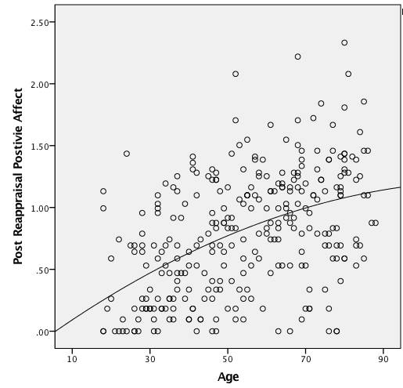
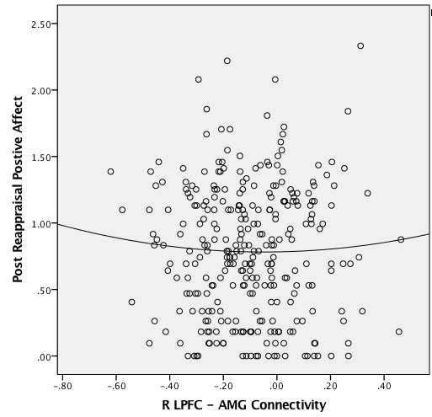
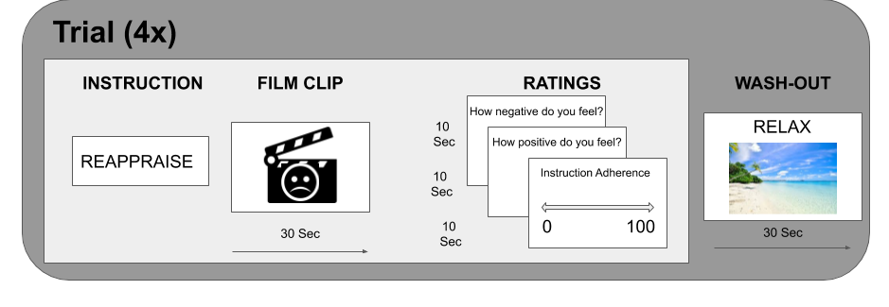
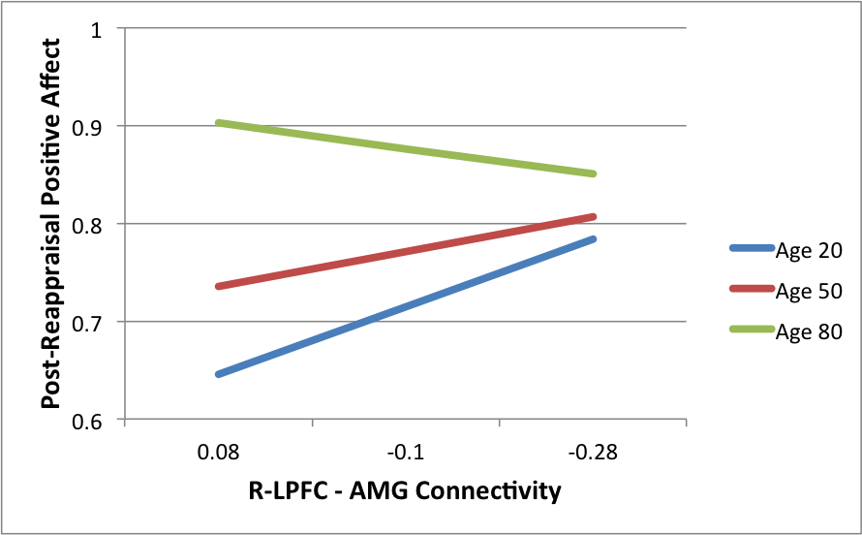
Lateral Prefrontal Cortex-Amygdala Resting State Functional Connectivity
Predicts Reappraisal Success in Younger Adulthood, but Less so in Later-Life
Parker Longwell¹, Youna Choi², Holly B. Laws¹, Cam-CAN³, & Bruna Martins-Klein¹
1- University of Massachusetts- Amherst, Amherst, MA; 2- Amherst College, Amherst, MA; 3- Cambridge Center for Aging Neuroscience
Introduction
Reappraisal is an effective emotion regulation strategy that relies on cognitive control¹
Lateral prefrontal cortex (LPFC), a central hub of the cognitive control network, activates during reappraisal to down-regulate amygdala response to negative stimuli ²
LPFC-amygdala functional connectivity during instructed reappraisal predicts task success^{3,4} and self-reported use of reappraisal in younger adults^{5,6}
Resting-state functional connectivity between frontal regions and amygdala is correlated with greater self-reported reappraisal use in adults^{1,5}
Lateral PFC-amygdala resting connectivity strength is associated with cardiac biomarkers of emotion regulation for younger, but not older adults; medial PFC-amygdala connectivity is predictive for all ages ⁷.
The relationship of resting connectivity of lateral and frontal PFC to amygdala and reappraisal task success across age has yet to be investigated
Hypothesis: RSFC between the LPFC and the amygdala will predict reappraisal success in a behavioral task; however, this relationship will be moderated by age.
Connectivity Analysis
Connectivity Analyses were run via Matlab CONN Toolbox¹⁰
Structural T1 scans were registered to the resting state functional Scan
Normalization performed with 8mm smoothing
ROI Masks:
Bilateral Amygdala (AMG): Conjunction of left and right Amygdala Harvard-Oxford anatomical masks ¹¹
Left LFPC, Right LPFC, and MPFC: Separate masks based on Harvard-Oxford atlas
RSFC between Bilateral Amygdala and each area of PFC were extracted from each subject in CONN.
Discussion
Older adults demonstrated greater post-reappraisal positive affect scores, replicating previous behavioral studies supporting increased ER and positivity bias with age. ^{12,19}
Extending on previous findings⁴ - LPFC-AMG was predictive of regulatory success for middle aged and younger adults, but not older adults, in a momentary behavioral reappraisal task
Regulatory model of anxiety suggests PFC-AMG structural connectivity is mechanism of inhibitory emotion regulation.¹⁷
PFC-AMG connectivity may represent a need to reappraise and engage with distressing stimuli during reappraisal, and PFC-AMG decoupling may be an indication of more successful emotion regulation.¹⁸
Future Directions & Implications
While mPFC-AMG connectivity was not predictive of reappraisal success across the lifespan, future work should investigate this relationship in older adults only
This investigation explored resting-state functional connectivity, and should be replicated in an fMRI version of the behavioral task used.
Future studies should clarify whether alternative PFC-AMG subnetworks may support reappraisal ability for older adults compared to other age groups, in line with Selective Optimization and Compensation of Emotion Regulation (SOC-ER) ¹⁶
. The medial PFC (mPFC) has been shown to be involved in reappraisal ^{7,13}, and preserved in older adults^{13,14}, thus may warrant further investigation.
Limitations
The data reported represented only 298 of the 700 (42%) participants in the total Cam-CAN study. There may be systematic biases among those who were able to complete an fMRI scan and an emotion regulation task.
ROIs were atlas based in MNI-space and not hand-traced or segmented for each individual in functional space. This may lead to greater error for older adults, who tend to have more structural heterogeneity than the younger adults
mPFC
L-LPFC
R-LPFC*
Bilateral Amygdala
Results
Univariate GLMs of Age x Connectivity on self-reported post-reappraisal positive affect
Left LFPC-AMG
R LPFC-AMG
MPFC-AMG
Covaried for instruction adherence and positivity bias (neutral watch affect rating)
Methods
Participants
N= 298, Age: 18-88 (m=54.3 SD= 18.6), 50% females from the Cam-CAN dataset⁸
8 minute resting state fMRI scan and Behavioral Emotion Regulation task
Behavioral Emotion Regulation Task: 8 Blocks: 4 film trials/block
Strategies
WATCH: view film naturally without regulating
REAPPRAISE: Decrease negative affect by reinterpreting meaning
Stimuli: Positive, Negative, and Neutral film clips (30 Sec)
4 Conditions:
WATCH positive, negative, neutral
REAPPRAISE negative
Rating: negative affect, positive affect, instruction adherence post-trial
Main effect of age on post-reappraisal positive affect
B= 0.004, SE= 0.001, p< 0.001
Main effect of R LPFC-AMG connectivity strength on positive affect
B= -0.419, SE= 0.159, p=0.009
References
Ochsner, K. N., & Gross, J. J. (2005). The cognitive control of emotion. Trends in cognitive sciences,
Buhle, et al (2014). Cognitive reappraisal of emotion: a meta-analysis of human neuroimaging studies. Cerebral cortex,
Banks, S. J., Eddy, K. T., Angstadt, M., Nathan, P. J., & Phan, K. L. (2007). Amygdala–frontal connectivity during emotion regulation. Social cognitive and affective neuroscience,
Sarkheil, P., Klasen, M., Schneider, F., Goebel, R., & Mathiak, K. (2019). Amygdala response and functional connectivity during cognitive emotion regulation of aversive image sequences. European archives of psychiatry and clinical neuroscience,.
Paschke et al. (2016). Individual differences in self-reported self-control predict successful emotion regulation. Social cognitive and affective neuroscience.
Drabant, et al. (2009). Individual differences in typical reappraisal use predict amygdala and prefrontal responses.
Sakaki, Nga, & Mather (2013). Amygdala functional connectivity with medial prefrontal cortex at rest predicts the positivity effect in older adults' memory.
Shafto, M. A., Tyler, L. K., Dixon, M., Taylor, J. R., Rowe, J. B., Cusack, R., ... & Henson, R. N. (2014). The Cambridge Centre for Ageing and Neuroscience (Cam-CAN) study protocol: a cross-sectional, lifespan, multidisciplinary examination of healthy cognitive ageing. BMC neurology,
Taylor, J. R., Williams, N., Cusack, R., Auer, T., Shafto, M. A., Dixon, M., ... & Henson, R. N. (2017). The Cambridge Centre for Ageing and Neuroscience (Cam-CAN) data repository: structural and functional MRI, MEG, and cognitive data from a cross-sectional adult lifespan sample. Neuroimage,
Whitfield-Gabrieli, S., & Nieto-Castanon, A. (2012). Conn: a functional connectivity toolbox for correlated and anticorrelated brain networks. Brain connectivity,
Summers D. (2003). Harvard Whole Brain Atlas: www.med.harvard.edu/AANLIB/home.html. Journal of Neurology, Neurosurgery, and Psychiatry,
Mather, M., & Carstensen, L. L. (2005). Aging and motivated cognition: The positivity effect in attention and memory. Trends in cognitive sciences,.
Allard, E. S., & Kensinger, E. A. (2014). Age-related differences in functional connectivity during cognitive emotion regulation.
Urry, et al. (2006). Amygdala and ventromedial prefrontal cortex are inversely coupled during regulation of negative affect and predict the diurnal pattern of cortisol secretion among older adults. Journal of Neuroscience,.
Picó-Pérez, et al., (2018). Dispositional use of emotion regulation strategies and resting-state cortico-limbic functional connectivity. Brain imaging and behavior,
Urry, H. L., & Gross, J. J. (2010). Emotion regulation in older age. Current Directions in Psychological Science,
Kim, M. J., et al.(2011). Anxiety dissociates dorsal and ventral medial prefrontal cortex functional connectivity with the amygdala at rest.
Clewett, D., Bachman, S., & Mather, M. (2014). Age-related reduced prefrontal-amygdala structural connectivity is associated with lower trait anxiety.
Shiota, M. N., & Levenson, R. W. (2009). Effects of aging on experimentally instructed detached reappraisal, positive reappraisal, and emotional behavior suppression.
Scan Parameters
T1-weighted structural scan:
TR=2250 ms, TE =2.99 ms; TI =900 ms; flip angle =9 degrees
FOV =256mm x 240mm x 192mm; Voxel size =1mm isotropic
GRAPPA acceleration factor =2 (4 min, 32 secs)
T2*-weighted fMRI Resting State scan - eyes-closed (8 min 40s)
TR =1970 milliseconds; TE =30 milliseconds; flip angle =78 degrees
FOV =192 mm × 192 mm; Voxel-size =3×3 mm × 4.44 mm
261 volumes, 32 axial slices; slice thickness= 3.7 mm
Inter-slice gap of 20% degrees.
Age x Connectivity Interaction on post-reappraisal positive affect.
B= 0.009, SE= 0.004, p=0.02, R² = 0.7
R LPFC-AMG negative functional connectivity predictive of positive affect for younger and middle aged adults, but predictive of less positive affect for older adults
Funding: from the Biotechnology and Biological Sciences Research Council (BBSRC), followed by support from the Medical Research Council (MRC) Cognition & Brain Sciences Unit (CBU) and the European Union Horizon 2020 LifeBrain project.
Notes:
‹#›
Absolute Values for figures?
Turn SPSS table into table
Number figures and reference in text & GRAPH TITLES
Shift CONN.img to Methods
Scan Parameters should be bullets
Meet with Joel to find shift point?
DISCUSSION:
-Implications: theoretical (supporting theories, what we didn’t know before, physiology or countering theories) or applied (how might finding downstream make changes to interventions, or real world applications)
RSFC can predict task
Emotionality plateaus? Co-vary
-lPFC is less relevant for older adults
Cortical-amygdala RSFC correlates with self-reported reappraisal use in adults¹⁵.
Descriptive Tables for example age groups

