Slide 1
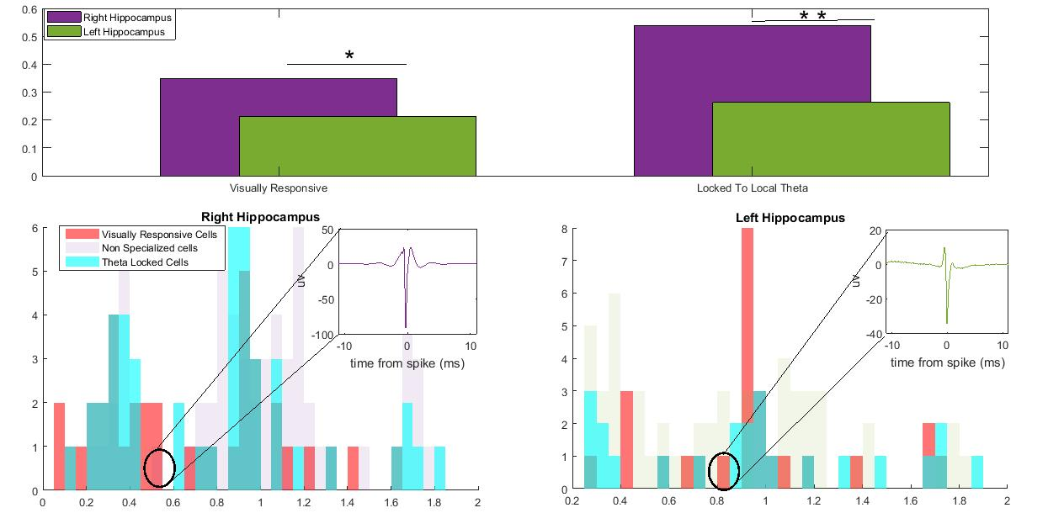
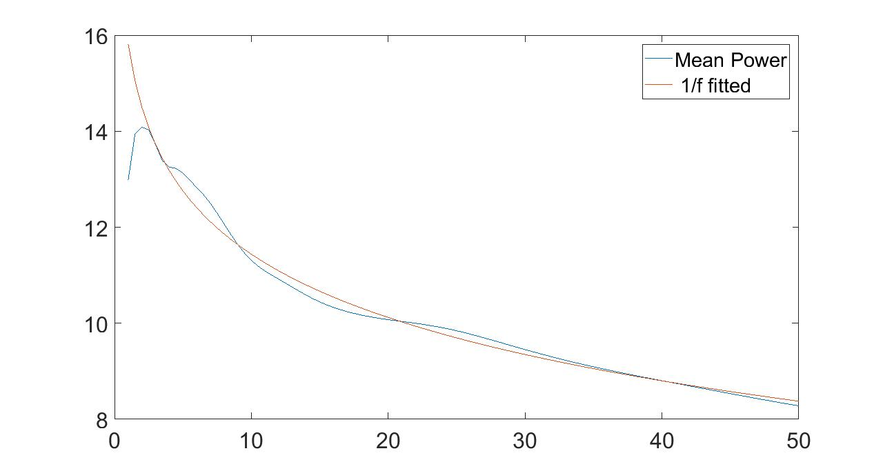
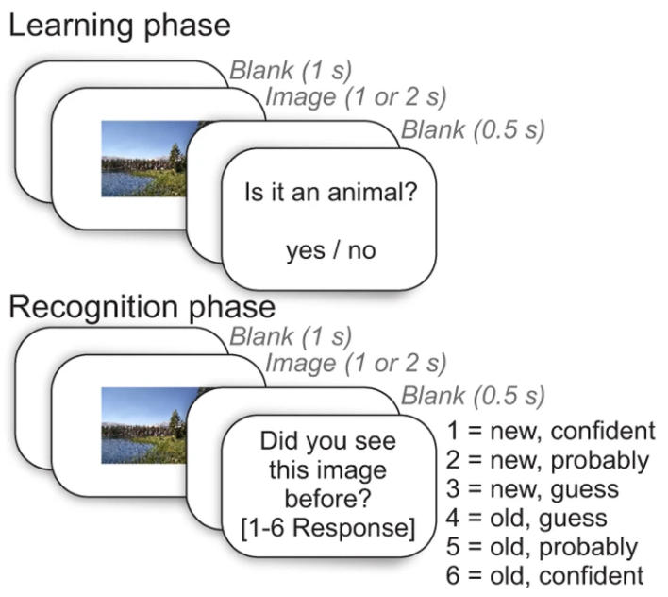
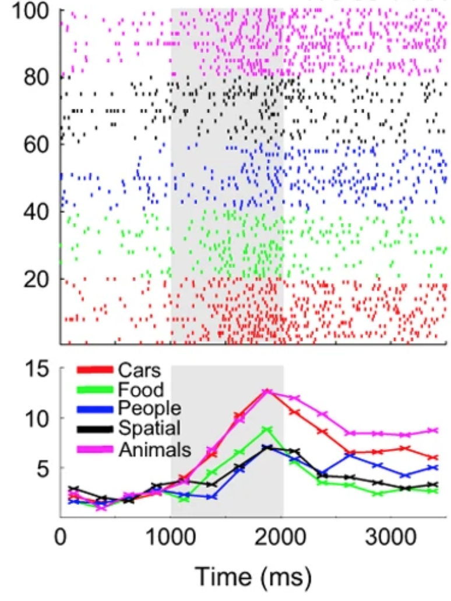
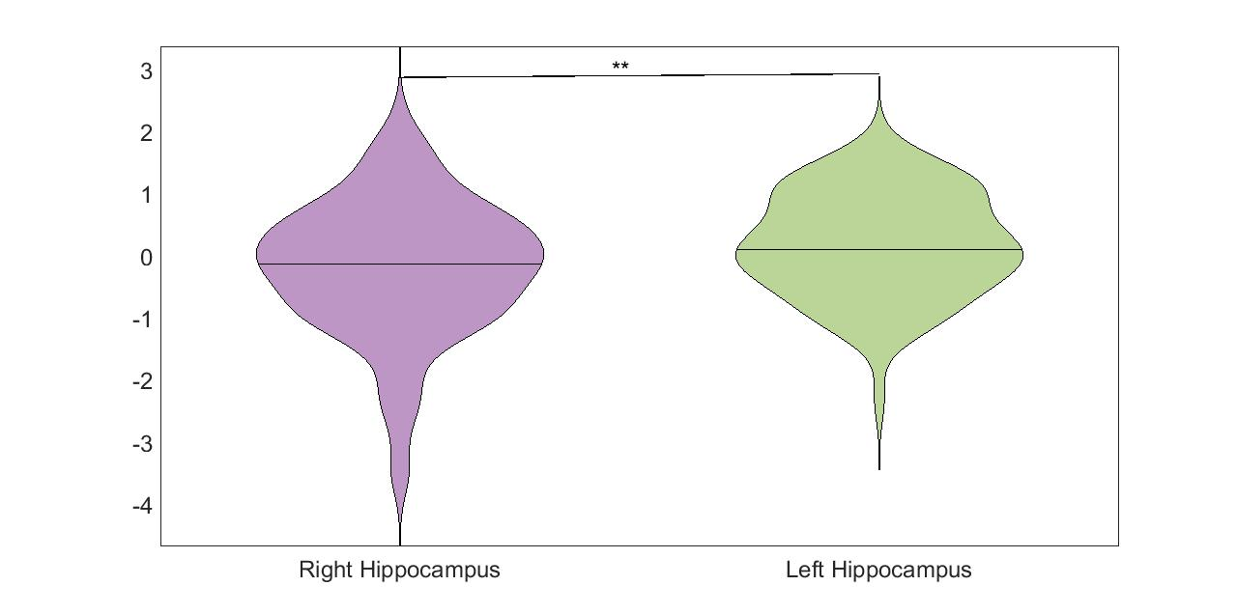
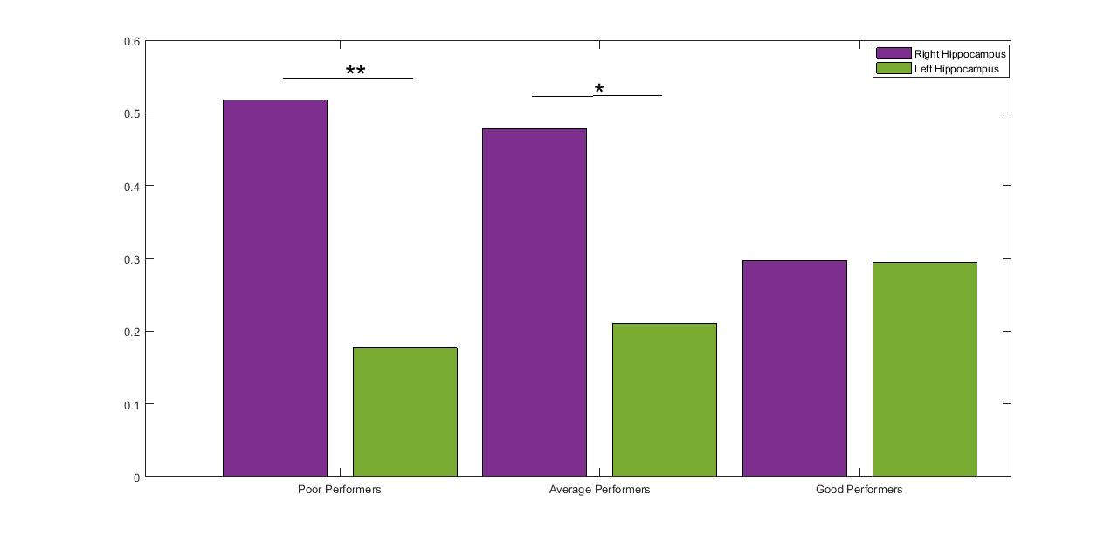
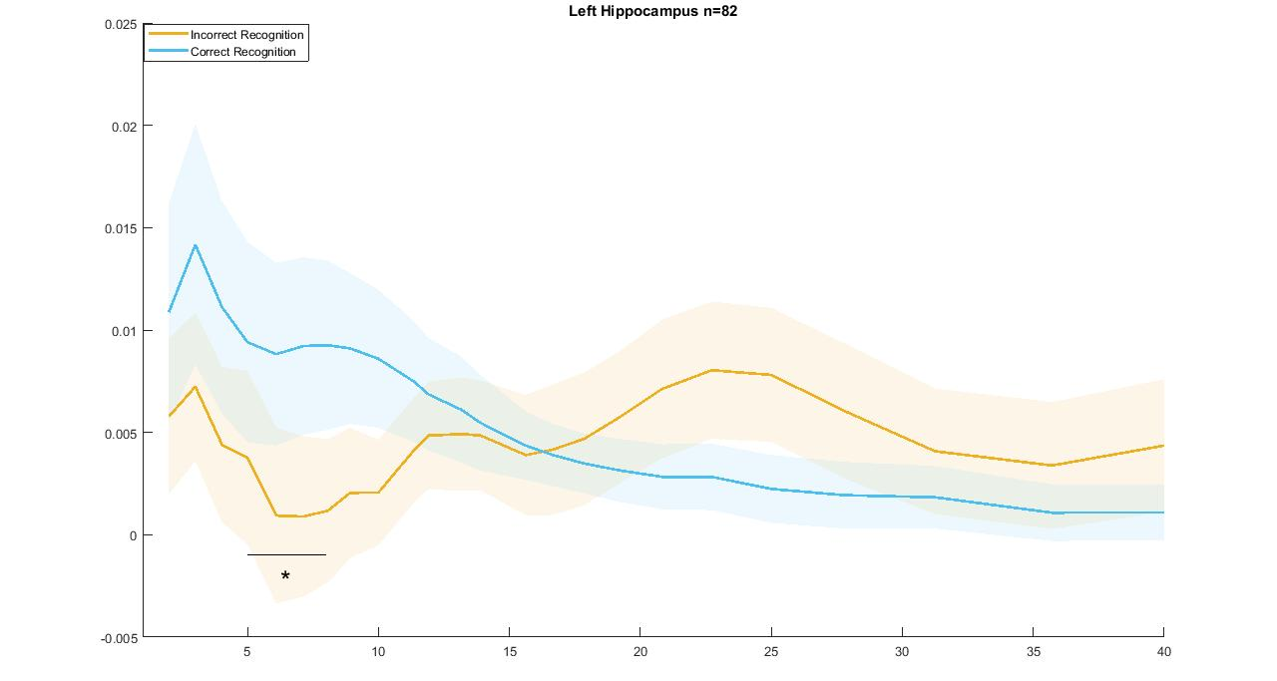
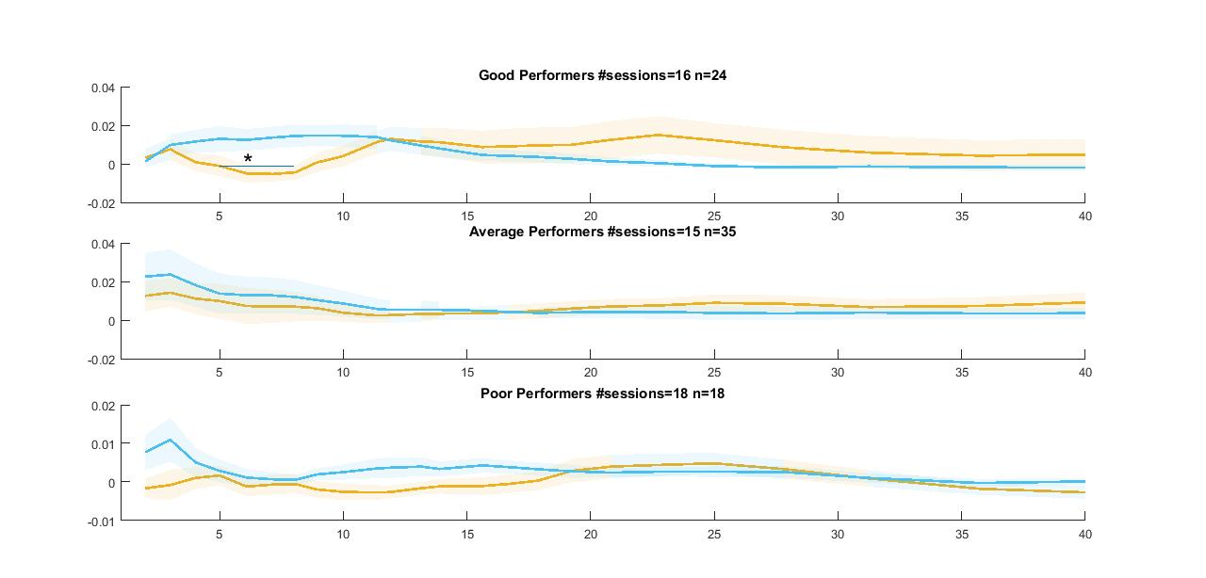
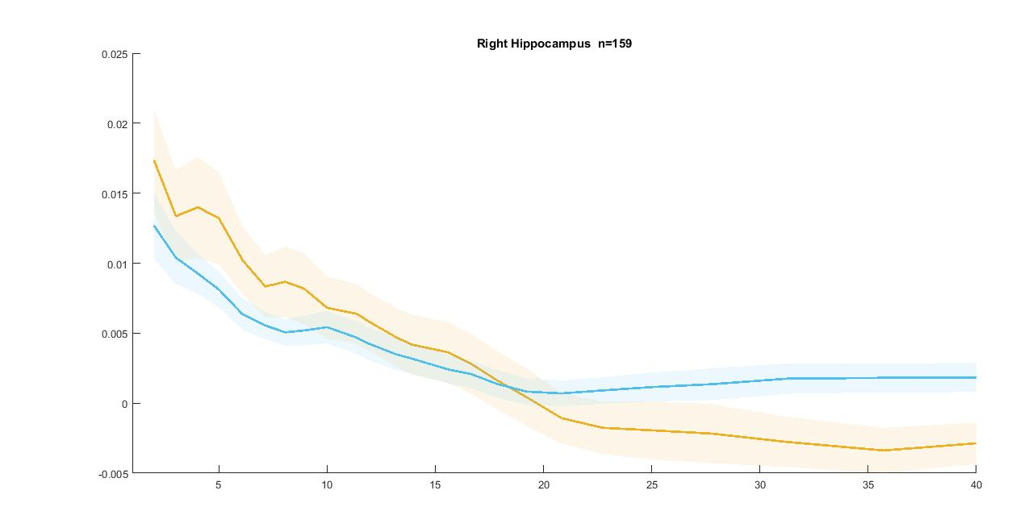
The Lateralized Hippocampus: Functional Differences Across Multiple Scales
of Neural Activity During Recognition Memory
C. K. Penner¹, J. Minxha^{1,2}, C. Mosher¹, A. N. Mamelak¹, U. Rutishauser^{1,3}
1 Department of Neurosurgery Cedars-Sinai Medical Center, Los Angeles, CA, USA 2 Center for Theoretical Neuroscience Columbia University, New York City, NY, USA
3 California Institute of Technology Department of Neuroscience, Pasadena, CA, USA
Background
Results 1: Right Hippocampal Neurons are more phase locked and visually responsive
Discussion
-There is extensive evidence that the human brain exhibits lateralization of function (3).
The human Hippocampus particularly appears to have two distinct computational motifs. The Left Hippocampus is thought to underlie semantic and long term memory processes . The Right Hippocampus is thought to underlie visual, spatial, and complex figurative memory processes (1,,4,5) . However, this dichotomy remains highly controversial.
However, the salient differences are typically not apparent at the electrophysiological level, in particular at the single-neuron level.
Here we sought out to evaluate these differences across multiple scales of Neural Activity recorded intracranially
during a recognition memory task.
1A
Figure 1A-C. Right Hippocampal neurons are significantly more likely to be visually responsive and locked to ongoing theta (3-8) rhythms.
Both of these factors are driven by a population of thin spiking putative inhibitory interneurons in the Right Hippocampus.
Proportion of Total Cells
We found evidence across multiple scales of neural activity (single cell functional types, theta power, and Spike Field Coherence) for left-right hemispheric disassociation of Hippocampal processes during recognition memory.
The classic dichotomy which predicts that the Right Hippocampus will be implicated in visual memory processes does not seem to clearly hold up in our data. While Right Hippocampal neurons were more visually responsive we find that it is the degree of spike field coherence in Left Hippocampal populations that most meaningfully predicted memory performance.
1B
1c
1C
Number of Total Cells
Number of Total Cells
1B
Trough to Peak Width (ms)
Results 2: Left Hippocampal True Theta Power is Higher than Right
Methods
2A
Works Cited
M1 Human Subjects (n=41) undergoing monitoring for intractable epilepsy carried out a recognition memory task using visual stimuli (2).
Figure 2A. Example of a Right Hippocampal Wire that exhibits Theta oscillations.
M1
M2
Power
1 Corsi, P. M. Verbal memory impairment after unilateral hippocampal excisions. Paper presented at the 40th Annual Meeting of the Eastern Psychological Association, Philadelphia, April 1969.
2 Faraut, M. C., Carlson, A. A., Sullivan, S., Tudusciuc, O., Ross, I., Reed, C. M., ... & Rutishauser, U. (2018). Dataset of human medial temporal lobe single neuron activity during declarative memory encoding and recognition. Scientific data, 5, 180010.
3 Gotts, S. J., Jo, H. J., Wallace, G. L., Saad, Z. S., Cox, R. W., & Martin, A. (2013). Two distinct forms of functional lateralization in the human brain. Proceedings of the National Academy of Sciences, 110(36), E3435-E3444.
4 Miller, J., Watrous, A. J., Tsitsiklis, M., Lee, S. A., Sheth, S. A., Schevon, C. A., ... & Worrell, G. A. (2018). Lateralized hippocampal oscillations underlie distinct aspects of human spatial memory and navigation. Nature communications, 9(1), 1-12.
5 Milner, Brenda. "Visually-guided maze learning in man: Effects of bilateral hippocampal, bilateral frontal, and unilateral cerebral lesions." Neuropsychologia 3.4 (1965): 317-338.
6 Rutishauser, U., Ye, S., Koroma, M., Tudusciuc, O., Ross, I. B., Chung, J. M., & Mamelak, A. N. (2015). Representation of retrieval confidence by single neurons in the human medial temporal lobe. Nature neuroscience, 18(7), 1041.
7 Vinck, M., van Wingerden, M., Womelsdorf, T., Fries, P., & Pennartz, C. M. (2010). The pairwise phase consistency: a bias-free measure of rhythmic neuronal synchronization. Neuroimage, 51(1), 112-122.
8 Watrous, Andrew J., et al. "Phase-tuned neuronal firing encodes human contextual representations for navigational goals." Elife 7 (2018): e32554.
Exemplar Visually Responsive neuron
2B
Figure 2B. When Considering only oscillatory periods the Left Hippocampus has significantly higher Theta Power during recognition periods.
Trial Number (re-sorted)
4-9 Hz Power During Stimulus Presentation (z)
Email: Cooper.Penner@cshs.org Twitter: @CooperPenner
Funding: The McKnight Foundation and NIMH (R01MH110831)
Firing Rate
(spikes per second)
Results 3: The Proportion Between Right and Left Hippocampal Locking Predicts Memory Performance
3A
3B
3C
Spike Field Coherence
(mean PPC)
M2 Single neurons were isolated and subsequently classified based on their functional tuning properties (visual responsiveness, memory selectivity, and category selectivity) as well as extracellular action potential features (6).
Artifacts and activity related to epilepsy were removed using a semi-automatic approach
Oscillatory periods were identified in the LFP with an augmented version of a peak finding approach (8). Only wires with theta rhythms above the 1/f spectrum were considered for the power analyses
The degree of neuronal phase locking to ongoing theta was quantified with
spike field coherence (SFC). We used Pair Wise Phase Consistency (7) [PPC] to
quantify SFC.
Spike Field Coherence
(mean PPC)
Proportion of Total Cells
3D
3A) Poor Performers (accuracy < 70 %) had a significantly higher proportion of cells locked to Right as compared with Left Hippocampal theta. This discrepancy vanished as memory capacity increased such that good performers had a nearly even proportion of cells locked to Right and Left Hippocampal Theta.
Spike Field Coherence
(mean PPC)
3B) Left Hippocampal locking to theta predicted correct memory on a trial to trial basis.
3C) This effect was driven by the Good Performers (accuracy >75%)
3D) There was no significant relationship between Right Hippocampal theta locking and memory performance on a trial to trial basis

