Slide 1
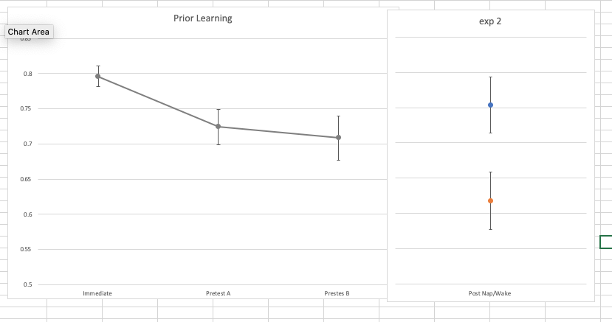
Does sleep-dependent memory consolidation rescue memories from decay in early childhood?
THE FUNCTION OF MID-DAY NAPS ON PRIOR DECLARATIVE LEARNING FOR PRESCHOOL CHILDREN
K. Rodheim, R.M.C. Spencer
Psychological and Brain Sciences, University of Massachusetts Amherst
RESULTS
DISCUSSION
These results thus far are consistent with predictions that naps can recover memories. Whether or not the memories were recovered by an active or a passive role is ongoing. Future analysis will include more participants to further explore the role of mid-day naps in preschool aged children.
REFERENCES
1. Kurdziel, L.B.F., K. Duclos, and R.M.C. Spencer, Sleep spindles in mid-day naps enhance learning in
early childhood. Proceedings of the National Academy of Sciences, 2013. 110: p. 17267-17272.
2. Ebbinghaus, H., Memory: A contribution to experimental psychology. 1964, New York, NY: Dover.
3. Diekelmann, S. and J. Born, The memory function of sleep. Nature Reviews Neuroscience, 2010.
11(2): p. 114-26.
4. Ellenbogen, J.M., et al., Interfering with theories of sleep and memory: sleep, declarative memory, and associative interference. Current Biology, 2006. 16(13): p. 1290-4.
katrinarodheim@gmail.com
INTRO
Naps in preschoolers have been found to benefit declarative learning. Intriguingly, these data also suggest that naps may recover memories that may have decayed over wake. That is, following an interval with >1hr awake followed by 2 hrs of sleep, performance was unchanged while accuracy declined if the 3hrs were spent awake. This study tested the prediction that memories decay over wake following learning and are then recovered by a delayed nap.
METHODS
Forty-seven preschool-aged children (M age = 51.9 mo, 54.5% female) learned a visuo-spatial memory task in the morning on two separate occasions separated one week apart, where on one occasion they napped and the other they did not.
Recall was tested immediately after encoding, and after the afternoon nap/wake interval. Additionally, performance was probed either 1hr (pre-test A) or 2hrs (pre-test B) after immediate recall.
Accuracy decayed between immediate recall and pre-test A (p=0.010; n=27)
Between immediate recall and pre-test B (p=0.005; n=20).
An additional 6 participants replicated previous findings that learning was protected following the nap and decayed following wake (p=0.038).
Figure A is depicting the hypothesis that the nap plays a passive role and Figure B is depicting the hypothesis that the nap is playing an active role in consolidation.
Find out more at…
Curious about our poster format? Check out…
Initial Learning | Immediate Recall | Pre-test A | Pre-test B | Nap/Wake | Delayed Recall |  | 24-hour Recall
9:30-10am | 10am | ~11am | ~12:30pm | 1-3pm | 3:30pm |  | 9:30am
Notes:
Notes:
In Powerpoint, click View > Guides
Keep text within gutter guides.
Author list: Don’t split names onto two lines (e.g., “Jimmy [break] Smith”). If that happens, use a new line, unless you need the space. Bold the first names of anybody who’s presenting in person.
Intro/methods/result: Do not drop below font size 28, but if you have extra space, jack up the font size until the space is full.
Do not use color in the sidebars except in graphs/figures. It’ll pull attention from the center and slow interpretation for passersby.

