Slide 1
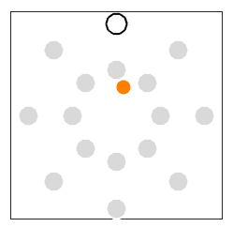
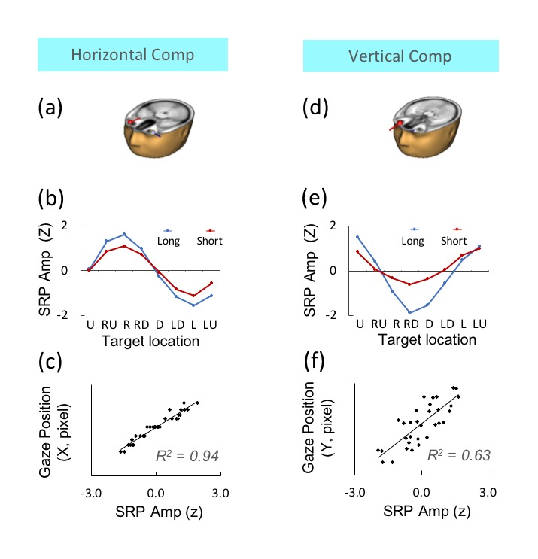
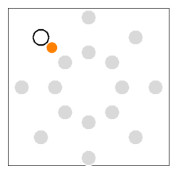
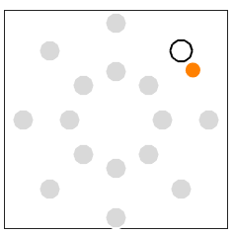
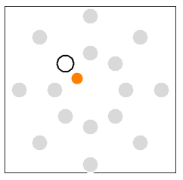
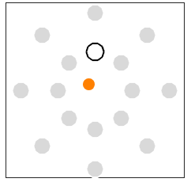
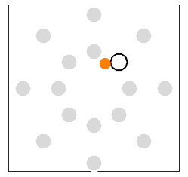
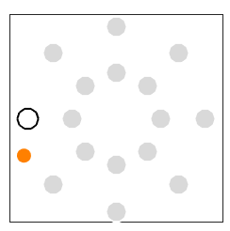
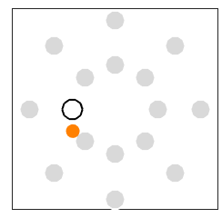
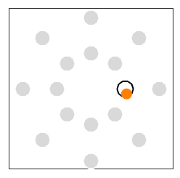
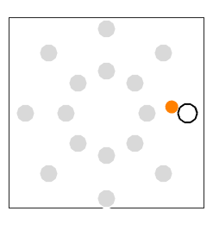
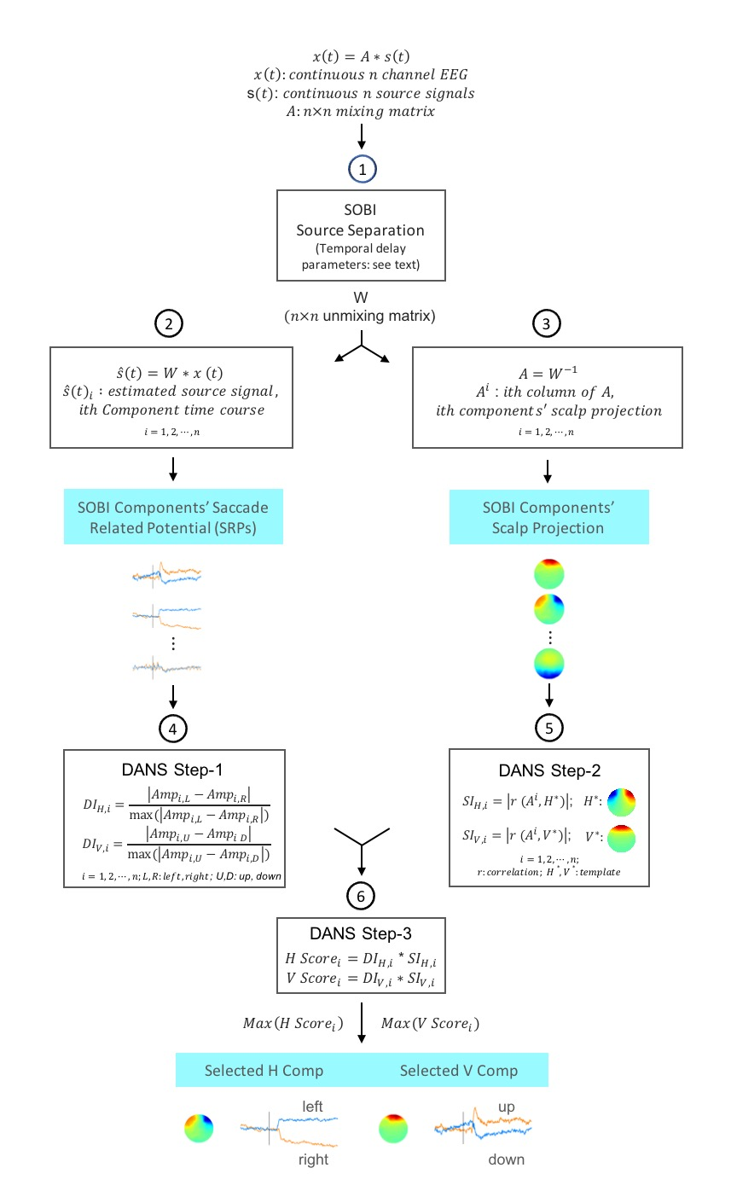
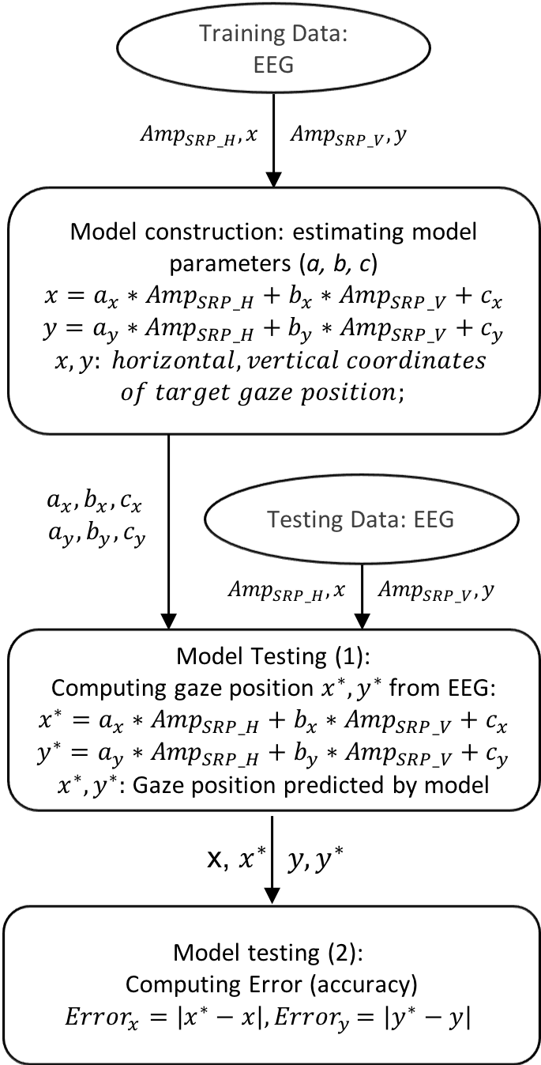
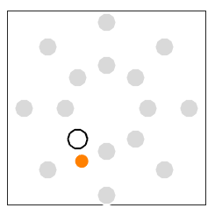
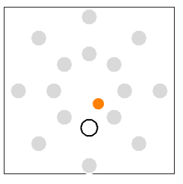
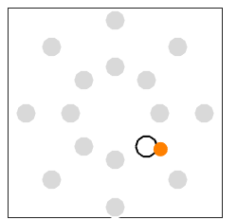
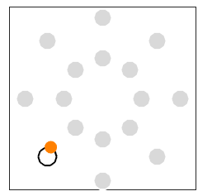
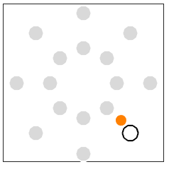
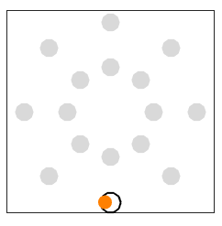
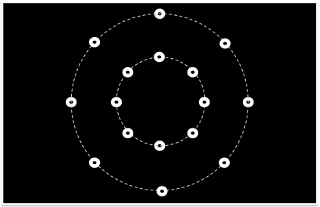
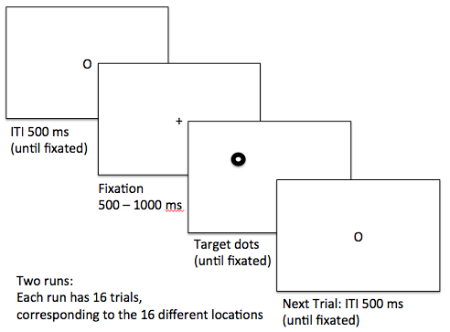
Tracking horizontal eye movement via ocular components extracted from EEG by second-order blind identification (SOBI)
Rui Sun¹, Cynthia Chan², Janet Hsiao², Akaysha C. Tang^{1,3**}
1. The Laboratory of Neuroscience for Education, Faculty of Education, the University of Hong Kong 2. Department of Psychology, the University of Hong Kong 3. The MIND Research Network, Albuquerque, NM, USA
INTRODUCTION
RESULTS
Ocular artefact in EEG has long been viewed as a problem for interpreting EEG data in basic and applied research.
Companion abstract 44616121) showed that two components (Comps), recovered by SOBI, can code horizontal (H) and vertical (V) saccadic eye movements. (Joyce et al, Psychophysiology, 2004) (Joyce et al, Psychophysiology, 2002) (Mannan et al, IEEE Access, 2018)
Here we attempt to use these SOBI derived H and V Comps as a virtual eye-tracker to construct a model to predict horizontal gaze positions in the context of a directed eye movement task.
We aim to answer two questions: (1) how much data will be needed to calibrate the model to produce asymptotic performance in prediction? (2) What is the asymptotic level of performance of our virtual eye tracker?
An example of H & V Comps:
The dipole locations are consistent with an ocular origin.
SRP amplitude is tuned by direction and distance
SRP amplitude are highly correlated with gaze position
Model performance on testing data
Target dot
Predicted position
SOBI-DANS performance: an example
Testing data from Block ?
Predictions made by M?
Errors in vertical dimension is bigger
Only error in the horizontal dimension is further analyzed in this work
METHODS
Data Acquisition
Single-subject performing directed eye movement to targets in 10 blocks of 16 trials
Stimuli per block: dots on 17.5-inch monitor with a screen resolution of 1280x720 pixels in 8 directions and 2 distance of 12.2° and 6.1° of visual angle.
Eye tracking data by SMI REDn eye tracker (60Hz) co-registered with EEG
EEG data (64 chan ANT EEGOTMMylab system) collected at 500Hz.
Error Between Gaze Position Predicted by SOBI-DANS and Target position
Model performance on training data
Asymptotic performance reached with a minium of 4 blocks of data: accuracy 0.44 ± 0.10 degree of visual angles (N=318) corresponding to an accuracy of 3 mm at a 40 cm reading distance and 3cm at a 4 meter recommended distance for watching a 32” TV.
R = 0.968 ± 0.001; R² = 0.937 ± 0.002 (N=7)
Error (Deg of Visual Angle)
Mode Parameters
Summary
Data processing flowcharts
Using SOBI blind source separation to derive unmixing matrix W from using different amount of continuous EEG data. Wi: W derived using data from Bock 1 to Block I ( i=1,2, 9)
DANS to identify one pair of H and V Comps from each Wi
Model Construction using training dataset: Mi—model constructed using training data from BK1 to BKi
Fitting linear regression model of gaze position as a function of SRP response of H and V Comps in training data
Using the model parameters obtained above to predict gaze positions
Model testing using testing dataset: BK i+1 to BK 10 ( i=1,2, 9)
We are able to construct models from EEG to predict gaze position in the horizontal dimension with a rather high level of accuracy (a few mm errors).
Our preliminary results raised the possibility of transform ocular artifacts into predictive signals for tracking eye movement.
The SOBI-DANS method may enable the investigation of neural mechanisms underlying natural reading. during which eye movement is an integral part of neural information processing.
Mode Parameters
$$a_{x}$$
$$b_{x}$$
We thank G.F Wong, PKY. Chan, SW. Yan, L. Pei., Privatera A. J. and Dr. JY. Liu of the for their assistance.

