Slide 1
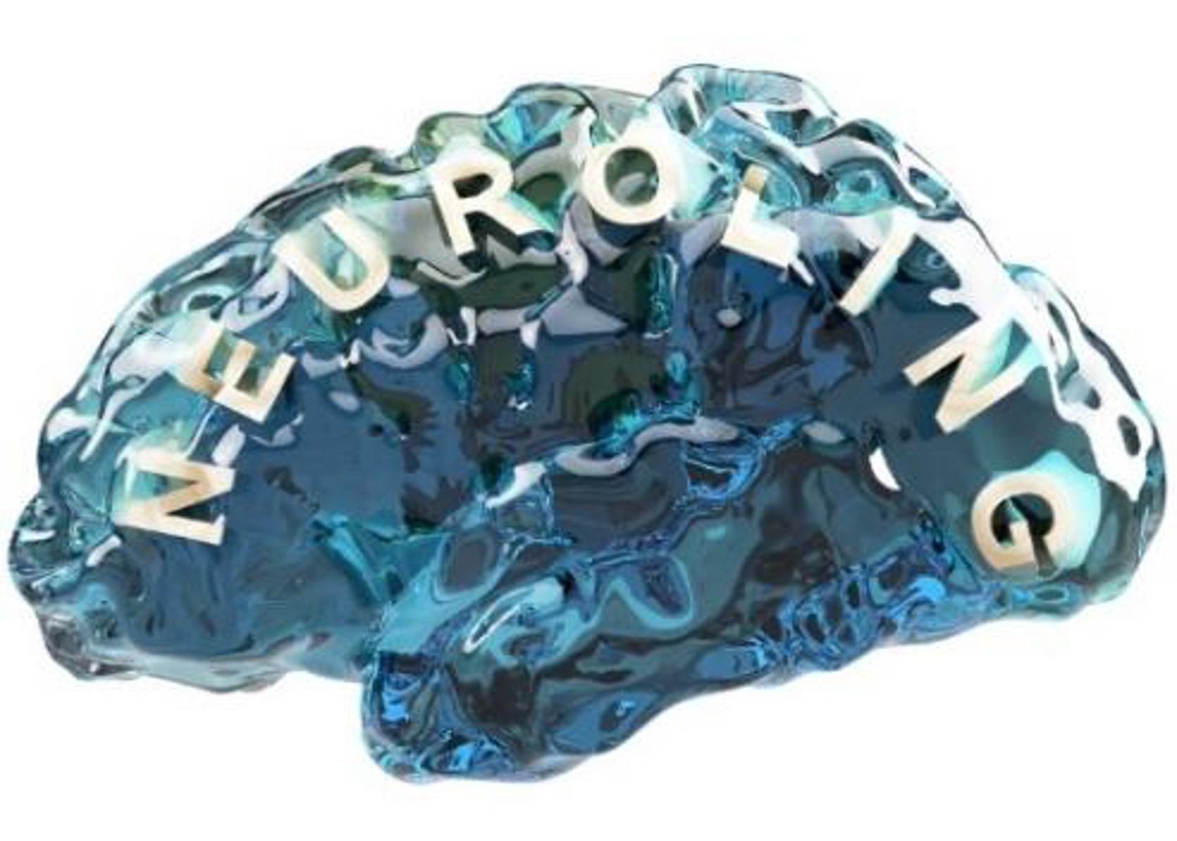
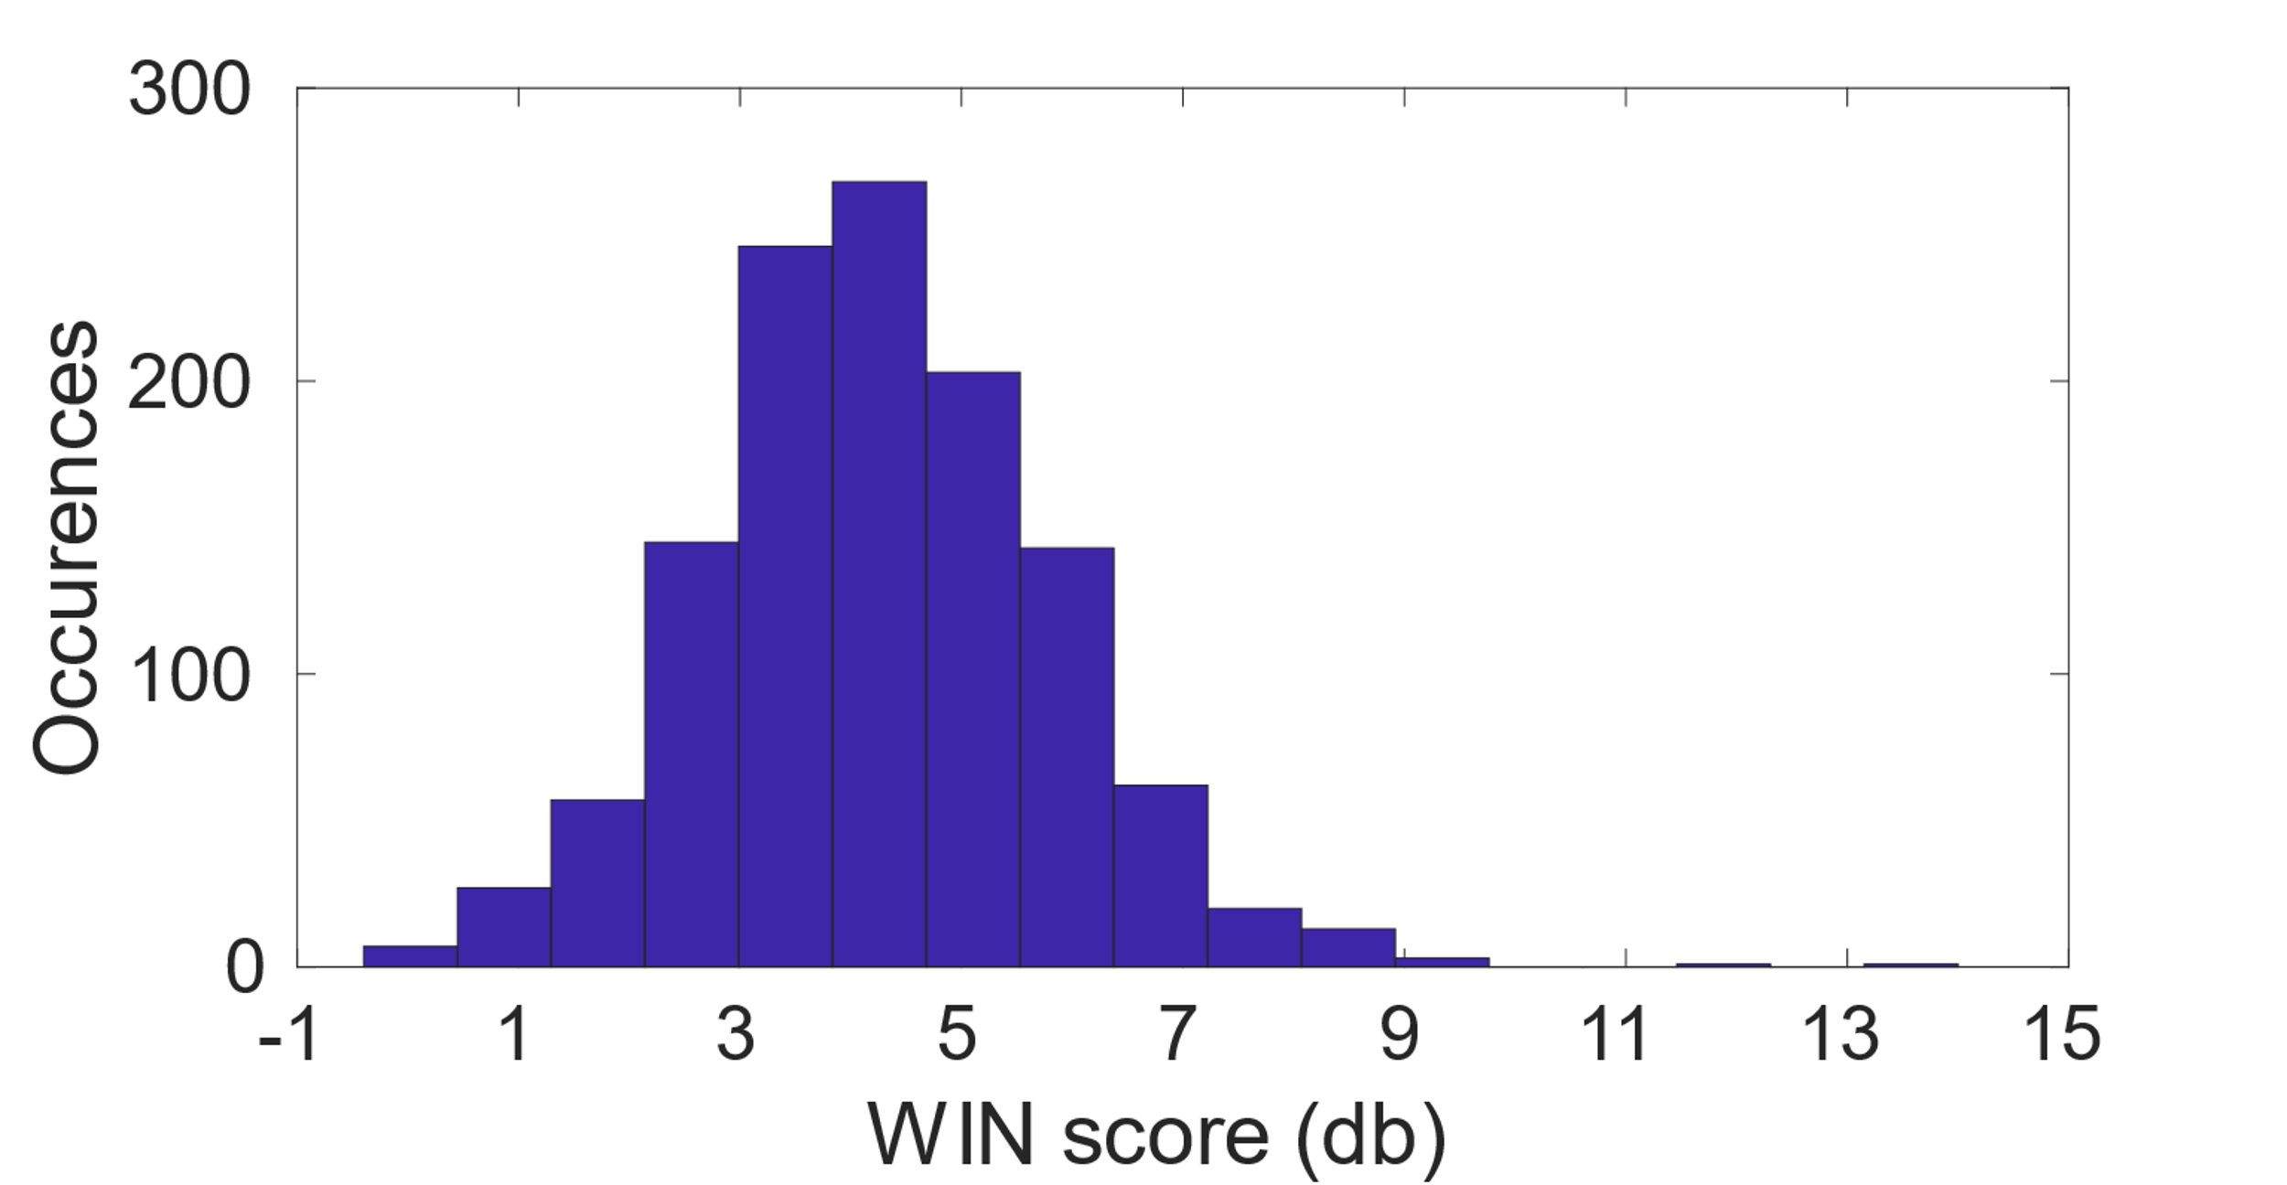
Function vs Structure: Factors Related to Speech In Noise Comprehension In A Thousand Young, Normally-Hearing Listeners
Robert Becker, Alexis Hervais-Adelman
Neurolinguistics, Department of Psychology
University of Zurich, Switzerland
Introduction
The ability to comprehend speech under acoustically challenging conditions varies widely across individuals. This is typically attributed to cognitive factors supporting the listening effort required to comprehend speech in adverse listening conditions. This notion has been formalised in a number of models that focus on the cognitive factors supporting speech comprehension in hearing impairment, e.g. the role of working memory and cognitive flexibility [1-3]. Here we probe the relationship between word in noise recognition (WIN) and a battery of cognitive factors as well as cortical thickness in a large cohort of young, normally hearing listeners.
Behavioral variable related to word in noise comprehension score | R | % variance explained
Picture Vocabulary Test | -0.21 | 4.53
Reading Test | -0.21 | 4.34
Language Comprehension Task | -0.12 | 1.45
Relational reasoning task | -0.15 | 2.24
List sorting task | -0.15 | 2.10
Picture sequence memory task | -0.12 | 1.53
Working memory task | -0.19 | 3.68
Total* |  | 7.19
Methods
Participants: 1113 participants made available by the Human
Connectome Project [4]. Age 22 - 37years, Mean = 28.80, SD = 3.69, Sex: 606 F, 507 M, Handedness (Edinburgh Handedness Inventory, -100 completely left dominant, 100 completely right dominant): Mean 65.88, SD 44.20.
Word in Noise Comprehension
assessment: Seven lists of five monosyllabic words presented at decreasing SNRs (dB: 26 to -2 in -4dB steps). WIN Performance
reported as Threshold in dB SNR.
Range: -0.4 to 14, Mean = 4.39, SD = 1.51 (see Fig. 1). For analysis, WIN scores were deconfounded for the factors: Age, Sex, Handedness.
Structural Imaging: 3D MPRAGE, 07mm isotropic voxels, TR=2400ms, TA=2.14ms, TI=100ms, Flip Angle=8deg, FOV=224x224mm.
Parcellation: Cortical thickness values were parcellated according to the Destrieux-Atlas (148 parcels covering the whole brain, [5]).
Stepwise regression: From a first full multiple regression mode, available terms were added (from n=148 + constant term) if F-test with p < 0.05, or, worst terms were removed, stopping if terms could neither be added or removed.
* R-square statistics in a multiple regression analysis.
Stepwise regression showed that these and five further regions contribute significantly to explaining WIN (adjusted r-squared=.06, p<.001).
Regressing out significantly related cognitive variables from WIN prior to stepwise regression did not change results qualitatively and only moderately reduced the amount of explained variance by cortical thickness (resulting in an adjusted r-squared = .05, p<.001, see Fig. 2).
Fig. 1. Distribution of WIN scores in cohort.
A
Left hemisphere
A
1.51
Medial
Beta coeffs.
0
Lateral
P
P
-0.7
Right hemisphere
Fig. 2. Results of step-wise regression of WIN scores (after regressing out variables from Table 1) with (parcellated) cortical thickness. Blue areas: positive correlation with WIN performance; red areas: negative correlation with WIN performance (WIN is an inverse score). A = anterior, P = posterior.
Exploratory analysis & results
Correlations between WIN (corrected for age) and scores on 218 behavioural and demographic indicators were evaluated. After correcting for multiple comparisons (p_{(Bonferroni)}<0.05, seven cognitive variables were identified as significantly related to speech in noise recognition performance, variables that reflect working memory performance, and crystallised and fluid intelligence (all with |r| > 0.12). Although the proportion of variance explained by these cognitive factors is low (at < 5% separately and 7% for total explained variance), this establishes that they are relevant even in younger listeners, although other factors are evidently also in play.
Notably, multiple regression indicated that cortical thickness explained up to 16% of the variance in WIN (p<0.05). Among the regions most correlated with WIN were left central sulcus and right superior frontal gyrus, as well as right Heschl's gyrus.
Discussion
Even despite reports of the functional relevance of brain structural information [6], it is intriguing that – given its static nature - it predicts WIN performance to this extent, more so than any of the cognitive test scores that are often associated with speech-in-noise comprehension. It is also noteworthy that the brain-function correlation observed here does not seem to be solely driven by these more overarching cognitive functions but that this link remains even after removing these covariations from the analysis.
References
[1] Fullgrabe, C., & Rosen, S. (2016). On The (Un)importance of Working Memory in Speech-in-Noise Processing for Listeners with Normal Hearing Thresholds. Front Psychol, 7, 1268. doi:10.3389/fpsyg.2016.01268
[2] Pichora-Fuller, M. K., Kramer, S. E., Eckert, M. A., Edwards, B., Hornsby, B. W., Humes, L. E., . . . Wingfield, A. (2016). Hearing Impairment and Cognitive Energy: The Framework for Understanding Effortful Listening (FUEL). Ear Hear, 37 Suppl 1, 5S-27S.
[3] Ronnberg, J., Lunner, T., Zekveld, A., Sorqvist, P., Danielsson, H., Lyxell, B., . . . Rudner, M. (2013). The Ease of Language Understanding (ELU) model: theoretical, empirical, and clinical advances. Front Syst Neurosci, 7, 31. doi:10.3389/fnsys.2013.00031
[4] David C. Van Essen, Stephen M. Smith, Deanna M. Barch, Timothy E.J. Behrens, Essa Yacoub, Kamil Ugurbil, for the WU-Minn HCP Consortium. (2013). The WU-Minn Human Connectome Project: An overview. NeuroImage 80(2013):62-79.
[5] Destrieux, C., Fischl, B., Dale, A., & Halgren, E. (2010). Automatic parcellation of human cortical gyri and sulci using standard anatomical nomenclature. Neuroimage, 53(1), 1-15. doi:10.1016/j.neuroimage.2010.06.010
[6] Llera, A., et al. (2019). "Inter-individual differences in human brain structure and morphology link to variation in demographics and behavior." eLife 8., doi: 10.7554/eLife.44443
Acknowledgments
Work supported by the Swiss National Science Foundation, Grant PP00P1_163726 awarded to A. H-A. Data were provided by the Human Connectome Project, WU-Minn Consortium (PIs: David van Essen and Kamil Ugurbil; 1U54MH091657) funded by the 16 NIH Institutes and Centers that support the NIH Blueprint for Neuroscience Research; and by the McDonnel Center for Systems Neuroscience at Washington University.

