Slide 1
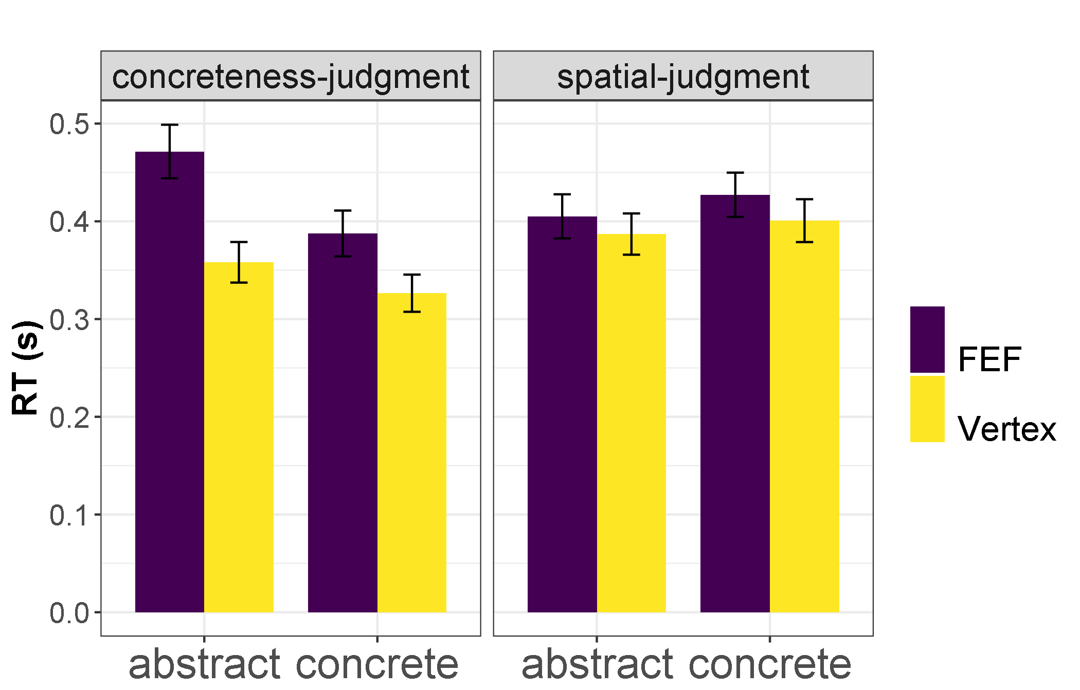
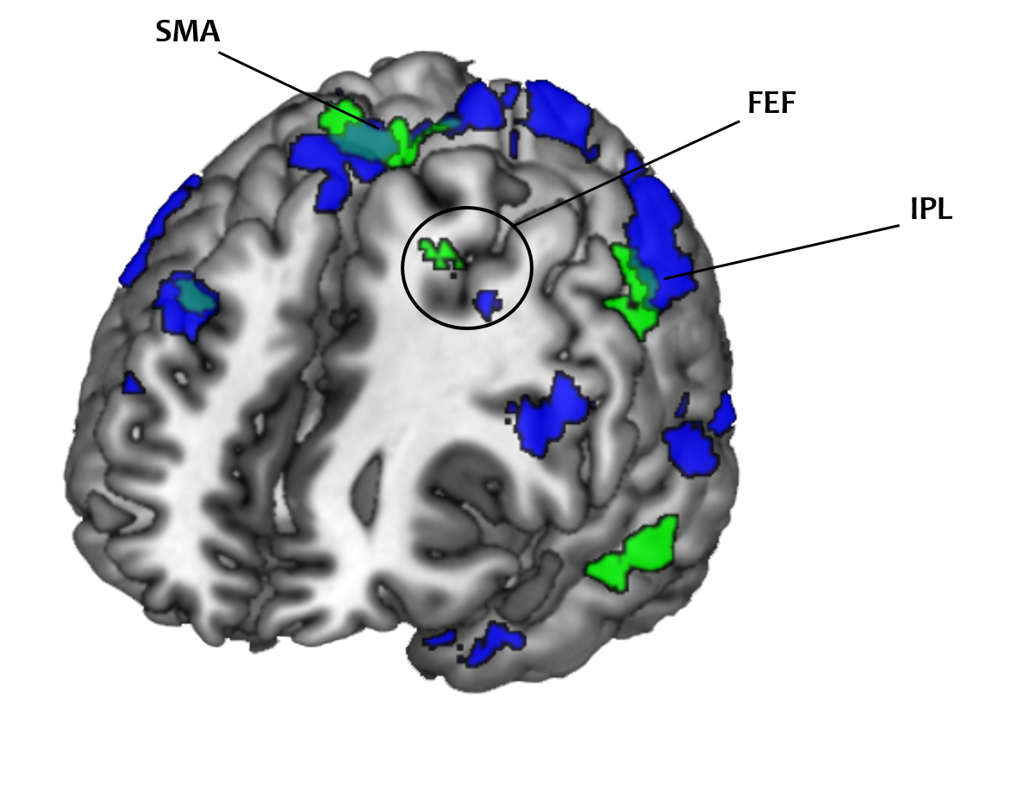
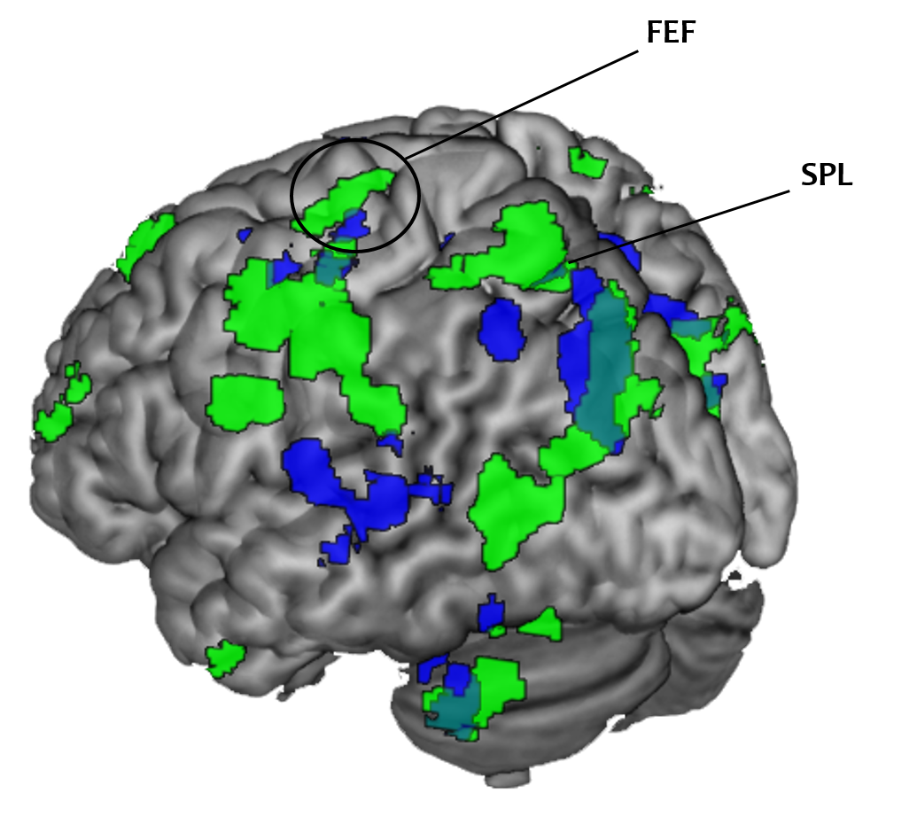
Comprehension of spatially-related words relies on direction-specific processes in the spatial attention network: a combined TMS-fMRI study
Center of Functionally Integrative Neuroscience
Markus.Ostarek@mpi.nl
Markus Ostarek 1, Nikola Vukovic 2,3, Jeroen van Paridon1, Yury Shtyrov2, Falk Huettig1 1MPI for Psycholinguistics Nijmegen, 2Aarhus University, 3UC San Francisco
Processing spatially-related words (e.g., bird, foot) influences the identification of targets in compatible (i.e. up vs. down) location [1]
Recent eye-tracking data suggest that up/down words activate the oculomotor system [2]
Hypothesis: Comprehension of up/down words relies on direction-specific patterns in the cortical oculomotor network
We used MVPA on fMRI data followed up by TMS on the frontal eye field (FEF)
TMS experiment
Does the FEF activation reflect processes that are functionally relevant for comprehension?
Participants performed concreteness or spatial judgments on the same word stimuli while either the left FEF or vertex was stimulated at 110% of the rMT with 4 biphasic pulses (every 50ms from word onset
Prediction: TMS of FEF interferes more strongly with concrete up/down words and more strongly in the spatial judgment task
Results: TMS on FEF interfered most strongly with abstract words in the concreteness judgment task
***
*
MVPA experiments
24 concrete words (12 up, 12 down), 24 abstract control words
Task 1: Concreteness task
Task 2: Eye movement task (up vs. down saccades)
Searchlight decoding of words‘ spatial associations and cross-decoding (up vs. down saccades to up vs. down words)
Significant clusters were observed in several regions involved in spatial attention including the FEF
However, the saccades caused motion artefacts, thus we carried out a second experiment with a covert spatial attention task instead
Cross-decoding
Conclusion
Whether a word referent is typically perceived up or down in space can be decoded from regions of the spatial attention network including the FEF
Activation patterns are shared between up/down word processing and spatial attention (overt and covert)
This suggests that up/down words activate simulations of situations in which their referents are experienced
Surprisingly, TMS of the FEF affected RTs in the concreteness task only and affected abstract words more strongly than concrete up/down words
Our results suggest that words with spatial associations activate direction-specific patterns in the spatial attention network, but TMS of the left FEF does not selectively impair their processing
Decoding of words’ spatial association
Cross-decoding
Decoding of words’ spatial association
1 Gozli, D. G., Chasteen, A. L., & Pratt, J. (2013). The cost and benefit of implicit spatial cues for visual attention. JEP: General, 142(4), 1028.
2 Ostarek, M., Ishag, A., Joosen, D., & Huettig, F. (2018). Saccade trajectories reveal dynamic interactions of semantic and spatial information during the processing of implicitly spatial words. JEP: LMC, 44(10), 1658.
Again, we observed significant decoding and cross-decoding in the same FEF location

