Slide 1
Bayesian Models of Atypical Sensory Perception in the Autism Spectrum
Randeniya, R.¹, Vilares I.²,Tanksale R.¹, Mattingley J.¹, Garrido I.³
      The University of Queensland
      The University of Minnesota
      The University of Melbourne
Contact: r.randeniya@uq.edu.au

Slide 2
Abstract

Slide 3
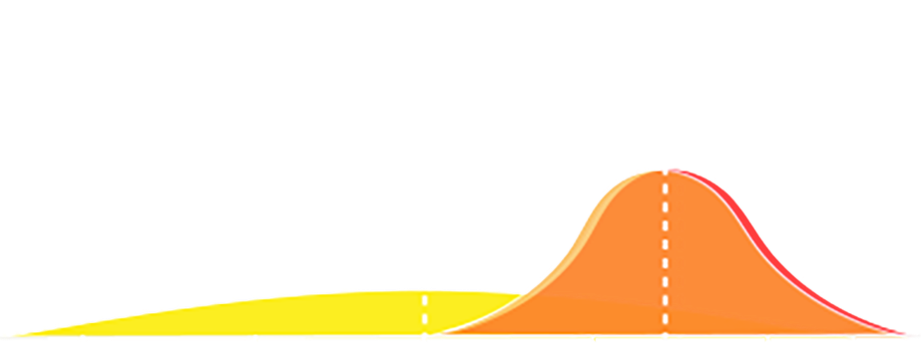
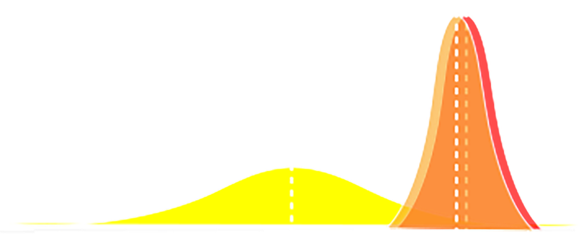
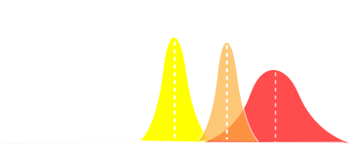
Bayesian Models of Sensory learning IN ASD:
Posterior
Prior
Sensory observation/
Likelihood
Hypo priors (Pelicano & Burr, 2012)
Weak priors (high variance) increases reliance on observation
Precise Likelihood (Brock, 2012)
Less noise in sensory observation (less variance) increases reliance on observation
HIPPEA (Van de Cruys et al. 2013)
high, inflexible precision of prediction errors (HIPPEA)
Notes:
So when we were trying to understand how a typical person learns from their environment and forms decisions, a very intuitive explanation is the Bayesian perspective of sensory learning. Imagine that since you came in the room you made sensory observations or you measured the level of light in the room. So over time this allows us to form a model of how we think the level light of works. So according to this Bayesian perspective we use both this sensory information and prior information to form a perception or decision which we call a posterior distribution.
the mechanisms of atypical perception in ASD, a very intuitive approach is to look at Bayesian explanation of sensory learning.
3 models specifically with a Bayesian perspective have attempted to explain why autistic perception and particularly hypersensitivities can occur.
Hypo-priors model states that this is caused by the prior learnt information is weak and thus the posterior representation is weighted more by the likelihood.
Precise-Likelihood model states that this is caused by too accurate sampling of information leading to again the likelihood being weighted more heavily.
Finally the precise-priors model states the distribution to be more narrowly tuned thus likelihood being weighted more.
Weighting of sensory infor
- Criticism of these views: they can only explain some symptoms (e.g. sensory overload)

Slide 4
Evidence for MODELS IN autism Spectrum
Long term priors have shown to be intact in children with ASD (Croydon et al 2017)
Evidence for hypo-priors model (Skewes et al 2014)
Evidence for precise likelihood model (Karvelis et al 2018)
Likelhood Std
Notes:
Light from above prior intact (Croydon et al 2017) - Found no evidence for disruptions in reliance on priors in ASD compared to typical.
Grating in gabor orientation (Skewes et al 2014) - Looked at autistic traits & found evidence for hypo-priors model and no evidence for sensory precision model
But a key aspect of ASD has been ignored, and that is the role of sensory sensitivities in forming these models of the environment. So in this talk I’m going to discuss a possible mediating role of sensory sensitivities in perception.

Slide 5
Research Questions
Increased reliance on likelihood as Autism traits and Sensory Sensitivities increase?
Likelihood reliance
Autism Traits
Visual sensitivities
2. Which Bayesian model can explain sensory learning with Autism traits?
Hypo priors
Precise Likelihood
HIPPEA
Notes:
So today I’m going to address the following questions.
First we want to investigate is there an increased reliance on new information related to Autism Traits and Sensory Sensitivities.
And next we want to try and see if we can disentangle any of the 3 current models.
So we did have an overarching goal of investigating the priors and likelihood representations in the brain, but I won’t be discussing this data today. ☺

Slide 6
Methods
Recruitment
Neurotypicals = 48 and ASD=32
Autism Diagnostic Observation Schedule (ADOS) Assessments and/or Questionnaires
The Autism Quotient (AQ) & Sensory Processing Questionnaire (SPQ)
(~30mins)
Coin-Task Practice (~10mins)
fMRI Session with Coin-Task (<1 hr)
Likelihood Only Task
(~15mins)
Notes:
So, before I get into the results this is what our participants underwent. We recruited 47 Neurotypicals and 32 individuals with a diagnosis of ASD. Autism diagnosis was confirmed by a psychologist who undertook the ADOS interview with them. And everyone completed Autism Quotient and Sensory Processing Questionnaire by the Baron-Cohen group. All participants did a short practice of the Coin Task and then did the task either in our outside of the scanner.

Slide 8
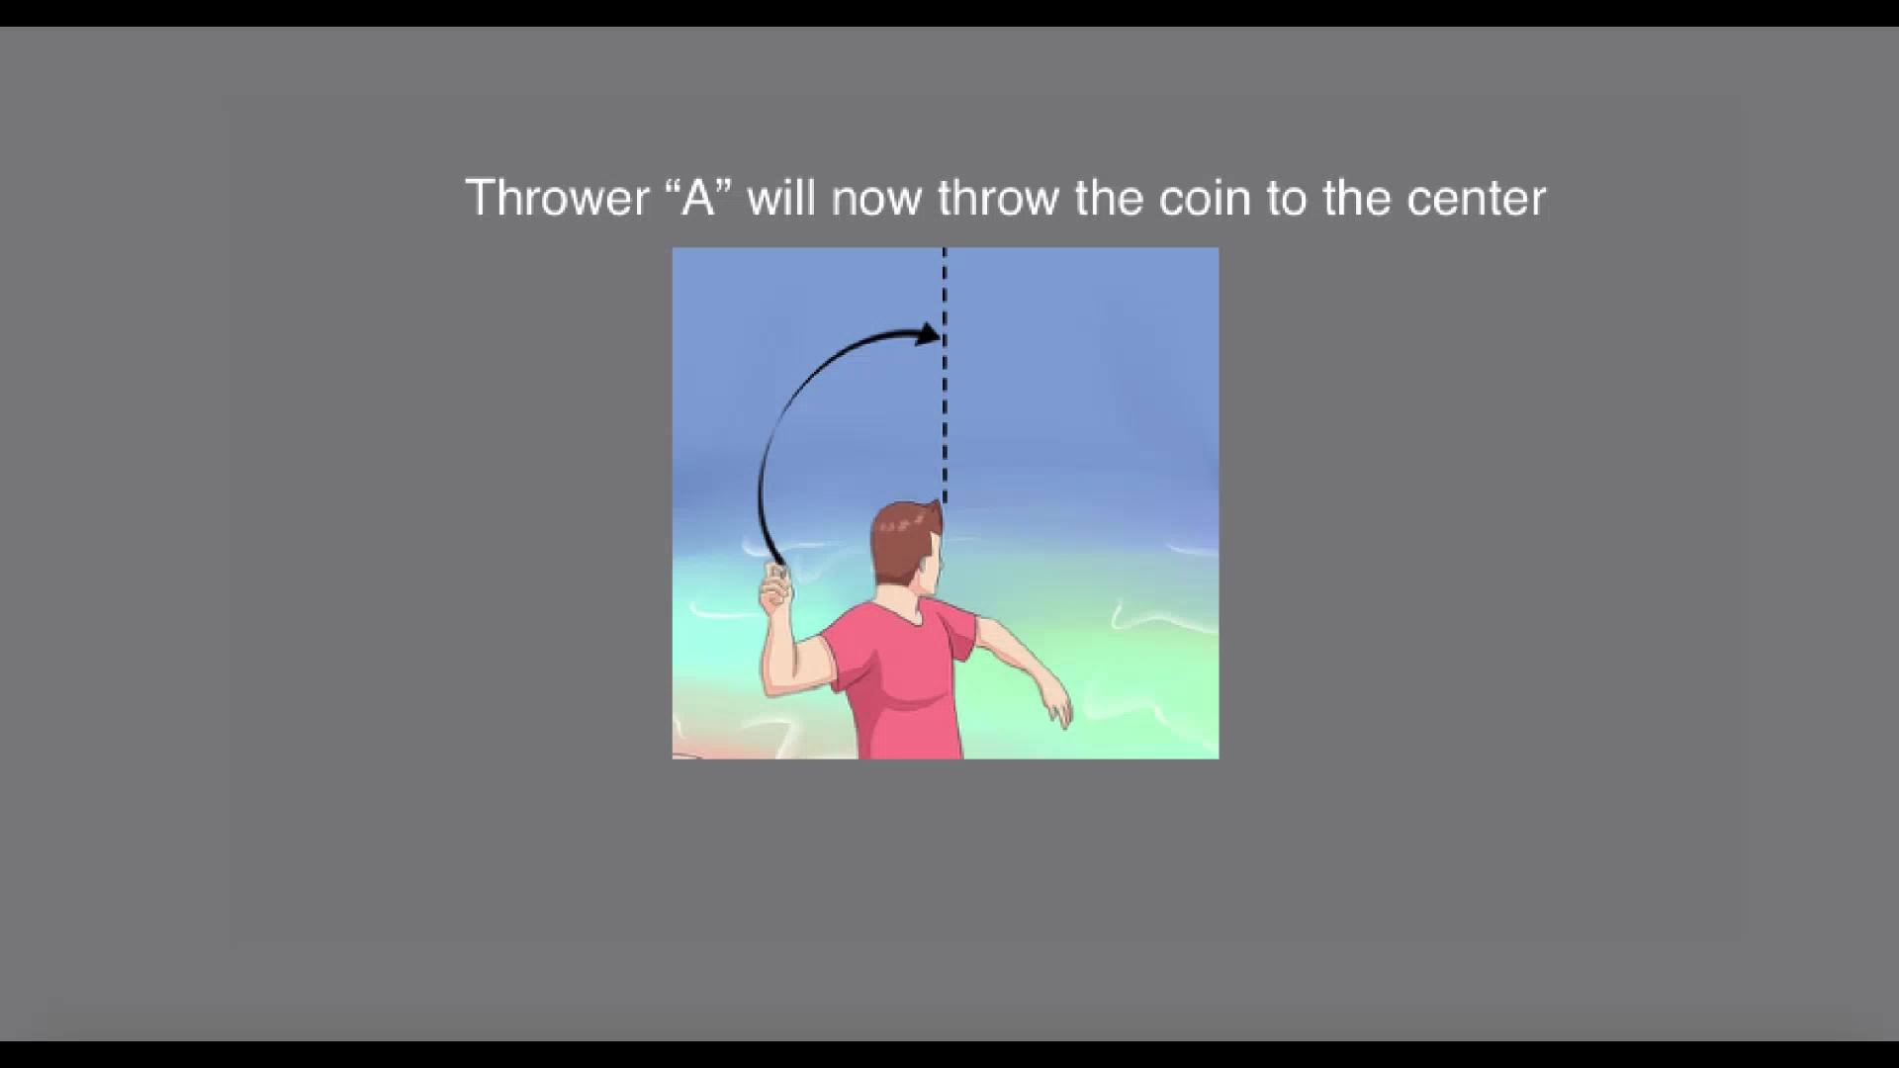

Slide 9
Coin Task (Vilares et al. 2012)
Notes:
So to answer the 3 questions I highlighted before we adapted task developed by Iris Vilares, which was designed to investigate Bayesian Learning.
So I’ll take a few minutes to run through the task with you.

Slide 10
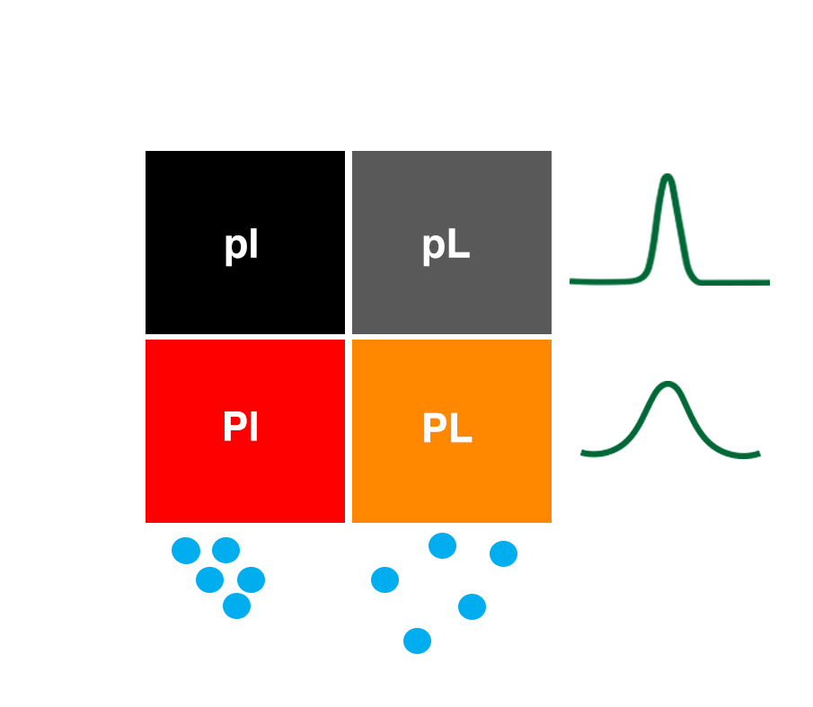
Four conditions/trial types:
P_{N}L_{N}
P_{N}L_{W}
P_{W}L_{N}
P_{W}L_{W}
Notes:
So task was a 2by2 design with four conditions. We had a “good thrower”, who was more likely to throw closer to the middle of the screen and a “Bad thrower” or wide prior. And similarly you saw that the splashes could be narrow or wide.

Slide 11
Results

Slide 12
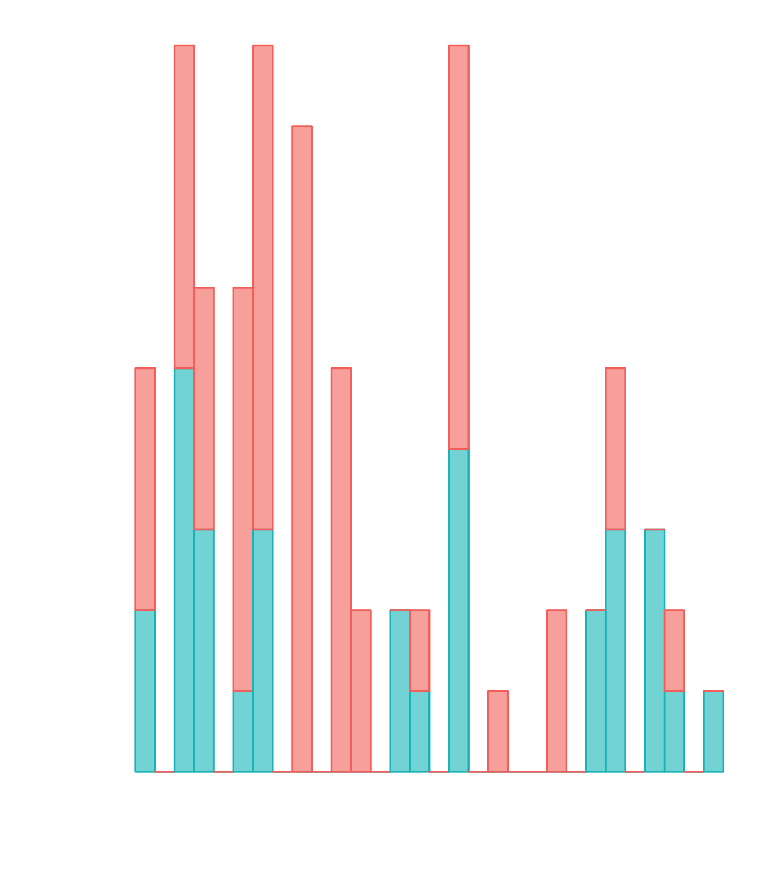

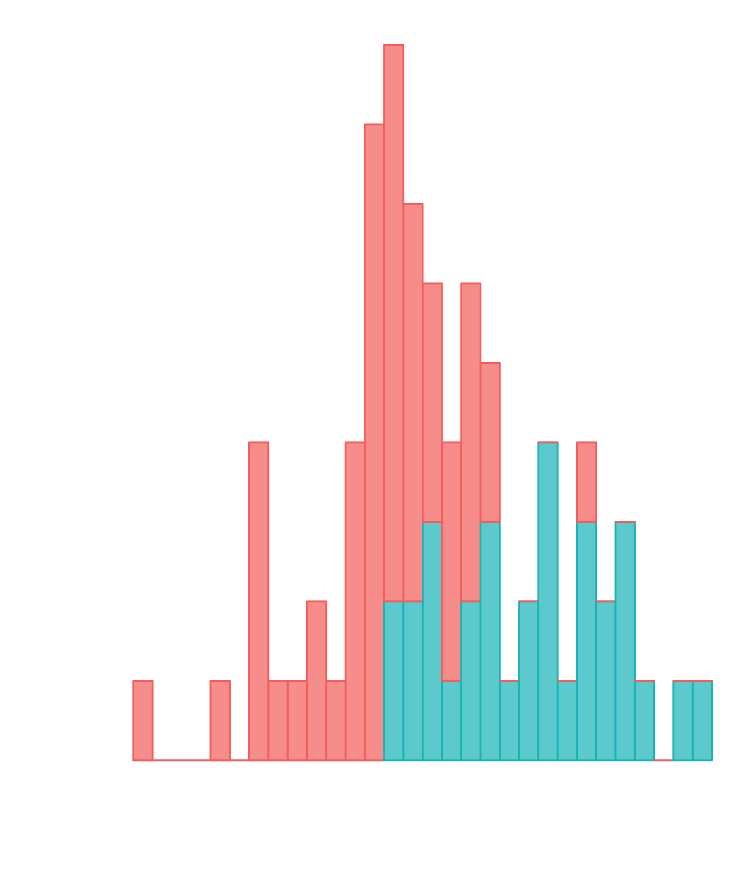
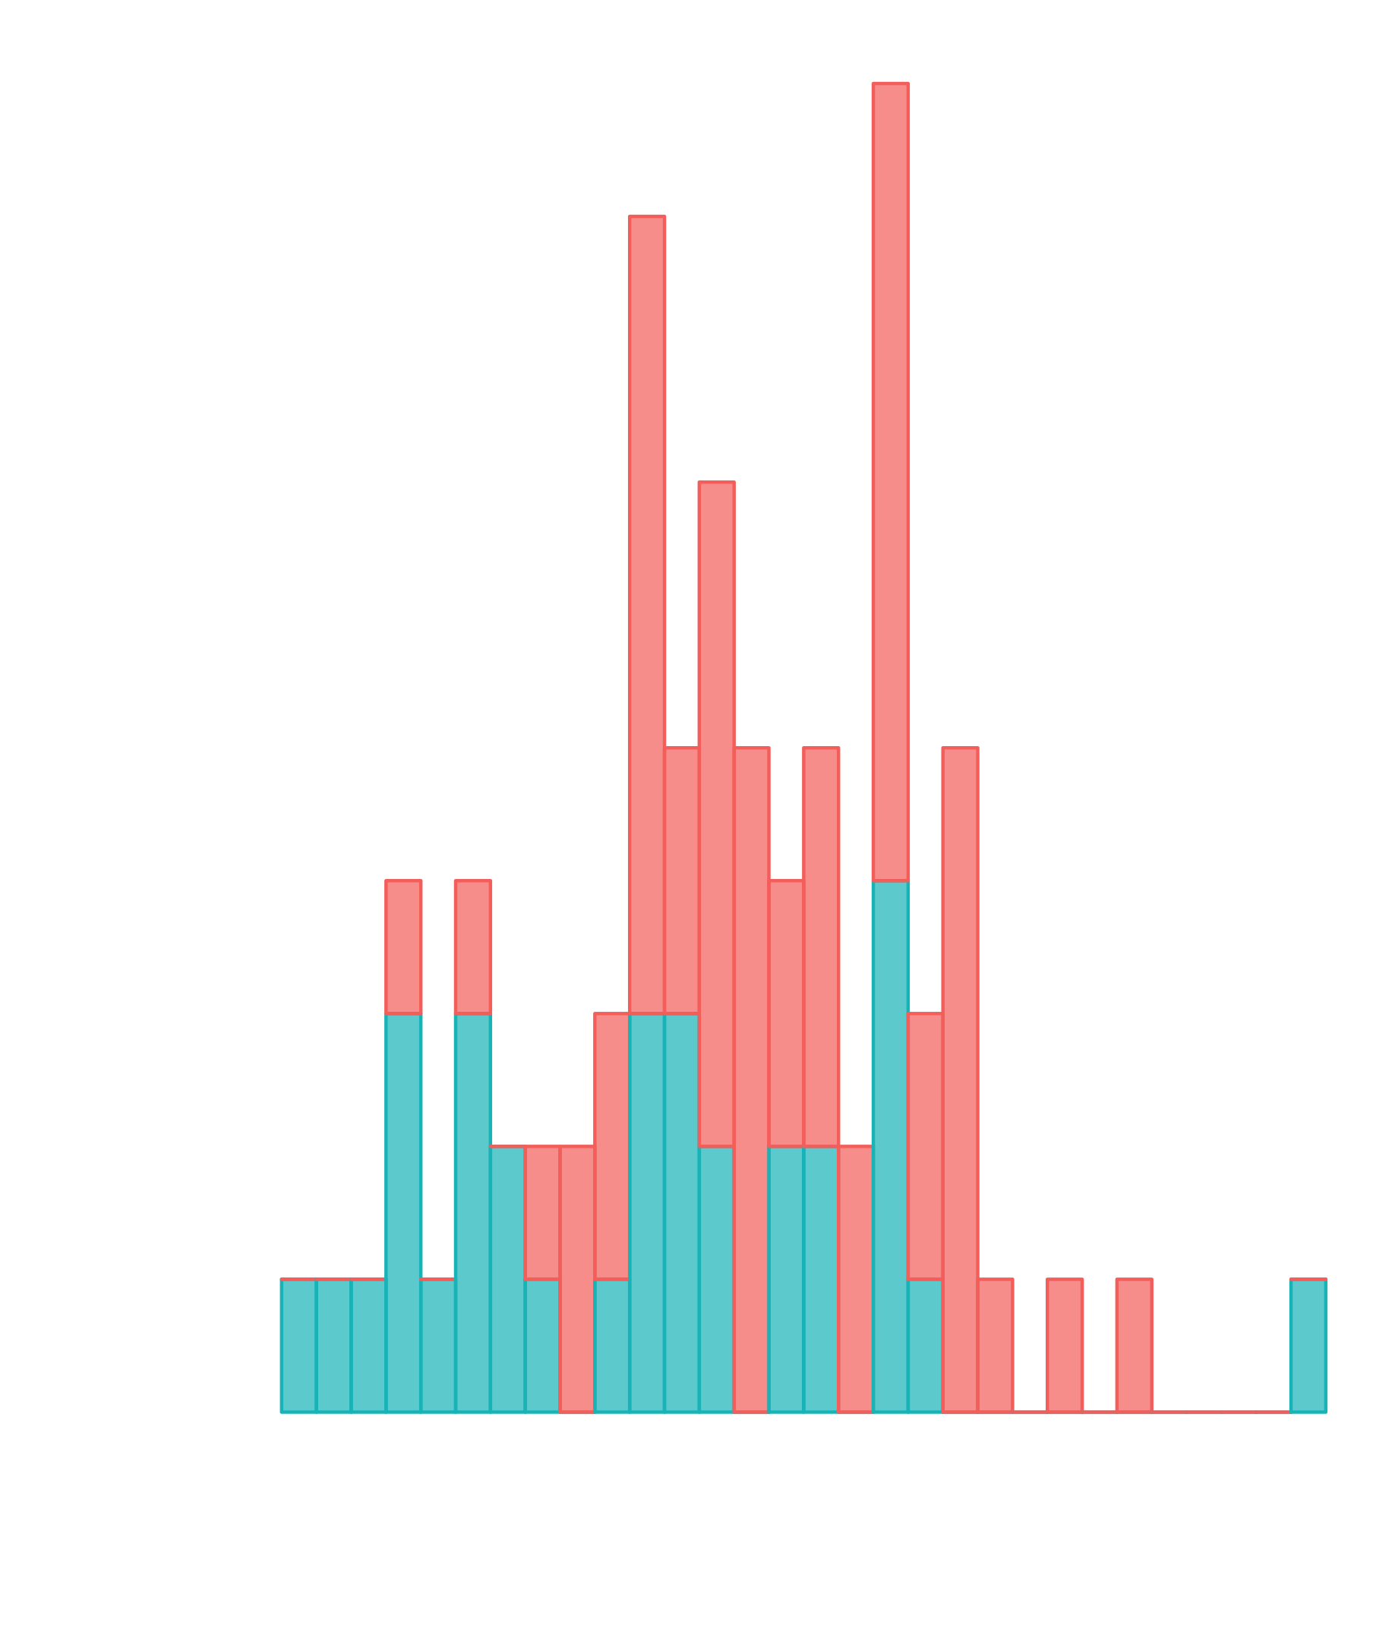
PARTICIPANT PROFILE
Neurotypical = 48 ASD = 32
AQ – Autism Quotient
SPQ – Sensory processing Questionnaire
Hypersensitivities increase
Notes:
So throughout the study you will see Neurotypicals in this pink/red colour and ASD in blue colour. We did exclude participant either due to behavioural performance or movement in the scanner and this left us with a smaller sample.
Participants ages ranged from 18 to 35 and we had more females in our group than males.
This is Autism Quotient distribution we can see that we actually had a good spread. And the sensory processing questionnaire which measures sensitivities shows a more heterogenous spread. Something important to note is that the SPQ has an opposite relationship to AQ. With lower scores indicating hypersensitivities. And finally here is the distribution for SPQ vision subscale because our task is visual this is most relevant.
Important to note that SPQ/SPQ Vision total are significantly correlated with AQ score medium effect size (~ -.4)

Slide 13
Increased reliance on likelihood as Autism traits and Sensory Sensitivities increase?
Likelihood reliance (Mean Slopes)
Autism Traits
(AQ Score)
Visual sensitivities
(SPQ Score)
Notes:
So the first question we are asking is there an increase in reliance on likelihood as autism traits and sensory sensitivities increase.

Slide 14
Calculating Reliance on Likelihood (sLOPE)
P_{N}L_{N}
Regression line
Likelihood only (slope =1)
Prior Only (slope = 0)
P_{N}L_{N}
P_{N}L_{W}
P_{w}L_{N}
P_{w}L_{w}
Centre of Likelihood
Slope = 1 → Reliant only on sensory information
Slope = 0 → Reliant only on priors
P_{N}L_{N}
P_{N}L_{W}
P_{w}L_{N}
P_{w}L_{w}
Notes:
For each condition we can on the X axis plot the middle of the 5 blue dots, and on the Y axis we can plot where the participant put the coin. Blue dots individual trials.
And then we can do is fit a regression line to the data. From any regression line y=mx+c we can get the slope and the intercept of the data.
So the slope is useful in this task in telling us how reliant the participant is on new information.
i.e. if the participants are putting the coin closer to the middle of the 5 dots all the time then we are going to get a slope of 1, and if the slope is closer to zero then we can say they are leaning more towards previous learnt information.
Here we can see how the slope would change for each condition if they were discriminating all four trial types as a Optimal Observer.

Slide 15
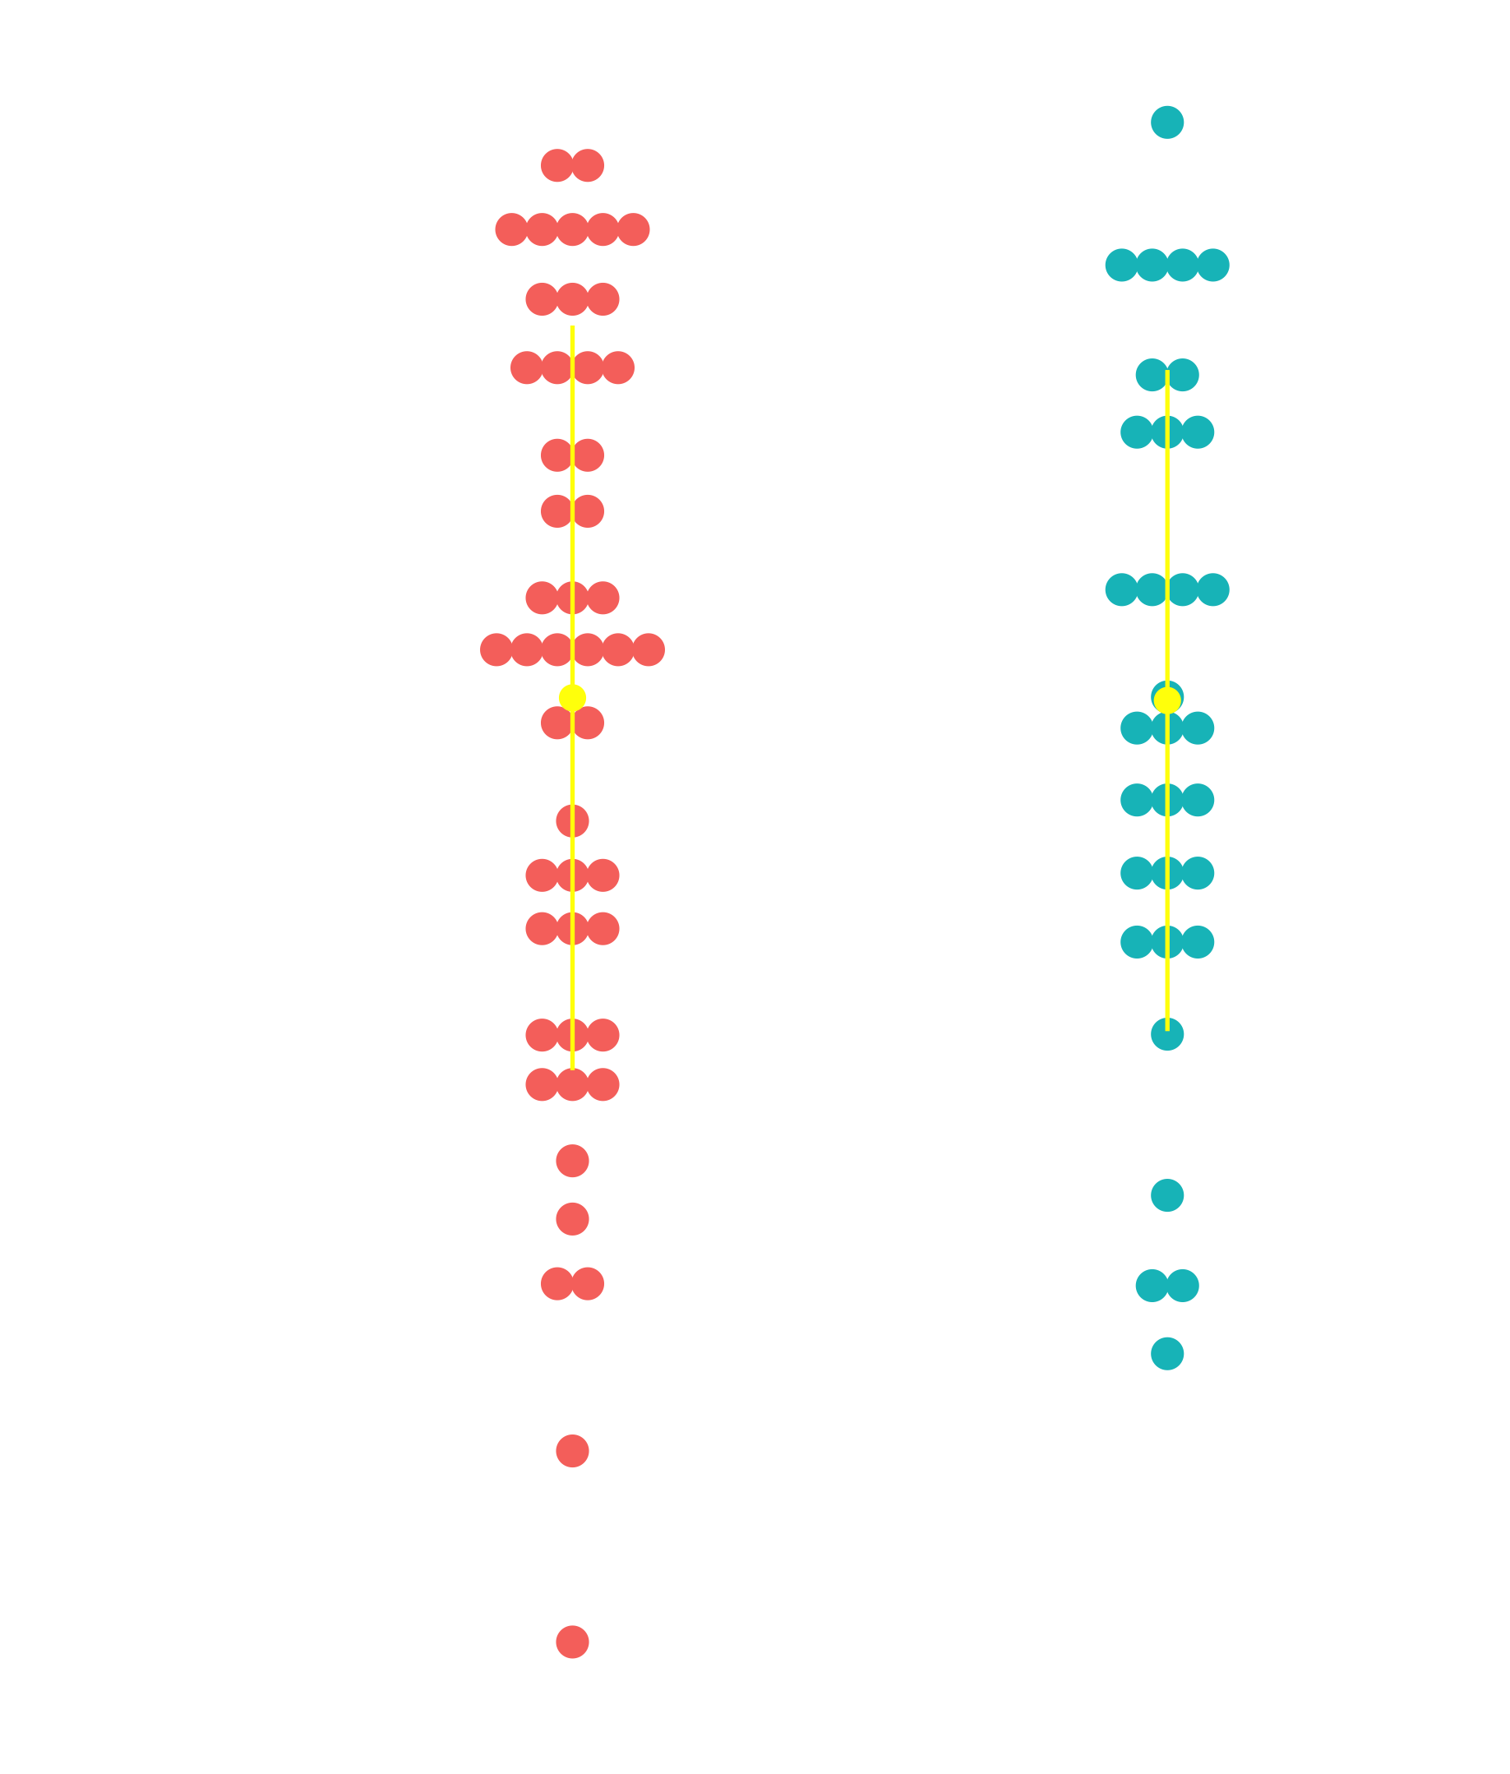
No differences in likelihood reliance between NT and ASD group
Z = -0.157
p = 0.875
NT = 48
ASD = 32

Slide 16
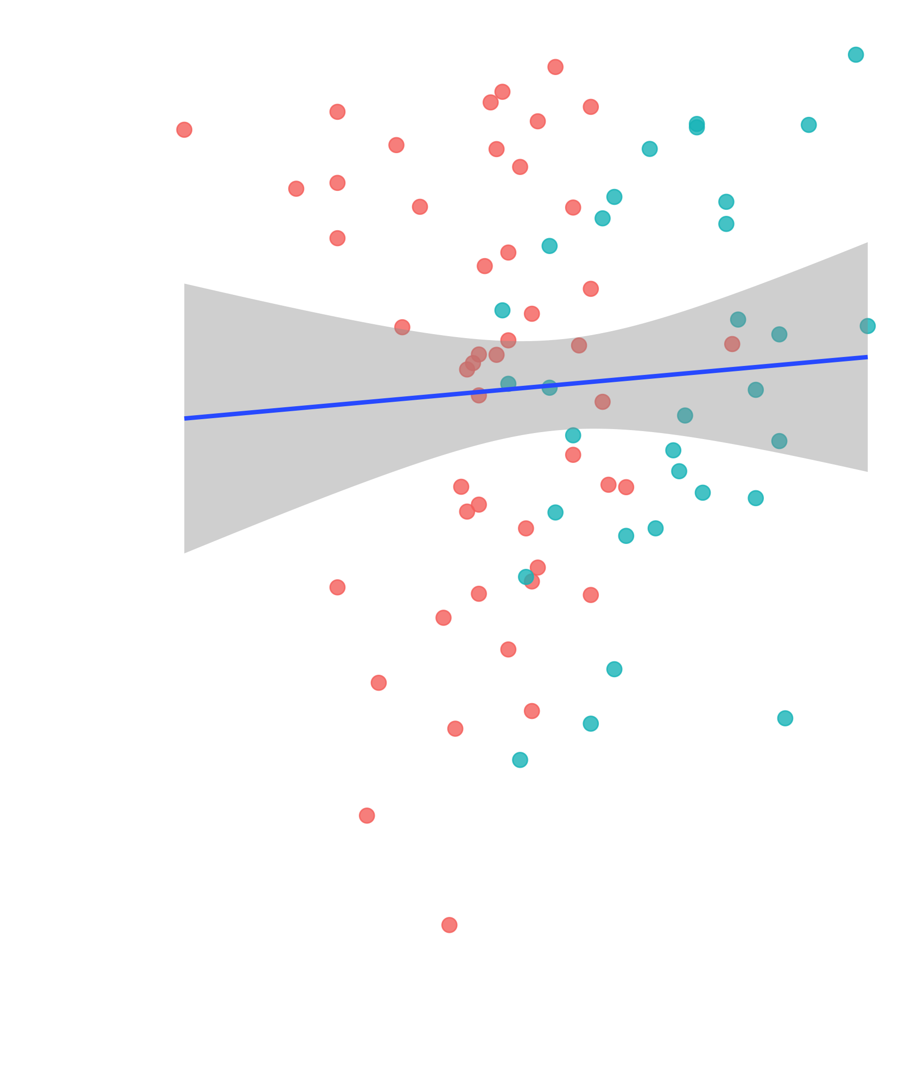
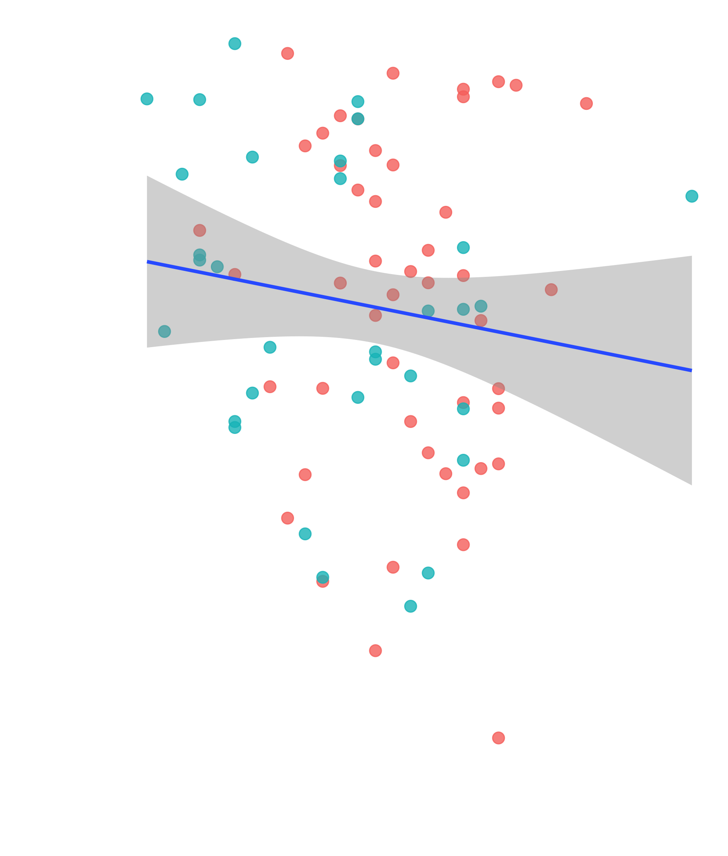
NT = 48
ASD = 32
r_{s} = 0.058
p = 0.610
r_{s} = - 0.150
p = 0.185
Notes:
So these are just correlations and we can see that with Autism Quotient scores there was no relationship, with SPQ score as well.
But the Visual sensitivities we can see there is a significant relationship with a small effect size, which would not survive FWEcorrection.

Slide 17
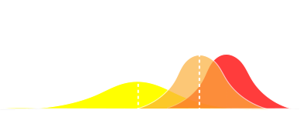
2 . Which Bayesian model can explain sensory learning in ASD?
Posterior
Sensory observation /
Likelihood
Prior
Subjective likelihood variance from Likelihood Only Task
Notes:
To disentangle between 3 models, we calculated the participant’s prior SD.

Slide 18
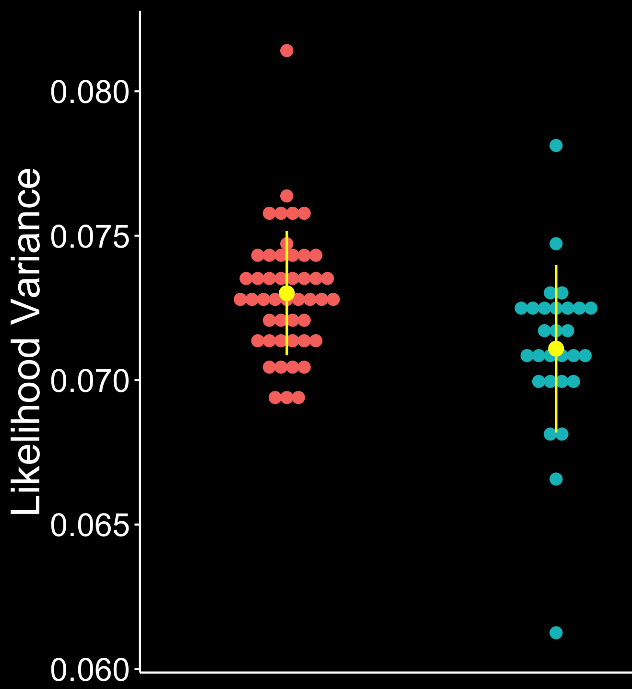
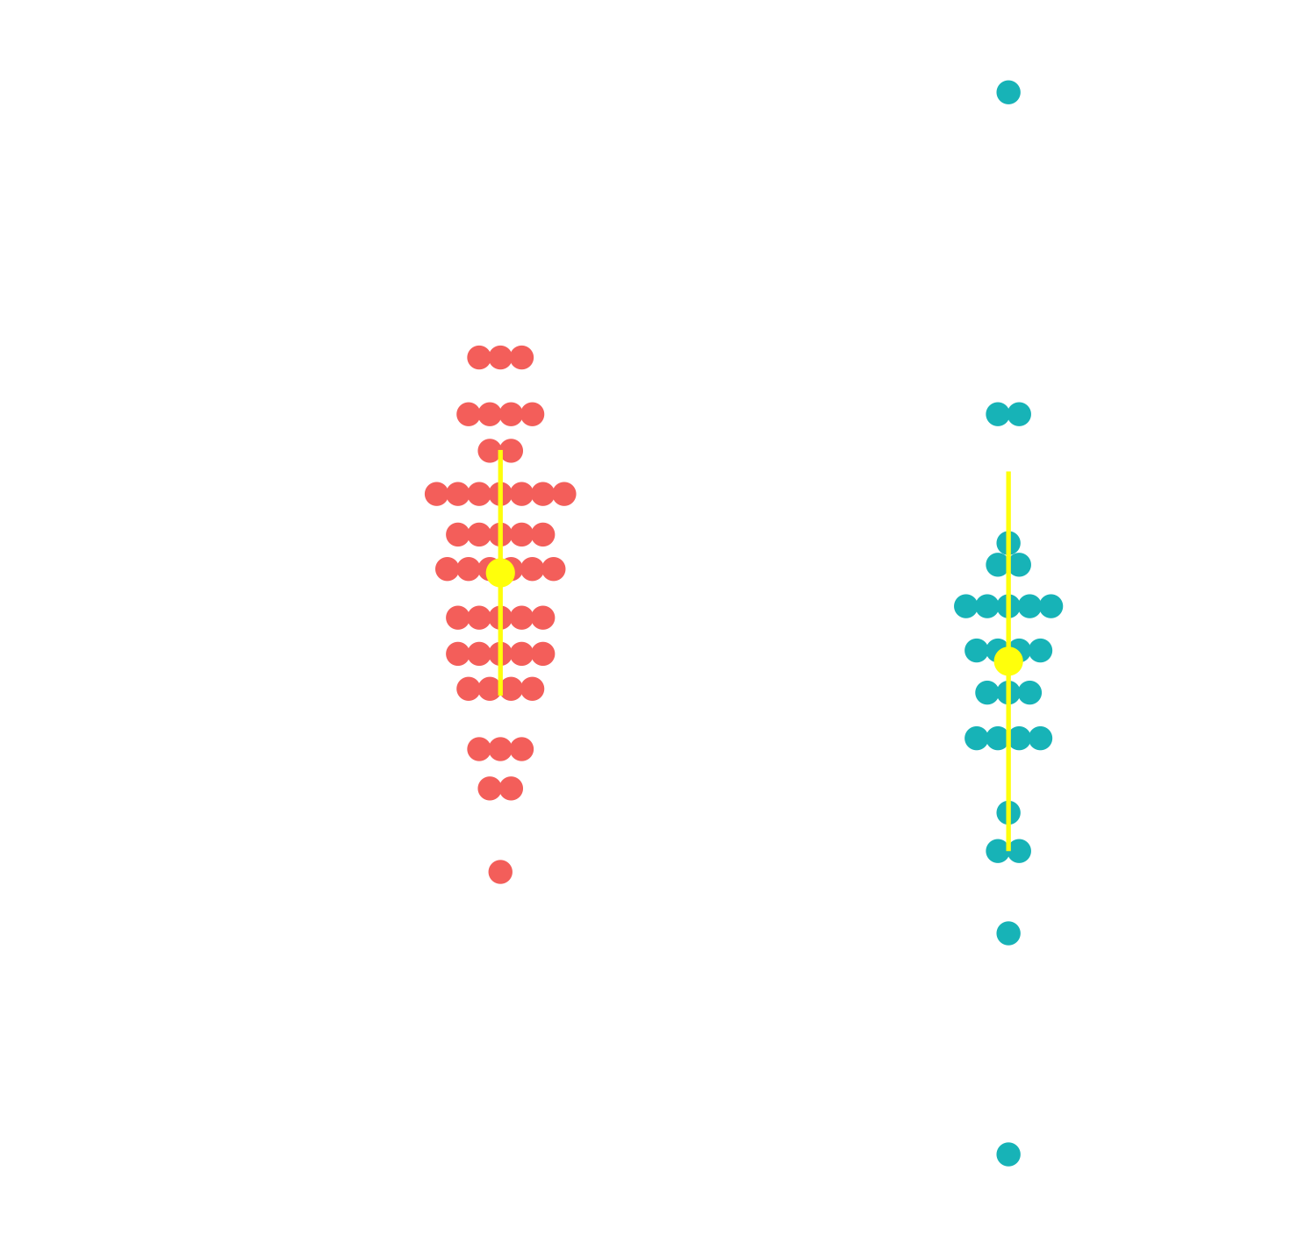
SUBJECTIVE LIKELIHOOD VARIANCE
NT = 47
ASD = 28
Narrow Likelihood
Wide Likelihood
p_{corr} = 0.002
p_{corr} = 0.016

Slide 19
Subjective Prior Variance
From Bayes Theorem
Subject’s Prior SD :
σ²_{P} = σ²_{L}* slope / (1- slope)
Assume σ²_{L} = true likelihood variance
Centre of Likelihood
See: Körding et al. 2004/ Vilares et al. 2009
Notes:
So we can also calculate participant’s acquired prior mean and standard deviation using the slope and intercept for each condition. And we are going to use this values to try and disentangle two of the models.

Slide 20
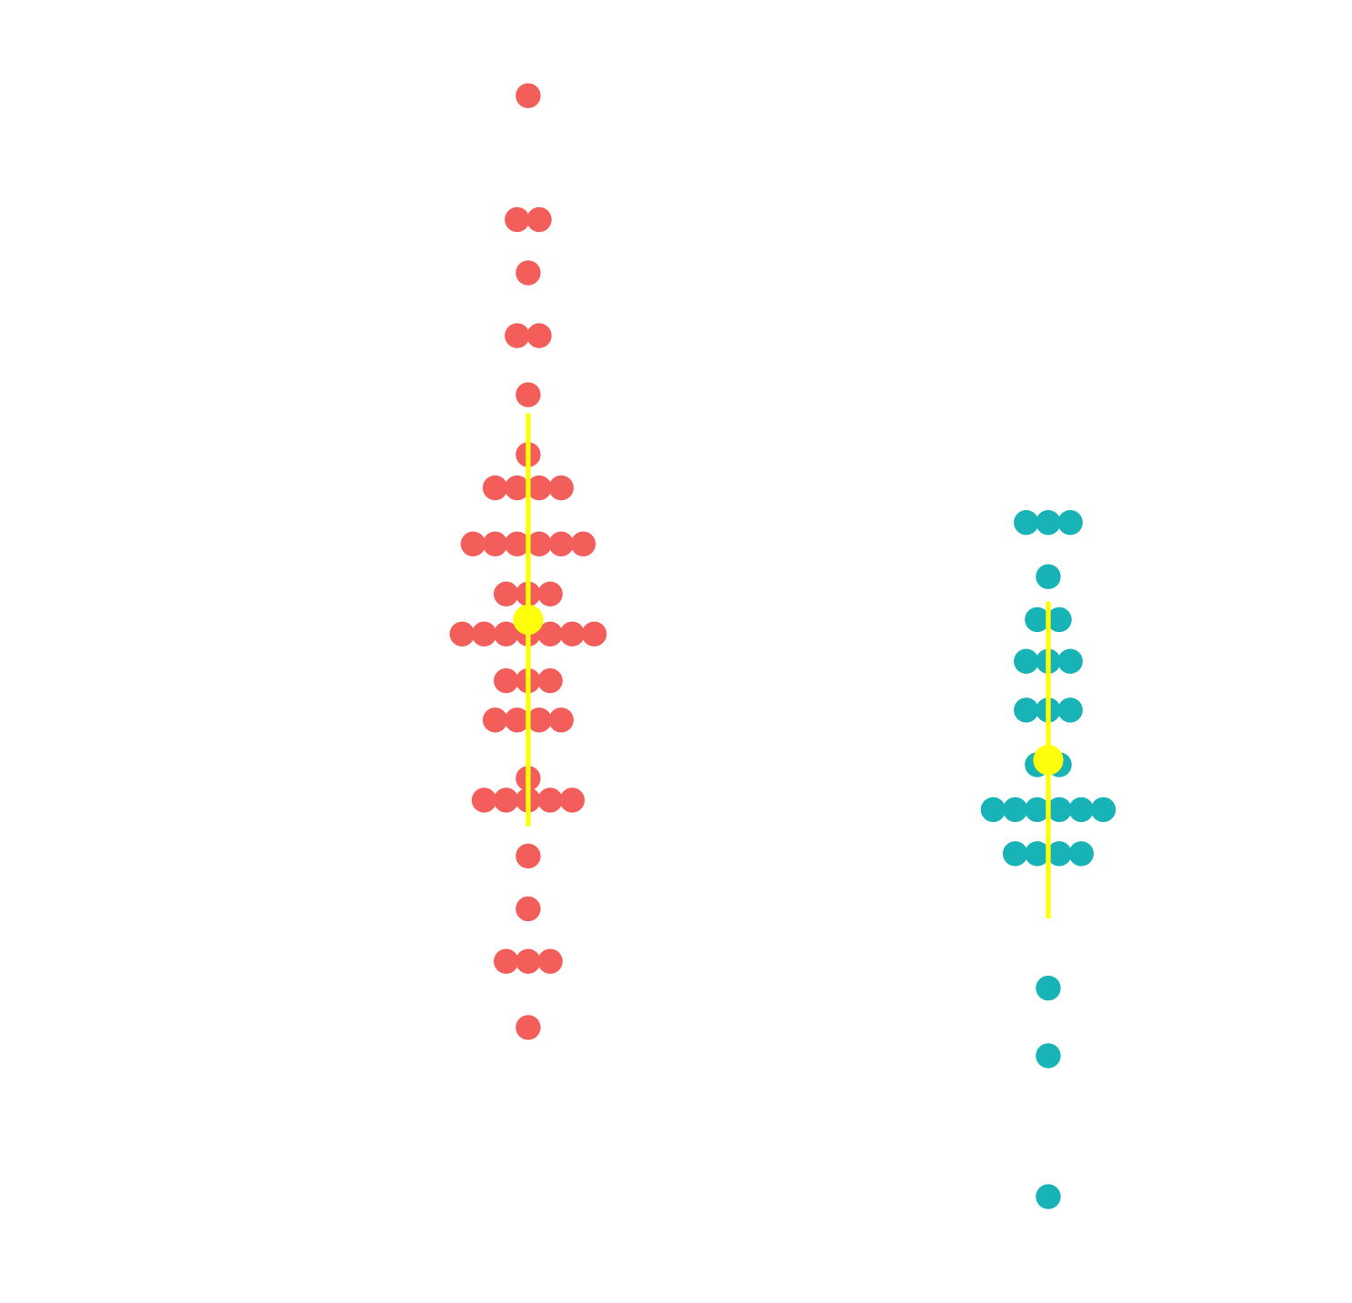
ASD group significantly narrow prior than NT in PwLw
P_{N}L_{N}
P_{N}L_{W}
P_{w}L_{N}
P_{w}L_{w}
p_{corr} = 0.016
HIPPEA Model
(Van de Cruys et al. 2014)
Priors too precise and predictions too narrowly tuned
NT = 48
ASD =28
Z = -2.914, p_{uncorr} = 0.004, p_{corr} = 0.016

Slide 21
Coin Task Summary
ASD Group showed increase in precision in both likelihood and prior variance
Support for HIPPEA Model (Van de Cruys et al. 2014)
Context adjustment in highly uncertain environments is altered in ASD

Slide 22
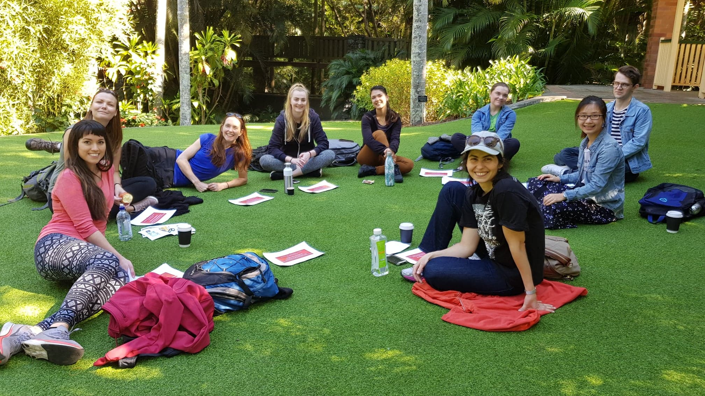
All Thanks to..
Advisors:
Marta Garrido, University of Melbourne
Jason Mattingley, Queensland Brain Institute
Radiographers:
Aiman Al-Najjar, Nicole Atcheson, Sarah Daniel
Centre for Advanced Imaging
Iris Vilares, University of Minnesota
Radhika Tanksale, The University of Queensland
Recruitment : Autism Queensland, Mind and Hearts, Asperger's Services Qld , University of Queensland
Funding: University of Queensland
Centre for Integrative Brain Function
Garrido Lab Group

Slide 23
References
Lawson, R.P., G. Rees, and K.J. Friston, An aberrant precision account of autism. Front Hum Neurosci, 2014. 8.
Körding, K., Wolpert, D. Bayesian integration in sensorimotor learning. Nature 427, 244–247 (2004) doi:10.1038/nature02169
Vilares I, Howard JD, Fernandes HL, Gottfried JA, Kording KP. Differential representations of prior and likelihood uncertainty in the human brain. Curr Biol. 2012;22(18):1641–1648. doi:10.1016/j.cub.2012.07.010
Simon Baron-Cohen, et al. (2001) The Autism-Spectrum Quotient (AQ): Evidence from Asperger Syndrome/High-Functioning Autism, Malesand Females, Scientists and Mathematicians. J Autism Dev Disord 5-17.
Tavassoli, T., Hoekstra, R.A., Baron-Cohen, S., 2014. The Sensory Perception Quotient (SPQ): development and validation of a new sensory questionnaire for adults with and without autism, Mol Autism, p. 29.

Slide 24
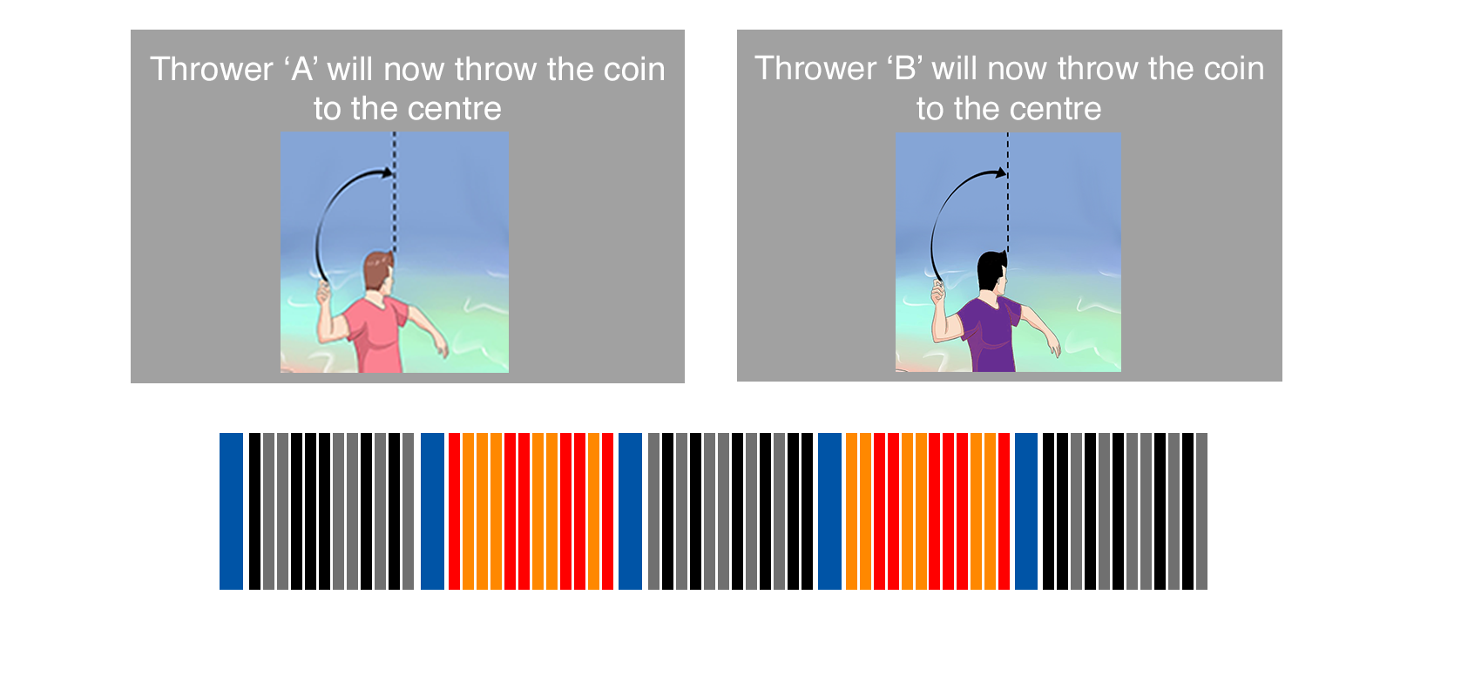
P_{N}L_{N}
P_{N}L_{W}
P_{w}L_{N}
P_{w}L_{w}
~2 mins
per block
Practice – 2 Blocks – 1 per thrower, 40 trials each
Experiment Session - 24 blocks (divided into 4 runs) - 72 trials per condition
Notes:
We modified the set up to have shorter blocks per Thrower. So the participants are introduced to – Thrower A (narrow prior) and B (wide prior). Each thrower would throw 12 trials each, before switching.
We conducted 10 behavioral pilots to ensure that participants on average behaved the same in terms of accuracy, discriminating the 4 conditions as in Iris’s study. We also conducted a power analysis using the behavioural data.

Slide 25



Single trial setup
1 -
1. Trial Start: Five blue dots(splashes) shown (Likelihood)
2 -
2. Participant moves the blue bar (net)
\\
3 -
3. Participants moves black bar to indicate confidence
\\
4 -
4. True position of coin is shown
1500ms
1 -
1. New Trial
3 -
\\

Slide 26

Calculating the Prior Mean and Variance
(Körding et al. 2004/ Vilares et al. 2012)
For each distribution apply a normal distribution and differentiate to arrive at:
X_{est} = σ²_{P}/(σ²_{L}+ σ²_{P})μ_{L} + σ²_{L}/(σ²_{L}+ σ²_{P})μ_{P}
Y = slope . X + Intercept
Subject’s Prior Mean :
μ_{P} = Intercept/(1- slope)
Subject’s Prior Variance :
σ²_{P} = σ²_{L}* slope / (1- slope)
Assume σ²_{L} = true likelihood variance
Notes:
In Vilares and another paper by Kording, they derive a method to calculate the participant’s distribution.
We can apply Bayes theorem to the prior, likelihood and posterior distributions. With the assumption of a normal distribution we can derive the following equation, what is interesting is this maps on to a linear regression equation we all are more familiar with.

Slide 27
OPTIMAL Prior Variance
P_{N}L_{N}
P_{N}L_{W}
P_{w}L_{N}
P_{w}L_{w}
Notes:
Prior variance Optimal Values

Slide 28
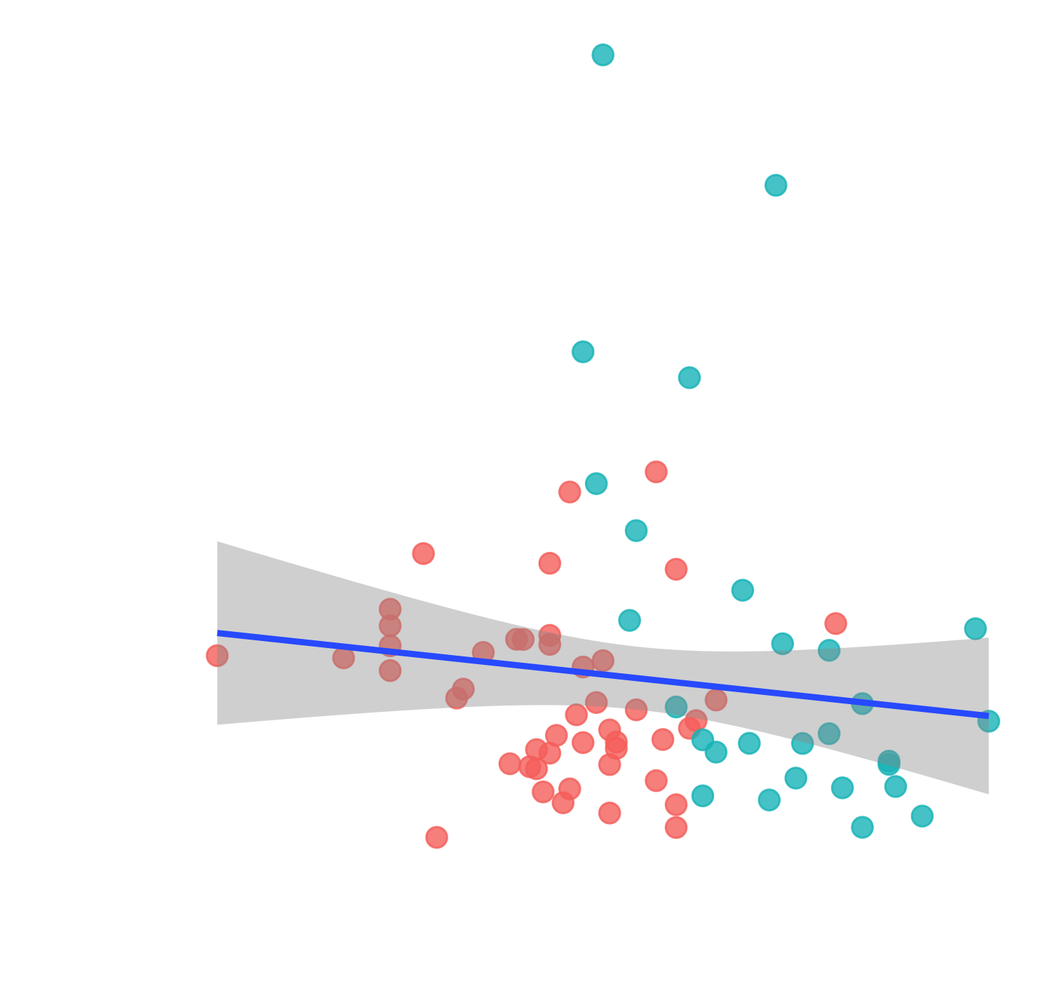
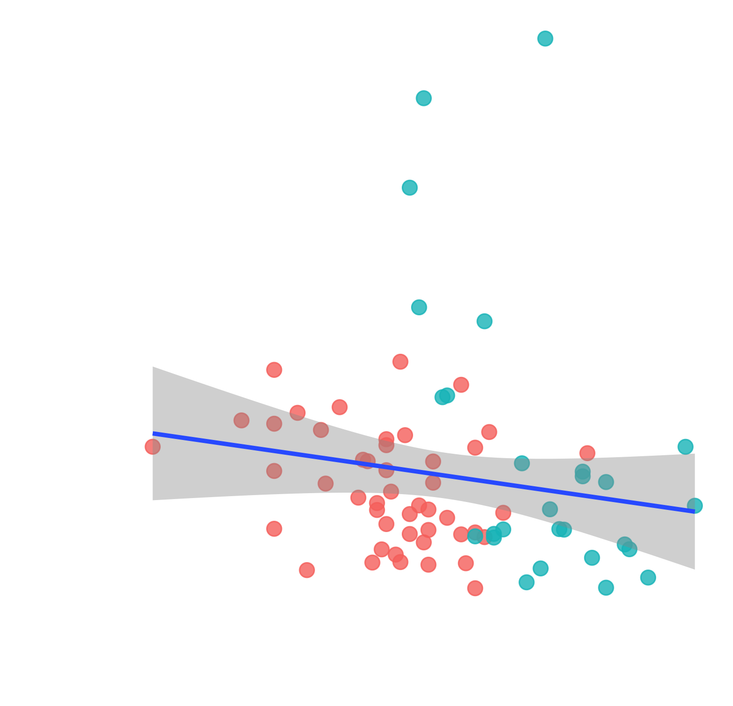
Errors on Likelihood Task
NT = 47
ASD = 28
Narrow Likelihood
Wide Likelihood
r_{s} = - 0.208
p_{corr} = 0.146
r_{s} = - 0.292
p_{corr} = 0.024*
No differences in group split

