Slide 1
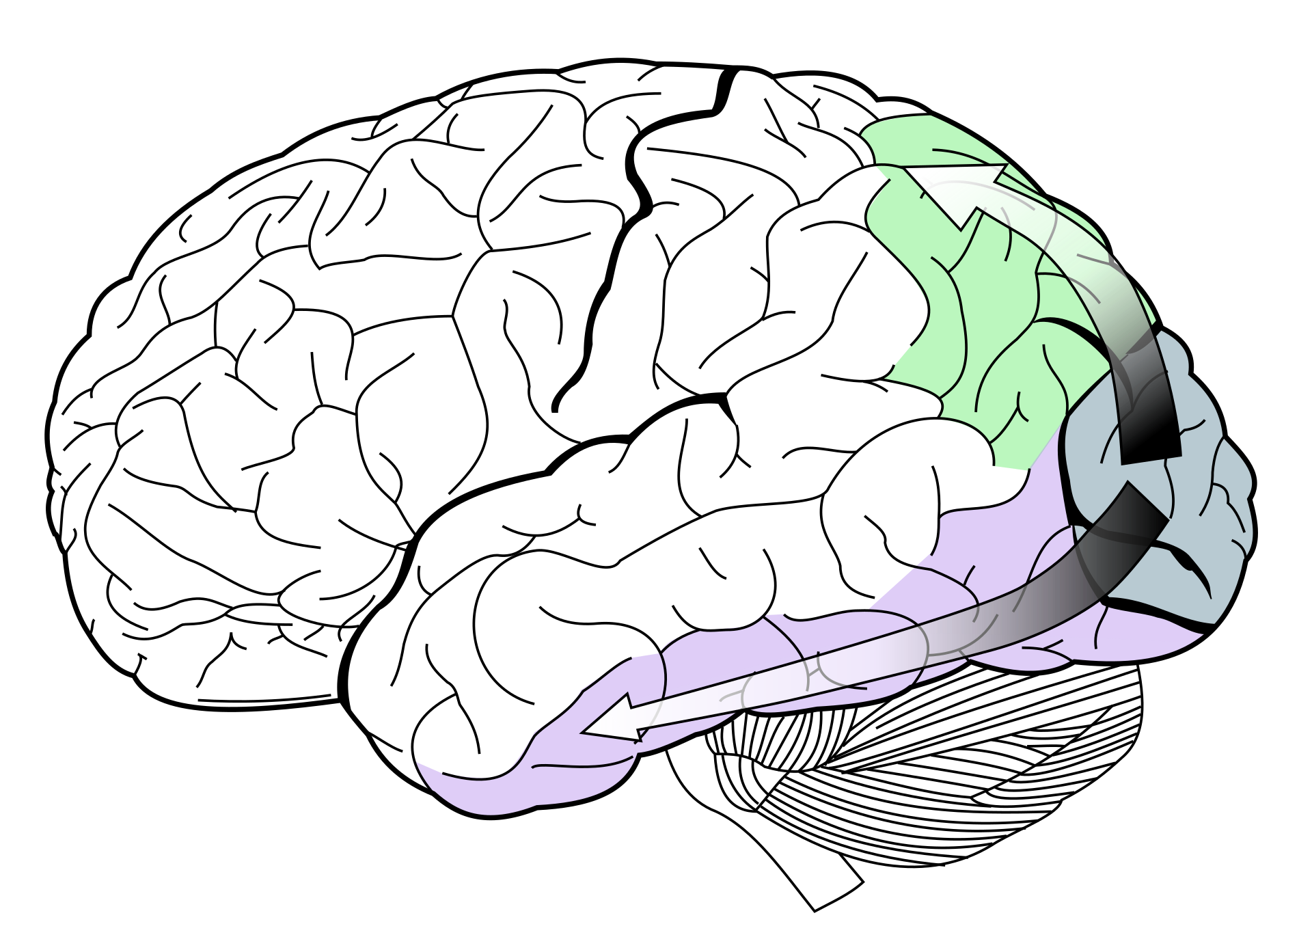
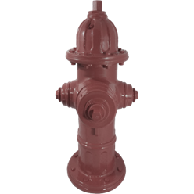
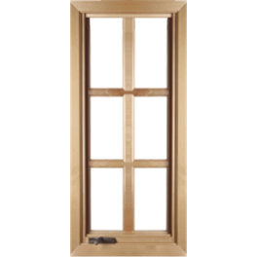
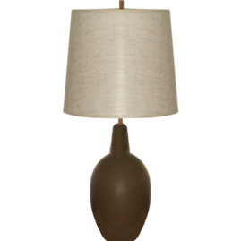
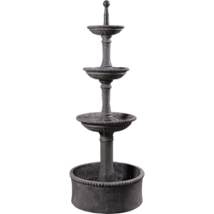
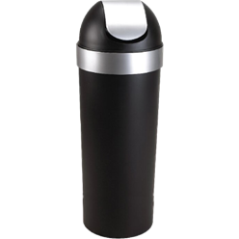
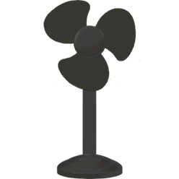
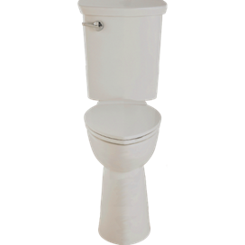
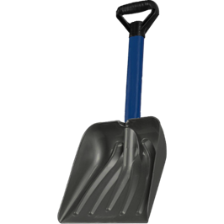
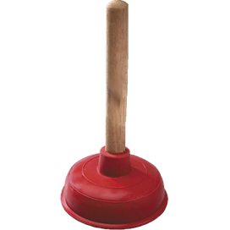
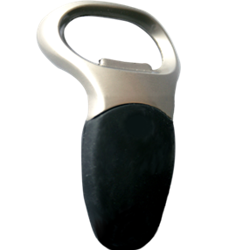
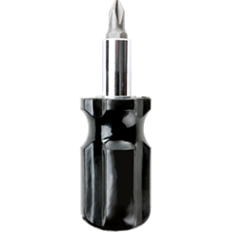
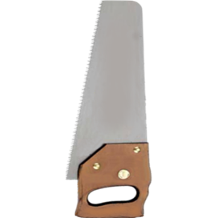
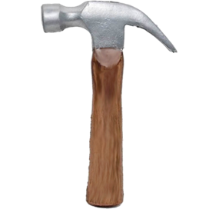
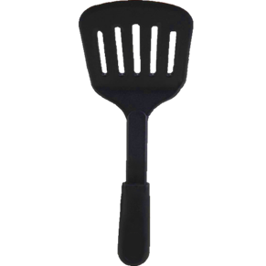
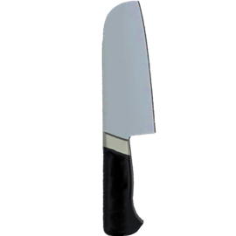
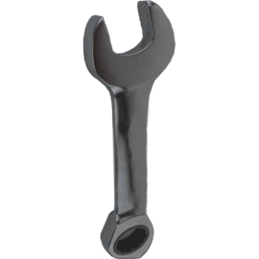
*Orientation, p = 0.024
*
Object Group x Task Type
p = 0.015
N = 26
Object Group x Task Type
p = 0.483
N = 26
*
Tools elicit lower RTs than non-tools in temporal discrimination.
Object Group
p = 0.012
N = 25
**
Mug with a Plant, 2019
Anna Freerksen
Oil on canvas
80 ms
16 ms
48 ms
*
Objects with strong action associations (tools) are biased toward the dorsal stream (magno- > parvo-cellular), while objects with no such association (non-tools) are biased toward the ventral stream.
Do these biases influence behavior?
80 ms
48 ms
48 ms
*Color
p = 0.045
Red reduces the tool deficit in the spatial task.
N = 26
Spatial Task
+
+
**
*
Incorrect.
1000 ms
100 ms
Object Group x Task Type
p = 0.001
Prediction: Better performance (higher sensitivity, d’) for non-tools.
Real objects replicate the original result.
N = 30
Time
Temporal Task
*
Incorrect.
1000 ms
80 ms
16 ms
48 ms
Object knowledge biases processing such that tools elicit temporal benefits while non-tools elicit spatial benefits.
Prediction: Better performance (higher sensitivity, d’) for tools.
This work was supported by NSF grants BCS-1534823 and BCS-1921415 to SS.

