Slide 1


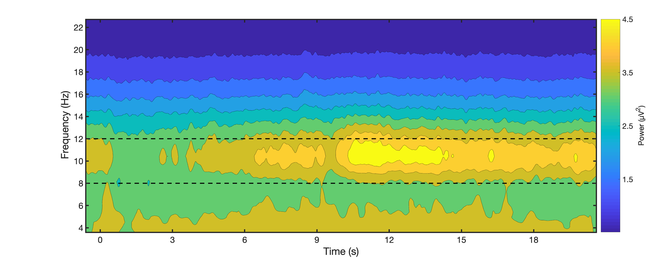
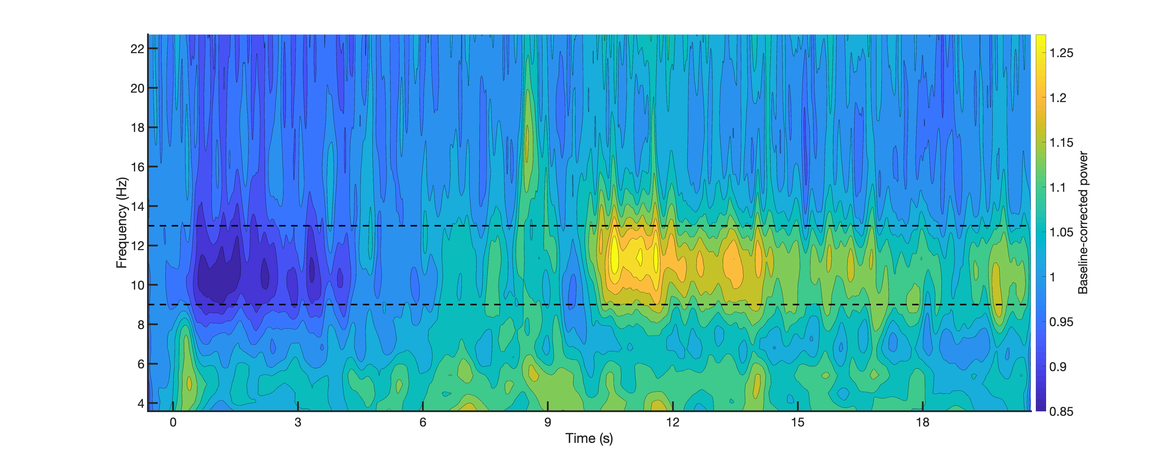
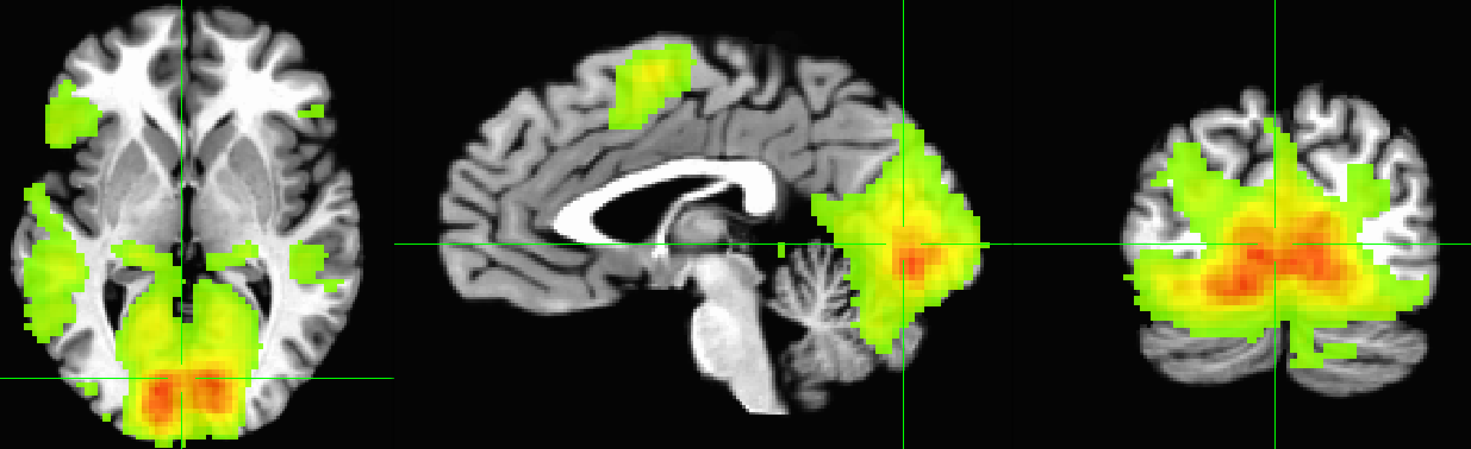
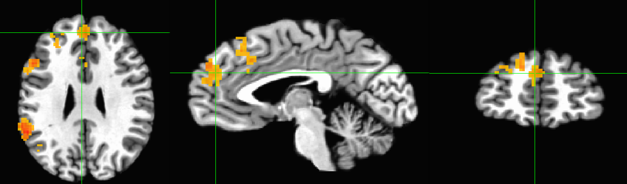
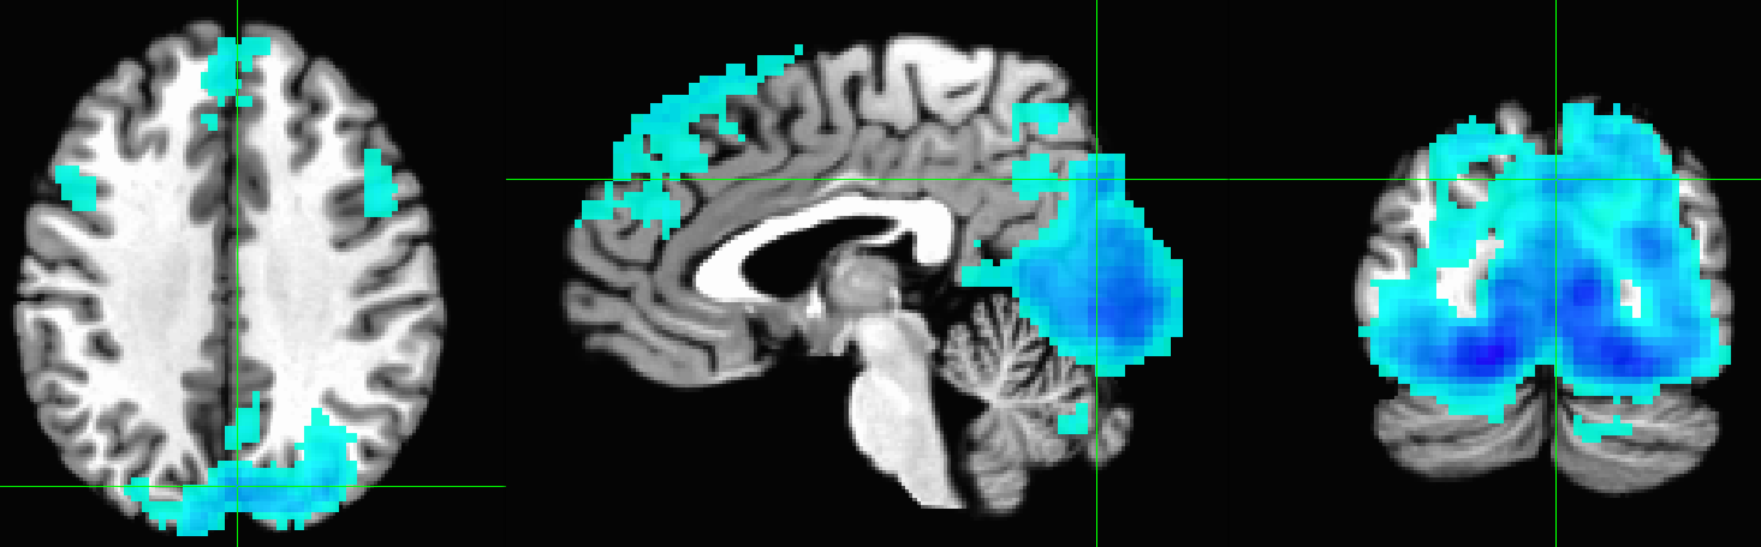
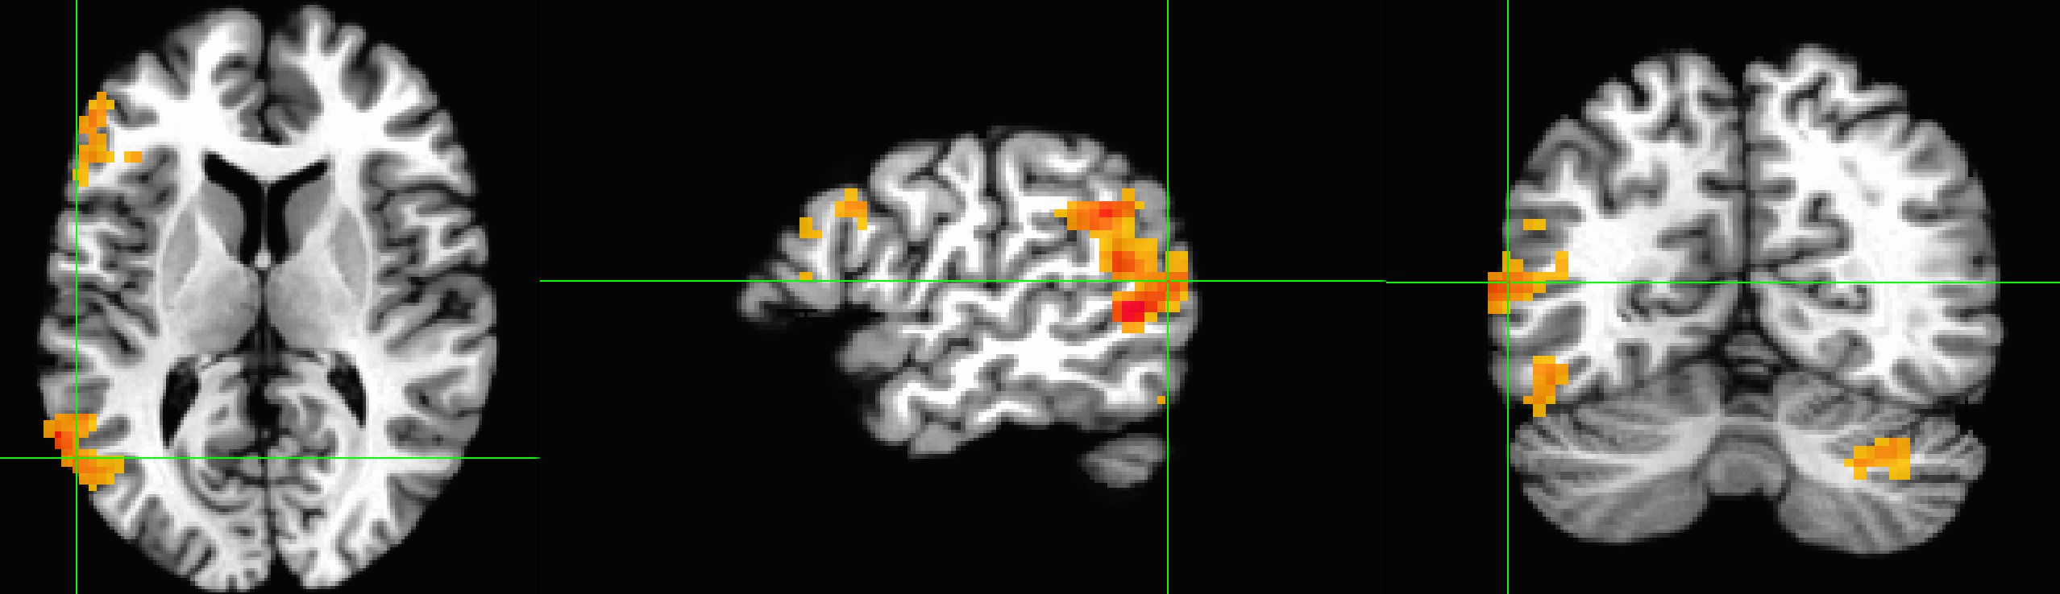
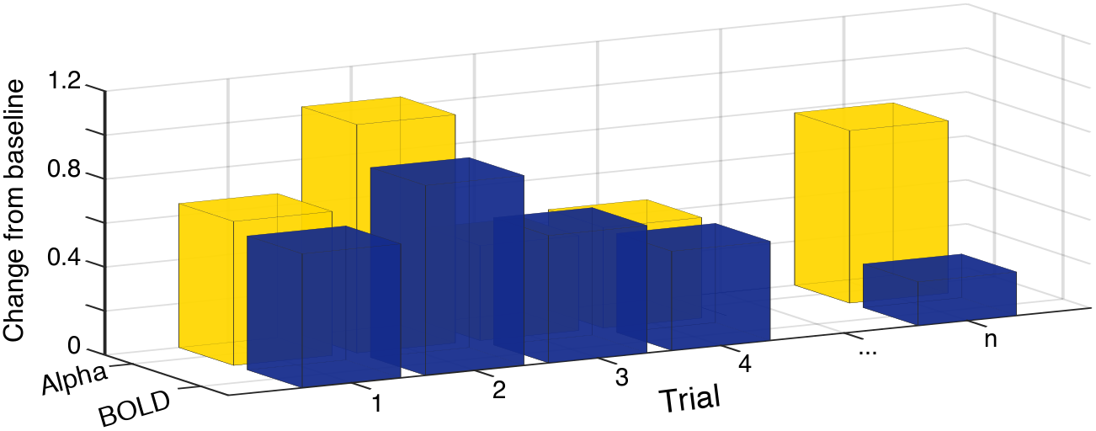
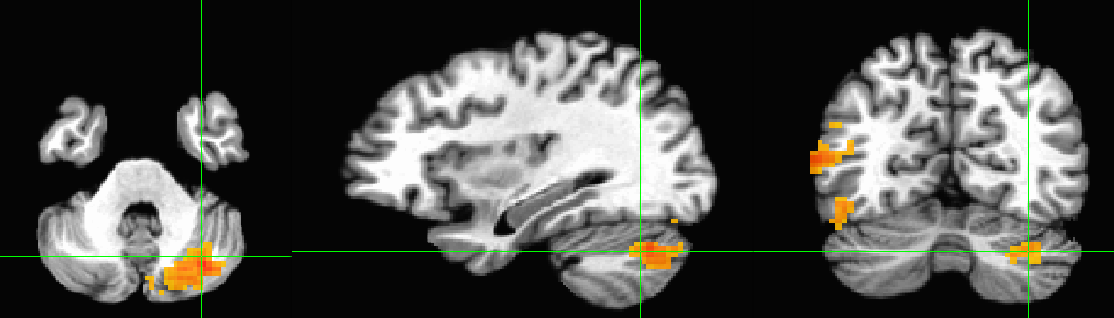
Assessing the relationship between alpha power and hemodynamic activation during emotional mental imagery
Maeve R Boylan, WM Friedl, Harold A Rocha, and Andreas Keil
University of Florida
Background
Method
Mental imagery is a critical factor in the etiology and maintenance of many psychiatric disorders, as well as a component in gold-standard treatment options. At the level of hemodynamics, research has demonstrated that mental imagery activates frontal, motor, and visual networks of the brain. Scalp-recorded EEG has also shown an increase in alpha-band activity during mental imagery tasks.
To define the neurophysiology of mental imagery, we combined the information from blood oxygen level-dependent (BOLD) signals with concurrently recorded EEG alpha-band power during a visual script-driven mental imagery task.
Participants: 21 undergraduate students, 7 female, M_{age} = 19
Stimuli: 57 pleasant, neutral, and unpleasant scenes
Analyses:
TR-based: BOLD percent change at each TR correlated with parietal power for each TR segment
Trial-based: Average BOLD percent change during the Imagery period correlated with alpha power change from reading period to imagery period across all trials
Results
Alpha Replication
.85
Baseline-corrected power
1.3
BOLD Replication
-36.3
t values
36.3
Time-frequency analyses demonstrate a decrease in the alpha-band during the reading period and a corresponding increase during the imagery period, which exceeds pre-trial alpha power, regardless of valence.
Average BOLD percent change during imagery is significantly larger than zero in the regions of the imagery network: frontal gyri, motor areas (precentral gyrus, SMA), the dorsal and ventral visual stream, primary visual, and cerebellum.
Alpha-BOLD
Are alpha power changes sensitive to BOLD changes in the imagery network?
TR-by-TR analysis (method check):
    Parietal alpha power correlated with BOLD percent change, per TR, results in significant negative correlations within occipito-parietal and midline frontal regions
Trialwise correlations
L inferior, middle, & superior gyri
Trialwise analysis (hypothesis testing):
    Parietal alpha power change correlated with mean BOLD percent change during imagery period, per trial
Dorsal visual stream
Ventral visual stream
R Cerebellum
Conclusions
Concurrent EEG-fMRI data acquisition did not interfere with data quality as both previous EEG-based alpha and fMRI-BOLD effects were replicated during imagery
Across the entire experiment, a negative correlation of BOLD and alpha-band activity is seen occipito-parietal and midline frontal regions
Alpha-band increases are associated with higher BOLD activity in the imagery network, suggesting alpha power indexes engagement in a mental imagery task
Notes:
Assessing the relationship between alpha power and hemodynamic activation during mental imagery
Maeve R Boylan, WM Friedl, Harold A Rocha, & Andreas Keil
University of Florida
Abstract
Mental imagery is a critical factor in the etiology and maintenance of many psychiatric disorders, as well as a component in gold-standard treatment options. The neural underpinnings of mental imagery are however poorly understood. At the level of hemodynamics, research has demonstrated that mental imagery activates emotion networks of the brain. Scalp-recorded EEG has also shown an increase in endogenous activity in the alpha band during mental imagery tasks. To define the neurophysiology of mental imagery, we combined the information from blood oxygen level-dependent (BOLD) signals with concurrently recorded EEG alpha-band power during a visual script-driven mental imagery task in a sample of 20 healthy participants. Ongoing analyses demonstrate that established BOLD activation patterns during mental imagery were replicated with the addition of EEG recordings: BOLD was selectively enhanced during emotional, compared to neutral imagery, in medial prefrontal cortex, precuneus, thalamus, and hippocampus. These changes were associated with alpha-power changes, assessed on a trial-by-trial basis, as well as related to the level of alpha-power change across trials. Together, findings suggest that alpha-power changes in the scalp-recorded EEG may represent a sensitive index of emotional imagery.

