Slide 1
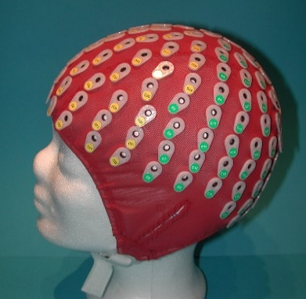
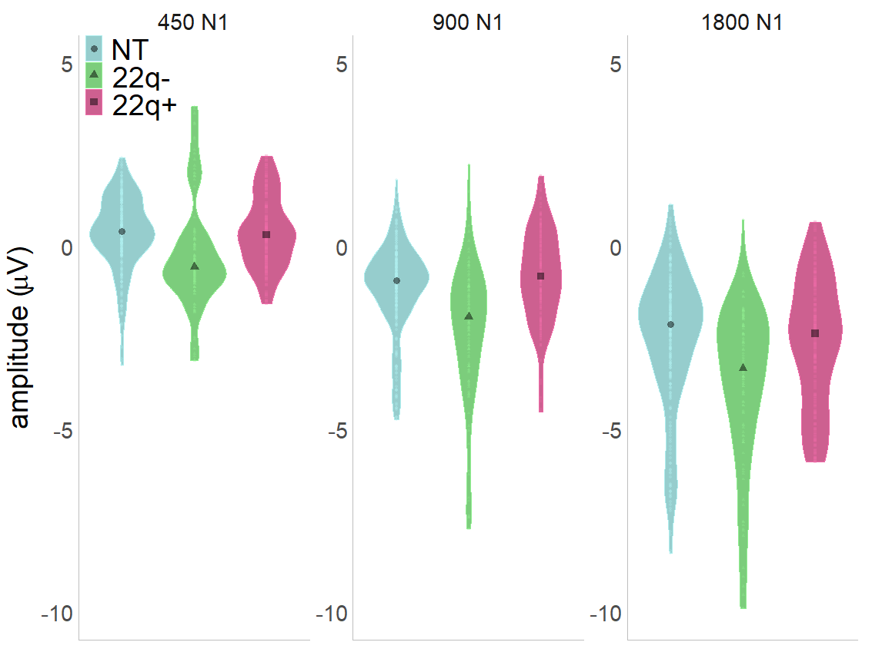
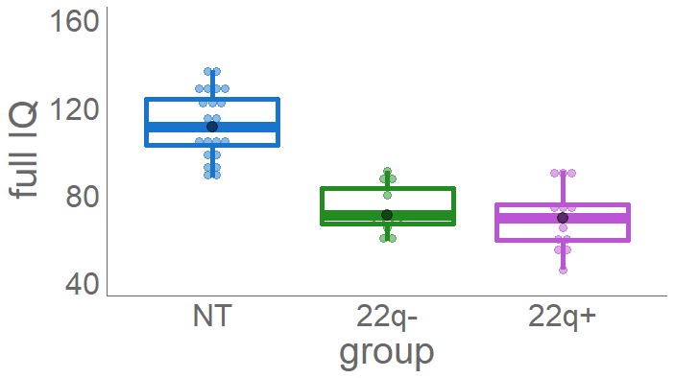
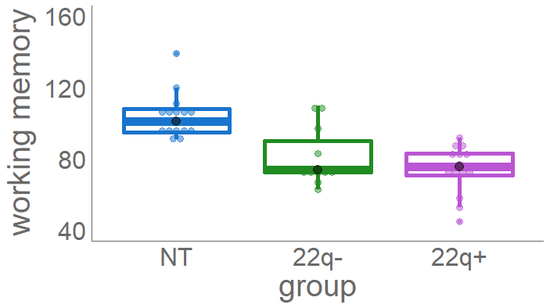
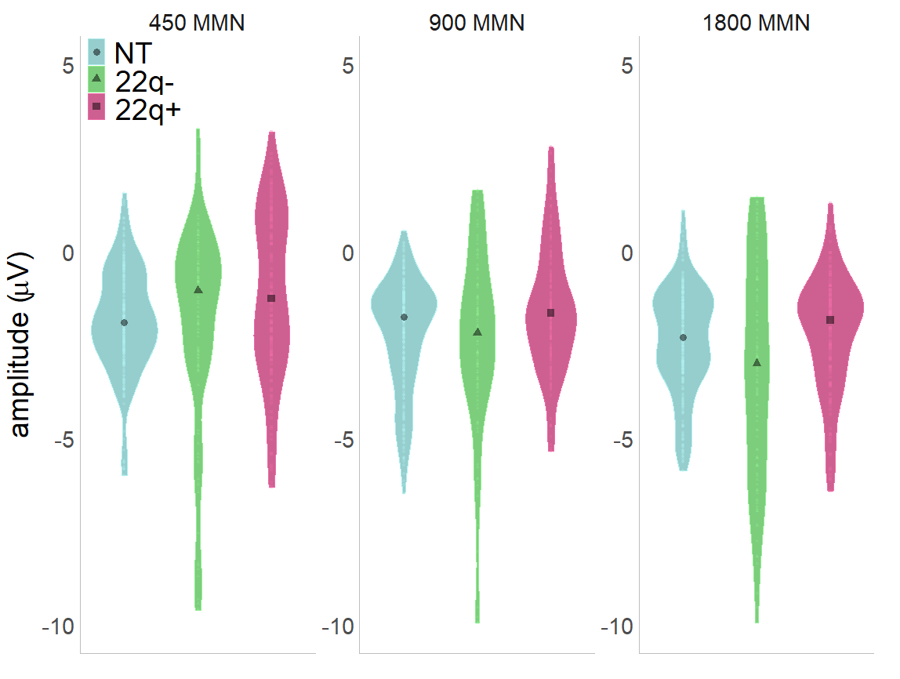
Assessing auditory processing endophenotypes associated with schizophrenia in individuals with 22q11.2 Deletion Syndrome
Douwe J Horsthuis¹, Ana A Francisco^{1,2}, John J Foxe^{1,2,3}, and Sophie Molholm^{1,2,3}
¹ The Sheryl and Daniel R. Tishman Cognitive Neurophysiology Laboratory, Albert Einstein College of Medicine
²Department of Neuroscience, Rose F. Kennedy Center, Albert Einstein College of Medicine
³ Department of Neuroscience, The Ernest J. Del Monde Institute for Neuroscience, School of Medicine and Dentistry, University of Rochester
BACKGROUND
22q.11.2DS is the most common chromosomal microdeletion disorder, with a prevalence ranging from 1:1000 to 1:4000 live births^{1,2}
It is characterized by a highly variable phenotypic expression, including: multi-organ dysfunction such as cardiac and palatal abnormalities, variable developmental delays, cognitive deficits, neuropsychiatric conditions³
30% of individuals with 22q11.2D go on to develop schizophrenia⁴; about 50% experience schizotypical traits and transient psychotic experiences⁵
PARTICIPANTS
11 individuals with 22q11.2DS without psychotic symptoms (22q-)
(age: M = 23.26; SD = 7.75; 5 males, IQ: M=73.91; SD=10.97
15 individuals diagnosed with 22q11.2DS with 1+ psychotic symptoms (22q+)
(age: M = 20.87; SD = 6.25; 4 males, IQ: M=69.43; SD=13.79)
26 neurotypical controls (NT)
(age: M = 21.88; SD = 6.86; 10 males, IQ:M=112.17; SD=14.76)
EEG PARADIGM
passive duration oddball paradigm
standard tone: 100ms (85%); deviant: 180ms (15%)
SOAs: 450, 900, 1800 ms
AIMS
To characterize basic auditory processing and sensory memory using EEG in a group of adolescents and adults with 22q11.2DS, with and without psychotic symptomatology.
To relate these measures to cognitive function.
To assess the potential informativeness of these measures with regard to vulnerability for psychosis.
EEG DATA COLLECTION
BiosemiActiveTwo 64-channel electrode cap
Data recorded at 512 Hz, filtered between 1 & 45Hz,
re-referenced TP8; artifact cutoff at 120uV.
CLINICAL ASSESSMENT
WAIS/WISC (IQ, working memory)
SCID-V/Kid-SCID (presence of psychotic symptoms)
RESULTS
N1: standards (basic auditory processing)
IQ
WORKING MEMORY
MMN: deviants-standards (sensory memory)
DISCUSSION
All groups presented typical N1 modulation as a function of SOA (all adapt).
All groups processed change in duration (MMN).
N1 adaptation effects interacted with psychotic symptomatology: When compared to the NT group, the 22q- group presented larger adaptation effects, whereas the 22q+ presented smaller effects
In contrast, individuals with 22q11.2DS showed increased effects of presentation rate on MMN amplitude, regardless of the presence of psychotic symptoms.
While IQ and working memory were lower in 22q11.2DS, these measures did not correlate with the electrophysiological data.
These findings suggest the presence of two distinct mechanisms: One intrinsic to 22q11.2DS resulting in increased N1 and MMN responses; another related to psychosis leading to a decreased N1 response.
REFERENCES
¹ Botto, L. D., May, K., Fernhoff, P. M., Correa, A., Coleman, K., Rasmussen, S. A., ... & Mahle, W. T. (2003). A population-based study of the 22q11. 2 deletion: phenotype, incidence, and contribution to major birth defects in the population. Pediatrics, 112(1), 101-107.
² Grati, F. R., Molina Gomes, D., Ferreira, J. C. P. B., Dupont, C., Alesi, V., Gouas, L., ... & Piotrowski, K. (2015). Prevalence of recurrent pathogenic microdeletions and microduplications in over 9500 pregnancies. Prenatal Diagnosis, 35, 801-809.
³ Philip, N., & Bassett, A. (2011). Cognitive, behavioural and psychiatric phenotype in 22q11. 2 deletion syndrome. Behavior Genetics, 41(3), 403-412.
⁵ Bassett, A. S. & Chow, E. W. C. (1999). 22q11 deletion syndrome: A genetic subtype of schizophrenia. Biological Psychiatry, 10.
⁶ Baker, K. D. & Skuse, D. H. (2005). Adolescents and young adults with 22q11 deletion syndrome: Psychopathology in an at-risk group. British Journal of Psychiatry186,115–120.
FUNDING
This work was supported by a grant from the Eunice Kennedy Shriver National Institute of Child Health & Human Development (NICHD U54 HD090260). We extend our deep appreciation to the families involved in this research for their time, patience, and care.

