Slide 1
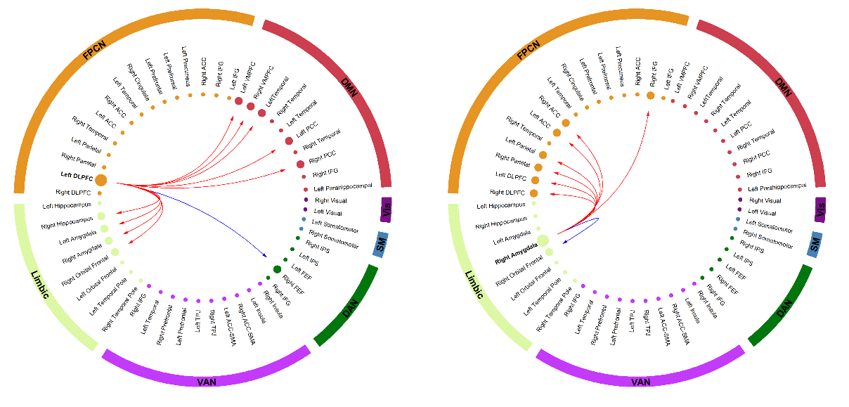
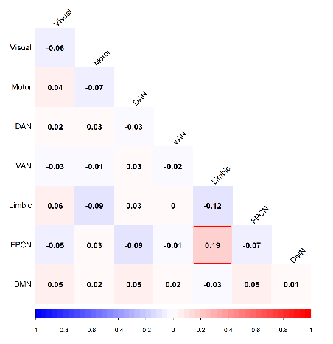
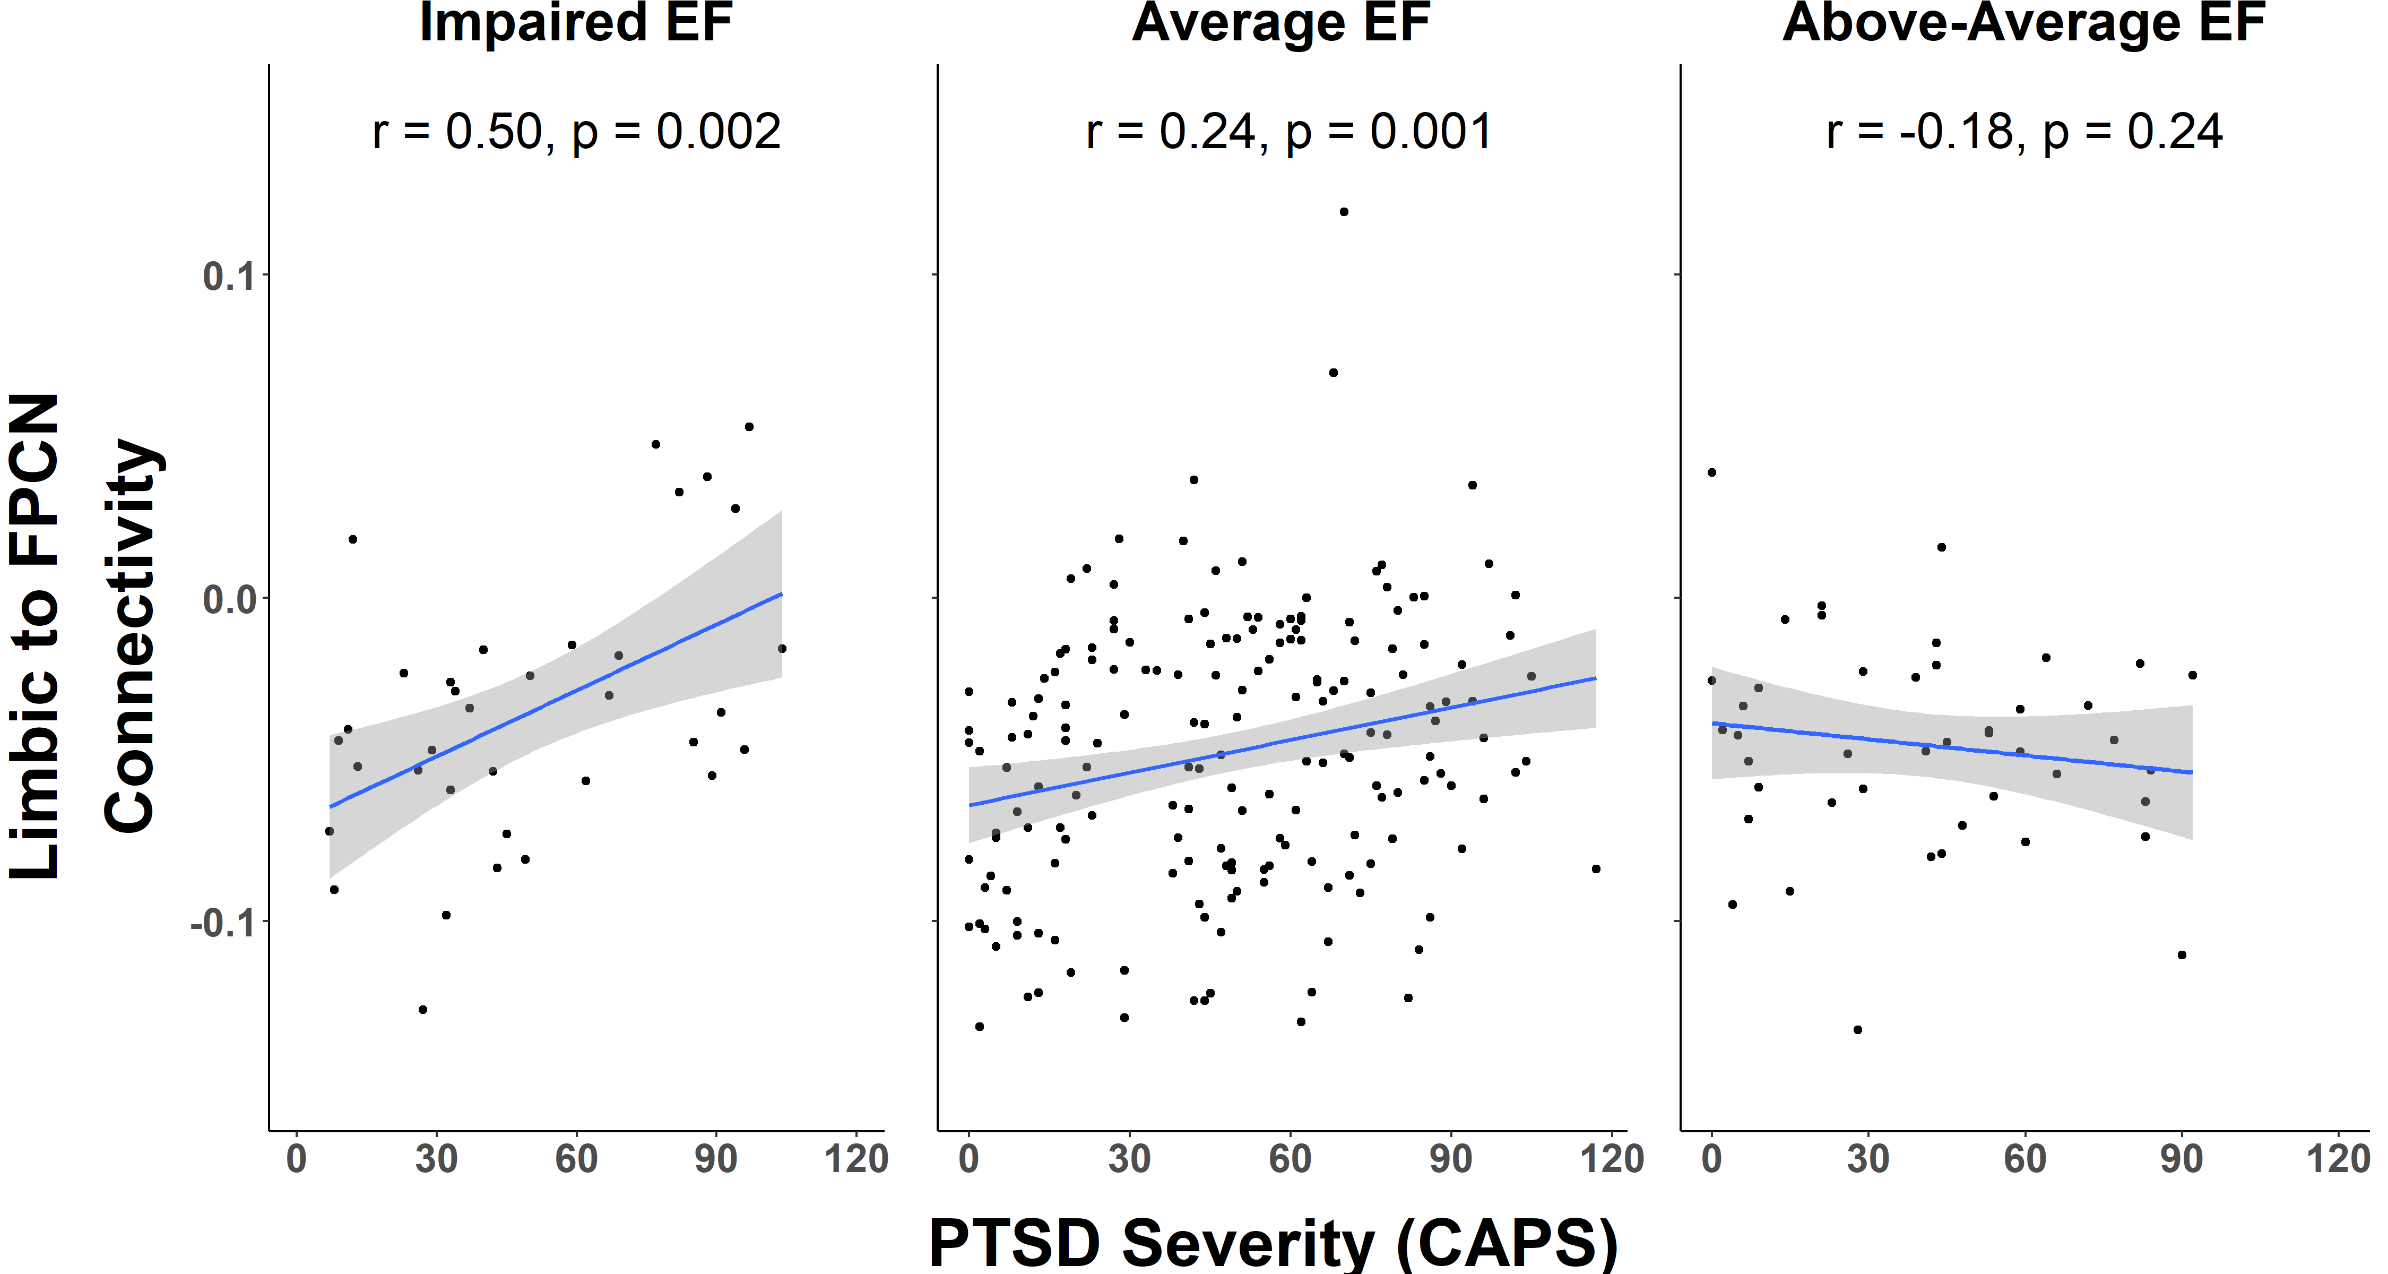
Executive functioning predicts unique relationships between PTSD symptoms
and resting-state connectivity.
Audreyana C. Jagger-Rickels, Anna Stumps, David Rothlein, Travis Evans, Fracesca Fortenbaugh, William Milberg, Brian Marx, Regina McGlinchey, Joseph DeGutis, Michael Esterman
List of Affiliations Here
Background
Methods
Demographics
Posttraumatic stress disorder (PTSD) is heterogeneous in its symptom presentation, long-term outcome, response to treatment and apparent neurobiology.
Two sources of heterogeneity:
1.) Clinical symptoms and subtypes do not clearly correspond with the underlying neurobiology, as the same symptoms can stem from dysregulation of different neurobiological systems.
2.) Nearly every large-scale brain network has been implicated in PTSD, however many of these studies used seed-based instead of large-scale whole-network based approaches.
This study aimed to address these sources of heterogeneity by:
1.) We used a large-scale network-based approach when measuring the relationships between PTSD symptom severity and brain connectivity.
2.) We included cognitive measures, explaining additional variance in the relationship between the brain and PTSD symptoms.
Imaging- 3T Siemens TIM Trio scanner (12-channel head coil), two T1-weighted anatomical MPRAGE scans (TR = 2530 ms, TE = 3.32ms, flip angle: 7, 1-mm isotropic), and two T2* weighted fMRI scans (gradient echo-planar imaging – TR: 3000ms, TE: 30ms, flip angle: 90, 3x3x3.7 mm slices for 38 slices) were acquired during rest.
Cognitive Composites - Using a priori, validated scales of memory, attention, and EF, a continuous composite score provided an overall approximation of an individual’s skills within that domain based on multiple neuropsychological tests/performance measures (Riely et al., 2019). Three groups for each cognitive domain were defined as below average, average, and above average performance.
Network Correlations – Using the parcellation developed by Yeo and Colleagues, 7 networks between and within network average connectivity (28 connectivity values) were first correlated with PTSD symptom severity (CAPS IV), then significant connections were entered into linear regressions (Network = 1+CAPS+Cognition+CAPS*Cognition).
Hubs of Dysfunction (HoD) analysis – Connectivity between each ROI other regions was correlated with PTSD severity, providing the number of connections with a significant relationship (nominal p<.05) with PTSD severity. Using randomization procedures, we determined which ROI had a significant number of connections, correlated with PTSD symptom severity. If an ROI was found to be significant is was determined to be a Hub of Dysfunction (HoD).
 | Total (N = 271) |  | Imp. EF (N = 35) |  | Avg. EF (N = 182) |  | Abv. Avg. EF (N = 45)
 | Percent
PTSD Diagnosis | 58.3 |  | 48.57 |  | 61.54 |  | 48.89
Gender (Males) | 90.0 |  | 88.57 |  | 89.01 |  | 93.33
Mild Military TBI | 42.4 |  | 34.29 |  | 42.86 |  | 46.67
Depression Medication | 21.4 |  | 22.86 |  | 20.33 |  | 22.22
Epileptic Medication | 2.6 |  | 5.71 |  | 1.65 |  | 2.22
Sedative/Hypnotics Medication | 6.6 |  | 5.71 |  | 6.59 |  | 6.67
Pain Medication | 27.3 |  | 31.43 |  | 24.73 |  | 28.89
 | Mean | SD | Mean | SD | Mean | SD | Mean | SD
Age | 31.2 | 8.0 | 32.8 | 7.9 | 31.02 | 8.22 | 30.22 | 6.99
Education | 13.9 | 1.8 | 13.9 | 1.8 | 13.80 | 1.72 | 14.51 | 2.00
Depression (DASS) | 8.0 | 8.7 | 9.2 | 9.6 | 7.90 | 8.68 | 6.79 | 8.26
WTAR** | 35.2 | 7.3 | 32.3 | 8.3 | 34.75 | 6.99 | 39.71 | 6.31
CAPS | 48.0 | 29.1 | 50.4 | 30.3 | 48.47 | 28.86 | 40.82 | 27.72
Memory Composite* | -0.30 | 0.99 | -0.6 | 0.9 | -0.29 | 1.02 | 0.09 | 0.87
Attention Composite** | 0.10 | 0.58 | -0.3 | 0.4 | 0.09 | 0.56 | 0.46 | 0.53
Executive Function Composite* | 0.10 | 0.55 | -0.6 | 0.4 | 0.08 | 0.42 | 0.75 | 0.34
Hubs of Dysfunction Related to PTSD Symptom Severity
Network Correlations and the Effects of Cognition on Limbic/FPCN Connectivity
 | Adjusted R² | Predictor | t-statistic | p-value
Attention | 0.03 | PTSD Severity | 1.39 | 0.17
 |  | Attention | -0.20 | 0.84
 |  | PTSD by Attention interaction | -0.09 | 0.93
Memory | 0.03 | PTSD Severity | 0.83 | 0.41
 |  | Memory | -0.25 | 0.80
 |  | PTSD by Memory interaction | 1.02 | 0.31
Executive | 0.07** | PTSD Severity | 4.47 | <0.001
 |  | Executive | 2.44 | 0.02
 |  | PTSD by Executive interaction | -3.45 | <0.001
Left Dorsal Lateral Prefrontal Cortex Hub
Right Amygdala Hub
Parcellation based on Yeo et al (2011). Red lines denote hyper-connectivity and blue lines denote hypo-connectivity. Vis = Visual Network, SM = Somatomotor Network, DAN = Dorsal Attention Network, VAN = Ventral Attention Network, Limbic = Limbic Network, FPCN = Frontal Parietal Control Network, DMN = Default Mode Network, IPS = Intraparietal Sulcus, FEF = Frontal Eye Fields, IFG = Inferior Frontal Gyrus, ACC-SMA = Anterior Cingulate Cortex/Supplementary Motor Area, TPJ = Temporal Parietal Cortex, DLPFC = Dorsal Lateral Prefrontal Cortex, ACC = Anterior Cingulate Cortex, VMPFC = Ventral Medial Prefrontal Cortex, PCC = Posterior Cingulate Cortex.
Summary and Conclusion
We found, through two different methods, that the PTSD symptom severity impacted regions within and between the Limbic and FPCN networks. In addition, the relationship between limbic and FPCN network connectivity and PTSD symptom severity was modulated by executive function.
We postulate that this study provides evidence for disrupted top down regulation of executive/emotional control with worse report of PTSD symptoms, which supports both an emotional and context regulation abnormalities in those with PTSD.
Some suggestions for future avenues to investigate include the relationship between emotional or context regulation to resting state connectivity and evidence to determine if executive function in risk/protective factor in a sub set of people with PTSD.
Acknowledgments: US Department of Veterans Affairs through the Translational Research Center for TBI and Stress Disorders (B3001-C); VA Rehabilitation Research & Development Traumatic Brain Injury National Research Center; Merit Review Award from the VA Clinical Sciences Research and Development Service (I01CX001653); VA Rehabilitation Research & Development SPiRE Award (1I21RX002737)

