Slide 1
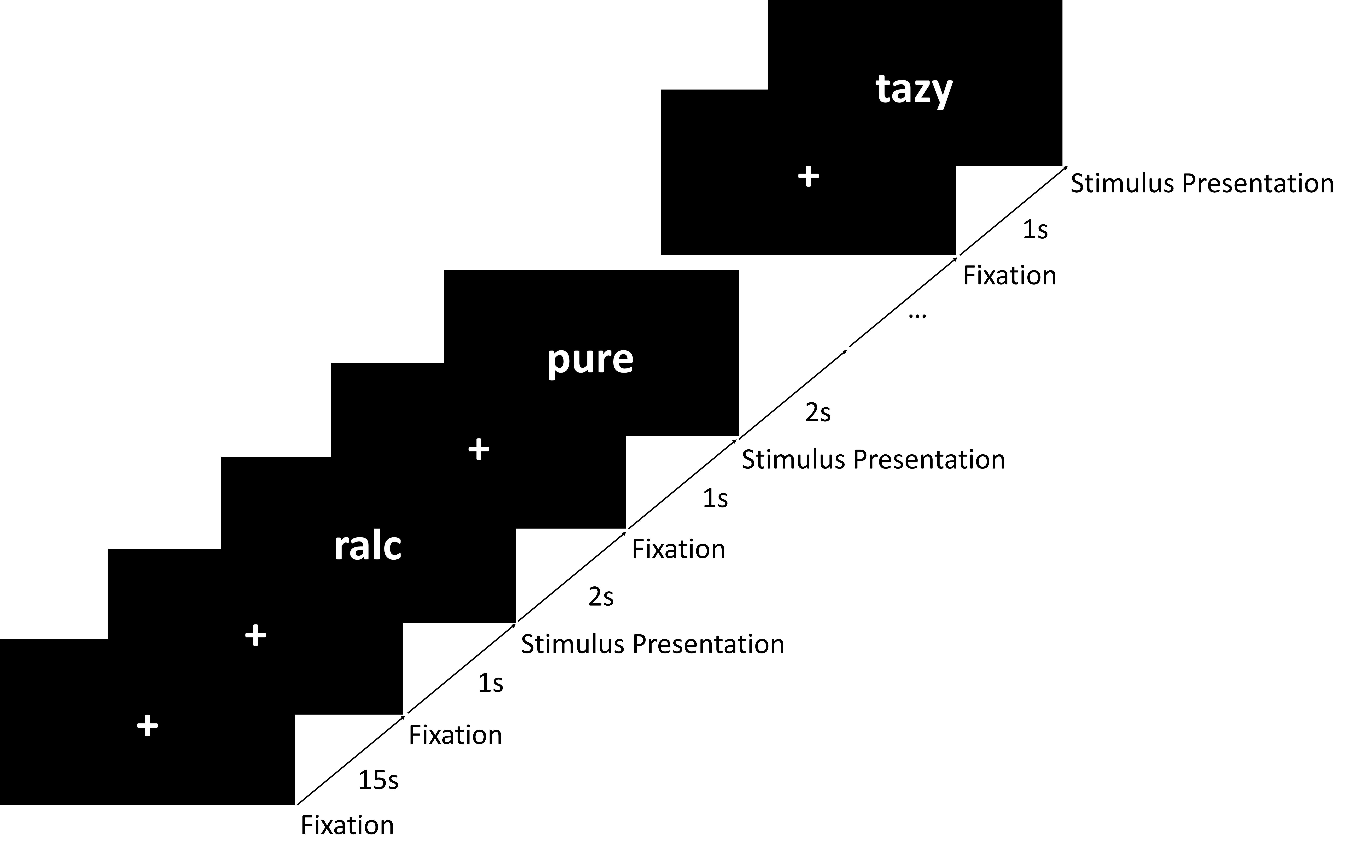
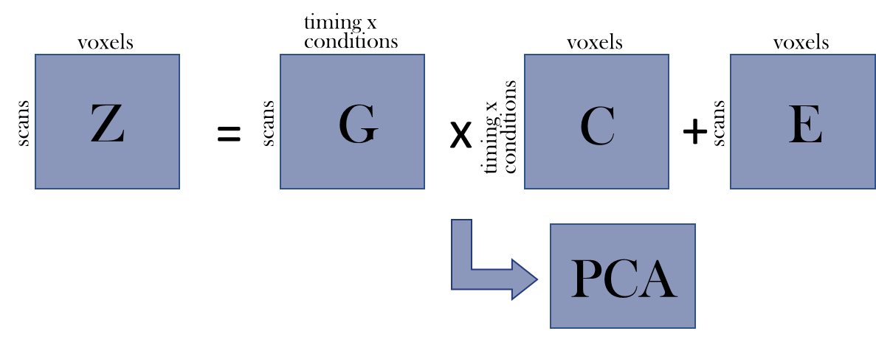
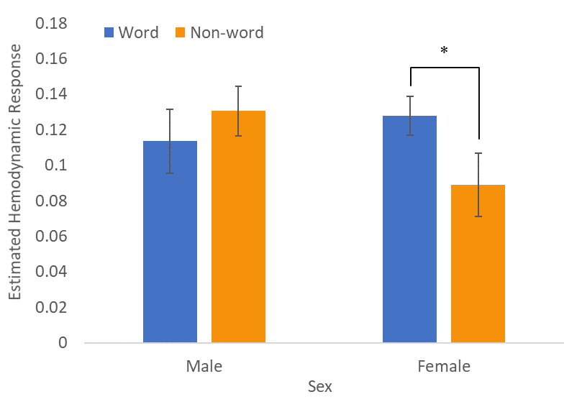
Sex Difference In Linguistic Processing Network Activation And
Lexical Decision Task Performance
Samantha T.S. Wong¹, Vina M. Goghari², Todd S. Woodward^{3,4}
¹ Department of Educational and Counselling Psychology, McGill University, Montreal, Quebec, Canada; ² Department of Psychology & Graduate Department of Psychological Clinical Science, University of Toronto Scarborough, Scarborough, ON, Canada; ³ Department of Psychiatry, University of British Columbia, Vancouver, Canada; ⁴ BC Mental Health and Addiction Research Institute, Vancouver, Canada
Introduction
Methods
Background
Participants were 59 healthy adults.
Lexical Decision Task involved participants deciding whether four-letter sequences were real English words or not through right-handed button press during fMRI scanning (see Figure 1).
Word and non-word stimuli were selected from the English Lexicon Project database. Easy/Hard was determined by lexical decision accuracy in this database, whereby more errors are expected to be made on words in the “Hard” condition. This produced four categories of stimuli to create four experimental conditions – regular non-word, hard (word-like) non-word, regular word, and hard (obscure) word (Balota et al., 2002).
fMRI data were analyzed using constrained principal component analysis for fMRI (fMRI-CPCA) with orthogonal rotation (see Figure 2) (Lavigne, Menon, & Woodward, 2019; Metzak, Feredoes, Takane, et al., 2011; Woodward, Feredoes, Metzak, Takane, & Manoach, 2013).
Letter-based visual lexical decision (LD) requires participants to decide, typically by button press, whether a visually presented letter string depicts a real word or not (Edwards, Pexman, Goodyear, & Chambers, 2005).
A recent meta-analysis of functional brain imaging studies on LD reported regions reliably activated during access to lexical representations, but these regions could have also been elicited by attentional and response processes (Murphy, Jogia, & Talcott, 2019).
Difference between sex is a nuance to account for in linguistic processing given previous findings on higher female performance in verbal and verbal memory tasks (Kimura, 1992; Kramer, Yaffe, Lengenfelder, & Delis, 2003; Van der Elst, van Boxtel, van Breukelen, & Jolles, 2005).
Research Aims
To separate functionally distinct task-based networks and respective hemodynamic response to experimental manipulations in LD anatomically and temporally.
To investigate potential sex difference in behavioral performance and functional activity in LD.
Figure 1. Timeline of the experimental procedure, lexical decision task.
Figure 2. Schematic overview of Constrained Principal Component Analysis for fMRI data (fMRI-CPCA).
Results
Discussion
Neuroimaging Results
A scree plot indexing the percentage of variance in the task-related brain activity for each of the components indicated that three components should be extracted. See Wong et al., 2020 for detailed findings.
Behavioral Results
Reaction time was not correlated with age or years of education
Including Gender as a between-groups variable in the 2×2 ANOVA resulted in a significant Lexicality × Gender interaction, F(1,57)=4.80, p < .05, η²=0.08, such that females responded more quickly than males to non-word stimuli, t(57)=2.04, p < .05, η²=0.07 (M=890 vs. 952 ms, respectively), indicating greater success at ignoring the word-like qualities of the non-words.
Females did not respond more quickly than males to word stimuli (M=823 vs. 821 ms, respectively).
The LD-specific peak that was retrieved in the 2019 meta-analysis (Murphy et al., 2019); namely, right precentral gyrus (LD > word reading contrast) was retrieved in both the LD and RESP networks in the current study.
In addition, fusiform and lingual activations, which were the other LD peaks identified in the meta-analysis, were also not preferentially specific to the LD or RESP networks in the current study.
This supports some of the conclusions of the meta-analysis, that attentional and response processes are elicited in addition to linguistic processing during LD, confirming that the multi-dimensional analytical approach can be valuable as a way to disentangle these cognitive processes.
Sex difference found in LPN suggests a more efficient use of the language network under LD conditions, whereby females were more resilient to the automatic processing of the interfering word information.
This accords with past findings showing stronger female performance on verbal tasks (Kimura, 1992), particularly verbal memory tasks (Kramer, et al., 2003; Van der Elst, et al., 2005), and the general observation that on many neuropsychological tests gender differences may be observed, reflected in norms tables (Lezak, 1995).
Component 1, Default Mode Network (DMN; Buckner, Andrews-Hanna, & Schacter, 2008):
Brain regions deactivating in this component accorded with the regions in the DMN including the frontal pole, precuneus cortex, angular gyrus, temporooccipital part of middle temporal gyrus and superior frontal gyrus (see Figure 3).
Figure 3. Dominant 10% of component loadings for Component 1, Default Mode Network.
Component 2, Motor Response Network (RESP):
Activation in this network involved left-dominant pre- and post-central gyri, juxtapositional lobule cortex, insular cortex, and right-dominant Cerebellum VIII, which are all typical motor response network regions for a right handed response (see Figure 4).
Figure 4. Dominant 10% of component loadings for Component 2, Motor Response Network.
Component 3, Linguistic Processing Network (LPN):
Brain regions included activations in left-dominant regions, including left prefrontal regions (BA 44, 47, 6; Broca’s area), left middle temporal gyrus (BA 22; Wernicke’s area), and left angular gyrus (BA 40) (see Figure 5).
References
Balota, D. A., Cortese, M. J., Hutchison, K. A., Neely, J. H., Nelson, D., Simpson, G. B., et al. (2002). The English Lexicon Project: A web-based repository of descriptive and behavioral measures for 40,481 English words and nonwords, from http://elexicon. wustl.edu/.
Edwards, J. D., Pexman, P. M., Goodyear, B. G., & Chambers, C. G. (2005). An fMRI investigation of strategies for word recognition. Cognitive Brain Research, 24(3), 648–662.
Kimura, D. (1992). Sex differences in the brain. Scientific American, 267(3), 118–125.
Kramer, J. H., Yaffe, K., Lengenfelder, J., & Delis, D. C. (2003). Age and gender inter- actions on verbal memory performance. Journal of the International Neuropsychological Society, 9(1), 97–102.
Lavigne, K., Menon, M., & Woodward, T. S. (2019). Functional brain networks underlying evidence integration and delusions in schizophrenia. Schizophrenia Bulletin, sbz032, 1–9.
Metzak, P. D., Feredoes, E., Takane, Y., Wang, L., Weinstein, S., Cairo, T., et al. (2011). Constrained principal component analysis reveals functionally connected load-de- pendent networks involved in multiple stages of working memory. Human Brain Mapping, 32(6), 856–871.
Murphy, K. A., Jogia, J., & Talcott, J. B. (2019). On the neural basis of word reading: A meta-analysis of fMRI evidence using activation likelihood estimation. Journal of Neurolinguistics, 49, 71–83.
Van der Elst, W., van Boxtel, M. P., van Breukelen, G. J., & Jolles, J. (2005). Rey's verbal learning test: Normative data for 1855 healthy participants aged 24–81 years and the influence of age, sex, education, and mode of presentation. Journal ofthe International Neuropsychological Society, 11(3), 290–302.
Woodward, T. S., Feredoes, E., Metzak, P. D., Takane, Y., & Manoach, D. S. (2013). Epoch- specific functional networks involved in working memory. NeuroImage, 65, 529–539.
Wong, S. T. S., Goghari, V. M., Sanford, N., Lim, R., Clark, C., Metzak, P. D., … Woodward, T. S. (2020). Functional brain networks involved in lexical decision. Brain and Cognition, 138. https://doi.org/10.1016/j.bandc.2019.103631
Fig 6. Estimated hemodynamic response in Linguistic Processing Network in male versus female.
When Gender was added to the ANOVA as a between-subjects factor, a significant Lexicality × Gender interaction emerged, F(1,23)=6.87, p = .015. This was caused by females showing less activation in LPN for nonword condition, p = .010 (see Figure 6).
Figure 5. Dominant 10% of component loadings for Component 3, Linguistic Processing Network.

